Slide 1

Click to get started…
Notes:
(Next Slide)

Slide 2
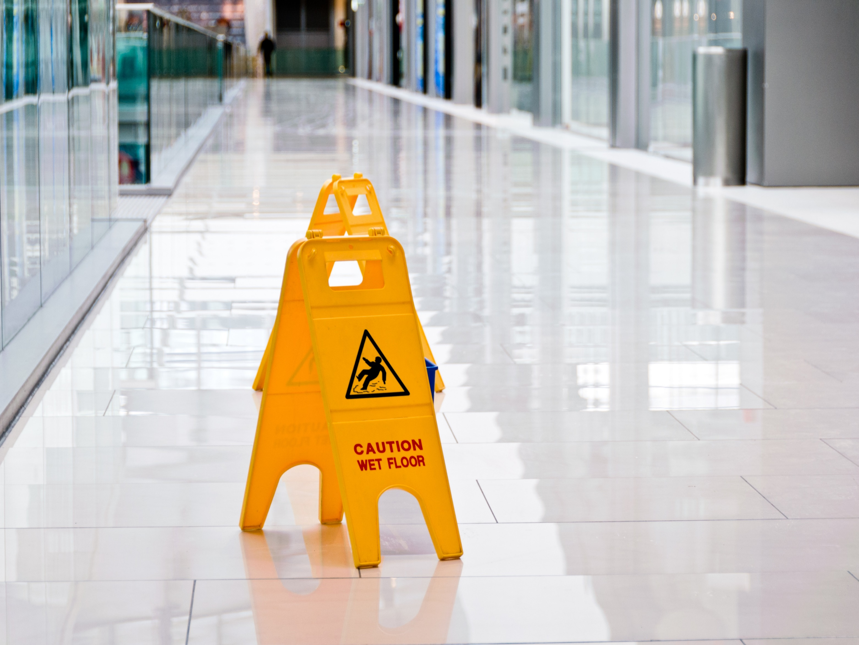

Workplace Spills
7 Sources and 7 Methods of Prevention and Control
Notes:
Workplace Spills - Seven Sources and Seven Methods of Prevention and Control
(Next Slide)

Slide 3
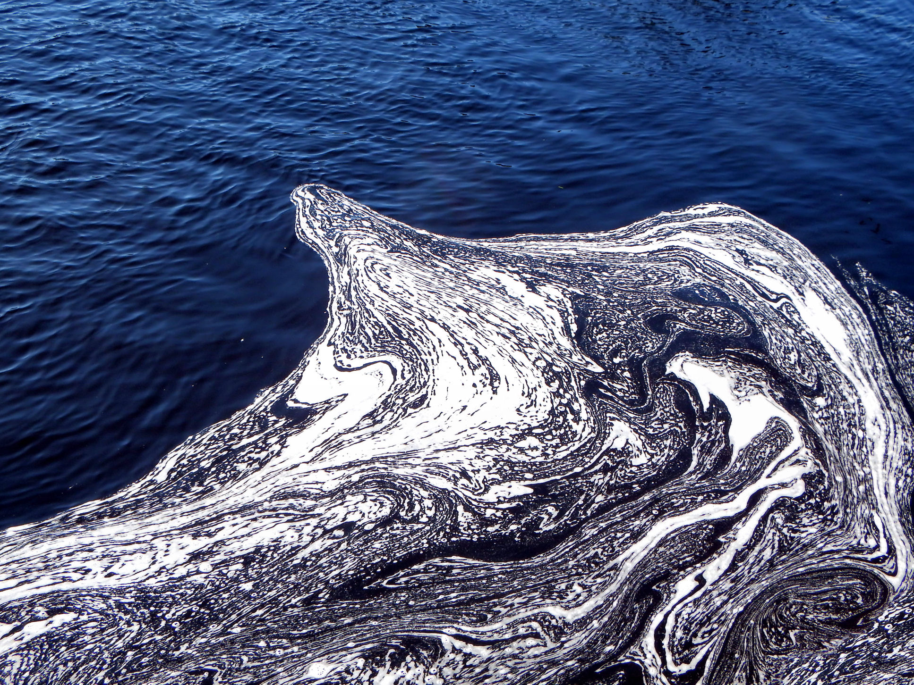
What’s at Stake
What’s at Stake
Notes:
WHAT'S AT STAKE
From soda pop spilled on the breakroom floor at a local factory, to a chemical spill from that same factory that pollutes the river and contaminates your community’s water supply—workplace spills can range from minor inconveniences to major catastrophes.
(Next Slide)

Slide 4
What’s the Danger
What’s at Stake
7 Sources of Workplace Spills
Improper handling and storage
Leaking or ruptured containment vessels
Burst pipes
Faulty equipment
No LOTO
Accidents
Human error
Notes:
WHAT’S THE DANGER
Spills present a danger to workers, the community and the environment. Knowing where spills are likely to occur can help you be on the lookout for them and ways to prevent them. Here are seven common sources of workplace spills:
Chemicals that are not stored or handled correctly.
Leaking or ruptured containment vessels.
Burst pipes.
Faulty equipment.
Equipment and piping systems that haven’t been properly blocked, drained and locked out before maintenance or repair work is undertaken.
Accidents involving tanker trucks, ships and railcars carrying toxic chemicals, oil or gasoline.
Human error.
(Next Slide)

Slide 5
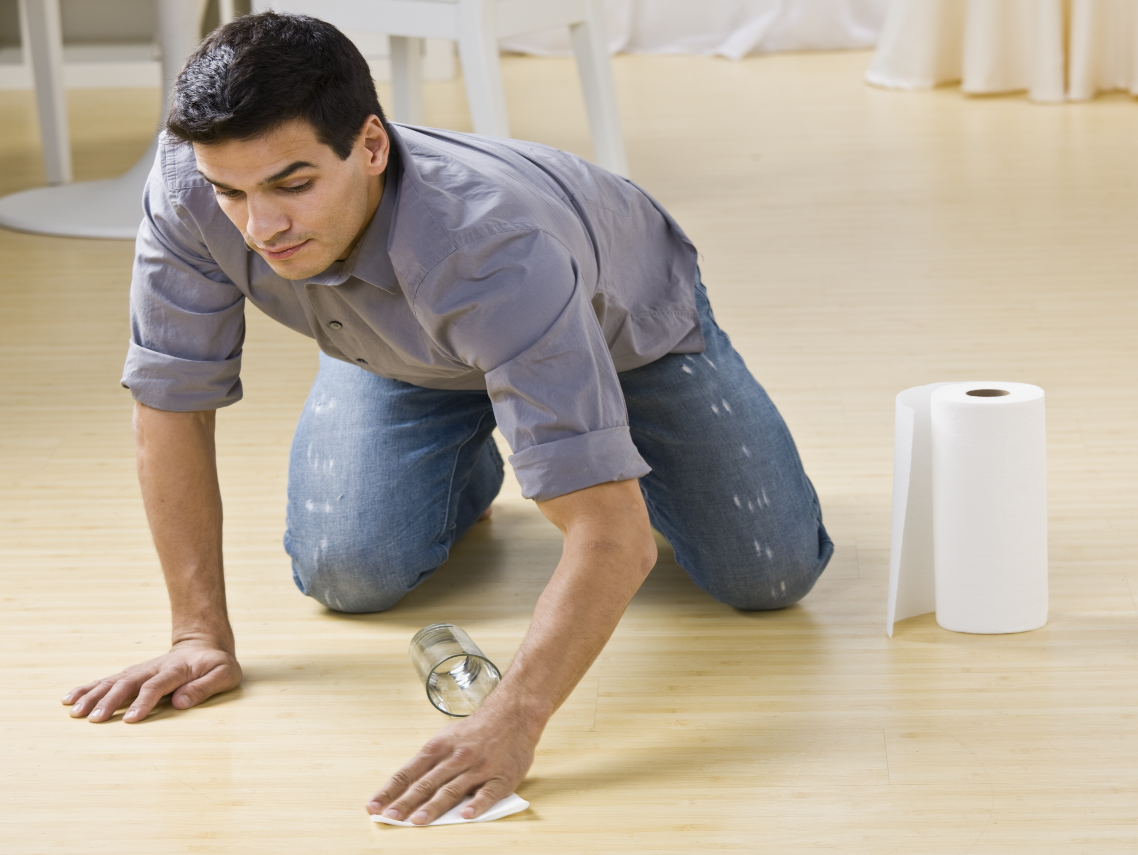
How to Protect Yourself
What’s at Stake
7 Tips for Spill Prevention and Control
Ask your supervisor about the SPCC plan.
Lists storage areas, equipment and processes with potential for spills.
Outlines procedures for spill response.
Notes:
HOW TO PROTECT YOURSELF
Of course, it’s best if a spill never happens but when one does, a quick and correct response goes a long way to minimizing the damage and protecting yourself, co-workers, the community and the environment.
Here are seven tips for spill prevention and control:
Ask your supervisor whether your company has a spill prevention and control or contingency plan. If the answer is no, ask whether one can be developed and implemented.
The plan should list storage areas, equipment and processes that have the potential for spills.
It should also outline procedures for spill response.
(Next Slide)

Slide 6
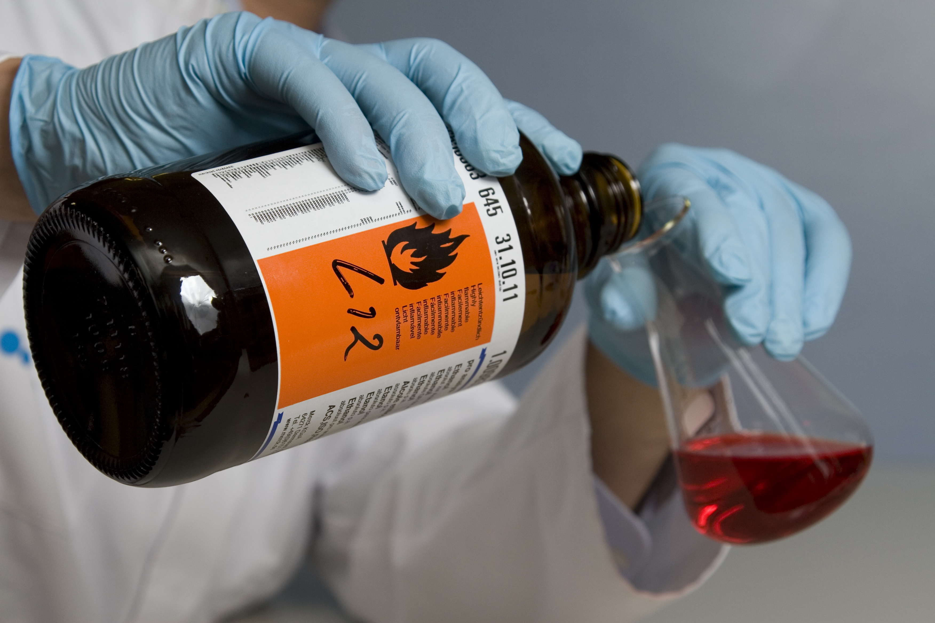
How to Protect Yourself
What’s at Stake
7 Tips for Spill Prevention and Control
Properly store and label all chemicals.
Inspect, maintain and repair.
Keeps equipment running and helps identify hazards.
Drip pans, containment barriers or drains contain/divert spills.
Notes:
HOW TO PROTECT YOURSELF
Properly store and label all chemicals.
Inspect, maintain and repair equipment, machines, vehicles and vessels.
Regular inspection and maintenance keeps equipment and machines running smoothly and lets you identify potential hazards before they become a problem.
Install drip pans, containment barriers or drains to safely contain or divert spills.
(Next Slide)

Slide 7
How to Protect Yourself
What’s at Stake
7 Tips for Spill Prevention and Control
Barricade or mark edges of wet areas and processes to keep people out when containment isn’t possible.
Request training on what to do in a spill emergency. Some spills can safely be cleaned up. Some spills require special or emergency services.
Notes:
HOW TO PROTECT YOURSELF
Barricade or mark edges of wet areas and processes to keep people out when containment isn’t possible.
Request training on what to do in a spill emergency.
Some spills can safely be cleaned up with the proper training and protective equipment.
Some spills require special or emergency services for cleanup.
(Next Slide)

Slide 8
How to Protect Yourself
What’s at Stake
7 Tips for Spill Prevention and Control
Ask your supervisor to set up spill kits and ensure:
Kits are clearly marked.
There are enough kits on site and in all high spill risk locations.
Kits are stocked with the right type of absorbent and cleaning materials.
Kits are checked on a regular basis and refilled after a spill incident.
Ensure all spills are cleaned up immediately and reported.
Notes:
HOW TO PROTECT YOURSELF
Ask your supervisor to set up spill kits and ensure that:
Kits are clearly marked.
There are enough kits on site and in all high spill risk locations.
Kits are stocked with the right type of absorbent and cleaning materials.
Kits are checked on a regular basis and refilled after a spill incident.
Ensure that all spills, regardless of size or material, are cleaned up immediately and reported in accordance with your workplace’s spill plan and regulatory guidelines.
(Next Slide)

Slide 9
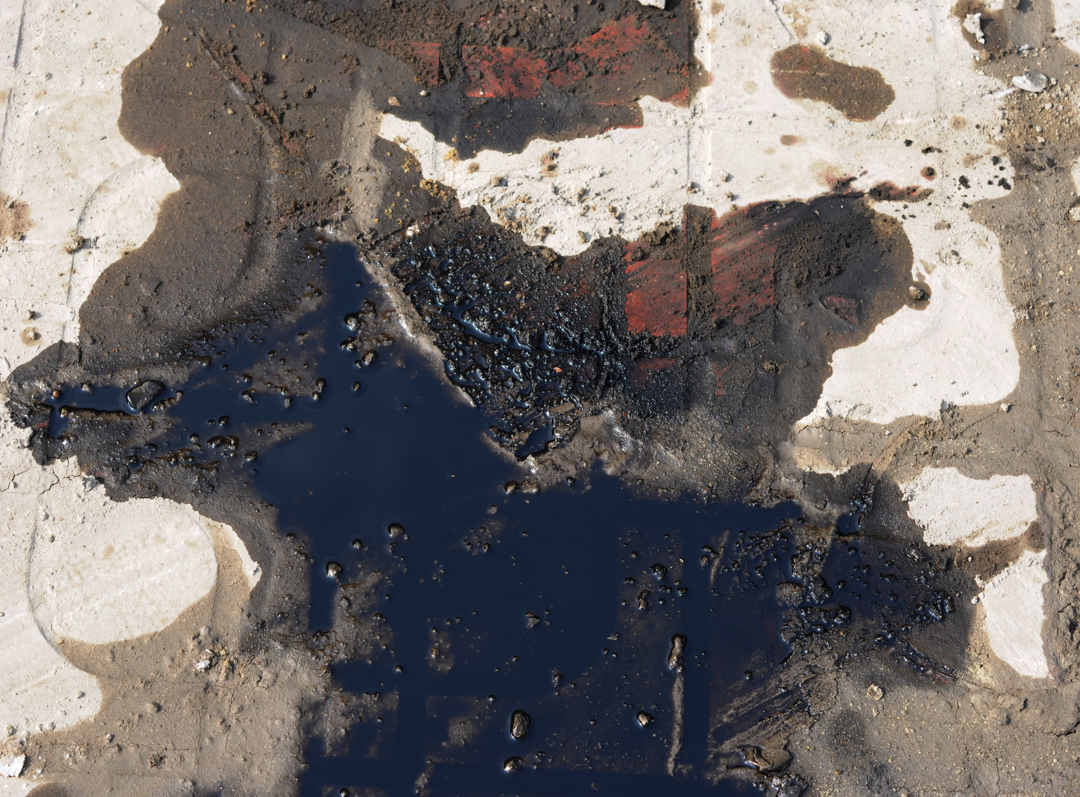
Final Word
What’s at Stake
Remembering the seven common sources of workplace spills and seven ways to prevent and control them can help make sure spills are more of a minor inconvenience and not a catastrophic event.
Notes:
FINAL WORD
Remembering the seven common sources of workplace spills and seven ways to prevent and control them can help make sure spills are more of a minor inconvenience and not a catastrophic event.
(Next Slide)

Slide 10
End of Presentation
Notes:
(Next Slide)

