Slide 1

Click to get started…
Notes:
(Next Slide)

Slide 2

WHMIS PICTOGRAMS
Notes:
TITLE
WHMIS Pictograms
(Next slide)

Slide 3






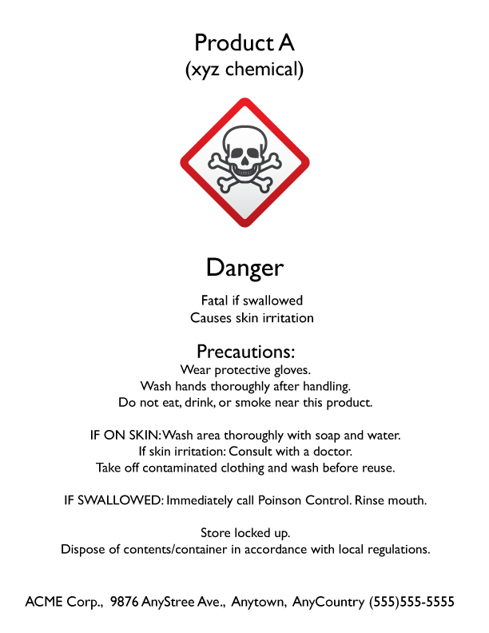
DANGER!
WHMIS 2015
Notes:
INTRO
Staying safe is paramount when working with or near hazardous chemicals. The first step towards safety is recognizing them. To do that, WHMIS 2015 uses pictograms, or representative images, to identify hazards on product labels and safety data sheets.
(Next slide)

Slide 4
WHMIS 2015
2 HAZARD CATEGORIES
HAZARDS WITH
NO PICTOGRAMS
IDENTIFY PICTOGRAMS
Notes:
INTRO
In this Safety Talk, we’ll discuss the two categories of hazards, discover which WHMIS 2015 hazards don’t have pictograms, and learn how to identify WHMIS 2015 pictograms.
(Next slide)

Slide 5








PHYSICAL HAZARDS
HEALTH HAZARDS
9 pictograms
WHMIS 2015
2 categories
Notes:
WHAT CAN GO WRONG
In WHMIS 2015, there are 9 pictograms divided into two categories that you’ll need to be able to identify. These categories are physical hazards and health hazards. There are 4 pictograms in the physical hazards category and 5 in the health hazards category.
(Next slide)

Slide 6
PHYSICAL HAZARDS
HEALTH HAZARDS
Notes:
WHAT CAN GO WRONG
The physical hazards pictograms are:
Flammable
Oxidizing
Compressed gas; and
Corrosives
The health hazard pictograms are:
Acutely toxic
Corrosives
Irritants
Health hazards; and
Biohazardous infectious materials
(Next slide)

Slide 7
PHYSICAL HAZARDS
HEALTH HAZARDS
DAMAGE METALS
DAMAGE EYES & SKIN
Notes:
WHAT CAN GO WRONG
Did you notice that Corrosives are both a physical and a health hazard? While it falls into both categories, the corrosive pictogram represents different types of damage. Physical corrosives damage metals, whereas health corrosives cause severe damage to eyes and skin.
(Next slide)

Slide 8

WHMIS 2015
COMBUSTIBLE DUSTS
SIMPLY ASPHYXIANTS
LESS SEVERE HAZARDS
Notes:
WHAT CAN GO WRONG
Additionally, there are hazards covered by WHMIS 2015 which don’t have pictograms. A few of these hazards are
combustible dusts
simple asphyxiants, and
some less severe hazard categories.
(Next slide)

Slide 9
Notes:
HOW TO PROTECT YOURSELF
You should be able to identify a hazard by its pictogram. Now, let’s learn more about pictograms, their associated hazard types, and what each means.
(Next slide)

Slide 10









FLAMMABLE
OXIDIZING
PHYSICAL HAZARDS
COMPRESSED GAS
CORROSIVES
Notes:
HOW TO PROTECT YOURSELF
PHYSICAL HAZARDS
Flammable - Ability to ignite easily, like fires or explosions; also combustible
Oxidizing - Cause or intensify a fire or cause a fire or explosion.
Compressed Gas - Compressed, liquefied, or dissolved gases pressurized inside a cylinder or container, which may explode if heated.
Corrosives - Chemically damage or destroy metals.
(Next slide)

Slide 11












BIOHAZARDOUS INFECTIOUS MATERIALS
HEALTH HAZARDS
IRRITANTS
ACUTELY TOXIC
CORROSIVES
HEALTH HAZARDS
Notes:
HOW TO PROTECT YOURSELF
HEALTH HAZARDS
Acutely Toxic - Fatal, toxic, or harmful if inhaled, swallowed, or following skin contact.
Corrosives - Causes severe skin burns or eye irritation.
Irritants - Damage to skin, eye, or organs, but less severe than toxics or corrosives.
Health Hazards - Hazards that cause cancer, genetic defects, and reproductive problems.
Biohazardous infectious materials - Blood, waste, or other material tainted with bacteria, parasites, or viruses.
(Next slide)

Slide 12

.
WHMIS 2015
Notes:
FINAL WORD
A pictogram with its distinctive red, diamond-shape border is an indicator of the type of hazard you will be working with or near. You should know all 9 pictograms and which hazards they represent. Use the information in this Safety Talk to recognize hazardous products and to stay safe.
(Next slide)

Slide 16
End of Presentation
Notes:
(Next Slide)

