Slide 1
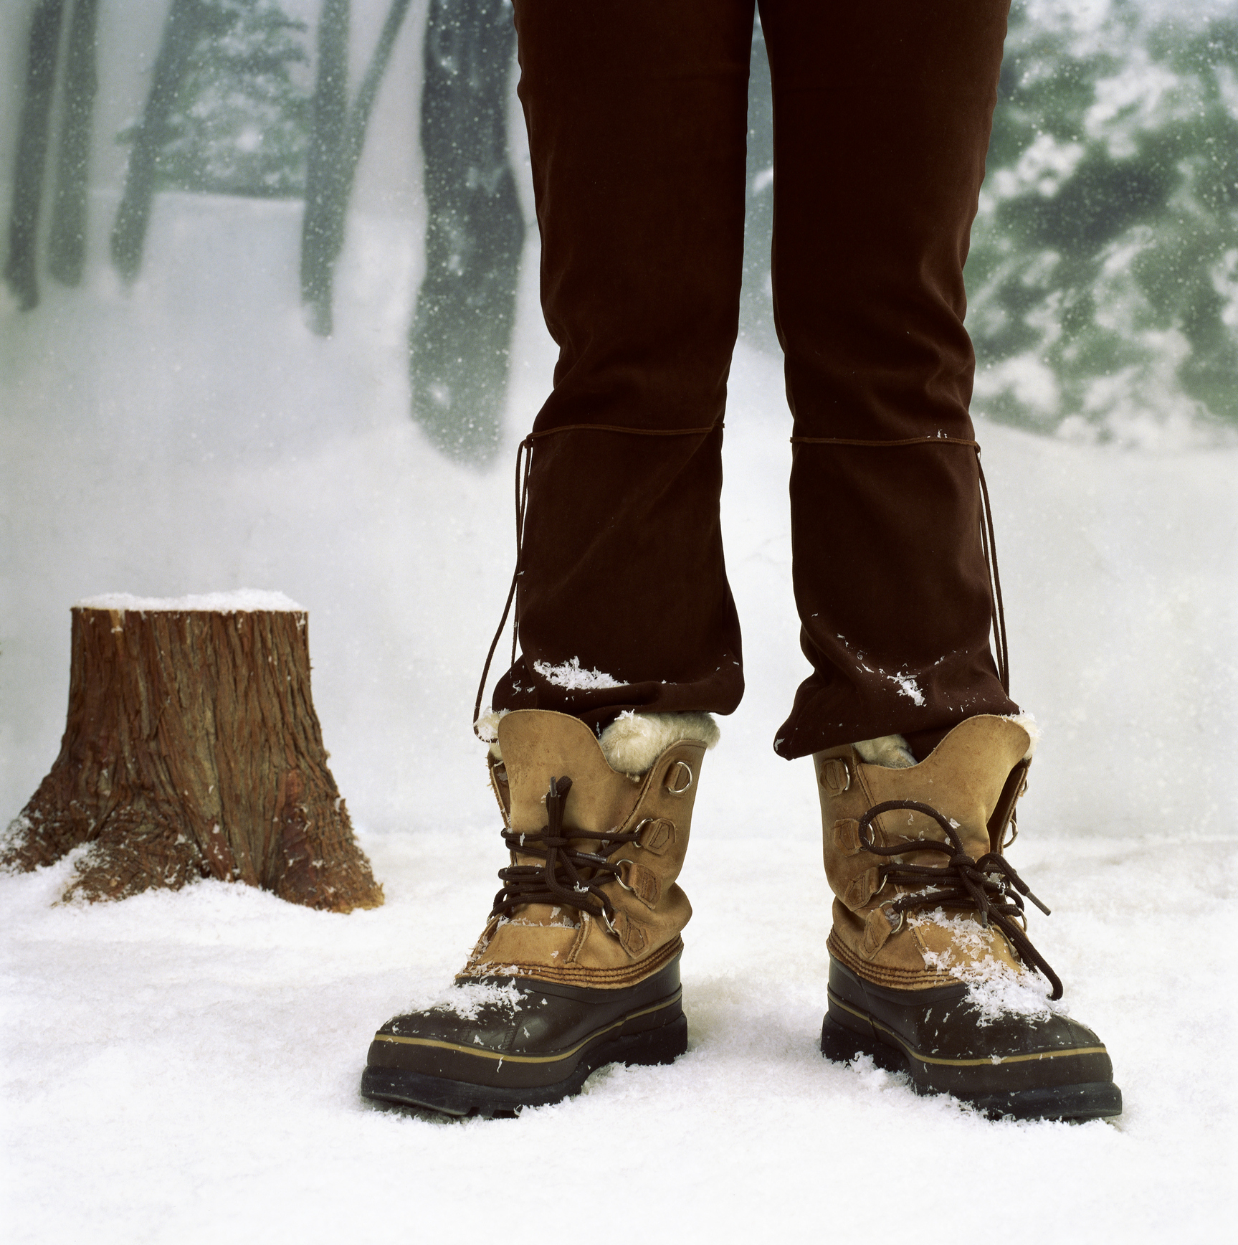

Use Your Head When It Comes to Your Feet
Notes:
Use Your Head When It Comes to Your Feet
(Next Slide)

Slide 2
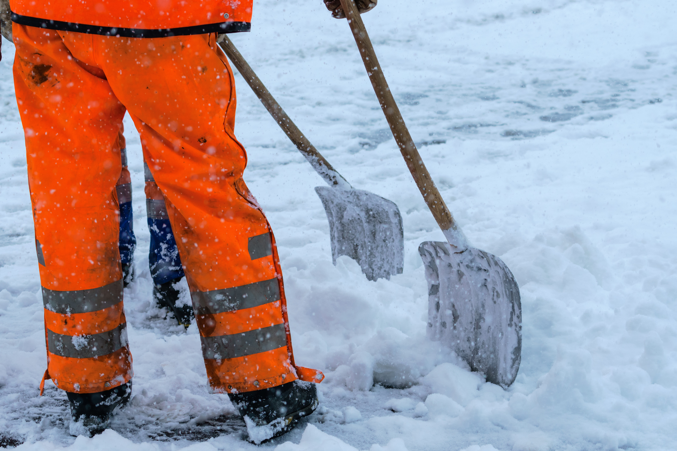
What’s at Stake
Your feet and toes may be at the opposite end from your head, but you still need to use your brain when it comes to which type of shoes you wear in the winter.
Notes:
WHAT'S AT STAKE
Your feet and toes may be at the opposite end from your head, but you still need to use your brain when it comes to which type of shoes you wear in the winter.
(Next Slide)

Slide 3
What’s the Danger
Not only are your feet farther from your head, they are also farther from your heart than any other part of your body.
Slips, trips and falls are all too common when temperatures drop and rain turns to snow and ice.
From a bruised ego, a concussion, a broken hip or a fatal fall, winter is no time to put your safety on ice.
You need to protect your feet from cold temps and harsh winter conditions.
Notes:
WHAT’S THE DANGER
Not only are your feet farther from your head, they are also farther from your heart than any other part of your body. Just like wearing gloves to keep your hands warm and dry, you need to protect your feet from cold temps and harsh winter conditions.
Slips, trips and falls are all too common when temperatures drop and rain turns to snow and ice. From a bruised ego, a concussion, a broken hip or a fatal fall, winter is no time to put your safety on ice.
(Next Slide)

Slide 4
How to Protect Yourself
1. Task
3. Requirements
What type of footwear is required by your employer?
2. Fit and comfort
Fit well.
Trying to keep your toes warm while you shovel the driveway?
Going to be working all day outside in cold wet conditions?
Are you required to wear steel toed shoes?
Luckily, there are lots of options available when it comes to winter safety shoes.
Be comfortable.
Do what you need them to do.
Notes:
HOW TO PROTECT YOURSELF
In the winter months you want to think about three things when it comes to selecting your footwear.
First, consider what you need to get done. Do you just need to slip on a pair of warm boots to keep your toes warm while you shovel the driveway or are you going to be working outside in cold wet conditions?
Second, is fit and comfort. Let’s face it, if the shoes aren’t comfortable and don’t do what you need them to do, you’re probably not going to wear them.
Third, you must take into consideration the type of footwear required by your employer. Are you required to wear steel toed shoes for example? Luckily, there are lots of options available when it comes to winter safety shoes.
(Next Slide)

Slide 5
How to Protect Yourself
Deeper snow and sub-freezing conditions:
Great for weather protection – not for walking long distances.
Good for shoveling driveway - not the best for all day work.
Walking longer distances:
They are designed for moderate weather protection.
Longer wear and walking, means a secure fit is essential.
Heavy duty boots with thick insulation and waterproof outer.
Lighter winter boots, such as insulated hiking boots.
Notes:
HOW TO PROTECT YOURSELF
Here’s a short list of other things to consider:
When working or walking in deeper snow and sub-freezing conditions, choose heavy duty boots with thick inner insulation and a waterproof outer material like rubber.
These types of boots are great for weather protection but less ideal for walking longer distances.
They would be great boots for shoveling your driveway but not the best for trudging all day at work in snow and muck.
Lighter winter boots, such as insulated hiking boots are better options when you have to walk longer distances and generally spend more time in them.
They are designed for moderate weather protection.
Since they are designed for longer wear and walking, a secure fit is essential.
(Next Slide)

Slide 6
How to Protect Yourself
DWR or durable water repellent coating on them.
Look for boots with a waterproof breathable membrane.
Invest in warm socks that wick away moisture.
Merino wool and some synthetic fibers.
Do your research and get professionally fitted.
Footwear should be comfortable but not constricting.
Notes:
HOW TO PROTECT YOURSELF
Many winter boots have a DWR or durable water repellent coating on them. For even better protection in extreme weather, look for boots with a waterproof breathable membrane, such as Gore-Tex®.
Invest in warm socks that wick moisture away from your feet. Merino wool and some synthetic fibers are perfect for warmth and wicking and will keep feet warm and dry.
Finally, do your own research and get professionally fitted.
Try on the footwear with the type of socks you intend to wear with them.
Whatever footwear you choose they should be comfortable but not constricting as this can cause circulation issues and colder feeling toes.
(Next Slide)

Slide 7
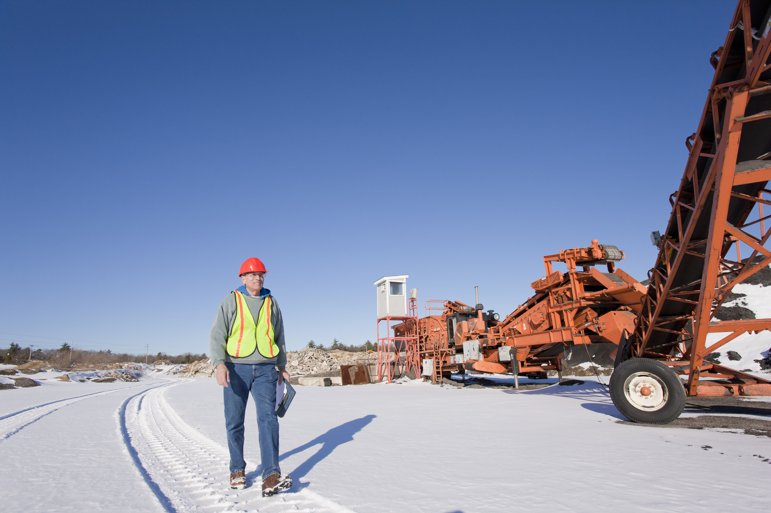
Final Word
  Your comfort and safety should be top of mind when it comes to choosing winter footwear.
Notes:
FINAL WORD
Your comfort and safety should be top of mind when it comes to choosing winter footwear.
(Next Slide)

