Slide 1

Click to get started…
Notes:
(Next Slide)

Slide 2

WHMIS CHANGES: 1988 TO 2015
Notes:
TITLE
WHMIS Changes: 1988 to 2015
(Next slide)

Slide 3

WHMIS
2015
1988
Workplace Hazardous Materials Information System
Global Standards for Hazard Communication
Notes:
INTRO
The Workplace Hazardous Materials Information System, or WHMIS, was launched in 1988 and was recently updated to WHMIS 2015. It now incorporates new, global standards for hazard communication.
(Next slide)

Slide 4
WHAT IS WHMIS?
Changes & You
1988 → 2015
Notes:
INTRO
In this Safety Talk, we’ll look at what WHMIS is, what the changes are for WHMIS 1988 to WHMIS 2015, and how these changes are important for you.
(Next slide)

Slide 5



Notes:
WHAT CAN GO WRONG
WHMIS ensures that you receive the correct information about hazardous products and chemicals used or located in your workplace.
(Next slide)

Slide 6

PICTOGRAMS
MANUFACTURERS
&
SUPPLIERS
WHMIS 1988
+
WHMIS 2015
LABELS
WHMIS 1988
WHMIS 2015
SDS
Notes:
WHAT CAN GO WRONG
As product manufacturers and suppliers transition from WHMIS 1988 to WHMIS 2015, you’re going to encounter pictograms, labels, and SDS following both standards. Knowing both sets of standards can mean the difference between being safe and risking your life.
(Next slide)

Slide 7




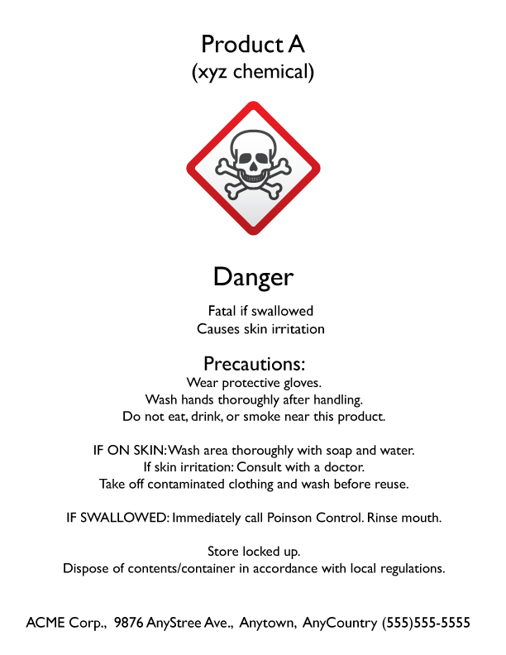
WHMIS 1988
WHMIS 2015
Notes:
HOW TO PROTECT YOURSELF
You’ll see changes in pictograms, labels, and safety data sheets (SDS) and possibly see both standards at the same time. Let’s look at each element and the changes in more detail.
(Next slide)

Slide 8
WHMIS 2015
WHMIS 1988
PICTOGRAMS
Notes:
HOW TO PROTECT YOURSELF
PICTOGRAMS
First, all WHMIS 2015 pictograms are diamond-shaped with a red border. The biohazardous infectious material pictogram and all WHMIS 1988 pictograms are circular with a black border.
(Next slide)

Slide 9

BIOHAZARDOUS INFECTIOUS MATERIAL HAZARDS
ACUTELY TOXIC HAZARDS
Notes:
HOW TO PROTECT YOURSELF
Second, acutely toxic hazards and biohazardous infectious material hazards have similar symbols but are described differently in WHMIS 2015.
(Next slide)

Slide 10
2015:
BIOHAZARDOUS INFECTIOUS MATERIAL HAZARDS
2015: ACUTELY TOXIC HAZARDS
1988: “Poisonous and infectious material causing immediate and serious effects”
1988: “Poisonous and infectious material – biohazardous infectious material”
Notes:
HOW TO PROTECT YOURSELF
In WHMIS 1988, acutely toxic hazards were “poisonous and infectious material causing immediate and serious effects” and biohazardous infectious material hazards were “poisonous and infectious material – biohazardous infectious material.”
(Next slide)

Slide 11



3 hazards
have both a
different symbol
and description
in WHMIS 2015
Notes:
HOW TO PROTECT YOURSELF
Third, three hazards have both a different symbol and description in WHMIS 2015: irritant hazards, health hazards, and explosive hazards.
(Next slide)

Slide 12





WHMIS 1988
WHMIS 2015
poisonous and infectious material causing other toxic effects
dangerously reactive material
Notes:
HOW TO PROTECT YOURSELF
The description for poisonous and infectious material causing other toxic effects in WHMIS 1988 was split into two symbols and descriptions. In WHIS 2015, it became Irritant Hazards and Health Hazards.
The symbol and description for Dangerously reactive material in WHMIS 1988 became Explosive Hazards in WHMIS 2015.
Finally, flammables, oxidizers, compressed gas, and corrosives have both a similar symbol and description in WHMIS 1988.
(Next slide)

Slide 13
WHMIS 2015 LABEL
WHMIS 1988 LABEL
LABELS
HAZARD STATEMENTS
RISK PHRASES
SIGNAL WORDS
PRECAUTIONARY MEASURES
&
FIRST AID MEASURES
PRECAUTIONARY STATEMENTS
SUPPLEMENTAL INFORMATION
Notes:
HOW TO PROTECT YOURSELF
LABELS
First, signal words and supplemental information are found on WHMIS 2015 but not on WHMIS 1988 labels.
Second, two WHMIS 1988 elements are categorized differently on WHMIS 2015 labels.
WHMIS 1988 Risk Phrases became hazard statements in WHMIS 2015.
Precautionary Measures and First Aid Measures in WHMIS 1988 became Precautionary Statements in WHMIS 2015.
(Next slide)

Slide 14
+
WHMIS 1988
WHMIS 2015
PRODUCT IDENTIFIER
PICTOGRAM
SUPPLIER IDENTIFIER
Notes:
HOW TO PROTECT YOURSELF
Third, a hatched border around WHMIS 1988 labels is not required in WHMIS 2015 labels.
Finally, the product identifier, pictogram, and supplier identifier are similar in both WHMIS 1988 and WHMIS 2015 labels.
(Next slide)

Slide 15
WHMIS 1988
WHMIS 2015
9 sections
remain the same
SAFETY DATA SHEETS
HAZARD IDENTIFICATION
ECOLOGICAL INFORMATION
4 new sections
TRANSPORT INFORMATION
REGULATORY INFORMATION
Notes:
HOW TO PROTECT YOURSELF
SAFETY DATA SHEETS (SDS)
First, there are many similarities. Nine sections remain the same.
There are, however, four new sections in WHMIS 2015 not found in WHMIS 1988:
Hazard identification
Ecological information
Transport information, and
Regulatory information
(Next slide)

Slide 16
WHMIS 1988
WHMIS 2015
PREVENTATIVE MEASURES
ACCIDENTAL RELEASE MEASURES
HANDLING AND STORAGE
WHEN PRACTICAL
WITHIN 90 DAYS
EXPOSURE CONTROL/
PERSONAL PROTECTION
DISPOSAL CONSIDERATIONS
Notes:
HOW TO PROTECT YOURSELF
There’s also one section of the WHMIS 1988 MSDS, preventive measures, which expanded to 4 separate sections in WHMIS 2015:
Accidental release measures
Handling and storage
Exposure control/personal protection
Disposal considerations
Finally, updates to labels by suppliers has changed from “when practical” in WHMIS 1988 to “within 90 days” in WHMIS 2015.
(Next slide)

Slide 17
WHMIS 1988
WHMIS 2015
Notes:
FINAL WORD
When looking at a pictogram, label, or SDS you should be able to spot the difference between the old system, WHMIS 1988, and the new, WHMIS 2015. Knowing the difference might save a life – maybe even yours!
(Next slide)

Slide 18
End of Presentation
Notes:
(Next Slide)

