Slide 1

Click to get started…

Slide 2
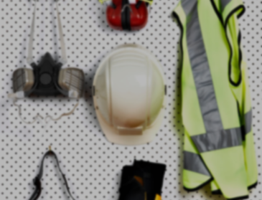
Maintain a Clean Workplace Together

Slide 3
What’s at Stake
Messy Hazards
Injury/Death from slips, trips or falls
Reduced Productivity
Injury/Death from fire

Slide 4
What’s the Danger
Fire in garbage can
Ignited acetylene
Lots of smoke, but no serious damage
New Policy
Be proactive!

Slide 5
How to Protect Yourself
Use checklists
Keep lighting sources clean
Clean dusty surfaces often
Clean up spills and leaks quickly
Keep aisles, exists and entrances clear
Clean/Store equipment properly
Keep work areas clean
Fix or report broken/damaged tools

Slide 6
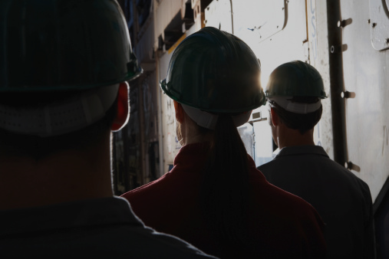
Final Word
Clean Workplace
Improved Morale

Slide 7
End of Presentation
Notes:
(Next Slide)

