Slide 1

Click to get started…
Notes:
(Next Slide)

Slide 2

HEAVY WORK MEANS STRAINS & SPRAINS
Notes:
TITLE
Heavy Work Means Strains & Sprains
(Next slide)

Slide 3


LOST WORK DAYS
LOST WORK DAYS
ON THE JOB
NON FATAL
INJURIES
PAIN
PAIN
MISSED DEADLINES
MISSED DEADLINES
Notes:
INTRO
Lost work days, pain, and missed deadlines can be the result of on-the-job, non-fatal injuries. The most common of these are strains and sprains.
Unfortunately, in some professions, strains and sprains are part of the job. Most workers, though, would rather live without this “job perk.”
(Next slide)

Slide 4
STRAINS VS SPRAINS
RISK FACTORS
PREVENTION
Notes:
INTRO
In this Safety Talk, we’ll learn about the difference between strains and sprains, discover the risk factors that increase the likelihood of a strain or sprain, and discuss how these injuries can be prevented.
(Next slide)

Slide 5

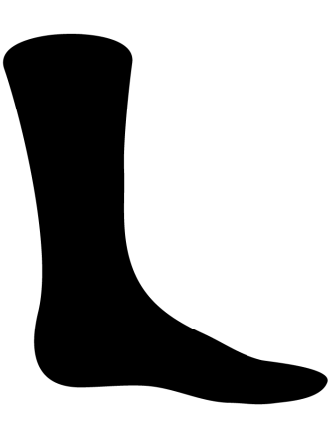
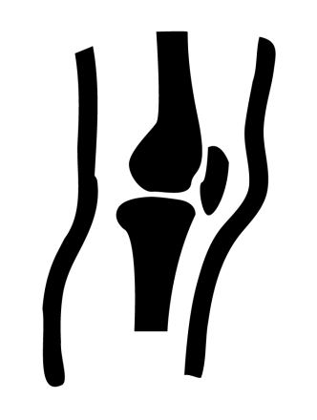

LIGAMENTS
MUSCLES
TENDONS
MUSKOSKELETAL DISORDERS
(MSDs)
SPRAINS
STRAINS
Notes:
WHAT CAN GO WRONG
Muskoskeletal disorders (MSDs) are injuries to soft body tissues, like muscles, tendons, and ligaments. Sprains and strains are both MSDs.
A sprain is an injury to a ligament, which is the tough, fibrous tissue that connects bones to other bones. A strain, on the other hand, is an injury to either a muscle or a tendon, which is the tissue that connects muscles to bones. The most common types of strains and sprains are to the back, ankles, knees, and wrists.
(Next slide)

Slide 6
AWKWARD POSTURES
FORCEFUL EXERTIONS
REPETITIVE MOTIONS
VIBRATION
EXTREME TEMPERATURES
POOR LIGHTING
Notes:
WHAT CAN GO WRONG
There are several risk factors that can increase your chance of a strain or sprain. These factors include:
awkward postures, like bending, kneeling, or twisting;
repetitive motions, like hammering, typing, or lifting;
forceful exertions, like pushing or pulling heavy objects; and
vibration, like when a power drill is used or sitting inside a heavy vehicle.
Environmental factors, like extreme temperatures or poor lighting, also lead to strains and sprains.
(Next slide)

Slide 7
PREVENTION
ELMINATE
REDUCE
RISK FACTORS
Notes:
HOW TO PROTECT YOURSELF
The best way to prevent strains and sprains is to eliminate or reduce the risk factors that cause them. Here are a few tips to keep injuries to a minimum.
(Next slide)

Slide 8


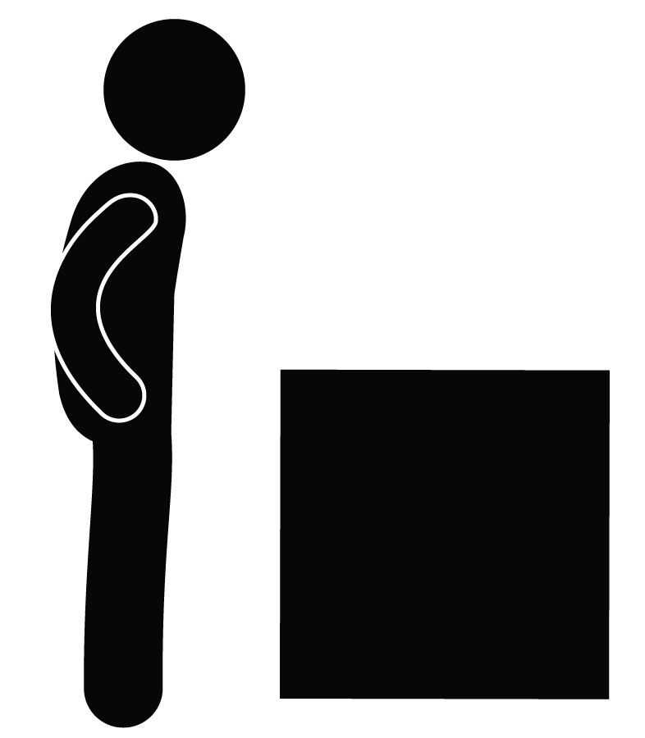
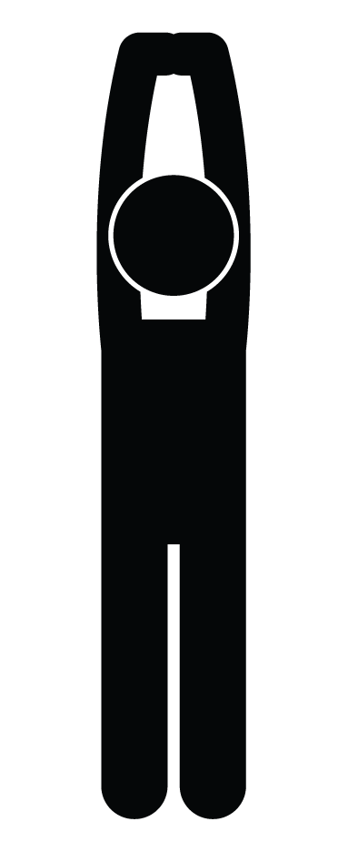


PROPER LIFTING & CARRYING
KNOW WHEN TO ASK FOR HELP
WARM UP & STRETCH
Notes:
HOW TO PROTECT YOURSELF
Warm up and stretch. Athletes warm up by stretching their muscles to reduce strains and sprains. So should you.
Use proper lifting and carrying techniques. Don’t twist when lifting, keep the load close to your body and in front of you, and lift with the legs.
Know when to get help. Ask for assistance if a job is too big for you to physically handle on your own.
(Next slide)

Slide 9
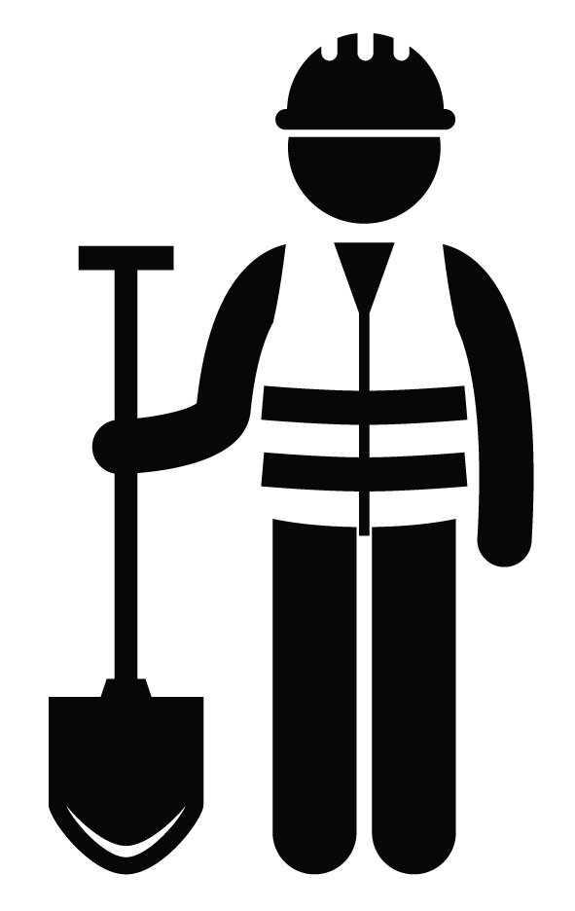
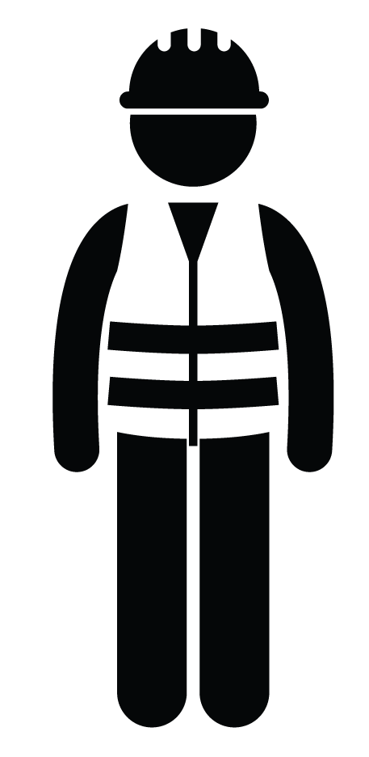
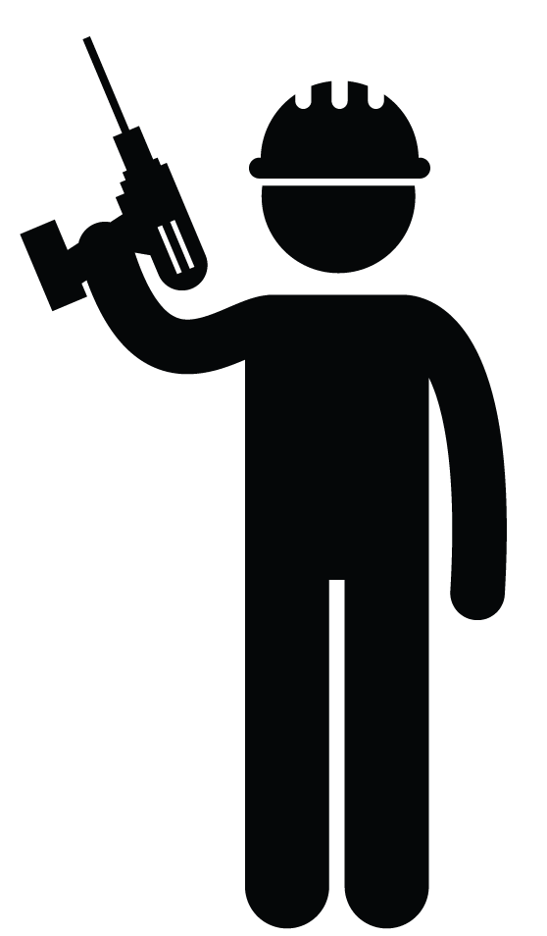
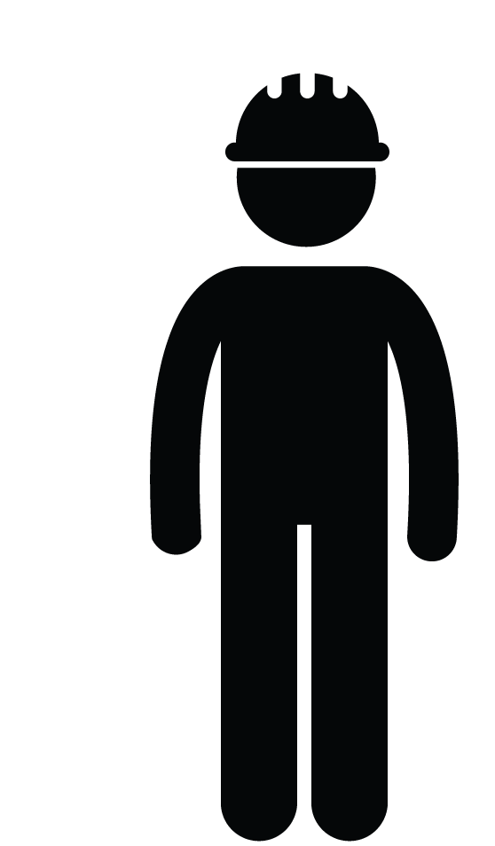
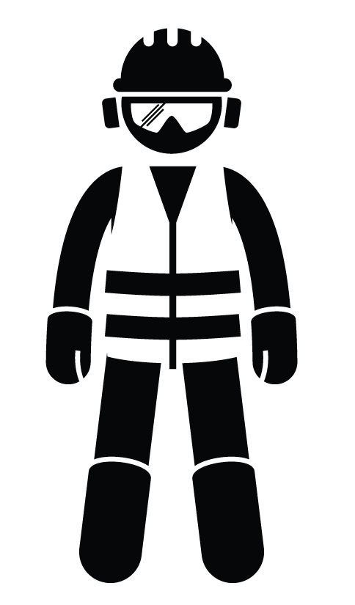
PERSONAL PROTECTIVE EQUIPMENT
PLAN AHEAD FOR SAFETY
POWER UP
Notes:
HOW TO PROTECT YOURSELF
Plan ahead for safety. Ensure that materials and equipment are close to where they’re going to be used ahead of time.
Use the right personal protective equipment (PPE) for the job. Knee pads, shoulder pads, or vibration reducing gloves are examples of equipment that can help reduce strains and sprains.
Power up. Use power tools whenever possible to reduce repetitive motions and vibration.
(Next slide)

Slide 10
STRAINS & SPRAINS
RISK FACTORS
REDUCE OR ELMINATE
NOT PART OF THE JOB!
Notes:
FINAL WORD
Strains and sprains shouldn’t be considered “part of the job.” Identify the risk factors and then use the tips in this Safety Talk to reduce or eliminate them.
(Next slide)

Slide 11
End of Presentation
Notes:
(Next Slide)

