Slide 1
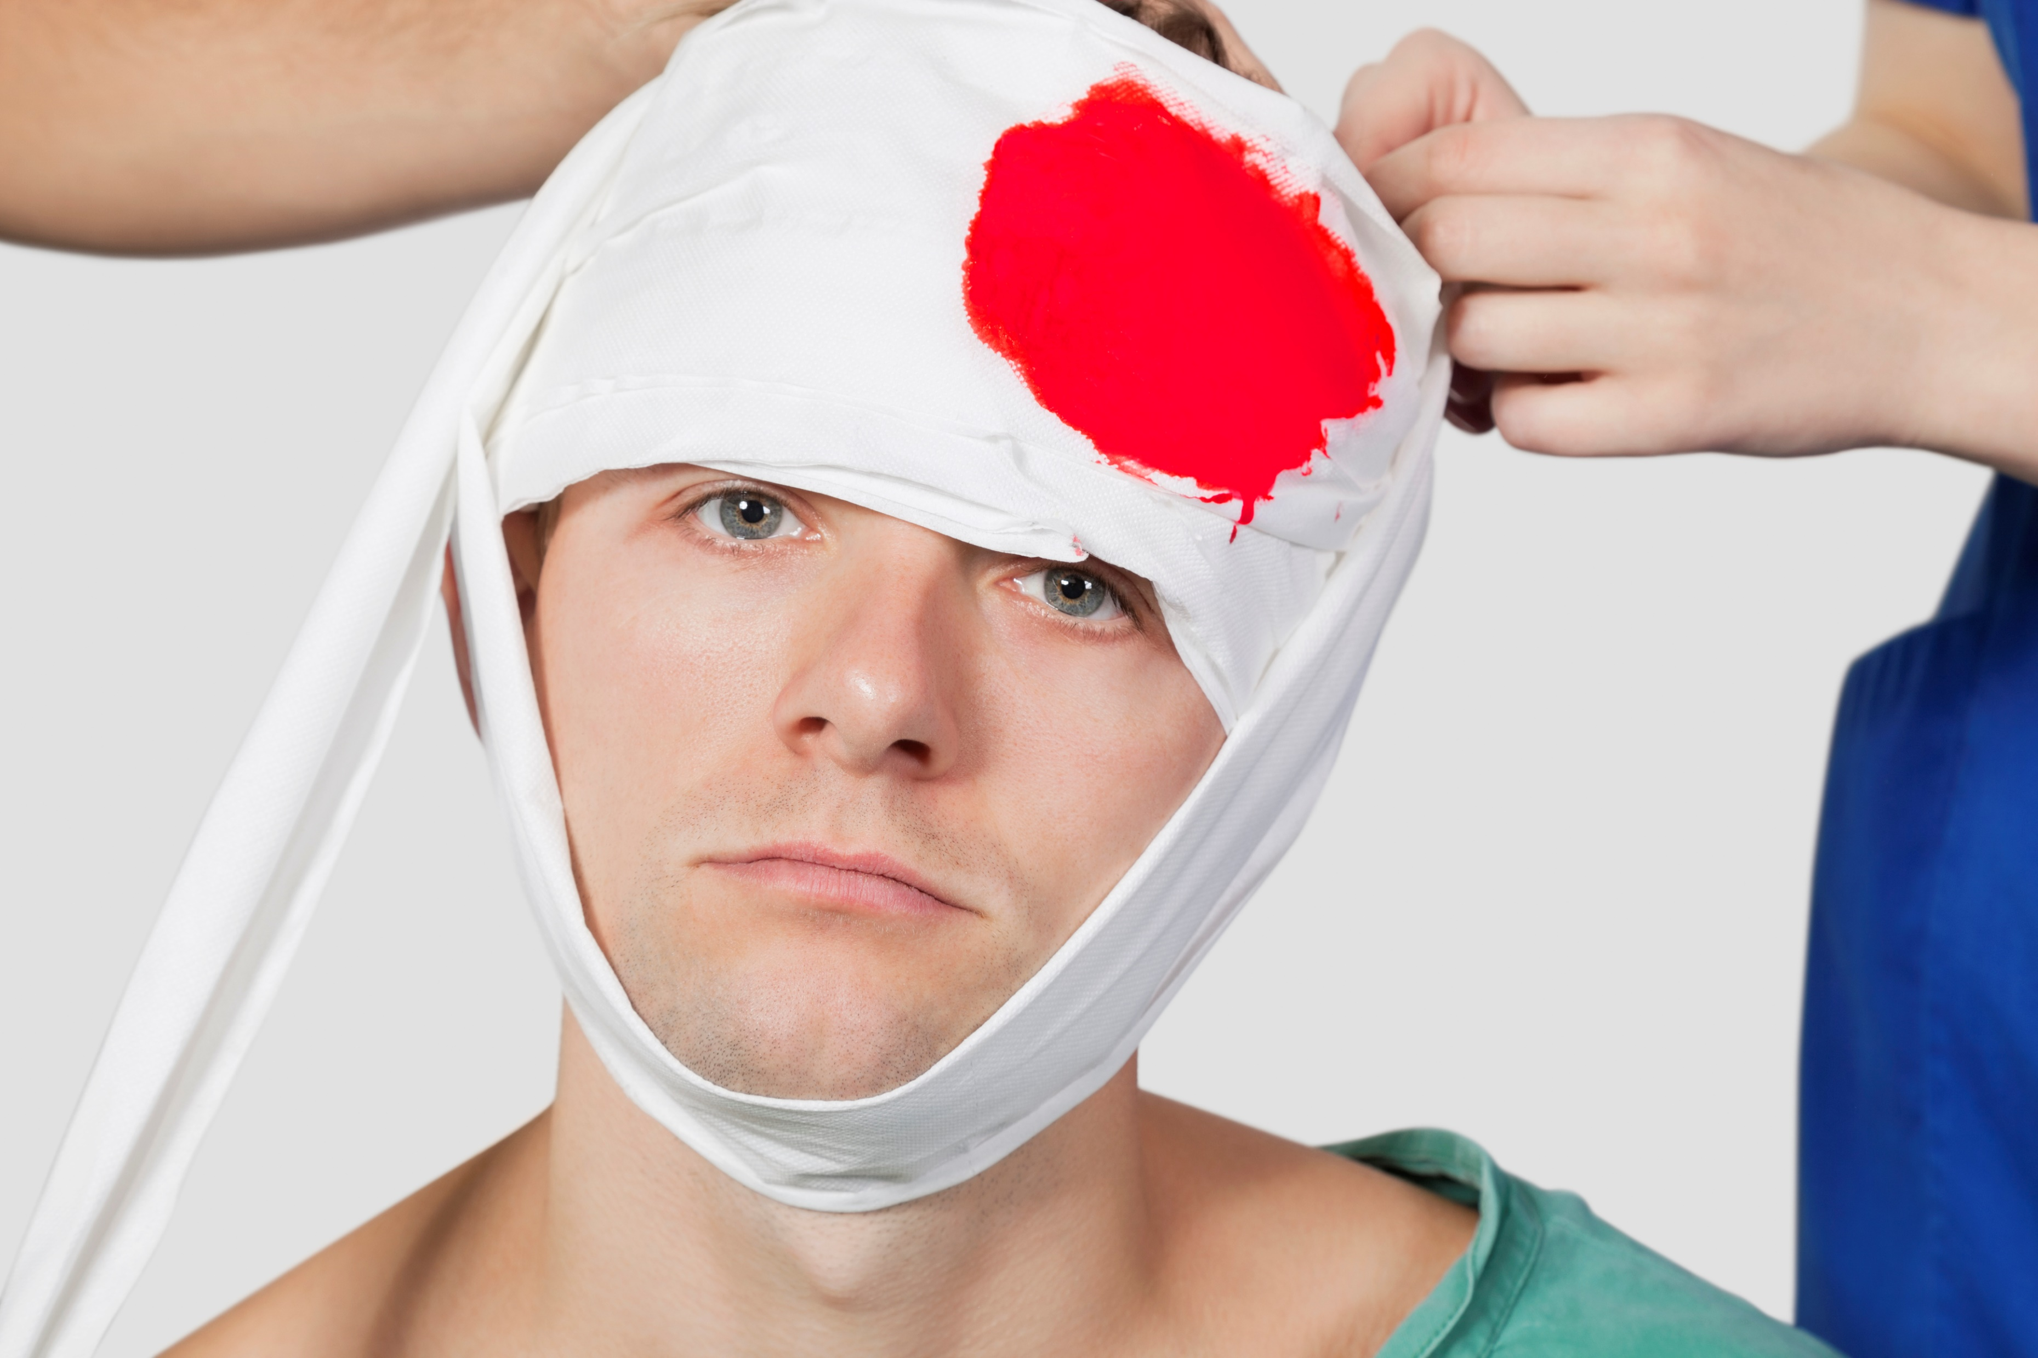

Are you Prepared for a Medical Emergency?
Notes:
Are you Prepared for a Medical Emergency?
(Next Slide)

Slide 2
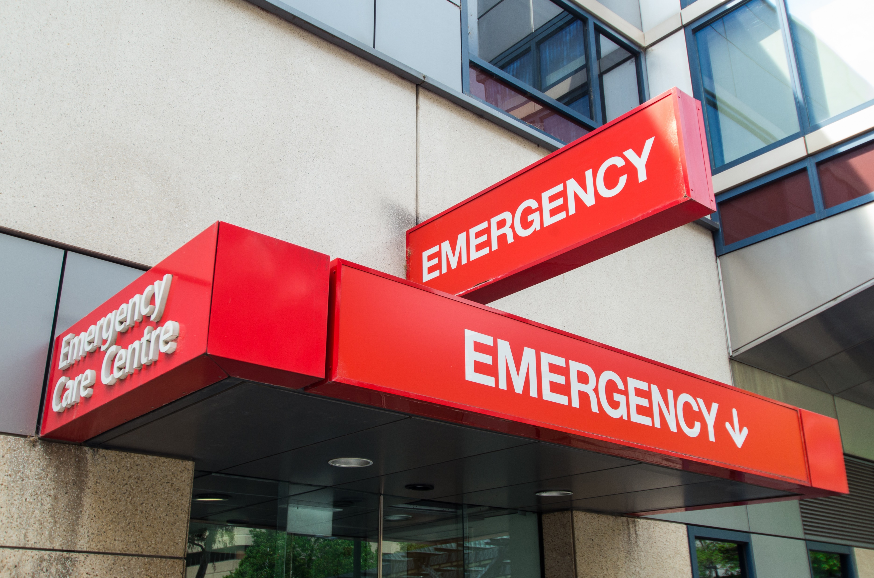
What’s at Stake
1 in 5 Americans make a trip to the emergency room each year.
Canadians are among the most frequent users of emergency departments in the world, with an average of 17 million visits a year.
Medical emergencies can happen at work, at home or while on vacation.
They often happen with little or no warning and can be frightening, stressful and chaotic.
Notes:
WHAT'S AT STAKE
According to a recent report released by the CDC, nearly 1 in 5 Americans make a trip to the emergency room each year. And Canadians are among the most frequent users of emergency departments in the world, with an average of 17 million visits a year. Medical emergencies can happen at work, at home or while on vacation. They often happen with little or no warning and can be frightening, stressful and chaotic.
(Next Slide)

Slide 3
What’s the Danger
What happens when an accident, a heart attack, poisoning or other emergency leaves you unconscious or otherwise unable to communicate to family, friends, co-workers and emergency personnel?
Will they know who to call, what medications you’re on or what pre-existing medical conditions you have?
Even those closest to you can have a hard time remembering and conveying that information to medical personnel during the stress of an emergency event.
Notes:
WHAT’S THE DANGER
What happens when an accident, a heart attack, poisoning or other emergency leaves you unconscious or otherwise unable to communicate to family, friends, co-workers and emergency personnel? Will they know who to call, what medications you’re on or what pre-existing medical conditions you have? Even those closest to you can have a hard time remembering and conveying that information to medical personnel during the stress of an emergency event.
(Next Slide)

Slide 4
How to Protect Yourself
Keep a list of meds on hand
Keep emergency contacts updated
Dose
Frequency
Keep multiple copies
At work and on your phone
I.C.E.
Notes:
HOW TO PROTECT YOURSELF
Here are some practical tips to help you be prepared for an emergency.
If you take medication on a daily or regular basis, keep a list of the names, doses and frequency with which you take them. Keep a list in your wallet or purse, store it on your phone, and keep at least one copy in your home, in your medicine cabinet or nightstand for example. Do this for your family members too.
Keep your emergency contact information updated at work and on your phone. Add I.C.E. or “In Case of Emergency” contact name and phone numbers to your cell phone. This should identify someone who is close to you and can communicate your medical history to emergency responders if you are not able to communicate for yourself.
(Next Slide)

Slide 5

How to Protect Yourself
Complete medical consent forms
Notify others of chronic conditions
Allow someone to authorize med treatment
You, spouse, children
Heart disease
Diabetes
Severe allergies
Notes:
HOW TO PROTECT YOURSELF
Complete medical consent forms for your family, which will allow someone to authorize medical treatment in an emergency when you’re unable to give consent (e.g., if you’re unconscious). If you have children, complete a medical consent form for each child and provide them to all caregivers.
If you have a chronic medical condition such as heart disease or diabetes, or severe allergies, consider telling a trusted colleague, HR or your manager and providing instructions about what to do in an emergency.
(Next Slide)

Slide 6

How to Protect Yourself
Warnings Signs of a Medical Emergency
Difficulty breathing, shortness of breath, chest or upper abdominal pain or pressure.
Fainting, sudden dizziness, weakness.
Severe or persistent vomiting or diarrhea, coughing or vomiting blood, and unusual abdominal pains.
Changes in vision or difficulty speaking.
Confusion or changes in mental status, unusual behavior, difficulty walking.
Any sudden or severe pain or uncontrolled bleeding.
Notes:
HOW TO PROTECT YOURSELF
5. Finally, learn the warning signs of medical emergencies.
Difficulty breathing, shortness of breath, chest or upper abdominal pain or pressure lasting two minutes or more.
Fainting, sudden dizziness, weakness.
Changes in vision or difficulty speaking.
Confusion or changes in mental status, unusual behavior, difficulty walking.
Any sudden or severe pain or uncontrolled bleeding; and
Severe or persistent vomiting or diarrhea, coughing or vomiting blood, and unusual abdominal pains.
(Next Slide)

Slide 7
Final Word
Seconds matter during a medical emergency.
With some forethought and planning you can help ease some of the uncertainty and panic that accompanies most emergency situations.
Notes:
FINAL WORD
Seconds matter during a medical emergency. With some forethought and planning you can help ease some of the uncertainty and panic that accompanies most emergency situations.
(Next Slide)

