Slide 1

Click anywhere to get started…

Slide 2
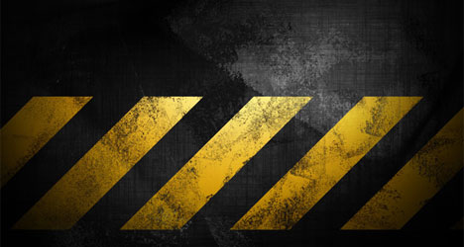


WORKPLACE INSPECTIONS - CONSTRUCTION
Notes:
WORKPLACE INSPECTIONS - CONSTRUCTION

Slide 3

What’s at Stake?
Workplace inspections prevent incidents, injuries and illnesses.
Notes:
What’s at Stake?
Workplace inspections are a basic necessity of safety programs. They help to prevent incidents, injuries and illnesses.

Slide 4

What’s the Danger?
What’s the Danger?
Hazards / Dangers in the Workplace.
Inspections should be done prior to the start of work as well as periodically throughout the shift and at the end of the work task.
Workplace inspections identify hazards in a work area. After identified, they need to be corrected before work proceeds.
Objects, equipment, people, or even animals find their way into work areas disrupting the work and creating additional hazards.
Elimination of hazards is the most effective way to avoid injuries and property damage incidents.
Notes:
What’s the Danger?
Hazards / Dangers in the Workplace.
Inspections should be done prior to the start of work as well as periodically throughout the shift and at the end of the work task.
Workplace inspections serve the purpose of identifying any hazards in a work area. After hazards are identified, they need to be corrected before work proceeds or continues. There can always additional hazards present in any work area that were not planned for.
Objects, equipment, people, or even animals find their way into work areas disrupting the work and creating additional hazards.
Elimination of hazards is the most effective way to avoid injuries and property damage incidents.

Slide 5
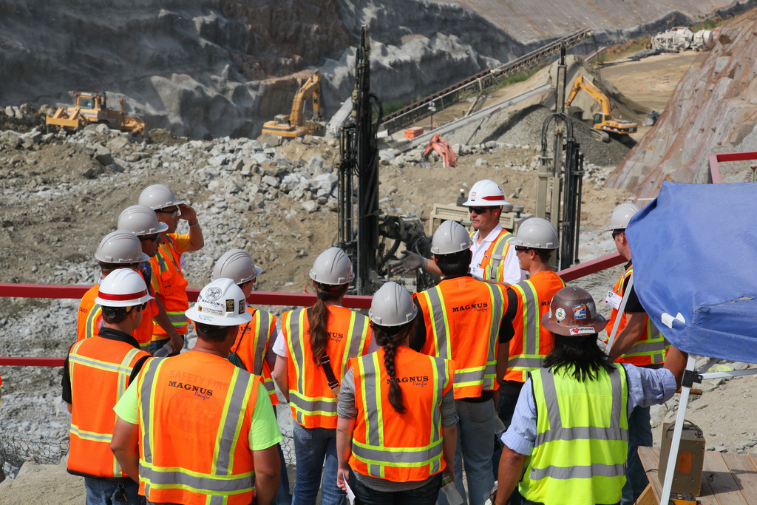
What’s the Danger?
Important to remove any unnecessary people, items, or equipment prior to the start of a work task.
By removing unnecessary personnel from a work area there are less people that have the chance to interfere with the work if something were to go wrong.
Objects that are not needed in the area create trip hazards or can be struck by moving equipment should be moved.
Biological hazards such as insects or wildlife in work areas can pose many hazards to workers.
Insects such as ticks or spiders can carry disease or poison that can affect an individual for years.
Insects and wildlife can also distract employees from their work.
Notes:
What’s the Danger?
It is important to remove any unnecessary people, items, or equipment prior to the start of a work task.
By removing unnecessary personnel from a work area there are less people that have the chance to interfere with the work or be in the line of fire if something were to go wrong.
Objects that are not needed in the area create trip hazards or can be struck by moving equipment and should be moved as well.
Biological hazards such as insects or wildlife in work areas can pose many hazards to workers.
Insects such as ticks or spiders can carry disease or poison that can affect an individual for years.
Insects and wildlife can also distract employees from their work which could cause an injury.

Slide 6
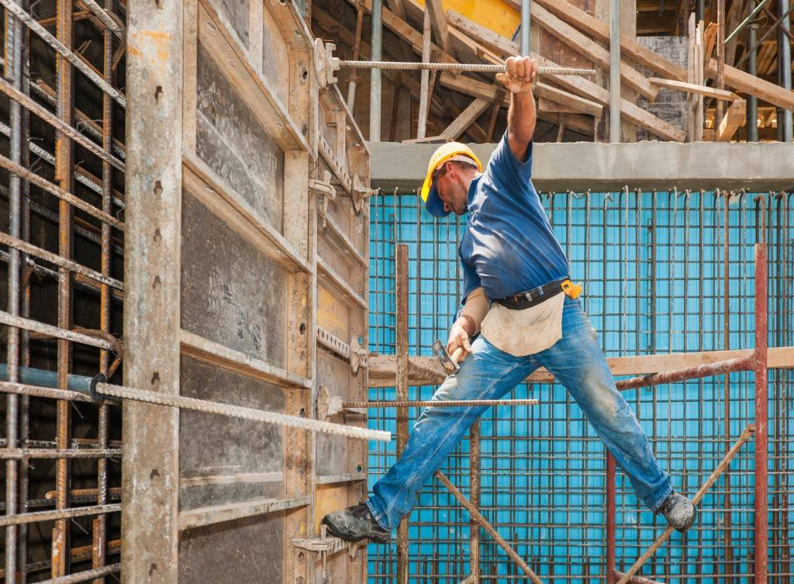
What’s the Danger?
Other types of hazards:
Safety hazards such as those caused by inadequate machine guards, unsafe workplace conditions, unsafe work practices.
Biological hazards caused by organisms such as viruses, bacteria, fungi and parasites.
Chemical hazards caused by a solid, liquid, vapor, gas, dust, fume or mist.
Ergonomic hazards caused by physiological and psychological demands on the worker, such as repetitive and forceful movements, awkward postures arising from improper work methods, and improperly designed workstations, tools, and equipment.
Physical hazards caused by noise, vibration, energy, weather, heat, cold, electricity, radiation and pressure.
Psychosocial hazards that can affect mental health or well-being such as overwork, stress, bullying, or violence.
Notes:
What’s the Danger?
Other types of hazards:
Safety hazards such as those caused by inadequate machine guards, unsafe workplace conditions, unsafe work practices.
Biological hazards caused by organisms such as viruses, bacteria, fungi and parasites.
Chemical hazards caused by a solid, liquid, vapor, gas, dust, fume or mist.
Ergonomic hazards caused by physiological and psychological demands on the worker, such as repetitive and forceful movements, awkward postures arising from improper work methods, and improperly designed workstations, tools, and equipment.
Physical hazards caused by noise, vibration, energy, weather, heat, cold, electricity, radiation and pressure.
Psychosocial hazards that can affect mental health or well-being such as overwork, stress, bullying, or violence.

Slide 7
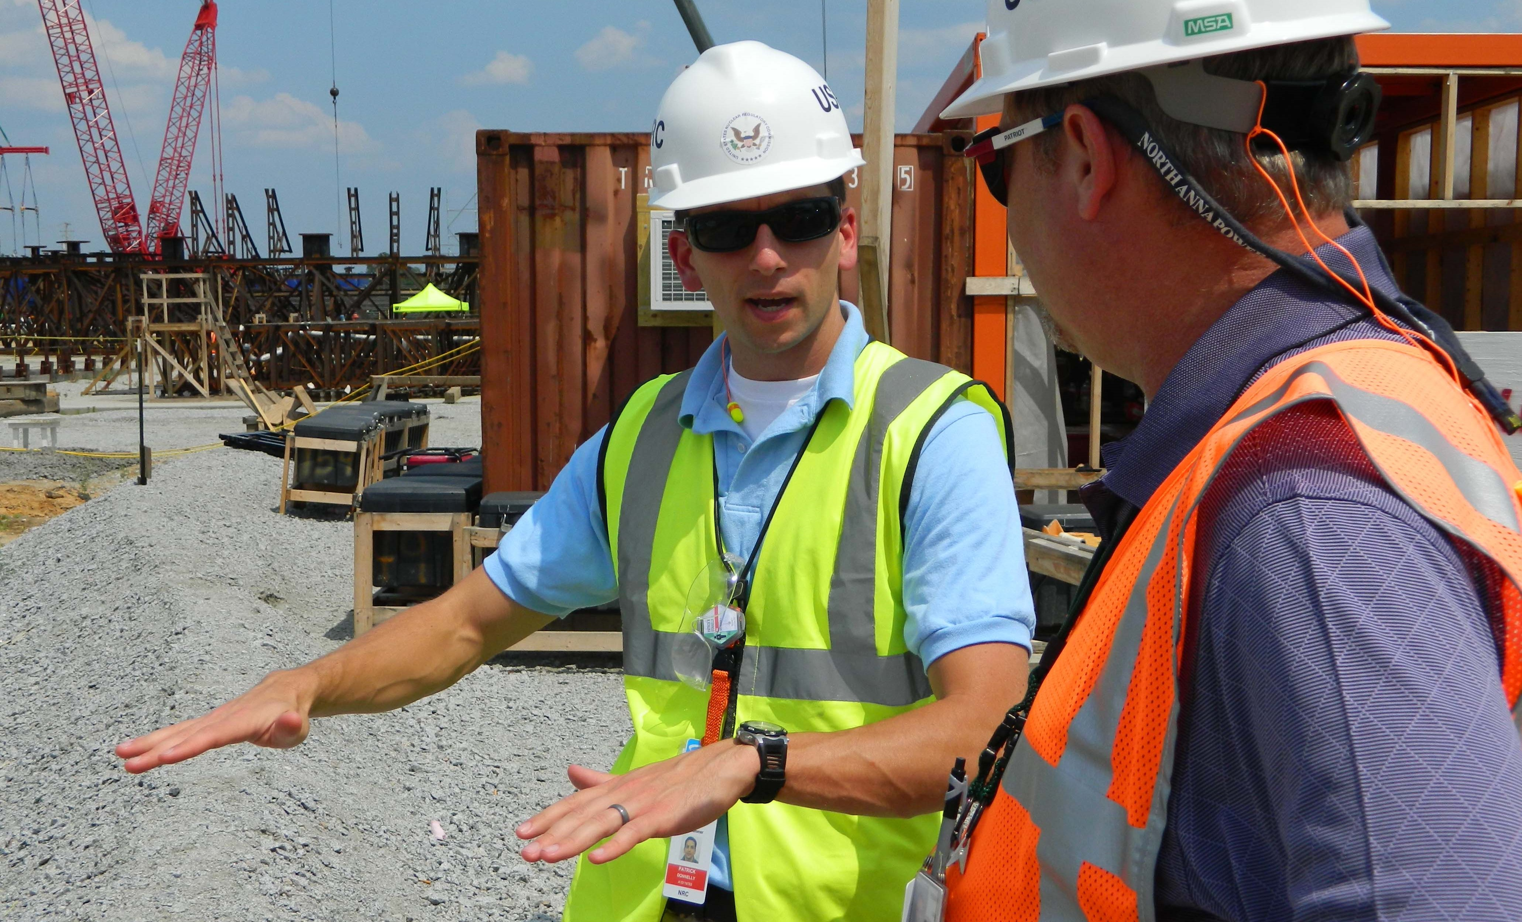
How to Protect Yourself
The phrase the “devil is in the detail” is particularly apt in unveiling a plan to implement an effective inspection.
Purpose of inspections:
listen to the concerns of workers and supervisors
gain further understanding of jobs and tasks
identify existing and potential hazards
determine underlying causes of hazards
recommend corrective action
monitor steps taken to eliminate hazards or control the risk (e.g., engineering controls, administrative controls, policies, procedures, personal protective equipment)
Notes:
How to Protect Yourself
The phrase the “devil is in the detail” is particularly apt in unveiling a plan to implement an effective inspection.
Purpose of inspections:
listen to the concerns of workers and supervisors
gain further understanding of jobs and tasks
identify existing and potential hazards
determine underlying causes of hazards
recommend corrective action
monitor steps taken to eliminate hazards or control the risk (e.g., engineering controls, administrative controls, policies, procedures, personal protective equipment)

Slide 8

How to Protect Yourself
What to examine:
Every inspection must examine the WHO, WHAT, WHERE, WHEN and HOW.
The length of an inspection depends on:
- What is found
How many questions are asked
How large and complex the work area is
Notes:
How to Protect Yourself
What to examine:
Every inspection must examine the WHO, WHAT, WHERE, WHEN and HOW.
What is the length of an inspection?
Depends on what is found, how many questions are asked, and how large and complex the work area is. Inspections are ineffective when the given time allows for only a quick look.

Slide 9

How to Protect Yourself
Inspection occur?
Depends on the following:
the frequency of planned formal inspections may be set in your legislation
past incident records
number and size of different work operations
type of equipment and work processes - those that are hazardous or potentially
number of shifts - the activity of every shift may vary
new processes or machinery
legislative requirements for your jurisdiction
Notes:
How to Protect Yourself
How often should inspection occur?
It depends on the following factors:
the frequency of planned formal inspections may be set in your legislation
past incident records
number and size of different work operations
type of equipment and work processes - those that are hazardous or potentially
number of shifts - the activity of every shift may vary
new processes or machinery
legislative requirements for your jurisdiction

Slide 10

How to Protect Yourself
Follow – up analysis of inspections:
Review the information from regular inspections to identify where corrective action was needed. Use older reports to identify trends. Analysis may show:
priorities for other corrective action
need for improving safe work practices
insight about why incidents are occurring in particular areas
need for education and training in certain areas
areas and equipment that require more in-depth hazard analysis
Notes:
How to Protect Yourself
Follow – up analysis of inspections:
Review the information from regular inspections to identify where corrective action was needed. Determine if these actions have been taken. Use older reports to identify trends. Analysis of inspection reports may show the following:
priorities for other corrective action
need for improving safe work practices
insight about why incidents are occurring in particular areas
need for education and training in certain areas
areas and equipment that require more in-depth hazard analysis

Slide 11

How to Protect Yourself
Reports:
Keeping inspection records is important. Past inspection records show what has been previously identified. They also show what an earlier inspection team concentrated on and what areas it did not inspect. Use the older inspection reports to help look for issues, and then determine whether recommendations were implemented.
Notes:
How to Protect Yourself
Reports:
Keeping inspection records is important. Past inspection records show what has been previously identified. They also show what an earlier inspection team concentrated on and what areas it did not inspect. Do not simply repeat or copy previous inspection results. Use the older inspection reports to help look for issues, and then determine whether recommendations were implemented. Note if the changes have been effective in sum, from past mistakes, one learns what works and does not work.
Two references to specific and general industry safety inspections are notable.

Slide 12
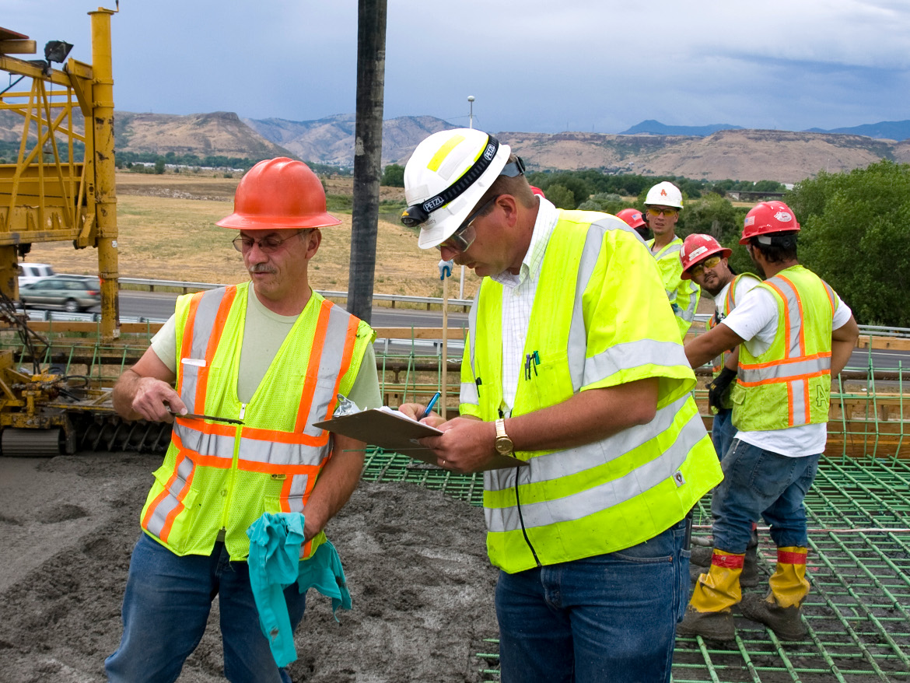
How to Protect Yourself
Construction Industry Safety Inspections
Conduct routine self – inspections which cover the entire worksite as often as necessary, but at least weekly.
Ensure that the subcontractor implements a similar self – inspection process.
More frequent due to dynamic nature.
General Industry Safety Inspections
Conduct routine self – inspections which cover the entire worksite with a frequency of at least monthly and the entire worksite covered at least quarterly.
Planning:
Underscoring all the written material referencing inspections is the theme that without thoughtful and strategic planning, effective inspections will not likely occur.
Notes:
How to Protect Yourself
Construction Industry Safety Inspections
Conduct routine self – inspections which cover the entire worksite as often as necessary, but at least weekly.
Ensure that the subcontractor implements a similar self – inspection process.
More frequent due to dynamic nature.
General Industry Safety Inspections
Conduct routine self – inspections which cover the entire worksite with a frequency of at least monthly and the entire worksite covered at least quarterly.
Planning:
Underscoring all the written material referencing inspections is the theme that without thoughtful and strategic planning, effective inspections will not likely occur.

Slide 13

Final Word
The foundation of a successful and effective investigation starts with strategic and thoughtful planning by all the stakeholders in the management and worker paradigm.
Notes:
Final Word
The foundation of a successful and effective investigation starts with strategic and thoughtful planning by all the stakeholders in the management and worker paradigm.

