Slide 1

Click anywhere to get started…

Slide 2
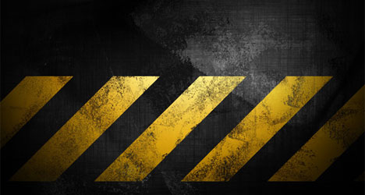
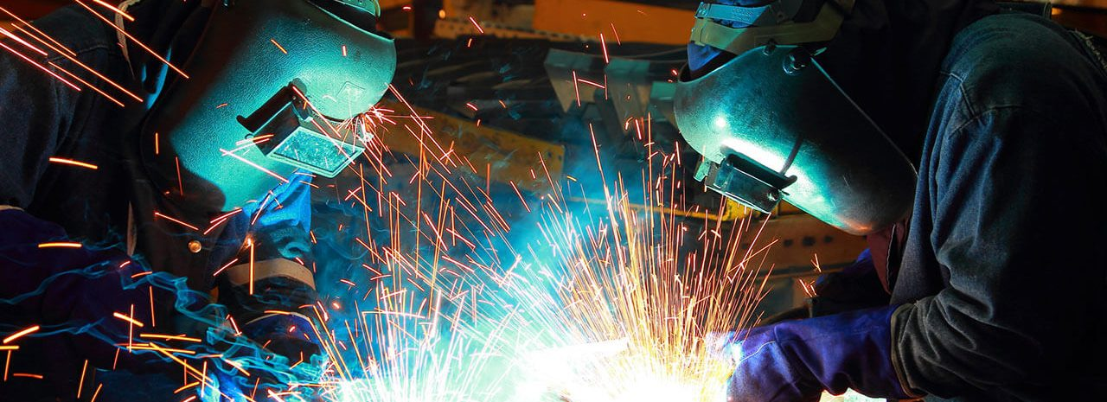

Welding / Brazing / Hot Work
Notes:
Welding / Brazing / Hot Work

Slide 3
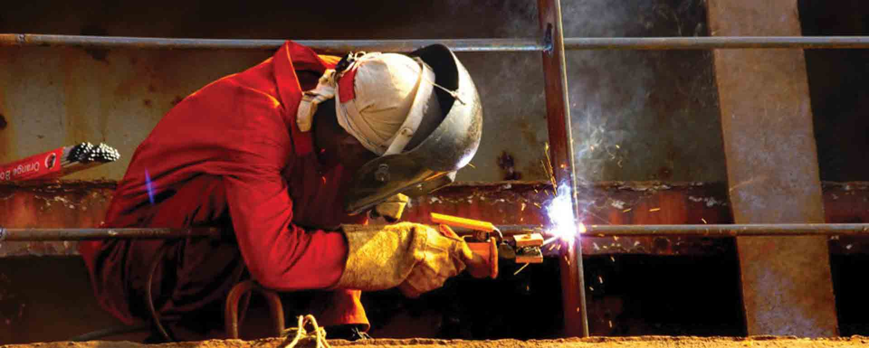
What’s at Stake?
Hot work / Welding includes riveting, flame, cutting, soldering, brazing, grinding, using an electric tool in a hazardous area.
The most common type of hot work is arc welding.
Notes:
What’s at Stake?
Hot work / Welding is any work that produces fire or sparks or hot material which has the potential and to cause fires or explosion. This includes riveting, flame, cutting, soldering, brazing, grinding, using an electric tool in a hazardous area.
The most common type of hot work is arc welding.

Slide 4
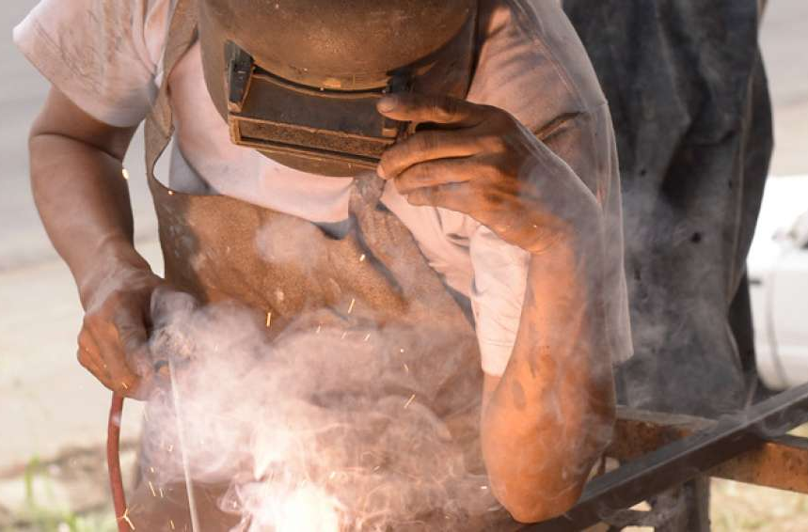
What’s the Danger?
500,000 employees suffer injuries in welding accidents each year.
Hazards / Dangers of hot work:
Fires and explosions.
Skin burns.
Welding “blindness”.
Respiratory hazards from fumes and smoke.
Notes:
What’s the Danger?
The Bureau of Labor statistics (B. L. S) documents more than 500,000 employees suffering injuries in welding accidents each year.
Hazards / Dangers of hot work:
Fires and explosions.
Skin burns.
Welding “blindness”.
Respiratory hazards from fumes and smoke.

Slide 5
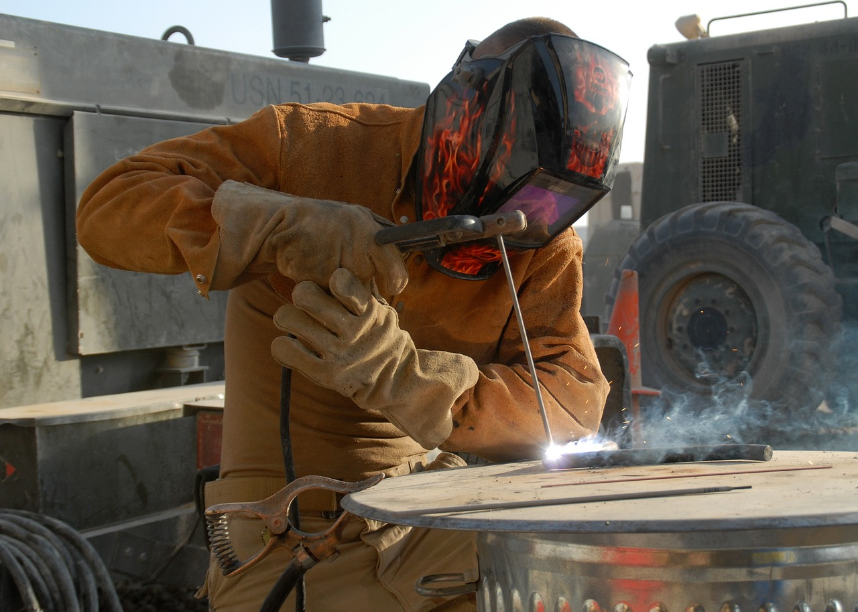
What’s the Danger?
Hazards occur when:
Hot work produces electrical arcs or flames that reach up to 10,000.
Arc welding produces intense UV light that can damage welders’ retinas or fatal electrocution.
More Dangers:
Arsenic, nickel, asbestos, silica, cadmium, fluorine are extremely toxic which are found in welding smoke.
Notes:
What’s the Danger?
The above hazards / dangers result because:
Hot work produces electrical arcs or flames that can reach up to 10,000. High temperatures, sparks and slag, are also an ever-present danger. Hot work equipment, such as arc welding circuits, can cause serious or fatal electrocution. Arc welding produces intense UV light that can damage welders’ retinas.
More Dangers:
Substances like arsenic, nickel, asbestos, silica, cadmium, fluorine are extremely toxic which are found in welding smoke.

Slide 6
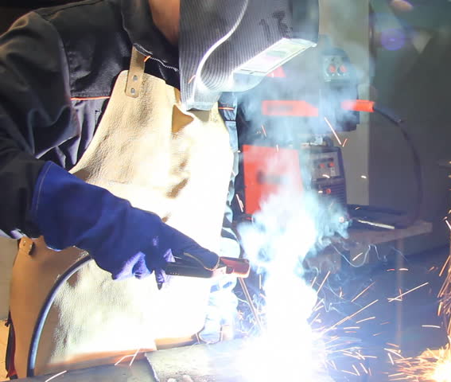
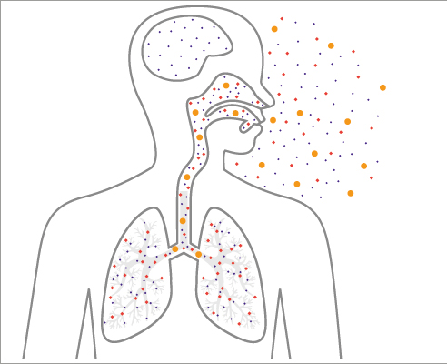
What’s the Danger?
Health Dangers:
Welding smoke affect the welder’s lungs, heart, kidneys and central nervous system.
Long-term exposure to welding smoke cause chronic respiratory problems, decreased lung capacity, heart disease, skin disease, hearing loss, kidney damage, reproductive harm.
Notes:
What’s the Danger?
Health Dangers:
These components in welding smoke can affect the welder’s lungs, heart, kidneys and central nervous system.
Long-term exposure to welding smoke can cause chronic respiratory problems, decreased lung capacity, heart disease, skin disease, hearing loss, kidney damage, reproductive harm, and other diseases.

Slide 7
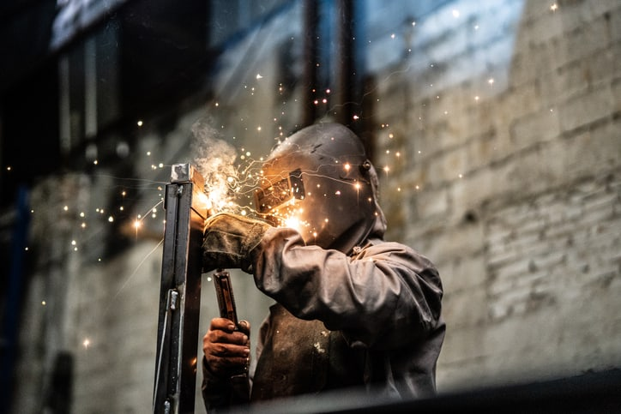
How to Protect Yourself
Four aspects incorporate the basis of preventative and precautionary steps to protect workers.
A. Hot Work Management Program
Hot work programs are designed to control or eliminate hot work hazards and their risks including policies, procedures, and the assignment of responsibilities for all aspects of hot work.
Policies
Where hot work is permitted.
When hot work is permitted.
Who authorizes, performs, and monitors hot work activities.
Notes:
How to Protect Yourself
These four aspects incorporate the basis of preventative and precautionary steps to protect workers from harm in this dangerous hot work undertakings.
A. Hot Work Management Program
Hot work programs are designed to control or eliminate hot work hazards and their risks including policies, procedures, and the assignment of responsibilities for all aspects of hot work.
Policies
Where hot work is permitted.
When hot work is permitted.
Who authorizes, performs, and monitors hot work activities.

Slide 8
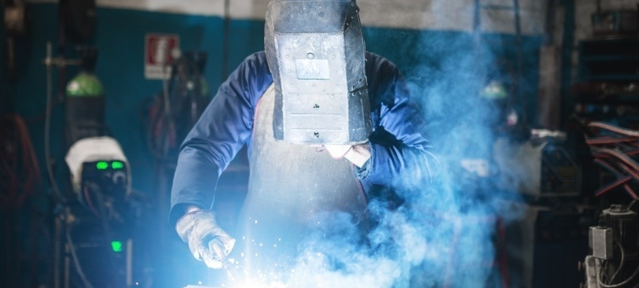
How to Protect Yourself
2. Procedures
What must be assessed before permitting / performing hot work in an area or on a process piece of equipment or area.
What to do to prepare an area for hot work.
What to do if hot work cannot be avoided in a particularly hazardous area.
What hot work tools are required?
How to obtain a hot work permit, when they are required, and who can administer them.
Notes:
How to Protect Yourself
2. Procedures
What must be assessed before permitting/performing hot work in an area or on a process piece of equipment or area.
What to do to prepare an area for hot work.
What to do if hot work cannot be avoided in a particularly hazardous area.
What hot work tools are required?
How to obtain a hot work permit, when they are required, and who can administer them.

Slide 9
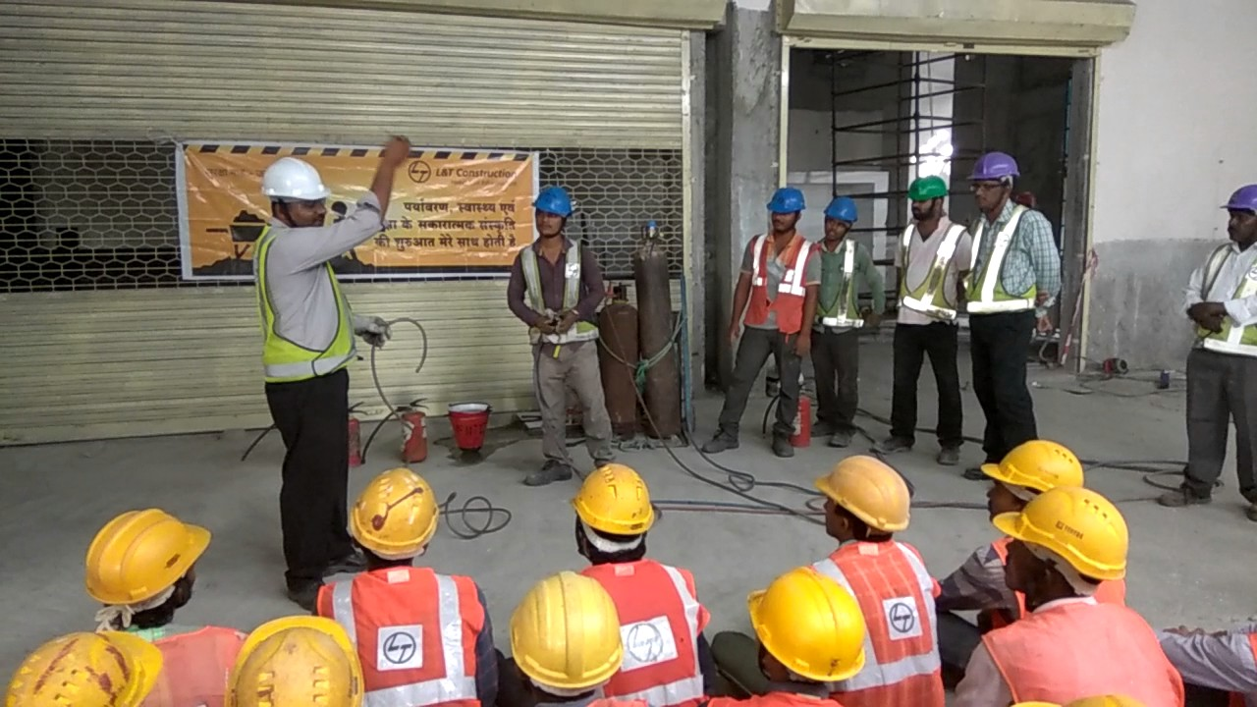
3. Training
Employees, supervisors, maintenance individuals, fire wardens, trained fire watch individuals, and contractors all have different roles, and must be trained accordingly.
4. Communications
Posting procedures.
Posting policies.
Posting signs in areas that are prohibited from having hot work performed in them.
How to Protect Yourself
Notes:
How to Protect Yourself
3. Training
Employees, supervisors, maintenance individuals, fire wardens, trained fire watch individuals, and contractors all have different roles, and must be trained accordingly.
4. Communications
Posting procedures.
Posting policies.
Posting signs in areas that are prohibited from having hot work performed in them.

Slide 10
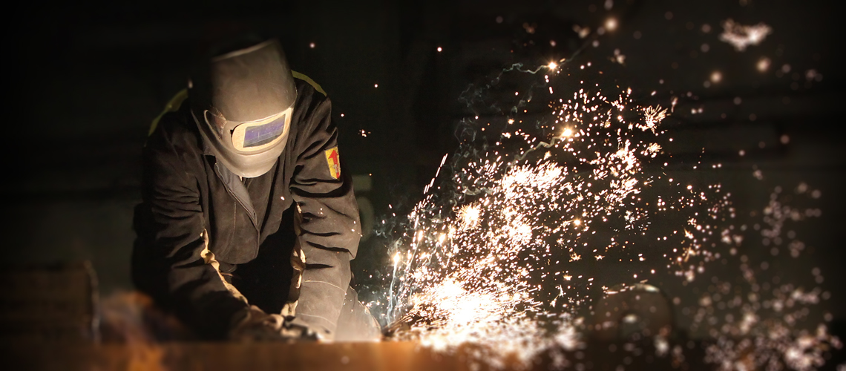
How to Protect Yourself
B. Substitutes / Alternatives
Assess the substitutes or alternate method for any risks or hazards.
C. Good Practices Checklist
Make sure that all equipment is in good operating order before work starts.
Make sure that all appropriate personal protective devices are available at the site and each worker has been trained on how to use, clean, and store them properly.
Inspect the work area thoroughly before starting. Look for combustible materials in structures (partitions, walls, ceilings).
Move all flammable and combustible materials away from the work area.
If combustibles cannot be moved, cover them with fire resistant blankets or shields. Protect gas lines and equipment from falling sparks, hot materials, and objects.
Sweep clean any combustible materials on floors around the work zone. Combustible floors must be kept wet with water or covered with fire resistant blankets or damp sand.
Notes:
How to Protect Yourself
B. Substitutes / Alternatives
Assess the substitutes or alternate method for any risks or hazards. Do not introduce any new risks or hazards.
C. Good Practices Checklist
Make sure that all equipment is in good operating order before work starts.
Make sure that all appropriate personal protective devices are available at the site and each worker has been trained on how to use, clean, and store them properly.
Inspect the work area thoroughly before starting. Look for combustible materials in structures (partitions, walls, ceilings).
Move all flammable and combustible materials away from the work area.
If combustibles cannot be moved, cover them with fire resistant blankets or shields. Protect gas lines and equipment from falling sparks, hot materials, and objects.
Sweep clean any combustible materials on floors around the work zone. Combustible floors must be kept wet with water or covered with fire resistant blankets or damp sand.

Slide 11
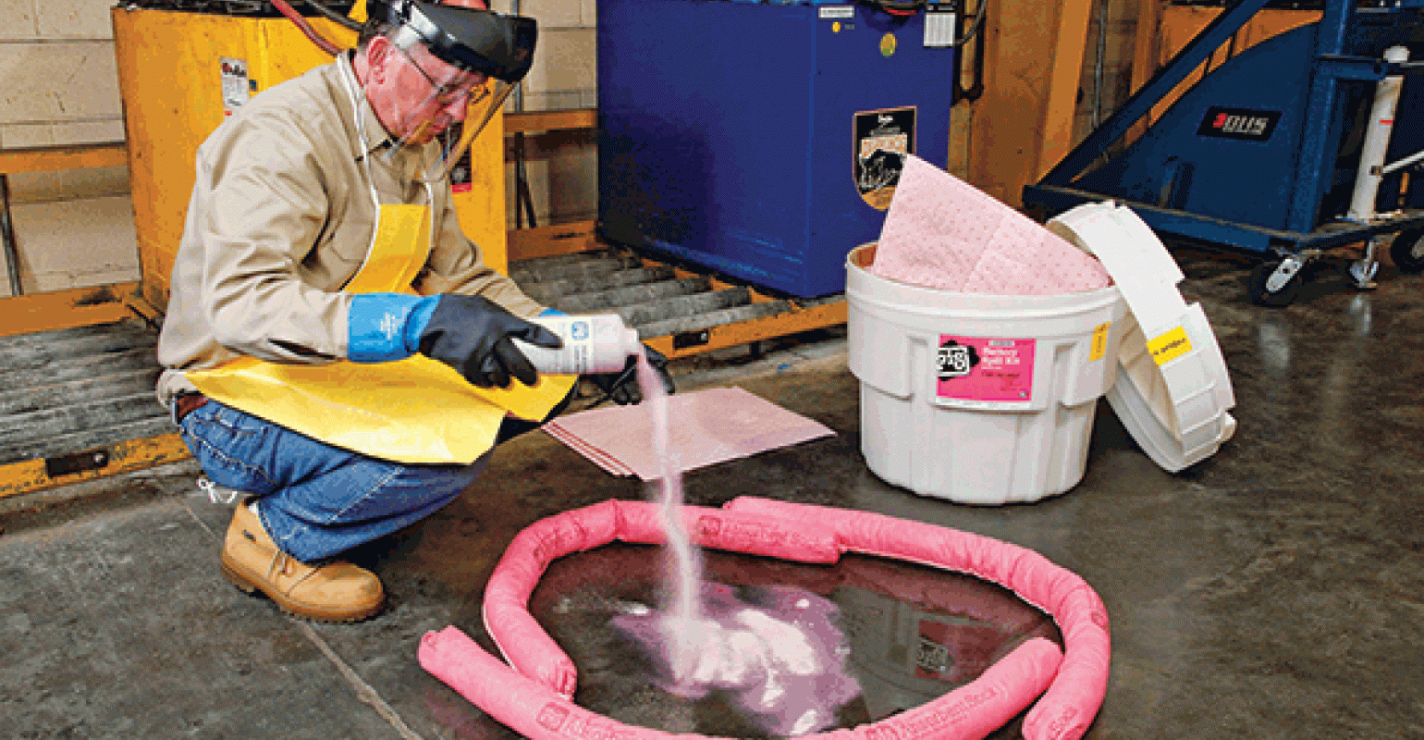
Use water ONLY if electrical circuits have been de-energized to prevent electrical shock.
Remove any spilled grease, oil, or other combustible liquid.
Vacuum away combustible debris from inside ventilation or other service duct openings to prevent ignition. Seal any cracks in ducts. Prevent sparks from entering into the duct work. Cover duct openings with a fire-resistant barrier and inspect the ducts after work has concluded.
Make sure that appropriate fire extinguishers (e.g., ABC fire extinguishers) are available and easily accessible.
Make sure that the first-aid boxes are available and easily accessible.
Block off cracks between floorboards, along baseboards and walls, and under door openings, with a fire-resistant material. Close doors and windows.
How to Protect Yourself
Notes:
How to Protect Yourself
Use water ONLY if electrical circuits have been de-energized to prevent electrical shock.
Remove any spilled grease, oil, or other combustible liquid.
Vacuum away combustible debris from inside ventilation or other service duct openings to prevent ignition. Seal any cracks in ducts. Prevent sparks from entering into the duct work. Cover duct openings with a fire-resistant barrier and inspect the ducts after work has concluded.
Make sure that appropriate fire extinguishers (e.g., ABC fire extinguishers) are available and easily accessible.
Make sure that the first-aid boxes are available and easily accessible.
Block off cracks between floorboards, along baseboards and walls, and under door openings, with a fire-resistant material. Close doors and windows.

Slide 12
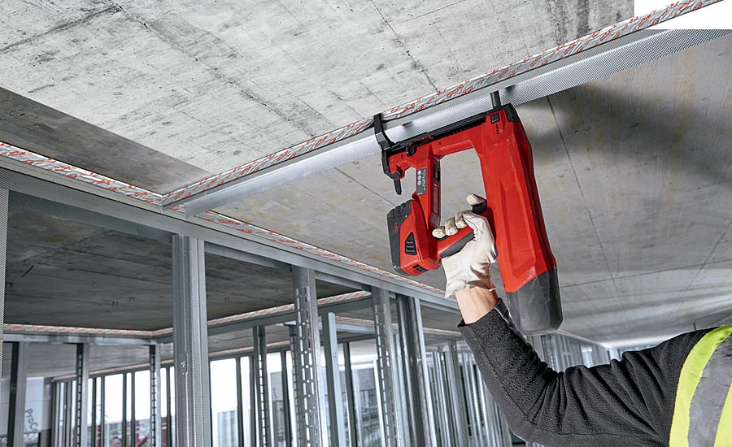
How to Protect Yourself
Cover wall or ceiling surfaces with a fire resistant and heat insulating material to prevent ignition and accumulation of heat.
Secure, isolate, and vent pressurized vessels, piping and equipment as needed before beginning hot work.
Inspect the area following work to ensure that wall surfaces, studs, wires or dirt have not heated up.
Post a trained fire watcher within the work area, including lower levels if sparks or slag may fall during welding, including during breaks, and for at least 60 minutes after work has stopped. Depending on the work done, the area may need to be monitored for longer (up to 3 or more hours) after the end of the hot work until fire hazards no longer exist.
Eliminate explosive atmospheres (e.g., vapors or combustible dust) or do not allow hot work. Shut down any process that produces combustible atmospheres, and continuously monitor the area for accumulation of combustible gases before, during, and after hot work.
If possible, schedule hot work during shutdown periods.
Comply with the required legislation and standards applicable to your workplace.
Notes:
How to Protect Yourself
Cover wall or ceiling surfaces with a fire resistant and heat insulating material to prevent ignition and accumulation of heat.
Secure, isolate, and vent pressurized vessels, piping and equipment as needed before beginning hot work.
Inspect the area following work to ensure that wall surfaces, studs, wires or dirt have not heated up.
Post a trained fire watcher within the work area, including lower levels if sparks or slag may fall during welding, including during breaks, and for at least 60 minutes after work has stopped. Depending on the work done, the area may need to be monitored for longer (up to 3 or more hours) after the end of the hot work until fire hazards no longer exist.
Eliminate explosive atmospheres (e.g., vapors or combustible dust) or do not allow hot work. Shut down any process that produces combustible atmospheres, and continuously monitor the area for accumulation of combustible gases before, during, and after hot work.
If possible, schedule hot work during shutdown periods.
Comply with the required legislation and standards applicable to your workplace.

Slide 13
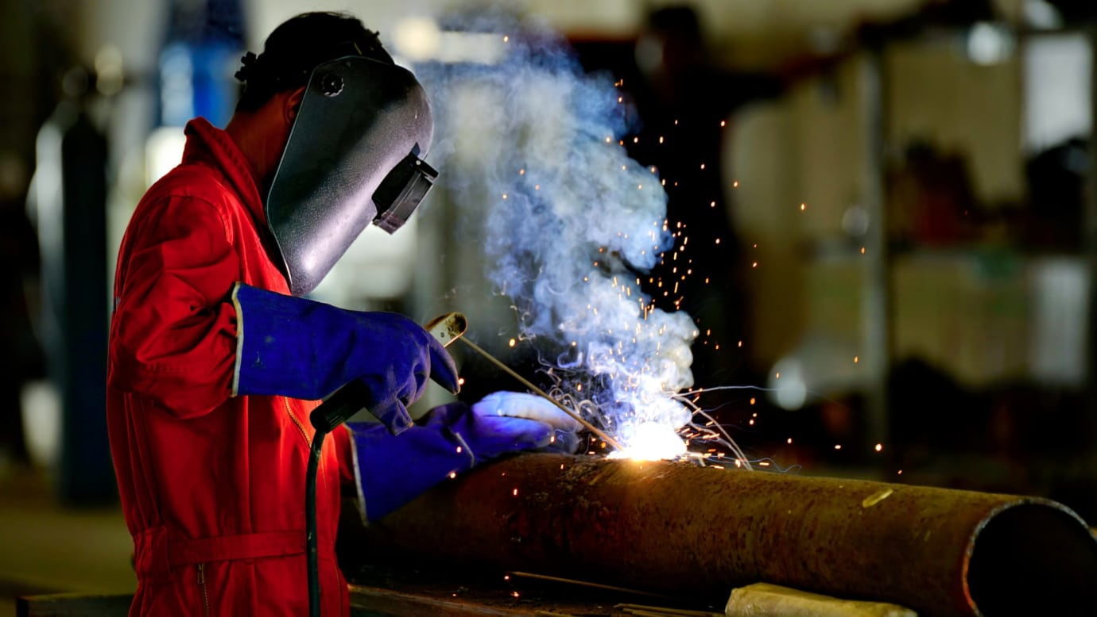
How to Protect Yourself
D. Personal Protective Equipment
Eye and face protection, such as goggles and face shield or helmets, helps protect workers from hot sparks and molten particles. Other common PPE for hot work includes insulated gauntlet gloves, hard-toed high-top shoes, leather aprons, insulated coveralls, safety glasses, helmets and hard hats, and leggings or high boots. Workers should always keep their clothes fully buttoned and uncuffed when performing hot work and wear wool or insulated fabrics. When welding overhead objects, workers will need extra protection, like heat-resistant shoulder covers, aprons, head covers, leggings, and suits. You must provide most types of PPE to your employees and train them on how to properly use, maintain, and dispose of it.
Notes:
How to Protect Yourself
D. Personal Protective Equipment
Eye and face protection, such as goggles and face shield or helmets, helps protect workers from hot sparks and molten particles. Other common PPE for hot work includes insulated gauntlet gloves, hard-toed high-top shoes, leather aprons, insulated coveralls, safety glasses, helmets and hard hats, and leggings or high boots. Workers should always keep their clothes fully buttoned and uncuffed when performing hot work and wear wool or insulated fabrics. When welding overhead objects, workers will need extra protection, like heat-resistant shoulder covers, aprons, head covers, leggings, and suits. You must provide most types of PPE to your employees and train them on how to properly use, maintain, and dispose of it.

Slide 14
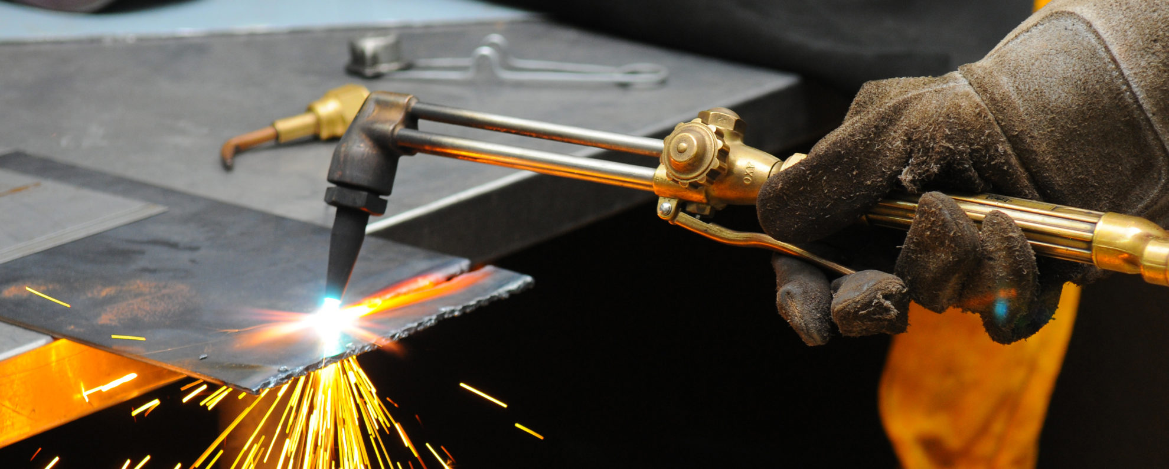
Final Word
Hot work is dangerous and even deadly, but with proper training and protective measures, your facility can reduce welding-related injuries and illnesses. Follow all precautions for hot work and remove or cover flammable and combustible materials before your employees begin. Ensure that all employees are provided with PPE and use it correctly.
Notes:
Final Word
Hot work is dangerous and even deadly, but with proper training and protective measures, your facility can reduce welding-related injuries and illnesses. Follow all precautions for hot work and remove or cover flammable and combustible materials before your employees begin. Ensure that all employees are provided with PPE and use it correctly.

