Slide 1

Click anywhere to get started…

Slide 2


TAKE SAFETY HOME WITH YOU
Notes:
The Basics of Forklift Safety

Slide 3

What’s at Stake?
Safety attitudes and habits should be the same at home as they are in your workplace.
Notes:
What’s at Stake?
Text here

Slide 4

What’s the Danger?
Failing to implement your safety attitudes and good safety habits at home can be costly. Off – the – job injuries affect your steady income, loss of productivity for business, loss of recreational time and a diminished overall life style.

Slide 5
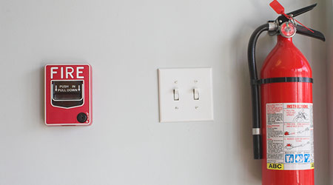
How to Protect Yourself
Useful guidelines to increase your off – the – job safety.
Fire Department
Have your local fire department conduct a home fire inspection for you.
Smoke detector:
Install smoke detectors in the recommended locations. Test them regularly and put in fresh batteries when needed.
Fire Extinguisher:
Keep the correct type of fire extinguisher in your kitchen. Teach everyone in the family.
Notes:
How to Protect Yourself
Machines of every description have standard operating procedures which include a “checklist” for its safe operation. Forklifts are no exception. There are procedures and protocols for the safe and effective use of the forklift.
These operating procedures are rooted out of common sense but are too often ignored or forgotten.

Slide 6
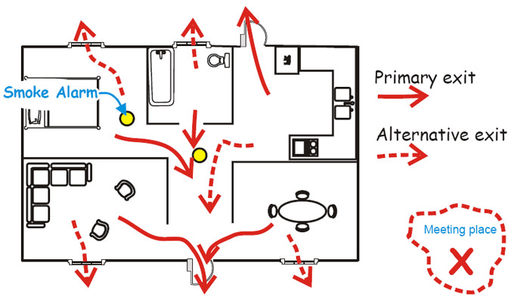
How to Protect Yourself
Escape plan:
Organize a fire escape plan and practice family fire drills.
Pathways:
keep all traffic pathways, inside and outside, clear of obstacles. Clean up spills immediately. Night lights:
Place night lights in hallways and bathrooms to prevent tripping accidents. Pets sleeping in hallways can be a hazard.
Non -slip:
Install non-slip surfaces in bathtubs, showers and on bathroom floors. Grab bars should be installed to prevent falls in tubs and showers.
Notes:
How to Protect Yourself
Follow safe speed limits – Drive only fast as you can comfortably walk. Forklifts can’t travel safely at high speeds. Without loads, they aren’t weighted and are especially unstable.
Keep the load low – While moving, forks should be low, with the mast tilted slightly back.
Maintain good visibility – If a load blocks forward vision, drive backwards.
Watch the slope – Back down slopes that have an incline greater than10 percent. Make sure your back up alarm is working properly.
Never carry hitchhikers – They are unsecured and can easily fall off and be injured.
Leave aisle room – Allow space for pedestrian and other traffic. Be alert at intersections. Honk your horn before and while you enter an intersection, even if it doesn’t appear to be busy.
Park safely – On a hill, always block the wheels, lower forks and set the parking brake.

Slide 7
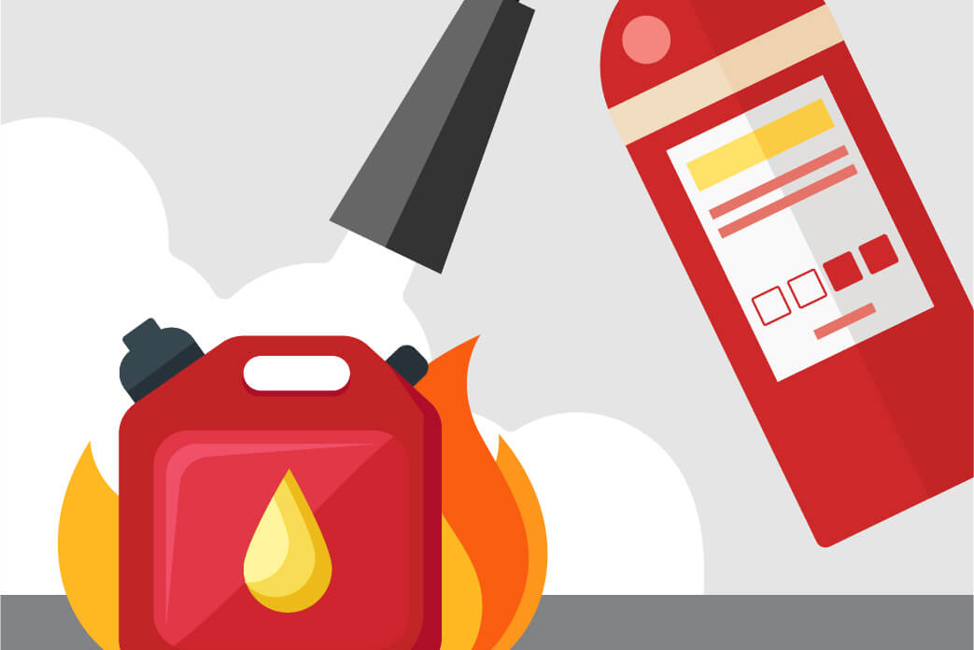
How to Protect Yourself
Stairways:
Keep stairways clean and clear. Don't store items you want to take upstairs later.
Toxic substances:
Store all toxic substances, cleaning products, paints or car products in a locked storage area and in their original containers.
Flammable liquids:
Keep flammable liquids stored in a well-ventilated area out-of-doors away from sources of ignition such as furnace pilot lights.
Power tools:
Keep sharp or electrically powered tools out of the reach of children.
Notes:
How to Protect Yourself

Slide 8

How to Protect Yourself
Correct tools:
Always use the correct tool for the job. Makeshift replacements cause injuries.
Ladder:
Never use the top few rungs of a ladder. For straight ladders one-to-four rule. Place the ladder at an angle so that the bottom is one foot away from the wall for every four feet of height.
Ground Fault Circuit Interrupter:
Have a Ground Fault Circuit Interrupter installed for electrical outlet locations that are near moisture. This includes bathroom, kitchen and outdoor electrical outlets.
Notes:
How to Protect Yourself

Slide 9
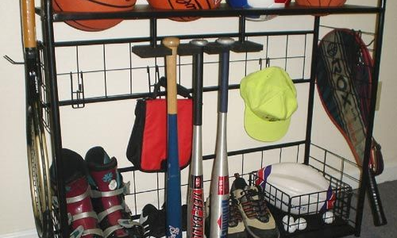
How to Protect Yourself
Plugs cords:
Keep plugs and electrical cords in good condition. Extension cords should only be used as temporary source of power and not as a permanent replacement for wiring.
Sports:
When you participate in sports on your days off, make sure you use the correct PPE (Personal Protective Equipment). Eye goggles, helmets, life jackets, shin-pads or gloves as may be necessary.
Equipment:
Keep your sports equipment in good condition. Well-maintained equipment last longer, saves money and reduces your risk of injury.
Notes:
How to Protect Yourself
Follow safe speed limits – Drive only fast as you can comfortably walk. Forklifts can’t travel safely at high speeds. Without loads, they aren’t weighted and are especially unstable.
Keep the load low – While moving, forks should be low, with the mast tilted slightly back.
Maintain good visibility – If a load blocks forward vision, drive backwards.
Watch the slope – Back down slopes that have an incline greater than10 percent. Make sure your back up alarm is working properly.
Never carry hitchhikers – They are unsecured and can easily fall off and be injured.
Leave aisle room – Allow space for pedestrian and other traffic. Be alert at intersections. Honk your horn before and while you enter an intersection, even if it doesn’t appear to be busy.
Park safely – On a hill, always block the wheels, lower forks and set the parking brake.

Slide 10

How to Protect Yourself
Drugs, alcohol:
Avoid using drugs and alcohol when you have to concentrate or be alert. Don’t drink when you are using a powered tool at home.
Seat Belt:
Buckle up before starting your car. Keep your car in good mechanical repair to avoid and observe all road signs and speed limits.
Notes:
How to Protect Yourself

Slide 11

Final Word
Safety awareness is a twenty-four hour a day job. Don’t leave your safety attitude at work when you punch the time clock at the end of your shift.
Notes:
Final Word

