Slide 1

Click anywhere to get started…

Slide 2
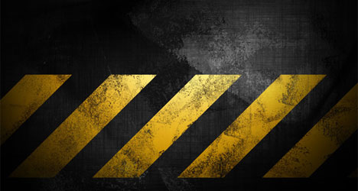
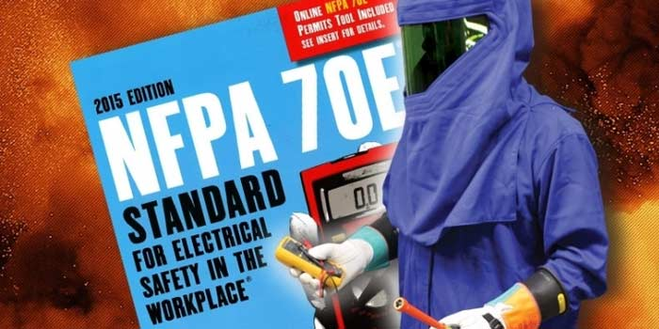

Substations - NFPA 70E
Notes:
Substations - NFPA 70E

Slide 3
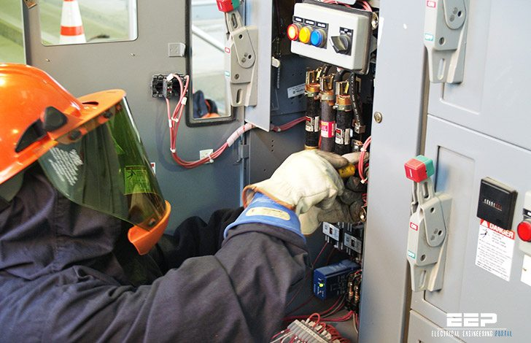
What’s at Stake?
To reduce risk of injury and protect employees from accident, injury and death is the stated purpose of NFPA 70E electrical training
Notes:
What’s at Stake?
To reduce risk of injury and protect employees from accident, injury and death is the stated purpose of NFPA 70E electrical training. NFPA 70E is the recognized tool that illustrates how employers comply with OSHA standards and regulations. The relationship between OSHA and NFPA 70E is best characterized as “OSHA” as the “shall” and NFPA 70E as the “how”.

Slide 4
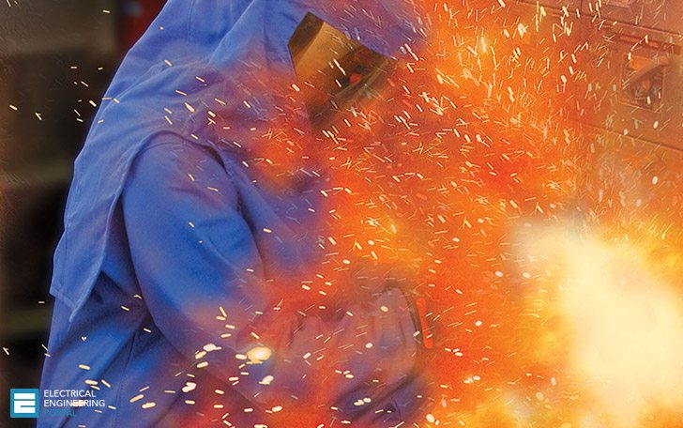
What’s the Danger?
When electrical faults occur, the electrical system is subjected to both thermal and magnetic forces.
These forces can severely damage equipment and are accompanied by fires, explosions and severe arcing.
Violent damage causes death or severe injury.
Costs of repairs, equipment replacements, and medical treatment cost millions.
Loss of production and damaged goods result.
High the cost of OSHA fines and litigation.
Notes:
What’s the Danger?
There is a moral and legal obligation to protect workers who may be exposed to Electrical Hazards.
Meeting OSHA regulations, reducing insurance costs, and minimizing downtime and repair costs are additional benefits of Electrical Safety programs. When electrical faults occur, the electrical system is subjected to both thermal and magnetic forces. These forces can severely damage equipment and are accompanied by fires, explosions and severe arcing. Such violent damage often causes death or severe injury to personnel. Costs of repairs, equipment replacements, and medical treatment can run into millions of dollars. Loss of production and damaged goods are also important considerations. Other major factors include the cost of OSHA fines and litigation. Severe electrical faults may shut down a complete process or assembly plant, sending hundreds or thousands of workers home for weeks while repairs are being made. It is also possible that one tragic event could close a plant permanently.

Slide 5
How to Protect Yourself
The US Department of Labor and the National Safety Council have compiled the following:
97% of all electricians have been shocked or injured on the job.
Approximately 30,000 workers receive electrical shocks yearly.
Over 3600 disabling electrical contact injuries occur annually.
Electrocutions are the 4th leading cause of traumatic occupational fatalities.
Over 2000 workers are sent to burn centers each year with severe Arc-Flash burns.
Estimates show that the 10 Arc-Flash incidents occur every day in the US.
60% of workplace accident deaths are caused by burn injuries.
Over 1000 electrical workers die each year from workplaces accidents.
Medical costs per person can exceed $4 million for severe electrical burns.
Total costs per electrical incident can exceed $15million.
In the year 2002, work injuries cost Americans $14.6 billion.
Hundreds of deaths and thousands of burns injuries occur each year due to shock, electrocution, arc flash and arc blast.
On average approximately 2000 workers each year are admitted to hospital treatment due to electrical burns.
Notes:
How to Protect Yourself
Organizations like the US Department of Labor and the National Safety Council compile statistics and facts on a regular basis. The following demonstrates the importance of electrical safety.
97% of all electricians have been shocked or injured on the job.
Approximately 30,000 workers receive electrical shocks yearly.
Over 3600 disabling electrical contact injuries occur annually.
Electrocutions are the 4th leading cause of traumatic occupational fatalities.
Over 2000 workers are sent to burn centers each year with severe Arc-Flash burns.
Estimates show that the 10 Arc-Flash incidents occur every day in the US.
60% of workplace accident deaths are caused by burn injuries.
Over 1000 electrical workers die each year from workplaces accidents.
Medical costs per person can exceed $4 million for severe electrical burns.
Total costs per electrical incident can exceed $15million.
In the year 2002, work injuries cost Americans $14.6 billion.
Hundreds of deaths and thousands of burns injuries occur each year due to shock, electrocution, arc flash and arc blast.
On average approximately 2000 workers each year are admitted to hospital treatment due to electrical burns.

Slide 6
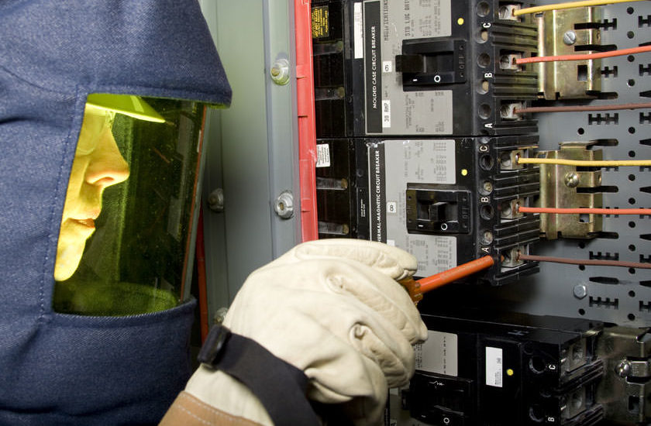
How to Protect Yourself
NFPA 70E training and strategy minimizes injuries and fatalities by covering:
Electrical Hazards
Existing and Proposed Standards
Preparing to Work Safely
Determining Safe Approach Distance
Determining Arc Hazard Category
Fault Current Calculations
Determination of Arcing Fault Clearing Time
Boundary Calculations
Determining Arc Flash Hazard Risk Category
Incident Energy Exposure Calculations
Hazard Analysis
Notes:
How to Protect Yourself
OSHA bases its electrical safety mandates on the comprehensive information in the NFPA 70E STANDARD. This standard covers the full range, of electrical safety issues from workplace practices to maintenance, special equipment requirements and installation.
The dangers of shock, electrocution fires, explosions and arc blast will always be present on the job. But proper NFPA 70E training and strategy can minimize the likelihood of injuries and fatalities.
Specifically, the NFPA 70E Standard covers the following:
Electrical Hazards
Existing and Proposed Standards
Preparing to Work Safely
Determining Safe Approach Distance
Determining Arc Hazard Category
Fault Current Calculations
Determination of Arcing Fault Clearing Time
Boundary Calculations
Determining Arc Flash Hazard Risk Category
Incident Energy Exposure Calculations
Hazard Analysis
An overview:
To protect workers from electric arc threats and, identify potential arc hazards in the workplace, one should confirm the potential and assess the severity of arc hazards by performing an arc hazard analysis, apply engineering solutions to reduce frequency and severity of exposure, train workers on the safe work practices and provide PPE as required in NFPA70E.

Slide 7
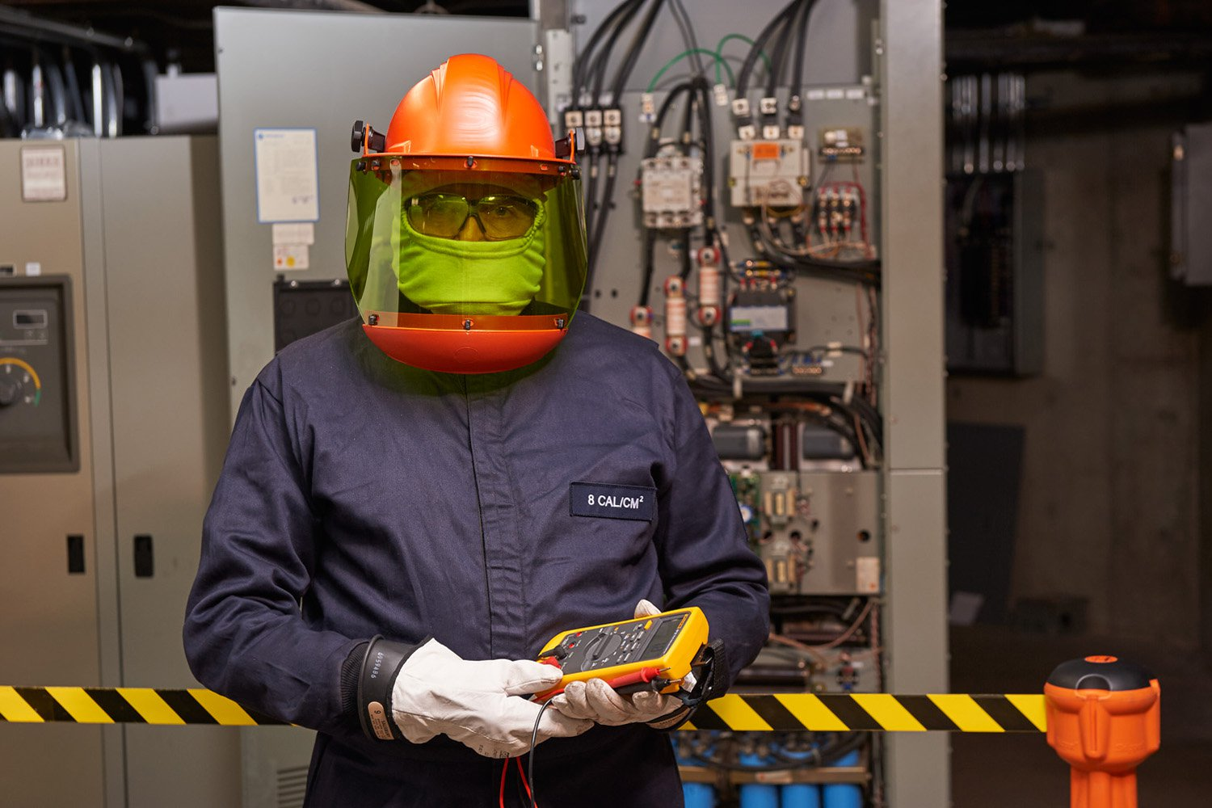
How to Protect Yourself
Basic preventive safety concepts
OSHA requires that circuits be deener­gized before any work is performed.
When placing equipment in an Electri­cally Safe Work Condition, follow proper Lockout/tagout procedures.
An Electrical Hazard Analysis must be performed on all circuits 50 volts and higher that may be worked on while energized.
The Hazards must be identified and warning labels must be applied to all equipment that may be worked on while energized.
Notes:
How to Protect Yourself
Basic preventive safety concepts
The following are basic electrical safety concepts that are encapsulated in NFPA 70E standard.
Unless there is a compelling safety issue such as life-support equipment, alarm systems, hazardous location ven­tilation, or lighting required for safety, OSHA requires that circuits be deener­gized and the system be placed in an Electrically Safe Work Condition before any work is performed.
When placing equipment in an Electri­cally Safe Work Condition, always follow proper Lockout/tagout procedures.
An Electrical Hazard Analysis must be performed on all circuits 50 volts and higher that may be worked on while energized.
The Hazards must be identified and warning labels must be applied to all equipment that may be worked on while energized.

Slide 8
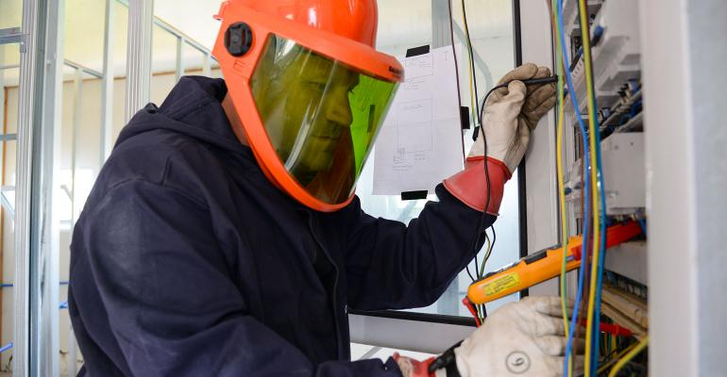
How to Protect Yourself
Workers must be trained on the equipment, hazards and safety precau­tions, and be certified as “qualified” to work on energized equipment.
All work performed on energized equipment must be preceded by a job briefing and a signed Energized Electrical Work Permit.
The minimum flame-retardant clothing, safety glasses, and protective gloves and equipment must meet OSHA and NFPA 70E guidelines.
Notes:
How to Protect Yourself
Workers must be trained on the equipment, hazards and safety precau­tions, and be certified as “qualified” to work on energized equipment. Training and certification must be documented.
All work performed on energized equipment must be preceded by a job briefing and a signed Energized Electrical Work Permit.
When working on or approaching energized circuits, proper protective clothing must be worn. The minimum flame-retardant clothing, safety glasses, and protective gloves and equipment must meet OSHA and NFPA 70E guidelines. Protective insulating blankets and mats are also used to minimize exposure.

Slide 9
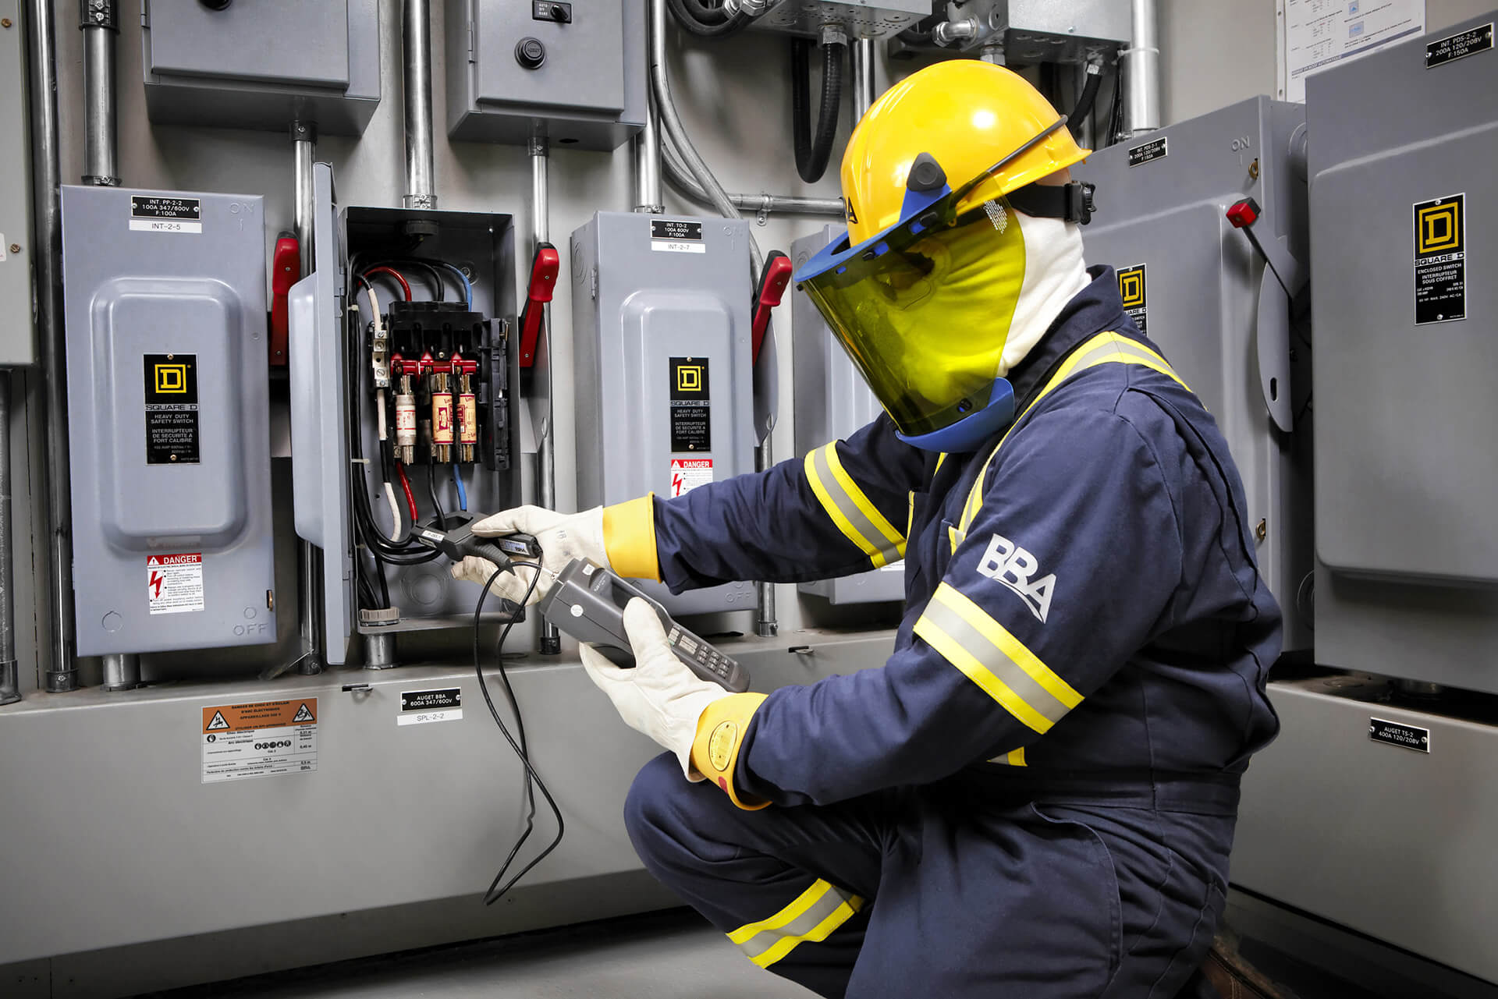
How to Protect Yourself
Be certain there is adequate lighting for the tasks.
Use barricades or barriers to warn unqualified individuals from entering the area.
Make sure emergency communica­tions and trained medical personnel are available.
Use current-limiting overcurrent protective devices wherever possible to reduce the potential electrical hazards.
Notes:
How to Protect Yourself
Be certain there is adequate lighting for the tasks to be performed. Portable lighting must be fully insulated so that it will not accidentally cause short circuits when used near energized components.
Use barricades or barriers to warn unqualified individuals from entering the area.
Be prepared for the unexpected. Make sure emergency communica­tions and trained medical personnel are available if something goes wrong.
Use current-limiting overcurrent protective devices wherever possible to reduce the potential electrical hazards.

Slide 10
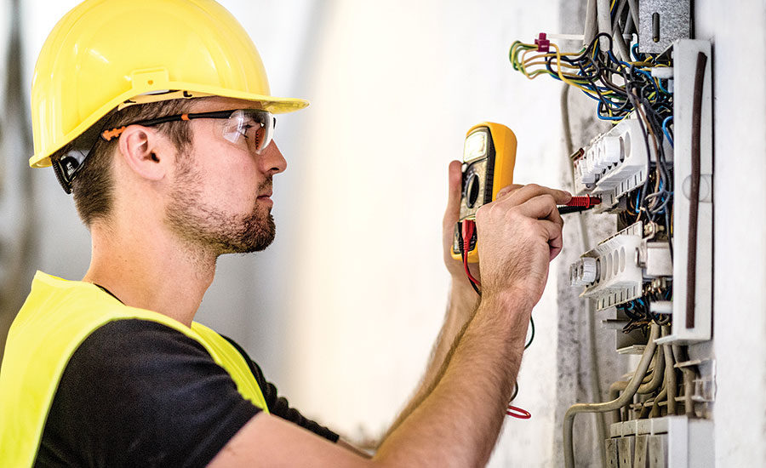
Final Word
Compliance with NFPA 70E STANDARD for Electrical Safety in the workplace is the only way for companies to protect their employees from accident, injury and death.
Notes:
Final Word
Compliance with NFPA 70E STANDARD for Electrical Safety in the workplace is the only way for companies to protect their employees from accident, injury and death.

