Slide 1

Click to get started…
Notes:
(Next Slide)

Slide 2
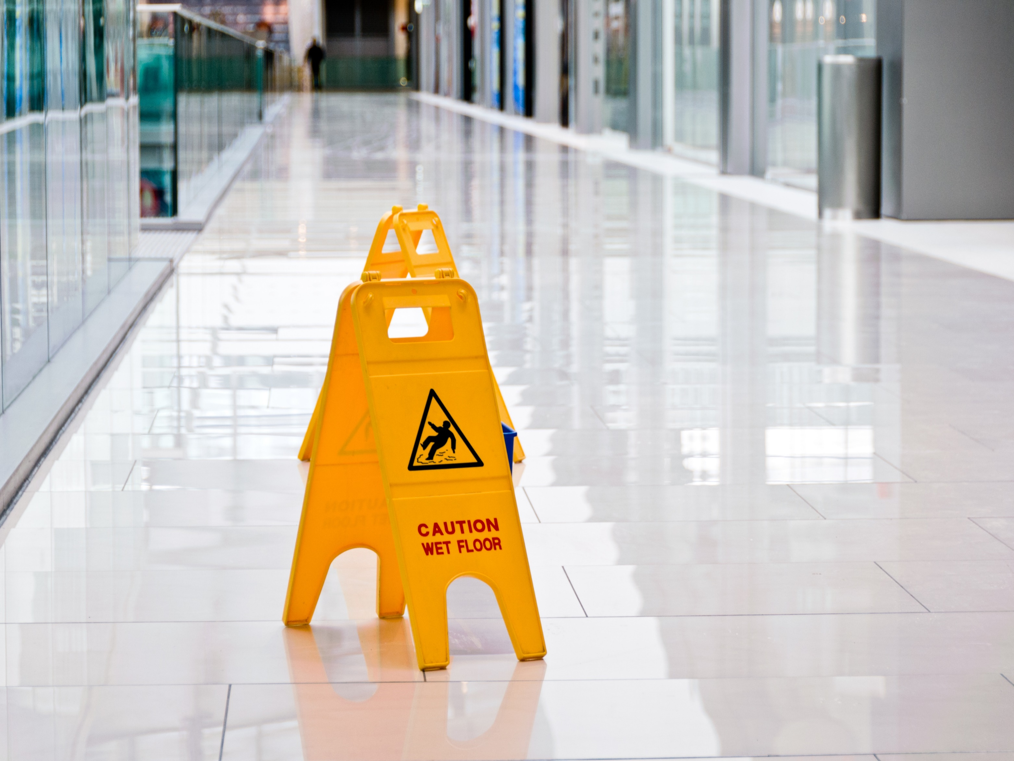
SPILL PREVENTION AND CONTROL
Notes:
SPILL PREVENTION AND CONTROL
(Next Slide)

Slide 3
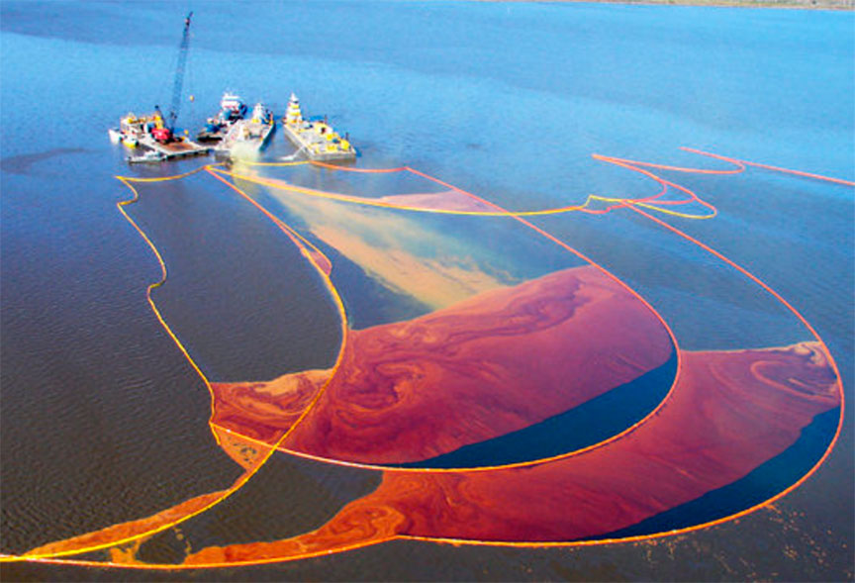
What’s at Stake
Workplace spills go from minor occurrences to catastrophic events. Coffee and chemical spills pollute the river and contaminate the water supply.
Notes:
WHAT'S AT STAKE
Workplace spills go from minor occurrences to catastrophic events. Coffee spilled on the floor of the lunch room to a chemical spill from the same factory that pollutes the river and contaminates the water supply.
(Next Slide)

Slide 4
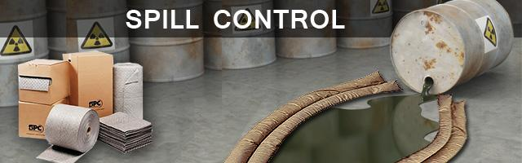
What’s the Danger
What’s at Stake
Spills whatever the source have the same affect. That is, spills present an existential threat to workers, the environment and the community at large. Knowledge is Power. Knowing where spills will likely occur will help coupled with ways to prevent spills.
Notes:
WHAT’S THE DANGER
Spills whatever the source have the same affect. That is, spills present an existential threat to workers, the environment and the community at large. Knowledge is Power. Knowing where spills will likely occur will help coupled with ways to prevent spills.
(Next Slide)

Slide 5
What’s the Danger
What’s at Stake
7 Sources of Workplace Spills
Chemicals that are not stored or handled correctly.
Leaking or ruptured containment vessels.
Burst pipes.
Faulty equipment.
Equipment and piping systems that haven’t been properly blocked, drained and locked out before maintenance or repair work is undertaken.
Accidents involving tanker trucks, ships and railcars carrying toxic chemicals, oil or gasoline.
Human error.
Notes:
WHAT’S THE DANGER
There are Seven Sources of workplace spills:
Chemicals that are not stored or handled correctly.
Leaking or ruptured containment vessels.
Burst pipes.
Faulty equipment.
Equipment and piping systems that haven’t been properly blocked, drained and locked out before maintenance or repair work is undertaken.
Accidents involving tanker trucks, ships and railcars carrying toxic chemicals, oil or gasoline.
Human error.
(Next Slide)

Slide 6
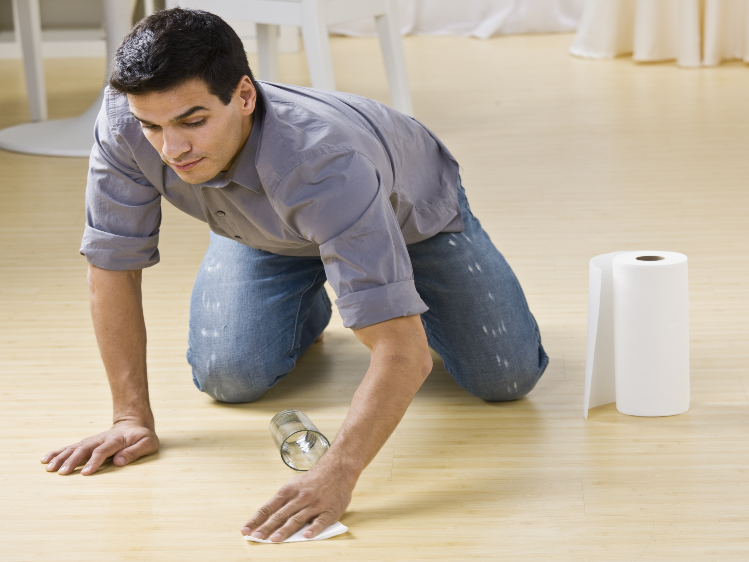
How to Protect Yourself
What’s at Stake
7 Tips for Spill Prevention and Control
Ask your supervisor about the SPCC plan.
Lists storage areas, equipment and processes with potential for spills.
Outlines procedures for spill response.
Notes:
HOW TO PROTECT YOURSELF
To expect spills will not occur fly's against reality. Humans error intentionally and intentionally. Therefore, one has to be proactive which means a quick and effective response is needed. Having done so, the damage is limited and contained while protecting workers, the community and the environment.
Here is the template for spill prevention and control:
Ask your supervisor whether your company has a spill prevention and control or contingency plan. If the answer is no, ask whether one can be developed and implemented.
The plan should list storage areas, equipment and processes that have the potential for spills.
It should also outline procedures for spill response.
(Next Slide)

Slide 7
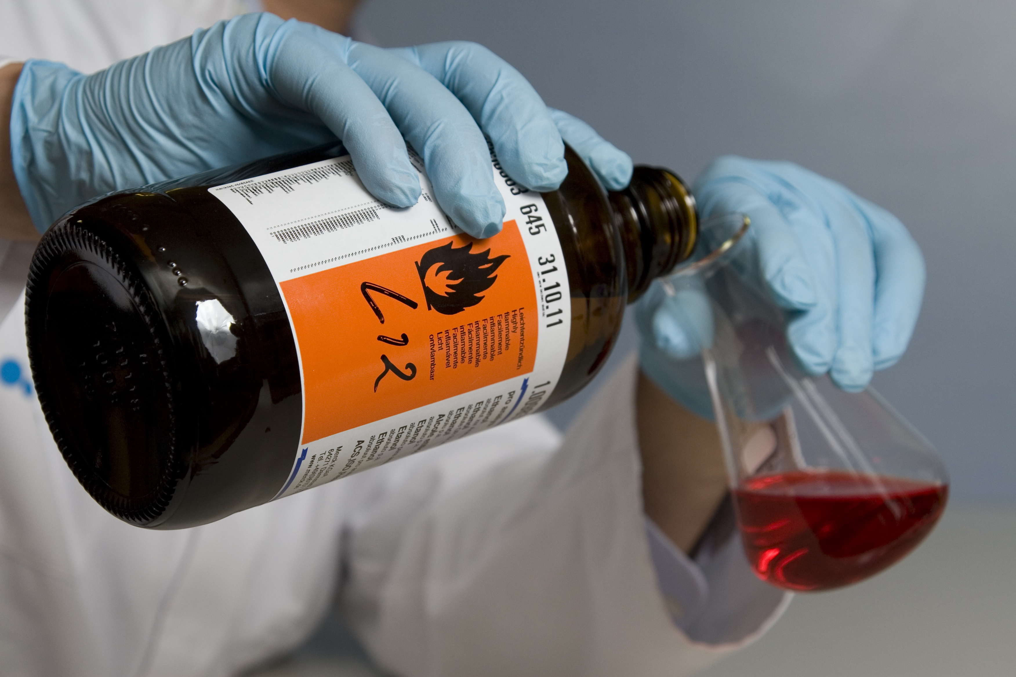
How to Protect Yourself
What’s at Stake
7 Tips for Spill Prevention and Control
Properly store and label all chemicals.
Inspect, maintain and repair.
Keeps equipment running and helps identify hazards.
Drip pans, containment barriers or drains contain/divert spills.
Notes:
HOW TO PROTECT YOURSELF
Properly store and label all chemicals.
Inspect, maintain and repair equipment, machines, vehicles and vessels.
Regular inspection and maintenance keeps equipment and machines running smoothly and lets you identify potential hazards before they become a problem.
Install drip pans, containment barriers or drains to safely contain or divert spills.
(Next Slide)

Slide 8
How to Protect Yourself
What’s at Stake
7 Tips for Spill Prevention and Control
Barricade or mark edges of wet areas and processes to keep people out when containment isn’t possible.
Request training on what to do in a spill emergency. Some spills can safely be cleaned up. Some spills require special or emergency services.
Notes:
HOW TO PROTECT YOURSELF
Barricade or mark edges of wet areas and processes to keep people out when containment isn’t possible.
Request training on what to do in a spill emergency.
Some spills can safely be cleaned up with the proper training and protective equipment.
Some spills require special or emergency services for cleanup.
(Next Slide)

Slide 9
How to Protect Yourself
What’s at Stake
7 Tips for Spill Prevention and Control
Ask your supervisor to set up spill kits and ensure:
Kits are clearly marked.
There are enough kits on site and in all high spill risk locations.
Kits are stocked with the right type of absorbent and cleaning materials.
Kits are checked on a regular basis and refilled after a spill incident.
Ensure all spills are cleaned up immediately and reported.
Notes:
HOW TO PROTECT YOURSELF
Ask your supervisor to set up spill kits and ensure that:
Kits are clearly marked.
There are enough kits on site and in all high spill risk locations.
Kits are stocked with the right type of absorbent and cleaning materials.
Kits are checked on a regular basis and refilled after a spill incident.
Ensure that all spills, regardless of size or material, are cleaned up immediately and reported in accordance with your workplace’s spill plan and regulatory guidelines.
(Next Slide)

Slide 10
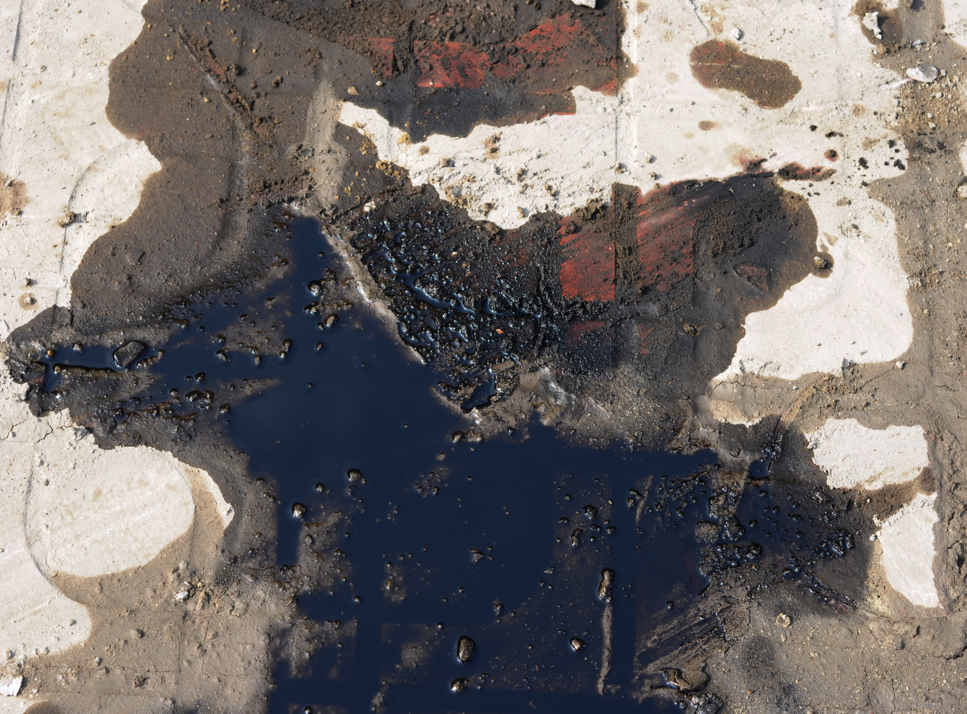
Final Word
What’s at Stake
Remembering common sources of workplace spills and ways to prevent and control them can help make sure spills are more of a minor inconvenience and not a catastrophic event.
Notes:
FINAL WORD
Remembering the seven common sources of workplace spills and seven ways to prevent and control them can help make sure spills are more of a minor inconvenience and not a catastrophic event.
(Next Slide)

Slide 11
End of Presentation
Notes:
(Next Slide)

