Slide 1

Click anywhere to get started…

Slide 2

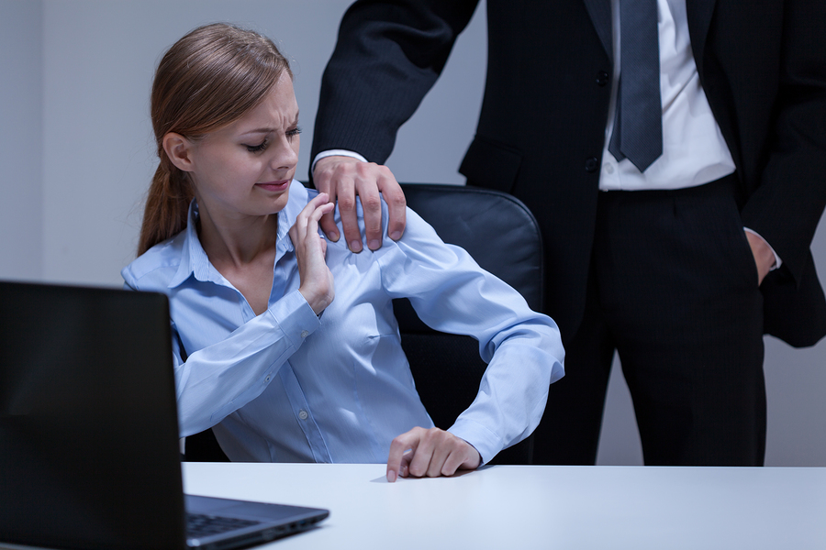

Sexual Harassment Prevention
Notes:
Sexual Harassment Prevention

Slide 3

What’s at Stake?
Sexual harassment is any unwelcome sexual advance or conduct on the job that creates an intimidating, hostile or offensive working environment.
Employers have a legal responsibility to maintain a workplace that is free of sexual harassment.
Notes:
What’s at Stake?
Sexual harassment is any unwelcome sexual advance or conduct on the job that creates an intimidating, hostile or offensive working environment. Any conduct of a sexual nature that makes an employee uncomfortable has the potential to be sexual harassment.
As an employer, you have a responsibility to maintain a workplace that is free of sexual harassment. It is your legal obligation!!!

Slide 4

What’s the Danger?
If employers let sexual harassment in their business, they pay a high price in poor employee morale, low productivity, and a flood of lawsuits and big legal bills.
Notes:
What’s the Danger?
Apart from the legal obligation to maintain a safe, sexual harassment, it makes perfect business sense. If you let sexual harassment in your business, you will pay a high price in poor employee morale, low productivity, and a flood of lawsuits and big legal bills.

Slide 5

What’s the Danger?
Sexual harassment is:
A supervisor implies to an employee that the employee must sleep with him to keep a job.
A sales clerk makes demeaning comments about female customers to his coworkers.
An office manager in a law firm is made uncomfortable by lawyers who regularly tell sexually explicit jokes.
A cashier at a store pinches and fondles a coworker against her will.
A secretary's coworkers belittle her and refer to her by sexist or demeaning terms.
Several employees post sexually explicit jokes on an office intranet bulletin board.
An employee sends emails to coworkers that contain sexually explicit language and jokes.
Notes:
What’s the Danger?
Sexual harassment comes in many forms:
A supervisor implies to an employee that the employee must sleep with him to keep a job.
A sales clerk makes demeaning comments about female customers to his coworkers.
An office manager in a law firm is made uncomfortable by lawyers who regularly tell sexually explicit jokes.
A cashier at a store pinches and fondles a coworker against her will.
A secretary's coworkers belittle her and refer to her by sexist or demeaning terms.
Several employees post sexually explicit jokes on an office intranet bulletin board.
An employee sends emails to coworkers that contain sexually explicit language and jokes.

Slide 6

What’s the Danger?
Who Can Be Sexually Harassed?
Men can sexually harass women, and women can sexually harass men.
Statistics show that the overwhelming majority of sexual harassment claims and charges are brought by women claiming that they were sexually harassed by men.
People of the same sex can also sexually harass each other, as long as the harassment is based on sex rather than sexual orientation.
If a man's coworkers constantly bombard him with sexually explicit photos of women, and this makes him uncomfortable, he might have a sexual harassment claim. If, however, a man's coworkers tease and belittle him because he is gay, that might not be illegal harassment under federal law as it is currently interpreted.
The line between harassment based on sex and harassment based on sexual orientation becomes blurred when gender-based stereotypes are at play. Courts have held when a woman is harassed and discriminated against because she does not act sufficiently feminine; similarly, a man who is harassed for having effeminate mannerisms and gestures is protected. These same employees might not be protected if their harassers relied more explicitly on homophobic slurs and remarks.
Notes:
What’s the Danger?
Who Can Be Sexually Harassed?
Sexual harassment is a gender-neutral offense, at least in theory: Men can sexually harass women, and women can sexually harass men. However, statistics show that the overwhelming majority of sexual harassment claims and charges are brought by women claiming that they were sexually harassed by men.
People of the same sex can also sexually harass each other, as long as the harassment is based on sex rather than sexual orientation, which is not a protected characteristic under Title VII. For example, if a man's coworkers constantly bombard him with sexually explicit photos of women, and this makes him uncomfortable, he might have a sexual harassment claim. If, however, a man's coworkers tease and belittle him because he is gay, that might not be illegal harassment under federal law as it is currently interpreted. However, such conduct may be illegal under laws enacted by certain states, or even cities. Even if this type of behavior isn't illegal, it also isn't appropriate, and savvy employers will put a stop to it promptly so everyone can get back to work.
The line between harassment based on sex and harassment based on sexual orientation becomes blurred when gender-based stereotypes are at play. Courts have held when a woman is harassed and discriminated against because she does not act sufficiently feminine; similarly, a man who is harassed for having effeminate mannerisms and gestures is protected. These same employees might not be protected if their harassers relied more explicitly on homophobic slurs and remarks. Again, however, smart employers won't parse the legal details.

Slide 7

How to protect yourself
Employers must ensure the health and safety of workers and that other persons are not put at risk by the business. The process can be accomplished by the following measures.
A. Build good relationships in a respectful work environment
Have a ‘no sexual harassment-tolerated’ work culture.
Promote good work relationships.
Recognize and promote diversity.
Set up a conflict management process.
Set up a process for people to report sexual harassment.
Notes:
How to Protect Yourself
Employers must ensure the health and safety of workers and that other persons are not put at risk by the business. The process can be accomplished by the following measures.
A. Build good relationships in a respectful work environment
Have a ‘no sexual harassment-tolerated’ work culture.
Have a code of conduct that describes expected behaviors and what misconduct and serious misconduct is.
Set the core values of your business.
Promote good work relationships.
Recognize and promote diversity.
Set up a conflict management process.
Set up a process for people to report sexual harassment.
Set up systems to support workers at a greater risk of being harassed.

Slide 8

How to Protect Yourself
B. Educate workers about sexual harassment
Train employees at least once a year by conducting training sessions for employees.
Train Employees on:
Consent.
what sexual harassment is.
what your sexual harassment policy contains.
what worker should do if they experience sexual harassment.
what workers can do if they see sexual harassment.
Ensure your induction for new workers covers the information above.
Talk about sexual harassment at team meetings and toolbox talks.
Put up posters reminding workers what’s acceptable work behaviour.
Notes:
How to Protect Yourself
B. Educate workers about sexual harassment
Train employees at least once a year by conducting training sessions for employees. These sessions should teach employees what sexual harassment is, explain that employees have a right to a workplace free of sexual harassment, review your complaint procedure, and encourage employees to use it.
Let your workers know what acceptable/non-acceptable work behaviour is, and that sexual harassment will not be tolerated.
Train Employees on:
Consent.
what sexual harassment is.
what your sexual harassment policy contains.
what worker should do if they experience sexual harassment.
what workers can do if they see sexual harassment.
Ensure your induction for new workers covers the information above.
Talk about sexual harassment at team meetings and toolbox talks.
Put up posters reminding workers what’s acceptable work behaviour.

Slide 9

How to Protect Yourself
C. Train supervisors and managers at least once a yearly by conducting training sessions for supervisors and managers that are separate from the employee sessions. The sessions should educate the managers and supervisors about sexual harassment and explain how to deal with complaints.
D. Develop good managers
Expect managers to intervene early to call out and deal with any unreasonable behavior before it escalates.
Notes:
How to Protect Yourself
C. Train supervisors and managers at least once a yearly by conducting training sessions for supervisors and managers that are separate from the employee sessions. The sessions should educate the managers and supervisors about sexual harassment and explain how to deal with complaints.
D. Develop good managers
Give your managers leadership training to help them effectively manage and supervise workers.
Expect managers to intervene early to call out and deal with any unreasonable behaviour before it escalates.

Slide 10

How to Protect Yourself
E. Make sure everyone knowns their responsibilities
While businesses must effectively deal with sexual harassment at work, everyone at work has a role in dealing with it.
Workers:
have duties to take reasonable care for their own health and safety and to take reasonable care that they don’t harm others while at work.
must cooperate with reasonable policies and procedures about sexual harassment the business has in place that have been notified to them.
must comply, with any reasonable instruction about sexual harassment given by the business so the business can comply with the law
should report sexual harassment they experience or see so their business can do something about it.
Notes:
How to Protect Yourself
E. Make sure everyone knowns their responsibilities
While businesses must effectively deal with sexual harassment at work, everyone at work has a role in dealing with it.
Make everyone at work aware of their roles and responsibilities.
Workers:
have duties to take reasonable care for their own health and safety and to take reasonable care that they don’t harm others while at work.
must cooperate with reasonable policies and procedures about sexual harassment the business has in place that have been notified to them.
must comply, so far as is reasonably practicable, with any reasonable instruction about sexual harassment given by the business so the business can comply with the law
should report sexual harassment they experience or see so their business can do something about it.

Slide 11
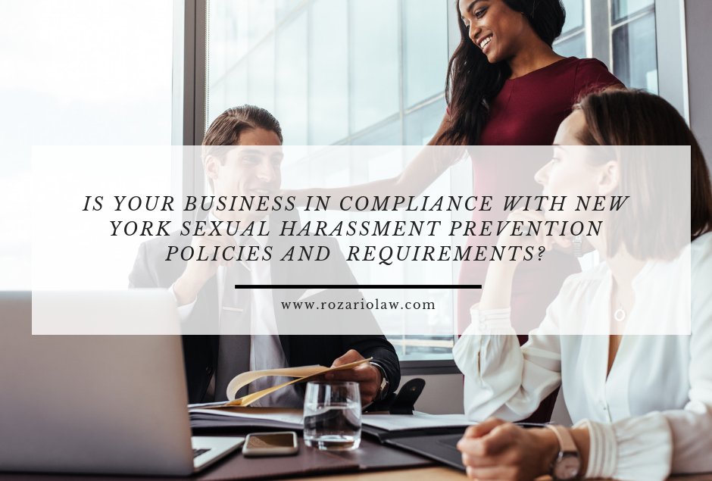
How to Protect Yourself
F. Make your sexual harassment policies, processes and systems transparent
Have a sexual harassment policy that outlines expectations for acceptable behavior and your commitment to deal with sexual harassment.
Put in place a policy on alcohol consumption at work events.
Make sure processes/systems cover how you will deal with sexual harassment.
how workers report sexual harassment, and what protection/support they will receive.
how you will investigate and deal with reports.
Notes:
How to Protect Yourself
F. Make your sexual harassment policies, processes and systems transparent
Have a sexual harassment policy that outlines expectations for acceptable behaviour and your commitment to deal with sexual harassment.
Put in place a policy on alcohol consumption at work events.
Make sure processes/systems cover how you will deal with sexual harassment including.
what training workers and managers will receive.
how workers report sexual harassment, and what protection/support they will receive.
how you will investigate and deal with reports.
how you will check that preventative measures are effectively managing the health and safety risks arising from sexual harassment.

Slide 12

How to Protect Yourself
G. Make sure your workers know how to report sexual harassment
Make sure workers know that you want to be told when sexual harassment occurs, and will support and protect those who report sexual harassment.
Tell workers:
how to record instances of sexual harassment.
the more specific information the better.
how to report about sexual harassment they directly experience or see to you.
what to expect after they report sexual harassment including how you will support and protect them from reprisals.
Notes:
How to Protect Yourself
G. Make sure your workers know how to report sexual harassment
Make sure workers know that you want to be told when sexual harassment occurs, and will support and protect those who report sexual harassment.
Set up multiple ways (formal, informal, anonymous) to report sexual harassment.
Tell workers:
how to record instances of sexual harassment.
the more specific information the better.
how to report about sexual harassment they directly experience or see to you.
what to expect after they report sexual harassment including how you will support and protect them from reprisals.

Slide 13

How to Protect Yourself
How to Protect Yourself
H. Provide protection and support to workers who experience sexual harassment or see sexual harassment
Protect all the people involved (including both sides of the complaint, support people and witnesses) from victimization (being punished, bullied, intimidated).
Provide the support as soon as possible after you receive a report of sexual harassment.
Notes:
How to Protect Yourself
H. Provide protection and support to workers who experience sexual harassment or see sexual harassment
Protect all the people involved (including both sides of the complaint, support people and witnesses) from victimization (being punished, bullied, intimidated).
Support can come from within the organization (trained sexual harassment contact persons) or other parties such as unions, or employee assistance programs.
Provide the support as soon as possible after you receive a report of sexual harassment.

Slide 14
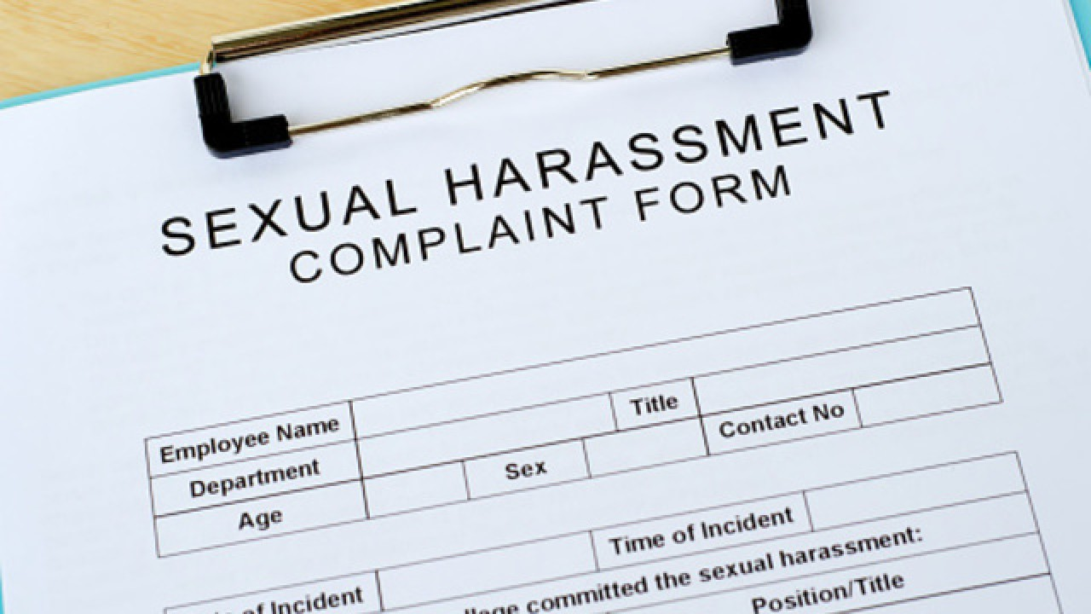
How to Protect Yourself
Reports of sexual harassment
Take all reports of sexual harassment seriously
Act promptly
Clearly communicate the process
Protect the people involved
Support the people involved
Maintain confidentiality
Treat everyone involved fairly
Keep good documentation
Notes:
How to Protect Yourself
General principles for dealing with reports of sexual harassment
Take all reports of sexual harassment seriously
Act promptly
Clearly communicate the process
Protect the people involved
Support the people involved
Maintain confidentiality
Treat everyone involved fairly
Keep good documentation

Slide 15

Final Word
Sexual harassment is a common and known source of harm and employers are expected by law to have appropriate processes in place to protect all employees in a safe and secure environment.
Notes:
Final Word
Sexual harassment is a common and known source of harm and employers are expected by law to have appropriate processes in place to protect all employees in a safe and secure environment.

