Slide 1

Click anywhere to get started…

Slide 2



REASONABLE SUSPICION FOR SUPERVISORS
Notes:
REASONABLE SUSPICION FOR SUPERVISORS

Slide 3

What’s at Stake?
Reasonable Suspicion Supervisor Training delivers the tools and skills to recognize employee substance abuse.
Notes:
What’s at Stake?
Every organization needs supervisors who are able to appropriately and effectively identify possible substance abuse on the job.
Reasonable Suspicion Supervisor Training delivers the necessary tools and skills to recognize and appropriately handle employees exhibiting signs of substance abuse.
Supervisors must determine whether or not reasonable suspicion exists and what to do when they suspect it.

Slide 4

What’s the Danger?
Delivery drivers, machine operators, field workers and warehouse personnel regularly perform safety-sensitive tasks.
While performing those safety-related activities under the influence of drugs or alcohol occur every day in thousands of workplaces across the country.
8% of full-time workers report that they are current illicit drug user. 4% of workers reported using alcohol 4 hours prior to reporting for work.
Notes:
What’s the Danger?
Delivery drivers, machine operators, field workers and warehouse personnel regularly perform safety-sensitive tasks as part of their normal work day.
And while performing those safety-related activities under the influence of drugs or alcohol may seem unthinkable for most of us, it surely happens; every day in thousands of workplaces across the country.
8% of full-time workers report that they are current illicit drug users, and 4% of workers reported using alcohol 4 hours prior to reporting for work.
These statistics only further highlight the need for implementing a program to identify workers with substance abuse issues.
Substance abusers cost employers approximately $10,000/year due to absenteeism, low productivity, lost time accidents, and increased health and Workers Compensation Board (WCB) costs.
Many employers solely focus their efforts on drug and alcohol testing programs but overlook education for their employees. Many employees are not aware of how drugs and alcohol negatively impact safety, productivity, and culture on a job site.

Slide 5
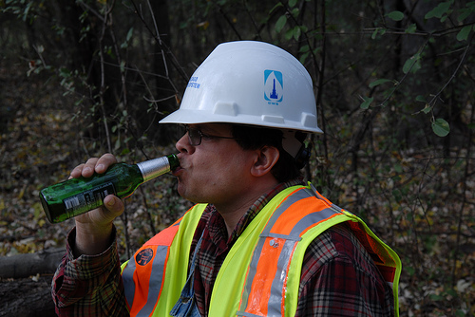
What’s the Danger?
Substance abusers cost employers approximately $10,000/year due to absenteeism, low productivity, lost time accidents, increased health and Workers Compensation Board costs.
Many employees are not aware of how drugs and alcohol negatively impact safety, productivity, and culture on a job site.
Notes:
What’s the Danger?
Substance abusers cost employers approximately $10,000/year due to absenteeism, low productivity, lost time accidents, and increased health and Workers Compensation Board (WCB) costs.
Many employers solely focus their efforts on drug and alcohol testing programs but overlook education for their employees. Many employees are not aware of how drugs and alcohol negatively impact safety, productivity, and culture on a job site.

Slide 6
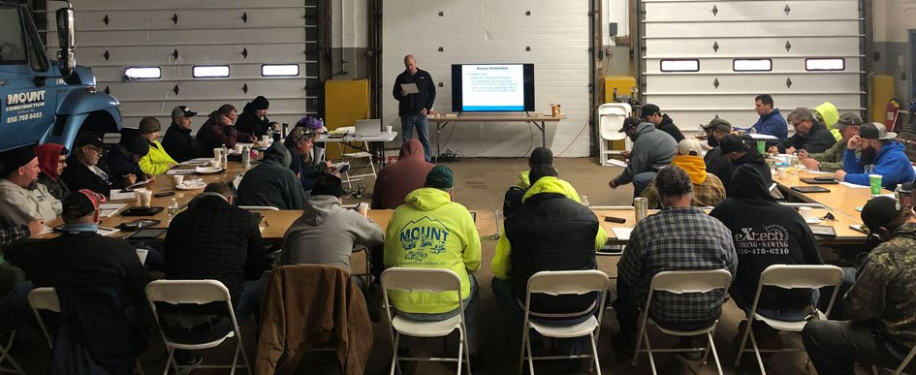
How to Protect Yourself
The importance of reasonable suspicion for supervisors.
Significant training is required.
It is also important that supervisors feel confident and comfortable in their role.
What is reasonable suspicion??
Notes:
How to Protect Yourself
The importance of reasonable suspicion for supervisors.
Significant training for any position in companies is required.
It is also important that supervisors feel confident and comfortable in their role. Reasonable Suspicion Training increases the safety of company’s work-site and their workforce.
Underlying the proposition that Reasonable Suspicion Training is beneficial and necessary for companies and workers, what is reasonable suspicion??

Slide 7

How to Protect Yourself
The odor of alcohol or a controlled substance on the breath
Unsteady gait
Slurred speech
Difficulty conversing or understanding
Dilated or pinpoint pupils
Red or glassy eyes
Hyperactivity or drowsiness
Notes:
How to Protect Yourself
Supervisors are trained to find any of the following signs in workers.
The odor of alcohol or a controlled substance on the breath
Unsteady gait
Slurred speech
Difficulty conversing or understanding
Dilated or pinpoint pupils
Red or glassy eyes
Hyperactivity or drowsiness

Slide 8
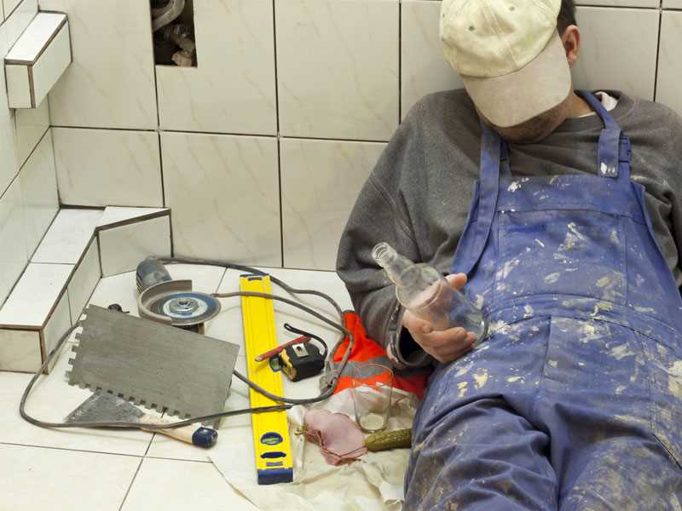
Confusion
Anxiety
Excessive thirst or hunger
Distorted sense of time
Flat emotions or exaggerated emotions
Difficulty focusing eyes and/or attention
Observation of the consumption of alcohol
Observation of the possession of a controlled substance or use of a controlled substance that is reported by a credible source
How to Protect Yourself
Notes:
How to Protect Yourself
Confusion
Anxiety
Excessive thirst or hunger
Distorted sense of time
Flat emotions or exaggerated emotions
Difficulty focusing eyes and/or attention
Observation of the consumption of alcohol
Observation of the possession of a controlled substance or use of a controlled substance that is reported by a credible source

Slide 9

Key elements for Supervisor Training:
Recognize the signs and symptoms of alcohol abuse and controlled substance use.
Know how to approach workers in a professional and respectful manner.
Have a high level of confidence in relation to reasonable suspicion testing responsibilities.
Alcohol and drugs explained (Marijuana, cocaine, Amphetamines, Methamphetamines, Opiates, Phencyclidine)
Assumptions:
No tolerance policy for this behavior in safety sensitive positions.
Professional and respectful methods must be employed.
Policy and procedure must be followed.
Zero tolerance does not necessarily equate with termination if the worker is found to be under the influence.
How to Protect Yourself
Notes:
How to Protect Yourself
Key elements of supervisor training
Recognize the signs and symptoms of alcohol abuse and controlled substance use.
Know how to approach workers in a professional and respectful manner.
Have a high level of confidence in relation to reasonable suspicion testing responsibilities.
Alcohol and drugs explained (Marijuana, cocaine, Amphetamines, Methamphetamines, Opiates, Phencyclidine)
Assumptions:
No tolerance policy for this behavior in safety sensitive positions.
Professional and respectful methods must be employed.
Policy and procedure must be followed.
Zero tolerance does not necessarily equate with termination if the worker is found to be under the influence.

Slide 10

How to Protect Yourself
Reasonable Suspicion Training – The Benefits
Decreases the chance of mistakes and delays in the production line.
Decreases absenteeism ensuring workers regularly attend their scheduled shifts.
Decreases the likelihood of theft and vandalism to equipment.
Notes:
How to Protect Yourself
Reasonable Suspicion Training – The Benefits
Decreases the chance of mistakes and delays in the production line- in any workforce it is important that all workers are safe and efficiently completing their job tasks.
Decreases absenteeism rate- ensuring that all workers are regularly attending their scheduled shifts, this will increase productivity and efficiency.
Decreases the likelihood of theft and vandalism to equipment- equipment in any industry can be costly, so it is important to have a trusting workforce to ensure the equipment and tools being used at the worksite will remain in good hands.

Slide 11
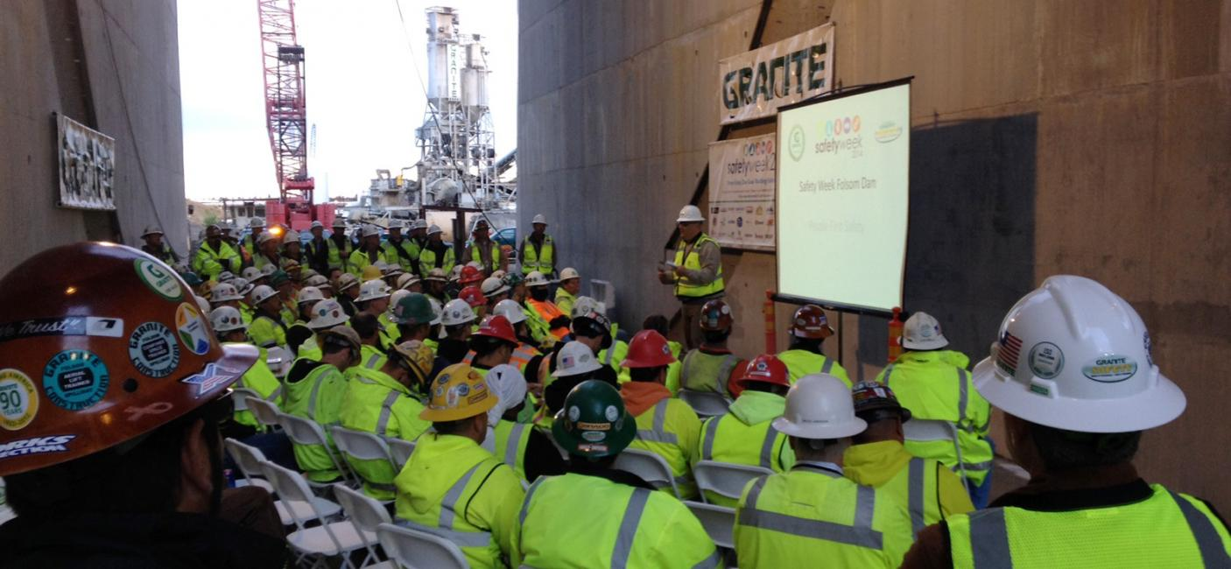
How to Protect Yourself
Mechanics / Procedures of Reasonable Suspicion Training
Employers cannot test employees randomly without proper documentation and proof.
Being trained in reasonable suspicion is a critical element in preventing impaired employees from endangering themselves and others.
The reasonable suspicion training process has five components — observation, confirmation, documentation, confrontation and testing.
Notes:
How to Protect Yourself
Mechanics / Procedures of Reasonable Suspicion Training
Employers must understand that you cannot test employees randomly without proper documentation and proof.
Being trained in reasonable suspicion is a critical element in preventing impaired employees from endangering themselves and the people they interact with. What’s required is a systematic approach to preparation, investigation and response. It’s a valuable first line of defense that might just save someone’s life.
The reasonable suspicion training process has five components — observation, confirmation, documentation, confrontation and testing.

Slide 12
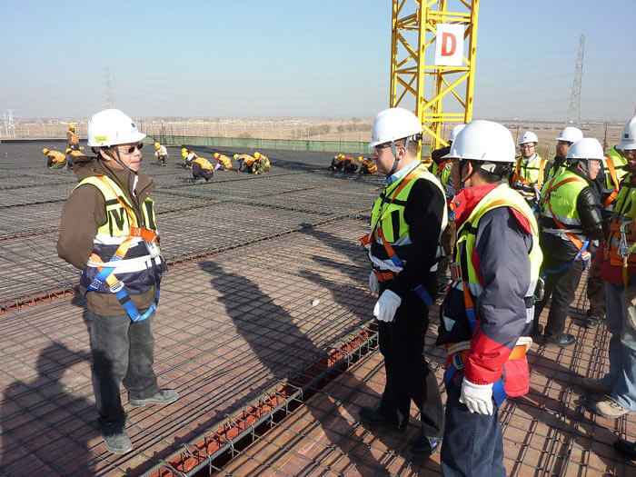
How to Protect Yourself
Observation is witnessing, firsthand, behavior that is unusual, erratic, unpredictable or otherwise uncharacteristic. This step usually results in an employee informing a supervisor of something that he or she directly observed from a coworker.
Confirmation is the process of verifying the observation. Upon notification, the person trained in reasonable suspicion will make his/her own observations that validate or refute the initial report.
Notes:
How to Protect Yourself
Observation is witnessing, firsthand, behavior that is unusual, erratic, unpredictable or otherwise uncharacteristic. This step usually results in an employee informing a supervisor of something that he or she directly observed from a coworker (See Toolbox Talk below).
Confirmation is the process of verifying the observation. Upon notification, the person trained in reasonable suspicion will make his/her own observations that validate or refute the initial report.

Slide 13

How to Protect Yourself
Documentation should be done by the person that has been trained in reasonable suspicion, and more specifically, by the person that participated in the confirmation process. By confirming the reported behavior, signs and symptoms observed can clearly be articulated in written form to memorialize that stage of the process. Proper documentation is critical, especially in cases that ultimately result in legal proceedings.
A written record must be prepared and signed within 24 hours of the observation. Any conversations that have taken place between the observer and relevant parties should be documented as well. Only signs and symptoms that have been observed can be noted.
Notes:
How to Protect Yourself
Documentation should be done by the person that has been trained in reasonable suspicion, and more specifically, by the person that participated in the confirmation process. By confirming the reported behavior, signs and symptoms observed can clearly be articulated in written form to memorialize that stage of the process. Proper documentation is critical, especially in cases that ultimately result in legal proceedings.
A written record must be prepared and signed within 24 hours of the observation. Any conversations that have taken place between the observer and relevant parties should be documented as well. Only signs and symptoms that have been observed can be noted. This is not an environment for hyperbole, supposition, intuition or unsubstantiated hearsay. Best practices for documentation are provided in the Toolbox Talk.

Slide 14
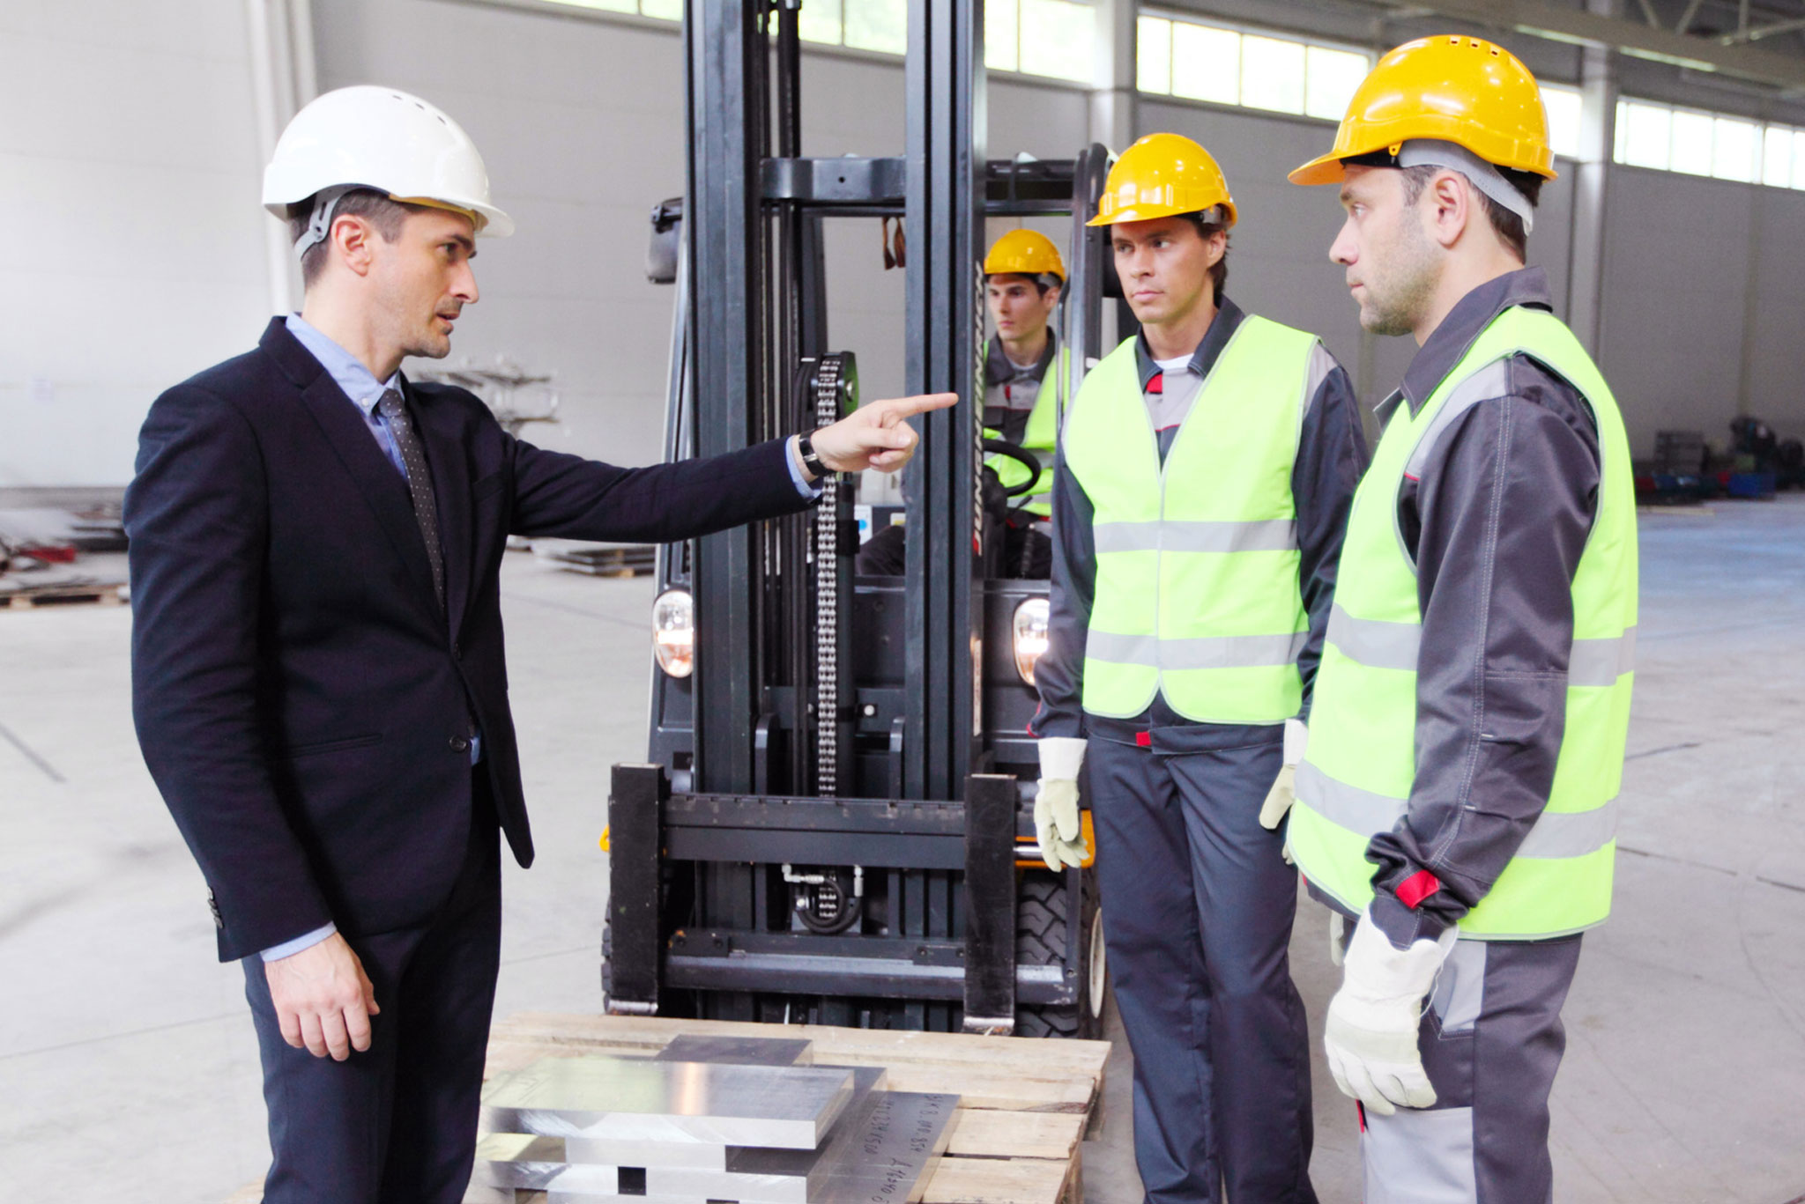
How to Protect Yourself
Confrontation must take place in a private setting. This is the phase in which the person trained in reasonable suspicion outlines what was observed and why alcohol/drug testing is required. The worker must be informed that he or she has been removed from all safety-sensitive functions until which time testing results allow for a return to normal work duty. Not all employees take this news graciously. Unpredictable responses are common. Proper training will include techniques that can prepare you for most situations that could arise. Follow-up documentation of the proceedings in this phase is a must.
Notes:
How to Protect Yourself
Confrontation must take place in a private setting. This is the phase in which the person trained in reasonable suspicion outlines what was observed and why alcohol/drug testing is required. The worker must be informed that he or she has been removed from all safety-sensitive functions until which time testing results allow for a return to normal work duty. Not all employees take this news graciously. Unpredictable responses are common. Proper training will include techniques that can prepare you for most situations that could arise. Follow-up documentation of the proceedings in this phase is a must.

Slide 15

How to Protect Yourself
Testing is a time-sensitive step. Only the supervisor trained in reasonable suspicion that has conducted the observation should order a test. Initiating a reasonable suspicion test based on third-party observations is prohibited. If the test is conducted away from the premises, the person being tested should not drive. Transportation to the testing site should be done by a person of the same gender. The supervisor making the determination that reasonable suspicion exists may not conduct the test.
Notes:
How to Protect Yourself
Testing is a time-sensitive step. Only the supervisor trained in reasonable suspicion that has conducted the observation should order a test. Initiating a reasonable suspicion test based on third-party observations is prohibited. If the test is conducted away from the premises, the person being tested should not drive. Transportation to the testing site should be done by a person of the same gender. The supervisor making the determination that reasonable suspicion exists may not conduct the test.

Slide 16

Final Word
It is essential to make sure your workers have a proper understanding of what reasonable suspicion training entails. Being prepared is necessary and it is best for a company to ensure they are handling a substance abuse situation efficiently and effectively.
Notes:
Final Word
It is essential to make sure your workers have a proper understanding of what reasonable suspicion training entails. Being prepared is necessary and it is best for a company to ensure they are handling a substance abuse situation efficiently and effectively.

