Slide 1

Clic para comenzar

Slide 2



Proteja su Audición y Evite Perderla
Notes:
Protect Your Hearing and Avoid Hearing Loss

Slide 3

¿Qué está en Riesgo?
El ruido puede causar muchos problemas de salud.
Síntomas indoloros que progresan desapercibidos, hasta que es demasiado tarde.
Tus oídos se acostumbran al ruido.
¡La pérdida de audición inducida por ruido no se puede revertir!
Notes:
What’s at Stake?
As the saying goes, “better the devil you know than the devil you don’t.” Our sly, unknown devil here is noise because it causes a host of health problems, with painless symptoms that progress unnoticed until it is too late. Even more disturbing is that the ears become accustomed to noise and the brain accepts it as normal, after a short while. Do not be fooled though, noise-induced hearing loss cannot be reversed!

Slide 4
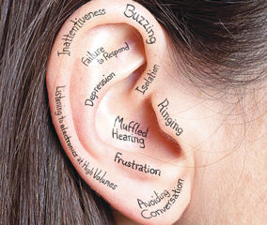
¿Cuál es el peligro?
Los daños del ruido
Sordera
Zumbido en los oídos
Ansiedad
Depresión
Estrés
Dolores de cabeza
Notes:
What’s the Danger?
Damage from long-term exposure to excessive noise includes deafness, tinnitus (ringing in the ears), anxiety, depression, stress, and headaches. Loss of hearing from high noise makes it hard to hear warnings and directions and this can lead to accidents. Though most employers make great effort to protect workers from noise hazards, sometimes, the problem is not what is done but how it is done.
Some workplaces might not understand what level of noise is harmful and this creates room for error when implementing controls. But safety regulations require employers to protect workers from excessive noise; this means, having a program that regulates noise exposure through noise level assessments, hearing protection, employee training and hearing tests. Without this program and its annual reviews, control measures are useless and may even become hazardous.

Slide 5
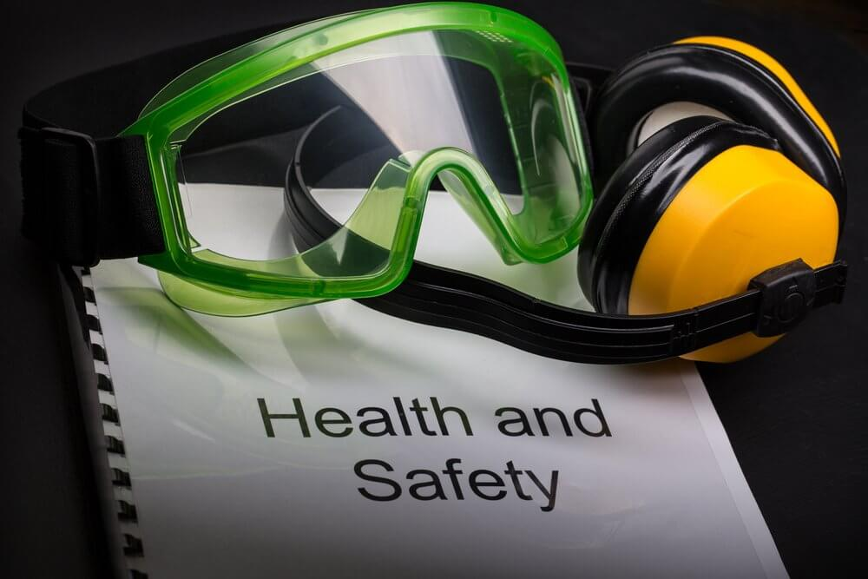
Como Protegerse
Medidas de control
Insonorización
Recinto
Mantenimiento
Rotación de trabajo
Señalización
Notes:
How to Protect Yourself
The best way to prevent hearing damage is by avoiding exposure to excessive noise. Noisy jobs should be identified, and control measures put in place.
Control measures might include:
Installing sound-dampening or sound-proofing materials.
Enclosing a noisy process or equipment.
Regular maintenance.
Job rotation – to lessen exposure time.
Putting up signage to warn workers hearing protection is required.

Slide 6

Como Protegerse
Prevenir la pérdida de audición
Manténgase informado y observe las señales de advertencia
Use y cuide el EPP
Usa el EPP correcto
Participar y entender
Hacer preguntas
Notes:
How to Protect Yourself
Workers can prevent hearing loss by:
Staying informed and watching for warning signs, such as ringing or humming in your ears and temporary loss of hearing when you leave work.
Wearing and maintaining all hearing protection provided by your employer.
Using the right hearing protection for the job, task, or area.
Participating in your employer’s audiometric program and understanding the results of your hearing tests.
Asking questions about noise levels, hearing protection, and other noise and hearing related issues, as soon as you have a concern.

Slide 7
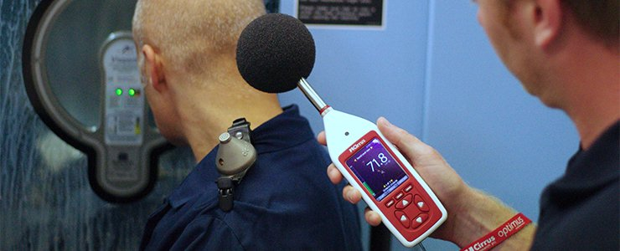
Conclusión
La pérdida de audición es permanente. Una vez que su audiencia se ha ido, el daño no se puede revertir. La prevención es tu única opción; proteja su audición mientras la tenga.
Notes:
Final Word
Hearing loss is permanent. Once your hearing is gone the damage can’t be reversed. Prevention is your only option; protect your hearing while you still have it.

