Slide 1

Click anywhere to get started…

Slide 2


OPENING THE WAY TO A DEADLY FALL
Notes:
The Basics of Forklift Safety

Slide 3
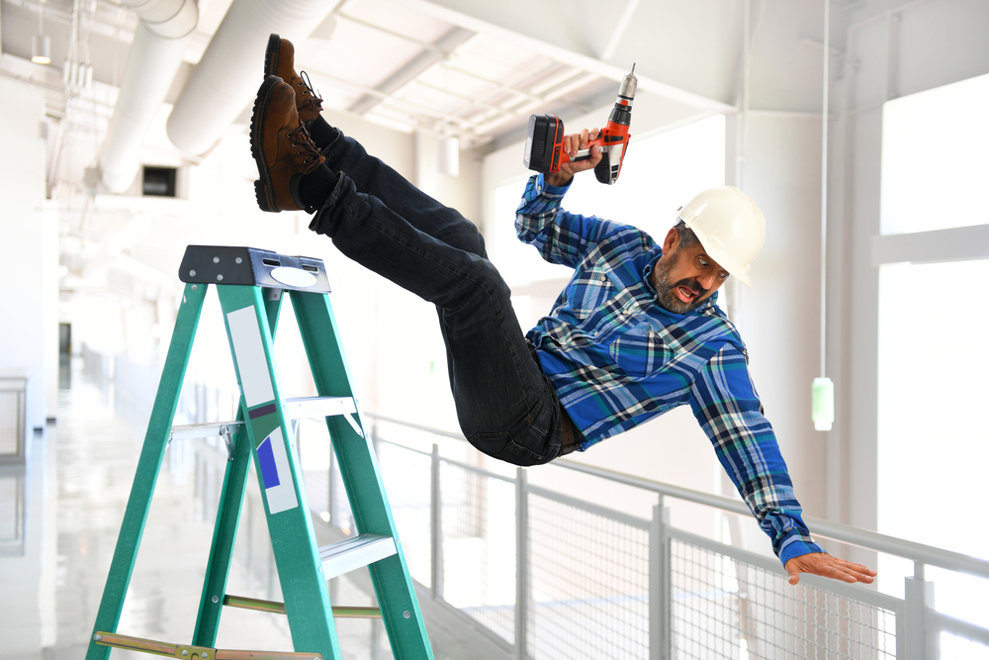
What’s at Stake?
The human factor is the reason why there are many incidents of severe injuries and even fatalities in floor opening falls due to negligence which results in loss of productivity, down time, and replacement costs. Workers lives are negatively impacted in many respects.
Notes:
What’s at Stake?
Text here

Slide 4

What’s the Danger?
Opening in floors and roofs are part of the work environment during construction, renovation and demolition. In the oil and gas industry, objects falling onto workers from opening are potential hazards.
Many workers have been severely injured and died as a result of falling through a floor or roof opening.

Slide 5

What’s the Danger?
Examples
A worker cleaning up after a roofing crew picks up a piece of plywood, not realizing it covers an opening, into which he falls.
A worker passing through a renovation site steps on a too-small covering placed over a hole and not secured. The board breaks, or, one end tips into the hole. The worker falls down the opening.
Skylights and other roof features not designed to bear weight also have been the route to death for workers who stepped on them.
Notes:
What’s the Danger?
Consider this real-life incident…
A senior rig toolpusher operating a forklift discovered a hydraulic leak of the lift controller for the forks. The load was raised about 10 feet (three meters) high and he began to repair the leak. He stood under the load and was attempting to tighten the fitting when it broke completely off the hydraulic line. This caused the load to drop, trapping the toolpusher under the load. He was killed immediately.

Slide 6
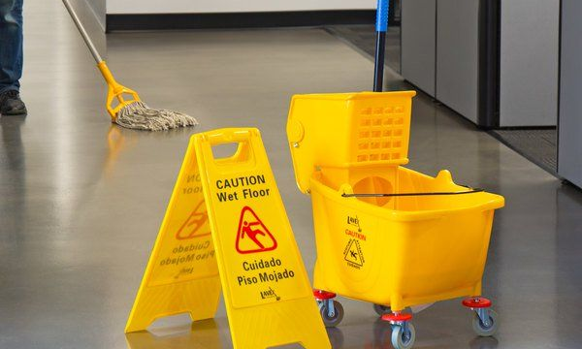
How to Protect Yourself
Safety laws require certain types of guards around openings including roof and floor openings, smoke shafts, vehicle repair pits, loading dock edges and other openings. Preventions of falls into water, or into a hazardous substance or object is also regulated.
By law, temporary and emergency floor and wall openings must be guarded by rails and toe boards or a cover.
Notes:
How to Protect Yourself
Machines of every description have standard operating procedures which include a “checklist” for its safe operation. Forklifts are no exception. There are procedures and protocols for the safe and effective use of the forklift.
These operating procedures are rooted out of common sense but are too often ignored or forgotten.

Slide 7
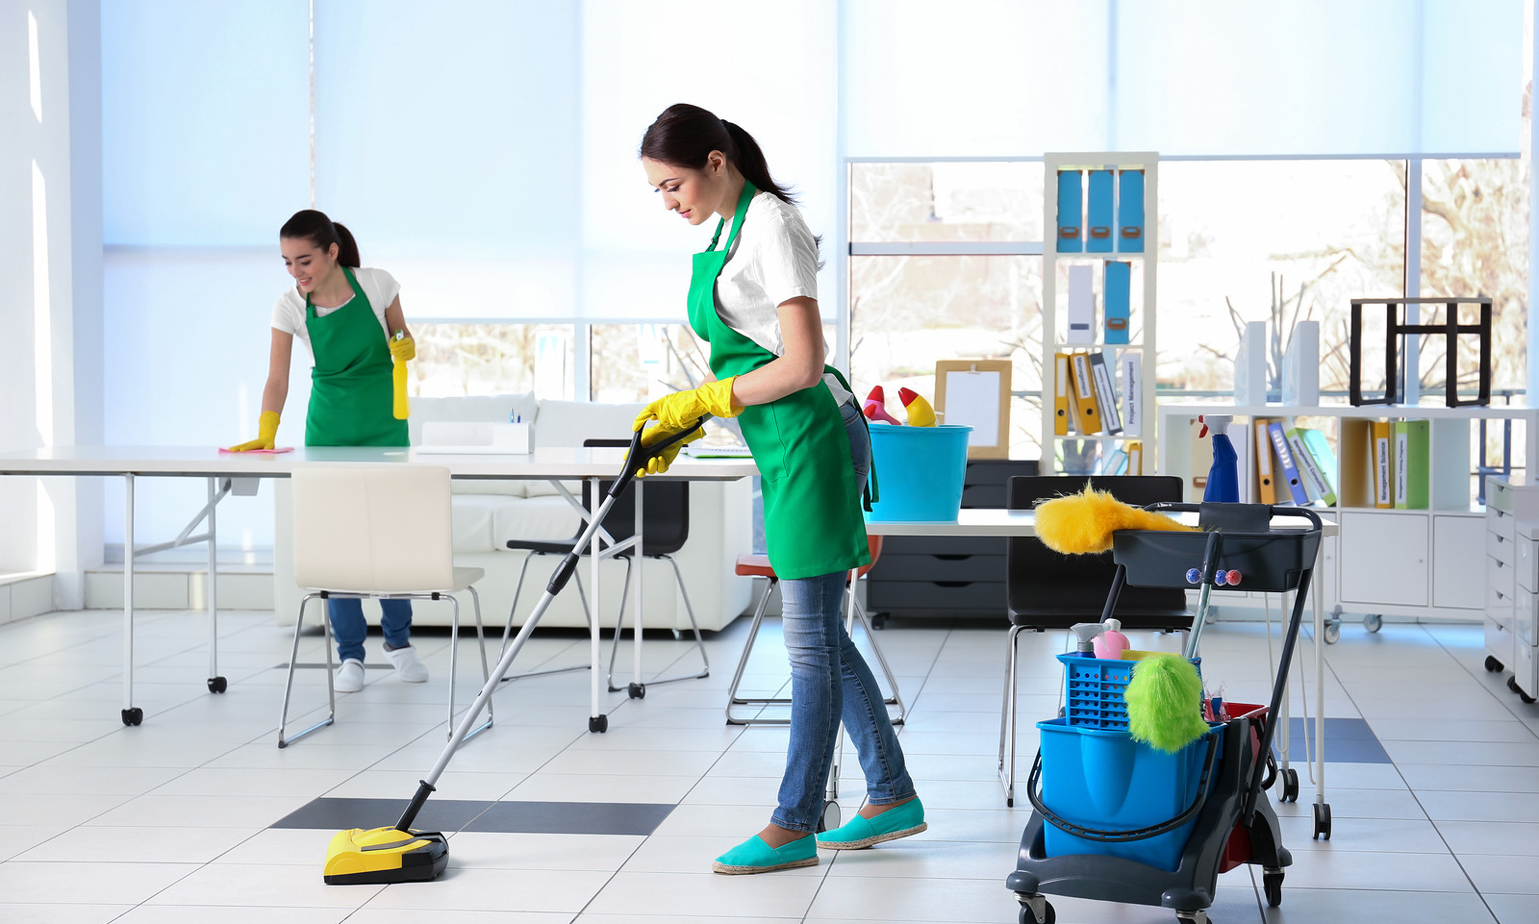
How to Protect Yourself
Compliance with law and regulations:
The floor opening cover must be capable of supporting any load placed on it. The cover should go over the entire opening unless guardrails are installed.
Ladder way floor openings and platforms must be guarded by railings and toe boards on all sites except the entrance.
The entrance must be arranged so the person cannot walk directly into the opening without encountering a gate or an offset area.
Notes:
How to Protect Yourself
Follow safe speed limits – Drive only fast as you can comfortably walk. Forklifts can’t travel safely at high speeds. Without loads, they aren’t weighted and are especially unstable.
Keep the load low – While moving, forks should be low, with the mast tilted slightly back.
Maintain good visibility – If a load blocks forward vision, drive backwards.
Watch the slope – Back down slopes that have an incline greater than10 percent. Make sure your back up alarm is working properly.
Never carry hitchhikers – They are unsecured and can easily fall off and be injured.
Leave aisle room – Allow space for pedestrian and other traffic. Be alert at intersections. Honk your horn before and while you enter an intersection, even if it doesn’t appear to be busy.
Park safely – On a hill, always block the wheels, lower forks and set the parking brake.

Slide 8
How to Protect Yourself
Guards are also required for hatchways, chute openings, skylight openings, pits and trap door openings and manhole floor coverings.
Besides guardrails and nets, fall prevention and fall arrest equipment might be required for you to work safely.
Pay attention to good housekeeping!!
Workers must file reports or contact a responsible line person when he or she encounter a hazardous situation like a “floor opening”.
Notes:
How to Protect Yourself

Slide 9
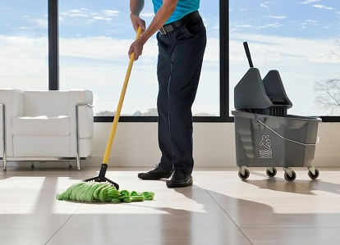
Final Word
A clean site is not always a safe start but is the best start.
Notes:
Final Word

