Slide 1

Click anywhere to get started…

Slide 2
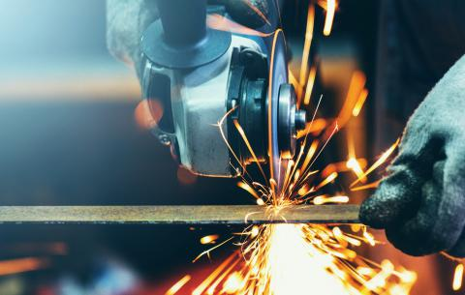

METAL WORKING
Notes:
The Basics of Forklift Safety

Slide 3
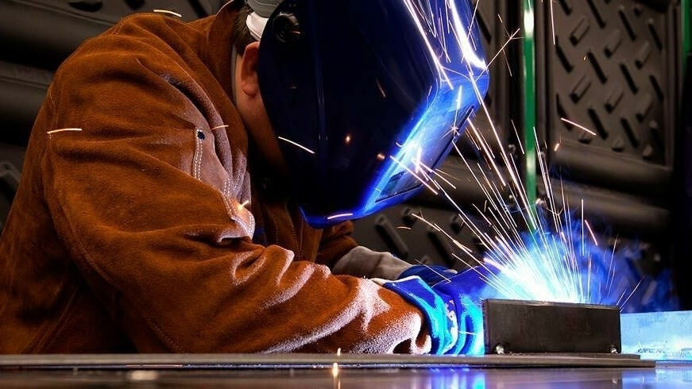
What’s at Stake?
Metal working is a dangerous work for only experienced and trained personnel.
Notes:
What’s at Stake?
Text here

Slide 4
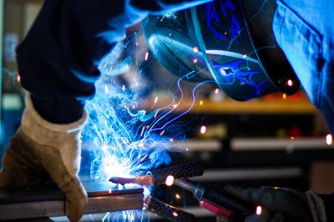
What’s the Danger?
The potential for injury from welding, grinding and cutting is significant.
Eyes and skin can be burned by infrared, ultraviolet and visible radiation from the light rays of the welding arc.
Loud noise can affect hearing.
Electric shock can injure or kill.
You can also be burned by hot metal, sparks and flying chips.
Compressed welding gases stored in high pressure cylinders can cause harm to people and property.
Fumes and gases from welding processes can damage the respiratory system or cause asphyxiation.

Slide 5
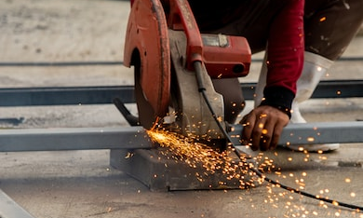
What’s the Danger?
Be cautious when welding, grinding or using powered cutting tools. Use approved equipment in good operating condition and follow all safety procedure instructions.
Keep work area safe. Be on the lookout for potential fire, electrical, explosive and toxic gas hazards.
Welding and cutting operations should never take place near flammable materials. Aisles and stairways should be cleared of clutter.
People should stay a safe distance away from welding and cutting operations.
Wear appropriate Personal Protective Equipment (PPE) while welding, grinding or power cutting.
Notes:
What’s the Danger?
Consider this real-life incident…
A senior rig toolpusher operating a forklift discovered a hydraulic leak of the lift controller for the forks. The load was raised about 10 feet (three meters) high and he began to repair the leak. He stood under the load and was attempting to tighten the fitting when it broke completely off the hydraulic line. This caused the load to drop, trapping the toolpusher under the load. He was killed immediately.

Slide 6
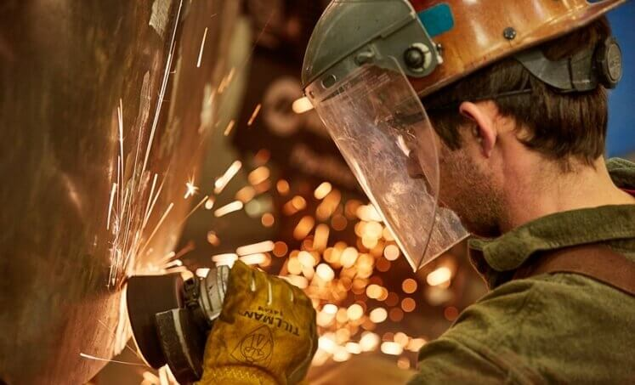
How to Protect Yourself
Eye protection: Shield your eyes from sparks, heat, molten metal, flying chips and splatter. You can receive painful eye burns known as welder’s flash from exposure to ultraviolet and infrared light from the welding arc.
Other PPE & Clothing: Guard your body while welding, cutting or grinding. Use hearing protection such as earplugs or earmuffs, wear clothes made of heat-resistance materials. An apron made of leather or other fire-resistant material provides extra protection.
Notes:
How to Protect Yourself
Machines of every description have standard operating procedures which include a “checklist” for its safe operation. Forklifts are no exception. There are procedures and protocols for the safe and effective use of the forklift.
These operating procedures are rooted out of common sense but are too often ignored or forgotten.

Slide 7
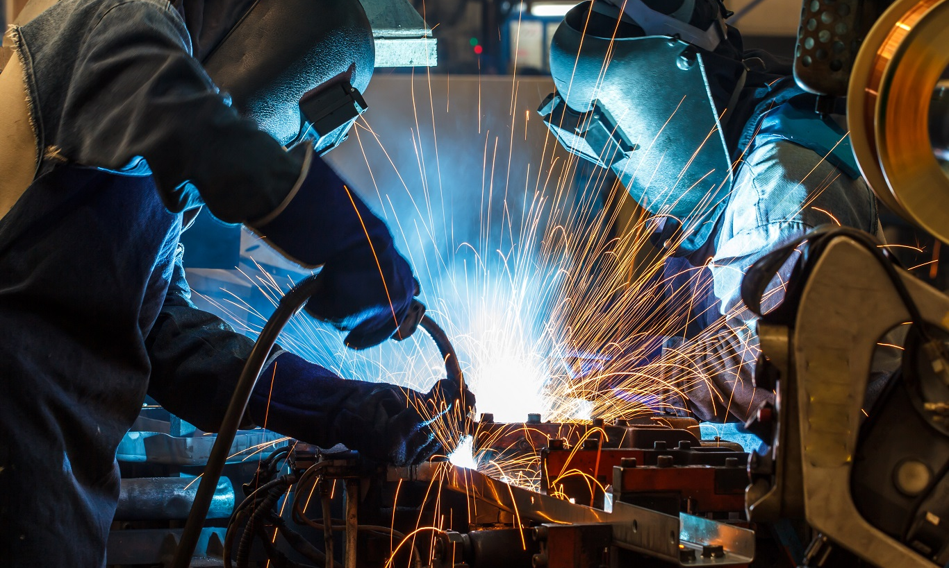
How to Protect Yourself
Foot and hand protection: the right kind of foot and hand protection is an essential part of shop safety. Gloves should be made of leather or other strong, flame-resistant fabric.
Respiratory Protection: Choose the right kind of approved respirator when you work around toxic chemicals, gases and materials, such as, a simple face mask to a supplied-air respirator.
Notes:
How to Protect Yourself
Follow safe speed limits – Drive only fast as you can comfortably walk. Forklifts can’t travel safely at high speeds. Without loads, they aren’t weighted and are especially unstable.
Keep the load low – While moving, forks should be low, with the mast tilted slightly back.
Maintain good visibility – If a load blocks forward vision, drive backwards.
Watch the slope – Back down slopes that have an incline greater than10 percent. Make sure your back up alarm is working properly.
Never carry hitchhikers – They are unsecured and can easily fall off and be injured.
Leave aisle room – Allow space for pedestrian and other traffic. Be alert at intersections. Honk your horn before and while you enter an intersection, even if it doesn’t appear to be busy.
Park safely – On a hill, always block the wheels, lower forks and set the parking brake.

Slide 8
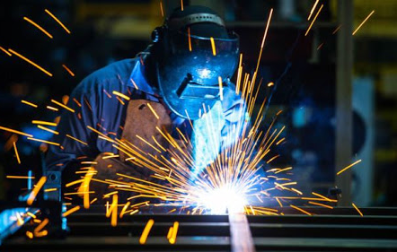
How to Protect Yourself
Tips for safe welding, cutting or grinding.
Avoid fires and explosions. Do not weld near flammable or combustible materials, liquids, vapors and dusts. Know where the fire extinguishers are located. Report any smell of propane, acetylene or other flammable substances.
Prevent electric shock. Inspect equipment for loose connections, bare wires or cables before operating.
Handle compressed gas cylinders safely. Learn the procedures for using and storing cylinders.
Know where safety showers and eye wash stations are and how to use them. Get help immediately when an incident occurs.
Notes:
How to Protect Yourself

Slide 9
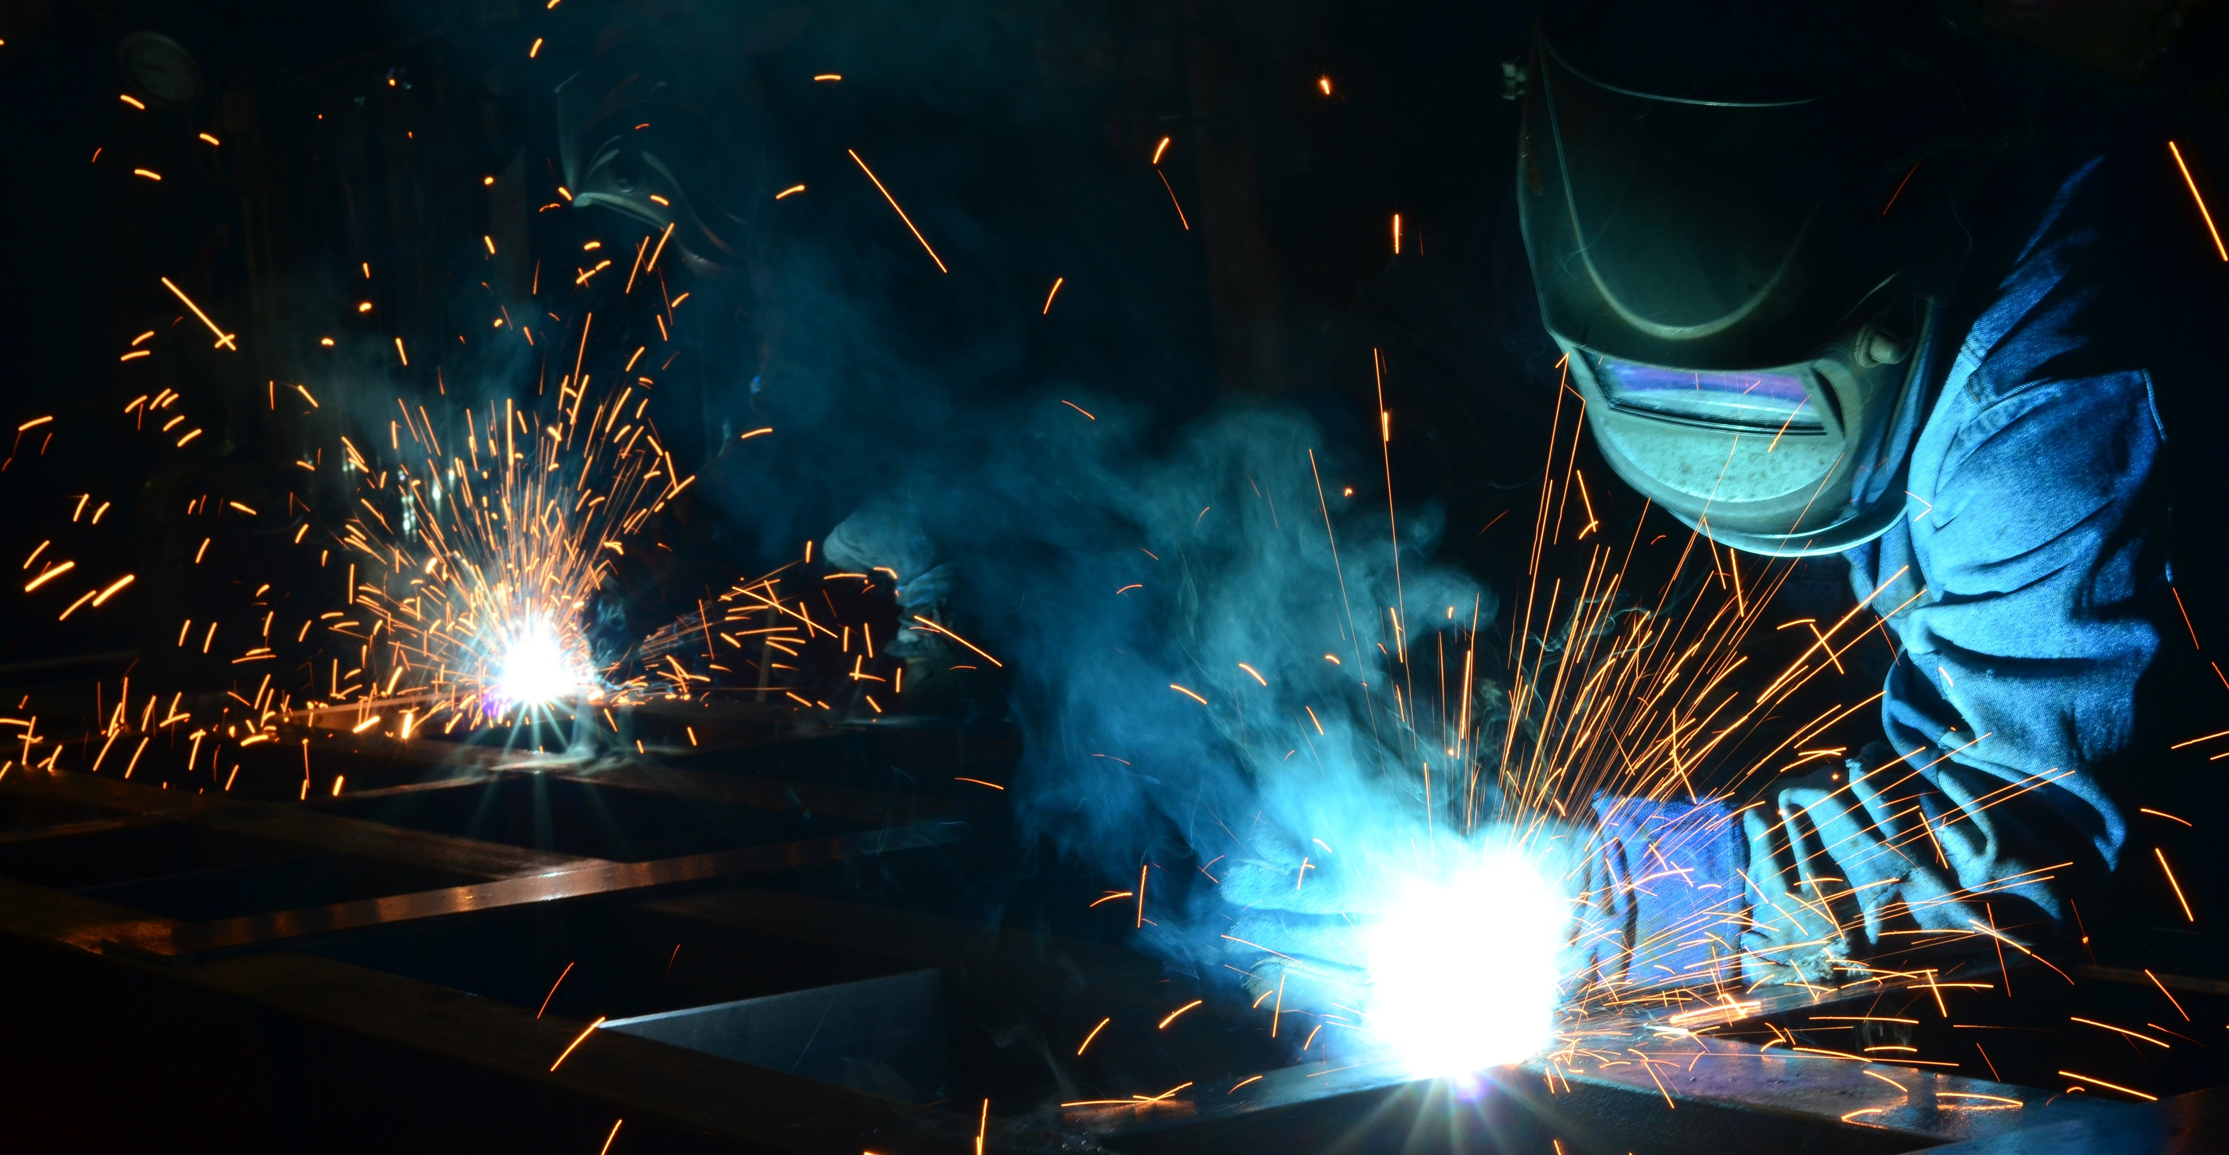
Final Word
Take responsibility for your own safety when you weld, cut or grind. Be familiar with the hazards. Wear the right PPE, maintain a safe environment and follow the safety rules.
Notes:
Final Word

