Slide 1

Haga clic para empezar...
Notes:
(Next Slide)

Slide 2

Los cascos protegen la cabeza
Notes:
Fatal or disabling head injuries happen when people are hit in the head with running equipment, tools falling from above, broken machine parts propelled through the air and many other moving and stationary objects.
(Next Slide)

Slide 3
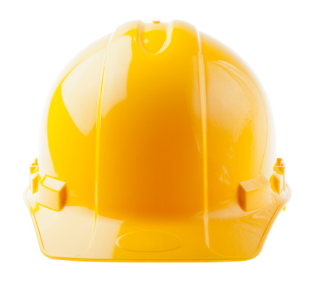
¿Qué está en riesgo?
Cascos duros
Absorbe el choque
Proteje su cabeza
Proporciona una barrera
Previene la lesión cerebral
Anfitrión de los peligros
Posibles lesiones
Notes:
WHAT’S AT STAKE
A hardhat provides protection against many workplace hazards. It is designed to provide a barrier and absorb shock, to prevent your brain from being injured. Even a minor brain injury can change your life, making it difficult to cope with physical, mental and emotional challenges.
One hardhat, two parts
Hardhats are made in two distinct parts. The first is the hard outer shell that protects against impact and penetration, preventing objects from striking your head. The second part is the inner suspension system, which absorbs the shock of impacts to prevent head injury.
(Next slide)

Slide 4

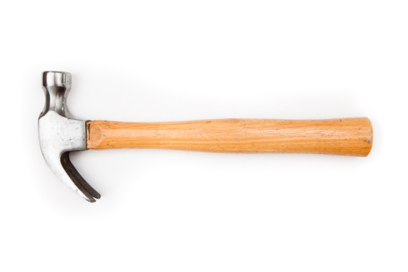
¿Qué puede salir mal?
Y causó una grave lesión cerebral
Un trabajador de la construcción estaba trabajando en el nivel del suelo
Su casco no le quedaba bien y se le resbaló...
Un compañero de trabajo dejó caer su martillo
La golpeó en la frente...
Notes:
WHAT CAN GO WRONG
A female construction worker was working on the ground level of the site while other workers were engaged with tasks on scaffolds. Her hardhat didn’t fit properly and slipped backwards on her head. A coworker on scaffolding dropped his hammer and it struck her on her forehead, causing severe brain damage.
(Next Slide)

Slide 5
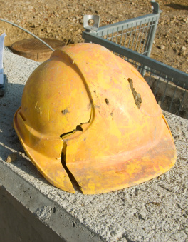
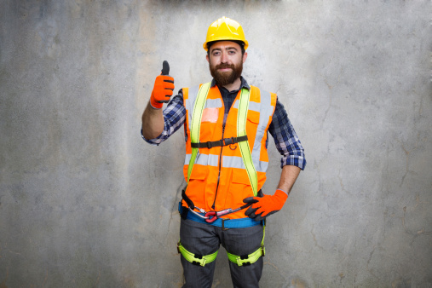
Cómo protegerse
Elija un casco que sea del color y tamaño apropiado
Obtengan ayuda de su supervisor para elegir el casco adecuado para sus riesgos particulares...
Ajusta tu casco para un ajuste cómodo
Elija un casco hecho de un material apropiado
Inspecciona tu casco antes de cada uso
Reemplace su casco después de un impacto significativo, incluso si no puede ver ningún daño.
Notes:
HOW TO PROTECT YOURSELF
Different styles and materials
Hardhats come in several styles, such as front brim only or full brim. They can be made of various materials such as plastic, fiberglass or aluminum.
Depending on the design and the material, the hardhat is made to protect against certain hazards. Some protect the head from limited voltage or high voltage, while others provide no protection whatsoever from electrical shock. Some also protect from sparks, heat and burns to the head.
Hardhats come in a variety of colors, including bright fluorescent colors for high visibility in traffic areas. They also come in different sizes.
Take care of your hardhat
Get help from your supervisor in choosing the right hardhat for the particular hazards of your job. Get advice in properly fitting the hat.
Adjust the hardhat for a comfortable fit, so you won't be tempted to take it off. The suspension system must be adjusted to leave a space between the hard shell and your skull.
Inspect your hardhat before each wearing. Check the shell for cracks, dents and other signs of damage or deterioration. Look for rips and other indications of excessive wear in the inner suspension system. Replace the hat if you find damage.
If the hat has received a significant impact, replace it even if you cannot see damage. There may be hidden cracks which can affect the hat's ability to protect you in the future.
(Next Slide)

Slide 6


Cómo protegerse
Prepárate...
No trate a un casco con rudeza.
No altere su casco pintándolo.
Mantén tu casco alejado de las temperaturas extremas
Lávate el casco periódicamente con agua y jabón suave.
No utilice disolventes de la industria para limpiar un casco.
Notes:
Do not alter your hardhat by painting it. This can change its ability to protect you from electrical shock. Don't drill holes in it to put on accessories; instead, obtain a hat designed for use with accessories.
Keep your hat away from extreme temperatures. Don't carry it in the window of a vehicle or leave it outdoors in freezing weather.
Don't treat a hardhat roughly. Dropping it or throwing it can cause damage which will reduce the protection it provides.
Wash your hardhat periodically with a mild soap and water. Do not use strong chemicals such as industrial solvents to clean a hardhat. You might damage the material and diminish its protective capabilities.
(Next Slide)

Slide 7
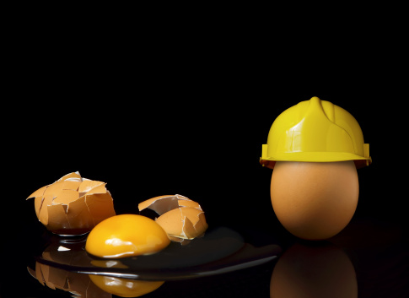
Conclusión
Siempre usa tu casco.
En el lugar de trabajo
Tu casco es inútil sentado en la cabina de tu camión
Notes:
Final Word
Wear your hardhat at all times when you are working in a hazardous area. Your hat is useless sitting in the cab of your truck instead of on your head.
(Next Slide)

Slide 8
Fin de la presentación
Notes:
(Next Slide)

