Slide 1

Click anywhere to get started…

Slide 2
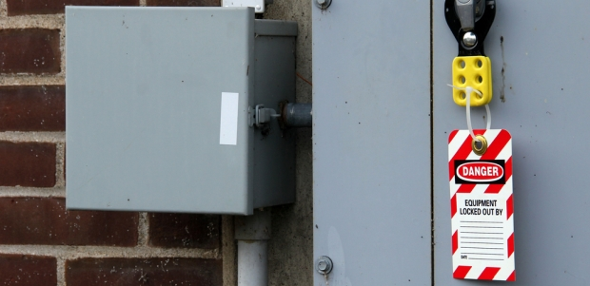

NFPA 70E
Notes:
NFPA 70E

Slide 3
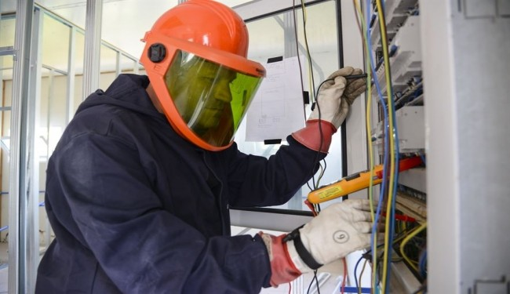
What’s at Stake?
NFPA 70E Standard is commonly used in the United States for electrical safety in the workplace.
LOTO or Lockout / Tagout is an integral part of the electrical safety requirements contained in the NFPA 70E Standard.
Notes:
What’s at Stake?
NFPA 70E Standard is commonly used in the United States for electrical safety in the workplace. This Standard is applied worldwide in industries like oil and gas and proper production. LOTO or Lockout / Tagout is an integral part of the electrical safety requirements contained in the NFPA 70E Standard.

Slide 4
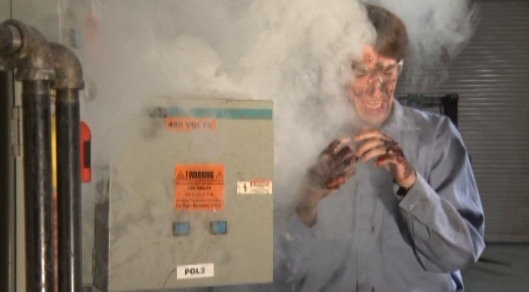
What’s the Danger?
Workers need to be protected from accidental electrocution and workplaces from expensive OSHA fines.
Notes:
What’s the Danger?
Dealing with electricity and hazardous energy has its perils. Workers need to be protected from accidental electrocution and workplaces and from expensive OSHA fines.
Electrical accidents and LOTO violations are among the top citations issued to businesses by OSHA.

Slide 5
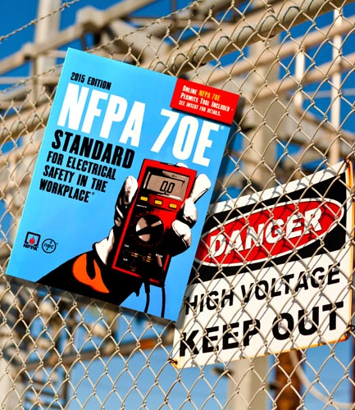
How to Protect Yourself
The following are terms defined for NFPA 70E and OSHA purposes:
Authorized person
Qualified person
Affected person
PPE
LOTO
Notes:
How to Protect Yourself
The following are terms defined for NFPA 70E and OSHA purposes:
Authorized person: Someone who is permitted due to knowledge of equipment or system to lock/tag the system in a safe and controlled manner, typically equipment operators.
Qualified person: Someone who is knowledgeable of the system enough to be able not only to lock/tag the system, but also troubleshoot, repair, or maintain the system again in a safe and controlled manner, typically technicians, electricians.
Affected person: Person who may be exposed to the hazards of energizing or de-energizing the equipment or system.
PPE: Personal protective equipment for electrical hazards: rubber insulating gloves for shock hazard and arc flash-rated clothing for arc flash hazards.
LOTO: Lockout/tagout, when an electrical system or equipment has been disabled to such an extent as to render the system safe from electrical hazards for interaction with personnel.

Slide 6
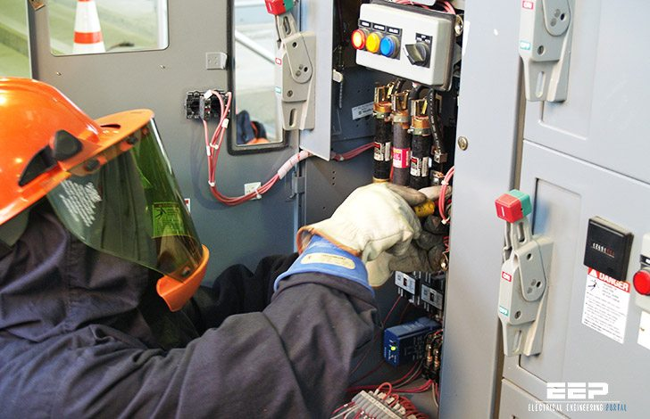
How to Protect Yourself
LOTO PREPARATIONS include the following:
Any person who may be exposed to the electrical energy should be party to the LOTO procedure.
A written LOTO procedure should be developed for each system or piece of electrical equipment.
Up-to-date and accurate documentation should be referenced when developing the LOTO process. This will address all forms of energy and ensure that hazard exposure is minimized (eliminated).
LOTO is applied only to power sources, not controls. (LOTO breaker, not on/off switch).
LOTO equipment unique (don't use LOTO locks for lockers, etc.).
Notes:
How to Protect Yourself
LOTO PREPARATIONS include the following:
Any person who may be exposed to the electrical energy should be party to the LOTO procedure.
A written LOTO procedure should be developed for each system or piece of electrical equipment.
Up-to-date and accurate documentation should be referenced when developing the LOTO process. This will address all forms of energy and ensure that hazard exposure is minimized (eliminated).
LOTO is applied only to power sources, not controls. (LOTO breaker, not on/off switch).
LOTO equipment unique (don't use LOTO locks for lockers, etc.).

Slide 7
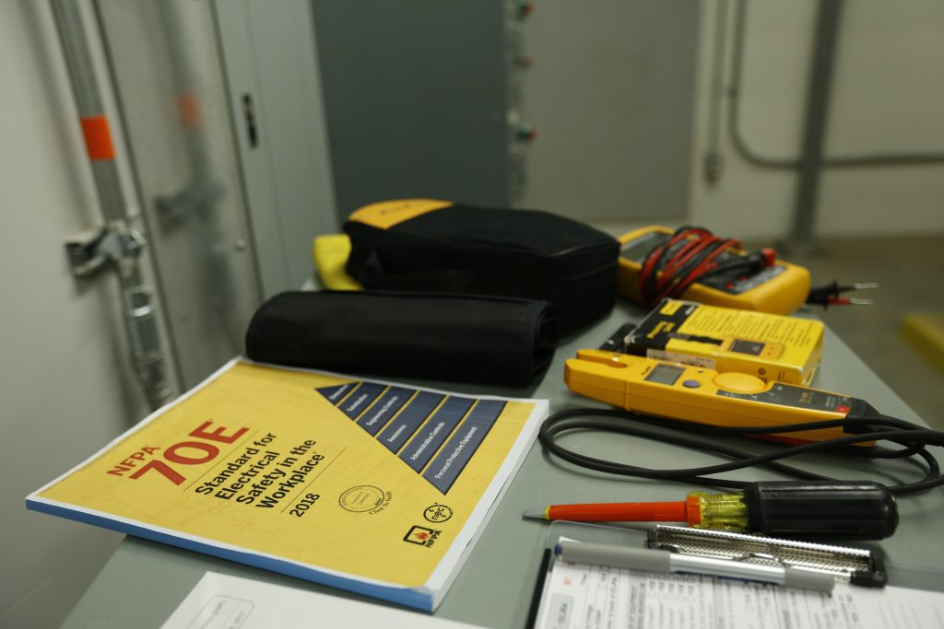
What are the LOTO Requirements for the employer?
Implement a LOTO program that will include written procedures for their electrical systems.
Provide necessary equipment for LOTO program (locks, tags, diagrams, etc.).
Provide documented LOTO training to all workers exposed to the hazards.
Audit the LOTO program as a whole to ensure compliance with the written program.
Audit individual personnel who implement the LOTO procedure to ensure compliance and maintain documentation of the audit.
How to Protect Yourself
Notes:
How to Protect Yourself
What are the LOTO Requirements for the employer?
Implement a LOTO program that will include written procedures for their electrical systems.
Provide necessary equipment for LOTO program (locks, tags, diagrams, etc.).
Provide documented LOTO training to all workers exposed to the hazards.
Audit the LOTO program as a whole to ensure compliance with the written program.
Audit individual personnel who implement the LOTO procedure to ensure compliance and maintain documentation of the audit.

Slide 8
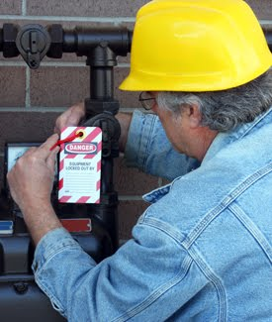
How to Protect Yourself
LOTO SCHEMATICS
LOTO EQUIPMENT
LOCK:
Any equipment installed / updated / replaced / modified after January 1990 should accept a lock in the open (off) position.
The employer provides the lock, but the employee has the responsibility to use the lock when working on equipment. The lock should have only one key, its combination known to only one person, and identify who placed the lock on equipment (name, face, department, phone number, etc.). It should prevent operation of equipment without undue force or tools (using a crowbar or grinder to bypass).
Notes:
How to Protect Yourself
LOTO SCHEMATICS
LOTO EQUIPMENT
LOCK:
Any equipment installed / updated / replaced / modified after January 1990 should accept a lock in the open (off) position.
The employer provides the lock, but the employee has the responsibility to use the lock when working on equipment. The lock should have only one key, its combination known to only one person, and identify who placed the lock on equipment (name, face, department, phone number, etc.). It should prevent operation of equipment without undue force or tools (using a crowbar or grinder to bypass).

Slide 9
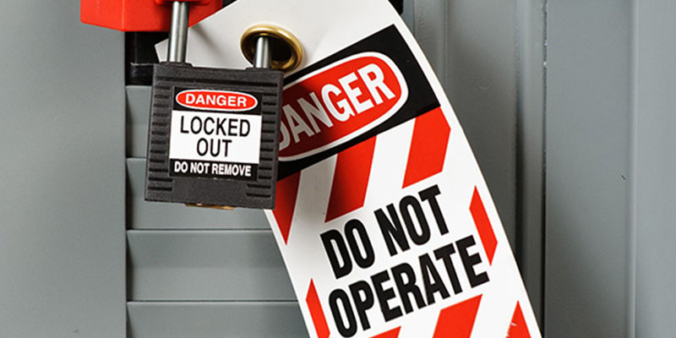
How to Protect Yourself
TAG:
Equipment should have a tag that displays "Do not use, Do not operate, etc." Equipment should be suitable for the environment (paper tag inside a water tank not permitted). Use tagout only if it is not possible to apply a lock, and this must use two isolation means (open breaker and remove cable from lug).
Notes:
How to Protect Yourself
TAG:
Equipment should have a tag that displays "Do not use, Do not operate, etc." Equipment should be suitable for the environment (paper tag inside a water tank not permitted). Use tagout only if it is not possible to apply a lock, and this must use two isolation means (open breaker and remove cable from lug).

Slide 10
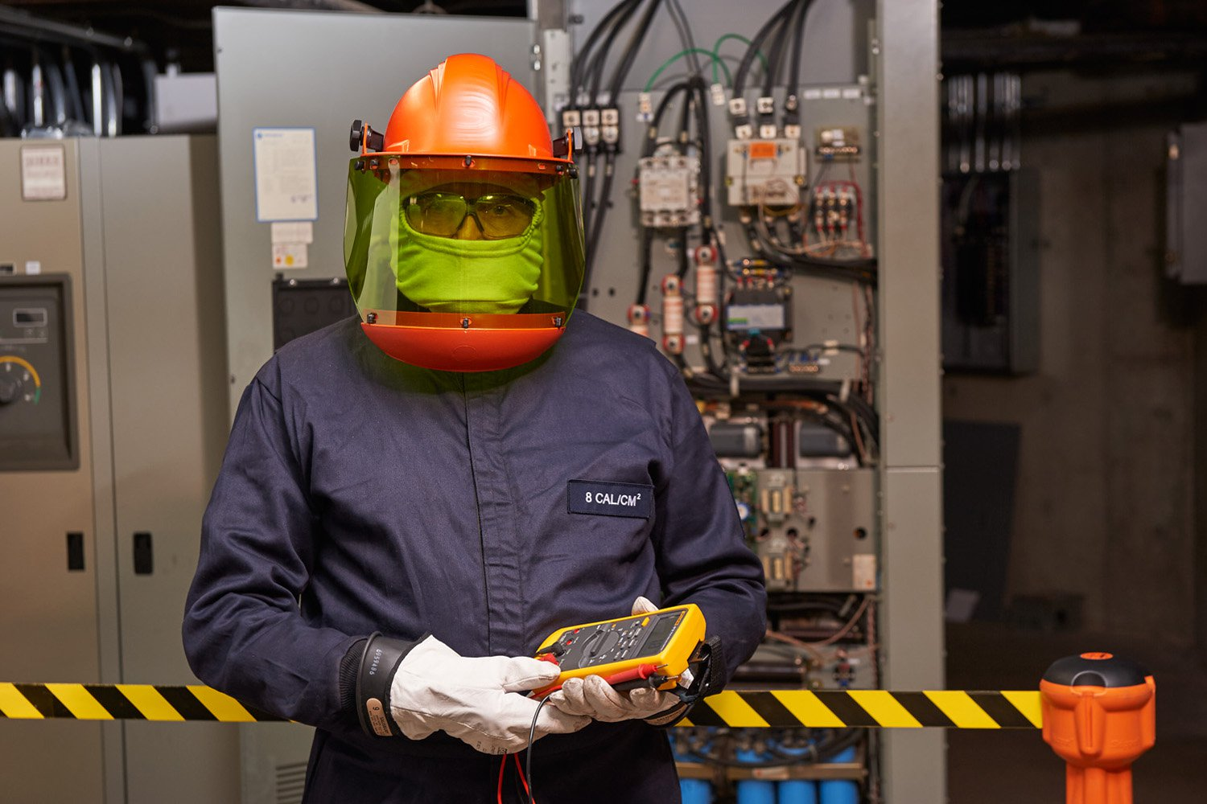
How to Protect Yourself
LOTO PROCEDURE:
Locate sources of energy on up – to – date, accurate single line diagrams.
Identify any personnel that are in hazardous positions for the purpose of LOTO and any PPE required for their location.
Identify the person who is responsible for the LOTO. This will provide for types of LOTO. Simple LOTO only has one source of energy and involves only qualified personnel. Complex LOTO involves multiple power sources, crafts, departments, etc.
Notes:
How to Protect Yourself
LOTO PROCEDURE:
Locate sources of energy on up – to – date, accurate single line diagrams.
Identify any personnel that are in hazardous positions for the purpose of LOTO and any PPE required for their location.
Identify the person who is responsible for the LOTO. This will provide for types of LOTO: Simple LOTO only has one source of energy and involves only qualified personnel. Complex LOTO involves multiple power sources, crafts, departments, etc.

Slide 11
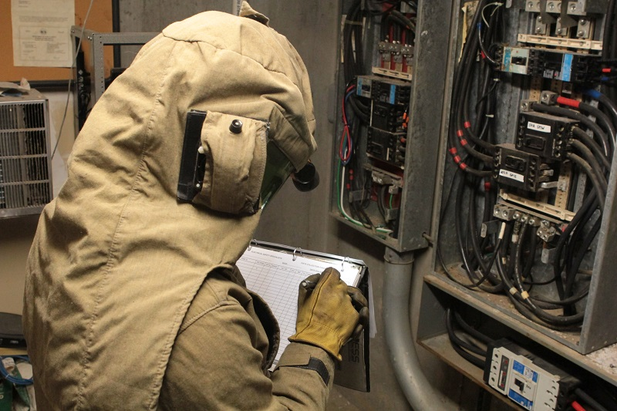
How to Protect Yourself
LOTO Control Elements are:
The shutdown procedure and the qualified person responsible.
Include methods for removal of all stored energy from equipment/system.
Disconnecting means verification. Ensure that the equipment is turned off.
Identify the responsible qualified person charged with coordinating LOTO as a whole.
Verify that the equipment/system cannot be restarted or energized. Attempt to start system, depress on button, attempt to close disconnect, etc.
Test target circuit/equipment to verify lack of energy. This process will consist of the following steps:
a) Verify test instrument on known good live source to verify test equipment is working properly.
b) Measure test circuit/equipment to verify no energy is present. Two steps are required:
1. Check zero energy on phase to phase measurement. Test each of the 1ɸ/3ɸ.
2. Check zero energy on phase to ground measurement. Test each of the 1ɸ/3ɸ.
c) Re-verify test instrument on known good live source to verify test equipment is still working properly.
7. Grounding requirements shall be examined. Generally, if there is danger of backfeed or the circuit is rated over 600V, then personnel safety grounding should be implemented.
Notes:
How to Protect Yourself
LOTO Control Elements are:
The shutdown procedure and the qualified person responsible.
Include methods for removal of all stored energy from equipment/system.
Disconnecting means verification. Ensure that the equipment is turned off.
Identify the responsible qualified person charged with coordinating LOTO as a whole.
Verify that the equipment/system cannot be restarted or energized. Attempt to start system, depress on button, attempt to close disconnect, etc.
Test target circuit/equipment to verify lack of energy. This process will consist of the following steps:
a) Verify test instrument on known good live source to verify test equipment is working properly.
b) Measure test circuit/equipment to verify no energy is present. Two steps are required:
1. Check zero energy on phase to phase measurement. Test each of the 1ɸ/3ɸ.
2. Check zero energy on phase to ground measurement. Test each of the 1ɸ/3ɸ.
c) Re-verify test instrument on known good live source to verify test equipment is still working properly.
7. Grounding requirements shall be examined. Generally, if there is danger of backfeed or the circuit is rated over 600V, then personnel safety grounding should be implemented.

Slide 12
Final Word
Implementing and following through with a sound electrical safety program and proper electrical safety training, including LOTO, is a giant step towards ensuring workplace safety.
Notes:
Final Word
Implementing and following through with a sound electrical safety program and proper electrical safety training, including LOTO, is a giant step towards ensuring workplace safety.

