Slide 1

Click anywhere to get started…

Slide 2
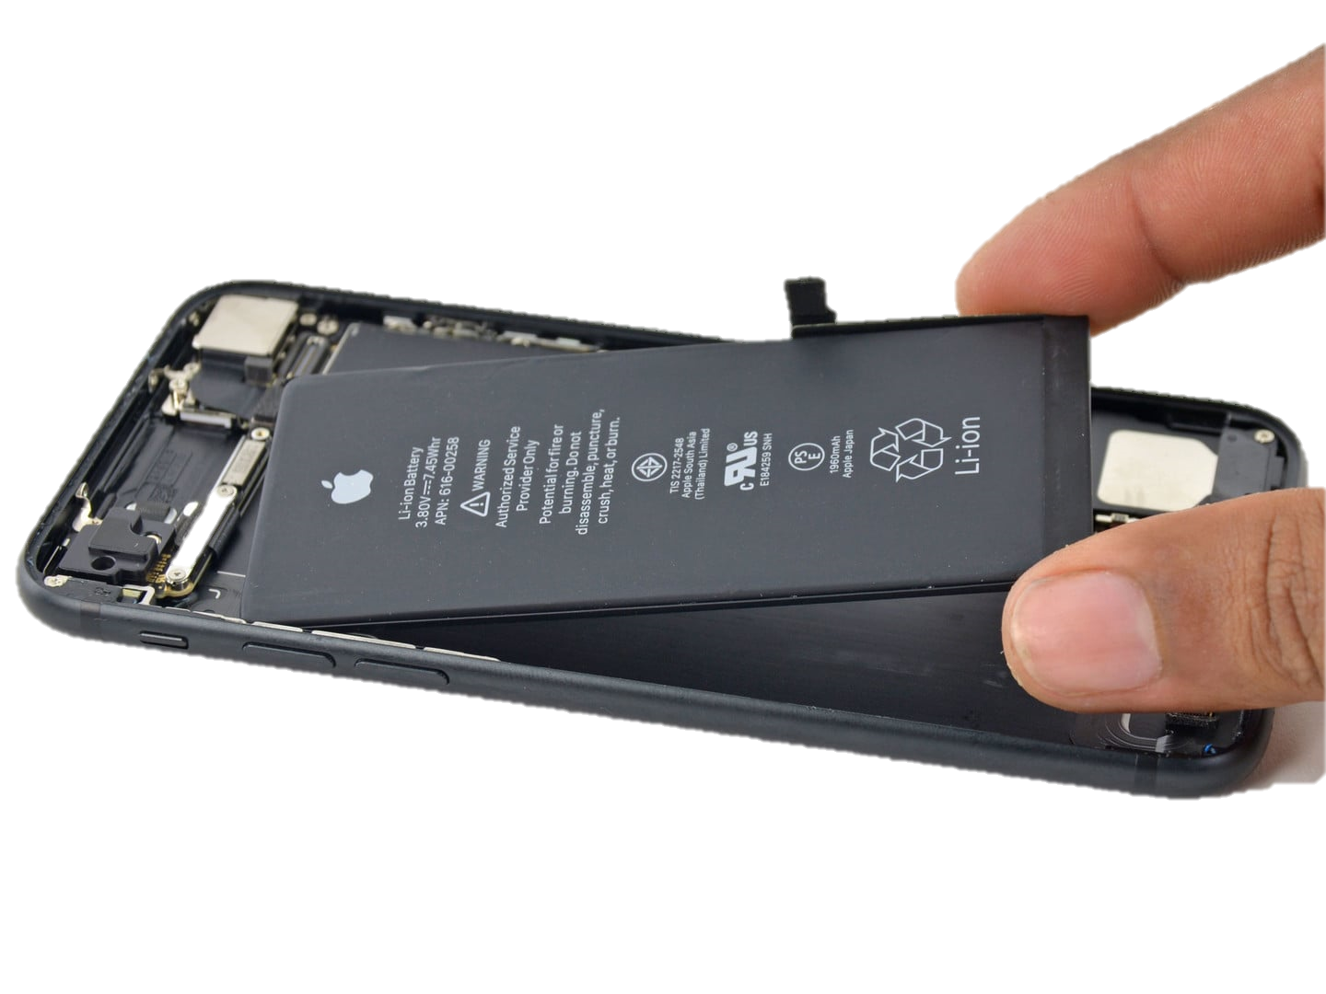


Lithium Battery Safety
Notes:
Lithium Battery Safety

Slide 3
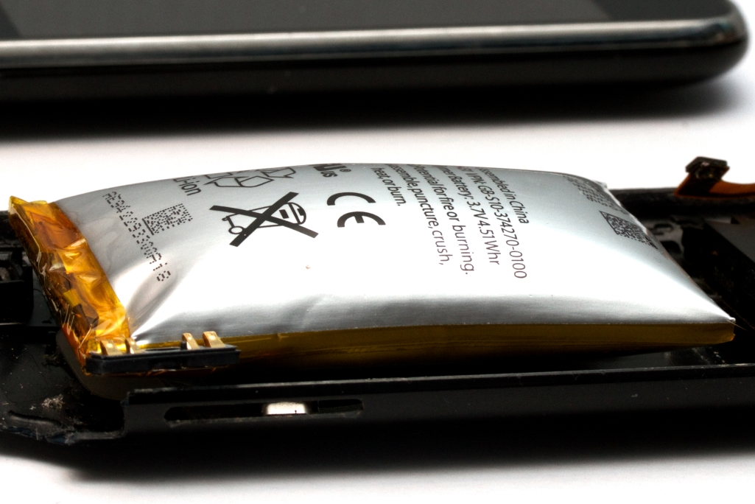
Lithium batteries have become the industry standard for rechargeable storage devices.
Lithium batteries are grouped into two general categories:
Primary (non-rechargeable) lithium batteries are comprised of single-use cells containing metallic lithium anodes and are referred to as “Lithium” batteries.
Secondary (rechargeable) lithium batteries are comprised of rechargeable cells containing an intercalated lithium compound for the anode and cathode and referred to as “Lithium-ion” batteries.
Single lithium-ion batteries have an operating voltage (V) that ranges from 3.6–4.2V. The ions reverse direction during charging. The litigated metal oxide or phosphate coating on the cathode defines the “chemistry” of the battery.
Lithium-ion batteries have electrolytes that are a mixture of organic carbonates such as ethylene carbonate or diethyl carbonate and have (flashpoint) of common carbonates used in lithium-ion batteries from 18 to 145 degrees C.
What’s at Stake?
Notes:
What’s at Stake?
Lithium batteries have become the industry standard for rechargeable storage devices. Lithium – ion battery fires and accidents are on the rise.
Lithium batteries are grouped into two general categories:
Primary (non-rechargeable) lithium batteries are comprised of single-use cells containing metallic lithium anodes. Non-rechargeable batteries are referred to throughout the industry as “Lithium” batteries.
Secondary (rechargeable) lithium batteries are comprised of rechargeable cells containing an intercalated lithium compound for the anode and cathode. Rechargeable lithium batteries are commonly referred to as “Lithium-ion” batteries.
Single lithium-ion batteries (also referred to as cells) have an operating voltage (V) that ranges from 3.6–4.2V. Lithium ions move from the anode to the cathode during discharge. The ions reverse direction during charging. The litigated metal oxide or phosphate coating on the cathode defines the “chemistry” of the battery.
Lithium-ion batteries have electrolytes that are typically a mixture of organic carbonates such as ethylene carbonate or diethyl carbonate. The flammability characteristics (flashpoint) of common carbonates used in lithium-ion batteries vary from 18 to 145 degrees C.

Slide 4
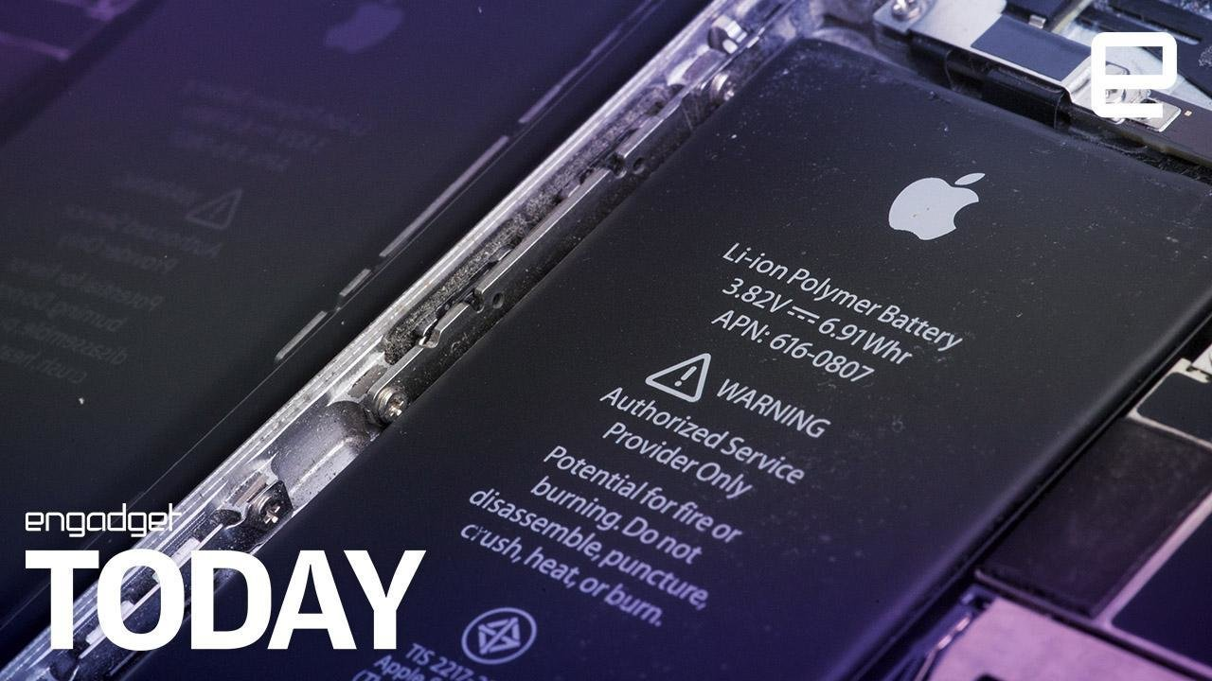
What’s at Stake?
Basic cell designs:
1. Polymer / pouch cells
Used in academic, research and in IPODs, tablets, cell phones.
2. Cylindrical cells
Similar design parameters that have been the standard for alkaline cells for years (A, AA, AAA, C and D.)
It is the “workhorse” of the lithium – ion battery industry. It is used in a majority of commercially available battery pack.
3. Prismatic cells
Used in cell phones, thin laptop computers.
Other than cell phones and tablets, most portable electronic/electrical devices operate above the normal operating voltage of single lithium-ion batteries.
Notes:
What’s at Stake?
There are basic cell designs; polymer/pouch cells, cylindrical cells, prismatic cells.
Polymer / pouch cells
Used in academic, research and in IPODs, tablets, cell phones.
Cylindrical cells
Similar design parameters that have been the standard for alkaline cells for years (A, AA, AAA, C and D.)
It is the “workhorse” of the lithium – ion battery industry and is used in a majority of commercially available battery pack.
Prismatic cells
Used in cell phones, thin laptop computers.
Other than cell phones and tablets, most portable electronic/electrical devices operate above the normal operating voltage of single lithium-ion batteries. For such devices, numerous cells connected in packs provide the desired voltage and capacity.

Slide 5
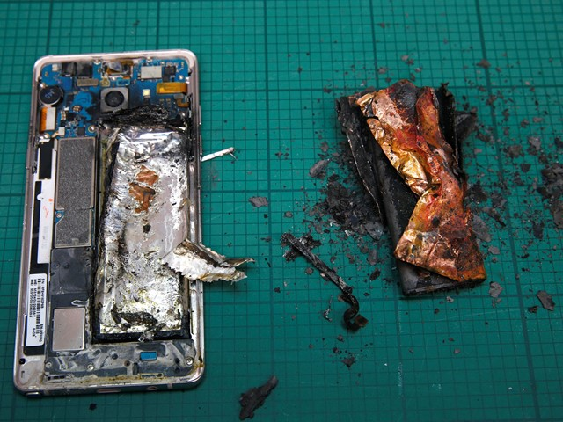
Lithium Battery Hazards
The flammability or flash point in Lithium – ion Batteries is dramatic (18 to 145 degrees C.). Thermal Runaway in Lithium Batteries
Physical damage, electrical abuse such as short circuits and overcharging, and exposures to elevated temperature can cause a Thermal Runaway.
More Thermal Runaway
Manufacturer’s defects such as imperfections and/or contaminants in the manufacturing process can also lead to Thermal Runaway.
The reaction vaporizes the organic electrolyte and pressurizes the cell casing. If (or when) the case fails, the flammable and toxic gases within the cell are released.
Severity
The severity of a Thermal Runaway battery reaction is, in part, related to the buildup and release of pressure from inside of the cell.
As a result, the cell construction can be a major variable pertaining to the severity of a battery incident.
What’s the Danger?
Notes:
What’s the Danger?
Lithium Battery Hazards
The flammability or flash point in Lithium – ion Batteries is dramatic (18 to 145 degrees C.). This is due to the high energy densities coupled with the flammable organic electrolyte.
Thermal Runaway
This creates new challenges for use, storage, and handling. Studies have shown that physical damage, electrical abuse such as short circuits and overcharging, and exposures to elevated temperature can cause a thermal runaway. This refers to rapid self-heating from an exothermic chemical reaction that can result in a chain reaction thermal runaway of adjacent cells.
More Thermal Runaway
Manufacturer’s defects such as imperfections and/or contaminants in the manufacturing process can also lead to thermal runaway. The reaction vaporizes the organic electrolyte and pressurizes the cell casing. If (or when) the case fails, the flammable and toxic gases within the cell are released.
Severity
The severity of a runaway battery reaction is, in part, related to the buildup and release of pressure from inside of the cell. Cells with a means of releasing this pressure (i.e., pressure relief vents or soft cases) typically produce less severe reactions than cells that serve to contain the pressure and rupture due to high pressure (i.e., unvented cylindrical cells). As a result, the cell construction can be a major variable pertaining to the severity of a battery incident.

Slide 6
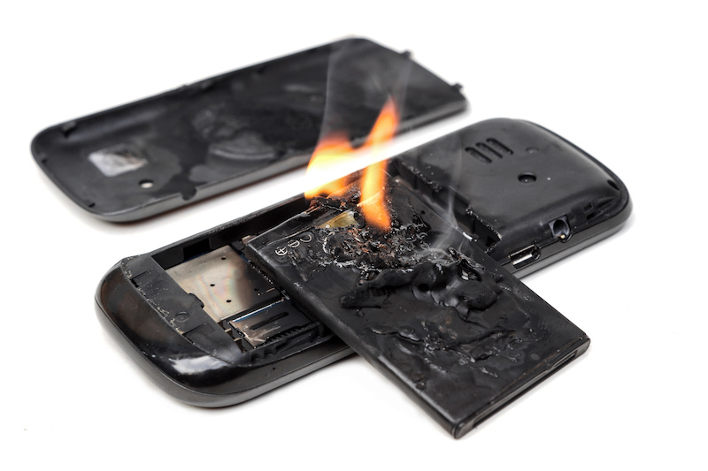
What’s the Danger?
Factors of severity
Battery size
Chemistry
Construction and battery state of charge (soc)
Significant Battery Reaction Produce Hazardous Components :
Flammable by – products (e.g. Aerosols, vapors, liquids)
Toxic gases and flying debris (burning)
In most cases sustained burning of the electrolyte and casing material.
Venting Reaction
During a venting reaction (i.e., no ignition of the vented products), the products consist primarily of electrolyte constituents.
The products in most batteries typically consist of:
carbon dioxide (CO2)
carbon monoxide (CO)
hydrogen (H2)
hydrocarbons (CxHx)
These gases are flammable and present fire and explosion risk.
Notes:
What’s the Danger?
Factors of severity
Includes battery size
Chemistry
Construction and battery state of charge (soc)
Significant Battery Reaction Produce Hazardous Components such as:
Flammable by – products (e.g. Aerosols, vapors, liquids)
Toxic gases and flying debris (some burning)
In most cases sustained burning of the electrolyte and casing material.
Venting Reaction
During a venting reaction (i.e., no ignition of the vented products), the products consist primarily of electrolyte constituents.
The products in most batteries typically consist of:
carbon dioxide (CO2)
carbon monoxide (CO)
hydrogen (H2)
hydrocarbons (CxHx)
These gases are flammable and present fire and explosion risk.

Slide 7

What’s the Danger?
Burning – Lithium Batteries
Electrolyte burns efficiently producing primarily carbon dioxide (CO2) and water (H2O) as the by-products.
Most batteries the products typically consist of CO2 and water vapor.
The burning reaction also tends to liberate the fluorine from the lithium salt dissolved in the electrolyte.
The fluorine typically reacts with hydrogen to form hydrogen fluoride (HF).
HF production is proportional to the electrical energy stored in the cell/battery and can result in dangerous concentrations.
HF reacts with the water vapor produced during the reaction and/or with the mucus membranes in the human body (i.e., eyes, nose, throat, lungs) and becomes hydrofluoric acid.
Notes:
What’s the Danger?
Burning Scenario
Electrolyte burns efficiently producing primarily carbon dioxide (CO2) and water (H2O) as the by-products.
Most batteries the products typically consist of CO2 and water vapor.
The burning reaction also tends to liberate the fluorine from the lithium salt dissolved in the electrolyte.
The fluorine typically reacts with hydrogen to form hydrogen fluoride (HF).
HF production is also proportional to the electrical energy stored in the cell/battery and can result in dangerous concentrations.
HF reacts with the water vapor produced during the reaction and/or with the mucus membranes in the human body (i.e., eyes, nose, throat, lungs) and becomes hydrofluoric acid.

Slide 8
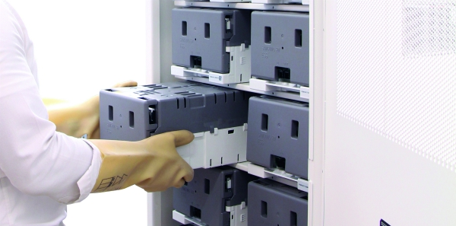
How to Protect Yourself
Best Practices for Storage and Use of Batteries
Procurement
B. Storage
Chargers and Charging Practice
Handling and Use
Disposal
Notes:
How to Protect Yourself
Best Practices for Storage and Use of Batteries
A. Procurement
Purchase batteries from a reputable manufacturer or supplier.
Avoid batteries shipped without protective packaging (i.e., hard plastic or equal).
Inspect batteries upon receipt and safely dispose of damaged batteries.
B. Storage
Store batteries away from combustible materials.
Remove batteries from the device for long-term storage.
Store the batteries at temperatures between 5°C and 20°C (41°F and 68°F).
Separate fresh and depleted cells (or keep a log).
If practical, store batteries in a metal storage cabinet.
Avoid bulk-storage in non-laboratory areas such as offices.
Visually inspect battery storage areas at least weekly.
Charge batteries in storage to approximately 50% of capacity at least once every six months.
C. Chargers and Charging Practice
Never charge a primary (disposable lithium or alkaline) battery; store one-time use batteries separately.
Charge or discharge the battery to approximately 50% of capacity before long-term storage.
Use chargers or charging methods designed to safely charge cells or battery packs at the specified parameters.
Disconnect batteries immediately if, during operation or charging, they emit an unusual smell, develop heat, change shape/geometry, or behave abnormally. Dispose of the batteries.
Remove cells and pack from chargers promptly after charging is complete. Don’t use the charger as a storage location.
Charge and store batteries in a fire-retardant container like a high quality Lipo Sack when practical.
Do not parallel charge batteries of varying age and charge status; chargers cannot monitor the current of individual cells and initial voltage balancing can lead to high amperage, battery damage, and heat generation. Check voltage before parallel charging; all batteries should be within 0.5 Volts of each other.
Do not overcharge (greater than 4.2V for most batteries) or over-discharge (below 3V) batteries.
D. Handling and Use
Handle batteries and or battery-powered devices cautiously to not damage the battery casing or connections.
Keep batteries from contacting conductive materials, water, seawater, strong oxidizers and strong acids.
Do not place batteries in direct sunlight, on hot surfaces or in hot locations.
Inspect batteries for signs of damage before use. Never use and promptly dispose of damaged or puffy batteries.
Keep all flammable materials away from operating area.
Allow time for cooling before charging a battery that is still warm from usage and using a battery that is still warm from charging.
Consider cell casing construction (soft with vents) and protective shielding for battery research and experimental or evolving application and use.
E. Disposal
Dispose of damaged cells and cells that no longer hold a substantial charge. To check the general condition of your cells, charge them, let them rest for an hour, then measure the voltage. If your cells are close to 4.2V, the cells are in good condition.
Dispose of used batteries by taking them to an e. Media bin (if less than five pounds) or by completing an Online Chemical Waste Collection Request.

Slide 9
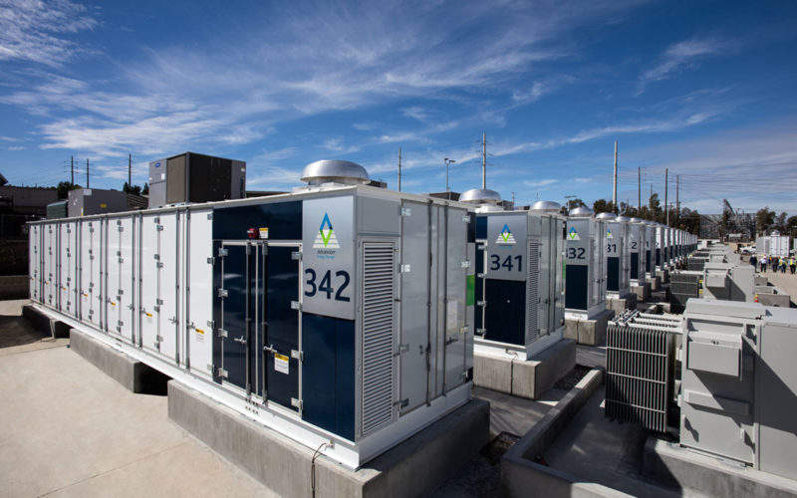
LITHIUM BATTERY SYSTEM DESIGN
Lithium battery system is a highly interdisciplinary topic that requires qualified designers.
TOPIC EXAMPLES:
Battery selection
Life
charging design
electric control systems
energy balance of the system,
warning labels
Systems designed for mobile applications should apply best practices to ensure appropriate safeguards are in place. Designs should include a hazard assessment that identifies health, physical and environmental hazards, with all hazards appropriately mitigated through engineering and administrative controls.
How to Protect Yourself
Notes:
How to Protect Yourself
LITHIUM BATTERY SYSTEM DESIGN
Lithium battery system is a highly interdisciplinary topic that requires qualified designers.
Examine these topics examples carefully:
Battery selection
Life
charging design
electric control systems
energy balance of the system,
warning labels
Systems designed for mobile applications should apply best practices to ensure appropriate safeguards are in place. Designs should include a hazard assessment that identifies health, physical and environmental hazards, with all hazards appropriately mitigated through engineering and administrative controls.

Slide 10
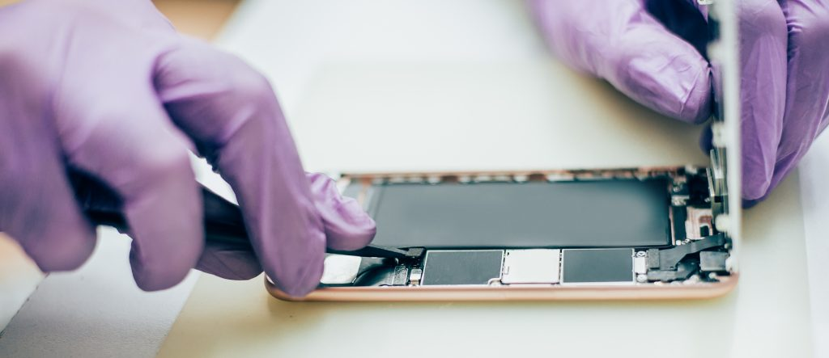
How to Protect Yourself
Precautions / Prevention
If there are signs or evidence of a battery malfunction such as (swelling, heating or irregular odors) follow these steps.
If batteries are showing evidence of thermal runaway failure, be very cautious because the gases may be flammable and toxic and failure modes can be hazardous.
Disconnect the battery (if possible).
Remove the battery from the equipment/device (if possible).
Place the battery in a metal or other container away from combustibles.
If a lithium battery fire occurs, use a CO2 (Class BC) or dry chemical (Class ABC) fire
extinguisher. Lithium batteries don’t have actual lithium metal so don’t use a Class D fire extinguisher.
Make sure you use personal protective equipment, such as gloves, goggles / safety glasses and lab coat.
Notes:
How to Protect Yourself
Precautions / Prevention
If there are signs or evidence of a battery malfunction such as (swelling, heating or irregular odors) follow these steps.
If batteries are showing evidence of thermal runaway failure, be very cautious because the gases may be flammable and toxic and failure modes can be hazardous.
Disconnect the battery (if possible).
Remove the battery from the equipment/device (if possible).
Place the battery in a metal or other container away from combustibles.
If a lithium battery fire occurs, use a CO2 (Class BC) or dry chemical (Class ABC) fire
extinguisher. These are common to campus buildings. Lithium batteries don’t have actual lithium metal so don’t use a Class D fire extinguisher.
Make sure you use personal protective equipment, such as gloves, goggles / safety glasses and lab coat.

Slide 11
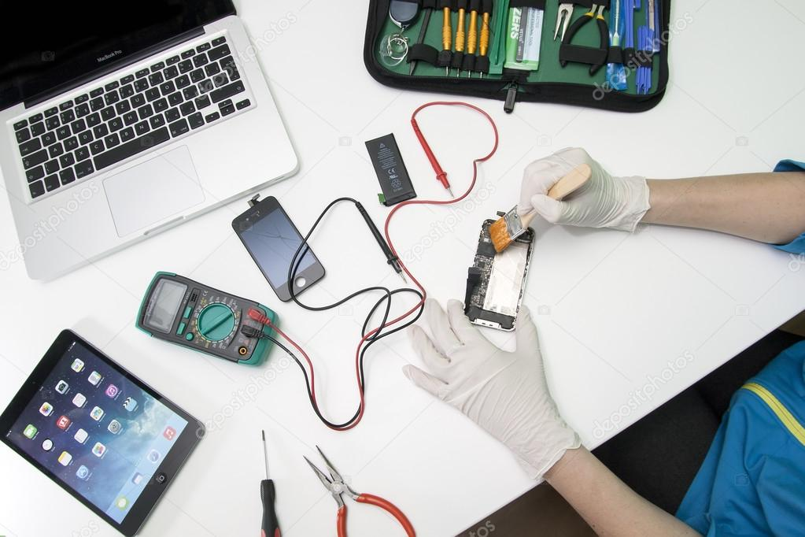
Final Word
Lithium batteries have become the industry standard for rechargeable storage devices.
Lithium-ion battery fires and accidents are on the rise and present risks that can be mitigated if the technology is well understood. By doing so, one can prevent fire, injury and loss of intellectual and other property.
Notes:
Final Word
Lithium batteries have become the industry standard for rechargeable storage devices.
Lithium-ion battery fires and accidents are on the rise and present risks that can be mitigated if the technology is well understood. By doing so, one can prevent fire, injury and loss of intellectual and other property.

