Slide 1

Click anywhere to get started…

Slide 2
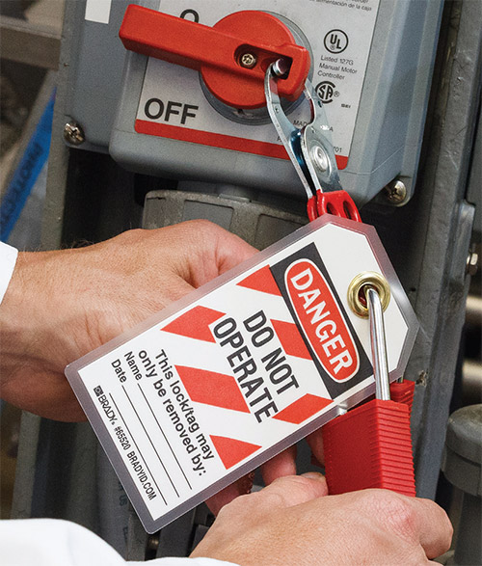

LOCKOUT / TAGOUT / TRYOUT
Notes:
The Basics of Forklift Safety

Slide 3
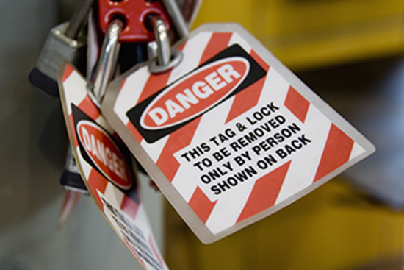
What’s at Stake?
Lockout / Tagout / Tryout is a procedure designed to prevent accidents when working on equipment
Notes:
What’s at Stake?
Text here

Slide 4
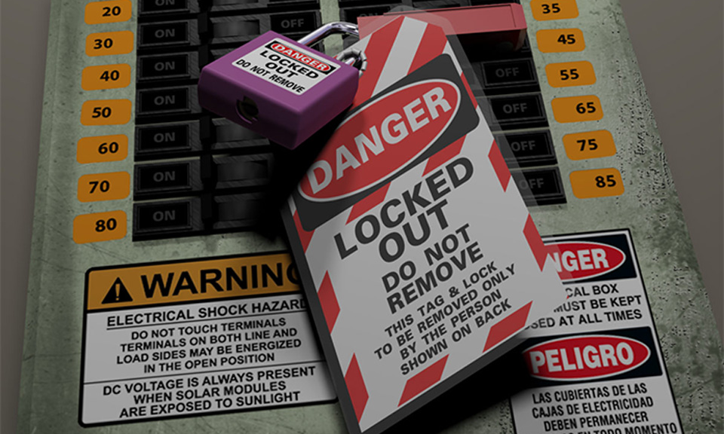
What’s the Danger?
Injuries and deaths can occur if procedures of lockout / tagout / tryout are not followed.

Slide 5
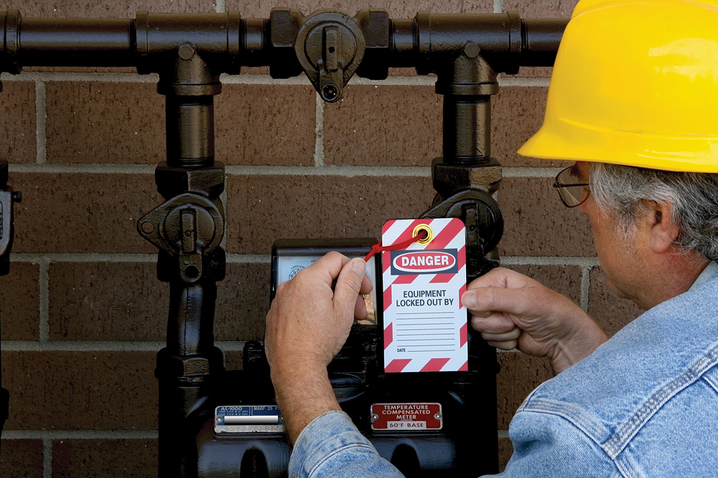
How to Protect Yourself
Lockout / tagout / tryout is a three-part procedure designed to protect you from accidental or unexpected start-up of equipment. The procedure serves four purposes:
To protect the person working on the equipment.
To protect other workers in the area.
To protect the equipment.
To serve as a communication device for the above three done in conjunction with a safe work permit.
Notes:
How to Protect Yourself
Machines of every description have standard operating procedures which include a “checklist” for its safe operation. Forklifts are no exception. There are procedures and protocols for the safe and effective use of the forklift.
These operating procedures are rooted out of common sense but are too often ignored or forgotten.

Slide 6
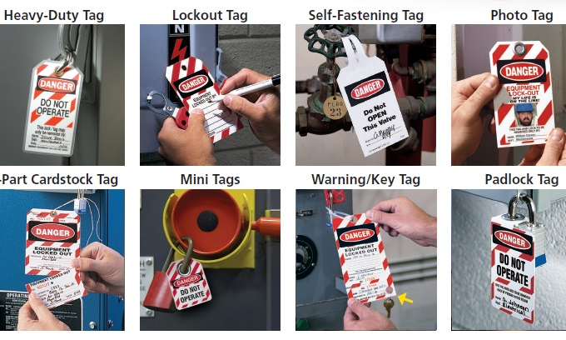
How to Protect Yourself
The “Lockout” involves the use of a specific lock or locks to isolate equipment from all energy sources. These sources may include air, water, electricity or hydraulic power. Once the shut-off devices have been identified, personal locks are attached to each device.
Notes:
How to Protect Yourself
Follow safe speed limits – Drive only fast as you can comfortably walk. Forklifts can’t travel safely at high speeds. Without loads, they aren’t weighted and are especially unstable.
Keep the load low – While moving, forks should be low, with the mast tilted slightly back.
Maintain good visibility – If a load blocks forward vision, drive backwards.
Watch the slope – Back down slopes that have an incline greater than10 percent. Make sure your back up alarm is working properly.
Never carry hitchhikers – They are unsecured and can easily fall off and be injured.
Leave aisle room – Allow space for pedestrian and other traffic. Be alert at intersections. Honk your horn before and while you enter an intersection, even if it doesn’t appear to be busy.
Park safely – On a hill, always block the wheels, lower forks and set the parking brake.

Slide 7
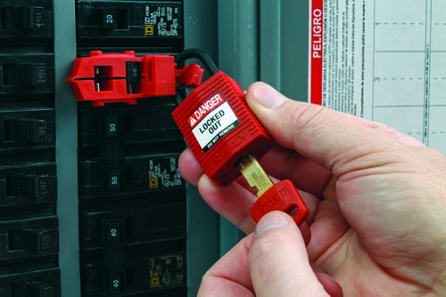
How to Protect Yourself
The “Tagout” requires a specific lockout tag to be completed and attached with each lock that is placed on an insolation device. The complete tag will usually have your lock number, name, department, equipment identification, and reasons why the equipment is down.
Notes:
How to Protect Yourself

Slide 8
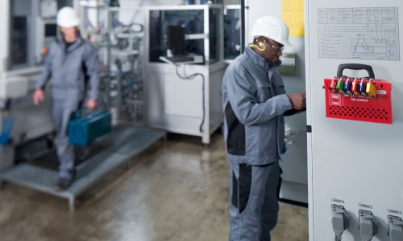
How to Protect Yourself
The “Tryout” requires that you physically attempt to turn on all power switches and devices once the equipment has been locked out. This is the final check and assurance that the equipment has been isolated from all power sources.
Notes:
How to Protect Yourself
Follow safe speed limits – Drive only fast as you can comfortably walk. Forklifts can’t travel safely at high speeds. Without loads, they aren’t weighted and are especially unstable.
Keep the load low – While moving, forks should be low, with the mast tilted slightly back.
Maintain good visibility – If a load blocks forward vision, drive backwards.
Watch the slope – Back down slopes that have an incline greater than10 percent. Make sure your back up alarm is working properly.
Never carry hitchhikers – They are unsecured and can easily fall off and be injured.
Leave aisle room – Allow space for pedestrian and other traffic. Be alert at intersections. Honk your horn before and while you enter an intersection, even if it doesn’t appear to be busy.
Park safely – On a hill, always block the wheels, lower forks and set the parking brake.

Slide 9
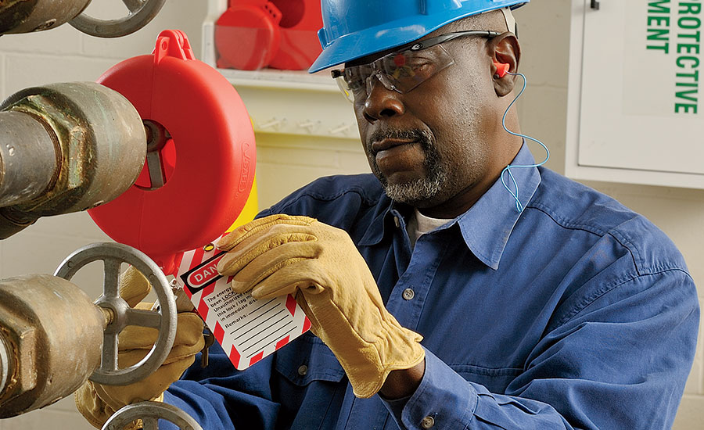
How to Protect Yourself
Once the equipment has been isolated and locked out no one should be able to start the equipment. They would not be able to do so until you have completed the necessary work and remove your personal locks from each power switch or device.
This procedure is the Key to Your Safety when working on equipment.
Notes:
How to Protect Yourself

Slide 10
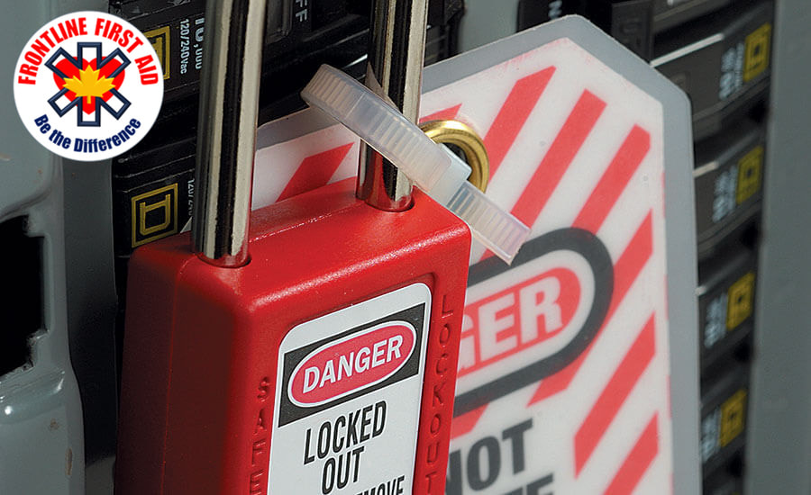
Final Word
Lockout / Tagout / Tryout requirements will always vary from one facility to the next. If you are unsure about any specific requirements, you should always ask for more information.
Notes:
Final Word

