Slide 1

Click anywhere to get started…

Slide 2
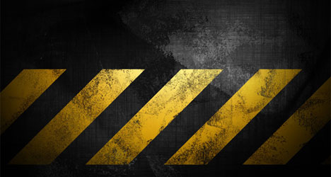
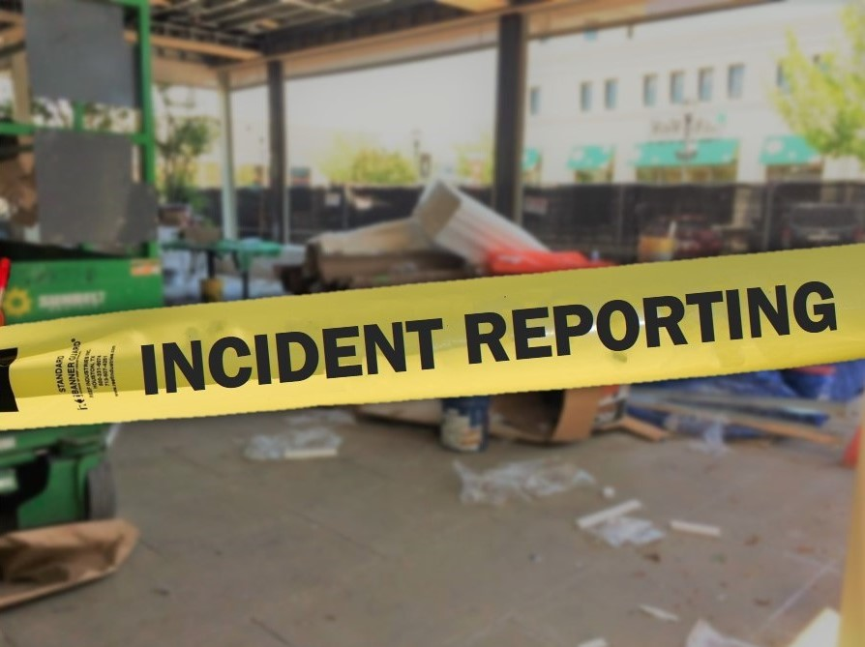

Injury, Illness and Incident Reporting
Notes:
Injury, Illness and Incident Reporting

Slide 3
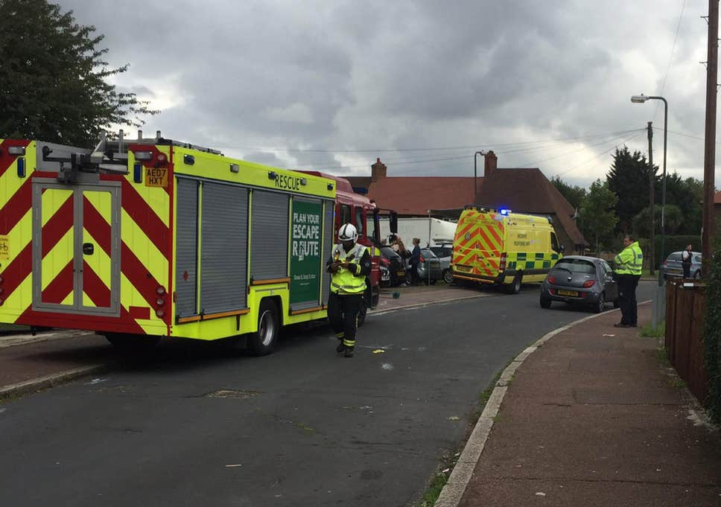
What’s at Stake?
Workplace accident or illness, or a close call / near miss must be reported.
Notes:
What’s at Stake?
Whenever, there is a workplace accident or illness, or a close call / near miss is experienced, the situation must be reported. Often times many of these incidents, especially first aid type of injuries are not reported. Injuries / illnesses / close calls are not reported for a variety of reasons.

Slide 4
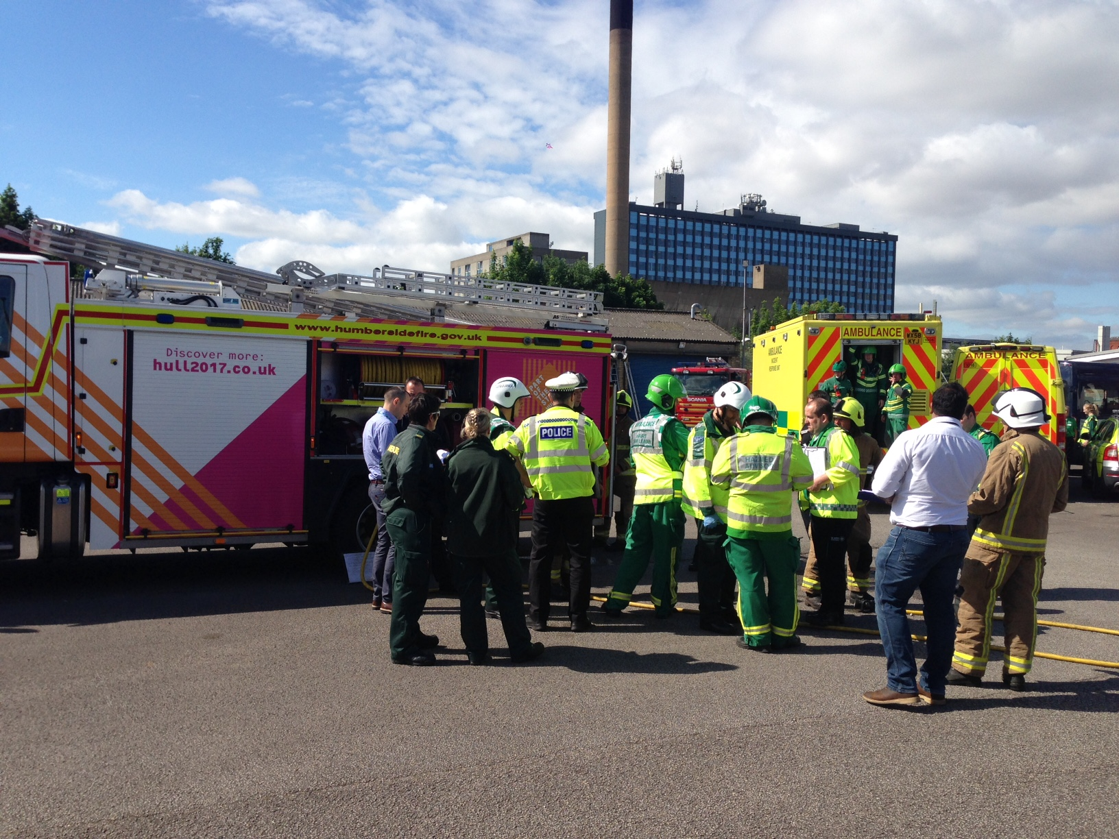
What’s the Danger?
Why incidents involving properly damage, near misses, spills, illnesses and injuries go unreported.
Pride – people do not want to admit their mistakes to others.
Fear the outcome from sharing what occurred with a supervisor.
Fear from being afraid of being disciplined.
What others may think.
The energy to do the paperwork.
Notes:
What’s the Danger?
There is a myriad of reasons why incidents involving properly damage, near misses, spills, illnesses and injuries go unreported.
Pride – people do not want to admit their mistakes to others.
Fear the outcome from sharing what occurred with a supervisor.
Fear from being afraid of being disciplined.
What others may think or fear the repercussions from the incident.
The energy it takes to do the paperwork.

Slide 5

What’s the Danger?
With injuries, even minor ones it is important to get them looked at by a supervisor or safety representative. While many injuries such as a small cut, or insect sting, may not seen like a big deal, can turn into a big one.
Example:
You are bit by some type of insect on a Friday afternoon at work but decide not to tell anyone. You go home and within a few hours you can see the bite area is swelling up. You have hives. You have trouble breathing.
You realize you need medical attention because you are having an allergic reaction.
Notes:
How to Protect Yourself
With injuries, even minor ones it is important to get them looked at by a supervisor or safety representative. While many injuries such as a small cut, or insect sting, may not seen like a big deal, can turn into a big one.
Example:
You are bit by some type of insect on a Friday afternoon at work but decide not to tell anyone. You go home and within a few hours you can see the bite area is swelling up. You also notice you have hives. You have trouble breathing.
You realize you need medical attention because you can see you are having an allergic reaction.

Slide 6

What’s the Danger?
You tell the doctor what happened at work beyond first aid. It is an OSHA recordable injury. Since the injury was not immediately reported at work, there are problems.
There is no record or witness to it happening at work which could raise concern by the employer whether or not the injury occurred at work. This may end up in a drawn-out dispute.
If the injury was reported immediately someone may have been able to recognize that it may develop into an allergic reaction. There could have been options for first aid instead of medical treatment to treat the issue before it worsened.
Notes:
How to Protect Yourself
You tell the doctor what happened at work beyond first aid. It is an OSHA recordable injury. Since the injury was not immediately reported at work, there are problems.
There is no record or witness to it happening at work which could raise concern by the employer whether or not the injury occurred at work. This may end up in a drawn out dispute since there have been many people in the past who have faked or had injuries off the job, but stated it occurred at work in an attempt for it to be paid through worker’s compensation.
If the injury was reported immediately someone may have been able to recognize that it may develop into an allergic reaction. There could have been options for first aid instead of medical treatment to treat the issue before it worsened which would have saved you a trip to the hospital and the company an OSHA recordable.

Slide 7
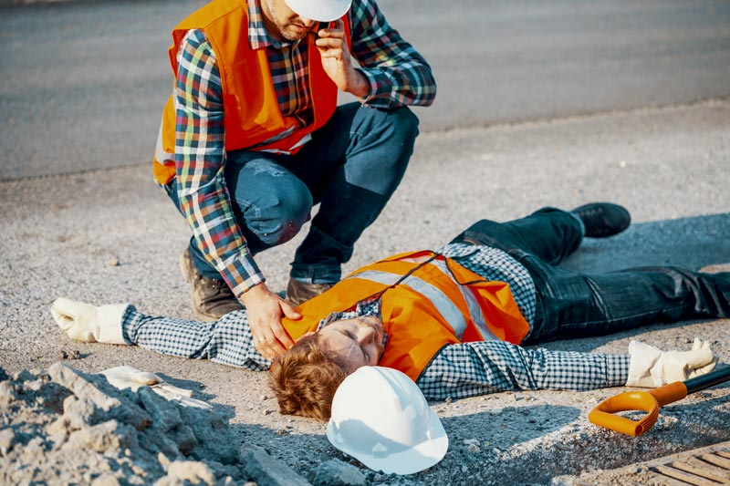
How to Protect Yourself
Most workplace injuries and illnesses are PREVENTABLE. It is critical to investigate immediately why it happened. By investigating changes, corrective action can be taken.
Purpose of investigation:
Do not play the “blame game” but identify factors which can then be controlled.
Investigatory protocol:
Basic facts (who, what, when and where) of the incident that resulted in injury are reviewed to determine the “Why” and “How” to prevent the incident from happening again.
Notes:
How to Protect Yourself
Most workplace injuries and illnesses are PREVENTABLE. So, when a work-related injury or illness occurs, it is critical to investigate immediately why it happened. By investigating changes, corrective action can be taken to prevent it from happening again.
Purpose of investigation:
Not to play the “blame game” but to identify factors which can then be controlled.
Similar incidents can be avoided in the future by identifying the factors that led to the incident and then changing the conditions or actions.
Investigatory protocol:
Basic facts (who, what, when and where) of the incident that resulted in injury are reviewed to determine the “Why” and “How” to prevent the incident from happening again.
The information desired from the investigation is shared only with those on a need – to – know basis while maintaining worker confidentiality.

Slide 8

How to Protect Yourself
TRENDS / TRACKING OF WORKPLACE INJURY AND ILLNESS
Summaries of work – related injuries and illnesses help identify trends and stabilize processes to prevent recurrence.
The trends identify unhealthy behavior or hazardous conditions by TRACKING work – related injuries and illnesses.
Notes:
How to Protect Yourself
TRENDS / TRACKING OF WORKPLACE INJURY AND ILLNESS
Summaries of work – related injuries and illnesses help identify trends and stabilize processes to prevent recurrence.
The trends identify unhealthy behavior or hazardous conditions by TRACKING work – related injuries and illnesses. Information so gained targets occupational health and safety education activities to prevent future worker work – related injuries and illnesses.

Slide 9

How to Protect Yourself
The trending analysis includes:
Tracking and monitoring workplace injuries and illnesses on an on-going basis.
Determining if any trends in workplace injuries or illnesses exist and graphing those trends if possible.
Identifying any equipment, materials, or environmental factors that may be commonly involved in workplace injury or illness incidents.
Identifying possible solutions and suggesting improvements to reduce or prevent the likelihood of future workplace injuries or illnesses.
Reviewing data for quality assurance.
Monitoring safety program leading and lagging indicators (i.e. training, workers compensation cost.
Notes:
How to Protect Yourself
The trending analysis includes:
Tracking and monitoring workplace injuries and illnesses on an on-going basis.
Determining if any trends in workplace injuries or illnesses exist and graphing those trends if possible.
Identifying any equipment, materials, or environmental factors that may be commonly involved in workplace injury or illness incidents.
Identifying possible solutions and suggesting improvements to reduce or prevent the likelihood of future workplace injuries or illnesses.
Reviewing data for quality assurance.
Monitoring safety program leading and lagging indicators (i.e. training, workers compensation cost.

Slide 10
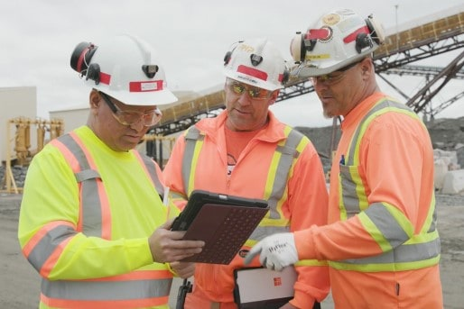
Final Word
All injuries need to be reported, no matter how small. Not only does it protect you, but it also protects the company as a whole by possibly preventing a first aid injury developing into an OSHA recordable. Something minor in nature can develop into something more serious. Lessons can be learned from minor injuries, to prevent other injuries occurring in the future.
Notes:
Final Word
All injuries need to be reported, no matter how small. Not only does it protect you, but it also protects the company as a whole by possibly preventing a first aid injury developing into an OSHA recordable. Something minor in nature can develop into something more serious. Lessons can be learned from minor injuries, to prevent other injuries occurring in the future.

