Slide 1

Click anywhere to get started…

Slide 2
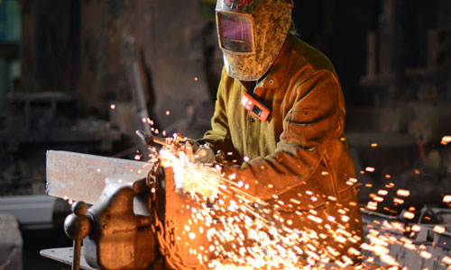

HOT WORK: WHEN THE HEAT IS ON!
Notes:
The Basics of Forklift Safety

Slide 3
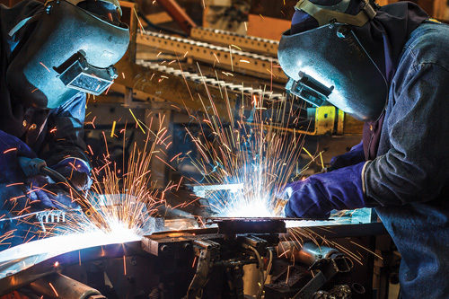
What’s at Stake?
Excessive heat creates safety risks. Your health is at risk.
Notes:
What’s at Stake?
Text here

Slide 4

What’s the Danger?
Excessive heat puts your life in danger.
It may make you sick, and can even be fatal.
It can make you short – tempered, inattentive, dizzy and slow.
Sweat can make your hands slippery and run into your eyes or eyewear and obscure your vision.
Heat can be caused by summer weather or by other conditions such as hot kitchens or foundries. Other factors can make you more susceptible to heat stress, including conditions such as heart disease, diabetes, excess weight or poor physical condition.

Slide 5

What’s the Danger?
Health and safety problems caused by excessive heat are called heat stress. Hyperthermia is another name for the medical condition caused by too much heat. It ranges from heat cramps to heat exhaustion to heat stroke.
Heat cramps are a warning sign that the body has lost too much salt through sweating. The cramps affect the muscles which have been used for working, such as legs, arms and abdomen.
Heat exhaustion is a warning that the body's heat control mechanism has become overtaxed. Symptoms are exhaustion, dizziness, nausea, pale and clammy skin, rapid pulse and low blood pressure. May lead to heat stroke if ignored.
Heat stroke can be fatal. It happens when the body's heat loss mechanism just shuts down.
Notes:
What’s the Danger?
Consider this real-life incident…
A senior rig toolpusher operating a forklift discovered a hydraulic leak of the lift controller for the forks. The load was raised about 10 feet (three meters) high and he began to repair the leak. He stood under the load and was attempting to tighten the fitting when it broke completely off the hydraulic line. This caused the load to drop, trapping the toolpusher under the load. He was killed immediately.

Slide 6

How to Protect Yourself
Heat Illness Prevention:
Get used to the heat gradually. When the weather suddenly turns hot, or when you return to working in a hot environment after a vacation, take it easy until you have become accustomed to the heat again.
Drink water often. The body loses water through perspiration, and you need to replace it frequently. Never drink alcoholic beverages as a fluid replacement.
Take frequent rest breaks. Move to a cooler area or change to lighter work periodically when working in a hot environment.
Notes:
How to Protect Yourself
Machines of every description have standard operating procedures which include a “checklist” for its safe operation. Forklifts are no exception. There are procedures and protocols for the safe and effective use of the forklift.
These operating procedures are rooted out of common sense but are too often ignored or forgotten.

Slide 7
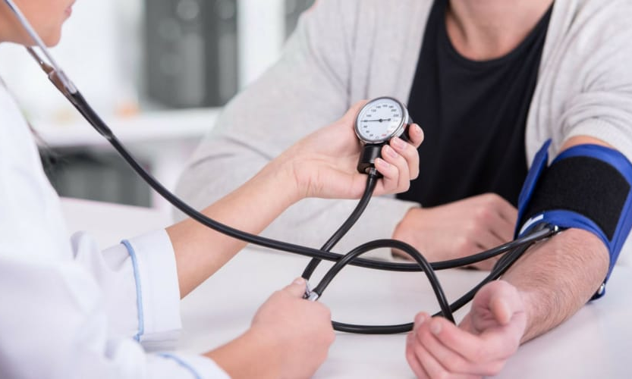
How to Protect Yourself
You may need to replace salt, but get the advice of a medical professional. Check medical reasons such as high blood pressure or heart problems. Salt tablets are not recommended. Instead, eat lightly salted foods. Start doing this before entering the hot work environment, to give the body a chance to adjust its balance of salt.
Dress lightly. Choose fabrics which let moisture and heat escape. Dress in layers so that you can peel off outerwear needed in the cooler morning air as the day progresses. Shade the skin with clothing and wear a hat in the sun.
Watch for heat stress in yourself and your fellow worker. If you suspect heat stroke, call for medical aid immediately.
Notes:
How to Protect Yourself
Follow safe speed limits – Drive only fast as you can comfortably walk. Forklifts can’t travel safely at high speeds. Without loads, they aren’t weighted and are especially unstable.
Keep the load low – While moving, forks should be low, with the mast tilted slightly back.
Maintain good visibility – If a load blocks forward vision, drive backwards.
Watch the slope – Back down slopes that have an incline greater than10 percent. Make sure your back up alarm is working properly.
Never carry hitchhikers – They are unsecured and can easily fall off and be injured.
Leave aisle room – Allow space for pedestrian and other traffic. Be alert at intersections. Honk your horn before and while you enter an intersection, even if it doesn’t appear to be busy.
Park safely – On a hill, always block the wheels, lower forks and set the parking brake.

Slide 8

Final Word
Remember that heat stoke is a serious medical emergency. It can be fatal!
Notes:
Final Word

