Slide 1

Haga clic para comenzar ...

Slide 2



Fundamentos de Primeros Auxilios: Sangrado, Cortes y Heridas
Notes:
Fundamentals of First Aid - Bleeding, Cuts, and Wounds

Slide 3
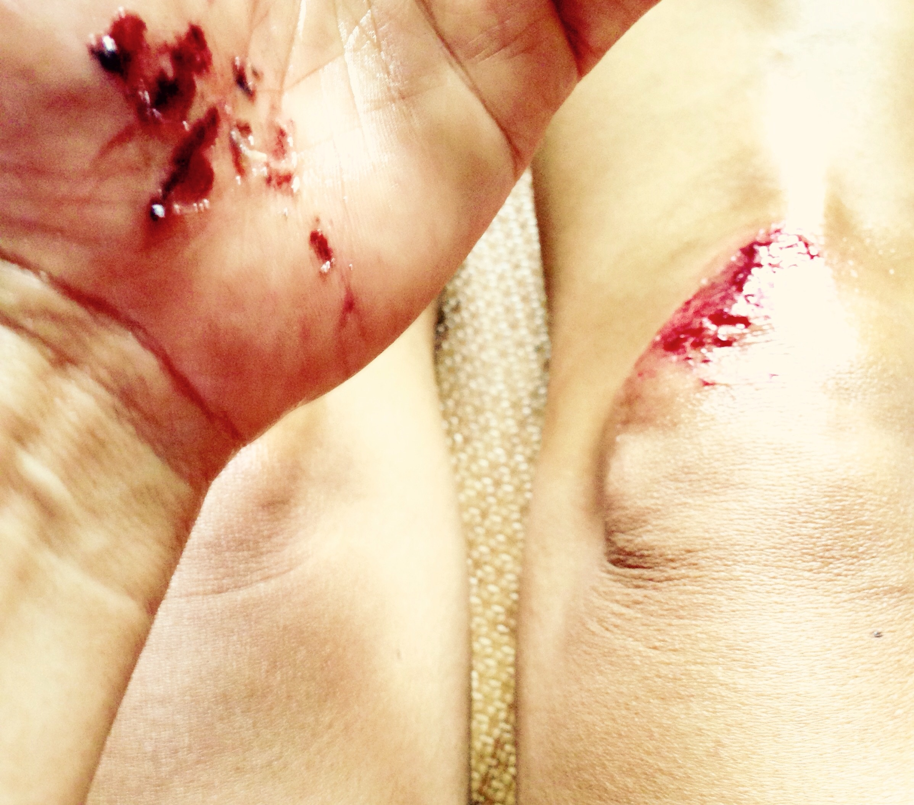
¿Qué está en Riesgo?
El sangrado es la respuesta del cuerpo a la piel, los huesos y el daño a los órganos.
El sangrado excesivo puede causar shock y muerte.
Síntomas de shock: piel fría y húmeda, pulso debilitado, pérdida de la conciencia.
Incluso la pérdida moderada de sangre puede hacer que una persona se maree o tenga náuseas.
Notes:
What’s at Stake?
When your skin is cut, pierced or scraped, blood vessels in the area are damaged or opened. This causes you to bleed. Bleeding is the body’s response to damage to skin, bone or internal organs.
For the skin damage, bleeding helps to clean out a wound and blood starts to clot which closes the skin again. However, sometimes the damage to the blood vessels in the skin, or other body part is so large, there may be excessive bleeding. This can cause the body to go into shock or to lose so much blood the person dies.
If a person is bleeding profusely, be on the lookout for symptoms of shock. Cold, clammy skin, a weakened pulse, and loss of consciousness can all indicate that a person is about to go into shock from blood loss. Even in cases of moderate blood loss, the bleeding person may feel lightheaded or nauseous.

Slide 4
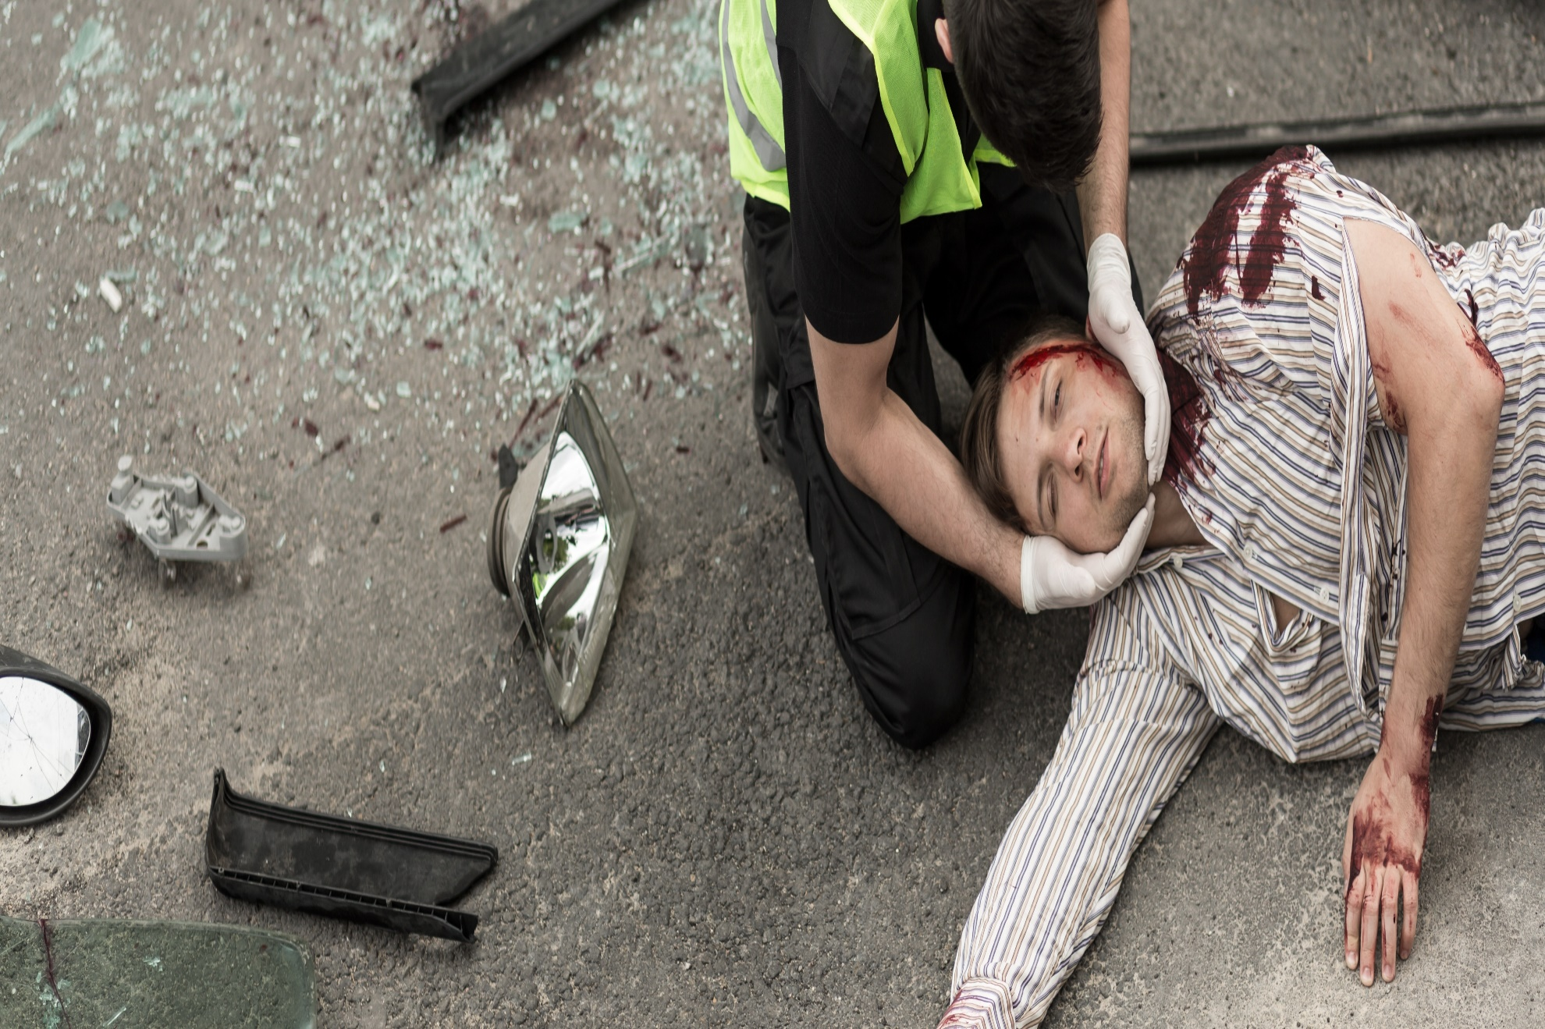
¿Cuál es el Peligro?
Las lesiones graves pueden sangrar muy poco, los cortes en la cabeza, la cara y la boca pueden sangrar mucho.
Las heridas abdominales y de tórax pueden causar hemorragia interna y shock.
Si sospecha un sangrado interno, llame al 911 lo antes posible.
Notes:
What’s the Danger?
You can’t always see how serious a cut or wound is just by the amount it bleeds. Serious injuries can bleed very little, but cuts on the head, face, and mouth often bleed a lot. This is because those areas contain a lot of blood vessels.
Abdominal and chest wounds can be quite serious. This is because internal organs may be damaged. This can cause internal bleeding as well as shock.
Before you begin to treat an injury, you should identify its severity as best you can. If you suspect that there’s internal bleeding or if there’s an embedded object surrounding the site of the injury, immediately call 911 or your local emergency services.

Slide 5
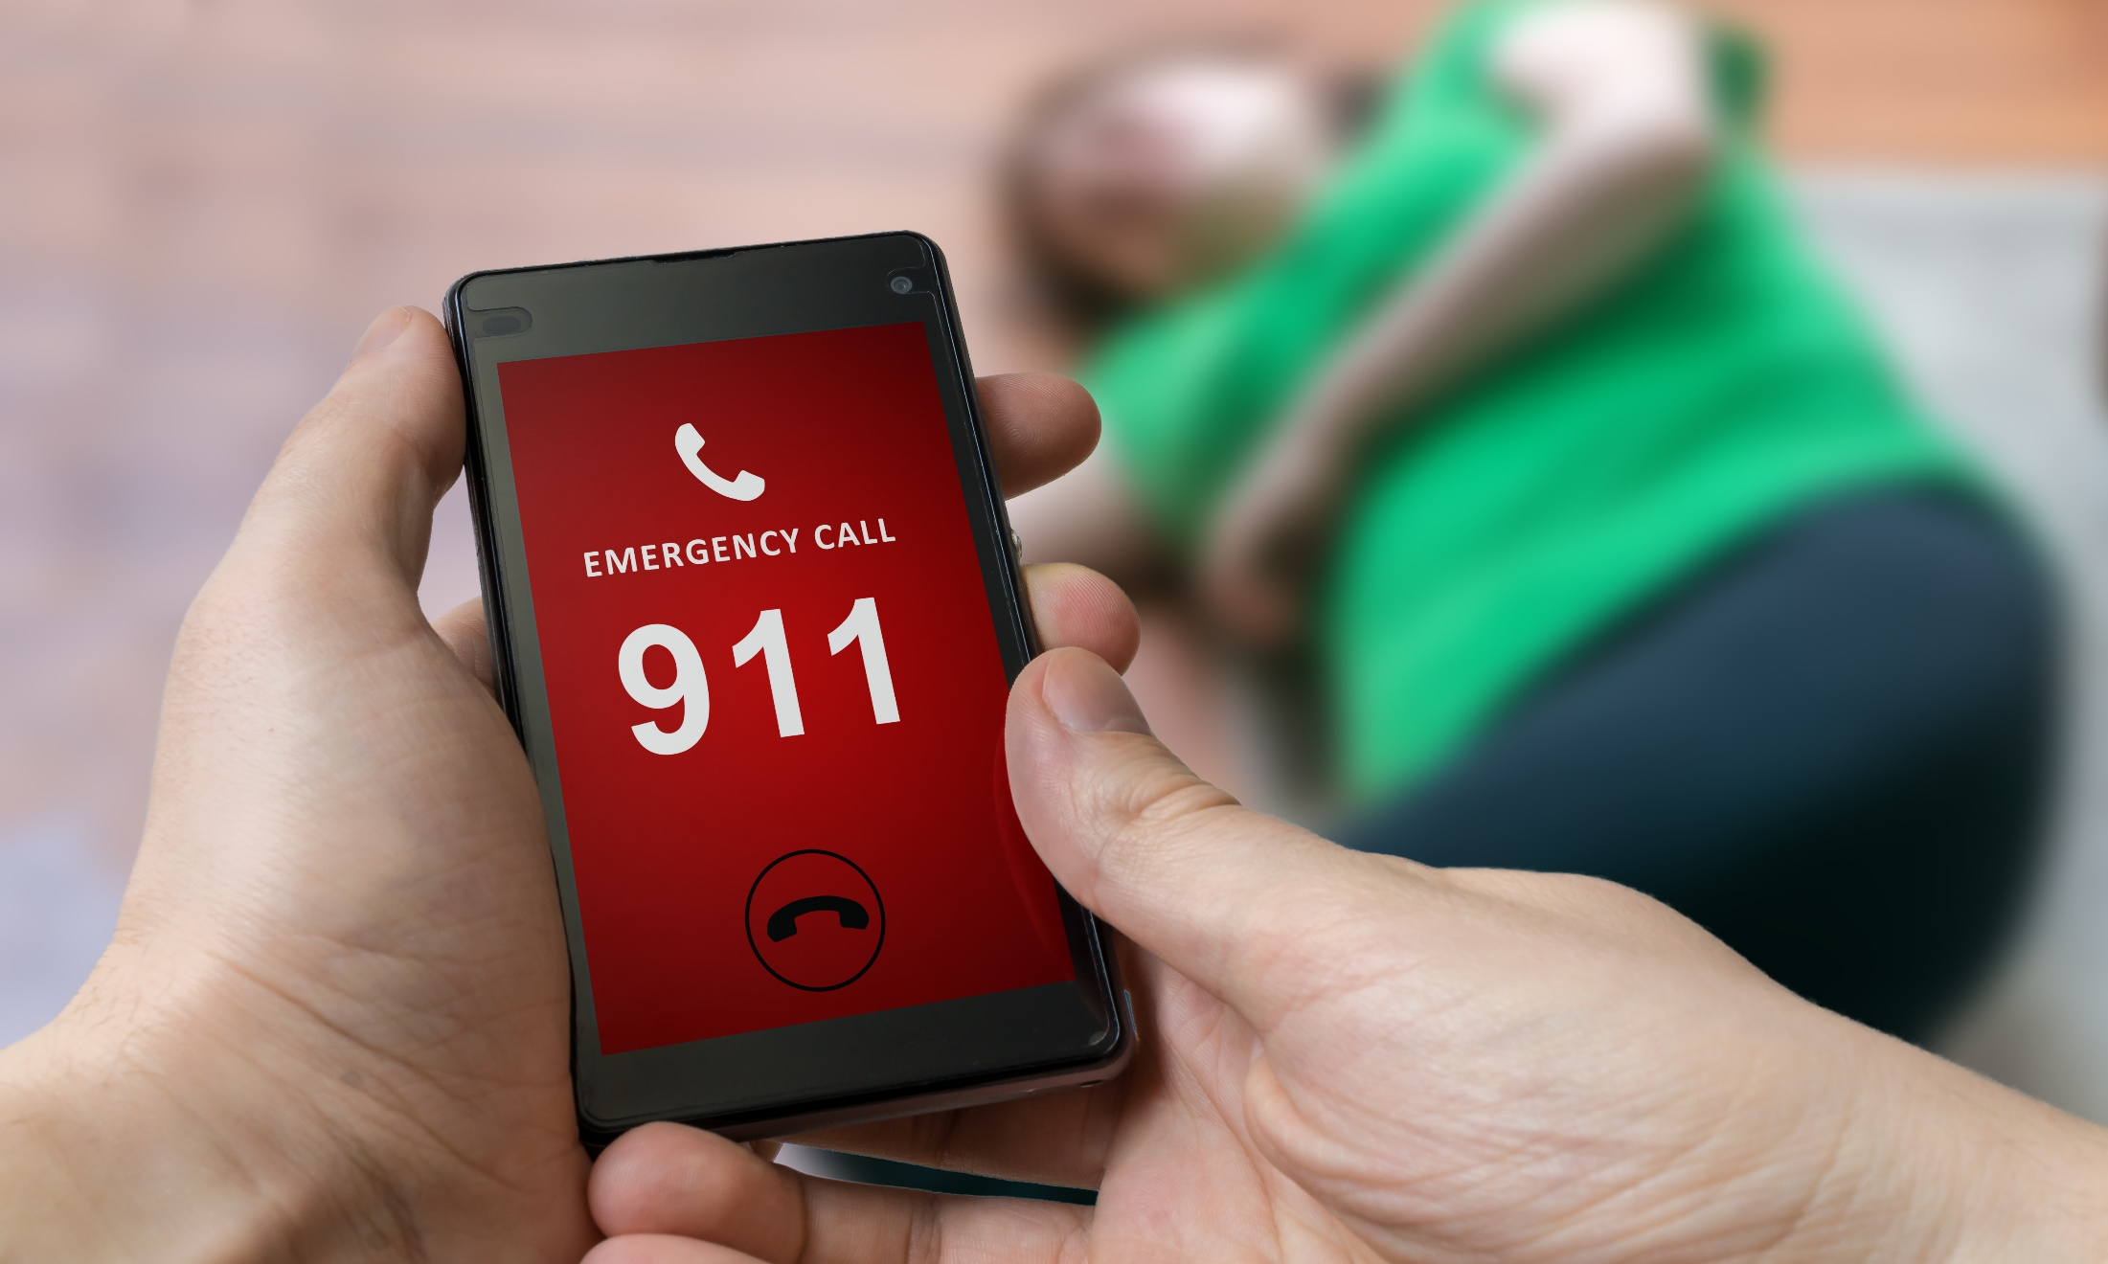
Como Protegerse
Seguridad Primero
Llama al 911
Evaluar la seguridad en la escena
Ponte EPP
Disparador 911
Sangrado severo o interno
Abdominal / herida en el pecho
El sangrado no se detiene
Incierto si EMS necesitaba
Notes:
How to Protect Yourself
6 easy ways to manage bleeding, cuts, and wounds
Keep yourself safe
Call 911 1st in an emergency.
Assess the scene and proceed with care only if it’s safe to do so.
Put on proper personal protective equipment (PPE) to protect yourself from blood and other potentially infectious materials (OPIM).
To call 911 or not to call
Call 911 if:
bleeding is severe;
you suspect internal bleeding;
there is an abdominal or chest wound;
bleeding can't be stopped after 10 minutes of firm and steady pressure;
blood spurts out of wound;
you are not sure if the person needs EMS care - better to be safe than sorry.

Slide 6
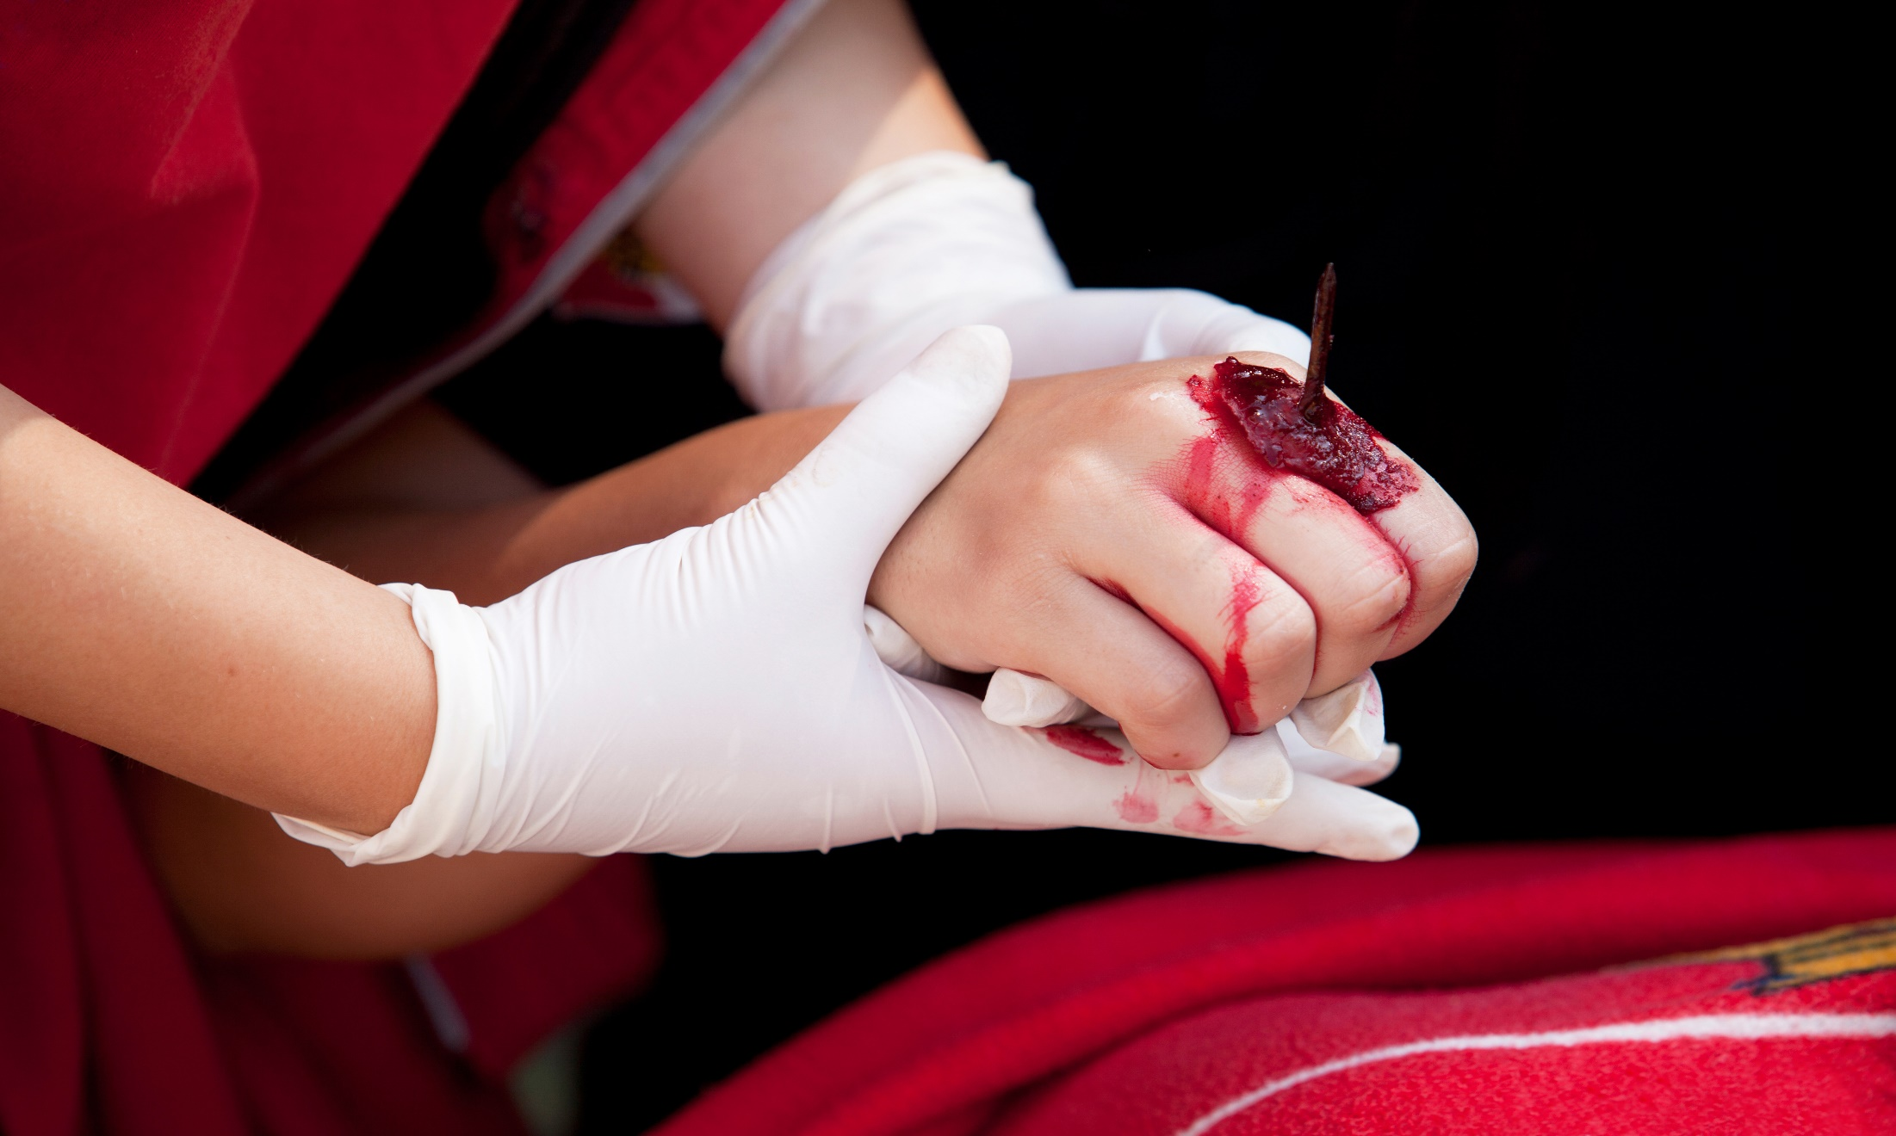
Como Protegerse
Ayudar a la víctima:
Acostarse
Mantener caliente
Mantenga la calma
Herida clara
EPP
Retire la ropa / escombros
Deje objetos grandes incrustados
No limpiar ni sondear la herida
Notes:
How to Protect Yourself
Help the injured person
Lie down.
Keep warm - cover them with rug or blanket to keep them warm.
Keep calm.
Clear the wound area
Wear disposable protective gloves if available.
Remove clothing or debris on the wound.
Leave large or deeply embedded objects.
Don't attempt to clean the wound or probe it.

Slide 7
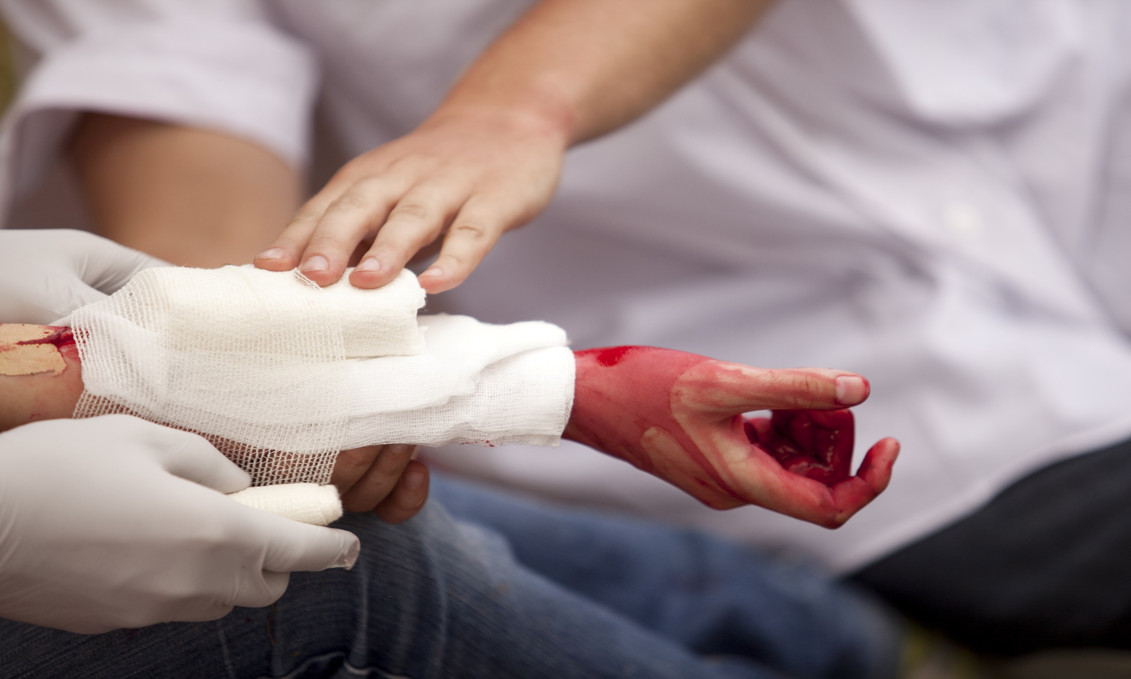
Como Protegerse
Intenta detener el sangrado
Intenta detener el sangrado
Presione el vendaje firmemente sobre la herida 10 minutos
No lo quite - ponga más tela / gasa en la parte superior
Levante las extremidades por encima del corazón
Mantener la presión y atar la herida
Sin presión directa sobre la lesión ocular / objetos incrustados
Sin torniquete sin entrenamiento
Notes:
How to Protect Yourself
Try to stop the bleeding
Put a sterile bandage, clean cloth or gauze on the wound.
Press the bandage firmly with your palm to control bleeding.
Keep the pressure on until the bleeding stops.
This takes about 10 minutes - do not be tempted to lift the bandage to check!
If blood soaks through the material, don’t remove it.
Put more cloth or gauze on top of it and continue to apply pressure.
If the wound is on the arm or leg, raise limb above the heart, if possible, to help slow bleeding.
Maintain pressure by binding the wound with a thick bandage or a piece of clean cloth and secure with tape.
Do not put direct pressure on an eye injury or embedded object.
Do not apply a tourniquet unless you have been trained.
A wrongly applied tourniquet can cause significant and lasting damage to the limb.

Slide 8
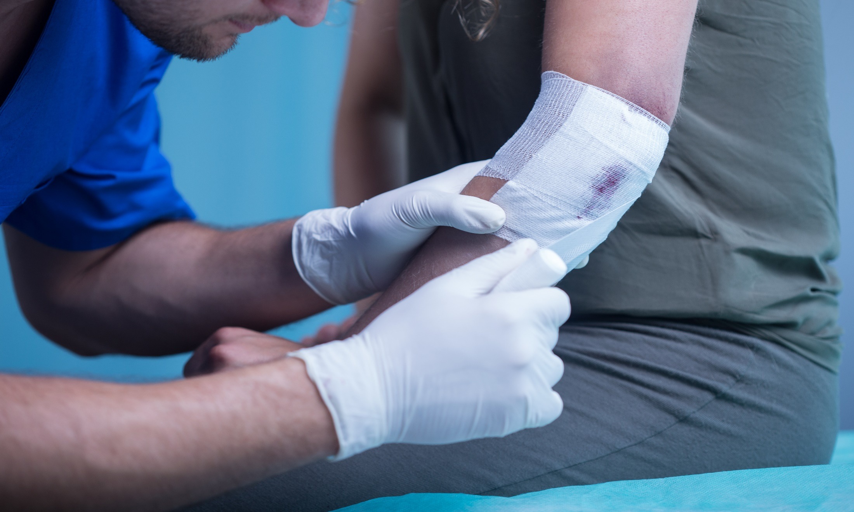
Como Protegerse
No necesitas el 911?
No necesitas el 911?
Lavar la herida
Sin yodo ni peróxido de hidrógeno
Enjuague con agua corriente
Secarlo y cubrirlo
Mantenga la herida tapada
Consulte a un médico si hay signos de infección
Notes:
How to Protect Yourself
Don’t need 911?
Wash the wound with clean, warm, slightly soapy water and a clean cloth.
Do not use iodine or hydrogen peroxide.
Rinse it well under running water to rinse any debris and soap out.
Pat it dry with the cloth and cover with a dressing.
You can use an antiseptic ointment if you wish.
Keep the wound covered with a dressing or bandage.
If the wound becomes increasingly painful, or if the area around the wound becomes hot, red and/or swollen, seek medical advice.

Slide 9
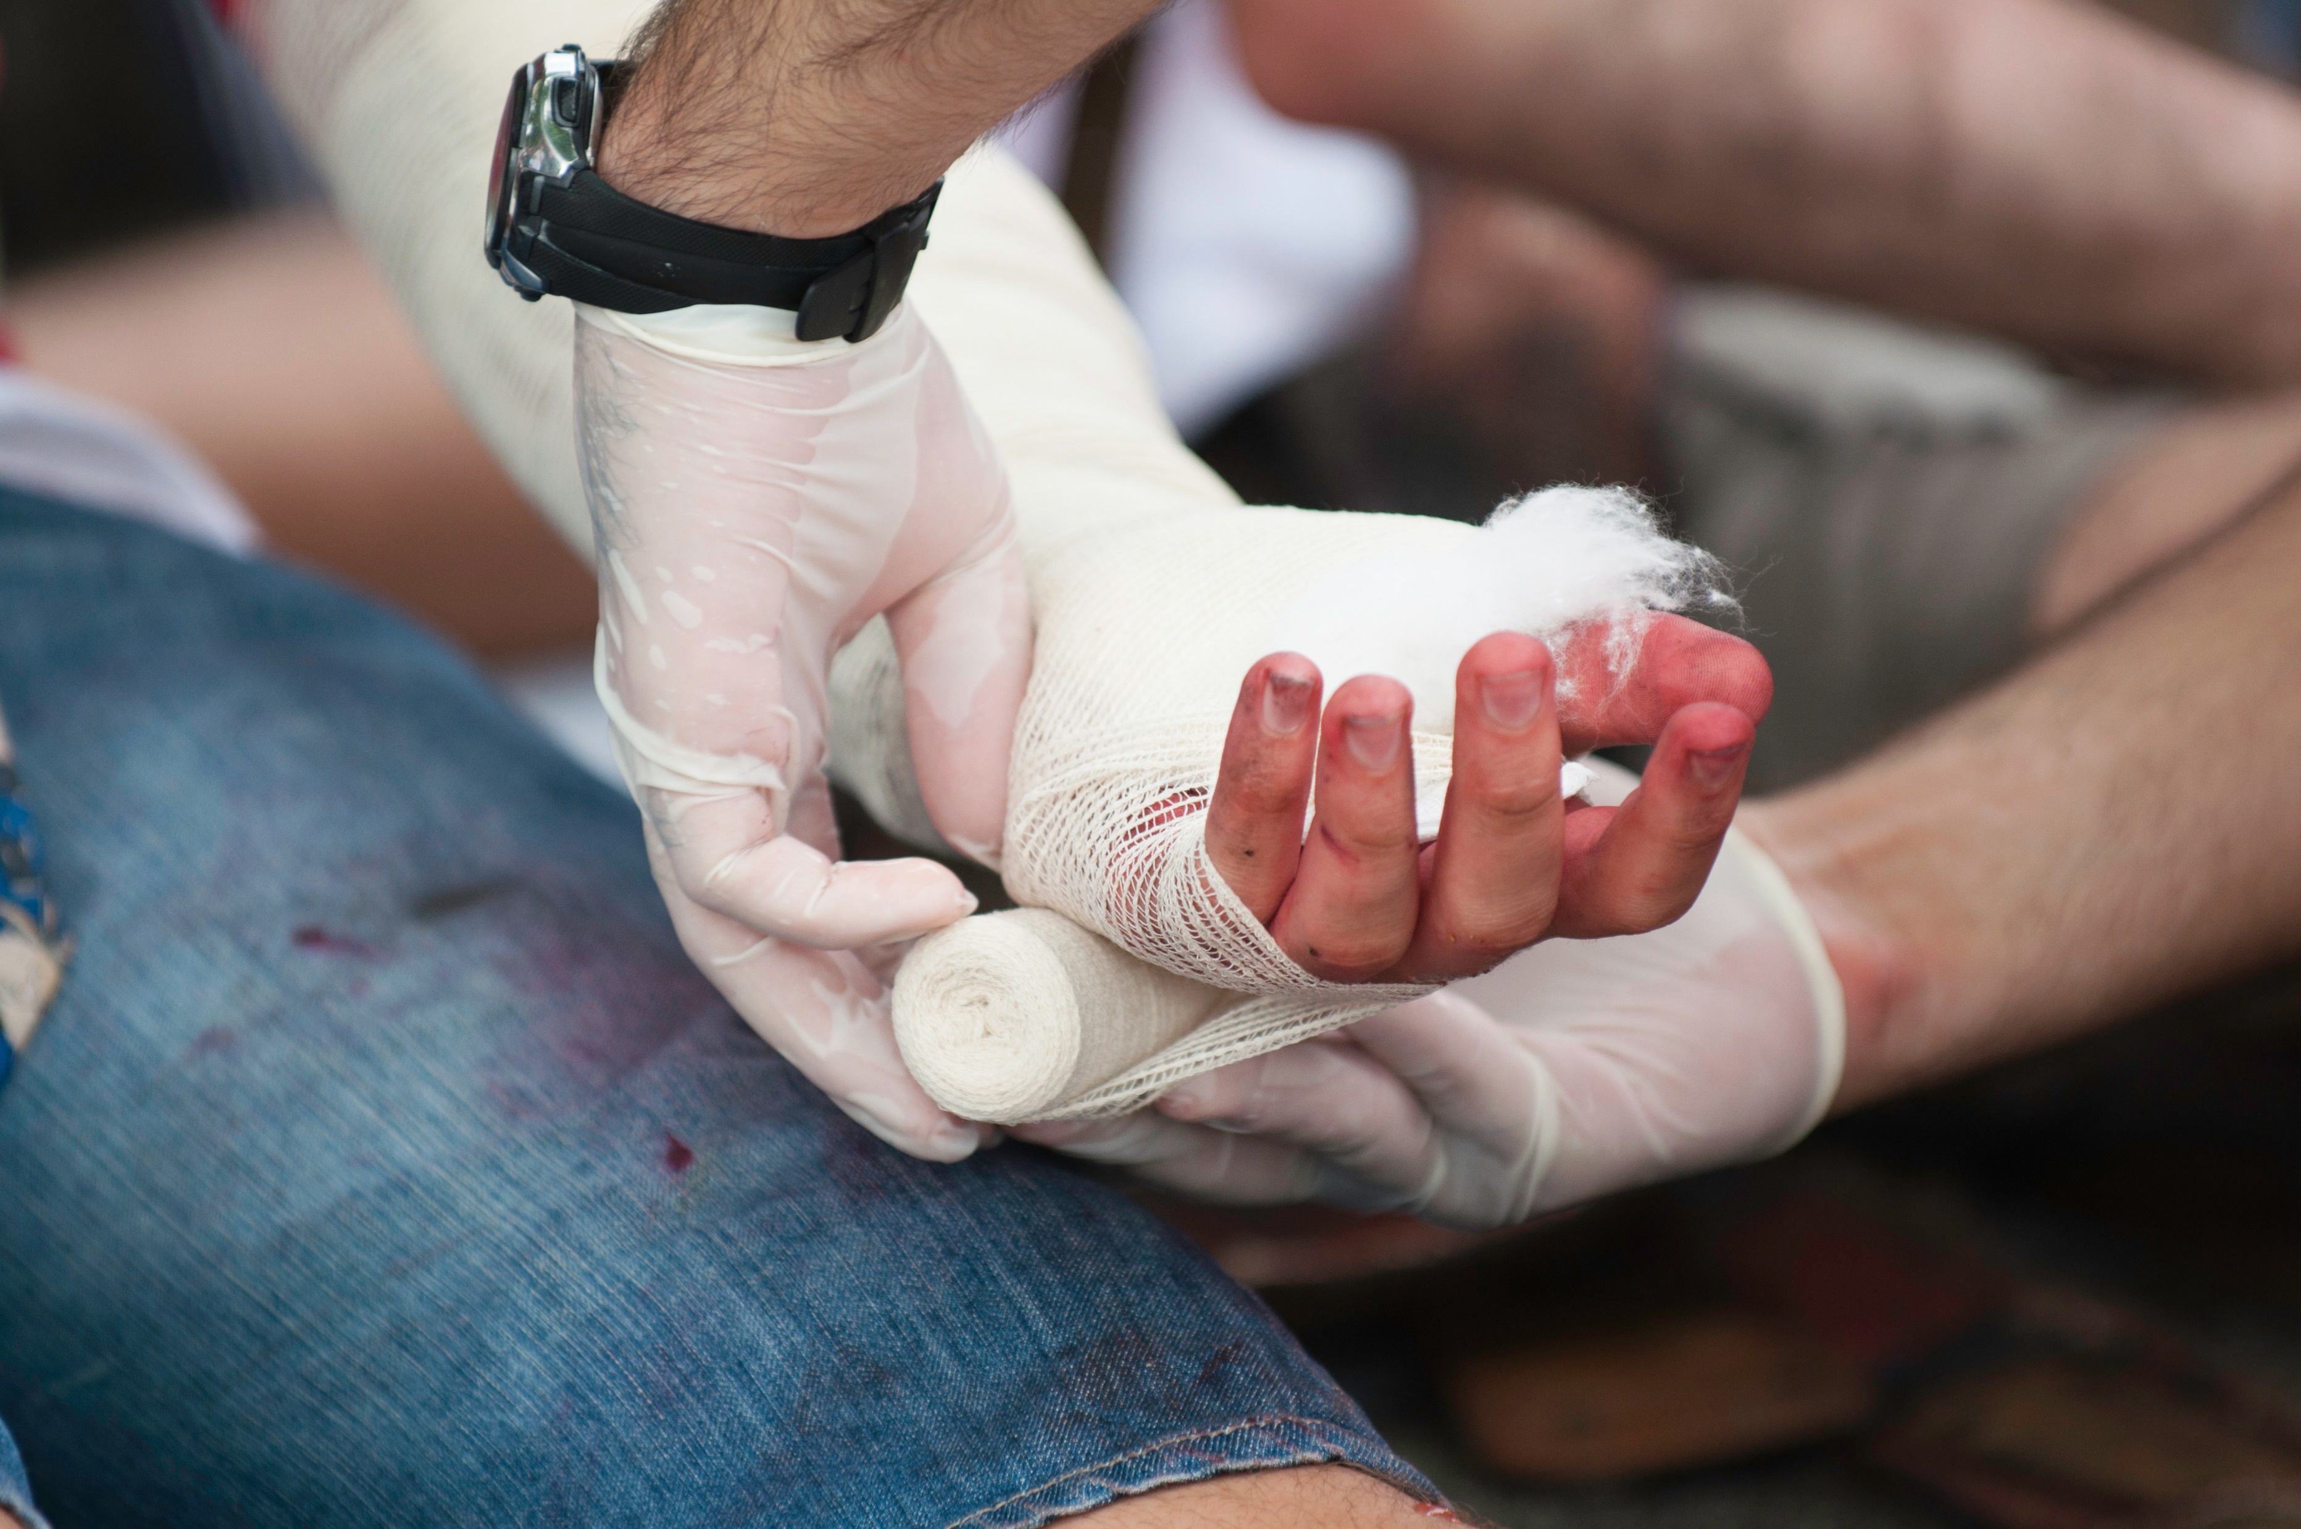
Palabra Final
Es normal que una persona sangre si sufre un corte o una herida.
Si el corte o la herida es significativo, puede provocar hemorragias graves y pérdida de sangre.
Saber cómo proporcionar primeros auxilios puede controlar la pérdida de sangre y minimizar las posibilidades de consecuencias más graves.
Notes:
Final Word
It is normal for a person to bleed if they suffer a cut or wound. However, if the cut or wound is significant this can lead to serious bleeding and blood loss. Knowing the steps to provide first aid for bleeding, cuts, and wounds can control blood loss and minimize the chances for more serious consequences.

