Slide 1

Click anywhere to get started…

Slide 2


FOOD SERVICE SAFETY
Notes:
The Basics of Forklift Safety

Slide 3
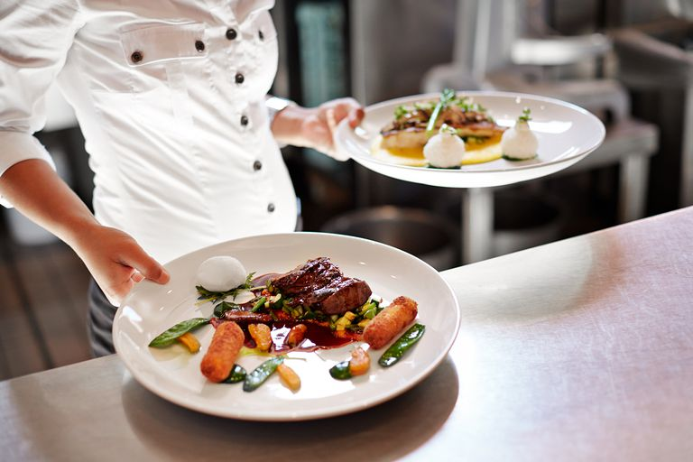
What’s at Stake?
People in food services jobs such as cooking, busing tables, and serving food are exposed to dangers that could be lethal.
Notes:
What’s at Stake?
Text here

Slide 4
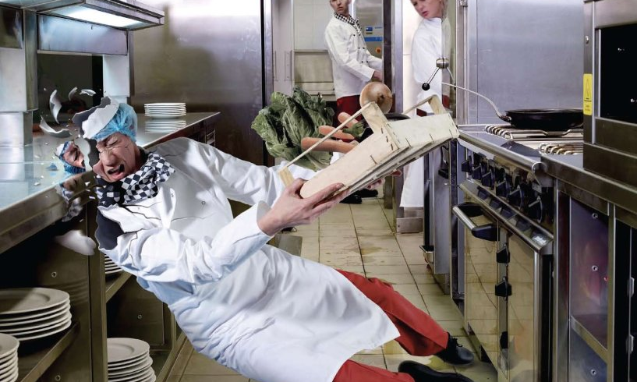
What’s the Danger?
Dangers food service workers face:
Musculoskeletal disorders (MSDs)
Cuts and abrasions
Infections
Heat
Chemicals
Slips, trips, and falls
Electricity

Slide 5
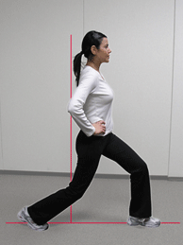
How to Protect Yourself
Hi–lites of preventative care.
Musculoskeletal disorders (MSDs)
Come from sitting or standing too long, or from repeated motion such as reaching or lifting.
To protect yourself, don’t lift heavy or awkward objects and don’t lift above your shoulders. If you work sitting down, get up and move around; stretch and exercise your muscles.
Notes:
How to Protect Yourself
Machines of every description have standard operating procedures which include a “checklist” for its safe operation. Forklifts are no exception. There are procedures and protocols for the safe and effective use of the forklift.
These operating procedures are rooted out of common sense but are too often ignored or forgotten.

Slide 6
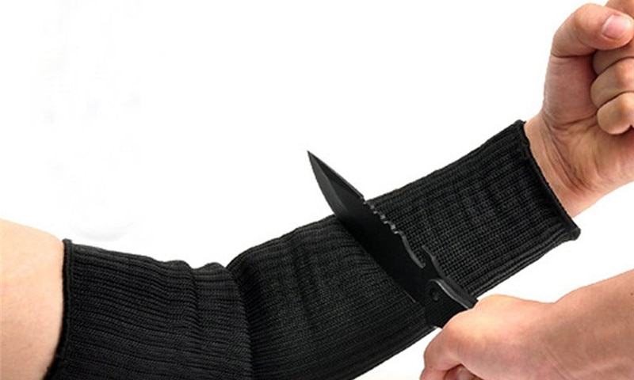
How to Protect Yourself
Cuts and abrasions: Workers shouldn’t use knives, appliances and other tools without proper training. Use steel-mesh gloves when working with knives.
Infections: If you get a serious cut or other injury, stay home until it’s healed. Cover cuts or injuries with a clean, waterproof dressing.
Heat: Workers in busy kitchens are at risk for burns and scalds. Wear long-sleeved gloves, aprons or other Food Service Safety clothing when working near hot items or hot liquids.
Notes:
How to Protect Yourself
Follow safe speed limits – Drive only fast as you can comfortably walk. Forklifts can’t travel safely at high speeds. Without loads, they aren’t weighted and are especially unstable.
Keep the load low – While moving, forks should be low, with the mast tilted slightly back.
Maintain good visibility – If a load blocks forward vision, drive backwards.
Watch the slope – Back down slopes that have an incline greater than10 percent. Make sure your back up alarm is working properly.
Never carry hitchhikers – They are unsecured and can easily fall off and be injured.
Leave aisle room – Allow space for pedestrian and other traffic. Be alert at intersections. Honk your horn before and while you enter an intersection, even if it doesn’t appear to be busy.
Park safely – On a hill, always block the wheels, lower forks and set the parking brake.

Slide 7
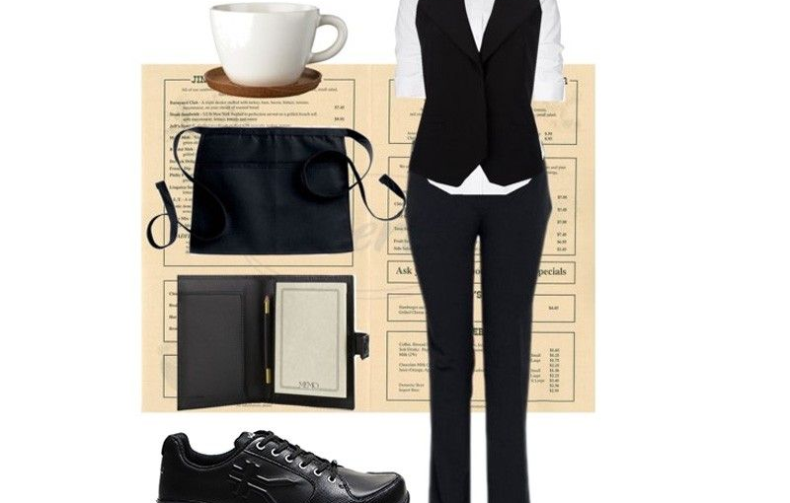
How to Protect Yourself
Chemicals: Cleaning solutions used to clean equipment can cause skin irritation, burns and respiratory problems. Read directions on all cleaning products before use and use protective equipment.
Slips, trips and falls: Make sure to wear proper work shoes. Keep floors and walkways clean and clutter-free.
Electricity: Make sure to turn off or unplug machinery before cleaning, and lock/tag out power at the breaker, if possible. Report loose or frayed wires inmediately.
Notes:
How to Protect Yourself

Slide 8
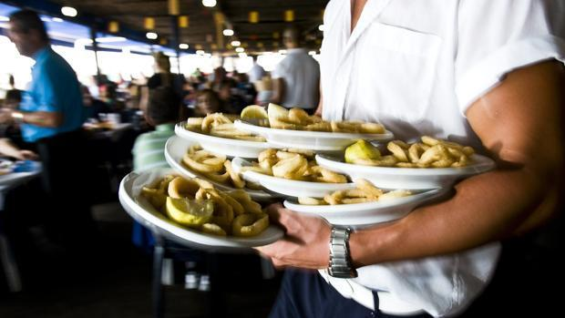
Final Word
Food service work is sometimes hard, but it doesn’t have to be dangerous. With care and attention, you can stay safe and injury-free at work — and in your own kitchen.
Notes:
Final Word

