Slide 1

Click anywhere to get started…

Slide 2
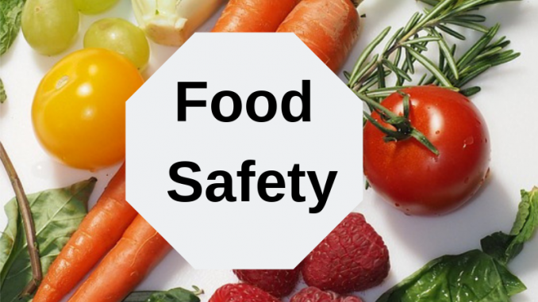

FOOD SAFETY: BEST BEFORE LUNCHTIME
Notes:
The Basics of Forklift Safety

Slide 3
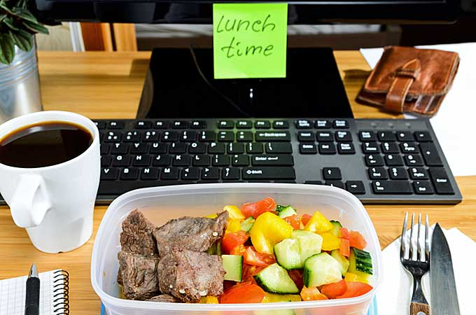
What’s at Stake?
Where did you store your lunch until lunch time?
Notes:
What’s at Stake?
Text here

Slide 4
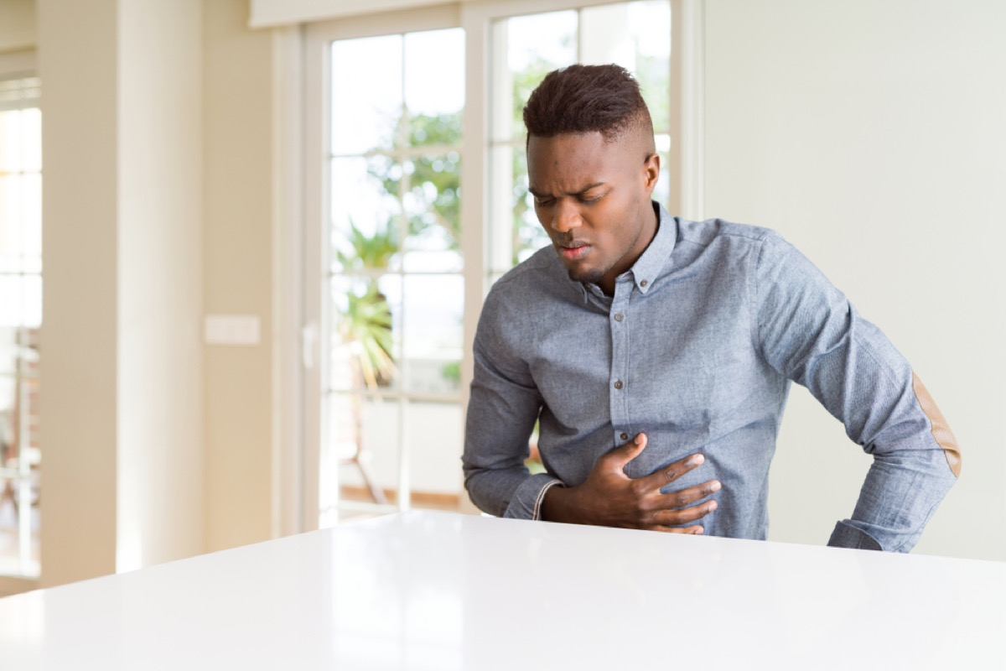
What’s the Danger?
Reasons for following food safety guidelines include hepatitis A, campylobacter, salmonellosis, botulism, Norwalk, E. coli, Yersiniosis and Listeria.
Safe food handling prevents discomfort, pain, nausea, vomiting, diarrhea, cramps, dehydration, weight loss, fever and death

Slide 5
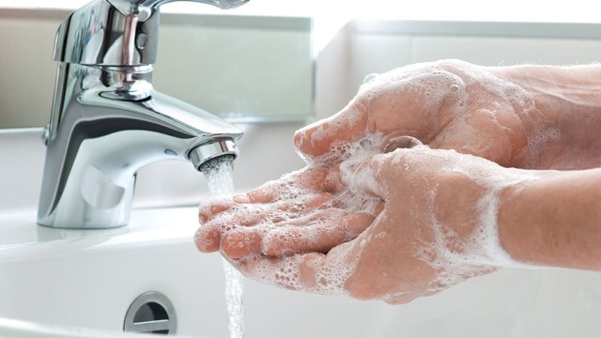
How to Protect Yourself
You have to keep hot foods hot and cold foods cold to prevent food related illnesses.
Wash your hands and clean food preparation surfaces, containers and utensils to stop the spread of foodborne diseases.
Temperature danger zones are between 40 degrees Fahrenheit (4 degrees Celsius) and 140 degrees Fahrenheit (60 degrees Celsius).
Do not eat food that has been left at room temperature for more than two hours period on warmer summer temperatures, the limit is one hour.
keep lunch foods cold in an insulated kit containing a gel freezer pack.
Pack a frozen gel pack to keep the temperature down.
Notes:
How to Protect Yourself
Machines of every description have standard operating procedures which include a “checklist” for its safe operation. Forklifts are no exception. There are procedures and protocols for the safe and effective use of the forklift.
These operating procedures are rooted out of common sense but are too often ignored or forgotten.

Slide 6
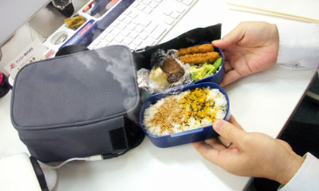
How to Protect Yourself
Hot food can be kept hot in a preheated thermal container. If you have access to a breakroom equipped with appliances, keep your food safely cold in the refrigerator.
Heat foods thoroughly in the microwave.
Do your part to keep your company’s lunchroom sanitary.
Label and date food, you leave in the refrigerator.
Get rid of outdated leftovers.
Put trash in a covered container. Help keep tables, counters and other surfaces clean and dry.
Don’t handle your lunch or utensils until you have washed your hands.
Notes:
How to Protect Yourself
Follow safe speed limits – Drive only fast as you can comfortably walk. Forklifts can’t travel safely at high speeds. Without loads, they aren’t weighted and are especially unstable.
Keep the load low – While moving, forks should be low, with the mast tilted slightly back.
Maintain good visibility – If a load blocks forward vision, drive backwards.
Watch the slope – Back down slopes that have an incline greater than10 percent. Make sure your back up alarm is working properly.
Never carry hitchhikers – They are unsecured and can easily fall off and be injured.
Leave aisle room – Allow space for pedestrian and other traffic. Be alert at intersections. Honk your horn before and while you enter an intersection, even if it doesn’t appear to be busy.
Park safely – On a hill, always block the wheels, lower forks and set the parking brake.

Slide 7
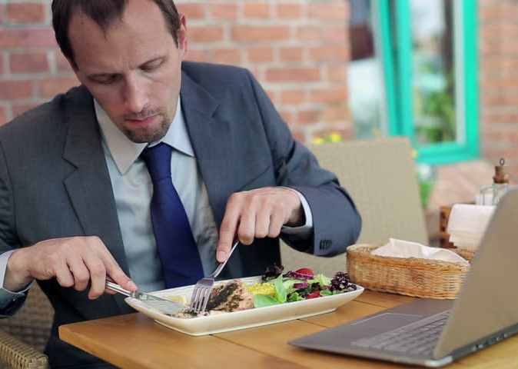
How to Protect Yourself
Safety reminders:
Shop for meats, poultry, fish and seafood last, and put them away in the refrigerator or freezer promptly when you get home. If you can’t get them home right away, keep them in a cooler in your car.
Keep raw meats separate from other food in the grocery cart, grocery bags and refrigerators. Make sure meat does not drip onto other food.
Wash fruits and vegetables under running water.
Notes:
How to Protect Yourself

Slide 8
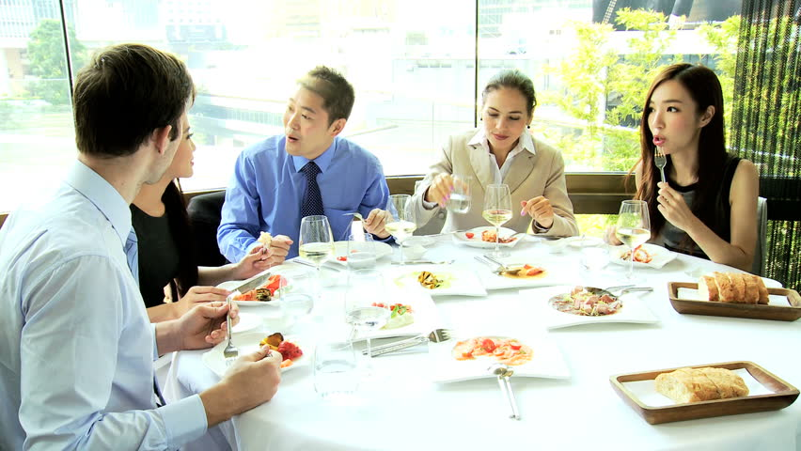
Final Word
Keep an eye on expiration dates for all your processed food products.
Notes:
Final Word

