Slide 1

Click anywhere to get started…

Slide 2
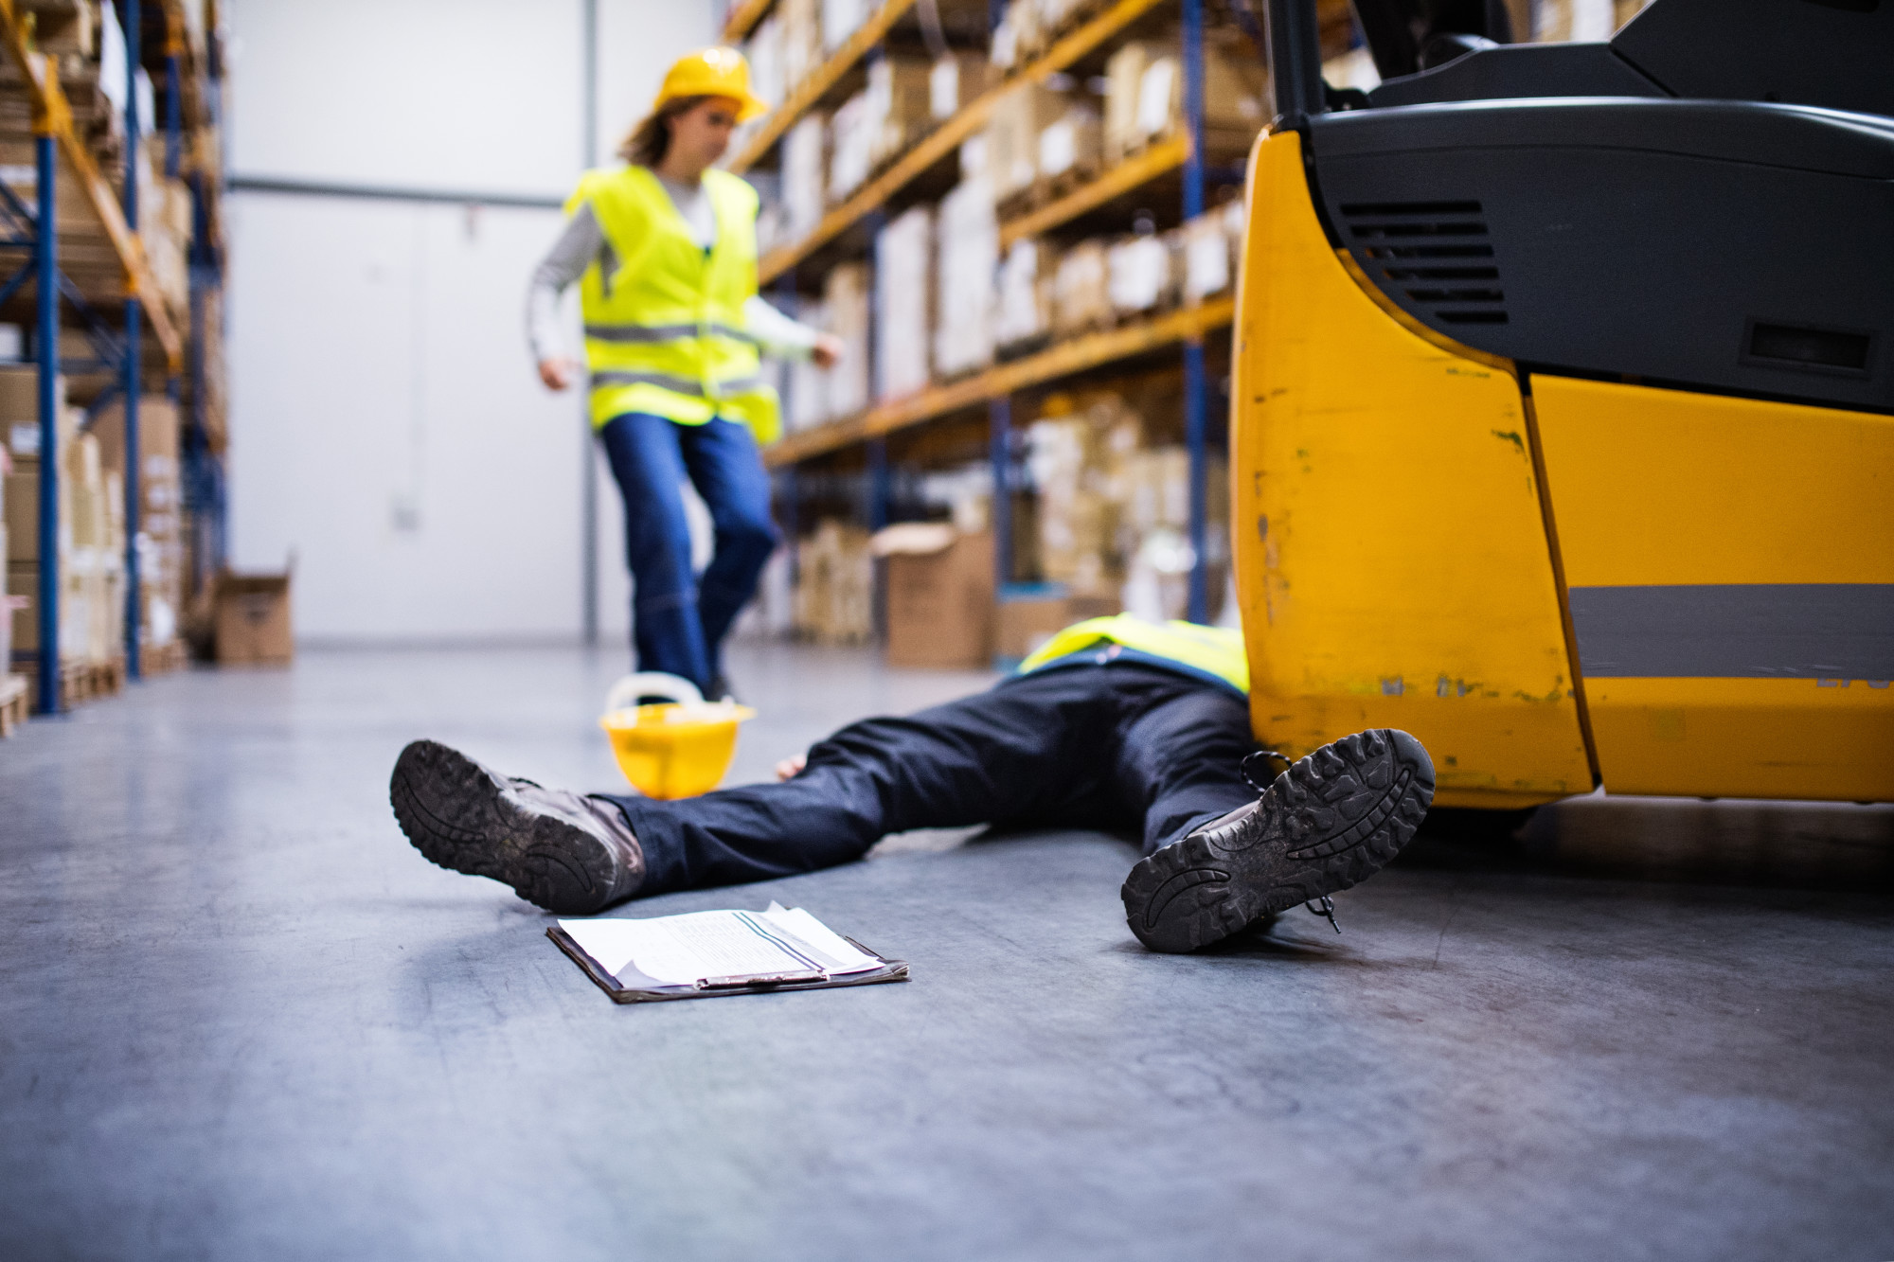

FINDING THE REAL CAUSES OF INJURIES
Notes:
The Basics of Forklift Safety

Slide 3
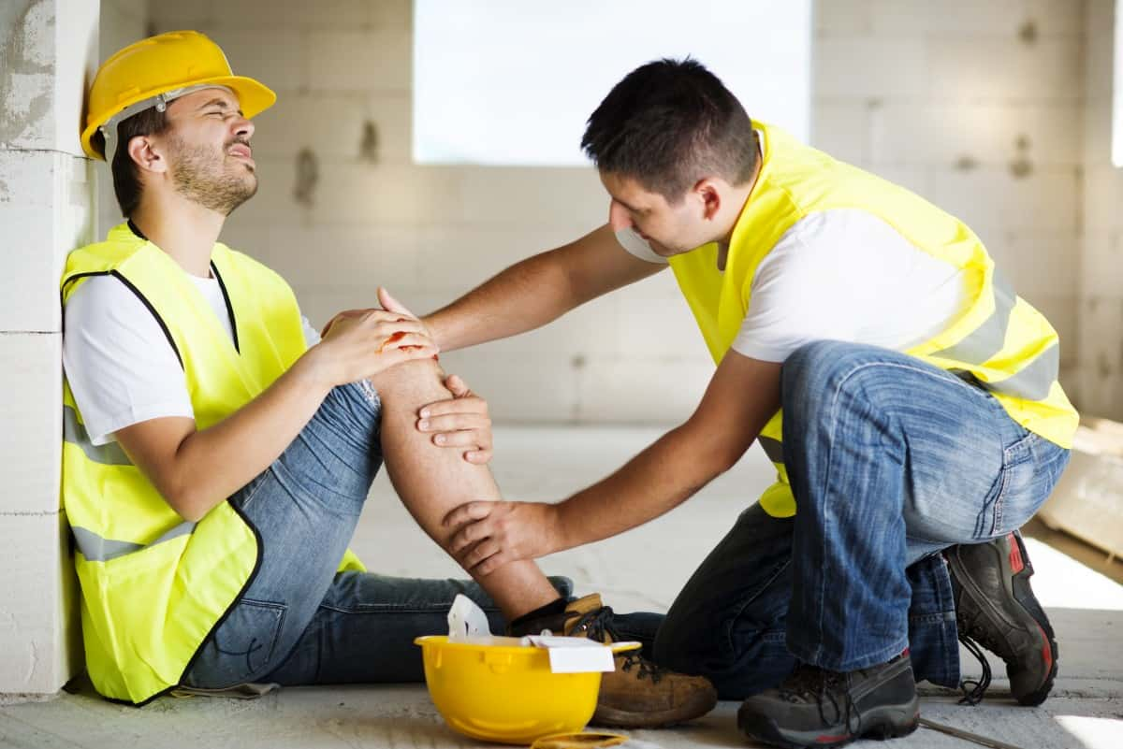
What’s at Stake?
Injuries of employees cause economic-down time, replacement costs and lower productivity.
Notes:
What’s at Stake?
Text here

Slide 4
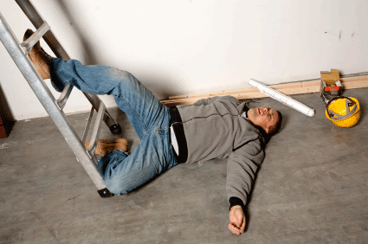
What’s the Danger?
Dangerous conditions which employees face are:
Stacking meat crates one of them fell, striking a man in the face.
Injured was painting the ceiling and the ladder fell with injured on it.
Man was assisting a crane lifting pallets. While helping to free the pallet from under a pipe, it swung free and pinned the man against another stationary pallet.
Woman was holding a locker next to the wall so it could be bolted in place. A man setting a second locker down next to the first. The second locker slipped and fell on the woman's left foot.
Notes:
What’s the Danger?
Despite the overall positive contribution of forklifts to industry, there have been times when things have gone terribly wrong.
Here are some examples:
Innocent by-standers have been pinned by the forks.
Unsuspecting workers have been run over.
Elevated loads have fallen.
Unauthorized “hitchhikers” have been crushed under wheels.

Slide 5
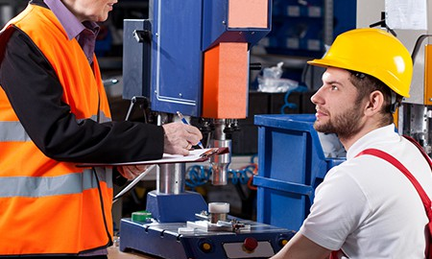
How to Protect Yourself
Three areas to delve into the examination of injury reports due to accidents.
Patterns
Attitudes
Personal responsibility
Notes:
How to Protect Yourself
Follow safe speed limits – Drive only fast as you can comfortably walk. Forklifts can’t travel safely at high speeds. Without loads, they aren’t weighted and are especially unstable.
Keep the load low – While moving, forks should be low, with the mast tilted slightly back.
Maintain good visibility – If a load blocks forward vision, drive backwards.
Watch the slope – Back down slopes that have an incline greater than10 percent. Make sure your back up alarm is working properly.
Never carry hitchhikers – They are unsecured and can easily fall off and be injured.
Leave aisle room – Allow space for pedestrian and other traffic. Be alert at intersections. Honk your horn before and while you enter an intersection, even if it doesn’t appear to be busy.
Park safely – On a hill, always block the wheels, lower forks and set the parking brake.

Slide 6
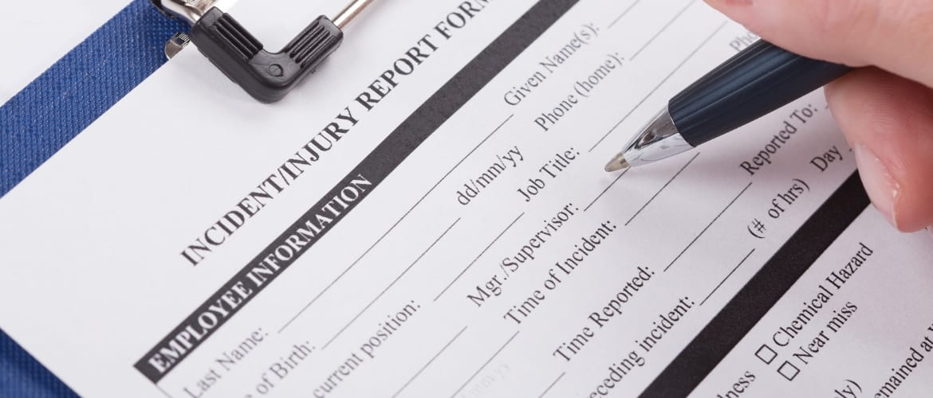
How to Protect Yourself
Safety specialists look for patterns they might see a certain type of equipment is involved in a number of injuries. They see attitudes expressed in the injury reports.
Apathy toward safety
Resentment at being told how to do a task
Risk-taking
Impatience
Notes:
How to Protect Yourself

Slide 7
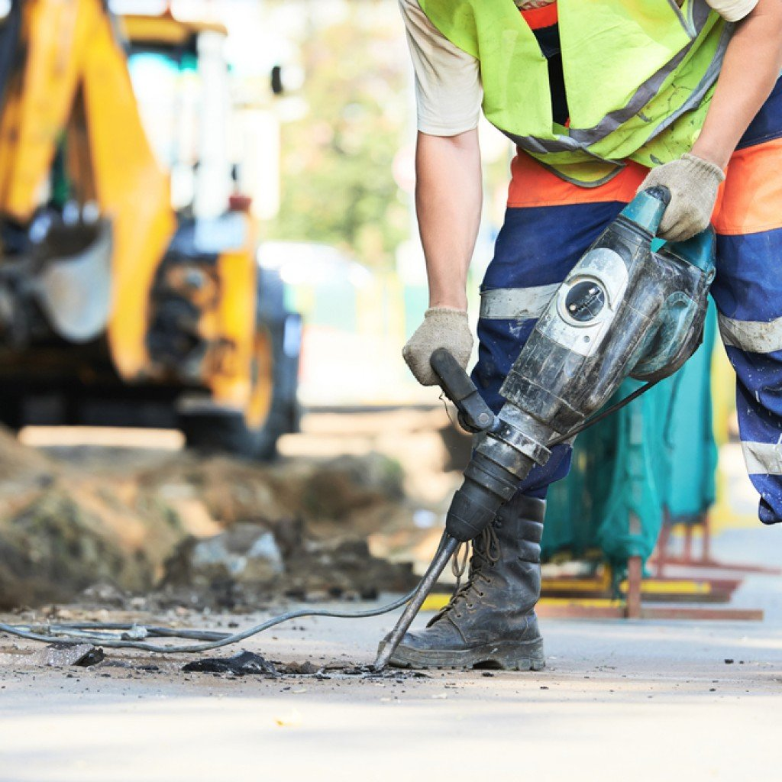
How to Protect Yourself
Look at the explanations of injuries at the beginning of this safety talk. What pattern do you see?
In every case somebody did something wrong and the objects either followed the natural laws of motion or the unintentional directions of the worker.
We ask why the object behaved as it did, and in each case, we will discover a human-made cause.
Injury incidents result because people did something wrong, or the omission of things they should have done. Some are caused by unsafe conditions or environment, but in most of these cases, the situation came about due to unsafe personal actions or omissions.
Notes:
How to Protect Yourself
Follow safe speed limits – Drive only fast as you can comfortably walk. Forklifts can’t travel safely at high speeds. Without loads, they aren’t weighted and are especially unstable.
Keep the load low – While moving, forks should be low, with the mast tilted slightly back.
Maintain good visibility – If a load blocks forward vision, drive backwards.
Watch the slope – Back down slopes that have an incline greater than10 percent. Make sure your back up alarm is working properly.
Never carry hitchhikers – They are unsecured and can easily fall off and be injured.
Leave aisle room – Allow space for pedestrian and other traffic. Be alert at intersections. Honk your horn before and while you enter an intersection, even if it doesn’t appear to be busy.
Park safely – On a hill, always block the wheels, lower forks and set the parking brake.

Slide 8
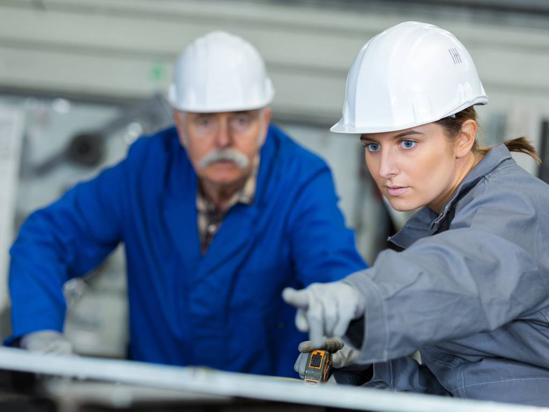
Final Word
Instead of blaming injuries on conditions or things, let's look at what people did to cause them. When we are personally responsible, we can determine what to do to prevent injuries. Get the real facts on the underlying causes into the injury reports, and the right answers can be found. And, perhaps most important of all, take a look at attitudes. They make the difference between injuries and safety.
Notes:
Final Word

