Slide 1

Click anywhere to get started…

Slide 2


TITLE HERE
Notes:
The Basics of Forklift Safety

Slide 3

What’s at Stake?
Text here
Notes:
What’s at Stake?
Text here

Slide 4
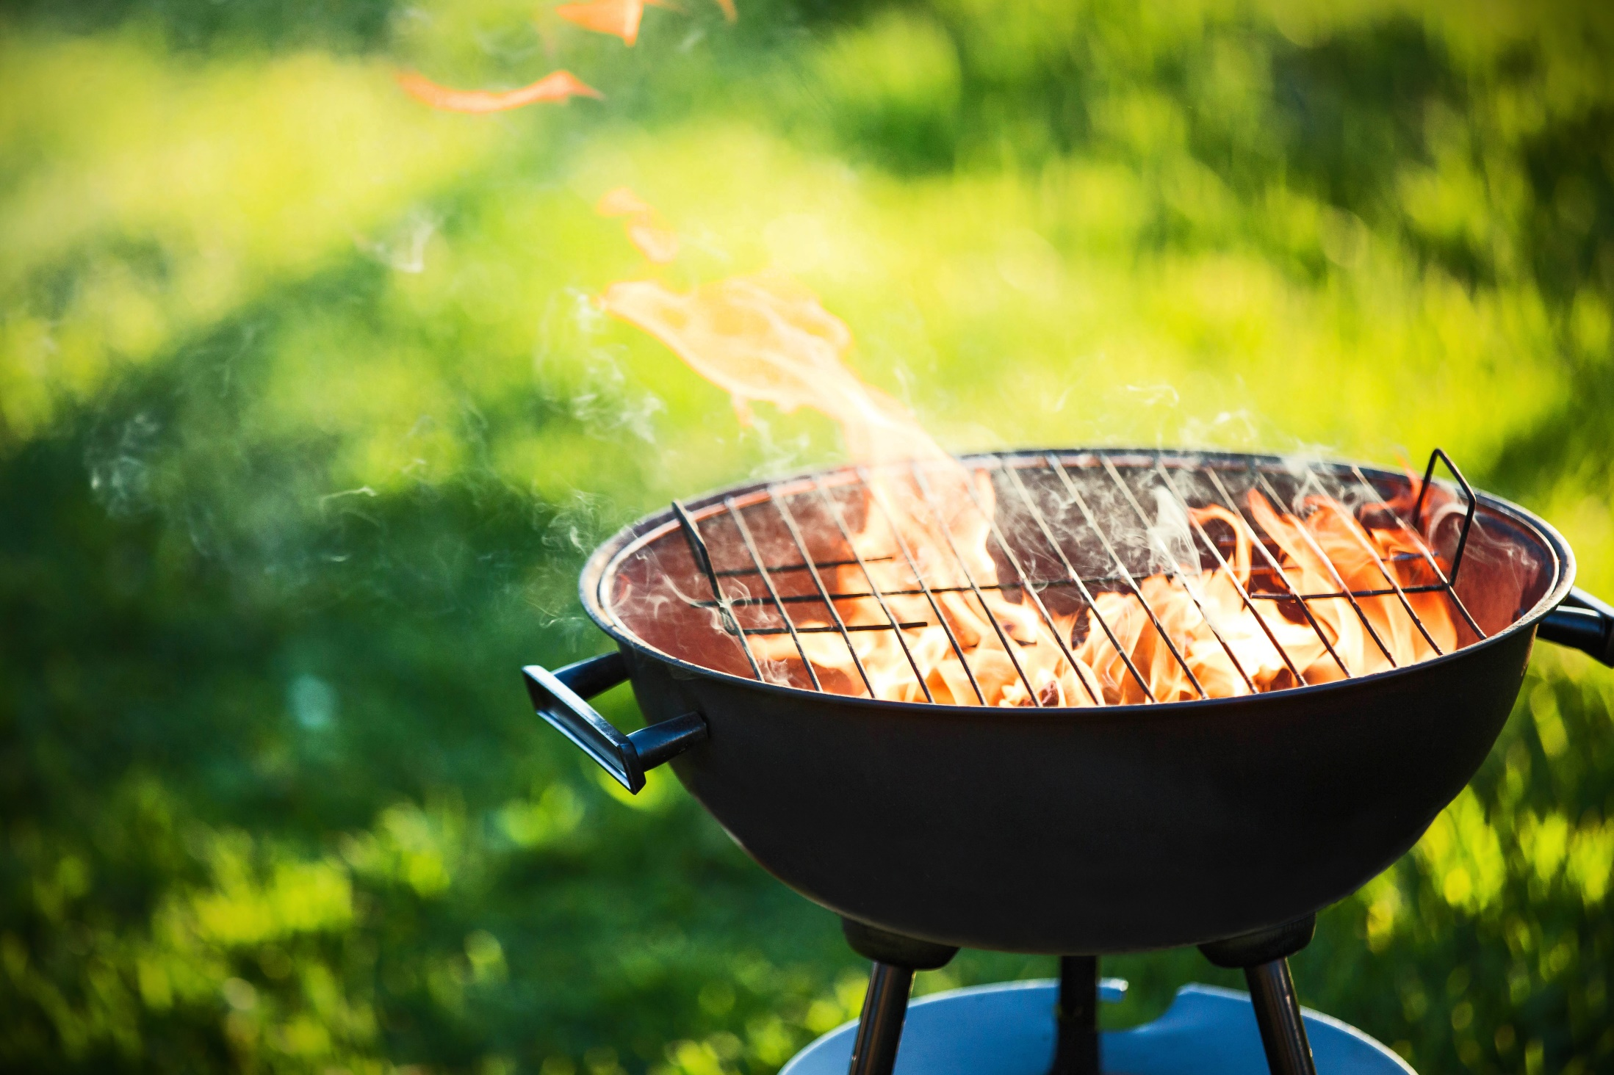
What’s the Danger?
Despite the overall positive contribution of forklifts to industry, there have been times when things have gone terribly wrong.
Examples:
Innocent by-standers pinned forks.
Unsuspecting workers run over.
Elevated loads have fallen.
Unauthorized “hitchhikers” crushed.
Notes:
What’s the Danger?
Despite the overall positive contribution of forklifts to industry, there have been times when things have gone terribly wrong.
Here are some examples:
Innocent by-standers have been pinned by the forks.
Unsuspecting workers have been run over.
Elevated loads have fallen.
Unauthorized “hitchhikers” have been crushed under wheels.

Slide 5
What’s the Danger?
Real-life incident…
A senior rig toolpusher operating a forklift discovered a hydraulic leak of the lift controller for the forks. The load was raised about 10 feet (three meters) high and he began to repair the leak. He stood under the load and was attempting to tighten the fitting when it broke completely off the hydraulic line. This caused the load to drop, trapping the toolpusher under the load. He was killed immediately.
Notes:
What’s the Danger?
Consider this real-life incident…
A senior rig toolpusher operating a forklift discovered a hydraulic leak of the lift controller for the forks. The load was raised about 10 feet (three meters) high and he began to repair the leak. He stood under the load and was attempting to tighten the fitting when it broke completely off the hydraulic line. This caused the load to drop, trapping the toolpusher under the load. He was killed immediately.

Slide 6

How to Protect Yourself
Machines of every description have standard operating procedures which include a “checklist” for its safe operation. Forklifts are no exception. There are procedures and protocols for the safe and effective use of the forklift.
These operating procedures are rooted out of common sense but are too often ignored or forgotten.
Notes:
How to Protect Yourself
Machines of every description have standard operating procedures which include a “checklist” for its safe operation. Forklifts are no exception. There are procedures and protocols for the safe and effective use of the forklift.
These operating procedures are rooted out of common sense but are too often ignored or forgotten.

Slide 7

How to Protect Yourself
Follow safe speed limits – Drive only fast as you can comfortably walk.
Keep the load low – Forks should be low, with the mast tilted slightly back.
Maintain good visibility – If a load blocks forward vision, drive backwards.
Watch the slope – Back down slopes that have an incline greater than10 percent.
Never carry hitchhikers
Leave aisle room – Allow space for pedestrian and other traffic.
Park safely – On a hill, always block the wheels, lower forks and set the parking brake.
Notes:
How to Protect Yourself
Follow safe speed limits – Drive only fast as you can comfortably walk. Forklifts can’t travel safely at high speeds. Without loads, they aren’t weighted and are especially unstable.
Keep the load low – While moving, forks should be low, with the mast tilted slightly back.
Maintain good visibility – If a load blocks forward vision, drive backwards.
Watch the slope – Back down slopes that have an incline greater than10 percent. Make sure your back up alarm is working properly.
Never carry hitchhikers – They are unsecured and can easily fall off and be injured.
Leave aisle room – Allow space for pedestrian and other traffic. Be alert at intersections. Honk your horn before and while you enter an intersection, even if it doesn’t appear to be busy.
Park safely – On a hill, always block the wheels, lower forks and set the parking brake.

Slide 8

How to Protect Yourself
Wow I never knew that stuff
Notes:
How to Protect Yourself

Slide 9

Final Word
And some final words and update the background image
Notes:
Final Word

