Slide 1

Click para comenzar…

Slide 2

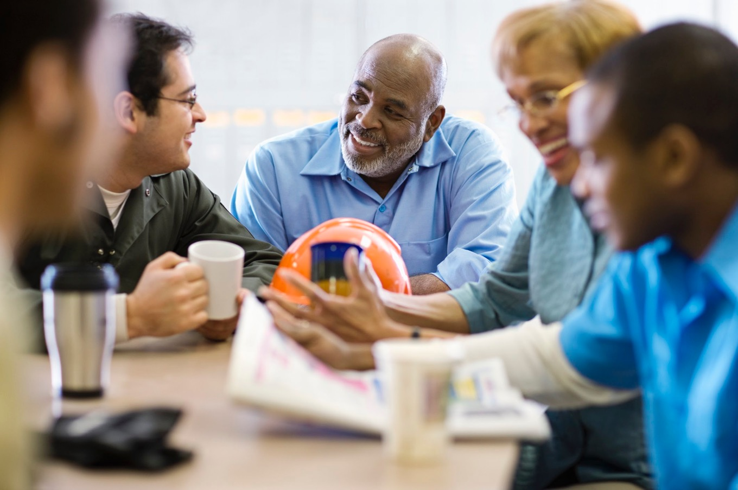

Cuidado con los Nuevos Trabajadores
Notes:
Look Out for New Workers

Slide 3
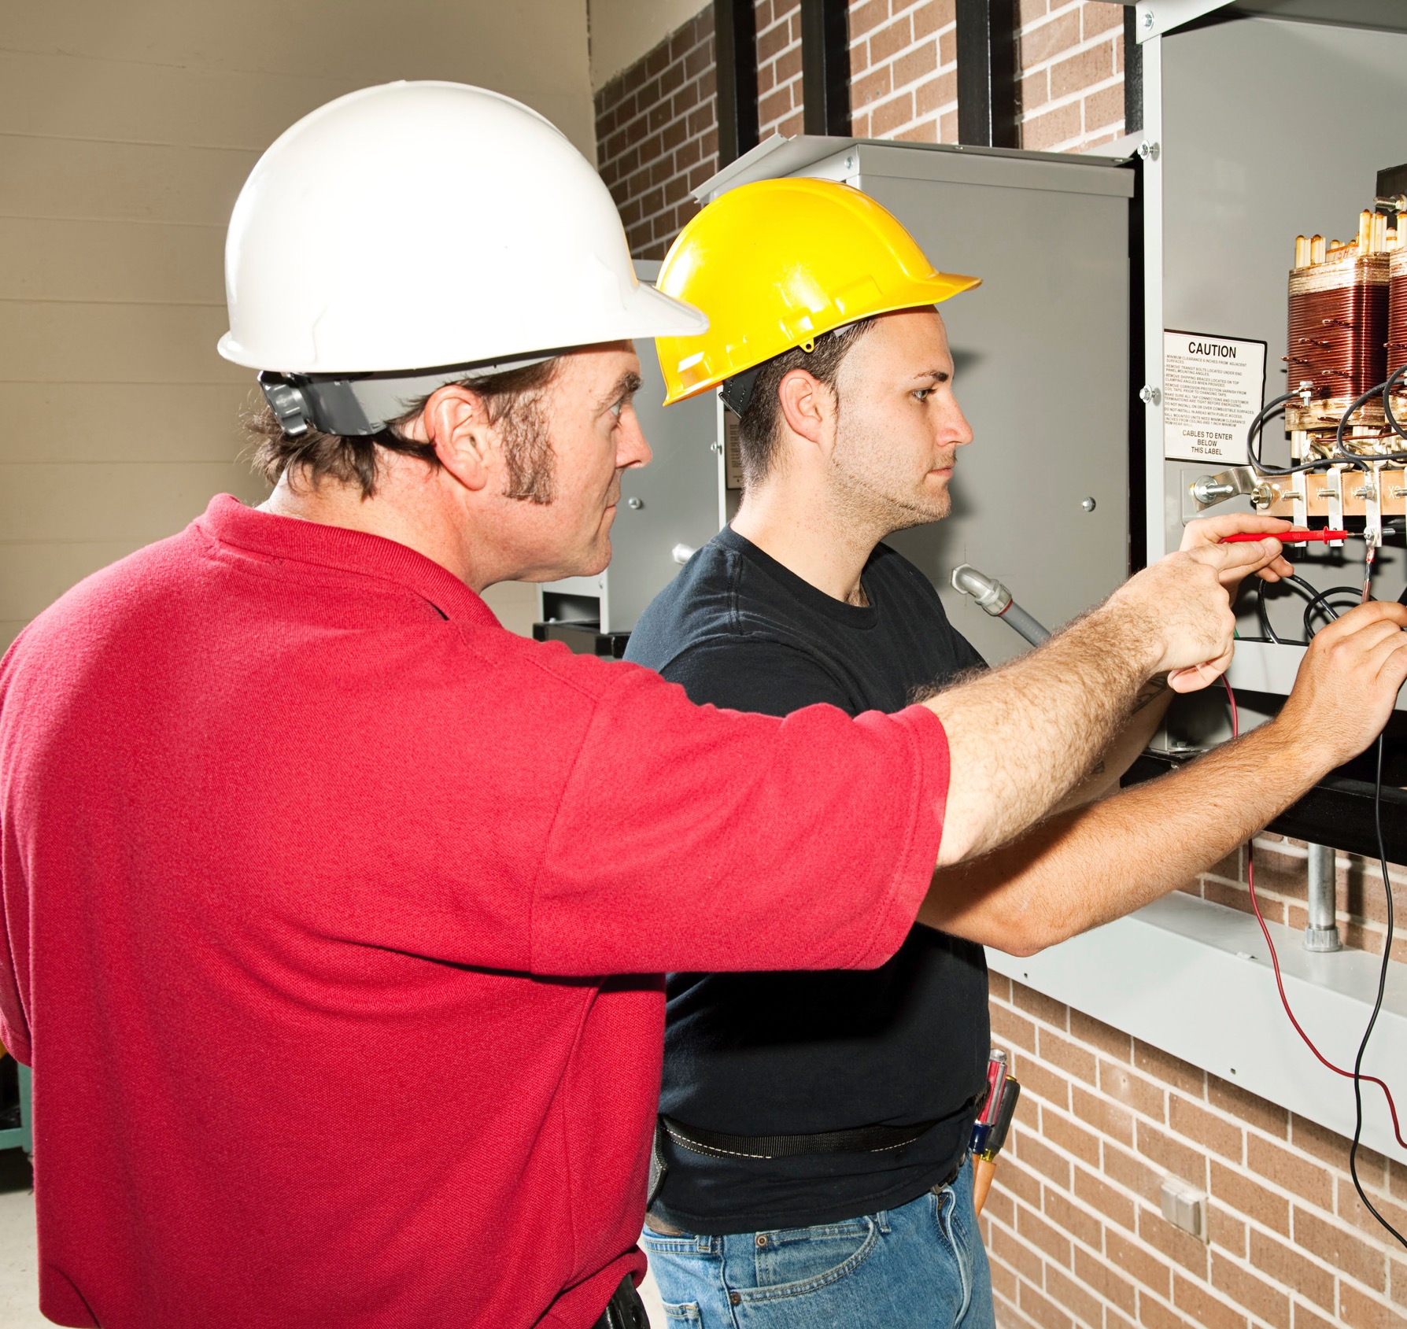
¿Qué está en Riesgo?
"No hay Yo en el Equipo".
Los deportes nos han demostrado que a menudo el éxito lo generan los jugadores que trabajan juntos por un objetivo común.
Los veteranos ayudan a los novatos a aprender tanto en los deportes como en el trabajo y los novatos lo estarán observando, ¿qué lecciones están aprendiendo?
Notes:
What’s at Stake?
You’ve likely heard the sports metaphors… “There is no I in team” … Sports has showed us that success is often generated by players working together for a common goal. And much like a team, you have veteran workers and rookies – either because of their age, their experience, in many cases, both. Veterans help the rookies learn the ropes in both sports and at work and the rookies will be watching you – what lessons are they learning?

Slide 4
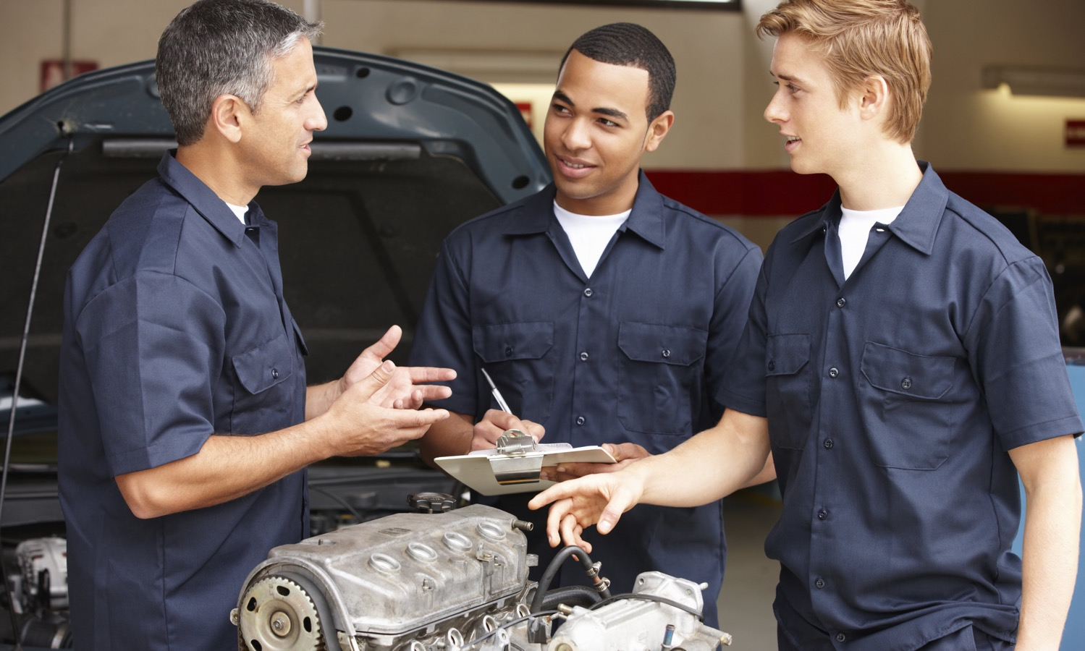
¿Cuál es el peligro?
El lugar de trabajo puede ser aterrador y lleno de peligros desconocidos para nuestros trabajadores novatos: equipos extraños, productos químicos desconocidos y tareas complicadas.
Es probable que intenten hacer todo lo posible sin pedir ayuda; esto puede conducir a errores, comportamientos riesgosos y lesiones.
Notes:
What’s the Danger?
The workplace can be scary and full of unknown hazards for our rookie workers; full of strange equipment, unfamiliar chemicals, and complicated tasks. It’s likely they are trying to do as much as they can without asking for help – and this can often lead to mistakes, risky behavior, and injuries. Consider these real-life stories…
An 18-year-old worker died after becoming entangled in a portable mortar mixer at a residential construction site. The victim was cleaning the mixer at the end of his shift to prepare it for the following day.
A 17-year-old assistant pool manager was electrocuted when she contacted an ungrounded electric motor. She was adding soda ash to the water while standing barefoot on the wet concrete floor of the pump room.
A 20-year-old carpenter was working for a construction company that was building an apartment building. While he was trying to install temporary supports for the roof trusses, he fell through the second story stairway opening and landed on the first-floor concrete walkway.

Slide 5
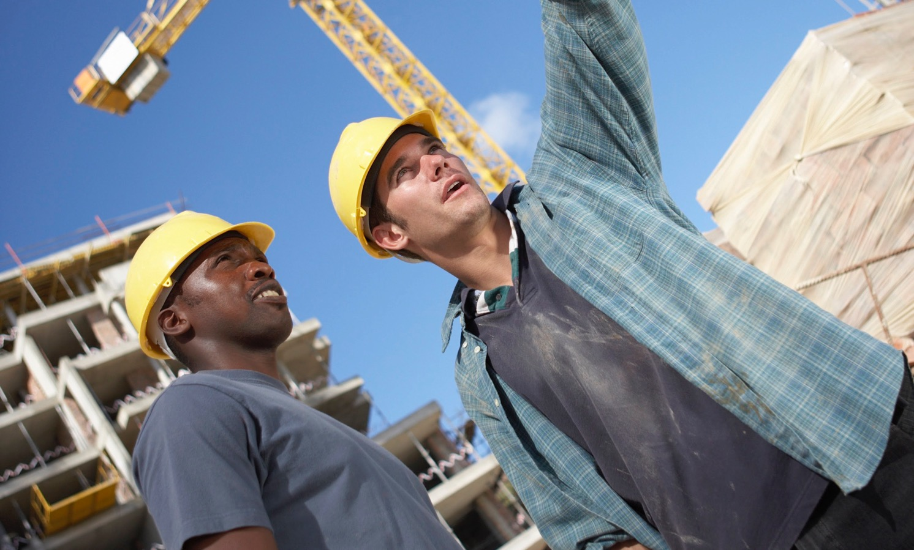
Como Protegerse
Pon un buen ejemplo.
Muéstreles dónde obtener materiales e instrucciones.
Ayudar en la elección de EPP y ajustarlo.
Recuérdeles dónde están el lavado de ojos de emergencia y la ducha de seguridad.
Notes:
How to Protect Yourself
Here are 9 ways you can help new and younger workers settle in safely with their new environment:
Set a good example by following the safety rules and procedures you’ve been trained on.
Show them where to obtain safety materials and instructions.
If they aren’t wearing the right PPE or wearing PPE in the right way, let them know and help them make it right.
Remind them where the emergency eyewash and safety shower are in your work area.

Slide 6

Como Protegerse
Ayúdelos a encontrar y leer Hojas de Datos de Seguridad.
Señale la ubicación del equipo de emergencia y los suministros de primeros auxilios.
Si ve a un trabajador novato lastimado, o si le informan acerca de una falla o lesión cercana, aliéntelos a denunciarlo.
Notes:
Help them find and read the Safety Data Sheets (SDS). It may be the first time they’ve ever had to work with them outside of their new hire training.
Point out the location of fire extinguishers, alarm boxes and other emergency equipment and first aid supplies.
They were likely told about injury reporting during their new hire training but may be fearful or embarrassed to report an injury. If you see a rookie worker get injured, or they tell you about a near miss or injury, encourage them to report it.

Slide 7
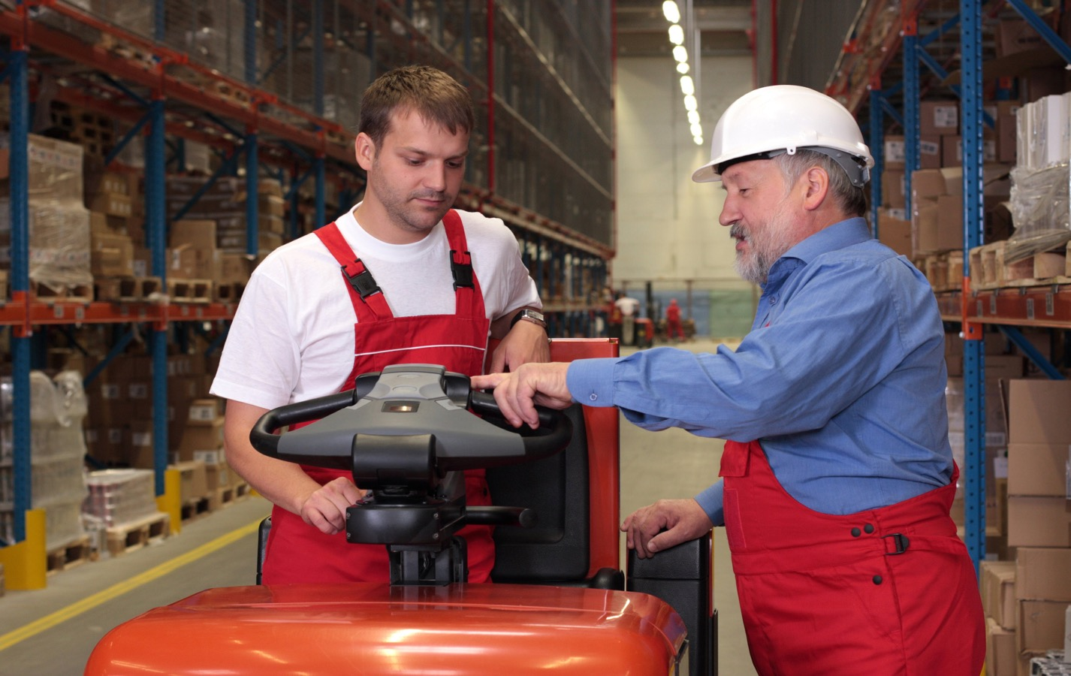
Como Protegerse
Predique con el ejemplo y demuéstreles la importancia de dejar las protecciones de la máquina en su lugar.
Finalmente, si ve a un nuevo trabajador cometiendo un "error de novato" o cualquier trabajador que hace algo inseguro, exprese su opinión.
Notes:
Lead by example and show them the importance of leaving machine guards in place to prevent accidental contact with moving equipment and stock.
Finally, if you see a new worker making a “rookie mistake” or any worker doing something unsafe, speak up.

Slide 8

Conclusión
Un consejo para un nuevo compañero de trabajo no es un reemplazo de la orientación, capacitación y supervisión de seguridad adecuada. Sin embargo, puede ayudar a asegurarse de que él o ella recoja la información necesaria para trabajar de manera segura, porque trabajar juntos de manera segura es un esfuerzo de equipo.
Notes:
Final Word
Your advice to a new co-worker is not a replacement for proper safety orientation, training and supervision. However, you can help make sure he or she picks up the information necessary to work safely, because working together safely is a team effort.

