Slide 1

Click anywhere to get started…

Slide 2



CORONAVIRUS (COVID-19) AND YOU
Notes:
WHAT YOU NEED TO KNOW ABOUT THE CORONAVIRUS (COVID-19)

Slide 3

What is it?
There are many types of human coronaviruses including some that commonly cause mild upper-respiratory tract illnesses. COVID-19 is a new disease, caused be a novel (or new) coronavirus that has not previously been seen in humans. The name of this disease was selected following the World Health Organization (WHO) best practice for naming of new human infectious diseases.
Notes:
WHAT IS IT?
A novel coronavirus is a new coronavirus that has not been previously identified. The virus causing coronavirus disease 2019 (COVID-19), is not the same as the coronaviruses that commonly circulate among humans and cause mild illness, like the common cold.
A diagnosis with coronavirus 229E, NL63, OC43, or HKU1 is not the same as a COVID-19 diagnosis. Patients with COVID-19 will be evaluated and cared for differently than patients with common coronavirus diagnosis.
On February 11, 2020 the World Health Organization announced an official name for the disease that is causing the 2019 novel coronavirus pandemic, first identified in Wuhan China. The new name of this disease is coronavirus disease 2019, abbreviated as COVID-19. In COVID-19, ‘CO’ stands for ‘corona,’ ‘VI’ for ‘virus,’ and ‘D’ for disease. Formerly, this disease was referred to as “2019 novel coronavirus” or “2019-nCoV”.
There are many types of human coronaviruses including some that commonly cause mild upper-respiratory tract illnesses. COVID-19 is a new disease, caused be a novel (or new) coronavirus that has not previously been seen in humans. The name of this disease was selected following the World Health Organization (WHO) best practice for naming of new human infectious diseases.

Slide 4
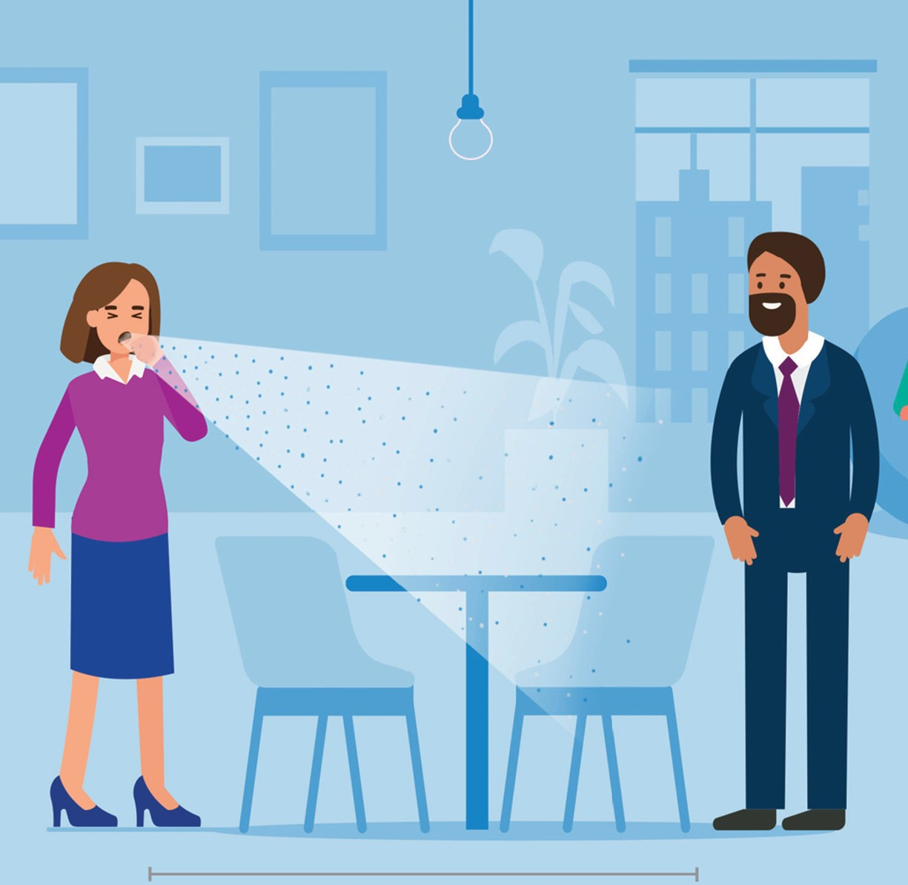
How it Spreads
The virus that causes COVID-19 spreads easily and sustainably in the community (“community spread”) in some affected geographic areas. Community spread means people have been infected with the virus in an area, including some who are not sure how or where they became infected.
The virus that causes COVID-19 is spreading from person-to-person. Someone who is actively sick with COVID-19 can spread the illness to others.
Notes:
HOW IT SPREADS
Coronaviruses are a large family of viruses. Some cause illness in people, and others, such as canine and feline coronaviruses, only infect animals. Rarely, animal coronaviruses that infect animals have emerged to infect people and can spread between people. This is suspected to have occurred for the virus that causes COVID-19. Middle East Respiratory Syndrome (MERS) and Severe Acute Respiratory Syndrome (SARS) are two other examples of coronaviruses that originated from animals and then spread to people.
The first infections were linked to a live animal market, but the virus is now spreading from person-to-person. It’s important to note that person-to-person spread can happen on a continuum. Some viruses are highly contagious (like measles), while other viruses are less so.
The virus that causes COVID-19 spreads easily and sustainably in the community (“community spread”) in some affected geographic areas. Community spread means people have been infected with the virus in an area, including some who are not sure how or where they became infected.
The virus that causes COVID-19 is spreading from person-to-person. Someone who is actively sick with COVID-19 can spread the illness to others. That is why CDC recommends that these patients be isolated either in the hospital or at home (depending on how sick they are) until they are better and no longer pose a risk of infecting others.

Slide 5

FAQ
Can someone who is quarantined spread the illness?
Quarantine means separating a person or group of people who have been exposed to a contagious disease but have not developed illness (symptoms) from others who have not been exposed, in order to prevent the possible spread of that disease.
Can the virus be spread through food?
Currently there is no evidence to support transmission of COVID-19 associated with food.
Notes:
Frequently Asked Questions
Can someone who is quarantined spread the illness?
Quarantine means separating a person or group of people who have been exposed to a contagious disease but have not developed illness (symptoms) from others who have not been exposed, in order to prevent the possible spread of that disease. Quarantine is usually established for the incubation period of the communicable disease, which is the span of time during which people have developed illness after exposure. For COVID-19, the period of quarantine is 14 days from the last date of exposure, because 14 days is the longest incubation period seen for similar coronaviruses. Someone who has been released from COVID-19 quarantine is not considered a risk for spreading the virus to others because they have not developed illness during the incubation period.
Can the virus be spread through food?
Coronaviruses are generally thought to be spread from person-to-person through respiratory droplets. Currently there is no evidence to support transmission of COVID-19 associated with food. Before preparing or eating food it is important to always wash your hands with soap and water for 20 seconds for general food safety. Throughout the day wash your hands after blowing your nose, coughing or sneezing, or going to the bathroom.
It may be possible that a person can get COVID-19 by touching a surface or object that has the virus on it and then touching their own mouth, nose, or possibly their eyes, but this is not thought to be the main way the virus spreads.
In general, because of poor survivability of these coronaviruses on surfaces, there is likely very low risk of spread from food products or packaging that are shipped over a period of days or weeks at ambient, refrigerated, or frozen temperatures.

Slide 6

FAQ
3: What temperature kills the virus?
It appears that a temperature of around 70°C (158°F) is effective at quickly killing the virus that causes Covid-19.
4: Can I get COVID-19 from my pets?
Currently there is no evidence to support transmission of COVID-19 associated with food.
Notes:
3: What temperature kills the virus?
Generally coronaviruses survive for shorter periods of time at higher temperatures and higher humidity than in cooler or dryer environments. It appears that a temperature of around 70°C (158°F) is effective at quickly killing the virus that causes Covid-19.
4: Can I get COVID-19 from my pets?
At this time, there is no evidence that animals play a significant role in spreading the new coronavirus that causes COVID-19. To date, CDC has not received any reports of pets or other animals becoming sick with COVID-19 in the United States and Canada.
Pets have other types of coronaviruses that can make them sick, like canine and feline coronaviruses. These other coronaviruses cannot infect people and are not related to the current COVID-19 pandemic.
However, since animals can spread other diseases to people, it’s always a good idea to practice healthy habits around pets and other animals, such as washing your hands and maintaining good hygiene.

Slide 7
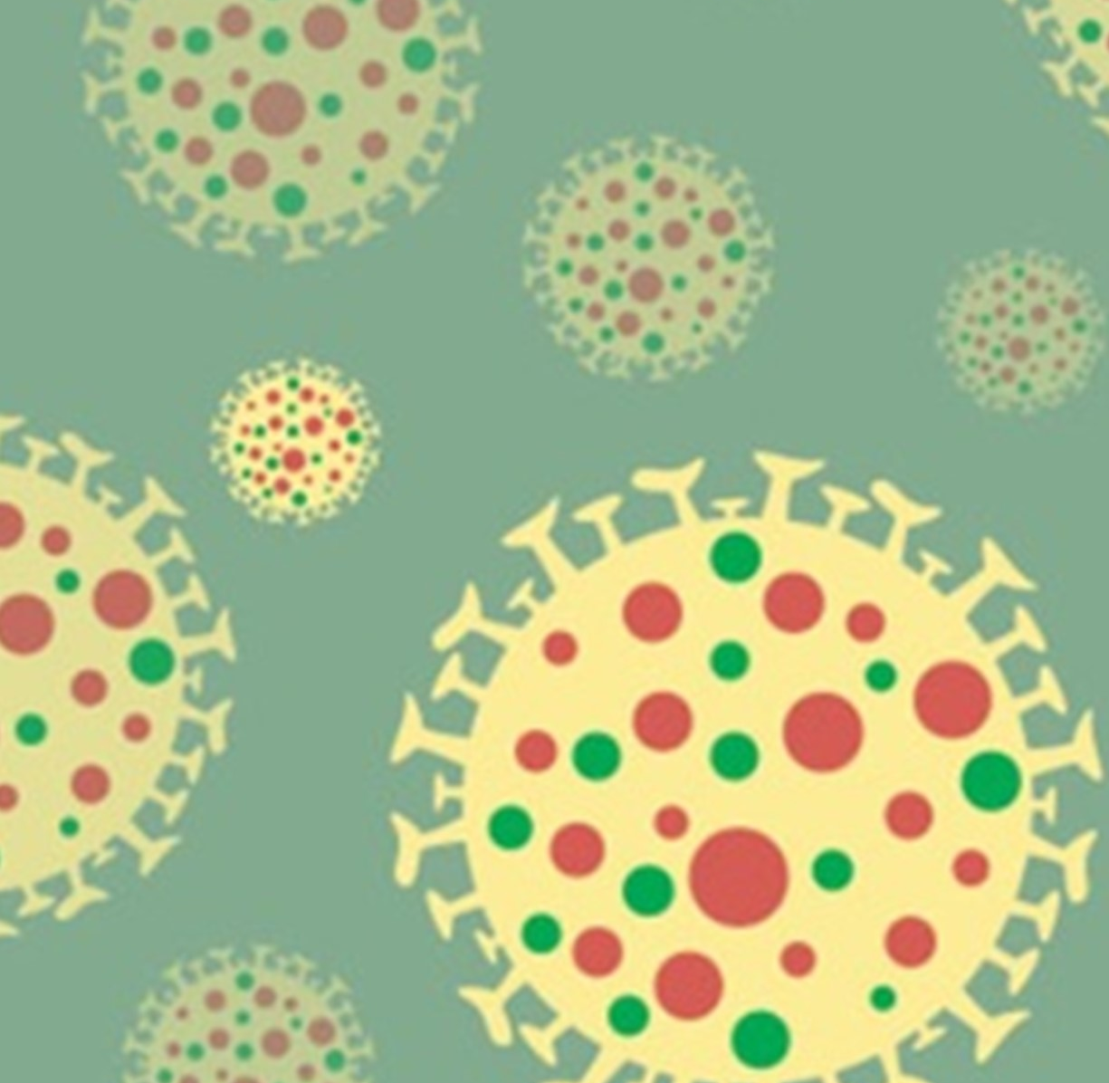
Am I at risk?
Risk of exposure:
People in places where ongoing community spread of the virus that causes COVID-19 has been reported are at elevated risk of exposure, with the level of risk dependent on the location.
Healthcare workers caring for patients with COVID-19 are at elevated risk of exposure.
Close contacts of persons with COVID-19 also are at elevated risk of exposure.
Travelers returning from affected international locations where community spread is occurring also are at elevated risk of exposure, with level of risk dependent on where they traveled.
Risk of Severe Illness:
Information shows that some people are at higher risk of getting very sick from this illness. This includes:
Older adults, with risk increasing by age.
People who have serious chronic medical conditions like:
Heart disease
Diabetes
Lung disease
Notes:
AM I AT RISK?
Risk depends on characteristics of the virus, including how well it spreads between people; the severity of resulting illness; and the medical or other measures available to control the impact of the virus (for example, vaccines or medications that can treat the illness) and the relative success of these. In the absence of vaccine or treatment medications, nonpharmaceutical interventions become the most important response strategy. These are community interventions that can reduce the impact of disease.
The risk from COVID-19 to North Americans can be broken down into risk of exposure versus risk of serious illness and death.
Risk of exposure:
People in places where ongoing community spread of the virus that causes COVID-19 has been reported are at elevated risk of exposure, with the level of risk dependent on the location.
Healthcare workers caring for patients with COVID-19 are at elevated risk of exposure.
Close contacts of persons with COVID-19 also are at elevated risk of exposure.
Travelers returning from affected international locations where community spread is occurring also are at elevated risk of exposure, with level of risk dependent on where they traveled.
Risk of Severe Illness:
Information shows that some people are at higher risk of getting very sick from this illness. This includes:
Older adults, with risk increasing by age.
People who have serious chronic medical conditions like:
Heart disease
Diabetes
Lung disease

Slide 8

HOW TO PROTECT YOURSELF
Take these steps to protect yourself:
Clean your hands often
Avoid close contact
Take these steps to protect others:
Stay home if you’re sick
Cover coughs and sneezes
Wear a facemask .
Clean and disinfect
Notes:
HOW TO PROTECT YOURSELF
The best way to prevent illness is to avoid being exposed to this virus.
The virus spreads mainly from person-to-person.
Between people who are in close contact with one another (within about 6 feet).
Through respiratory droplets produced when an infected person coughs or sneezes.
These droplets can land in the mouths or noses of people who are nearby or possibly be inhaled into the lungs.
Take these steps to protect yourself:
Clean your hands often
Wash your hands often with soap and water for at least 20 seconds especially after you have been in a public place, or after blowing your nose, coughing, or sneezing.
If soap and water are not readily available, use a hand sanitizer that contains at least 60% alcohol. Cover all surfaces of your hands and rub them together until they feel dry.
Avoid touching your eyes, nose, and mouth with unwashed hands.
Avoid close contact
Avoid close contact with people who are sick
Put distance between yourself and other people if COVID-19 is spreading in your community. This is especially important for people who are at higher risk of getting very sick.
Take these steps to protect others:
Stay home if you’re sick
Stay home if you are sick, except to get medical care. Learn what to do if you are sick.
Cover coughs and sneezes
Cover your mouth and nose with a tissue when you cough or sneeze or use the inside of your elbow.
Throw used tissues in the trash
Immediately wash your hands with soap and water for at least 20 seconds. If soap and water are not readily available, clean your hands with a hand sanitizer that contains at least 60% alcohol.
Wear a facemask
If you are sick: You should wear a facemask when you are around other people (e.g., sharing a room or vehicle) and before you enter a healthcare provider’s office. If you are not able to wear a facemask (for example, because it causes trouble breathing), then you should do your best to cover your coughs and sneezes, and people who are caring for you should wear a facemask if they enter your room. Learn what to do if you are sick.
If you are NOT sick: It is recommended you still wear a face mask in public or if you are caring for someone who is sick (and they are not able to wear a facemask). This will both help protect yourself and others, if you have COVID-19 but are asymptomatic.
Clean and disinfect
Clean AND disinfect: frequently touched surfaces daily. This includes tables, doorknobs, light switches, countertops, handles, desks, phones, keyboards, toilets, faucets, and sinks.
If surfaces are dirty, clean them: Use detergent or soap and water prior to disinfection.

Slide 9
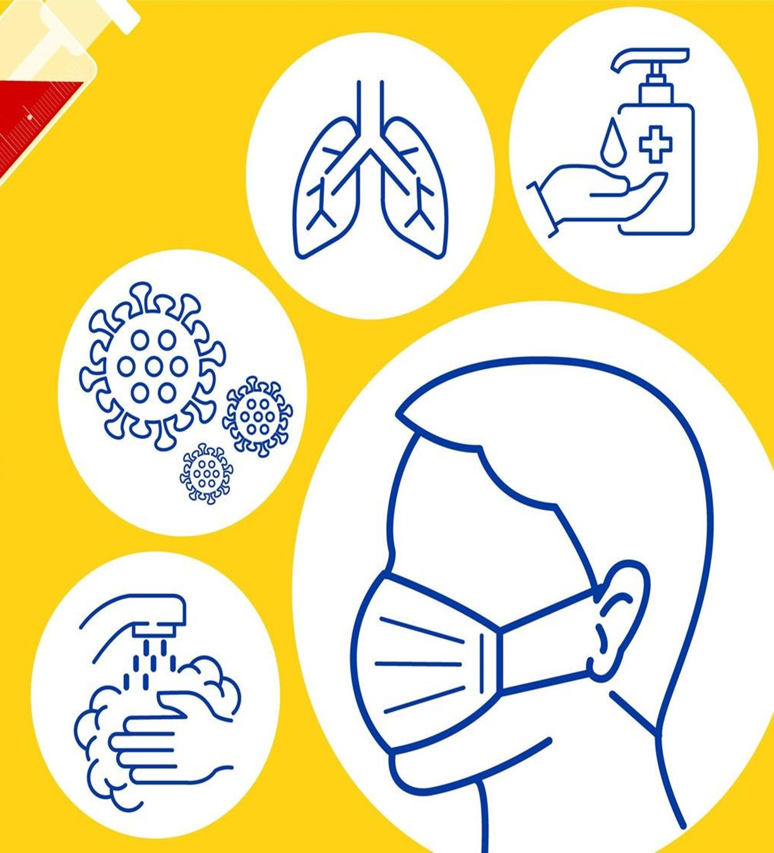
HOW TO CLEAN & DISINFECT
Clean and disinfect high-touch surfaces daily in household common areas (e.g. tables, hard-backed chairs, doorknobs, light switches, remotes, handles, desks, toilets, sinks).
Household members should follow home care guidance when interacting with persons with suspected/confirmed COVID-19 and their isolation rooms/bathrooms.
Notes:
HOW TO CLEAN & DISINFECT
Community members can practice routine cleaning of frequently touched surfaces (for example: tables, doorknobs, light switches, handles, desks, toilets, faucets, sinks) with household cleaners and EPA-registered disinfectants that are appropriate for the surface, following label instructions. Labels contain instructions for safe and effective use of the cleaning product including precautions you should take when applying the product, such as wearing gloves and making sure you have good ventilation during use of the product.
Clean and disinfect high-touch surfaces daily in household common areas (e.g. tables, hard-backed chairs, doorknobs, light switches, remotes, handles, desks, toilets, sinks).
In the bedroom/bathroom dedicated for an ill person: consider reducing cleaning frequency to as-needed (e.g., soiled items and surfaces) to avoid unnecessary contact with the ill person.
As much as possible, an ill person should stay in a specific room and away from other people in their home, following home care guidance.
The caregiver can provide personal cleaning supplies for an ill person’s room and bathroom, unless the room is occupied by child or another person for whom such supplies would not be appropriate. These supplies include tissues, paper towels, cleaners and EPA-registered disinfectants.
If a separate bathroom is not available, the bathroom should be cleaned and disinfected after each use by an ill person. If this is not possible, the caregiver should wait as long as practical after use by an ill person to clean and disinfect the high-touch surfaces.
Household members should follow home care guidance when interacting with persons with suspected/confirmed COVID-19 and their isolation rooms/bathrooms.

Slide 10
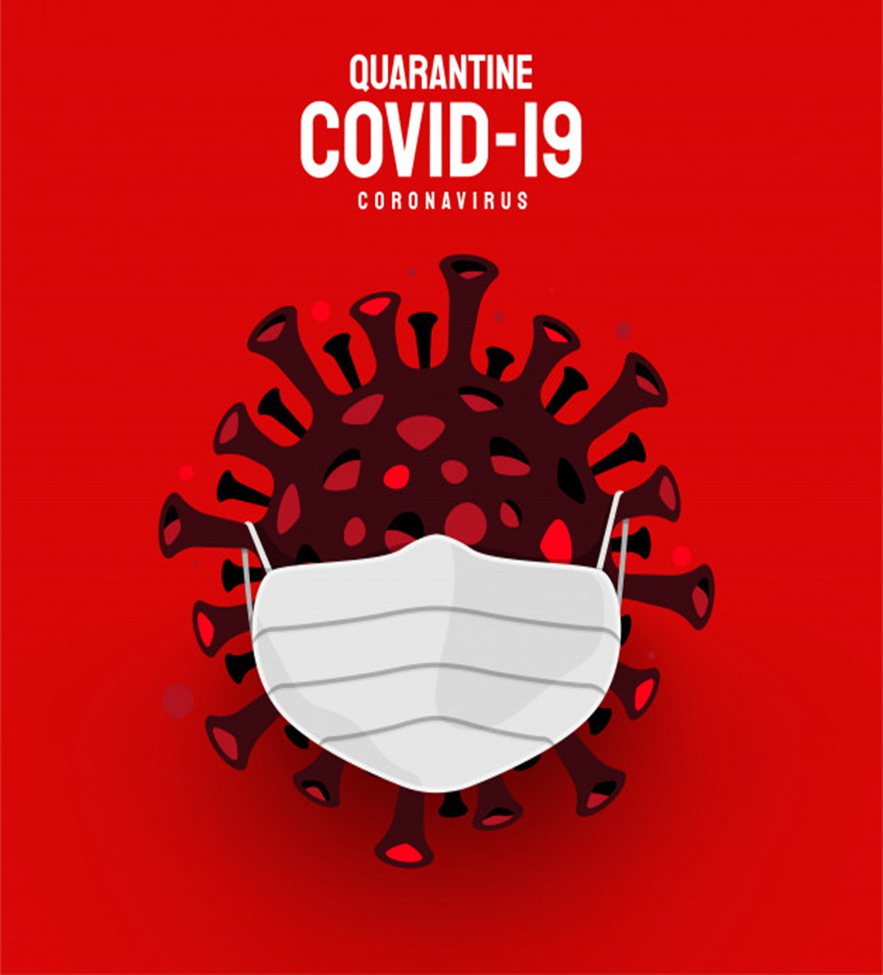
HOW TO CLEAN & DISINFECT
Wear disposable gloves when cleaning and disinfecting surfaces. Gloves should be discarded after each cleaning. If reusable gloves are used, those gloves should be dedicated for cleaning and disinfection of surfaces for COVID-19 and should not be used for other purposes.
For disinfection, diluted household bleach solutions, alcohol solutions with at least 70% alcohol, and most common EPA-registered household disinfectants should be effective.
Notes:
Wear disposable gloves when cleaning and disinfecting surfaces. Gloves should be discarded after each cleaning. If reusable gloves are used, those gloves should be dedicated for cleaning and disinfection of surfaces for COVID-19 and should not be used for other purposes. Consult the manufacturer’s instructions for cleaning and disinfection products used. Clean hands immediately after gloves are removed.
If surfaces are dirty, they should be cleaned using a detergent or soap and water prior to disinfection.
For disinfection, diluted household bleach solutions, alcohol solutions with at least 70% alcohol, and most common EPA-registered household disinfectants should be effective.
Diluted household bleach solutions can be used if appropriate for the surface. Follow manufacturer’s instructions for application and proper ventilation. Check to ensure the product is not past its expiration date. Never mix household bleach with ammonia or any other cleanser. Unexpired household bleach will be effective against coronaviruses when properly diluted.
Prepare a bleach solution by mixing:
5 tablespoons (1/3rd cup) bleach per gallon of water or
4 teaspoons bleach per quart of water
Products with EPA-approved emerging viral pathogens icon are expected to be effective against COVID-19 based on data for harder to kill viruses. Follow the manufacturer’s instructions for all cleaning and disinfection products (e.g., concentration, application method and contact time, etc.).

Slide 11

HOW TO CLEAN & DISINFECT
For soft (porous) surfaces such as carpeted floor, rugs, and drapes, remove visible contamination if present and clean with appropriate cleaners indicated for use on these surfaces.
Wear disposable gloves when handling dirty laundry from an ill person and then discard after each use. If using reusable gloves, those gloves should be dedicated for cleaning and disinfection of surfaces for COVID-19 and should not be used for other household purposes. Clean hands immediately after gloves are removed.
Notes:
For soft (porous) surfaces such as carpeted floor, rugs, and drapes, remove visible contamination if present and clean with appropriate cleaners indicated for use on these surfaces. After cleaning:
Launder items as appropriate in accordance with the manufacturer’s instructions. If possible, launder items using the warmest appropriate water setting for the items and dry items completely, or
Use products with the EPA-approved emerging viral pathogens claims that are suitable for porous surfaces.
Wear disposable gloves when handling dirty laundry from an ill person and then discard after each use. If using reusable gloves, those gloves should be dedicated for cleaning and disinfection of surfaces for COVID-19 and should not be used for other household purposes. Clean hands immediately after gloves are removed.
If no gloves are used when handling dirty laundry, be sure to wash hands afterwards.
If possible, do not shake dirty laundry. This will minimize the possibility of dispersing virus through the air.
Launder items as appropriate in accordance with the manufacturer’s instructions. If possible, launder items using the warmest appropriate water setting for the items and dry items completely. Dirty laundry from an ill person can be washed with other people’s items.
Clean and disinfect clothes hampers according to guidance above for surfaces. If possible, consider placing a bag liner that is either disposable (can be thrown away) or can be laundered.

Slide 12
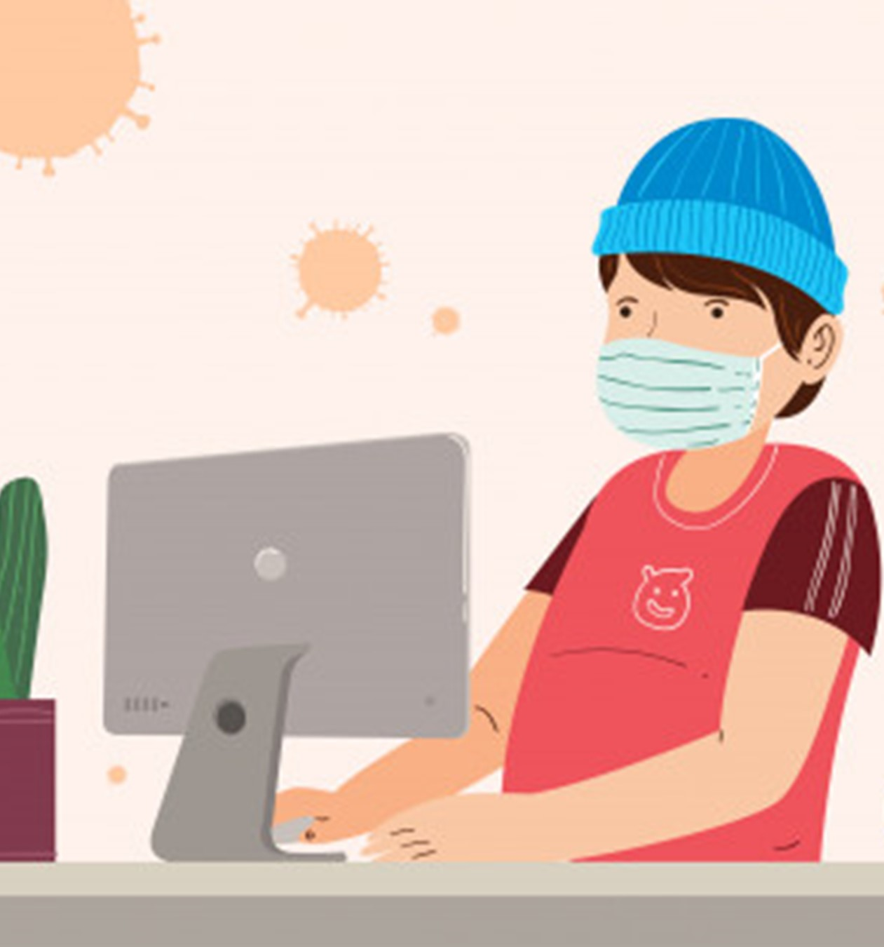
Final Word
The spread of COVID-19 has made daily life stressful everyone. Whether you are immunocompromised or have loved ones at risk, you can take action to prevent the spread of this virus. By wearing a mask, practicing social distancing, and regularly cleaning surfaces, you can protect yourself, others, and your community from being ravaged by COVID-19.
Notes:
FINAL WORD
The spread of COVID-19 has made daily life stressful everyone. Whether you are immunocompromised or have loved ones at risk, you can take action to prevent the spread of this virus. By wearing a mask, practicing social distancing, and regularly cleaning surfaces, you can protect yourself, others, and your community from being ravaged by COVID-19.

