Slide 1

Click para comenzar…

Slide 2

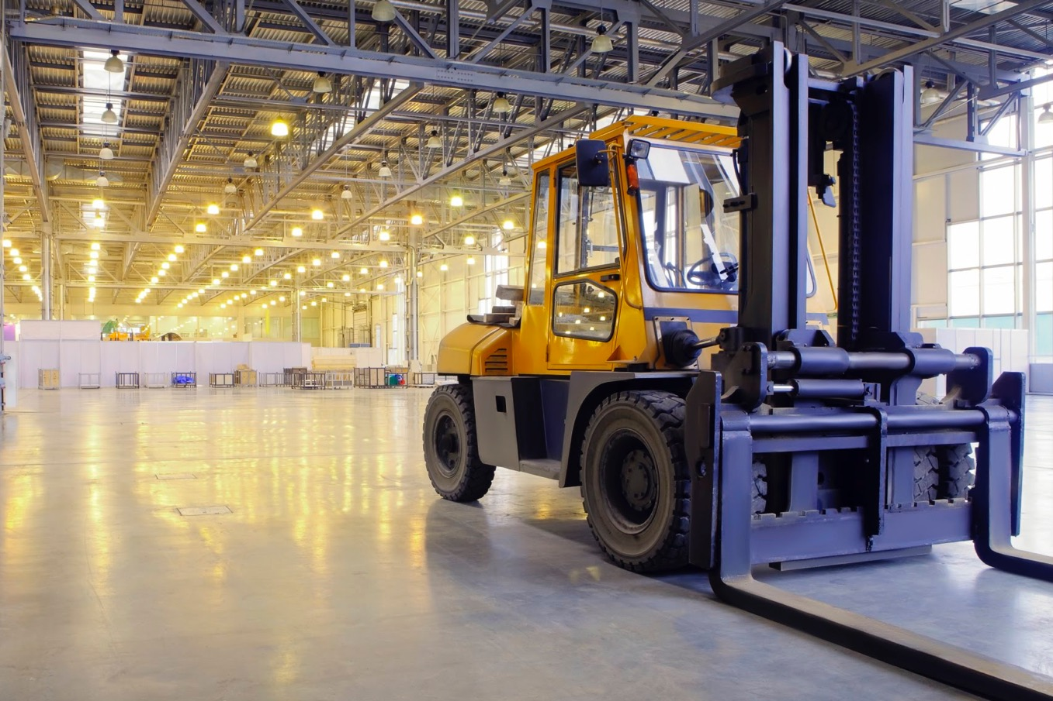

Conceptos Básicos De La Seguridad En Montacargas
Notes:
The Basics of Forklift Safety

Slide 3
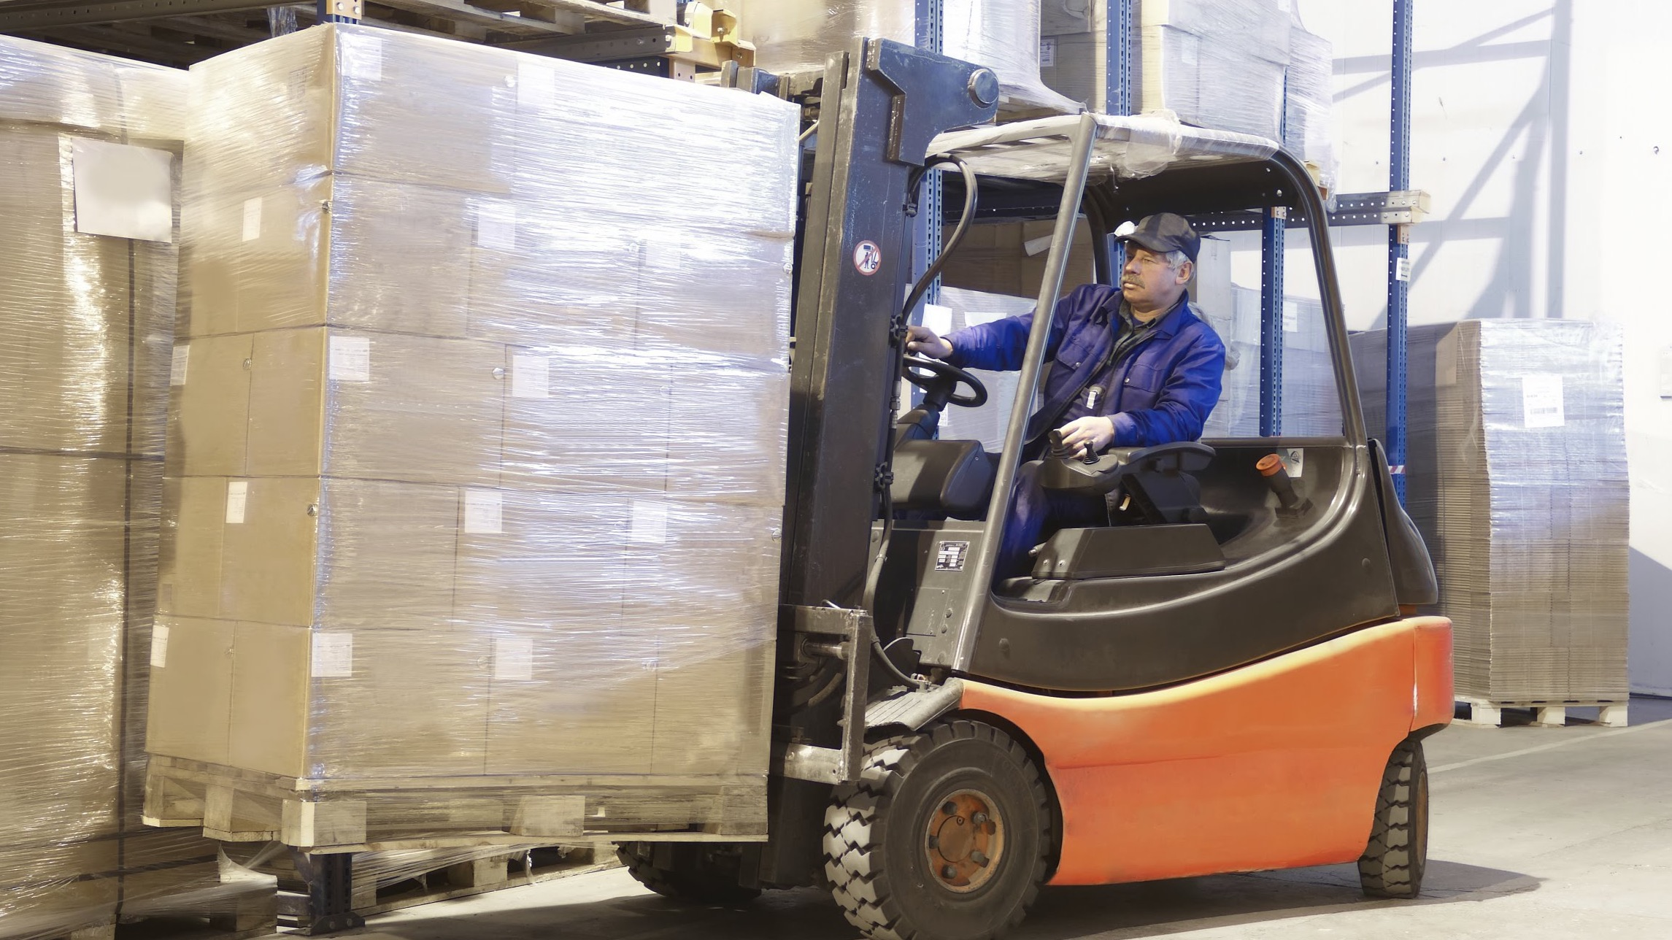
¿Qué Está En Riesgo?
Las máquinas han reemplazado prácticamente toda la fuerza muscular en la sociedad industrial moderna.
Los montacargas son utilizados en casi todas partes donde el material necesita ser movido.
Si se operan correctamente, ahorran tiempo y dinero, previenen lesiones en la espalda y ayudan a que las operaciones se realicen sin problemas.
Notes:
What’s at Stake?
Machines have all but replaced muscle power in modern industrial society. Forklifts are a prime example. Forklifts are utilized just about everywhere material needs to be moved. Operated properly, they save time and money, prevent back injuries, and help operations run smoothly.

Slide 4
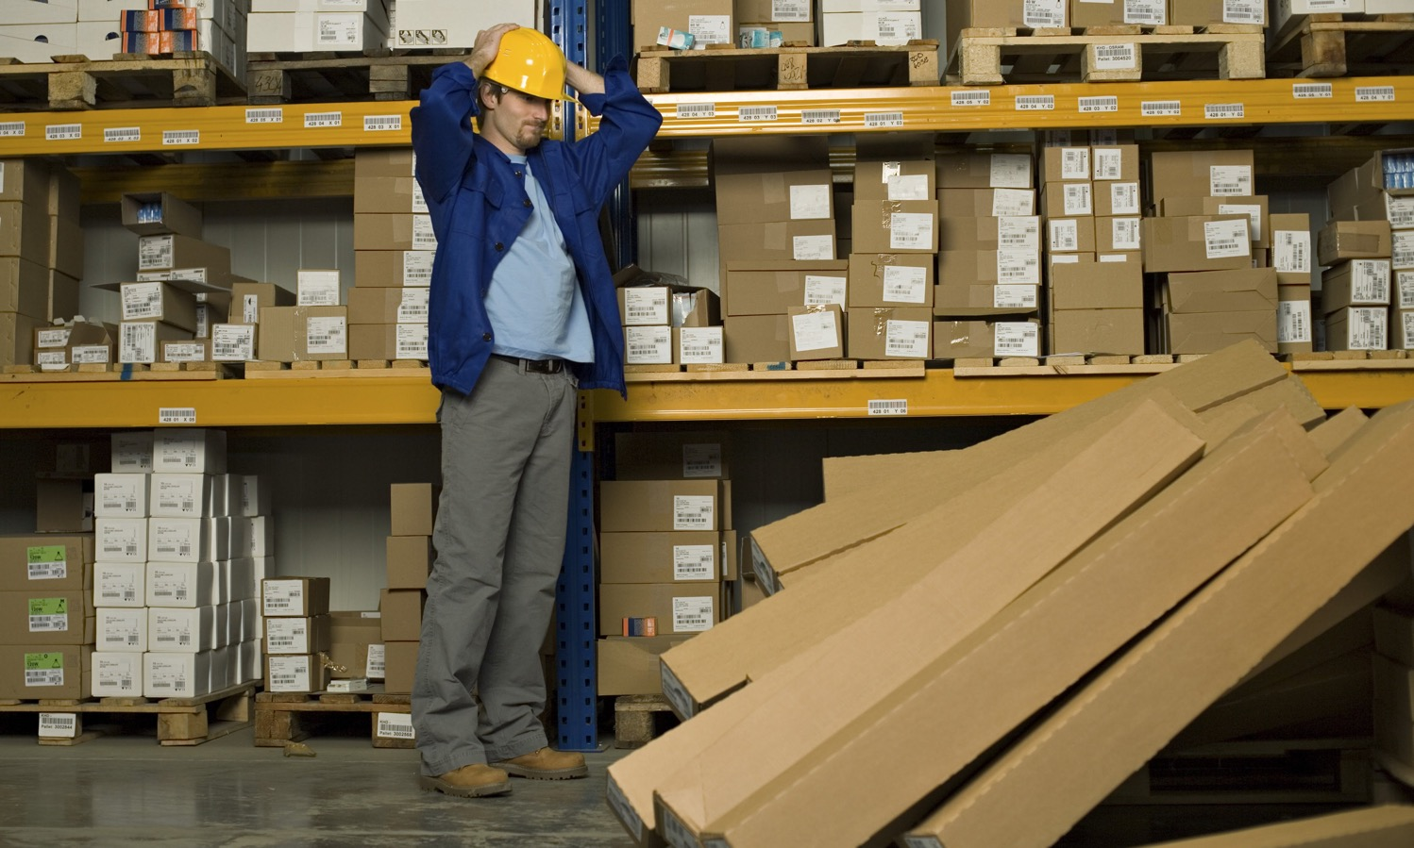
¿Cuál Es El Peligro?
A pesar de la contribución positiva general de las carretillas elevadoras a la industria, ha habido momentos en que las cosas han ido terriblemente mal.
Ejemplos:
Inocentes transeúntes clavados con horquillas
Trabajadores desprevenidos atropellados
Cargas elevadas han caído
Los "autoestopistas" no autorizados son aplastados
Notes:
What’s the Danger?
Despite the overall positive contribution of forklifts to industry, there have been times when things have gone terribly wrong.
Here are some examples:
Innocent by-standers have been pinned by the forks.
Unsuspecting workers have been run over.
Elevated loads have fallen.
Unauthorized “hitchhikers” have been crushed under wheels.

Slide 5

¿Cuál Es El Peligro?
Incidentes de la vida real....
Un empujador de herramientas descubrió una fuga hidráulica en el controlador de la carretilla elevadora.
La carga se elevó 10 pies (tres metros)
Comenzó a reparar la fuga - se mantuvo bajo carga.
El accesorio rompió la línea hidráulica - la carga cayó.
Lo atrapó bajo carga, lo mató inmediatamente.
Notes:
What’s the Danger?
Consider this real-life incident…
A senior rig toolpusher operating a forklift discovered a hydraulic leak of the lift controller for the forks. The load was raised about 10 feet (three meters) high and he began to repair the leak. He stood under the load and was attempting to tighten the fitting when it broke completely off the hydraulic line. This caused the load to drop, trapping the toolpusher under the load. He was killed immediately.

Slide 6

Como Protegerse
Las máquinas de todo tipo tienen procedimientos de funcionamiento estándar que incluyen una "lista de comprobación" para su funcionamiento seguro.
Los montacargas no son una excepción. Existen procedimientos y protocolos para el uso seguro y efectivo del montacargas.
Estos procedimientos operativos están arraigados en el sentido común, pero con demasiada frecuencia son ignorados u olvidados.
Notes:
How to Protect Yourself
Machines of every description have standard operating procedures which include a “checklist” for its safe operation. Forklifts are no exception. There are procedures and protocols for the safe and effective use of the forklift.
These operating procedures are rooted out of common sense but are too often ignored or forgotten.

Slide 7
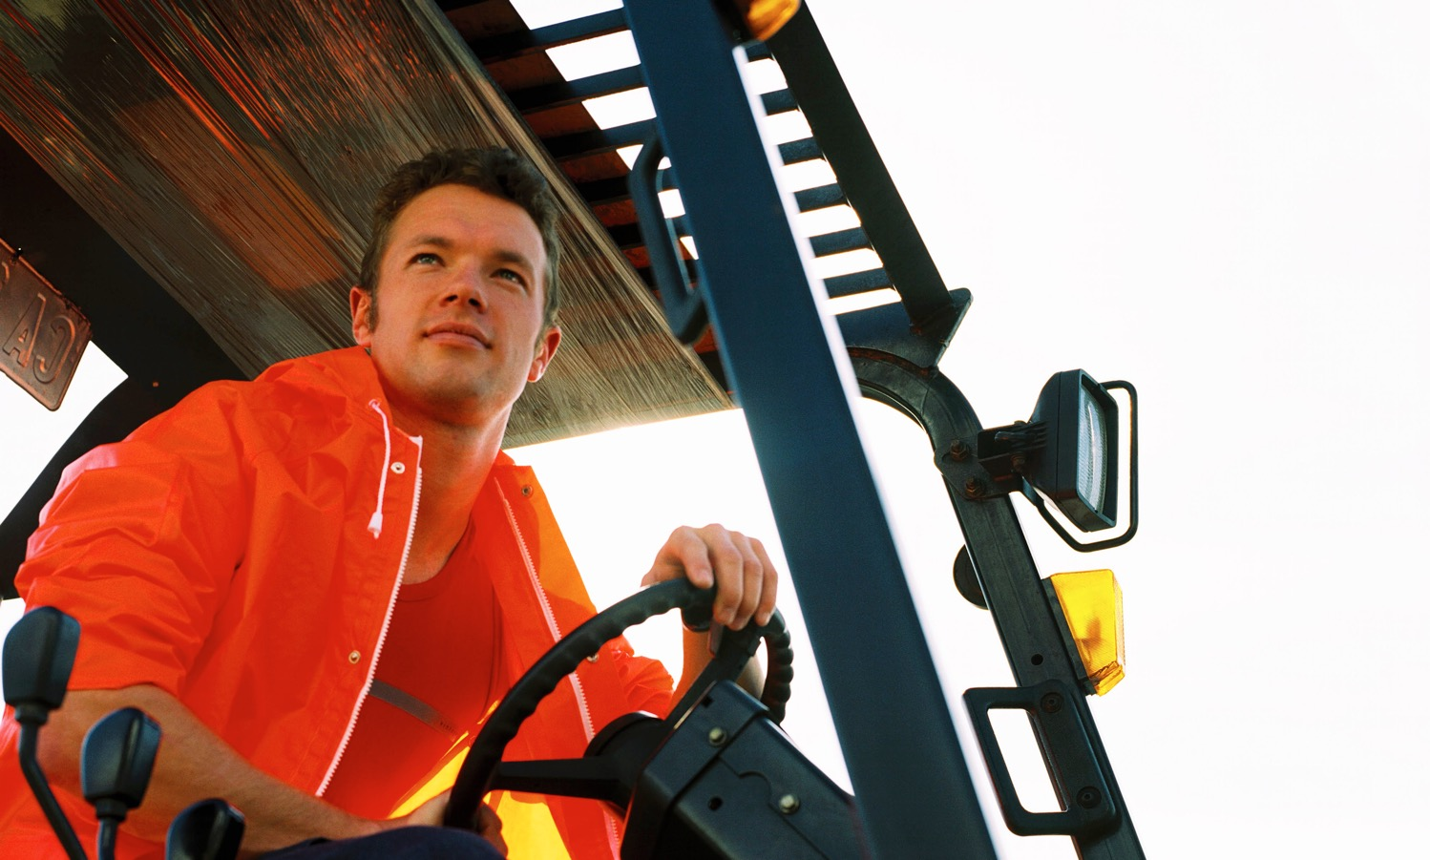
Como Protegerse
Seguir los límites de velocidad seguros
Mantener la carga baja - Horquillas bajas, mástil inclinado hacia atrás
Mantenga la visibilidad - Conduzca hacia atrás si la carga bloquea la vista
Vigilar la pendiente - Volver a bajar pendientes si la inclinación es > 10%.
Nunca cargue a los autostopistas
Dejar espacio - Dejar espacio para el tráfico de peatones/vehículos
Estacione con seguridad - Bloquee las ruedas, baje las horquillas y fije el freno.
Notes:
How to Protect Yourself
Follow safe speed limits – Drive only fast as you can comfortably walk. Forklifts can’t travel safely at high speeds. Without loads, they aren’t weighted and are especially unstable.
Keep the load low – While moving, forks should be low, with the mast tilted slightly back.
Maintain good visibility – If a load blocks forward vision, drive backwards.
Watch the slope – Back down slopes that have an incline greater than10 percent. Make sure your back up alarm is working properly.
Never carry hitchhikers – They are unsecured and can easily fall off and be injured.
Leave aisle room – Allow space for pedestrian and other traffic. Be alert at intersections. Honk your horn before and while you enter an intersection, even if it doesn’t appear to be busy.
Park safely – On a hill, always block the wheels, lower forks and set the parking brake.

Slide 8
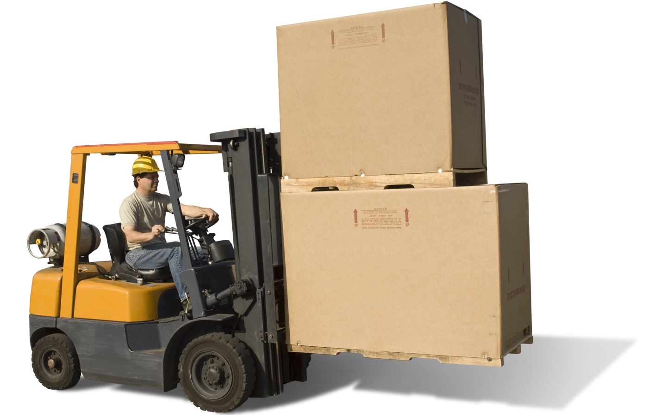
Como Protegerse
Evite volcar
No conduzca con cargas altas
Haga giros bruscos lentamente
Actualización de cargas de transporte
Rampas para bajar
No girar nunca en las pendientes
Desconfíe de los golpes repentinos
Notes:
How to Protect Yourself
Avoid Tipping Over
Don’t drive with tall loads – Too tall or top-heavy loads can change your forklift’s center of gravity and cause you to tip over.
Make sharp turns slowly – If you turn too fast, you’re likely to shift your load. Any sudden movement can cause you to tip over.
Keep load upgrade – To avoid tipping:
Carry your load upgrade.
Back down ramps.
Never turn on grades.
Be wary of sudden bumps – Chuck holes and other uneven ground can cause you to tip. Watch the road and cross railroads diagonally.

Slide 9
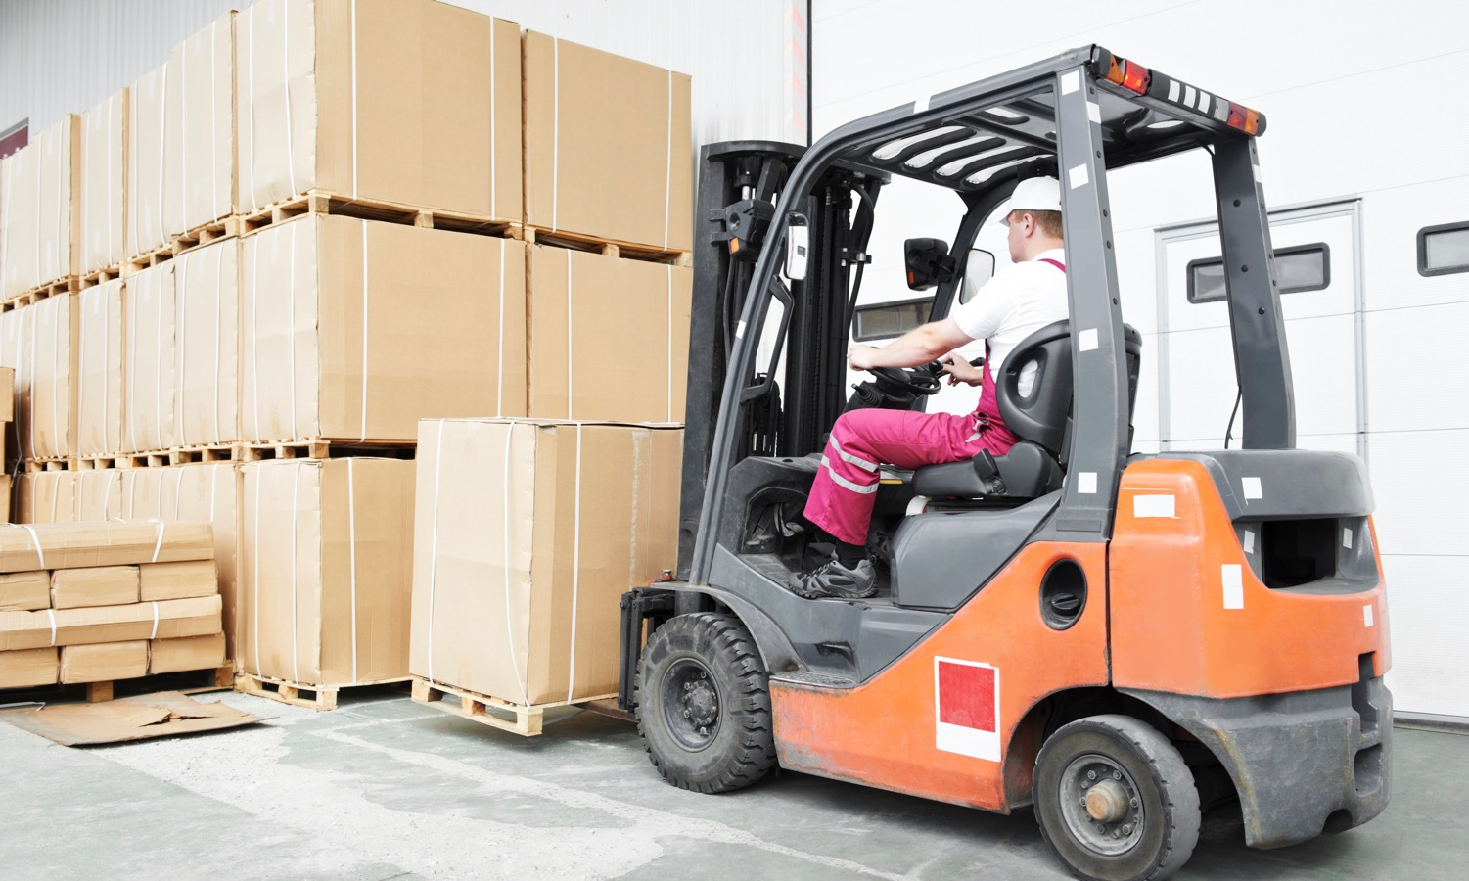
Como Protegerse
Cargar y descargar con seguridad
Entrar en el palet - horquillas altas y anchas
Capturar la carga - levantar e inclinar
Distancia mínima - 6-8 in/15-20 cm
Planifique su ruta - compruebe los peligros
Apilar en la estantería - subir, posicionar, inclinar, bajar, retirar
Apilar en el camión - asegurar la plataforma del muelle, posición, inclinación, liberación
Notes:
How to Protect Yourself
Load and Unload Safely
Enter the pallet – Keep the forks high enough to enter the pallet and as wide apart as possible.
Capture the load – Lift and tilt load back so it is secure, and never load over your forklifts weight limits.
Minimum clearance – Forks should clear the road by six to eight inches (15 to 20 centimeters). Raise them higher for ramps and grades.
Plan your route – Be aware of surface conditions, visibility, pedestrian traffic, up ramps and intersections.
Stack on a rack – Raise the load to the right height. Position load. Tilt the load forward and lower the pallet onto the rack. Withdraw the forks slowly. Back out, looking over your shoulder.
Stack on a truck – First, make sure the dock plate and truck can’t move. Position the load, tilt it forward and release. Back out carefully, looking over your shoulder as you drive.

Slide 10
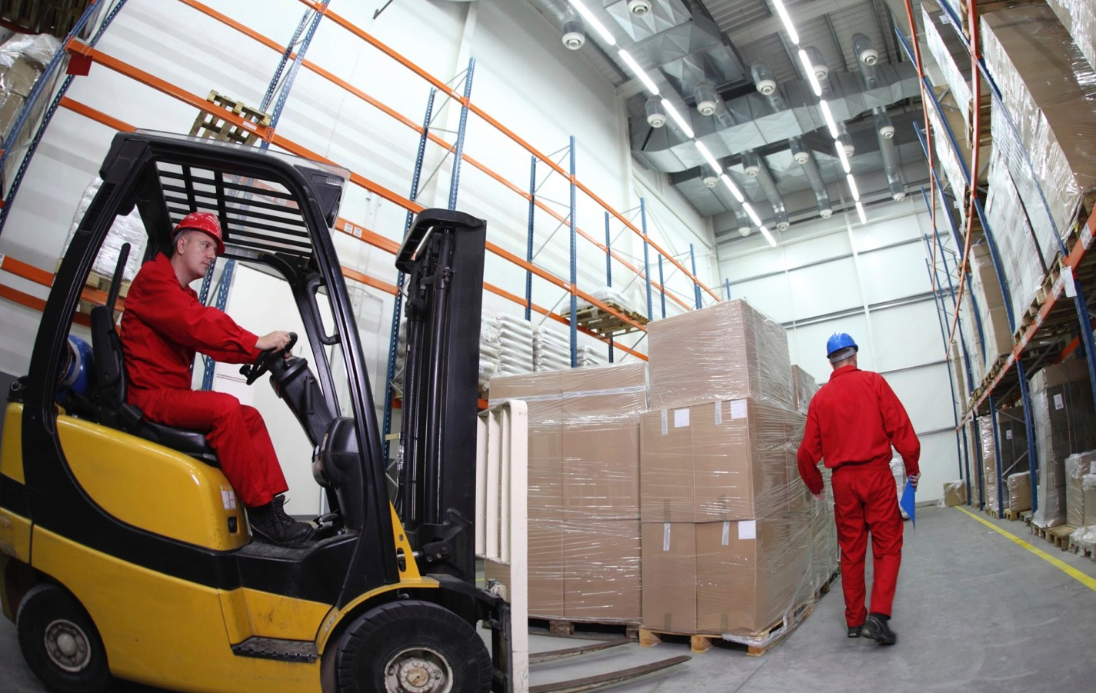
Como Protegerse
Precauciones generales
No asuma que el conductor de la carretilla elevadora lo ve
Entienda que el montacargas usualmente tiene dirección en la rueda trasera y se balanceará en la parte trasera al girar.
Manténgase alejado de todas las partes de un montacargas
Nunca conduzca un montacargas a menos que esté calificado y capacitado
Notes:
How to Protect Yourself
There are also some precautions that should be observed by everyone in an area where there is forklift traffic:
Don’t assume a forklift driver sees you.
Understand that the forklift usually has rear-wheel steering and will swing out at the rear end when turning.
Keep clear of all the parts of a forklift, including the forks and wheels, which can potentially catch you or crush you.
Never drive a forklift unless you are qualified to do so. Fatalities have occurred when unqualified personnel have “borrowed” a forklift for just a few minutes.

Slide 11
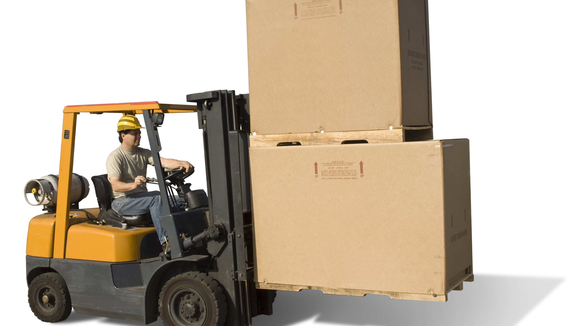
Conclusión
El poder del montacargas ha reemplazado la fuerza muscular en la industria moderna.
No ignore ni olvide las reglas bien establecidas para el manejo seguro de montacargas.
Notes:
Final Word
Forklift power has replaced muscle power in the modern day industry. Don’t ignore or forget well-established rules of safe forklift operation.

