Slide 1

Clic para comenzar

Slide 2

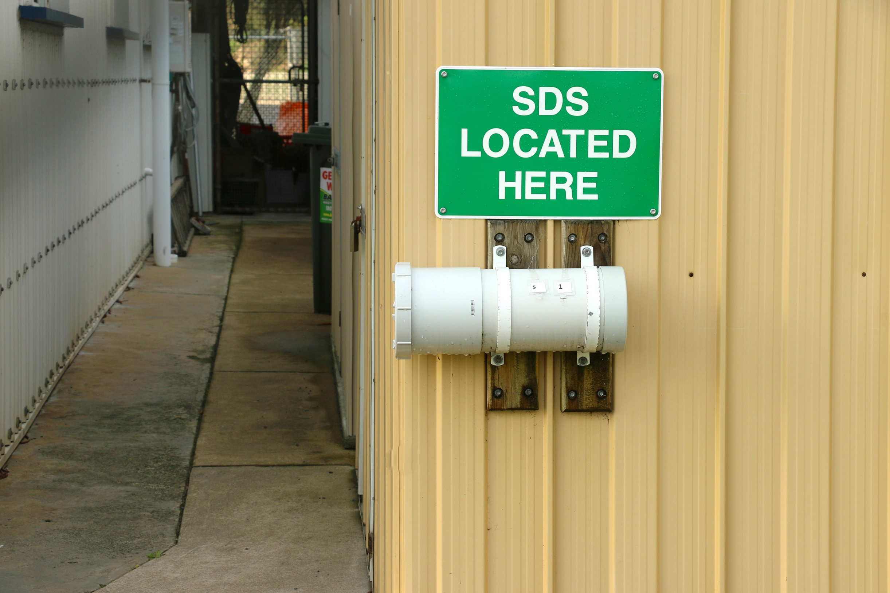

Comprensión de las Hojas de Datos de Seguridad
Notes:
Understanding Safety Data Sheets

Slide 3

¿Qué está en Riesgo?
Trabajar con sustancias químicas peligrosas es una causa conocida de enfermedad y lesiones para los trabajadores.
Se debe proporcionar una Hoja de Datos de Seguridad (HHDS).
El HDS debe estar fácilmente disponible para los trabajadores en todo momento.
Notes:
What’s at Stake?
Working with hazardous chemicals is a known cause of illness and injury to workers. A Safety Data Sheet (SDS) must be provided by the supplier for any substance classified as hazardous. An SDS contains a lot of vital, specific information on how to store, handle, and work with a substance.
The information is essential for all staff working with a hazardous chemical as it gives more detail than the chemical’s label.
The SDS for each chemical must be easily available to workers at all times and can either be a paper copy or electronic copy, provided staff can access it when needed, such as on their cell phone or laptop.

Slide 4
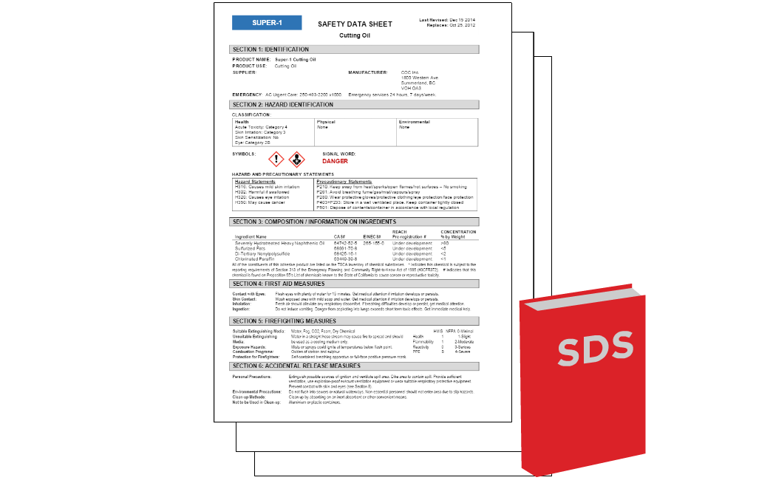
¿Cuál es el peligro?
HDS - 16 secciones fáciles de leer
La falta de lectura /seguimiento es arriesgado y puede provocar enfermedades y lesiones.
Los empleadores deben capacitar a los trabajadores sobre cómo leer una HDS y cómo trabajar de manera segura con productos químicos.
Notes:
What’s the Danger?
A Safety Data Sheet is written for everyone who works with the substance. This means a lot of the information can be quite technical or not relevant to all workers. This can lead workers to think the SDS does not apply to them or it’s too technical to read, so they don’t read it.
Safety Data Sheets are designed to be easy to read, with 16 standardized sections. And since many sections apply to most workers, failure to read the SDS is risky and can lead to illness and injury. Employers have a responsibility to train workers on how to read an SDS and how to work safely with chemicals.
Hazards
Lost or out of date SDS
Workers do not know what risks and precautions they need to take
Complex information leads to misunderstanding

Slide 5

Como Protegerse
1. Conoce el HDS
Ubicación y acceso
Revisión con el supervisor
Verifique la etiqueta
Asiste a entrenamiento
Notes:
How to Protect Yourself
3 easy ways to use Safety Data Sheets
Know the SDS
Know where the SDSs are kept and how to get to them.
How to access electronic version.
Where the paper file is kept.
Make sure your supervisor talks you through relevant SDSs when you start work or first start using a hazardous substance.
Check the chemical label.
This gives you a heads up there is more you need to know.
Attend training updates on working with specific hazardous substances.

Slide 6

Como Protegerse
2. Leer con Propósito
Identificación
Peligros
Prevención
Respuesta
Notes:
How to Protect Yourself
Read with a purpose
There are 4 main types of information on each SDS.
Identification
Of the product and supplier.
Hazards
Physical e.g. fire, and to health, e.g. breathing difficulties.
Prevention
How to work safely, reduce or prevent exposure.
Response
Appropriate responses in various situations (e.g., first aid, fire, accidental release).

Slide 7
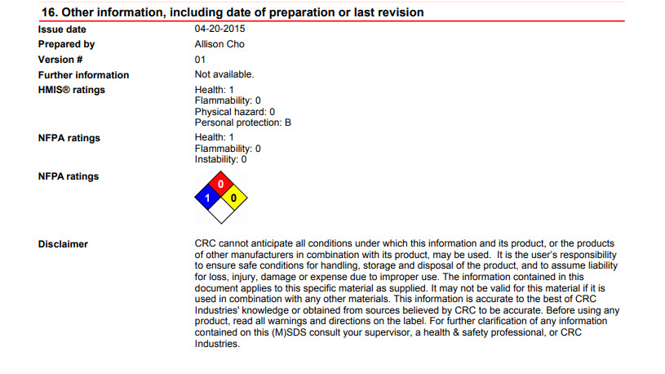
Como Protegerse
3. Detalles importantes
Sección 1 - Nombre químico, uso
Sección 2 - Posibles peligros
Sección 7: Manejo y Almacenamiento
Sección 4,5,6 - Emergencia
Sección 16 - Fecha de la última revisión
Notes:
How to Protect Yourself
Important details for everyone
Check the name of the chemical (Section 1).
Know what it is typically used for, and when it should not be used (Section 1).
Know the potential hazards (Section 2).
Read safe handling and storage instructions (Section 7).
Know what to do in an emergency (Sections 4, 5 and 6).
Date of latest SDS revision (Section 16).

Slide 8

Conclusión
Es vital que tenga información sobre los productos químicos con los que está trabajando.
Su empleador debe asegurarse de que los empleados conozcan la información que necesitan y puedan obtener fácilmente esa información.
La capacitación periódica y las actualizaciones sobre los productos químicos utilizados y almacenados en el lugar de trabajo complementan la información provista en un HDS.
Notes:
Final Word
It is vital you have as much information as possible about chemicals you are working with. Your employer must make sure employees are aware of the specific information they need and can easily get that information when needed. Regular training and updates on the chemicals used and stored at the worksite, complement the information provided in an SDS.

