Slide 1

Click anywhere to get started…

Slide 2
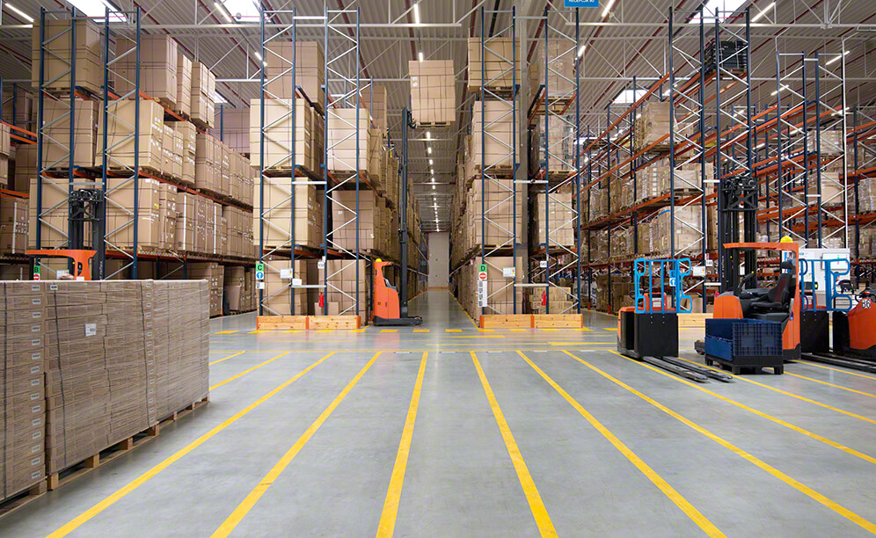


BE WARY OF WAREHOUSE HAZARDS
Notes:
BE WARY OF WAREHOUSE HAZARDS

Slide 3

What’s at Stake?
There are thousands of warehouses across North America, employing more than 100 000 people, and these workers face a host of potential hazards. In fact, the fatal injury rate for the warehousing industry is one of the highest of all industries.
Notes:
What’s at Stake?
There are thousands of warehouses across North America, employing more than 100 000 people, and these workers face a host of potential hazards. In fact, the fatal injury rate for the warehousing industry is one of the highest of all industries.

Slide 4

What’s the Danger?
It shouldn’t be a surprise that warehouse workers are at risk of musculoskeletal diseases, often related to improper lifting or overexertion. However, a warehouse also has other dangers, ranging from possible exposure to chemicals, forklift accidents, explosions, fires and falling materials.
Notes:
What’s the Danger?
It shouldn’t be a surprise that warehouse workers are at risk of musculoskeletal diseases, often related to improper lifting or overexertion. However, a warehouse also has other dangers, ranging from possible exposure to chemicals, forklift accidents, explosions, fires and falling materials.

Slide 5
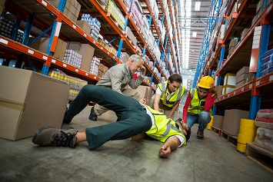
What’s the Danger?
Example
A man working in an electronics store warehouse fell six feet/two meters to his death, as he attempted to retrieve boxes from a forklift. The man was standing on a wooden pallet raised by the forklift, despite written warnings on the forklift stating it was not to be used to lift people.
The man was found bleeding from the back of his head. His pulse was faint, and his breathing was irregular. Coworkers began CPR and called 911. However, their efforts to save him were not successful. He died from blunt force trauma to the head.
Notes:
Example
A man working in an electronics store warehouse fell six feet/two meters to his death, as he attempted to retrieve boxes from a forklift. The man was standing on a wooden pallet raised by the forklift, despite written warnings on the forklift stating it was not to be used to lift people. The victim was not wearing fall protection and neither the forklift nor the wooden pallet was equipped with a guardrail to prevent a fall.
The man was found bleeding from the back of his head. His pulse was faint, and his breathing was irregular. Coworkers began CPR and called 911. However, their efforts to save him were not successful. He died from blunt force trauma to the head.

Slide 6

How to Protect Yourself
Learning about the hazards in your warehouse and how to avoid them will result in a safer work environment for you and for co-workers.
Remember these safety guidelines in warehouse and all storage areas:
Personal Protective Equipment will be required in many circumstances. Hardhats, leather gloves, safety-toed footwear and safety eyewear will be needed for many warehouse jobs.
Keep aisles and traffic areas free of obstacles, which can cause tripping accidents.
Notes:
How to Protect Yourself
Learning about the hazards in your warehouse and how to avoid them will result in a safer work environment for you and for co-workers.
Remember these safety guidelines in warehouse and all storage areas:
Personal Protective Equipment will be required in many circumstances. Hardhats, leather gloves, safety-toed footwear and safety eyewear will be needed for many warehouse jobs.
Keep aisles and traffic areas free of obstacles, which can cause tripping accidents.

Slide 7

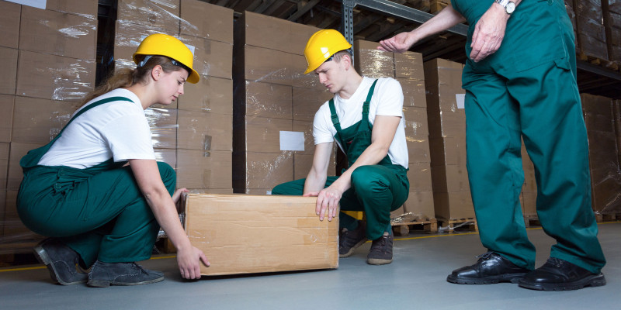
How to Protect Yourself
If you’re moving containers of chemicals, you will need certain protective clothing. Consult the chemical’s material safety data sheet to learn about the chemical’s hazards and how to protect yourself.
Learn to lift safely, using the strength in your legs rather than your back. Get help when lifting heavy or awkward loads. Use lifting and moving equipment such as jacks and carts to save your back from injury.
Stack materials safely. Use appropriate shelving, racks or pallets. Strap or interlock items for security. Put heavier items on the bottom.
Notes:
Be aware of all the precautions for materials you are handling. If you’re moving containers of chemicals, you will need certain protective clothing. Consult the chemical’s material safety data sheet to learn about the chemical’s hazards and how to protect yourself.
Learn to lift safely, using the strength in your legs rather than your back. Get help when lifting heavy or awkward loads. Use lifting and moving equipment such as jacks and carts to save your back from injury.
Stack materials safely. Use appropriate shelving, racks or pallets. Strap or interlock items for security. Put heavier items on the bottom.

Slide 8
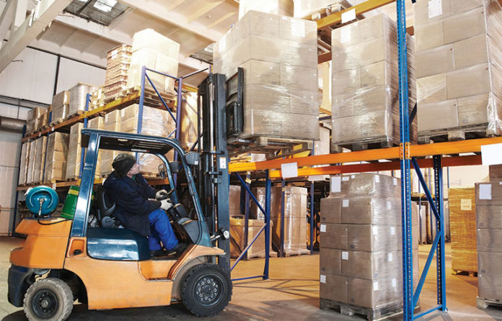
How to Protect Yourself
When stacking materials, maintain proper clearances under overhead sprinklers and leave aisles wide enough for firefighters and first aid crews to work.
Barricade and report any spills on the floor so they can be cleaned up before someone slips and falls.
Good lighting is required for warehouse safety.
Stay alert around plant vehicles.
Operate a forklift only if you have the training and authorization to do so.
Notes:
Emergency exits and equipment must always be kept clear. When stacking materials, maintain proper clearances under overhead sprinklers and leave aisles wide enough for firefighters and first aid crews to work.
Barricade and report any spills on the floor so they can be cleaned up before someone slips and falls.
Good lighting is required for warehouse safety. Report burned out light fixtures so they can be replaced.
Stay alert around plant vehicles. Pedestrians are often the victims in forklift accidents, so stay clear of mobile machinery.
Operate a forklift only if you have the training and authorization to do so.

Slide 9

Final Word
Always keep your warehouse work area safe by reporting hazards and following safe work practices.
Notes:
Final Word
Always keep your warehouse work area safe by reporting hazards and following safe work practices.

