Slide 1

Click anywhere to get started…

Slide 2

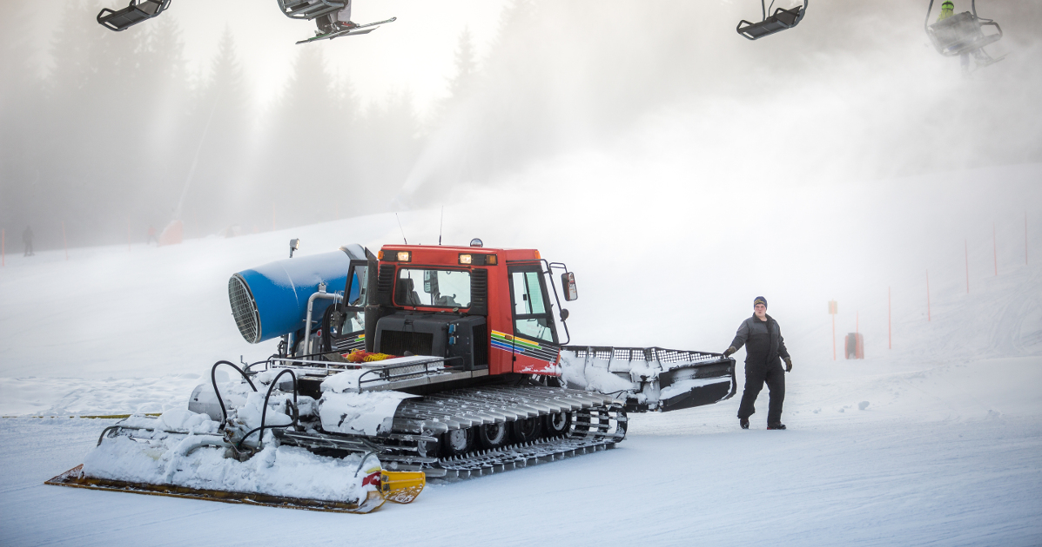

COLD WEATHER MACHINES
Notes:
Cold Weather Machines

Slide 3
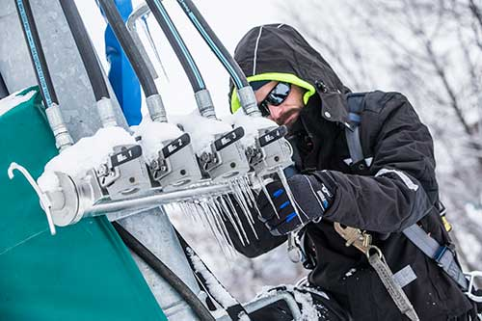
What’s at Stake?
Before you get caught in the winter cold, winterize your equipment to protect it from damage.
Notes:
What’s at Stake?
Before you get caught in the winter cold, winterize your equipment to protect it from damage. Any equipment being stored for the season should be prepared and protected, or it may not start up again in the spring.

Slide 4
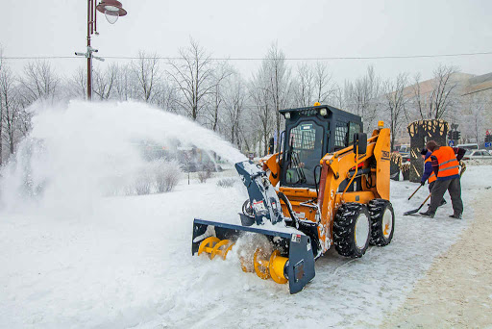
What’s the Danger?
Freezing air can fundamentally alter the efficiency of lubricants and how machinery operates. However, winter does not need to unnecessarily slow or delay operations — or compromise the safety of your operators. Take necessary precautions to prevent the negative effects of cold temperature.
Maintain in Optimal Condition
Engine
Battery
Starter
Machine Warm-Up
Operation
Notes:
What’s the Danger?
When Temperatures Drop
Freezing air can fundamentally alter the efficiency of lubricants and how machinery operates. However, winter does not need to unnecessarily slow or delay operations — or compromise the safety of your operators. Take necessary precautions to prevent the negative effects of cold temperature protect your machines and equipment. Check the owner’s manual for each of your machines and contact your local dealer before making any modifications to a machine’s regular maintenance practices.
Maintain in Optimal Condition
Engine
Take extra care when fuelling machines and equipment to prevent water and other particles from getting into the tank.
Check the fuel, air, and hydraulic filters regularly so equipment can start easily.
Battery
Be cautious when using jumper cables, especially during the winter. Incorrect use (reverse polarization hookup) could potentially result in extensive damage to an electrical system.
Avoid charging a frozen battery to prevent battery explosion.
Starter
Handling, using, and storing highly volatile ether starting aids in pressurized cans is a major safety concern. If handled improperly, the engine may seize, or crank/bend the valve stems.
Safety measures are crucial, especially when two or more workers are involved when starting a machine. Before proceeding to jump-start any machinery, assign each person a specific role and discuss the entire process in detail beforehand.
Machine Warm-Up
Freezing temperatures can make hoses and wires brittle. Take time to warm up machines before operating.
Warm hydraulics quickly by holding the control valve to open the relief valve.
Operation
Before winter arrives, inspect atmospheric systems (defrosting devices and operator compartment heaters) to ensure they are in good working condition. This practice helps prevent unexpected problems that can cause operational delays.
Cab or machine windows can easily fog up and reduce visibility. Clean windows thoroughly so the driver can spot nearby obstacles, machines, and other workers.
Frozen ground makes work difficult and sometimes impossible. Wheels can easily slip on ice and snow, causing collisions with other equipment and structures — and endangering anyone in the vicinity.
Maintain control of each machine by reducing ground speed and lessening the shock of impact on brittle ground contact surfaces.
Winter puts more strain on every machine. Batteries work harder to start and provide power. Preseason maintenance is imperative for optimal performance. Make sure to regularly inspect your machinery to detect damage, leaks, and other problems. Fix them immediately and avoid downtime. Also, check the auxiliary hydraulic connections, hoses, belts, attachment connections, and fluid levels for any signs of damage.

Slide 5
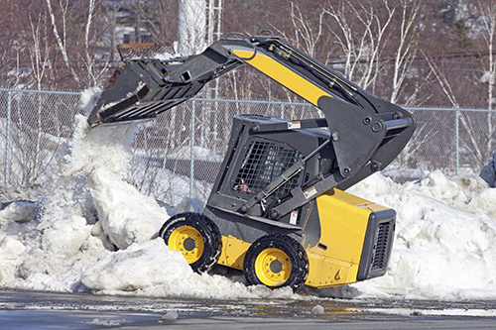
How to Protect Yourself
Daily Inspections
Check all parts of your equipment including:
1. Battery Health
2. Tire Inflation
3. Tire Tread
4. Fluids
5. Filter Replacement
6. Fuel Filters And Fuel Gelling
Notes:
How to Protect Yourself
Daily Inspections
Cold weather can take a toll on even the toughest equipment. It is essential to perform daily inspections of all equipment on your site before use, so you can catch any problems quickly before they turn into something more serious. Check all parts of your equipment including:
Battery
Tire pressure and tread
Fluid levels and flow
Fuel levels
Build-up on filters
Lubrication of engine parts, joints and hinges
Headlights
Windshield wipers
Heaters and defrosters
Brakes
Body surface and glass
Undercarriage
1. Battery Health
In cold weather, batteries do not perform as efficiently as they normally do. Batteries will have less pulling voltage in winter, meaning more pressure on the engine during start-up. In weather below freezing, the pressure on the engine can increase by 50 percent. When batteries are weakened by cold conditions, machines may have issues starting or maintaining power. Before each use, be sure that the battery is fully charged. If you need to charge or jump a battery, never do so when the battery is frozen. Allow it to warm up to at least 40 degrees Fahrenheit before charging it. Charging a battery when it is frozen may cause the battery to explode.
Batteries will also charge more slowly in the winter and may die more quickly. Before use, check that there are no signs of corrosion on the cables or connectors of the battery. You should also look out for signs that your machine’s battery may be dying, such as:
Slow engine crank
Corrosion on battery posts or cables
Issues with other electrical components in the machine
Battery not holding a charge
2. Tire Inflation
Check your tire pressure before using a machine to ensure that tires stay fully inflated. Cold weather also makes it more difficult for tires to maintain pressure. Under-inflated tires lead to worse fuel efficiency which means higher operating costs. If tires have low pressure, they will also wear more easily and may be more likely to burst due to brittleness in the winter. When inflating tires, do so in a heated area. Using dry nitrogen in tires can also help eliminate ice crystals. When ice crystals occur, they cause the valve stem to stay open which further increases the deflation rate of the tires.
3. Tire Tread
Equipment and ice It is extremely important for safe operation of machines in winter that tires have good tread. Even large equipment can slide on ice or snow, which can lead to accidents or injury. Make sure tire tread is appropriate and replace tires if they become too worn down for safe operation in slippery conditions.
4. Fluids
Even when you are using the proper winter fluids in your equipment, extremely cold weather can cause fluids to thicken which increases the pressure on seals and hoses. If fluids freeze or become too thick, they can cause hoses, which are already more brittle in cold weather, to burst. When inspecting fluids, check fluid levels and viscosity by checking the dipstick. If the fluid drips, it is fluid enough. You should also look for signs of leaks that could indicate cracks in seals or hoses.
As part of the winterizing process, you should change the oil in your machine to a synthetic base multi-grade oil so that it will flow better in colder temperatures, posing less risk of solidifying and clogging filters.
5. Filter Replacement
Be sure to check all filters as dirty or clogged filters can impact a machine’s ability to start or cause it to lose power in the middle of a job. If a machine loses power during operation in the winter, it may be stuck in ice and snow that would lead to further damage to the machine.
6. Fuel Filters And Fuel Gelling
Diesel particulate filters are extremely important to check carefully in the winter as colder temperatures will affect the emissions system of your machines. If there is any free water in your fuel tank, it can freeze and create ice crystals. These crystals can cause wear on your fuel systems or clog filters and pipes. To reduce the potential for free water to collect in your fuel tank, top off the fuel tank daily to prevent condensation from building in the tank.
a. Fuel Gelling
Another major cause of clogged filters in the winter is fuel gelling. Gelling occurs when compounds in the fuel reach their freezing point then turn into thick, waxy solids. These soft solids can coat and block filters. Diesel fuel is a mixture of around 250 chemicals, most of which are hydrocarbons. Each hydrocarbon has a different freezing point, but a good winter diesel will contain a mixture of hydrocarbons with lower freezing points. Be sure your winter diesel is number 1 diesel (1–D) or a mixture of 1-D and 2-D.
b. Cold Filter Plugging Point (CFPP)
You should also be aware of the Cold Filter Plugging Point, or CFPP, of your fuel. The CFPP is the temperature at which wax will form crystals that drop out of the diesel and clog fuel filters. If operating your machines in temperatures lower than the CFPP, be sure to allow proper warm-up time and avoid storing your equipment overnight in cold conditions.
c. Biodiesel
If you are using biodiesel in your machines, you face an additional risk of glycerin solids forming in your fuel tanks. Glycerin is a byproduct created in biodiesel production that is removed from the fuel before use. However, even a small amount of glycerin left in biodiesel can cause major issues for your equipment operation in winter. When glycerin freezes, it clogs fuel filters just as gelled fuel does, however, glycerin will not become liquid again once the temperature rises above its freezing point. Instead, the glycerin will remain solid in your fuel tank, preventing fuel from flowing even after it warms up.
d. Build-Up
When gelling or glycerin build-up occurs on a fuel filter, it can be difficult to notice if you are not looking for it. Soft solids will form a waxy coating over the filter and can sometimes collect in the filter can, but the filter itself may appear clean. Be sure to look out for waxy build-up on your diesel fuel filters and change filters before clogged fuel flow causes your machines to break down or be unable to start in the morning.

Slide 6
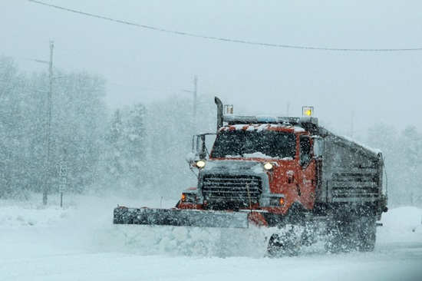
How to Protect Yourself
7. Fuel Levels
8. Lubrication
9. Lights and Wipers
10. Heaters and Defrosters
11. Check Brakes
12. Surface Damage or Cracks in Glass
ADDITIONAL COLD WEATHER REMINDERS/RECOMMENDATIONS
Notes:
How to Protect Yourself
7. Fuel Levels
It is best practice to top off your fuel every night so moisture will not collect in the tank. This will prevent the formation of ice crystals inside of your machine. It is also best to empty the water separator daily so it does not have a chance to freeze. Your fuel rating should be 40 Cetane or higher in the winter and 50 Cetane or higher when temperatures go below zero.
8. Lubrication
Any moving parts of your vehicle should remain properly lubricated as cold weather can cause parts to freeze or stick. This can halt processes and cause damage to the machine if parts jam during operation. Check all joints and hinges daily for proper lubrication.
9. Lights and Wipers
Checking that all lights and wipers on equipment are functional becomes even more important in the winter. Winter months tend to bring lower light levels, more condensation and more precipitation. In these poor-visibility conditions, it is essential that lights are kept clean and bad headlights are replaced immediately.
10. Heaters and Defrosters
For the comfort and safety of your employees, the defrosters and heaters in all machine cabs must be functional. Defrosters ensure that visibility can be maintained even in poor winter weather. Maintaining a comfortable temperature inside machines allows operators to move properly as extreme cold temperatures can cause muscles to stiffen which impairs proper operating.
11. Check Brakes
In winter weather, equipment is more likely to slip or skid so it is essential that brakes are working in top condition.
12. Surface Damage or Cracks in Glass
If there are any cracks in the glass of a windshield or window, these can become a serious issue in the winter when moisture seeps into cracks and freezes. The expansion of the ice will cause even small cracks to spread and could lead to the glass shattering. Small paint chips on equipment surfaces can lead to the machine rusting if it is left out in the snow or ice. Be sure to identify and repair any surface damage to machines before it becomes a bigger issue.
ADDITIONAL COLD WEATHER
REMINDERS/RECOMMENDATIONS
Always read and understand the Operation and Maintenance manual
To better prepare your machines for cold weather try the following:
Use block heaters
Use enclosed storage facilities when machines are not being used
Be sure to install the correct lubricants
Provide the correct cooling system protection for the conditions you are working
Inspect all rubber parts weekly
Keep all batteries fully charged
Always fill the fuel tank at the end of the shift
Check the air filters on a regular basis when snow is present
Before your shift, run the engine until it reaches operating temperatures
If your machine is shut down for more than 16 hours, the engine will cool to the external temperature
Always maintain your machine per the Operation and Maintenance Manual during cold weather

Slide 7

Final Word
Cold weather affects motorized equipment — not only the engine, but the hydraulic systems as well. Equipment that does not operate smoothly or predictably is a safety hazard to operators and other workers near it.
Notes:
Final Word
Cold weather affects motorized equipment — not only the engine, but the hydraulic systems as well. Equipment that does not operate smoothly or predictably is a safety hazard to operators and other workers near it.

