Slide 1

Click anywhere to get started…

Slide 2



SAFETY AROUND DEGREASING SOLVENT
Notes:
Safety around degreasing solvent

Slide 3
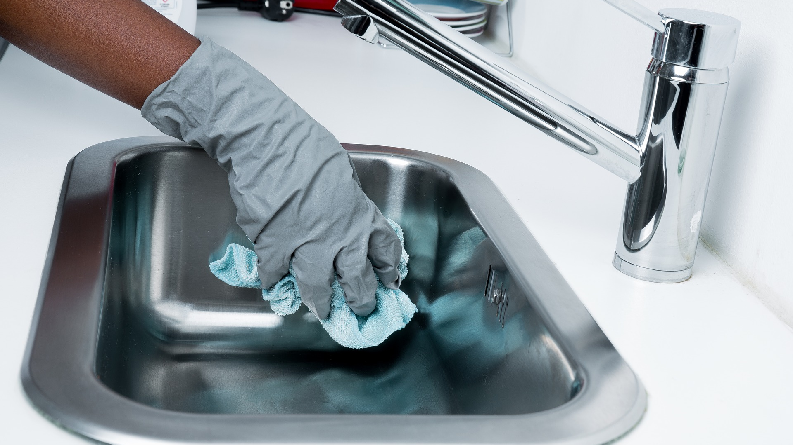
What’s at Stake?
All industrial grade degreasers have one thing in common: They excel at cutting through tough accumulations of grease and leaving the material underneath free of greasy residue.
Cleaning solvents are used to remove oil, grease, solder and other contaminants.
Notes:
What’s at stake?
All industrial grade degreasers have one thing in common: They excel at cutting through tough accumulations of grease and leaving the material underneath free of greasy residue.
Cleaning solvents are used to remove oil, grease, solder and other contaminants.

Slide 4
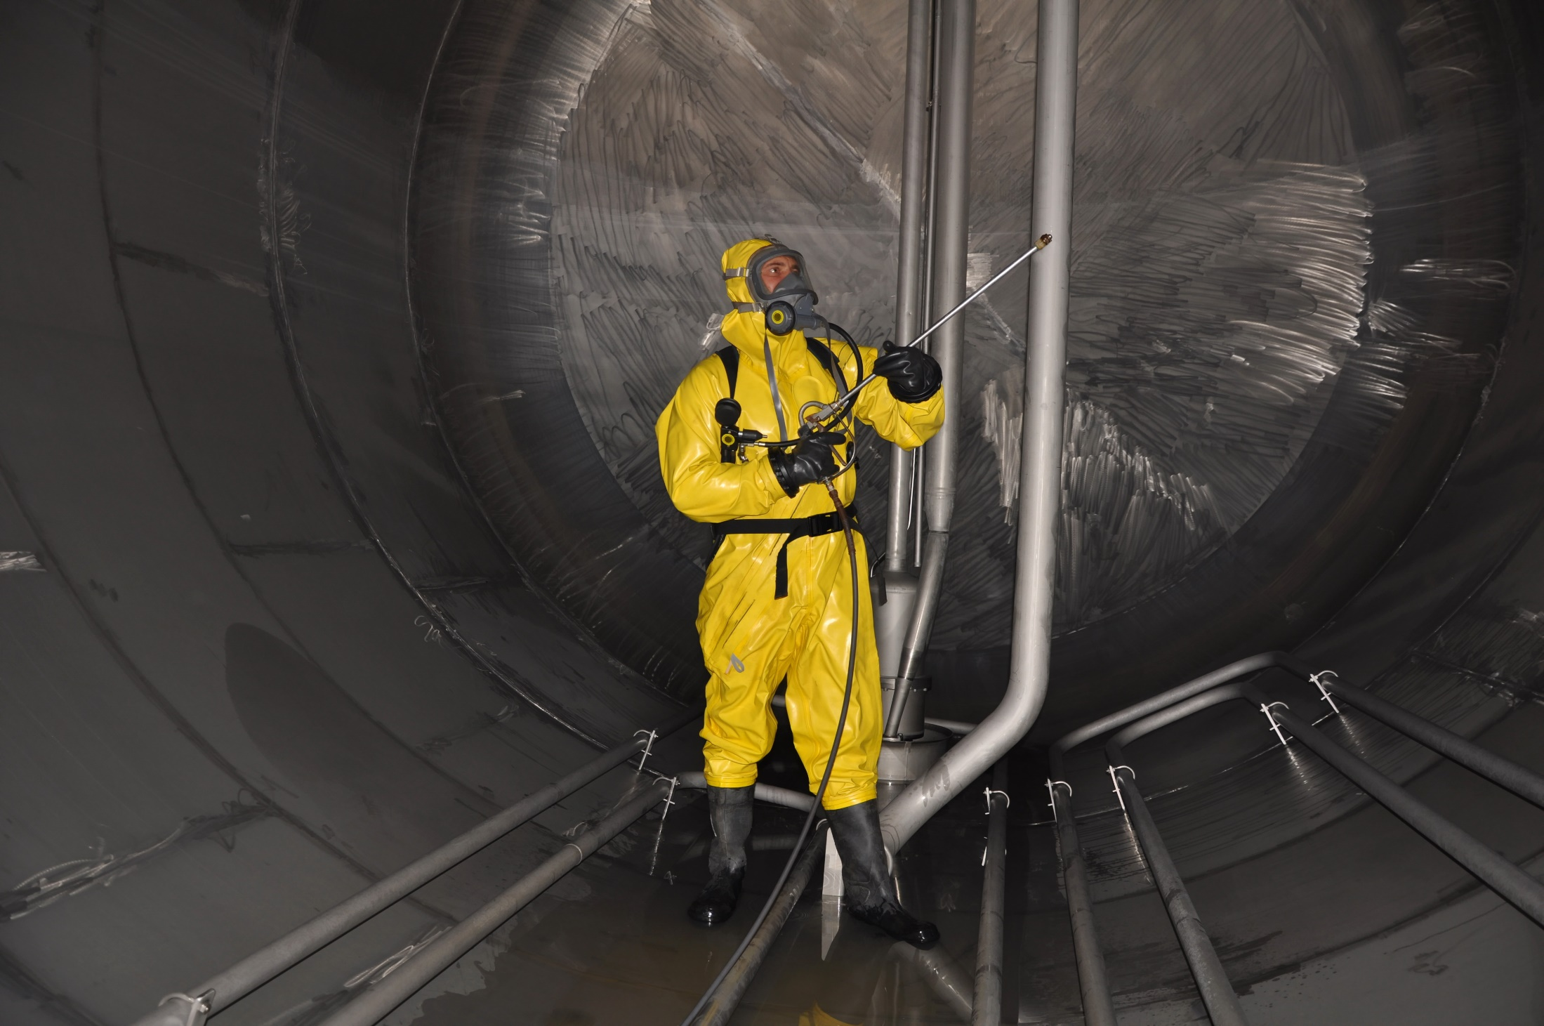
What’s the Danger?
HEALTH EXPOSURE
Some commonly used solvents, and their uses, are:
Acetone (industrial coating)
Trichloro ethylene (degreasing)
Toluene (industrial coating, manufacture)
Methyl ethyl ketone (MEK) (printing ink)
Perchloro ethylene (dry cleaning)
White spirit (paints, printing ink, manufacturing)
Ethylene glycol ethers (maintenance work; semiconductor industry)
Notes:
What’s the danger?
Health exposure
Millions of workers are exposed to solvents on a daily basis. Health hazards associated with solvent exposure include toxicity to the nervous system, reproductive damage, liver and kidney damage, respiratory impairment, cancer, and dermatitis.
Sometimes it is necessary to get rid of grease, particularly in equipment maintenance. There are hundreds of different solvents that can do the job, and many of these have varying degrees of danger to the human body.
Solvents
Solvents are among the most commonly used chemicals in workplaces. Workers in different jobs regularly use solvents for degreasing, metal cleaning, and adhesion and as paint thinners or lubricants. Exposure to solvents can have both short and long-term health effects on workers.
Solvents are substances used to dilute or dissolve another substance to create a solution, and are widespread in workplaces. While water is the most common solvent (many substances are easily soluble in water), some substances cannot be easily dissolved and require strong chemicals as solvents.
Many solvents have exposure standards that must be complied with in the workplace. These standards indicate the permissible "airborne contaminant" levels of exposure, and, in some cases, ceiling levels to which workers may be exposed without causing detrimental health effects.
Some commonly used solvents, and their uses, are:
Acetone (industrial coating)
Trichloro ethylene (degreasing)
Toluene (industrial coating, manufacture)
Methyl ethyl ketone (MEK) (printing ink)
Perchloro ethylene (dry cleaning)
White spirit (paints, printing ink, manufacturing)
Ethylene glycol ethers (maintenance work; semiconductor industry)

Slide 5
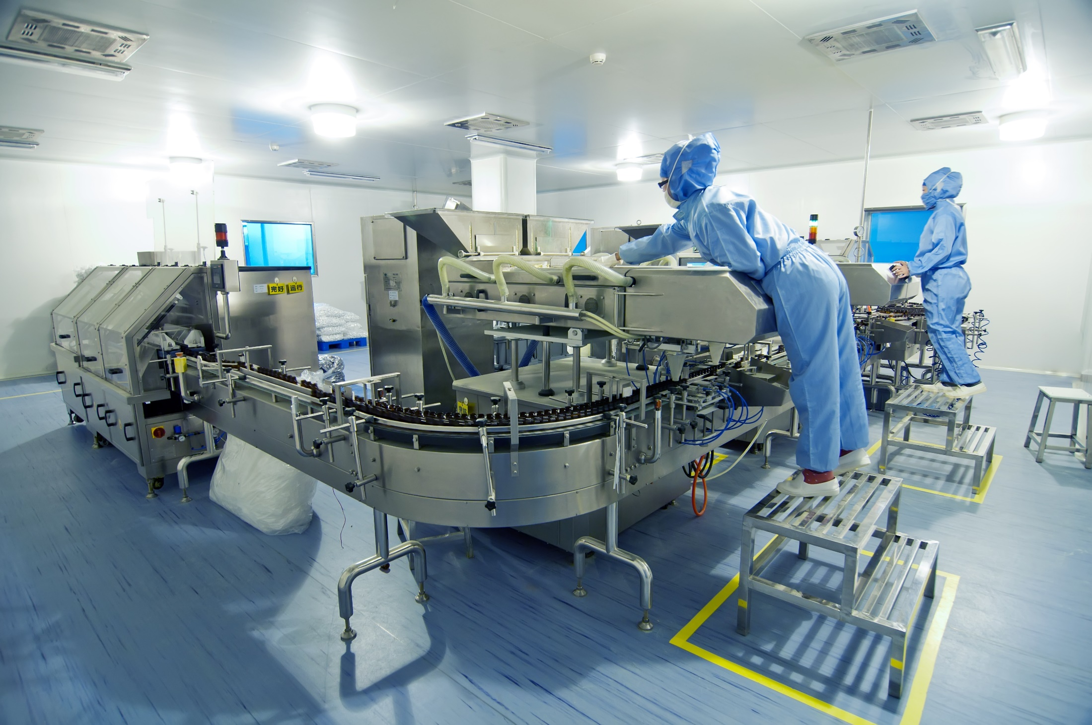
What’s the Danger?
HOW DO SOLVENTS ENTER THE BODY?
Inhalation
Ingestion
Skin Absorption
THE HEALTH EFFECTS
Short Term Effects
Repeated (Long Term) Exposure
Notes:
What’s the danger?
How do solvents enter the body
Inhalation: most solvents are "volatile", ie they evaporate into the air very quickly. The fumes, dusts, gases and vapours that result can then be breathed in and easily passed through the lungs into the blood stream.
Ingestion: solvent droplets can form in the hairs inside the nose, be sniffed in or swallowed. Mouth contact with contaminated hands, food and cigarettes can also result in the ingestion of solvents.
Skin absorption: solvents can be absorbed through the skin by direct contact and enter the bloodstream in this way.
The health effects
Different solvents have different effects, depending on how exposure happens, how much and for how long. The effects of many solvents are still poorly understood.
Short-term effects can be caused by single exposures, often to a large amount of solvent. Short-term exposure can cause:
Dermatitis or skin problems
Headaches
Drowsiness
Poor coordination
Nausea (feeling sick)
These effects usually take place very quickly. In cases of exposure to very high concentrations of solvent vapour, unconsciousness and even death can occur.
Repeated (long term) exposure to solvents may affect:
The brain and the nervous system (see below)
The skin - causing dermatitis
The liver - causing liver damage
The blood-forming system
The kidneys
The fertility of both men and women
The foetus in a pregnant woman and increased likelihood of spontaneous abortion
Some solvents, for example, benzene, can cause cancer.
Some solvents will have synergistic effects with other hazards and drugs. This means that the solvent will have greater health effects when it is in combination with other hazards. For example, after using an organic solvent, the effects from exposure will be greater if the person smokes cigarettes or drinks alcohol soon afterwards.

Slide 6

How to Protect Yourself
SOLVENTS AND OTHER CHEMICALS SHOULD BE DEALT WITH IN THIS WAY
Employer Responsibilities
Workers’ Responsibilities
Notes:
How to protect yourself
Solvents and other chemicals should be dealt with in this way
Identification of the hazard
Assessment of the risk
Elimination or reduction of the risk
Review and evaluation of any control strategies.
Employer responsibilities
Provide information and training, and increases awareness of people who work with solvents.
Ensure solvents are appropriately stored in a cool place, away from any potential ignition sources.
Ensure the storage area is well ventilated and firmly secured.
Ensure that solvent containers are properly labeled indicating the hazards of the substance and what should be done in case of an emergency.
Ensure spills or leaks are contained with sand or other appropriate absorbents. Spillages must not be allowed to enter drains or other waterways.
Provide adequate facilities for working and dining.
Provide proper p.P.E. For employees.
Workers ‘responsibilities
Do not use a substance unless you have been provided with adequate information about it and training in how to use it. All workers should make sure they know what the substance is, its effects, and how to use it correctly. They should have the appropriate PPE if it is needed.
Workers should also practice good hygiene by washing hands well before eating, drinking, smoking or going to the toilet.

Slide 7

Final Word
Solvents represent the best and worst of our economics with the resultant impact on the health of society and the environment. We strive to continually meet the challenge of balancing the needs of society and protecting the environment through the lens of solvent use.
Notes:
Final Word
Solvents represent the best and worst of our economics with the resultant impact on the health of society and the environment. We strive to continually meet the challenge of balancing the needs of society and protecting the environment through the lens of solvent use.

