Slide 1

Click anywhere to get started…

Slide 2
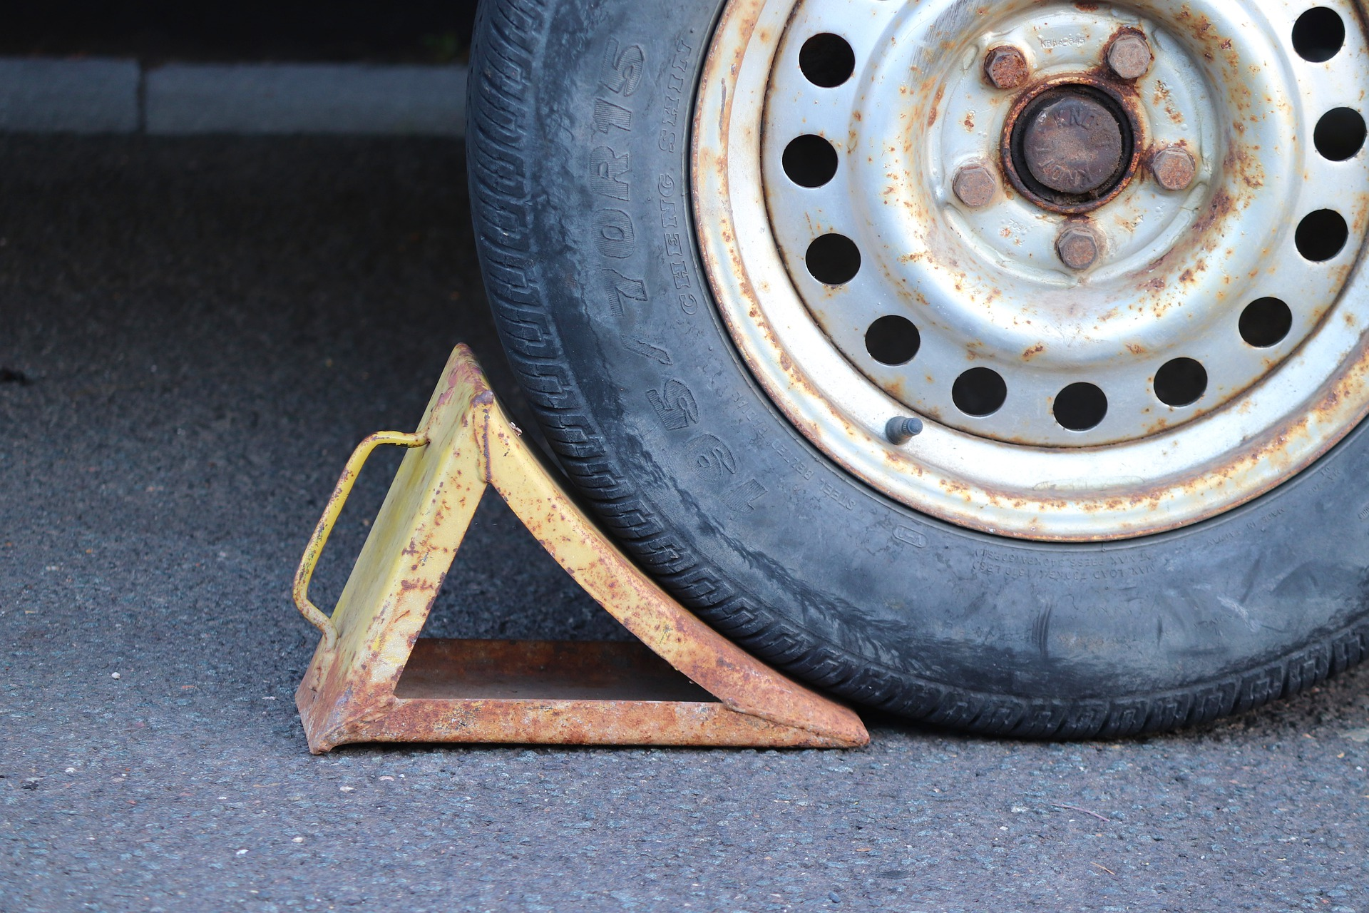


CHOCKING WHEELS
Notes:
Chocking Wheels

Slide 3
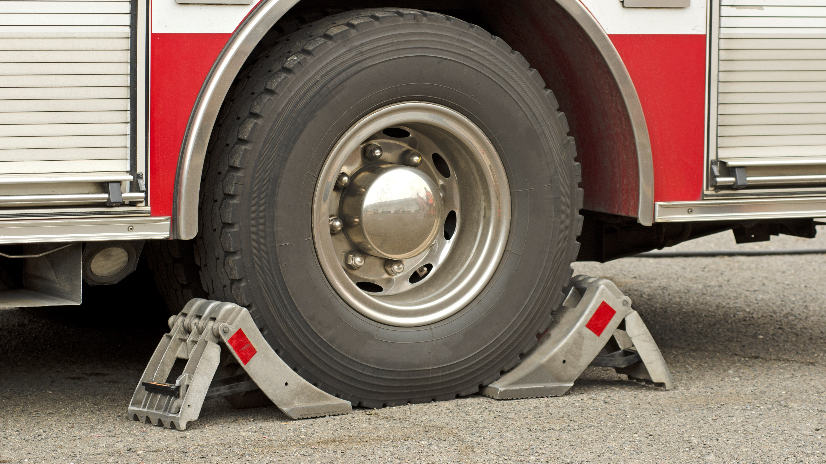
What’s at Stake?
Chocking is the act of using a wedge to immobilize the wheels of a vehicle or equipment to keep it from accidentally moving.
Notes:
What’s at Stake?
Chocking is the act of using a wedge to immobilize the wheels of a vehicle or equipment to keep it from accidentally moving. Chocking the wheels of a vehicle, such as a truck or trailer, physically stops the movement of wheels to prevent runaways that can injure workers and destroy property.

Slide 4
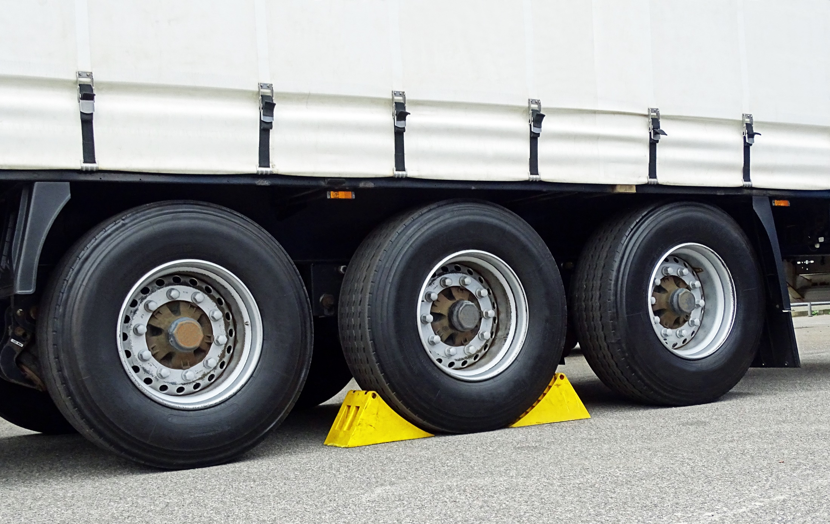
What’s the Danger?
There are many dangers and perils workers and highly trained specialists on the plant floors of industrial organizations encounter and experience on a daily basis.
Chocking prevents movements
Notes:
What’s the Danger?
There are many dangers and perils workers and highly trained specialists on the plant floors of industrial organizations encounter and experience on a daily basis.
Chocking prevents movements
As an illustration, crush points are created when two objects move toward each other or one object moves toward a stationary one. For example, you would create a potential crush point if you fail to chock a wagon’s wheels before you unhitch it from a tractor. The wagon could roll toward the tractor and potentially crush you as you unhitch the wagon.
There are glaring examples where, dangerous situations are created by improper applications of procedures to prevent movements of machines.

Slide 5
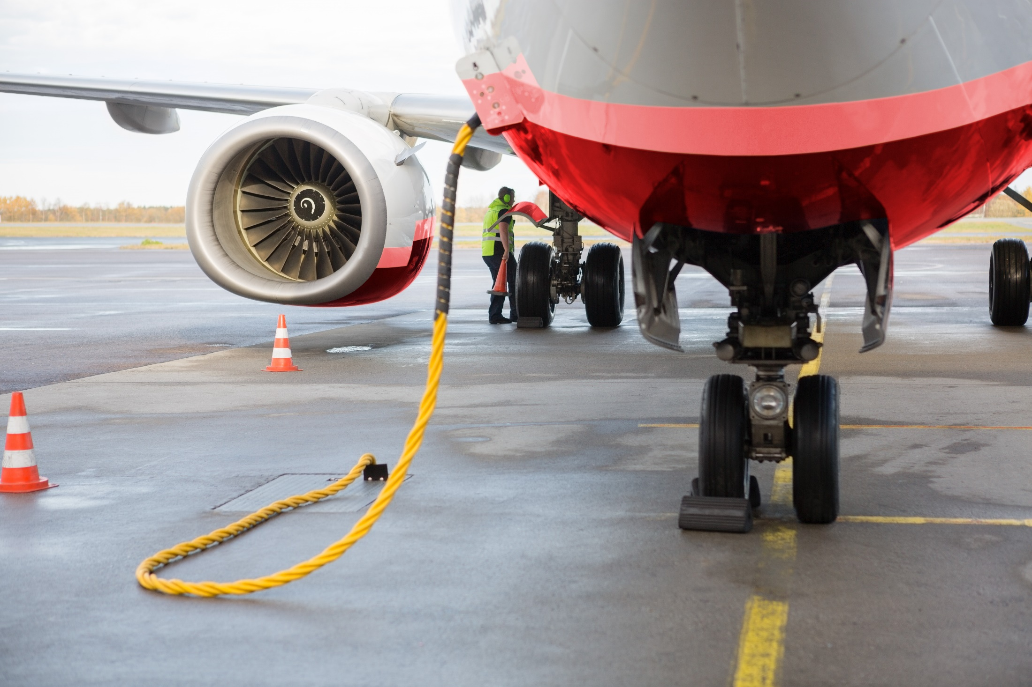
What’s the Danger?
Examples
A worker was repairing a front-end loader with the bucket raised but without following LOTO procedures and without putting blocking on the hydraulic arms of the bucket. The hydraulics start to lose pressure and the bucket falls to the ground and fatally crushes the worker.
A by-stander is struck and receives disabling injuries after a delivery driver failed to properly chock the wheels on her truck.
Notes:
What’s the Danger?
Examples
A worker was repairing a front-end loader with the bucket raised but without following LOTO procedures and without putting blocking on the hydraulic arms of the bucket. The hydraulics start to lose pressure and the bucket falls to the ground and fatally crushes the worker.
A by-stander is struck and receives disabling injuries after a delivery driver failed to properly chock the wheels on her truck.

Slide 6
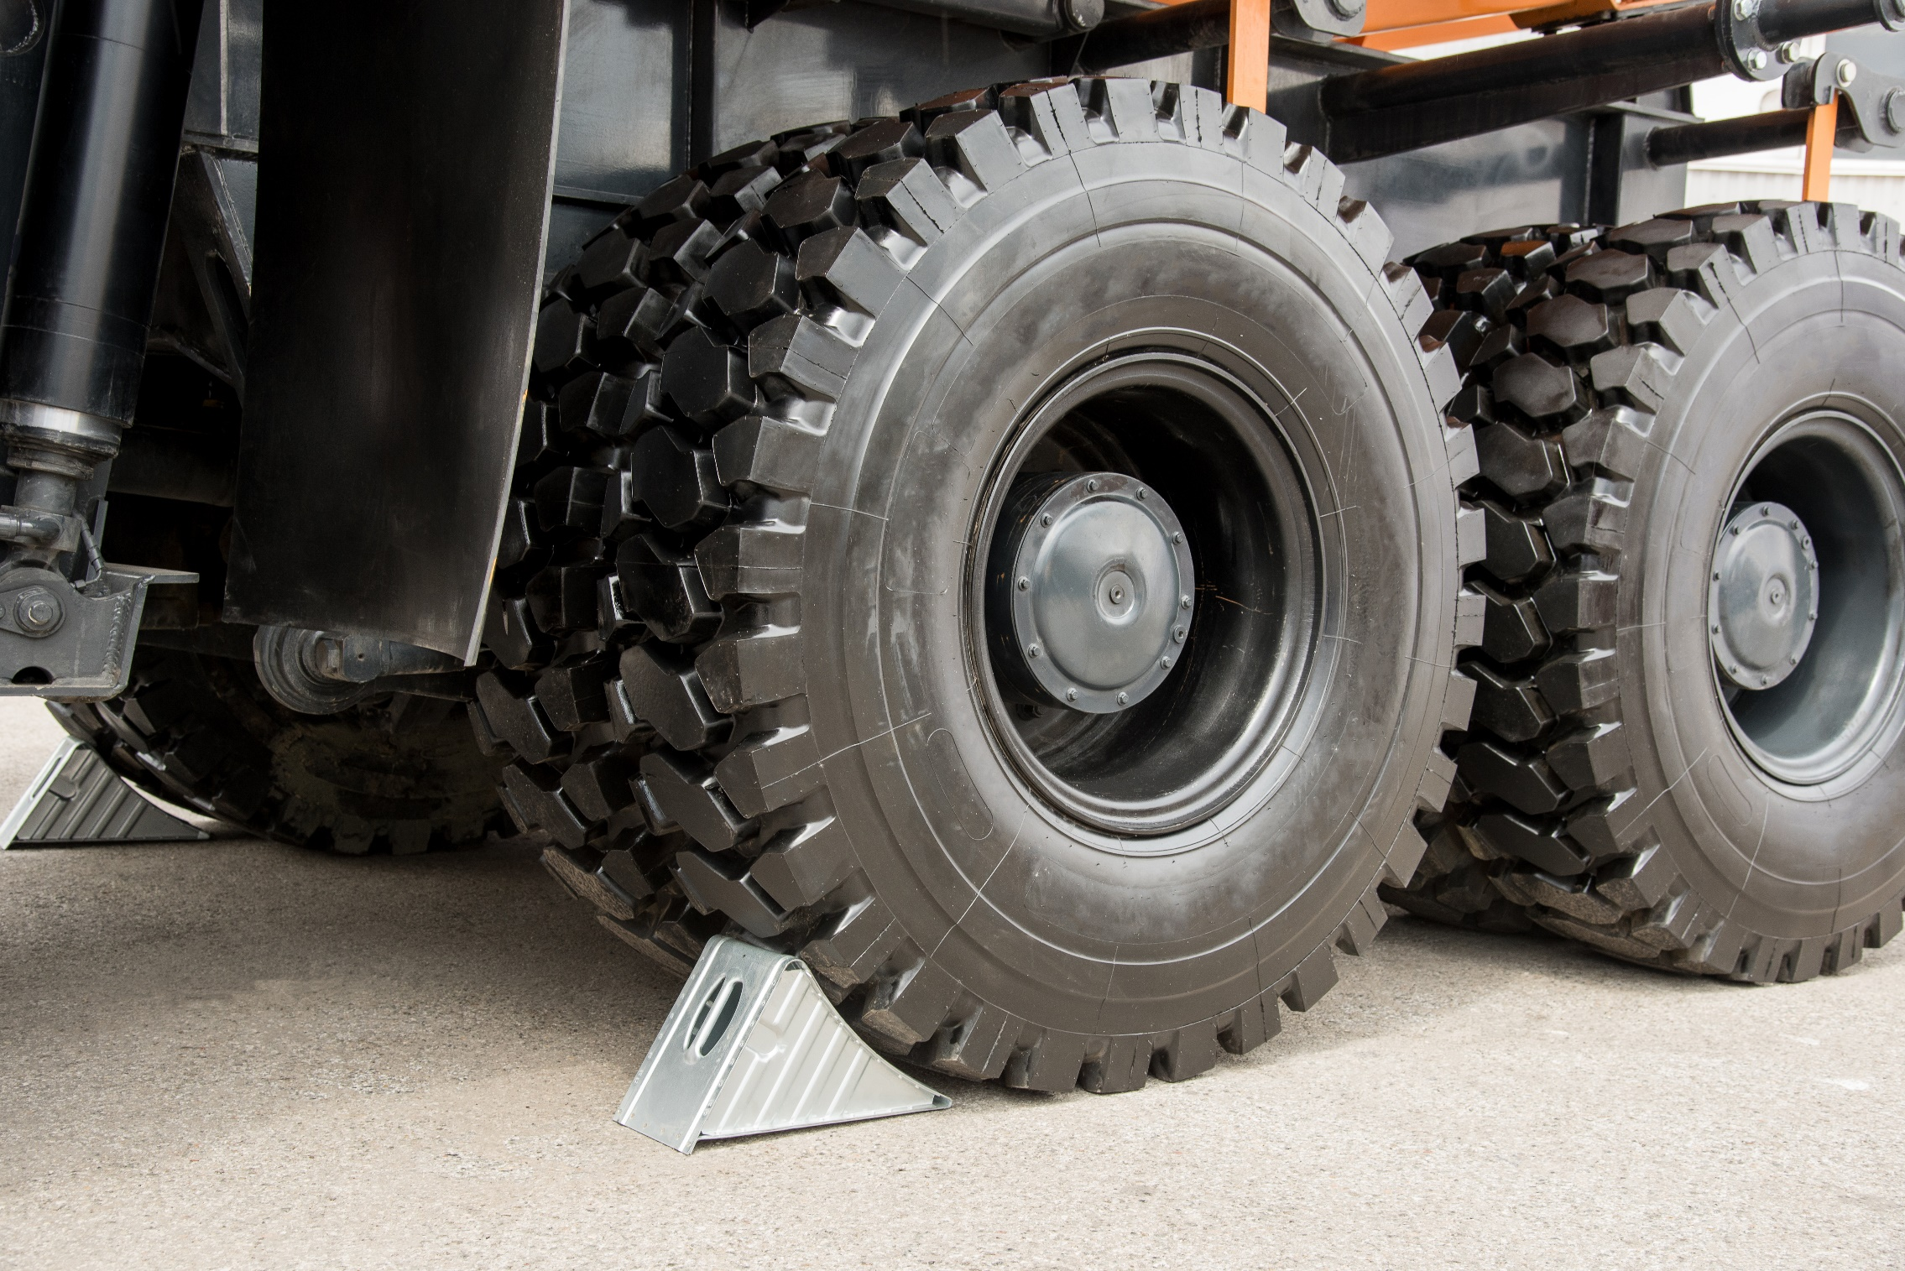
How to Protect Yourself
Chocking
If you drive a truck, tractor, or other mobile equipment, use special caution when exiting the vehicle.
To chock a freestanding vehicle place chocks on the left and right rear axle wheels.
To secure vehicles at loading dock, first make sure the trailer is backed up against the loading dock edges and place chocks on the left and right wheels that are closest to the loading dock.
Only use chocks designed to be used with trucks, vehicles and equipment. Stay away from lumber, cement blocks, rocks, or other homemade items.
Notes:
How to Protect Yourself
Chocking
If you drive a truck, tractor, or other mobile equipment, use special caution when exiting the vehicle.
Ensure the brakes are set, the vehicle is at a complete standstill, and that it will not roll forward or backward before you exit.
To chock a freestanding vehicle place chocks on the left and right rear axle wheels.
It is safest to chock both the front and back wheels on both sides of a vehicle.
Some vehicle wheels may also need to be chocked at the front and back of each tire.
To secure vehicles at loading dock, first make sure the trailer is backed up against the loading dock edges and place chocks on the left and right wheels that are closest to the loading dock.
This placement allows a forklift to push down on the trailer wheels and seat them more firmly against the chock.
When only the front axle is chocked, the forward motion of a forklift entering the trailer can loosen the chock, allowing the vehicle to creep forward or jump the chock.
The safest bet is to chock both the front and back wheels on both sides of a vehicle.
Only use chocks designed to be used with trucks, vehicles and equipment. Stay away from lumber, cement blocks, rocks, or other homemade items.
Store chocks inside trailers so they are easy to find and readily available.
Chain chocks to loading docks to keep them from being misplaced.

Slide 7
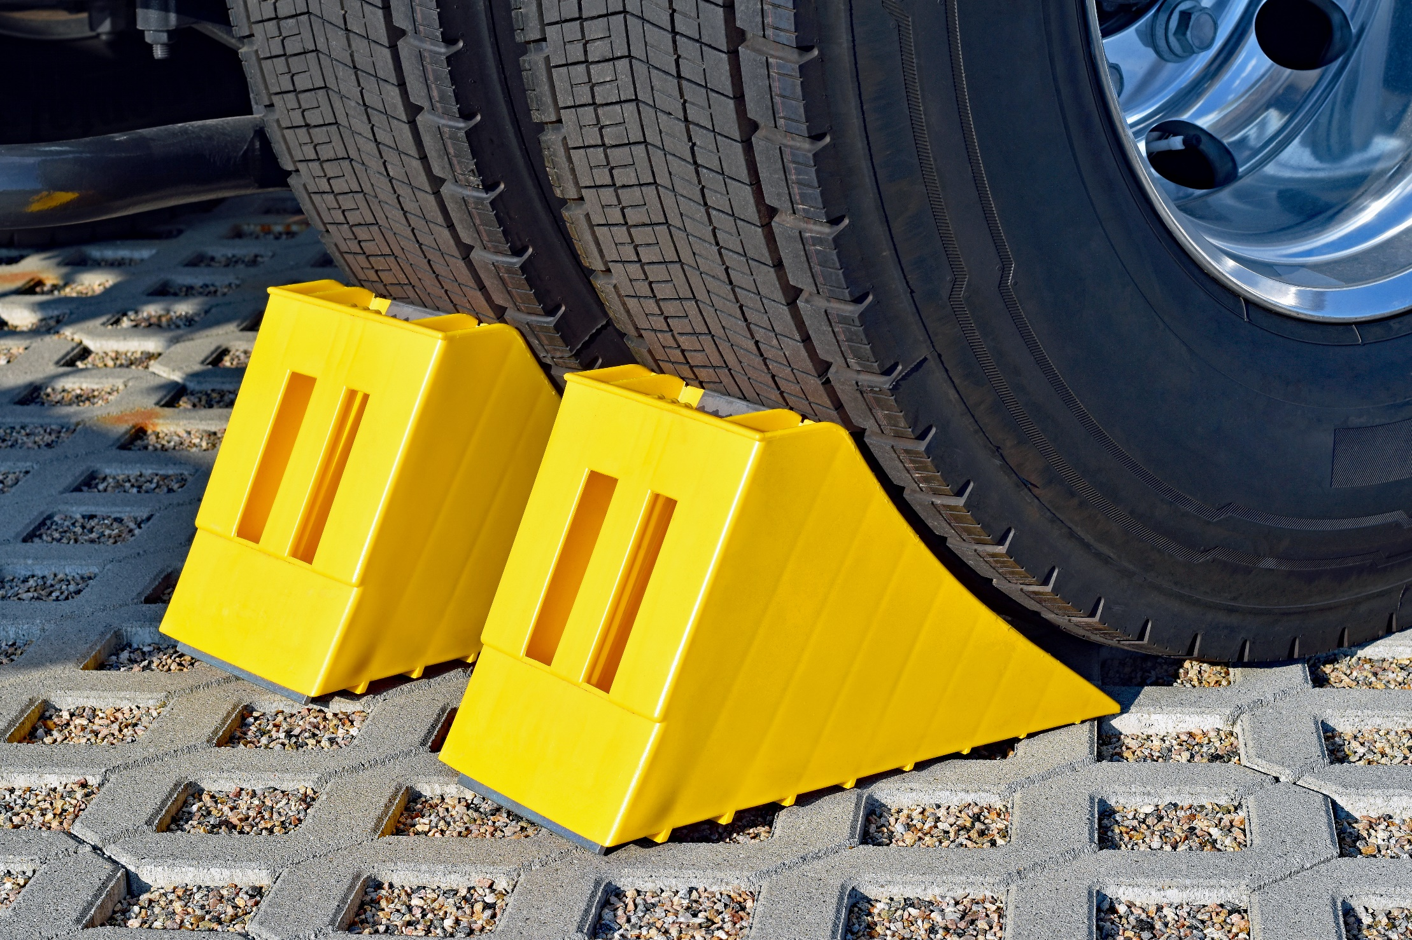
How to Protect Yourself
Choosing the Right Chocks
You’ll find wheel chocks in a wide range of sizes, which correspond to the sizes of various tires.
Type of tire
Chock material
Road material
Load weight
Limitations of Wheel Chocks
While OSHA standards mandate the use of chocks, they have their limitations and must be used as part of a larger safety strategy to keep docked trailers in place.
Notes:
How to Protect Yourself
Choosing the Right Chocks
You’ll find wheel chocks in a wide range of sizes, which correspond to the sizes of various tires. Most manufacturers specify the tire height that their chocks are designed to accommodate, but there are other important considerations:
Type of tire
Chock material
Road material
Load weight
Limitations of Wheel Chocks
While OSHA standards mandate the use of chocks, they have their limitations and must be used as part of a larger safety strategy to keep docked trailers in place.
Trailers are extremely heavy, especially when loaded, and wheel chocks simply don’t offer enough restraining force to fully prevent early departure from the loading dock. Many businesses also lack an effective communication system to signal the status of the chocks to truck drivers and forklift operators.

Slide 8
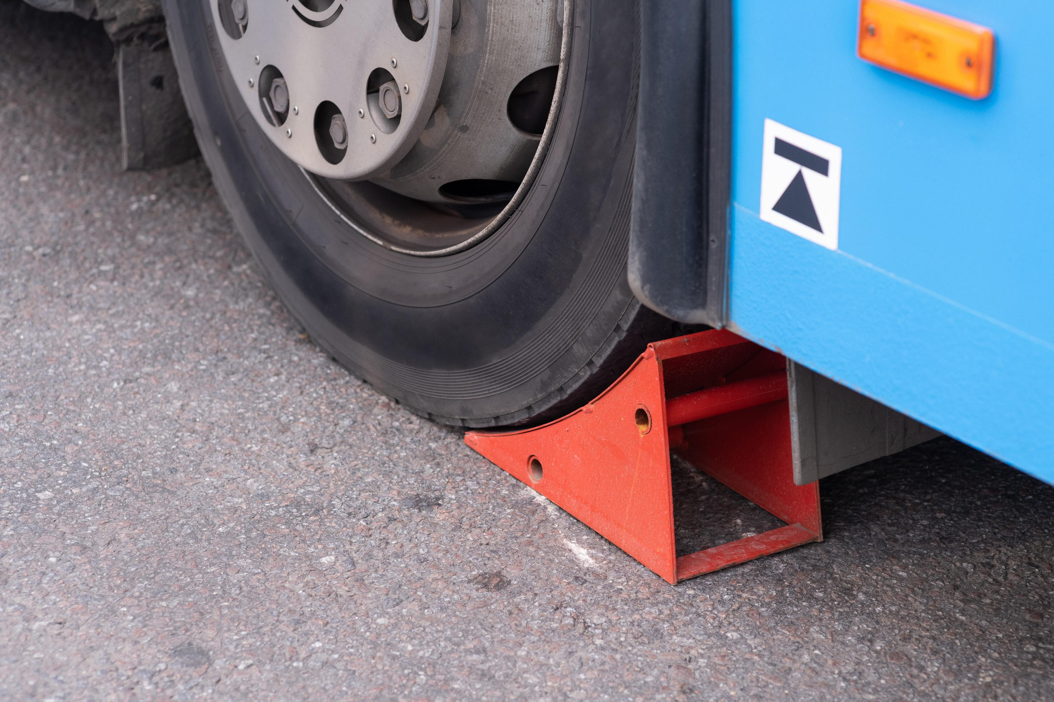
How to Protect Yourself
Takeaways for Chocks
Chocks can easily slip on ice and snow, resulting in trailer creep
They are often damaged, misplaced, and even stolen
Employees responsible for setting them in place must take care to prevent back injuries
Employee Responsibility
If you’re working in and around the loading dock, you should understand what wheel chocks are and why they’re used.
If you’re the one in charge of putting the wheel chocks into place, you have a great responsibility. Follow these steps to ensure you’re chocking the trailer properly:
Notes:
How to Protect Yourself
Takeaways for Chocks
Chocks can easily slip on ice and snow, resulting in trailer creep
They are often damaged, misplaced, and even stolen
Employees responsible for setting them in place must take care to prevent back injuries
Employee Responsibility
If you’re working in and around the loading dock, you should understand what wheel chocks are and why they’re used. You must also understand (and apply) the established communication procedures for confirming the status of the chocks. Failure to adhere to policies like this could result in the loading or unloading process beginning before the chocks are set and it’s safe to do so.
If you’re the one in charge of putting the wheel chocks into place, you have a great responsibility. Follow these steps to ensure you’re chocking the trailer properly:
Make sure the parking brake is set
Use chocks in pairs
Chock in the direction of the grade (if the surface is level, chock both sides of one wheel)
Center the chocks against the wheel
Use established communication procedures to confirm that chocking is complete and that loading or unloading can begin

Slide 9

How to Protect Yourself
Employer Responsibility
For wheel chocks to be effective, employers must provide proper training to loading dock workers. Training could include:
Conclusion
Despite their limitations, wheel chocks should always be used as an added safety measure against the early departure of trailers from the loading dock.
Proper Use
Types of Wheel Chocks
Notes:
How to Protect Yourself
Employer Responsibility
For wheel chocks to be effective, employers must provide proper training to loading dock workers. Training could include:
What wheel chocks are and why they’re used
How to properly set and remove a wheel chock
Inspecting chocks for signs of damage or excess wear
Conclusion
Despite their limitations, wheel chocks should always be used as an added safety measure against the early departure of trailers from the loading dock. With a bit of training, good communication, and safe work practices, this will make the difference between a safe workday and a tragic accident.
Proper Use
Wheel chocks must be secured properly to keep trucks and other vehicles from moving, especially on a grade. For vehicles that sit on level ground, the chocks should be placed on both sides of tires. For downhill grades, chocks should be placed on the front sides of the tires and for uphill grades; chocks should be placed outside of the rear wheels.
Types of Wheel Chocks
There is a variety of wheel chocks for different industries.

Slide 10
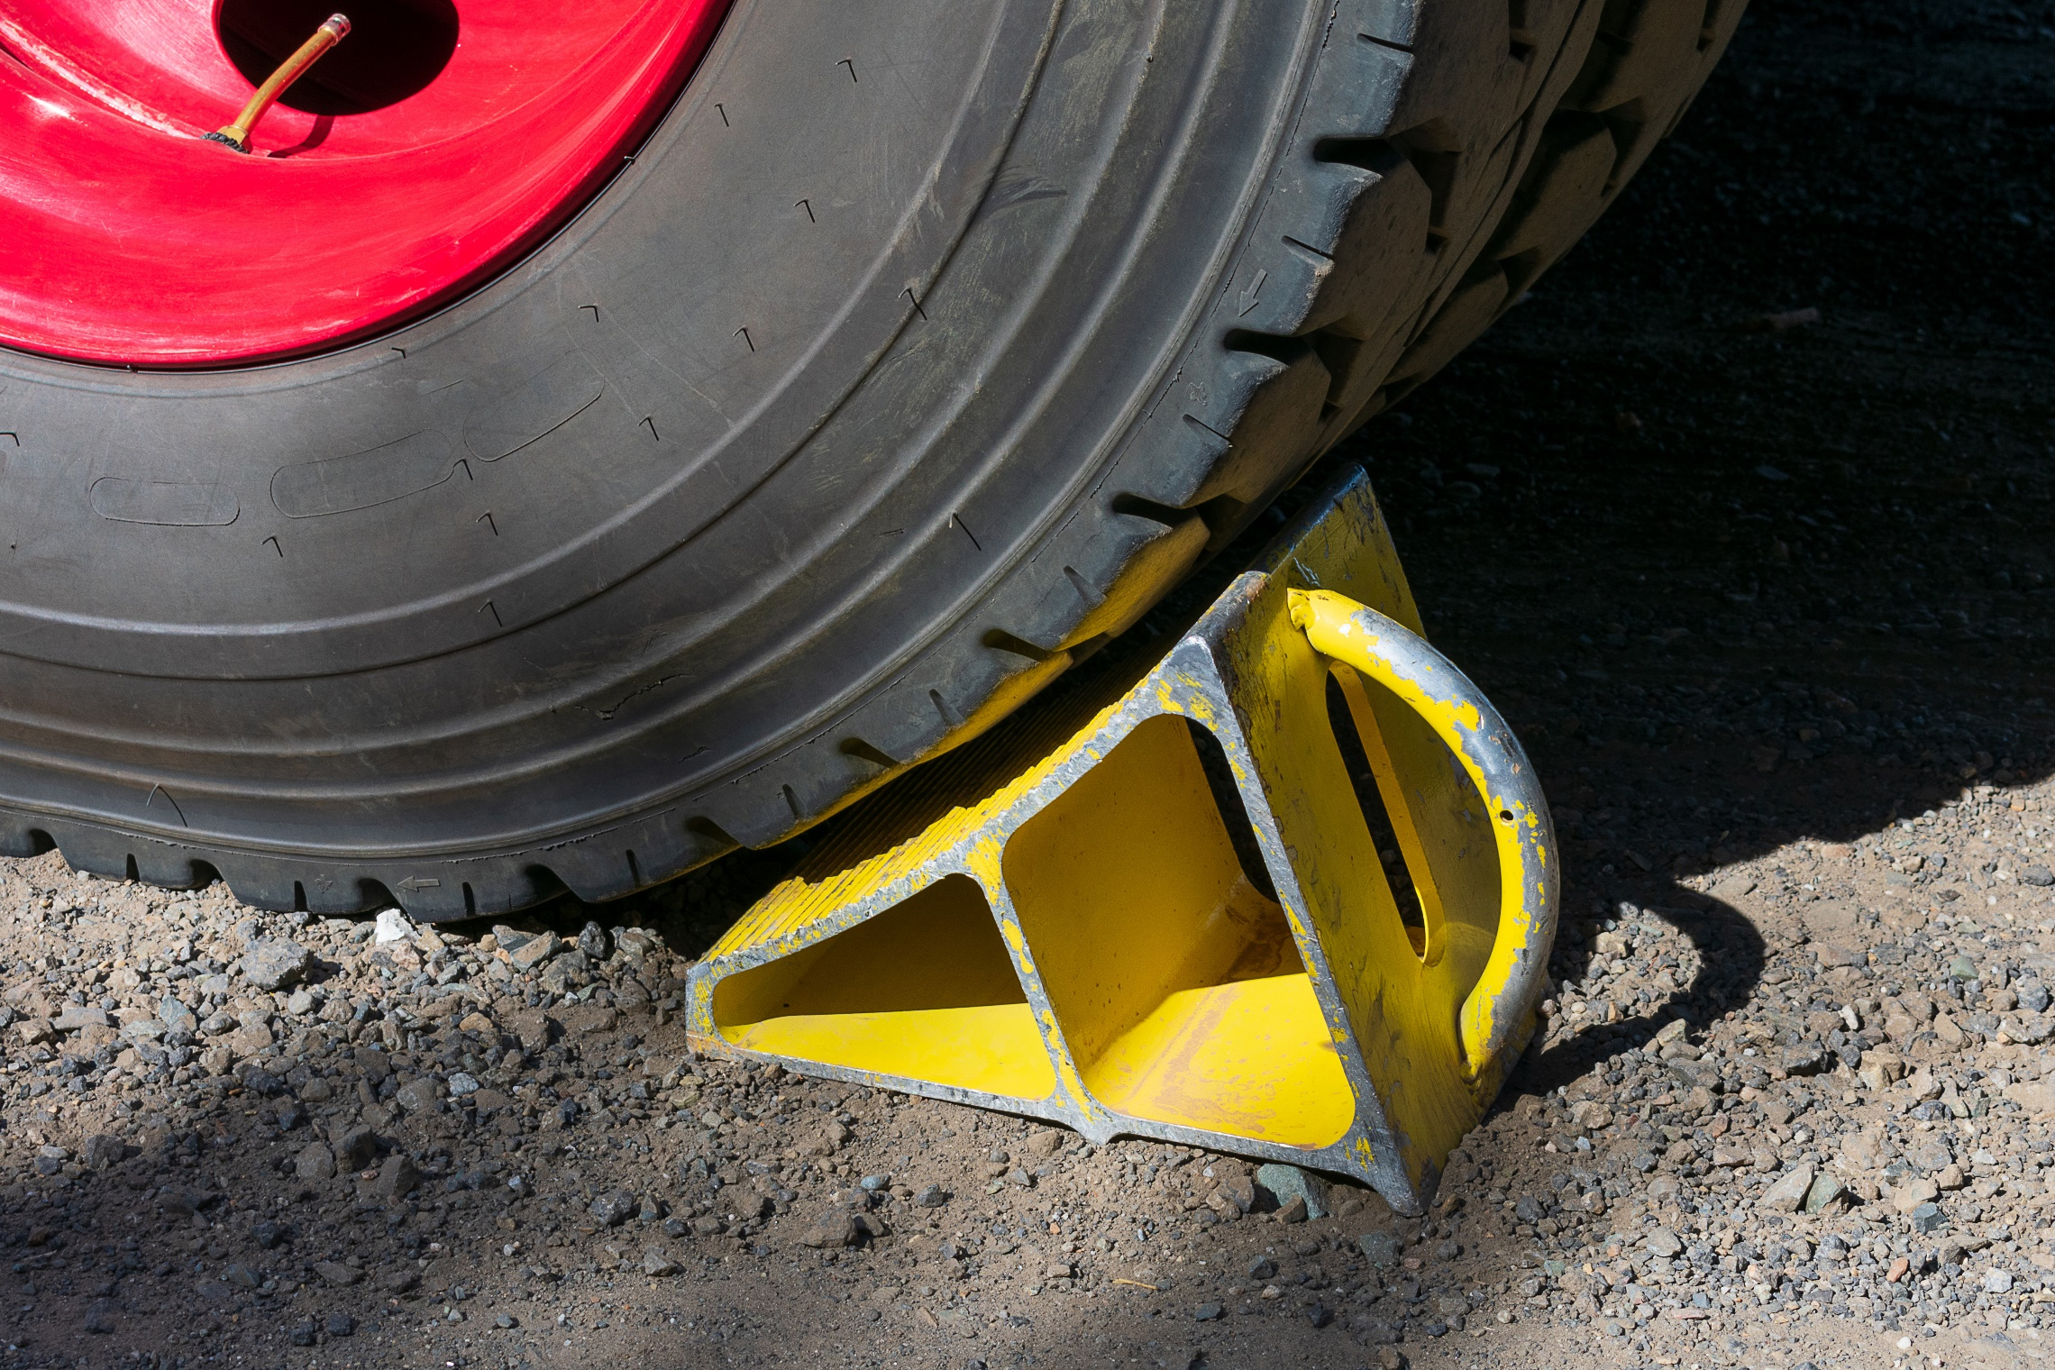
How to Protect Yourself
Heavy Duty wheel chocks
General Purpose wheel chocks
Aviation wheel chocks
Rubber aviation wheel chocks
It is the responsibility of the end user to make the ﬁnal determination about proper chocking of a vehicle under the circumstances presented.
Notes:
How to Protect Yourself
Heavy Duty wheel chocks are designed for heavy equipment, haul trucks, cranes, loaders, underground mining vehicles, fire engines as well as large military tactical vehicles. These chocks are durable and lightweight due to their innovative urethane construction.
General Purpose wheel chocks are ideal for over the road trucks, trailers, utility vehicles and pick-ups. They come in a variety of sizes, but they are all industrial grade.
Aviation wheel chocks won’t splinter or crack, eliminate maintenance cost, and are made of durable urethane, which is lightweight and easy to use. We provide chocks for most sizes and styles of aircraft.
Rubber aviation wheel chocks are durable and made of 100% recycled rubber. Additionally, the design allows for the either side of the chock to be placed against the tire and will fit the needs of a variety of aircraft.
It is the responsibility of the end user to make the ﬁnal determination about proper chocking of a vehicle under the circumstances presented. You cannot simply test a pair of wheel chocks with a speciﬁc vehicle on a speciﬁed grade and broadly assume that the wheel chocks will hold the same truck every time. Countless combinations of conditions exist and this must be considered when selecting the most appropriate wheel chock for each application. Thorough testing must be completed at each location to ensure that speciﬁc wheel chocks will meet their speciﬁc chocking requirements.

Slide 11
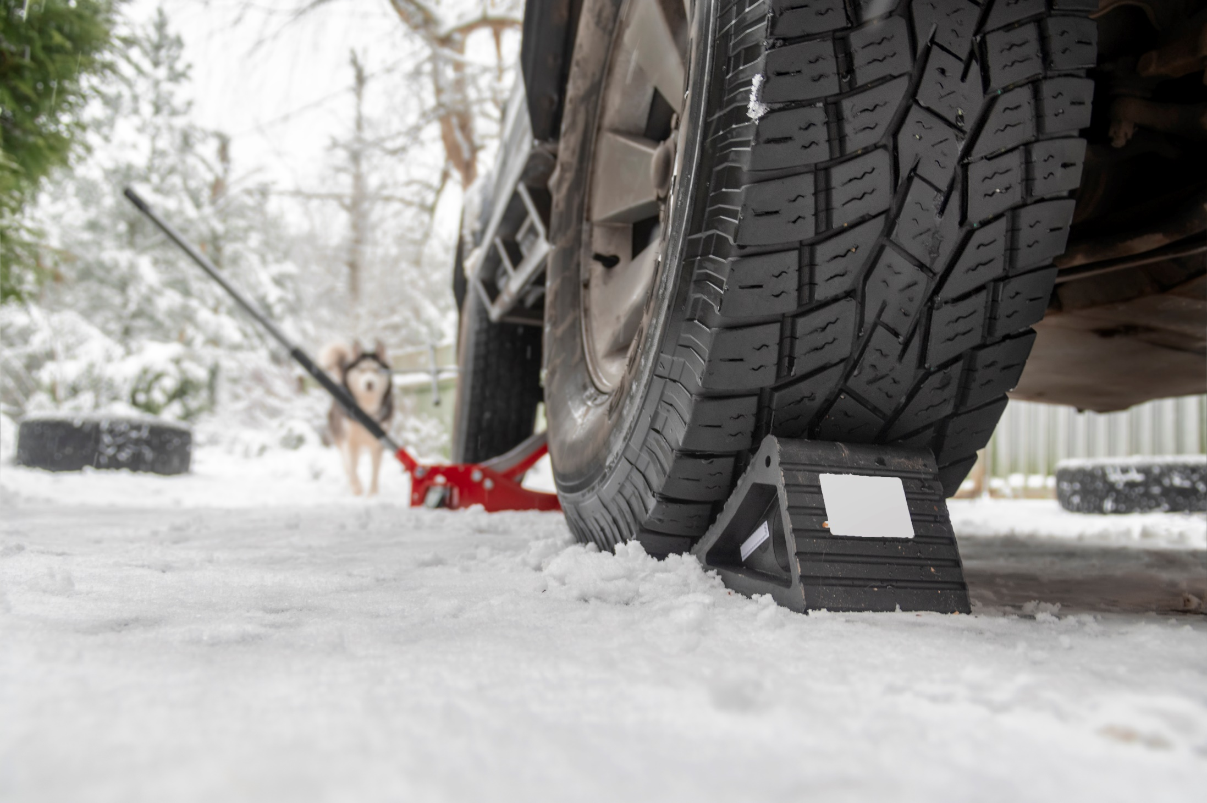
How to Protect Yourself
Here are the combinations of conditions must be considered for safe, proper chocking procedures:
Tire size
Gross vehicle weight
Level or grade of the ground surface
Radial Tires vs. Bias-Ply Tires
Tire pressure variance due to environment
Condition of the ground
The second key to proper chocking is the actual positioning of the chocks themselves. When chocking a vehicle, always follow these simple rules to ensure maximum efficiency and safety.
Notes:
How to Protect Yourself
Here are the combinations of conditions must be considered for safe, proper chocking procedures:
Tire size
Smaller tires require smaller chocks, while larger tires require larger chocks.
Gross vehicle weight
Heavier vehicles require larger chocks than lighter vehicles.
Level or grade of the ground surface
Chocks need to be positioned in different ways depending on if the ground is level or not. Ensuring that the chocking configuration is correct based on surface grade is paramount for proper chocking.
Radial Tires vs. Bias-Ply Tires
Radial tires by design deflect more than bias-ply tires. While this flexibility allows the vehicle to move more smoothly, it also allows the tire to wrap around the wheel chock, which reduces the chocks effectiveness.
Tire pressure variance due to environment
It is important to monitor tire pressure, especially in harsh environments. Improperly inflated tires can lead to chocking failures.
Condition of the ground
Whether the ground is firm, soft, wet, dry, icy, or frozen is a key determination in the type of chock to use. For frozen or icy terrain, choose a chock with a cleated bottom. For severely wet or muddy terrain, multiple chocks may be necessary to ensure safe chocking.
The second key to proper chocking is the actual positioning of the chocks themselves. When chocking a vehicle, always follow these simple rules to ensure maximum efficiency and safety.
1. Always ensure the chock is centered and squared with the tire.
2. Position the chock snuggly against the tire tread.
3. Always use wheel chocks in pairs.
4. Wheel chocks must be positioned downhill and below the vehicle’s center of gravity.
5. On a downhill grade, position the chocks in front of the front wheels.
6. On an uphill grade, position the chocks behind the rear wheels.
7. On a level grade, position the chocks on the front and back of a single wheel.

Slide 12
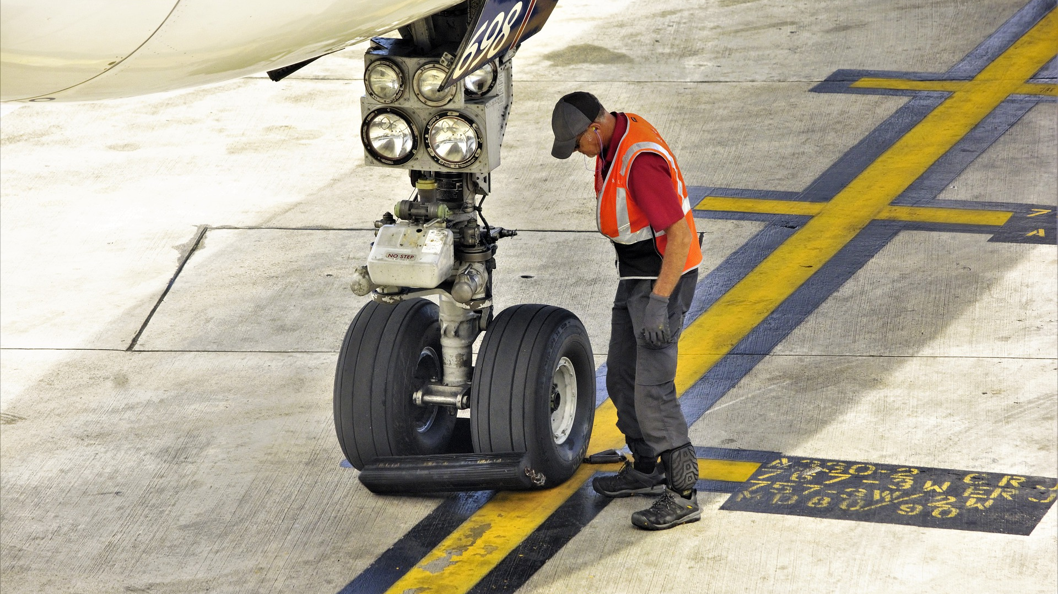
Final Word
Chocking and blocking are good practices to prevent heavy loads and vehicles from unintentionally moving. If you are loading or unloading, hitching or unhitching, or performing maintenance on a vehicle, you must take time to chock and block the equipment to protect you and others from unintended movement of the equipment and/or cargo.
Notes:
Final Word
Chocking and blocking are good practices to prevent heavy loads and vehicles from unintentionally moving. If you are loading or unloading, hitching or unhitching, or performing maintenance on a vehicle, you must take time to chock and block the equipment to protect you and others from unintended movement of the equipment and/or cargo.

