Slide 1

Click anywhere to get started…

Slide 2



USE OF PERSONAL PROTECTIVE EQUIPMENT (PPE)
Notes:
USE OF PERSONAL PROTECTIVE EQUIPMENT (PPE)

Slide 3
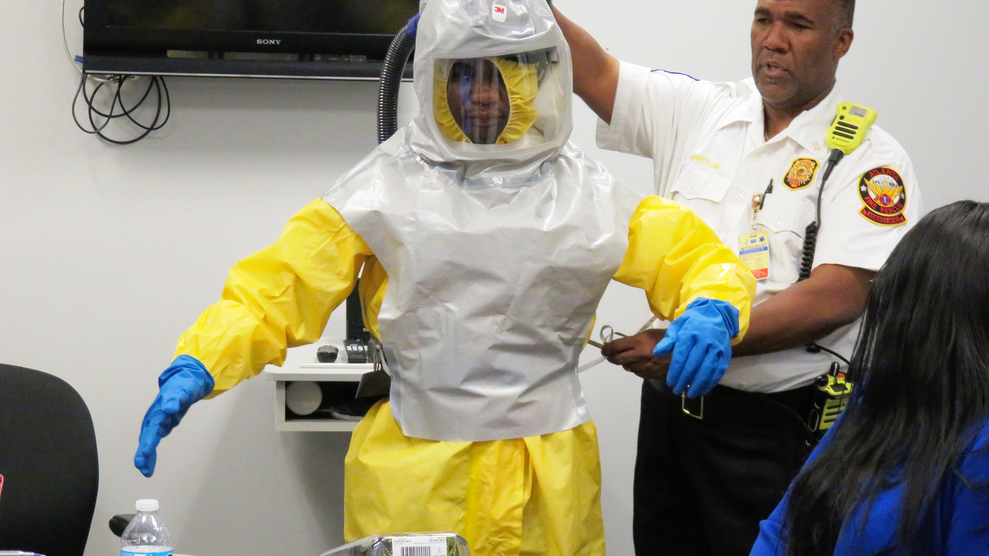
What’s at Stake?
Hazards exist in every workplace. Controlling a hazard at its source should be the first choice of protection because this method will eliminate it from the workplace altogether.
Notes:
What’s at Stake?
Hazards exist in every workplace. Controlling a hazard at its source should be the first choice of protection because this method will eliminate it from the workplace altogether. When elimination is not possible, try substitution of the material with non-hazardous ones, isolation of hazards, addition of safety features to existing equipment, redesign of the work processes, or purchase new equipment. When the hazard cannot be removed or controlled adequately, personal protective equipment is the last line of defense if the work process is to continue.

Slide 4
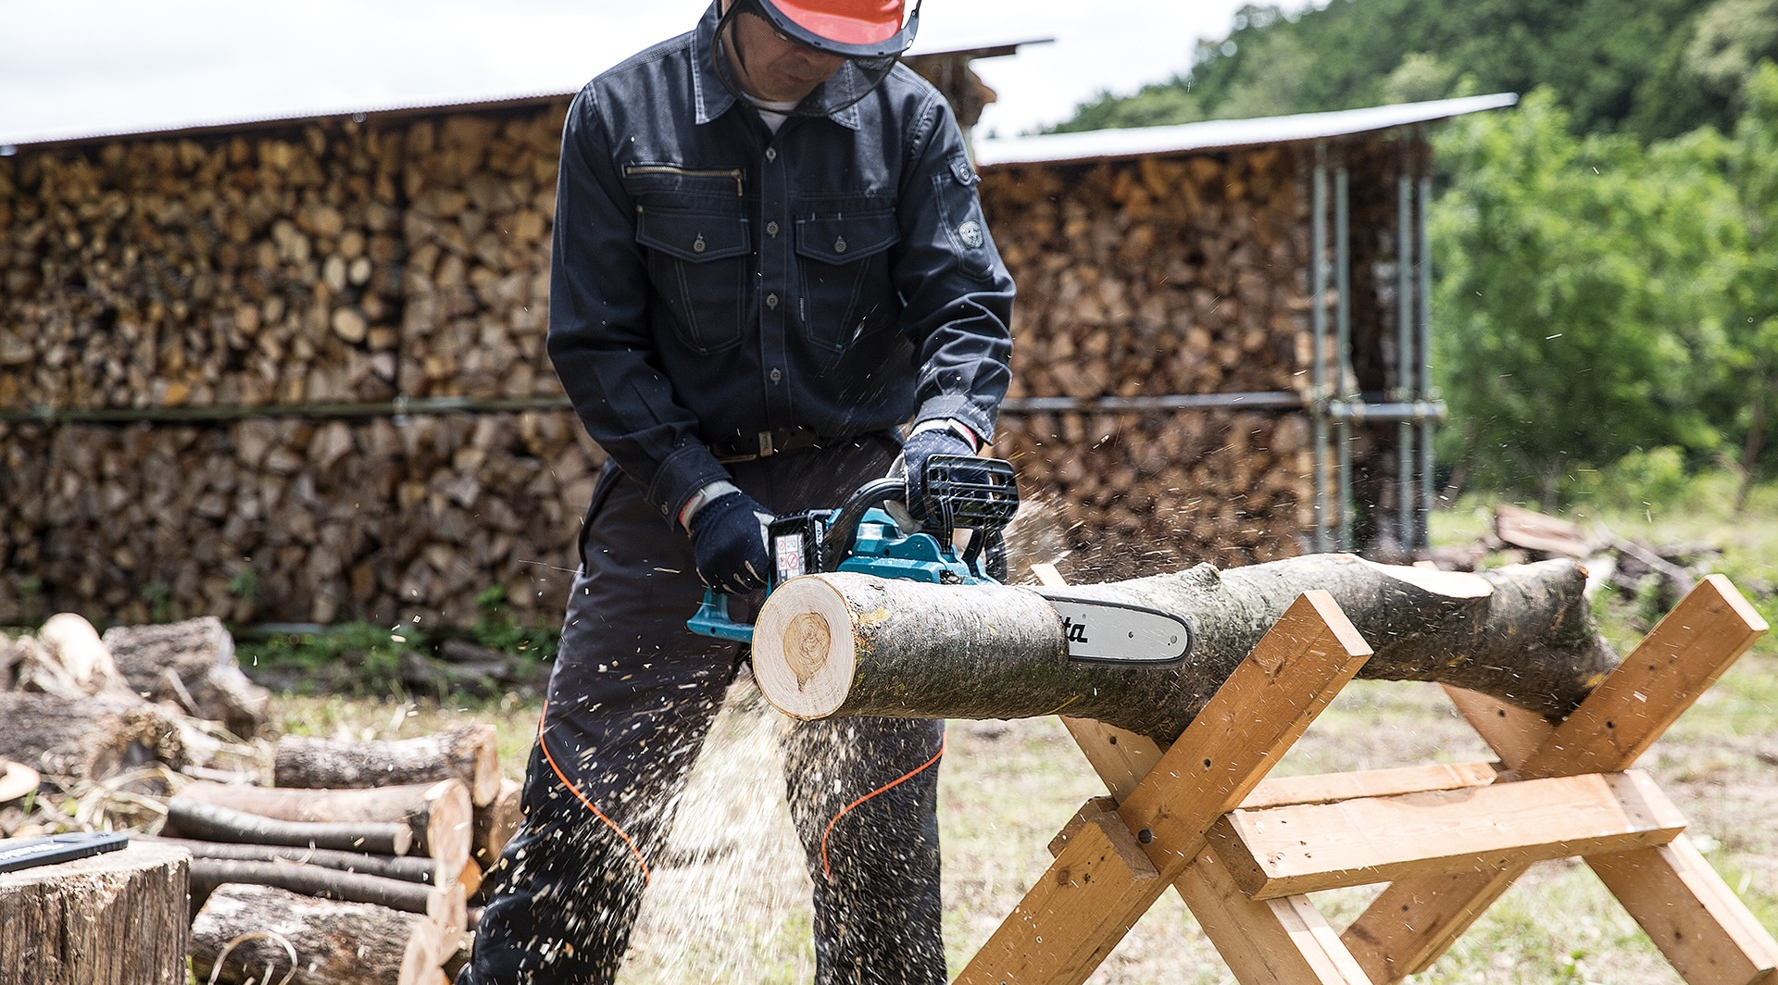
What’s the Danger?
HAZARD RESIDUE
What to do?
Ask These Questions:
Dangers of employee refusal to wear PPE
Notes:
What’s the Danger?
HAZARD RESIDUE
Even where engineering controls and safe systems of work have been applied, some hazards might remain. These include injuries to:
The lungs, ie. from breathing in contaminated air.
The head and feet, ie. from falling materials.
The eyes, ie. from flying particles or splashes of corrosive liquids.
The skin, ie. from contact with corrosive materials.
The body, ie. from extremes of heat or cold.
What to do?
Only use PPE as a last resort.
If PPE is still needed after implementing other controls (and there will be circumstances when it is, eg head protection on most construction sites), you must provide this for your employees free of charge.
You must choose the equipment carefully and ensure employees are trained to use it properly, and know how to detect and report any faults.
Ask These Questions:
Who is exposed and to what?
How long are they exposed for?
How much are they exposed to?
When selecting and using PPE:
Choose products which are CE marked in accordance with the Personal Protective Equipment (Enforcement) Regulations 2018.
Choose equipment that suits the user – consider the size, fit and weight of the PPE. If the users help choose it, they will be more likely to use it.
If more than one item of PPE is worn at the same time, make sure they can be used together, ie. wearing safety glasses may disturb the seal of a respirator, causing air leaks.
Instruct and train people how to use it, eg train people to remove gloves without contaminating their skin. Tell them why it is needed, when to use it and what its limitations are.
Dangers of employee refusal to wear PPE
An employee's refusal to wear PPE may be cause for discipline, particularly if the refusal creates a risk of infection for other employees at the workplace. However, each case should be considered on its own facts and with a view to the individual employee's situation.
What if an employee would like to provide their own PPE?
If an employee wishes to provide their own PPE, employers must ensure that the employee can adhere to PPE protocols, including measures for donning, doffing, and disposing of PPE. Some issues that may arise are:
Can the employer ensure the self-provided PPE is being properly cleaned or disposed of?
Is the self-provided PPE fit for its purpose?
Are there any hazards associated with the re-use of self-provided PPE?

Slide 5

How to Protect Yourself
LAST LINE OF DEFENSE
PPE does not remove or reduce workplace hazards
Employer's obligation to provide PPE
Selecting, Using, and Maintaining PPE
Training
Skin Protection
Notes:
How to Protect Yourself
LAST LINE OF DEFENSE
PPE does not remove or reduce workplace hazards and does not replace effective engineering or administrative control methods such as substitution or ventilation. PPE is the last line of defense when the hazard cannot be removed or controlled adequately. Proper selection, use and care of the equipment are vital to provide the proper level of protection.
Employer's obligation to provide PPE
Businesses resuming operations may have an obligation to provide PPE as part of their workplace occupational health and safety ("OHS") obligations, depending on the nature of the business and the services provided. PPE is more likely to be required in situations where it is not possible to maintain two-metre distancing.
Selecting, Using, and Maintaining PPE
Employers are responsible for selecting, providing and fitting of appropriate PPE for the hazardous exposures in the workplace. Consult the Material Safety Data Sheet (MSDS) for advice. Consider how the materials will be used, the quantity used, and the types and duration of exposure. Ensure that there will be an adequate margin of protection in case of a spill or other emergency.
Ensure that the PPE provides a good fit. The PPE should not impair dexterity or flexibility or create safety issues such as entrapment.
Proper maintenance is essential. Follow the PPE manufacturer's recommended procedures for cleaning and storage.
Training
Employers must ensure that employees are trained to properly use, maintain and store PPE. Employees also must:
Have training with "hands on" instruction in the fit, use and maintenance of assigned PPE.
Understand the limitations of the PPE and know what to do in the event of exposure or device failure (e.g. how to use emergency showers, eyewash stations, and first aid).
Understand when to discard/replace PPE (e.g. end of shift, every hour).
Report any missing or defective devices to the supervisor.
Skin Protection
Many kinds of protective gloves and clothing are available, including aprons, full body suits and boots. Gloves and clothing may be manufactured from many different materials such as latex, rubber, Viton™ and Tychem®TK. No one material can protect from all chemical hazards. Contact the product manufacturer or supplier or a PPE supplier to find out which specific protective materials are best for the chemicals with which you are working.
Also consider issues such as temperature conditions or the need to protect against punctures, tears and abrasion.

Slide 6

How to Protect Yourself
SPECIFIC PPE PROTECTION
Eyes
Hazards
Options
Head and neck
Hazards
Options
Ears
Hazards
Options
Hands and arms
Hazards
Options
Feet and legs
Hazards
Options
Notes:
How to Protect Yourself
SPECIFIC PPE PROTECTION
Eyes
Hazards
Chemical or metal splash, dust, projectiles, gas and vapour, radiation
Options
Safety spectacles, goggles, face screens, face shields, visors.
Make sure the eye protection chosen has the right combination of impact / dust / splash / molten metal eye protection for the task and fits the user properly.
Head and neck
Hazards
Impact from falling or flying objects, risk of head bumping, hair getting tangled in machinery, chemical drips or splash, climate or temperature.
Options
Industrial safety helmets, bump caps, hairnets and firefighters' helmets
Some safety helmets incorporate or can be fitted with specially-designed eye or hearing protection.
Don't forget neck protection, eg scarves for use during welding.
Replace head protection if it is damaged.
Ears
Hazards
Noise – a combination of sound level and duration of exposure, very high-level sounds are a hazard even with short duration.
Options
Earplugs, earmuffs, semi-insert/canal caps
Provide the right hearing protectors for the type of work, and make sure workers know how to fit them.
Choose protectors that reduce noise to an acceptable level, while allowing for safety and communication.
Hands and arms
Hazards
Abrasion, temperature extremes, cuts and punctures, impact, chemicals, electric shock, radiation, biological agents and prolonged immersion in water.
Options
Gloves, gloves with a cuff, gauntlets and sleeving that covers part or all of the arm.
Avoid gloves when operating machines such as bench drills where the gloves might get caught.
Some materials are quickly penetrated by chemicals – take care in selection, see HSE’s skin at work website.
Barrier creams are unreliable and are no substitute for proper PPE.
Wearing gloves for long periods can make the skin hot and sweaty, leading to skin problems. Using separate cotton inner gloves can help prevent this.
Feet and legs
Hazards
Wet, hot and cold conditions, electrostatic build-up, slipping, cuts and punctures, falling objects, heavy loads, metal and chemical splash, vehicles.
Options
Safety boots and shoes with protective toecaps and penetration-resistant, mid-sole wellington boots and specific footwear, eg foundry boots and chainsaw boots.
Footwear can have a variety of sole patterns and materials to help prevent slips in different conditions, including oil - or chemical-resistant soles. It can also be anti-static, electrically conductive or thermally insulating.
Appropriate footwear should be selected for the risks identified.

Slide 7
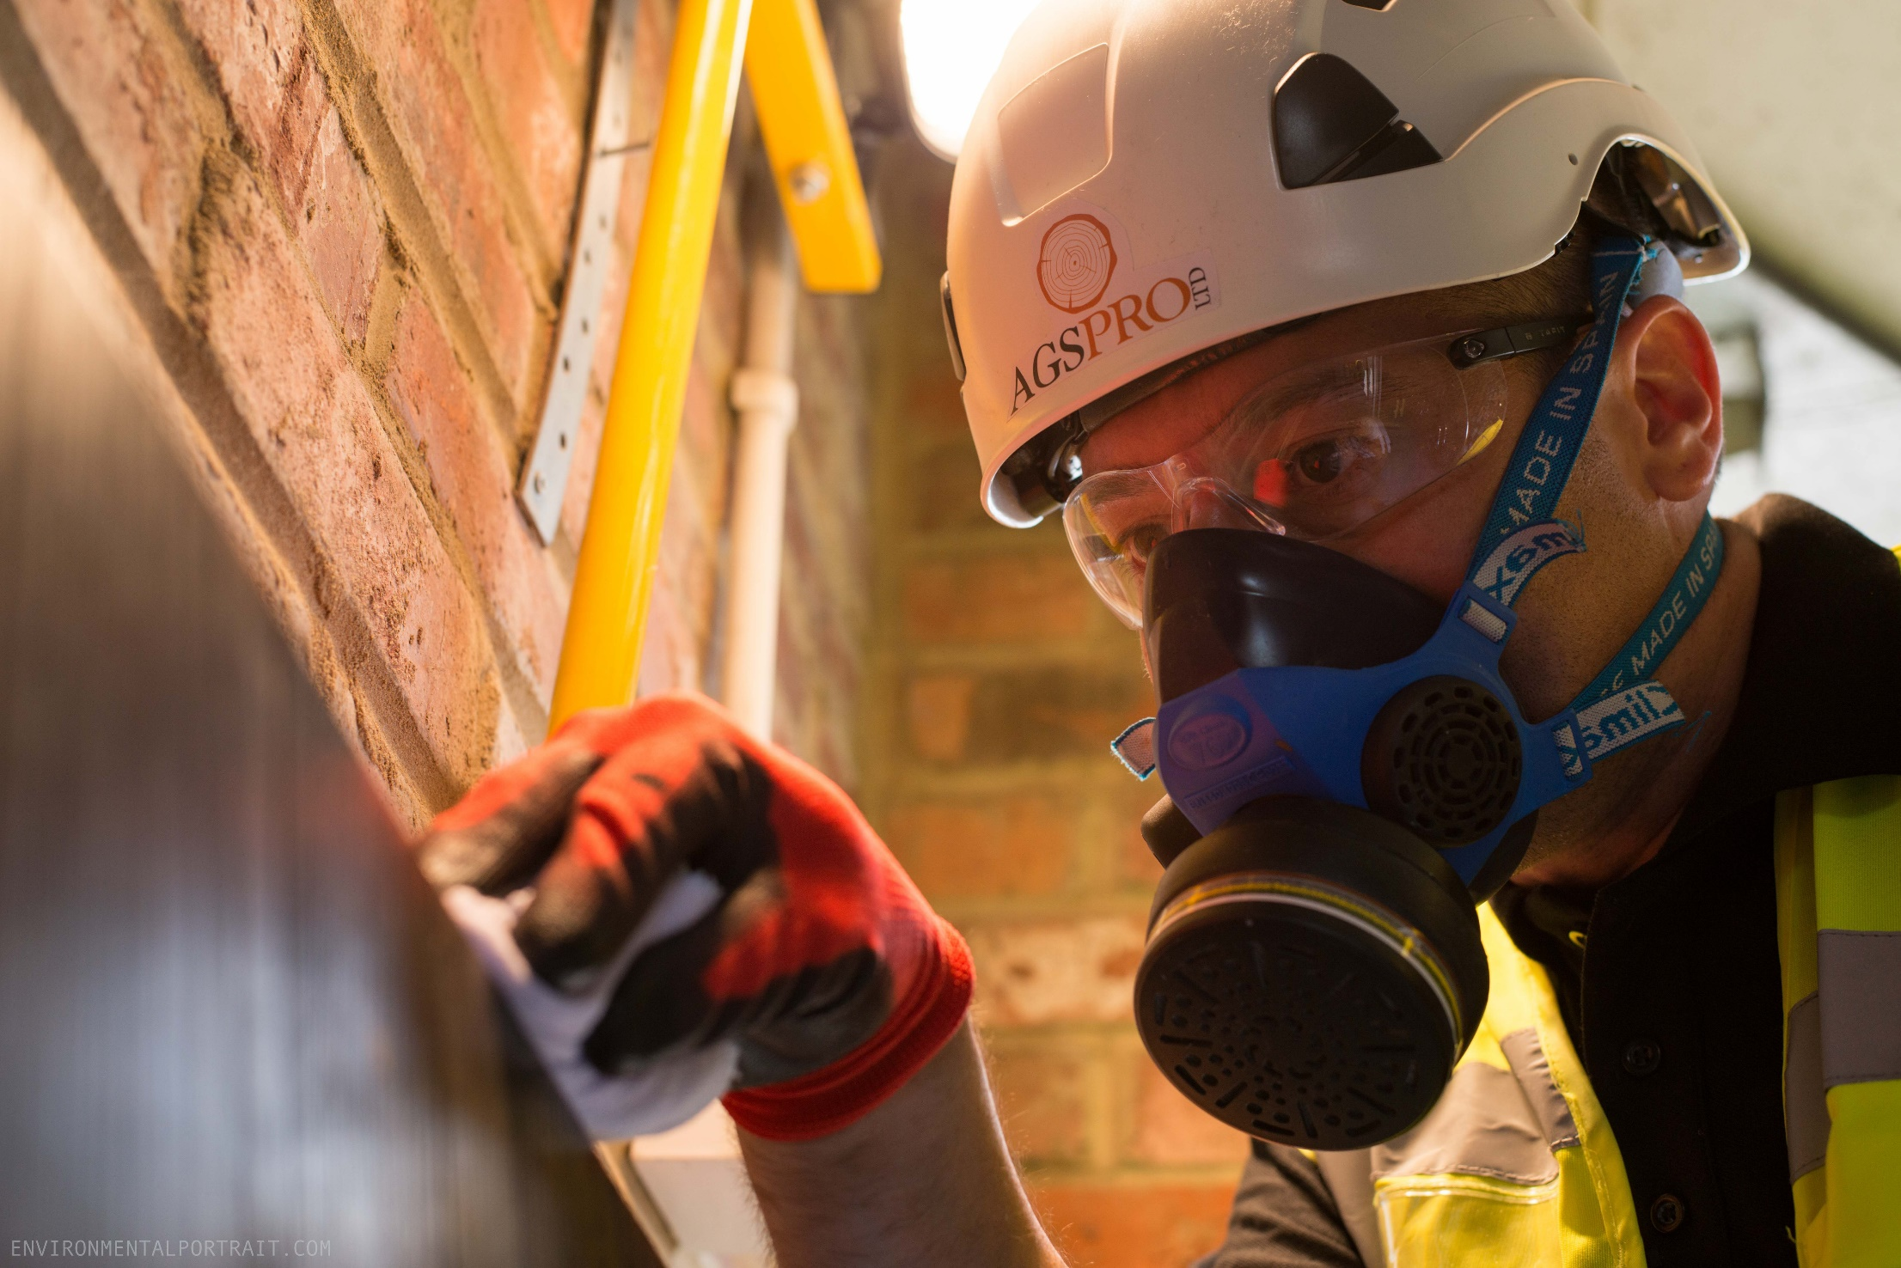
How to Protect Yourself
Lungs
Hazards
Options
Whole body
Hazards
Options
CRUCIAL DONNING/DOFFING PROCEDURES
More than one donning method may be acceptable.
Identify and gather the proper PPE to don.
Perform hand hygiene using hand sanitizer.
Put on isolation gown.
Notes:
How to Protect Yourself
Lungs
Hazards
Oxygen-deficient atmospheres, dusts, gases and vapours.
respiratory protective equipment (RPE)
Options
Some respirators rely on filtering contaminants from workplace air. These include simple filtering facepieces and respirators and power-assisted respirators.
Make sure it fits properly, eg for tight-fitting respirators (filtering facepieces, half and full masks).
There are also types of breathing apparatus which give an independent supply of breathable air, eg fresh-air hose, compressed airline and self-contained breathing apparatus.
The right type of respirator filter must be used as each is effective for only a limited range of substances.
Filters have only a limited life. Where there is a shortage of oxygen or any danger of losing consciousness due to exposure to high levels of harmful fumes, only use breathing apparatus – never use a filtering cartridge.
You will need to use breathing apparatus in a confined space or if there is a chance of an oxygen deficiency in the work area.
If you are using respiratory protective equipment, look at HSE’s publication.
Whole body
Hazards
Heat, chemical or metal splash, spray from pressure leaks or spray guns, contaminated dust, impact or penetration, excessive wear or entanglement of own clothing
Options
Conventional or disposable overalls, boiler suits, aprons, chemical suits
The choice of materials includes flame-retardant, anti-static, chain mail, chemically impermeable, and high-visibility.
Don't forget other protection, like safety harnesses or life jackets.
CRUCIAL DONNING/DOFFING PROCEDURES
More than one donning method may be acceptable. Training and practice using your healthcare facility’s procedure is critical. Below is one example of donning.
Identify and gather the proper PPE to don. Ensure choice of gown size is correct.
Perform hand hygiene using hand sanitizer.
Put on isolation gown. Tie all of the ties on the gown. Assistance may be needed by other healthcare personnel.

Slide 8

How to Protect Yourself
Put on NIOSH-approved N95 filtering facepiece respirator or higher (use a facemask if a respirator is not available).
Respirator:
Facemask:
Put on face shield or goggles.
Put on gloves.
Take It Off (Doff) PPE Gear
Remove gloves.
Remove gown.
Healthcare personnel may now exit patient room.
Perform hand hygiene.
Remove face shield or goggles.
Notes:
How to Protect Yourself
Put on NIOSH-approved N95 filtering facepiece respirator or higher (use a facemask if a respirator is not available). If the respirator has a nosepiece, it should be fitted to the nose with both hands, not bent or tented. Do not pinch the nosepiece with one hand. Respirator/facemask should be extended under chin. Both your mouth and nose should be protected. Do not wear respirator/facemask under your chin or store in scrubs pocket between patients.
Respirator: Respirator straps should be placed on crown of head (top strap) and base of neck (bottom strap). Perform a user seal check each time you put on the respirator.
Facemask: Mask ties should be secured on crown of head (top tie) and base of neck (bottom tie). If mask has loops, hook them appropriately around your ears.
Put on face shield or goggles. When wearing an N95 respirator or half facepiece elastomeric respirator, select the proper eye protection to ensure that the respirator does not interfere with the correct positioning of the eye protection, and the eye protection does not affect the fit or seal of the respirator. Face shields provide full face coverage. Goggles also provide excellent protection for eyes, but fogging is common.
Put on gloves. Gloves should cover the cuff (wrist) of gown.
Healthcare personnel may now enter patient room.
Take It Off (Doff) PPE Gear
More than one doffing method may be acceptable. Training and practice using your healthcare facility’s procedure is critical. One example of doffing.
Remove gloves. Ensure glove removal does not cause additional contamination of hands. Gloves can be removed using more than one technique (e.g., glove-in-glove or bird beak).
Remove gown. Untie all ties (or unsnap all buttons). Some gown ties can be broken rather than untied. Do so in gentle manner, avoiding a forceful movement. Reach up to the shoulders and carefully pull gown down and away from the body. Rolling the gown down is an acceptable approach. Dispose in trash receptacle.
Healthcare personnel may now exit patient room.
Perform hand hygiene.
Remove face shield or goggles. Carefully remove face shield or goggles by grabbing the strap and pulling upwards and away from head. Do not touch the front of face shield or goggles.

Slide 9
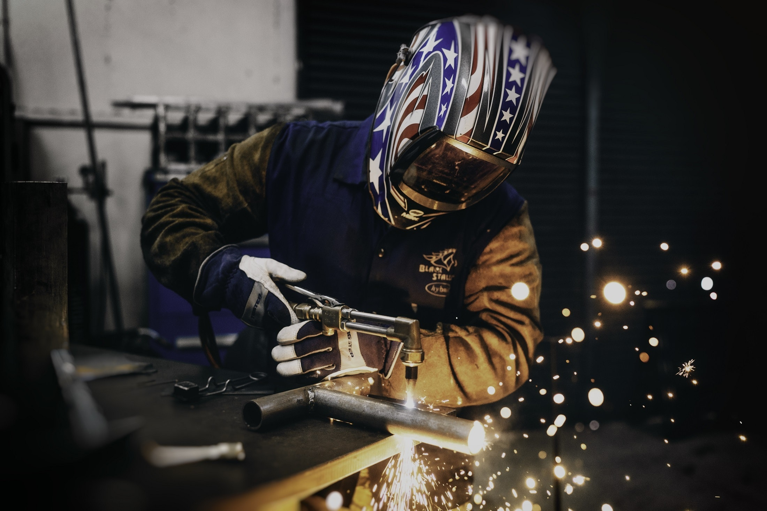
How to Protect Yourself
Remove and discard respirator (or facemask if used instead of respirator).
Respirator
Facemask
Perform hand hygiene after removing the respirator/facemask and before putting it on again if your workplace is practicing reuse.
Notes:
How to Protect Yourself
Remove and discard respirator (or facemask if used instead of respirator). Do not touch the front of the respirator or facemask.
Respirator: Remove the bottom strap by touching only the strap and bring it carefully over the head. Grasp the top strap and bring it carefully over the head, and then pull the respirator away from the face without touching the front of the respirator.
Facemask: Carefully untie (or unhook from the ears) and pull away from face without touching the front.
Perform hand hygiene after removing the respirator/facemask and before putting it on again if your workplace is practicing reuse.

Slide 10
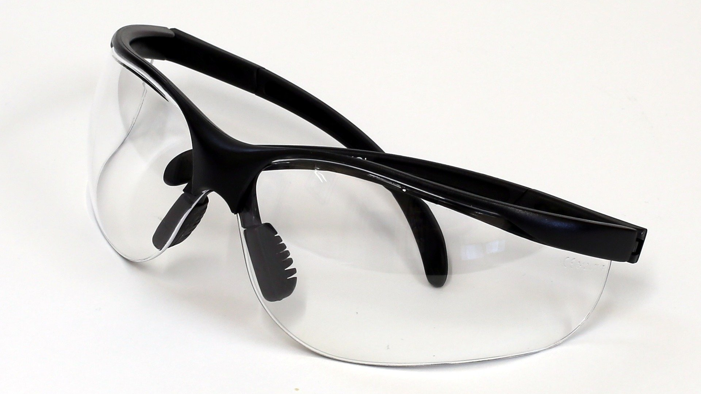
Final Word
Personal protective equipment (PPE) is equipment or clothing worn to minimize exposure to hazards in the workplace. PPE does not remove or reduce workplace hazards, it only reduces the risk of exposure to the hazard. And most importantly, PPE only works if you use it!
Notes:
Final Word
Personal protective equipment (PPE) is equipment or clothing worn to minimize exposure to hazards in the workplace. PPE does not remove or reduce workplace hazards, it only reduces the risk of exposure to the hazard. And most importantly, PPE only works if you use it!

