Slide 1

Click anywhere to get started…

Slide 2

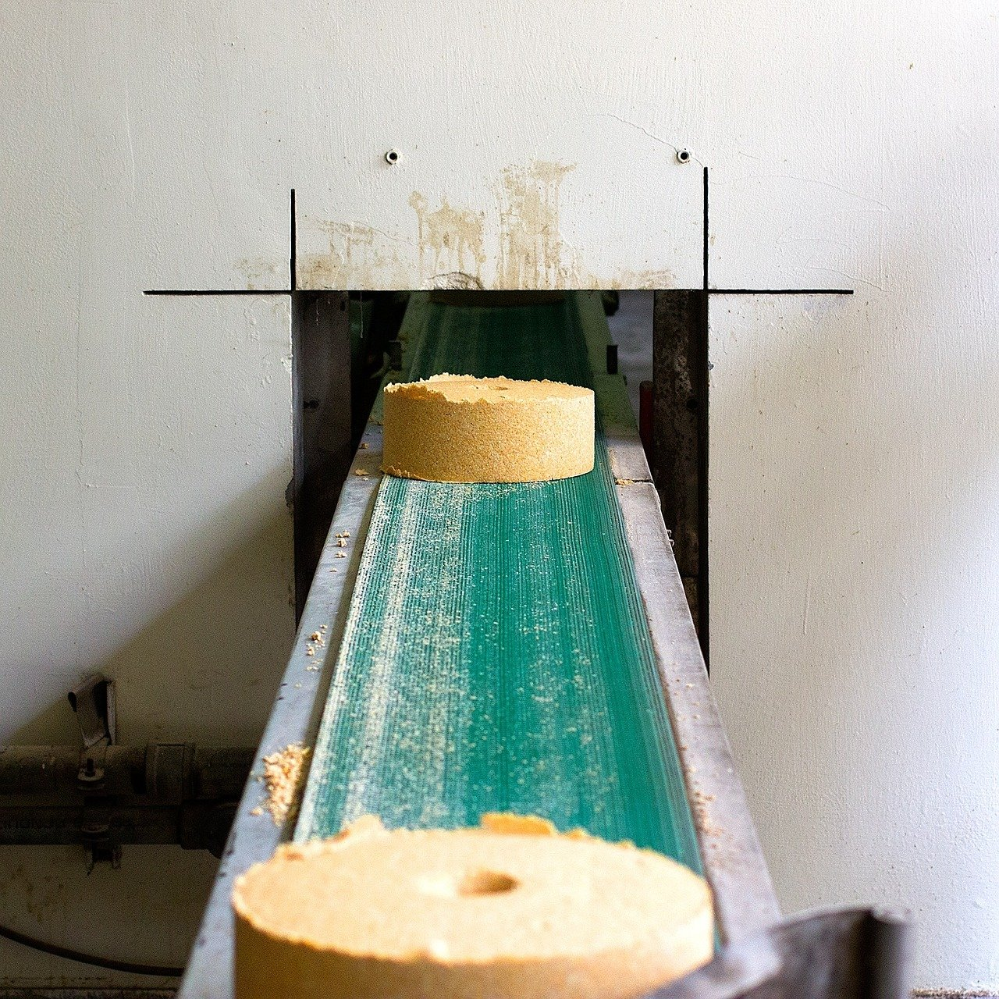

SAFETY AROUND CONVEYORS
Notes:
SAFETY AROUND CONVEYORS

Slide 3
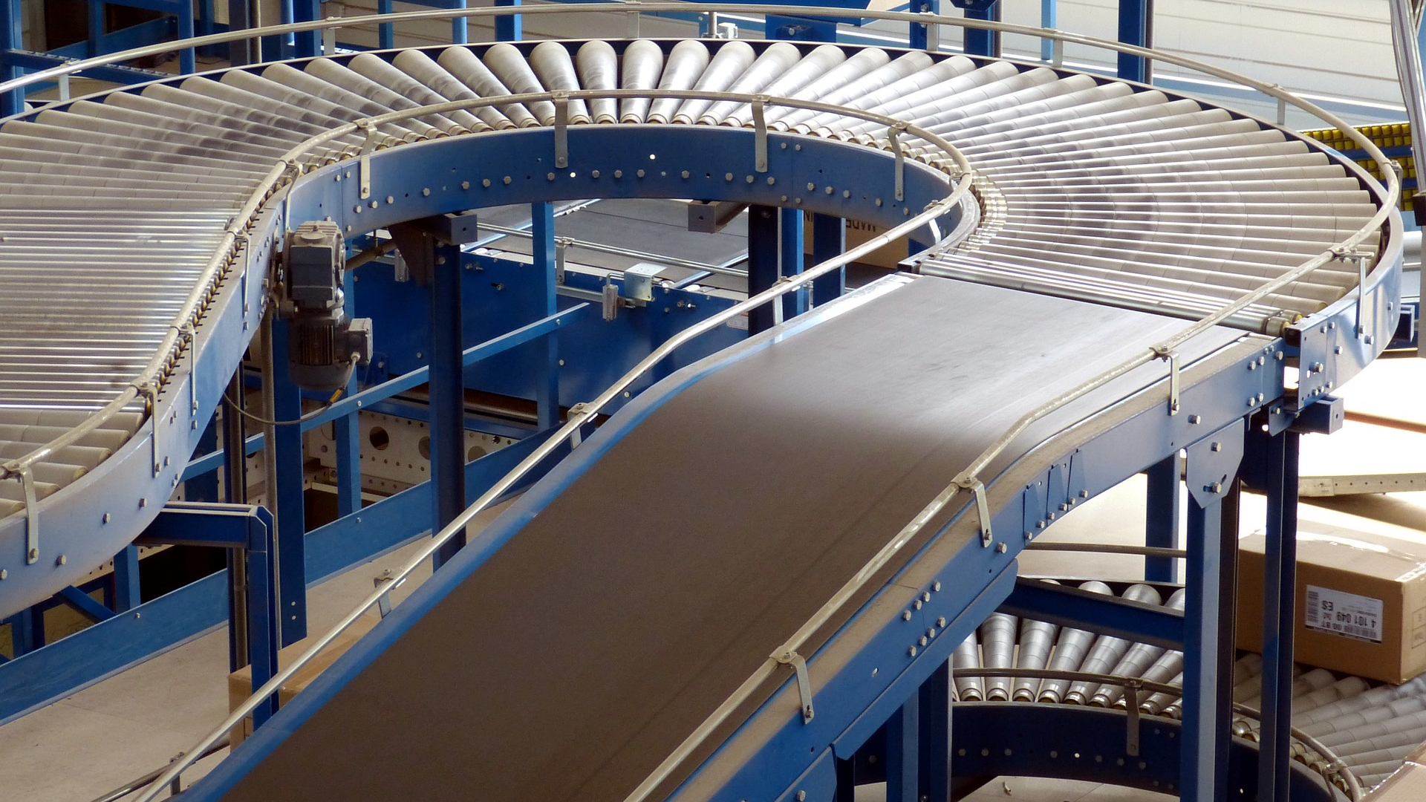
What’s at Stake?
A conveyor is a machine that transfers material from one area to another by use of stationary framework and rotating or vibrating belts, rollers, chains, etc. Conveyors may or may not be motorized and can be used overhead, underground or at working height.
Notes:
WHAT’S AT STAKE?
A conveyor is a machine that transfers material from one area to another by use of stationary framework and rotating or vibrating belts, rollers, chains, etc. Conveyors may or may not be motorized and can be used overhead, underground or at working height. Transfer methods may include belts, buckets, or other material-specific carriers. Conveyors can be hazardous due to the nature of the moving parts and transferred material. Caution needs to be used when working with or around them.

Slide 4
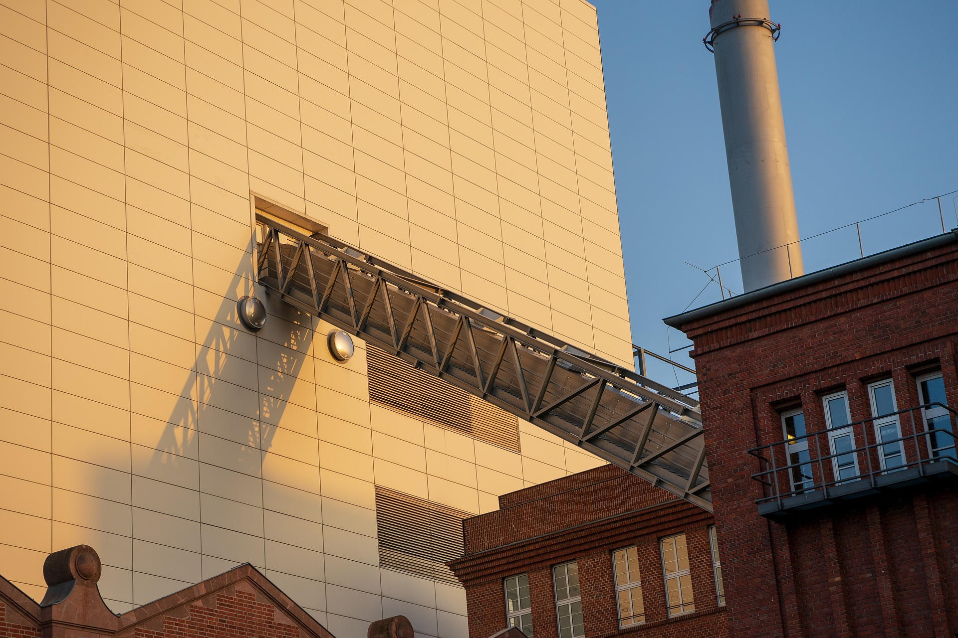
What’s the Danger?
HAZARDS/DANGERS
Common Hazards Around Conveyors
Musculoskeletal Injuries
Notes:
WHAT’S THE DANGER?
Common Hazards Around Conveyors Include:
Spills and falling materials.
Power transmission interfaces, such as drives or shafts.
Rotating parts or pinch points can drag in, crush or entangle.
Confinement or assembly areas (the area between a fixed object and a moving one) can shear or crush.
Parts that slide or reciprocate (press down) can crush or shear.
Items can break or be ejected (thrown from) the conveyor system.
Items can fall off the conveyor.
Electrical, fire or explosion hazards.
Musculoskeletal Injuries
Working at a conveyor or belt may include manual material handling, including repetitive motions, reaching, and lifting that may lead to musculoskeletal injuries, especially when movements are done quickly and for a long period of time.

Slide 5
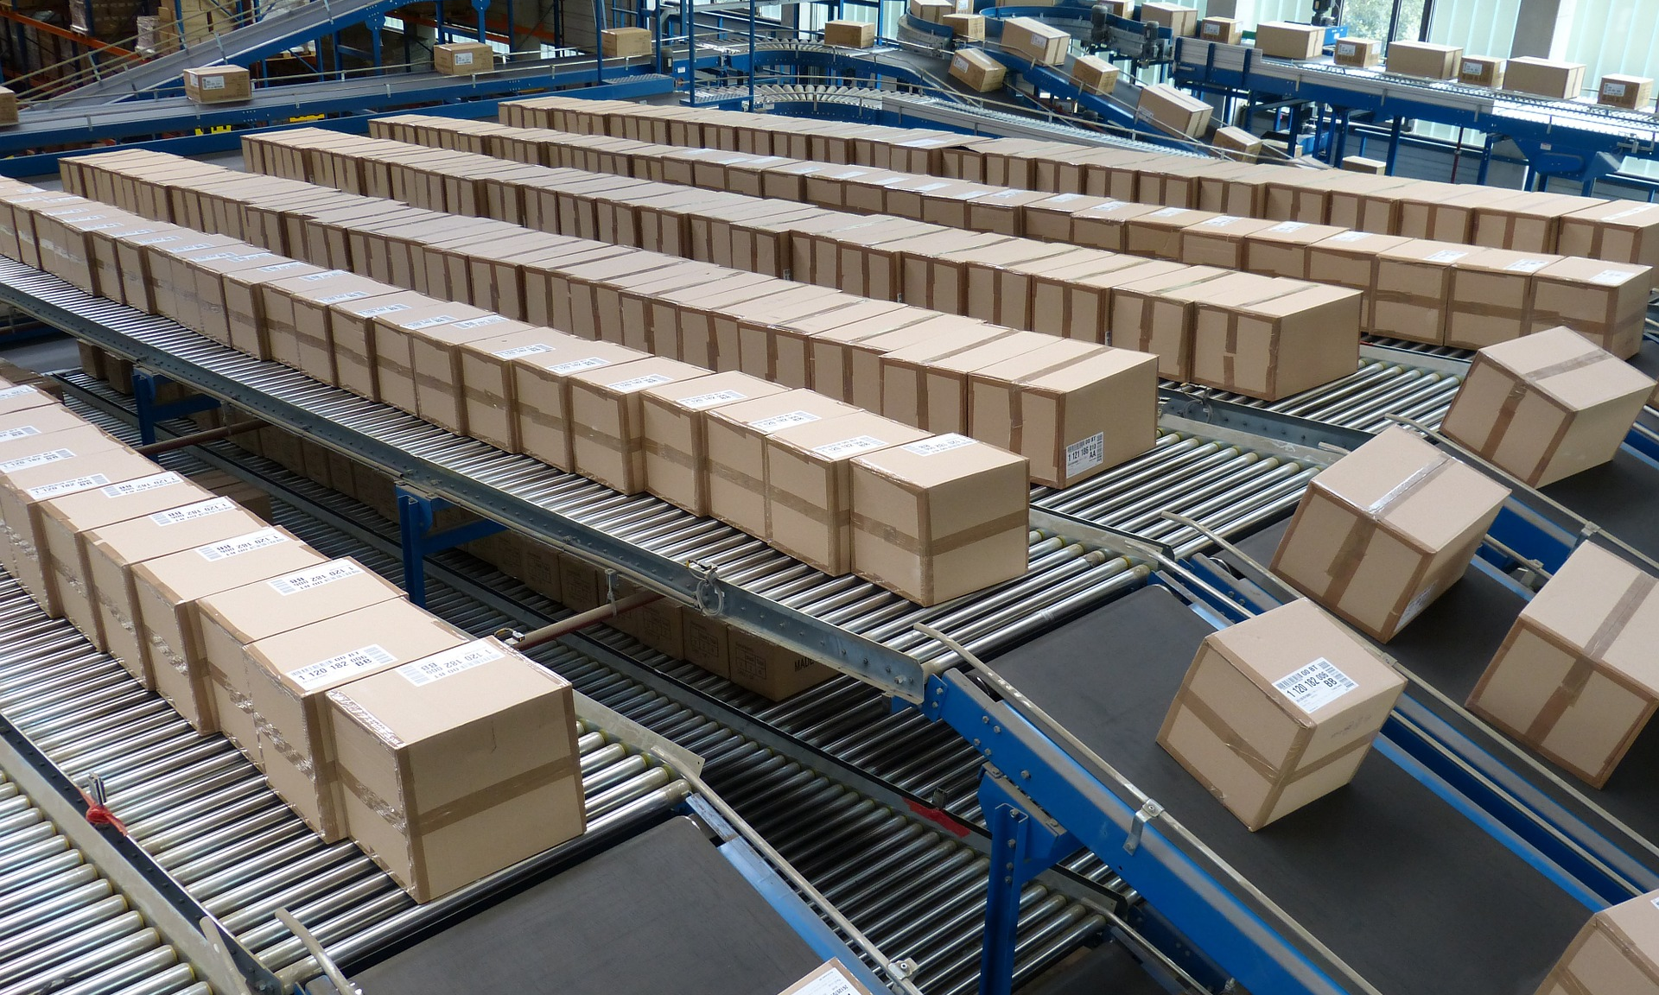
How to Protect Yourself
The conveyor equipment manufacturers association, CEMA, recommends the following guidelines for conveyor safety.
Notes:
HOW TO PROTECT YOURSELF
The conveyor equipment manufacturers association, CEMA, recommends the following guidelines for conveyor safety.
Do not climb, sit, stand, walk, ride, or touch the conveyor at any time
Do not perform maintenance on conveyor until electrical, air, hydraulic, and gravity energy sources have been locked out or blocked
Operate equipment only with all approved covers and guards in place
Do not load a stopped conveyor or overload a running conveyor
Ensure that all personnel are clear of equipment before starting
Allow only authorized personnel to operate or maintain material handling equipment
Do not modify or misuse conveyor controls
Keep clothing, body parts, and hair away from the conveyor
Remove trash, paperwork, and other debris only when power is locked out and tagged out
Ensure that ALL controls and pull cords are visible and accessible
Know the location and function of all stop and start controls
Report all unsafe conditions. Jams should be cleared ONLY BY authorized, trained personnel
While these safety rules are deemed the most obvious and most important by CEMA, each employee should be on alert for potential safety concerns while working around conveyor equipment.

Slide 6
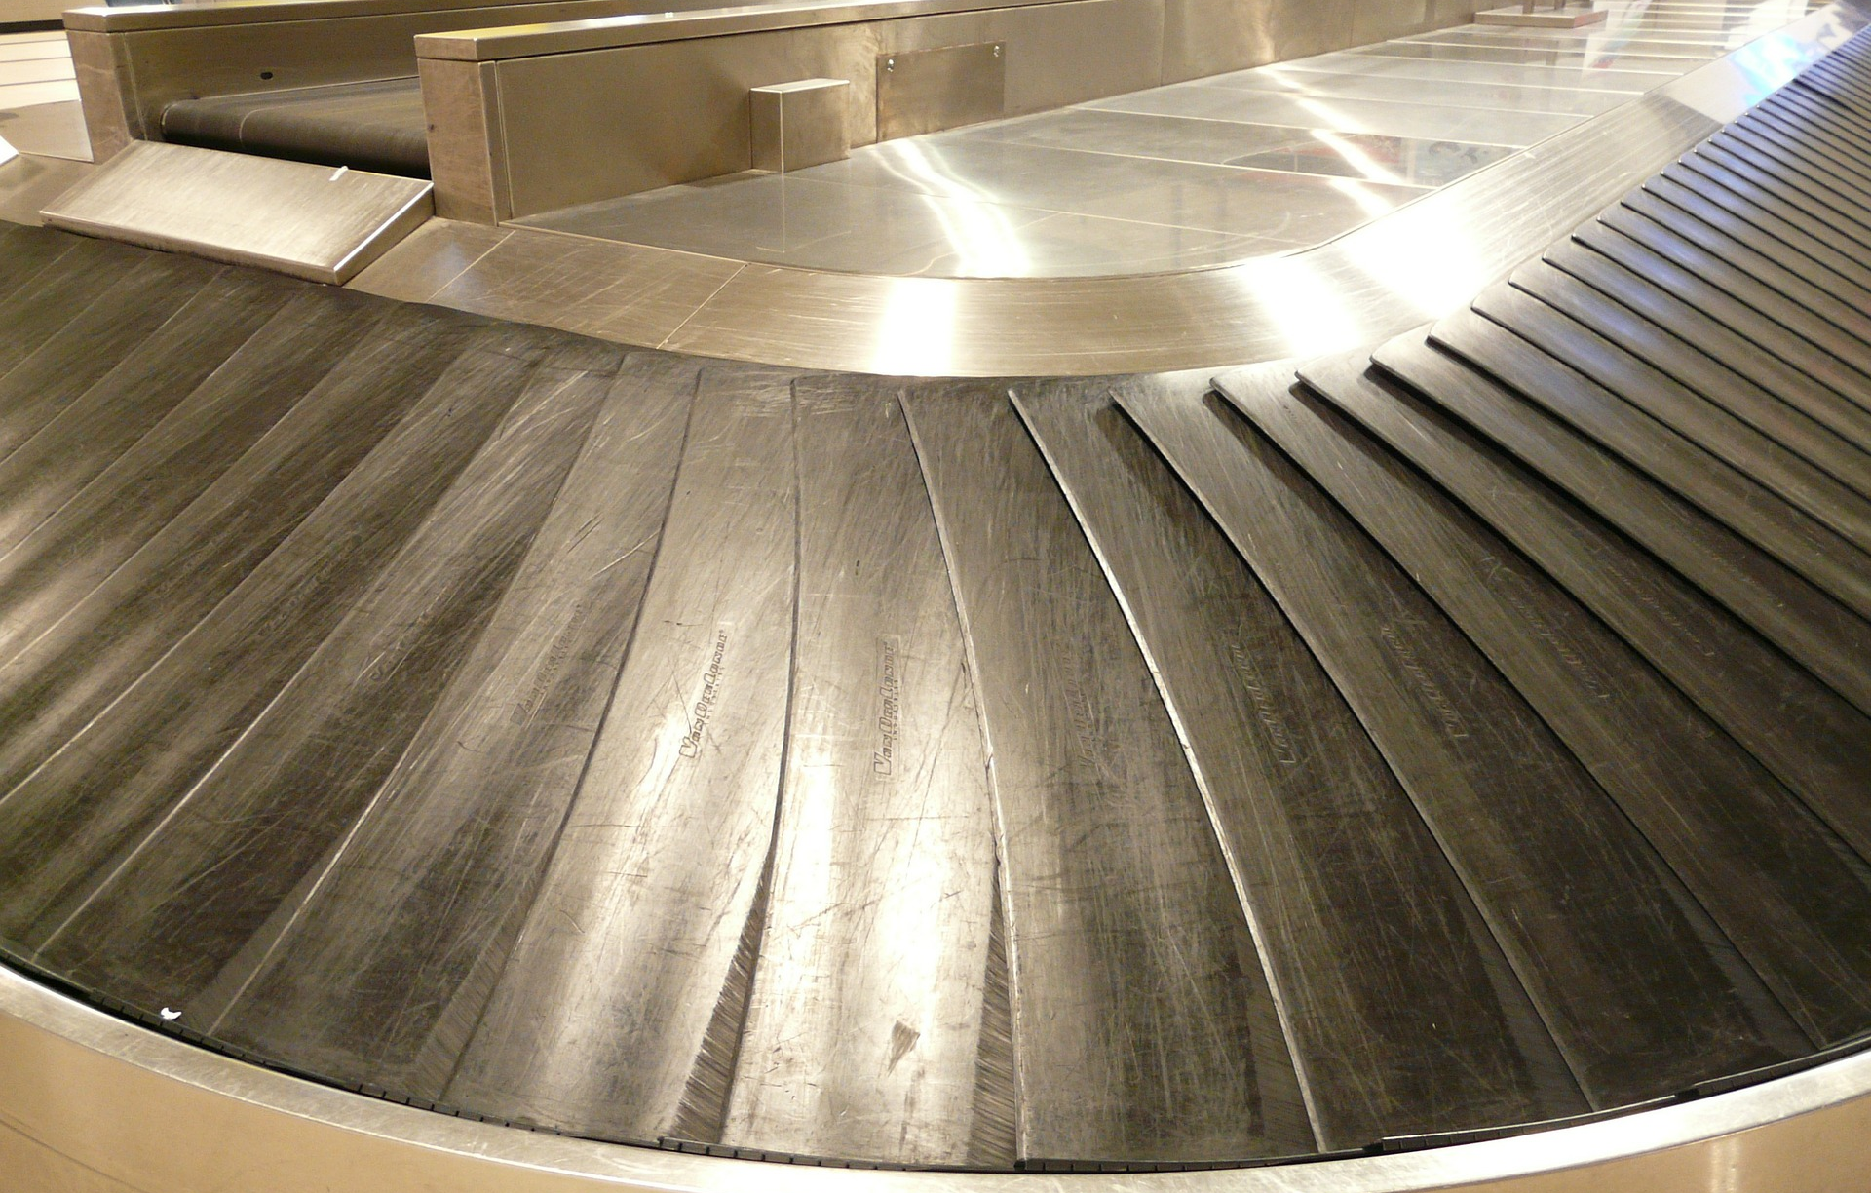
How to Protect Yourself
Employer Responsibilities
Employee Responsibilities
Notes:
How to Protect Yourself
EMPLOYERS’ RESPONSIBILITIES
General
Employers are responsible for ensuring that conveyors and machinery are safe, and that all applicable regulations are followed. Employers must identify job-related hazards. Once the hazards are identified, the employer must implement safe work procedures, with input from the joint health and safety committee (JHSC), or health and safety representative. If the workplace does not have a JHSC or health and safety representative, the employer should work directly with the affected employees and supervisors to identify hazards and safeguarding solutions. Employers are responsible to train their employees on the safe use, maintenance and repair of conveyors and the safety devices.
Specific
Employers must ensure that:
There is enough clearance between the material being transported and any fixed or moving object.
Shearing points between the moving and fixed parts are avoided.
Material is not fed onto a stopped conveyor.
Power-driven conveyors that can be accessed by employees have emergency stop devices at the loading and unloading stations, drive and take-up sections and other accessible places along the run of the conveyor.
The conveyor has an anti-rollback device for loads carried up an incline.
An elevated conveyor that an employee can access must have a walkway along its entire length that is not less than 500 mm wide and is equipped with guardrails.
Designated crossing areas are provided where employees must travel over a conveyor.
Sheet metal or screen guards are installed under or alongside the conveyor, if it is not entirely enclosed, to prevent material from falling off the conveyor.
Employer Takeaway
Employers have the responsibility to train employees on the safe use, maintenance and repair of conveyors and the safety devices. Training should be repeated often.
EMPLOYEES RESPONSIBILITY
Employees must:
Never climb or stand on a conveyor frame to load, unload or clear a blockage, unless it is stopped and locked out.
Never remove heavy or bulky articles by hand from a moving conveyor unless at a designated station.
Never ride or sit on a conveyor.
Not do maintenance or complete repairs on a conveyor without following lock-out procedures.
Wear close-fitting clothing and ensure head and facial hair is cut or confined when working near a machine where clothing may come into contact with moving parts.

Slide 7
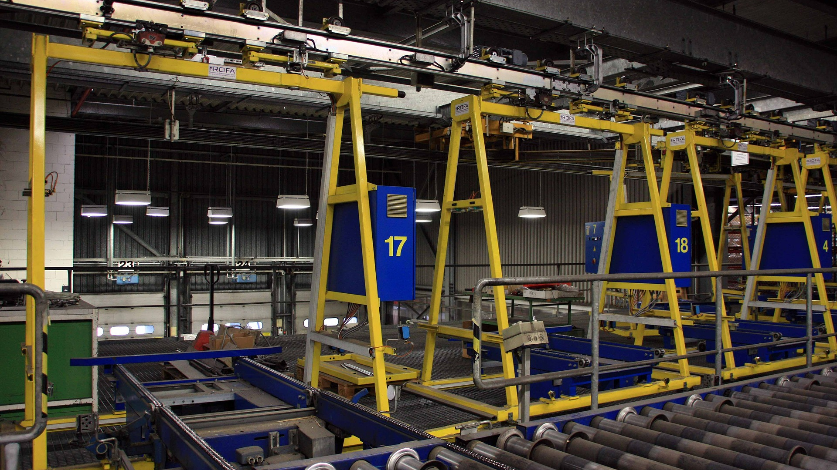
Final Word
Conveyors, like forklifts, drive the industry and business in our modern industrial matrix. Conveyors can and are hazardous if proper training is not meted out to employees in the operation and safe use of conveyors. On-going training and refresher protocols must be conducted on a regular basis.
Notes:
Final Word
Conveyors, like forklifts, drive the industry and business in our modern industrial matrix. Conveyors can and are hazardous if proper training is not meted out to employees in the operation and safe use of conveyors. On-going training and refresher protocols must be conducted on a regular basis.

