Slide 1

Click anywhere to get started…

Slide 2

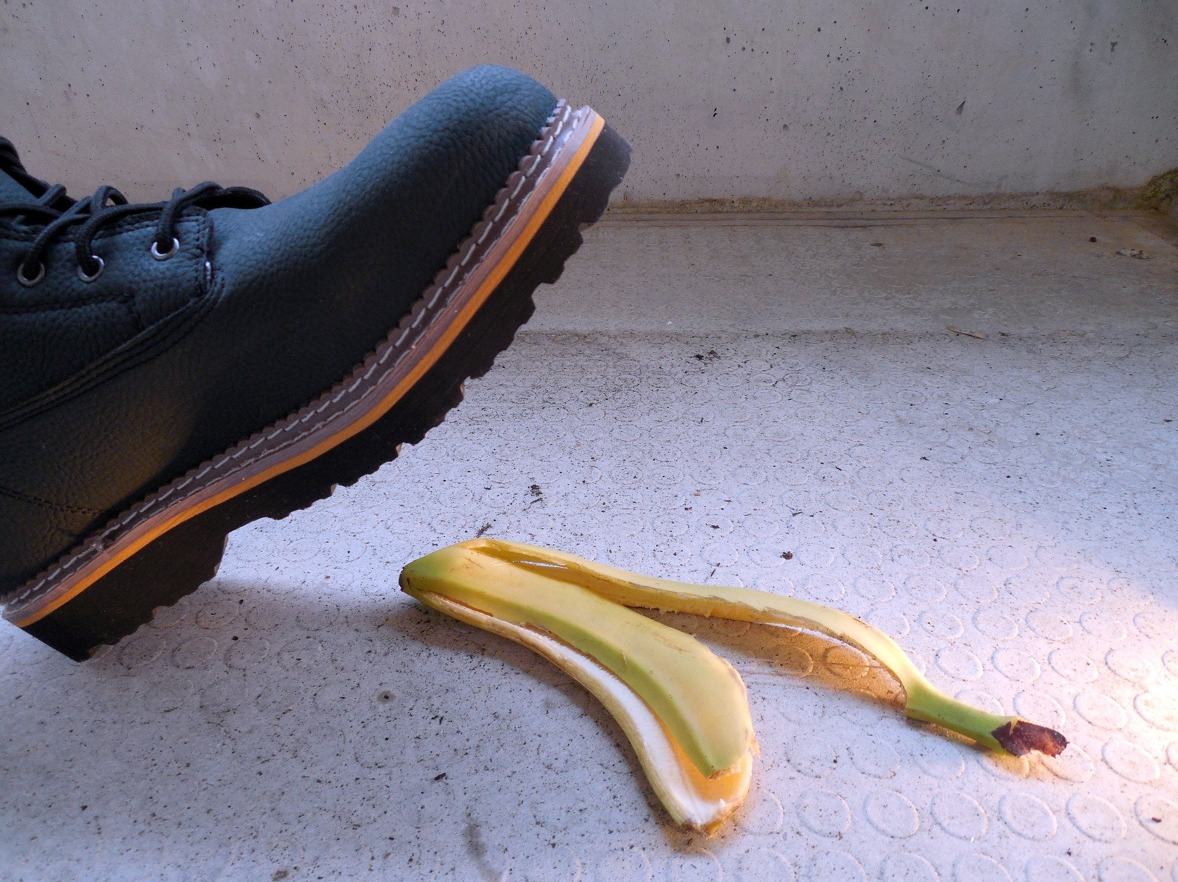

SAFETY FOOTWEAR
Notes:
SAFETY FOOTWEAR

Slide 3
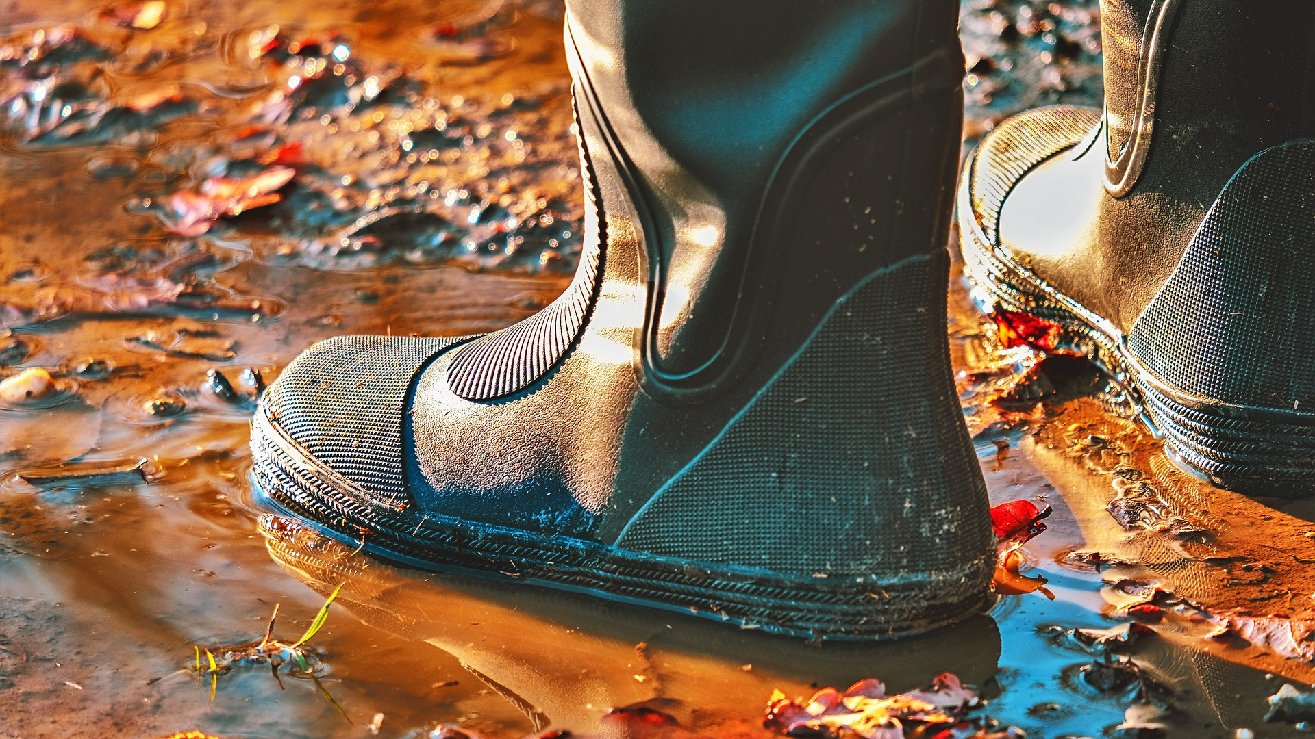
What’s at Stake?
A good safety footwear program begins not with selecting a new pair of shoes or boots, but by addressing all of the walking and working surfaces that employees are going to be exposed to and assuring that they are in the best condition possible.
Notes:
What’s at Stake?
Protecting employees' feet with good industrial footwear cuts lost work hours, improves productivity, and heightens morale and reduces injuries.
To abide by federal regulations adopted and enforced by the Occupational Safety & Health Administration (OSHA), protective footwear is required for workers in industrial settings. OSHA has an abundance of rules and regulations regarding workplace safety, including section 29 CFR 1910.136 on occupational foot protection.
A good safety footwear program begins not with selecting a new pair of shoes or boots, but by addressing all of the walking and working surfaces that employees are going to be exposed to and assuring that they are in the best condition possible.
OSHA's personal protective equipment standard, 1910.132 (d)(1), requires that employers "assess the workplace to determine if hazards are present, or are likely to be present, which necessitate the use of personal protective equipment."

Slide 4
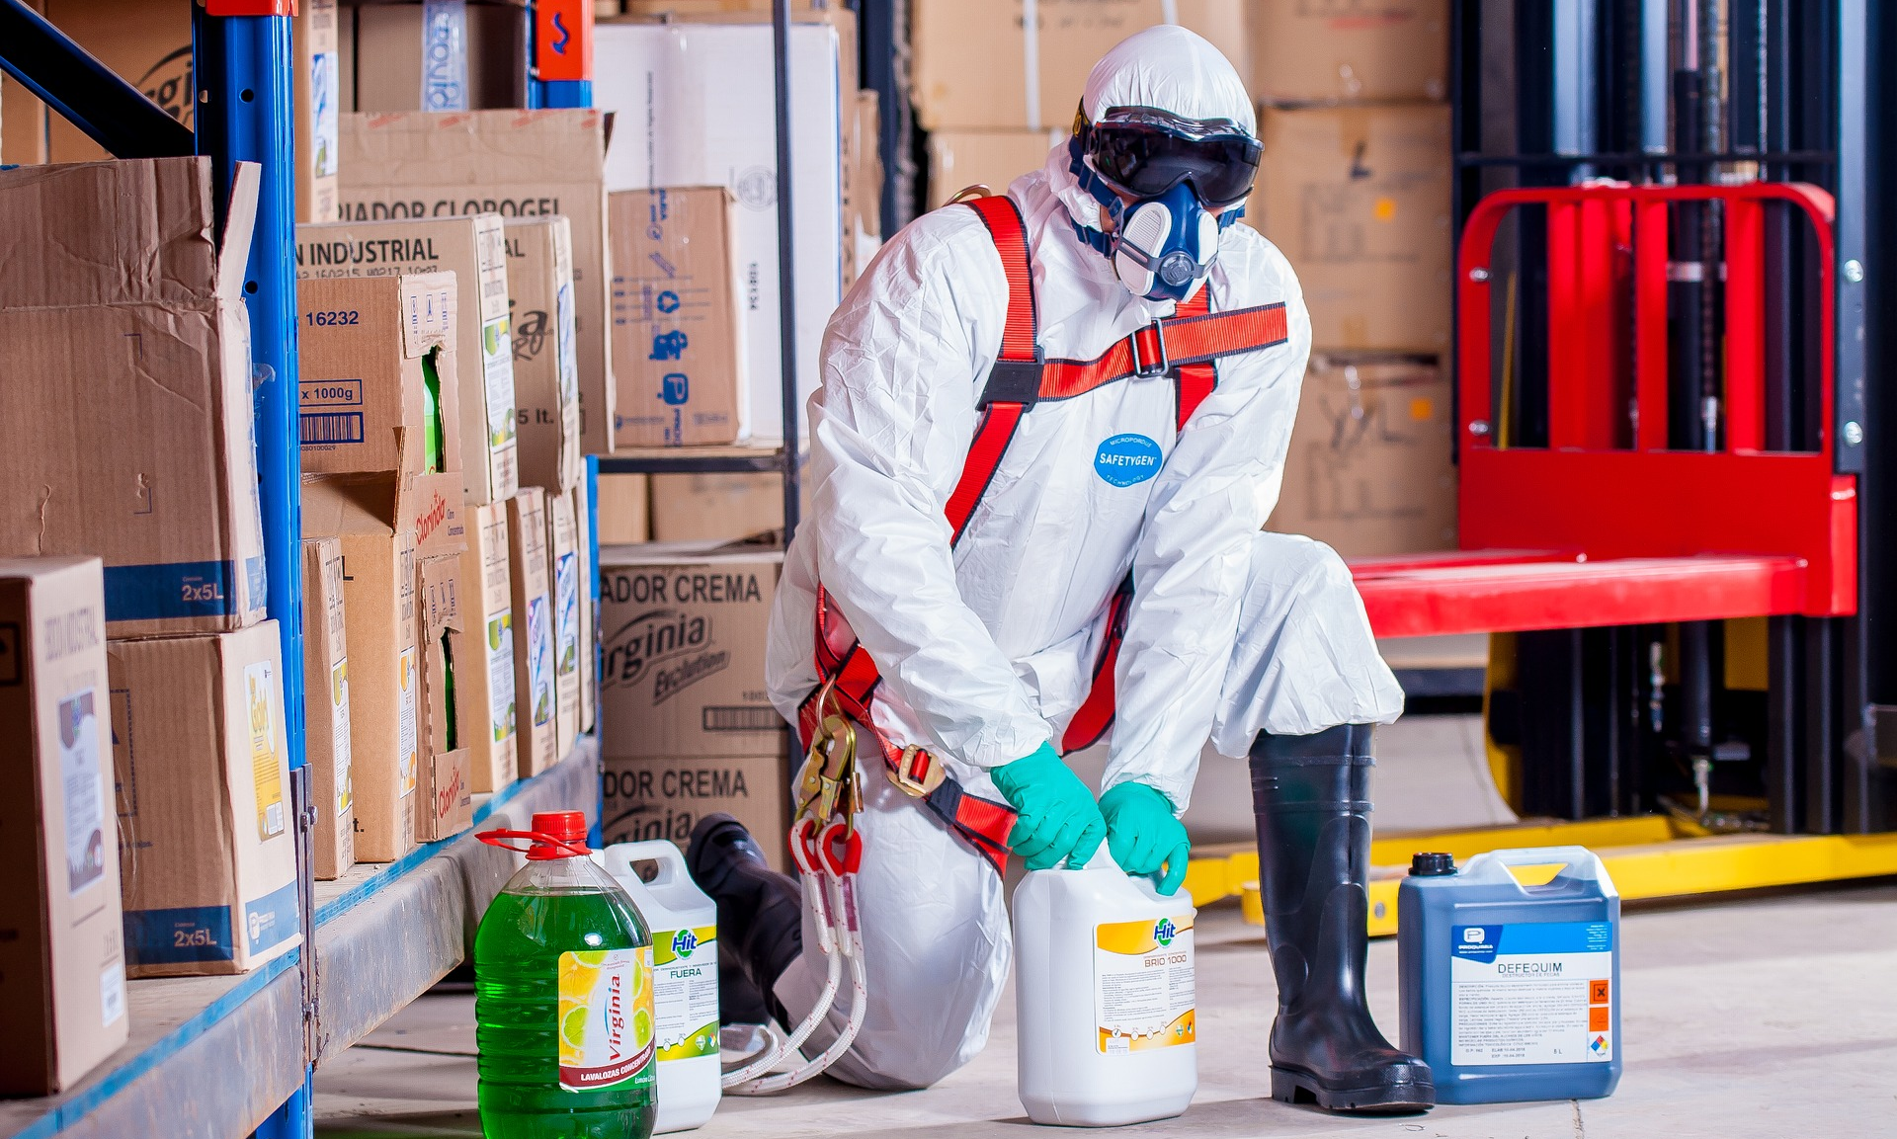
What’s the Danger?
There is certainly sufficient financial incentive for industry to pay close attention to foot-related hazards. Workers suffered 180,000 disabling injuries to the feet and toes in 1995, according to the National Safety Council.
Notes:
What’s the Danger?
There is certainly sufficient financial incentive for industry to pay close attention to foot-related hazards. Workers suffered 180,000 disabling injuries to the feet and toes in 1995, according to the National Safety Council. During that same period, says the National Council on Compensation Insurance, injuries to the feet and toes cost an average of $6,700 per claim.
Foot and Toe injuries are only part of what can happen with a poor footwear program.
It is the Questions that need to be asked.
• have you had slips and falls in the workplace?
• are employees tired at the end of the day and less likely to perform effectively?
• can that result in other, secondary injuries?
HAZARD ASSESSMENT
In the hazard assessment process, safety and health managers should consider the kinds of operations within a facility, the processes being used, the tasks being performed, environmental conditions and the nature of any chemicals in use. They also have to examine "key human performance factors,", such as the fit of footwear or whether the foot will sweat profusely.
The questions need to posed before selecting protective foot wear:
• Why are we protecting this individual?
• What are protecting from?
• Why is he working in these?
OSHA
OSHA requires that employers document that the hazard assessment has taken place. This written certification includes the identity of the workplace evaluated, the name of the person who performed the evaluation, and date(s) of the hazard assessment.
FOOT PROBLEMS
There are two major categories of work-related foot injuries. The first category includes foot injuries from punctures, crushing, sprains, and lacerations. The second group of injuries includes those resulting from slips, trips and falls. Slips and falls do not always result in a foot injury but lack of attention to foot safety plays an important role in their occurrence.
These two categories of foot injuries, however, do not exhaust the whole range of foot problems at work. There are also other conditions such as calluses, ingrown toenails or simply tired feet that are common among workers. Although these may not be considered as occupational injuries in the strictest sense, they can have serious consequences for health and safety at the workplace. They cause discomfort, pain and fatigue. Fatigue sets up the worker for further injuries affecting the muscles and joints. Also, a worker who is tired and suffering pain is less alert and more likely to act unsafely. An accident or incident of any kind may result.
The Working Position Contributes to Foot Problems
Common foot problems occur both on and off the job. Still, there is no doubt that some work-related factors can lead to foot problems, especially jobs that require long periods of standing. Since the human foot is designed for mobility, maintaining an upright stance is extremely tiring. Standing for hours, day after day, not only tires the worker's feet but can also cause permanent damage. Continuous standing can cause the joints of bones of the feet to become misaligned (e.g., cause flat feet) and can cause inflammation that can lead later to rheumatism and arthritis.
Flooring Contributes to Foot Problems
The type of flooring used in the workplace has an important influence on comfort, especially on tender feet. Hard, unyielding floors like concrete are the least comfortable surfaces to work on. Working on a hard floor has the impact of a hammer, pounding the heel at every step. Slippery floors are hazardous for slips and falls that can result in sprained ankles or broken foot bones.
Foot-Wear Contributes to the Foot Problems
Footwear that fits poorly or is in need of repair also contributes heavily to foot discomfort. Pointed toes and high heels are particularly inappropriate for working footwear.

Slide 5
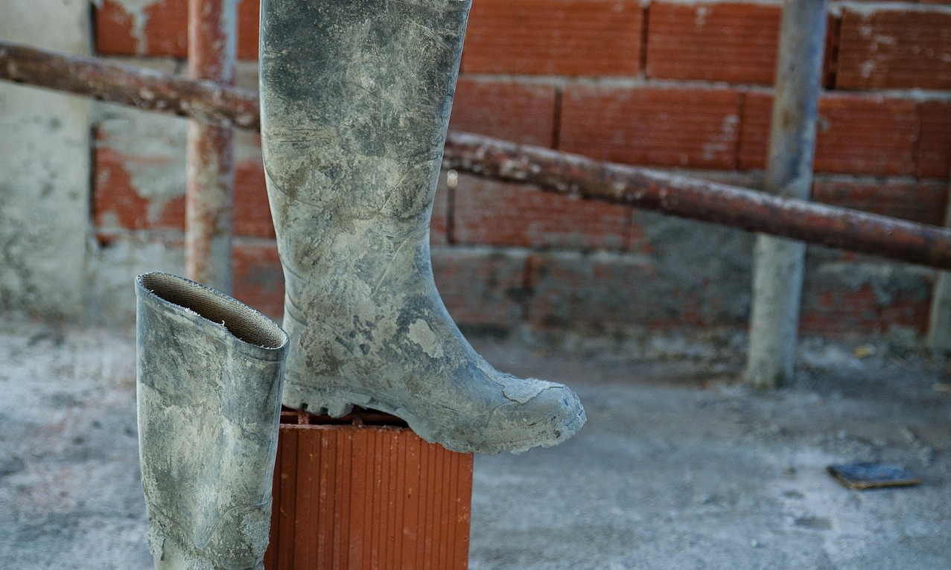
How to Protect Yourself
AMERICAN NATIONAL STANDARDS INSTITUTE
Notes:
How to Protect Yourself
AMERICAN NATIONAL STANDARDS INSTITUTE
Protective footwear must comply with American National Standards Institute standard ANSI Z41-1991, which breaks footwear down into six categories:
Impact - and compression - resistance, which uses a steel or nonmetallic toe cap (steel toe) to protect against falling objects or crushing from heavy rolling objects.
Metatarsal footwear, which provides similar protection against falling objects to the area of the foot between the ankle and the toes.
Electrical hazard, where the sole of the shoe or boot is designed to protect workers from electric shock from 600 volts or less, under dry conditions.
Conductive footwear, which prevents the buildup of static electricity.
Puncture-resistance, where the sole resists penetration from sharp objects; such as nails or broken glass.
Static-dissipative, which reduces the buildup of static electricity by conducting body charge to ground, while protecting the employee from electrical hazards.

Slide 6
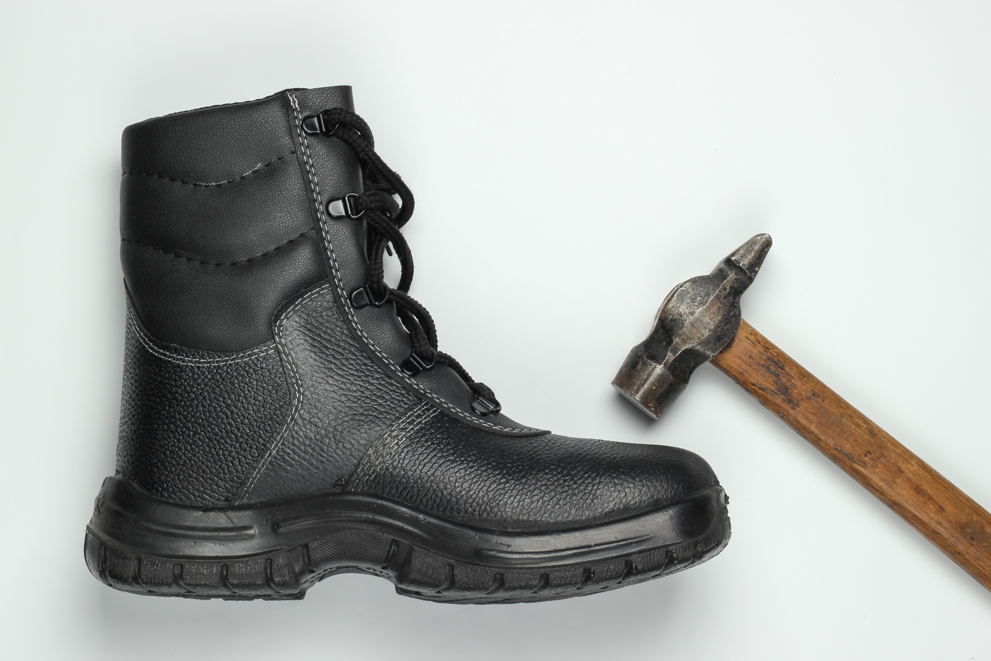
How to Protect Yourself
Safety Footwear Knowledge
If you are at risk for foot injury at your workplace, you should wear the appropriate protective footwear.
Notes:
How to Protect Yourself
Safety Footwear Knowledge
If you are at risk for foot injury at your workplace, you should wear the appropriate protective footwear.
If foot protection is required, set up a complete foot safety protection program including selection, fit testing, training, maintenance and inspection.
Safety footwear is designed to protect feet against a wide variety of injuries. Impact, compression, and puncture are the most common types of foot injury.
Choose footwear according to the hazard. Refer to CSA Standard Z195-14 "Protective Footwear".
Select CSA-certified footwear. Ensure that it has the proper rating for the hazard and the proper sole for the working conditions.
Use metatarsal protection (top of the foot between the toes and ankle) where there is a potential for injury.

Slide 7
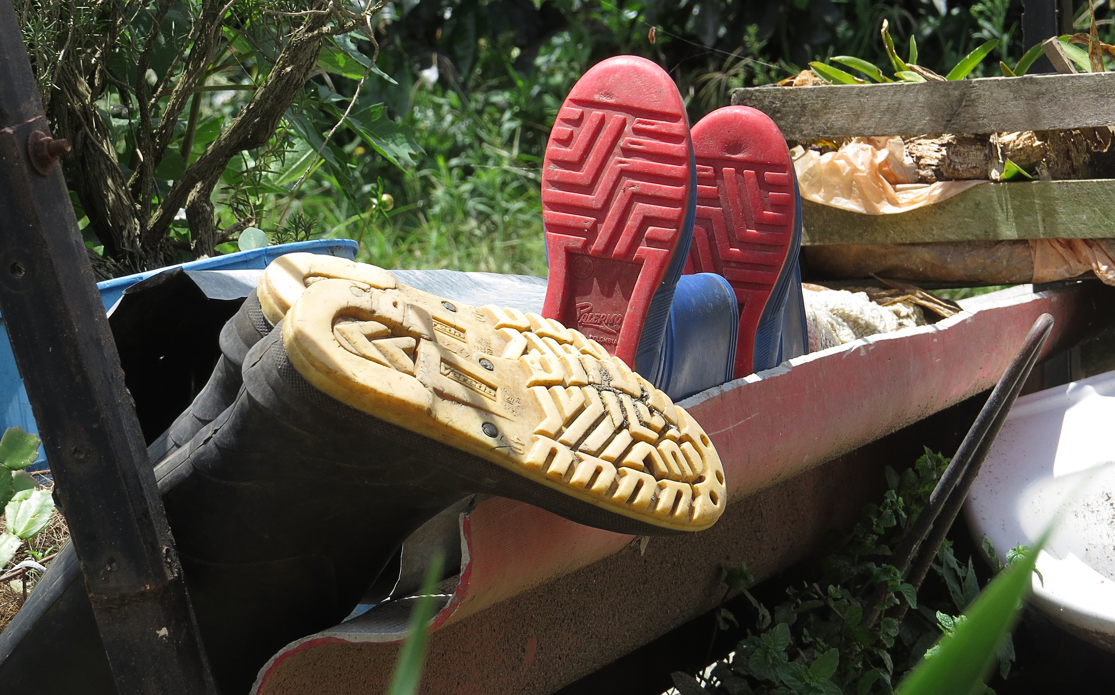
How to Protect Yourself
Footwear Selection
Good Footwear Should Have the Following Qualities
Notes:
How to Protect Yourself
Footwear Selection
Footwear must be chosen based on the hazards that are present. Assess the workplace and work activities for:
Materials handled or used by the worker.
Risk of objects falling onto or striking the feet.
Any material or equipment that might roll over the feet.
Any sharp or pointed objects that might cut the top of the feet.
Objects that may penetrate the bottom or side of the foot.
Possible exposure to corrosive or irritating substances.
Possible explosive atmospheres including the risk of static electrical discharges.
Risk of damage to sensitive electronic components or equipment due to the discharge of static electricity.
Risk of coming into contact with energized conductors of low to moderate voltage (e.g., 220 volts or less).
Good Footwear Should Have the Following Qualities
The inner side of the shoe must be straight from the heel to the end of the big toe.
The shoe must grip the heel firmly.
The forepart must allow freedom of movement for the toes.
The shoe must have a fastening across the instep to prevent the foot from slipping when walking.
The shoe must have a low, wide-based heel; flat shoes are recommended.
The shoe should have a low, wide-based heel. Small heels (1/4” to 1/3” for a men size 9, scaled to other sizes) are recommended.

Slide 8
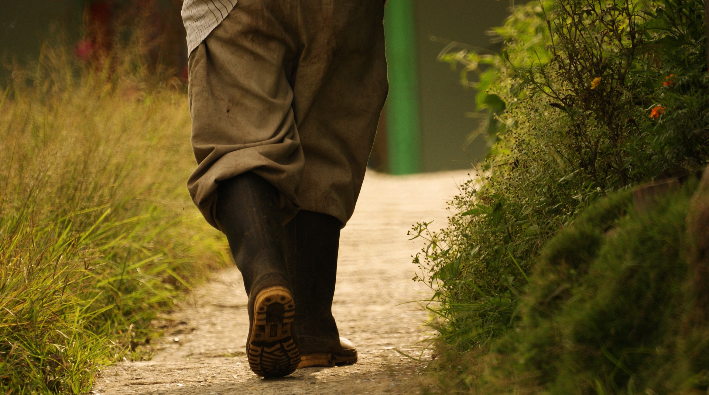
How to Protect Yourself
Buying Footwear for Work Should Take the Following Advice
Improve the Foot Safety in Workplaces Where Foot Injuries Occur Frequently
Notes:
How to Protect Yourself
Buying Footwear for Work Should Take the Following Advice
Do not expect that footwear which is too tight will stretch with wear.
Have both feet measured when buying shoes. Feet normally differ in size.
Buy shoes to fit the bigger foot.
Buy shoes late in the afternoon when feet are likely to be swollen to their maximum size.
Ask a doctor's advice if properly fitting shoes are not available.
Consider using shock-absorbing insoles where the job requires walking or standing on hard floors.
Improve the Foot Safety in Workplaces Where Foot Injuries Occur Frequently
Job and workplace designs also have the potential to increase foot safety in workplaces that are specifically hazardous. Here are some examples:
Separating mobile equipment from pedestrian traffic and installing safety mirrors and warning signs can decrease the number of incidents that might result in cut or crushed feet or toes.
Proper guarding of machines such as chain saws or rotary mowers can avoid cuts or severed feet or toes.
Effective housekeeping reduces the number of incidents at workplaces. For example, loose nails, other sharp objects, and littered walkways are hazards for foot injury.
Using colour contrast and angular lighting to improve depth vision in complicated areas such as stairs, ramps and passageways reduces the hazard of tripping and falling.
Posting safety signs in conspicuous places where safety foot wear is required when there is a potential hazard from falling objects, sharp objects, etc.

Slide 9
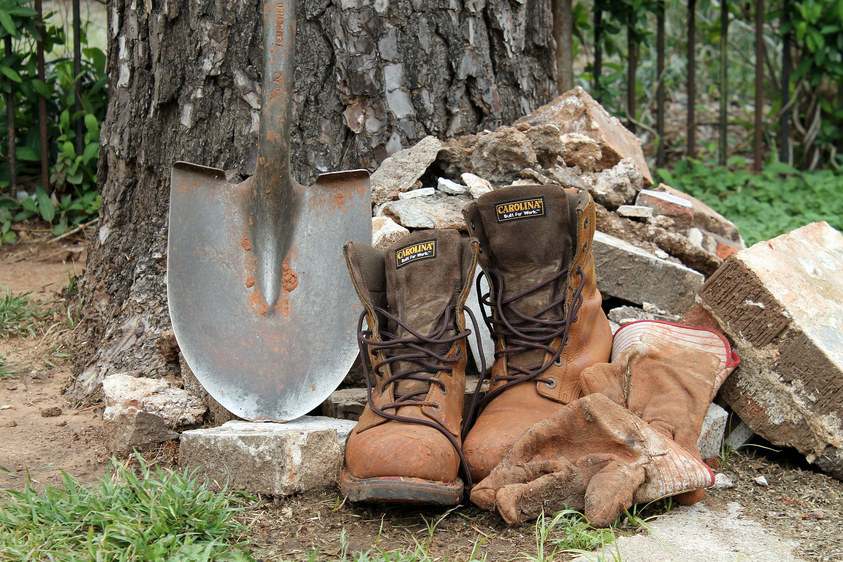
How to Protect Yourself
What Kind of Floors Improve Foot Comfort?
Standing or working on a hard, unyielding floor can cause a lot of discomfort. Wood, cork, carpeting, or rubber – anything that provides some flexibility – is gentler on workers' feet. Where resilient floors are not practical, footwear with thick, insulating soles and shock-absorbing insoles can alleviate discomfort.
Footwear Knowledge
Foot Injury Prevention
Notes:
How to Protect Yourself
What Kind of Floors Improve Foot Comfort?
Standing or working on a hard, unyielding floor can cause a lot of discomfort. Wood, cork, carpeting, or rubber – anything that provides some flexibility – is gentler on workers' feet. Where resilient floors are not practical, footwear with thick, insulating soles and shock-absorbing insoles can alleviate discomfort. Anti-fatigue matting can also be useful wherever workers have to stand or walk. They provide a cushioning which reduces foot fatigue. However, the use of matting requires caution. When installed improperly, it can lead to tripping and slipping incidents.
Special anti-slip flooring or matting can reduce slipping incidents. If installed properly, these mats are useful, but workers may find that their feet burn and feel sore. The non-slip properties of the flooring mat cause their shoes to grab suddenly on the flooring making their feet slide forward inside the shoes. Friction inside the shoes produces heat that creates soreness and, eventually, calluses. A non-slip resilient insole can reduce this discomfort.
Footwear Knowledge
Proper footwear is important, not only for foot comfort but also for one's general well-being. Improper footwear can cause or aggravate existing foot problems. Unfortunately, being fashionable sometimes takes precedence over choosing well-fitting, supportive safety footwear. However, many safety footwear manufacturers produce safety footwear that does look fashionable.
The best way to involve workers in programs to protect their feet is to provide:
Training and information on the health hazards of wearing improper shoes.
Principles for selecting proper shoes.
Simple rules of general foot care.
Foot Injury Prevention
There is no workplace where a worker is immune to foot injury. However, the hazards differ according to the workplace and the types of tasks the worker does. The first step in developing a strategy to reduce foot problems is to identify the relevant hazards at the workplace. Such hazards should be assessed in each workplace, no matter how safe or how dangerous it may seem. Foot injuries then can be prevented by looking for measures through proper job design and/or workplace design, and identifying proper foot wear.

Slide 10
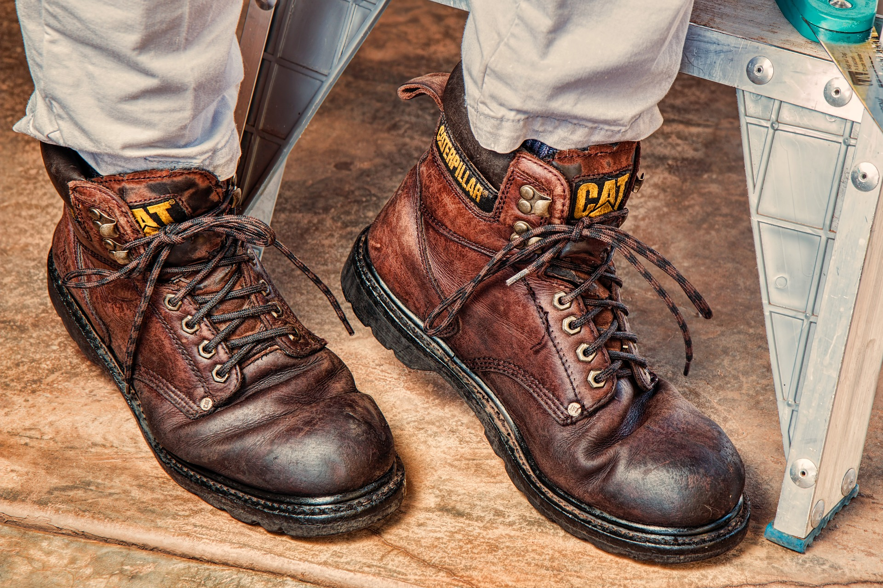
How to Protect Yourself
Good Job Design Improves Foot Safety
Workplace Design Improves Foot Safety
Notes:
How to Protect Yourself
Good Job Design Improves Foot Safety
Aching, flat or tired feet are common among workers who spend most of their working time standing.
The most important goal of job design is to avoid fixed positions especially fixed standing positions. Good job design includes varied tasks requiring changes in body position and using different muscles. Job rotation, job enlargement and team work are all ways to make work easier on the feet.
Job rotation moves workers from one job to another. It distributes standing among a group of workers and shortens the time each individual spends standing. However, it must be a rotation where the worker does something completely different such as walking around or sitting at the next job.
Job enlargement includes more and different tasks in a worker's duties. If it increases the variety of body positions and motions, the worker has less chance of developing foot problems.
Team work gives the whole team more control and autonomy in planning and allocation of the work. Each team member carries a set of various operations to complete the whole product. Team work allows workers to alternate between tasks which, in turn, reduces the risk of overloading the feet.
Rest breaks help to alleviate foot problems where redesigning jobs is impractical. Frequent short breaks are preferable to fewer long breaks.
Workplace Design Improves Foot Safety
Redesigning the job alone will not effectively reduce foot problems if it is not combined with the proper design of the workplace.
For standing jobs, an adjustable work surface is the best choice. If the work surface is not adjustable, two solutions include installing a platform to raise the shorter worker or a pedestal to raise the object for a taller worker.
Work station design should allow the worker room to change body position.
A foot-rail or footrest enables the worker to shift weight from one leg to the other. This ability reduces the stress on the lower legs and feet.
Where possible, a worker should be able to work sitting or standing at will. Even when work can only be done while standing, a seat should be provided for resting purposes.

Slide 11
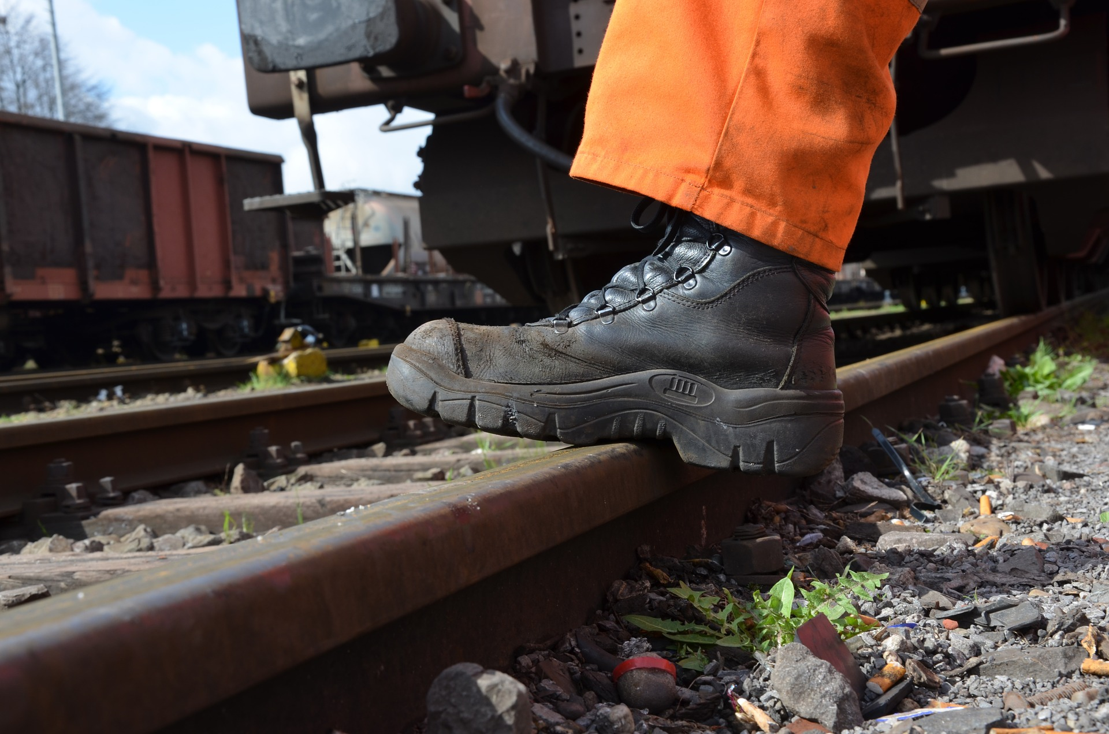
How to Protect Yourself
Men and Women
Footwear Appropriate for Cold Conditions
Feet Care
Exercises at The Workstation
Notes:
How to Protect Yourself
Men and Women
All working footwear, for both men and women, whether it is safety wear or not, should provide comfort without compromising protective value. In addition, protective footwear should conform with CSA Standard CAN/CSA-Z195-14 or appropriate standard for your jurisdiction.
A steel toe cap should cover the whole length of the toes from tips to beyond the natural bend of the foot. A soft pad covering the edge of the toecap increases comfort. If the toecap cuts into the foot, either the size or style of the footwear is incorrect.
Soles come in a variety of thicknesses and materials. They need to be chosen according to the hazards and type(s) of flooring in the workplace.
Uppers of protective footwear come in a variety of materials. Selection should take into account the hazards, and individual characteristics of the worker's foot.
A steel midsole which protects the foot against penetration by sharp objects should be flexible enough to allow the foot to bend.
No one type of non-slip footwear can prevent the wearer from slipping on every surface type.
Footwear Appropriate for Cold Conditions
Selection should be made to suit the specific working condition. Working outdoors in cold weather poses a special requirement on selecting the proper footwear. "Normal" protective footwear is not designed for cold weather. "Insulated" footwear may give little temperature protection in the sole if it has no insulation there. Loss of heat through steel toe caps (commonly blamed for increased heat loss) is insignificant.
Foot protection against cold weather can be resolved by:
Insulating the legs by wearing thermal undergarments.
Wearing insulating overshoes over work footwear.
Wearing insulating muffs around the ankles and over the top of the footwear.
Feet Care
Feet are subject to a great variety of skin and toenail disorders. Workers can avoid many of them by following simple rules of foot care:
Wash feet daily with soap, rinse thoroughly and dry, especially between the toes.
Trim toenails straight across and not too short. Do not cut into the corners.
Wear clean socks or stockings and change them daily.
Some feet sweat more than others and are more prone to athlete's foot. Again, following a few simple guidelines may help:
Select shoes made of leather or canvas – not synthetic materials.
Keep several pairs of shoes on hand and rotate shoes daily to allow them to air out.
For some workers, non-coloured woollen or cotton socks may be recommended since dyes may cause or aggravate skin allergies.
Use foot powder.
If problems persist, see a doctor or health care specialist.
In cases of persisting ingrown toenails, calluses, corns, fungal infection and more serious conditions such as flat feet and arthritis, see a doctor and follow the doctor's advice.
Exercises at The Workstation
Standing still requires considerable muscular effort. Even so, it is not exercise – only a strain. It does not allow for the alternate contracting and relaxing of muscles of the feet and legs.
To keep feet healthy, it is necessary to compensate for working in a stationary position. One action that can be done frequently on the job is alternately to contract and relax the calf muscles, and flex and straighten ankles and knees. Another bit of advice is to walk whenever practical instead of riding. More information on exercise for feet can be obtained from a foot specialist or from a local fitness centre.

Slide 12
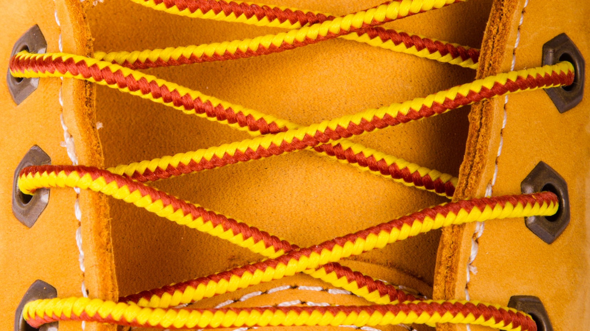
Final Word
Protecting feet and ankles from injuries involve selecting and wearing the proper footwear according to task and hazards. In general, it is a good idea to always use CSA-approved safety footwear. It’s also important to select the right footwear for conditions and the task.
Notes:
Final Word
Protecting feet and ankles from injuries involve selecting and wearing the proper footwear according to task and hazards. In general, it is a good idea to always use CSA-approved safety footwear. It’s also important to select the right footwear for conditions and the task.

