Slide 1

Click anywhere to get started…

Slide 2

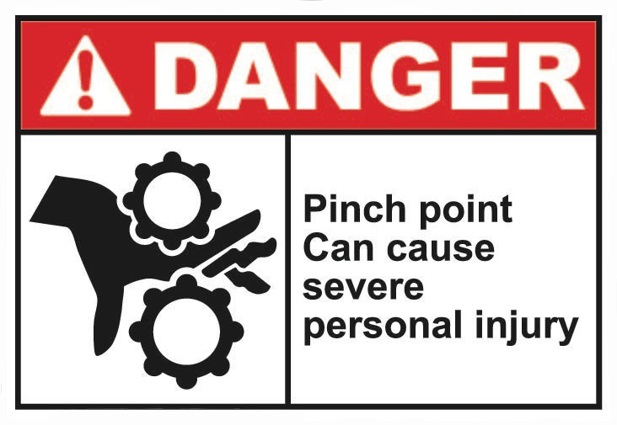

PINCH POINTS
Notes:
PINCH POINTS

Slide 3

What’s at Stake?
A pinch point is “any point at which it is possible for a person or part of a person’s body to be caught between moving parts of a machine, or between the moving and stationary parts of a machine, or between material and any part of the machine” according to the Michigan Occupational Safety and Health Administration.
Notes:
WHAT’S AT STAKE?
A pinch point is “any point at which it is possible for a person or part of a person’s body to be caught between moving parts of a machine, or between the moving and stationary parts of a machine, or between material and any part of the machine” according to the Michigan Occupational Safety and Health Administration.

Slide 4
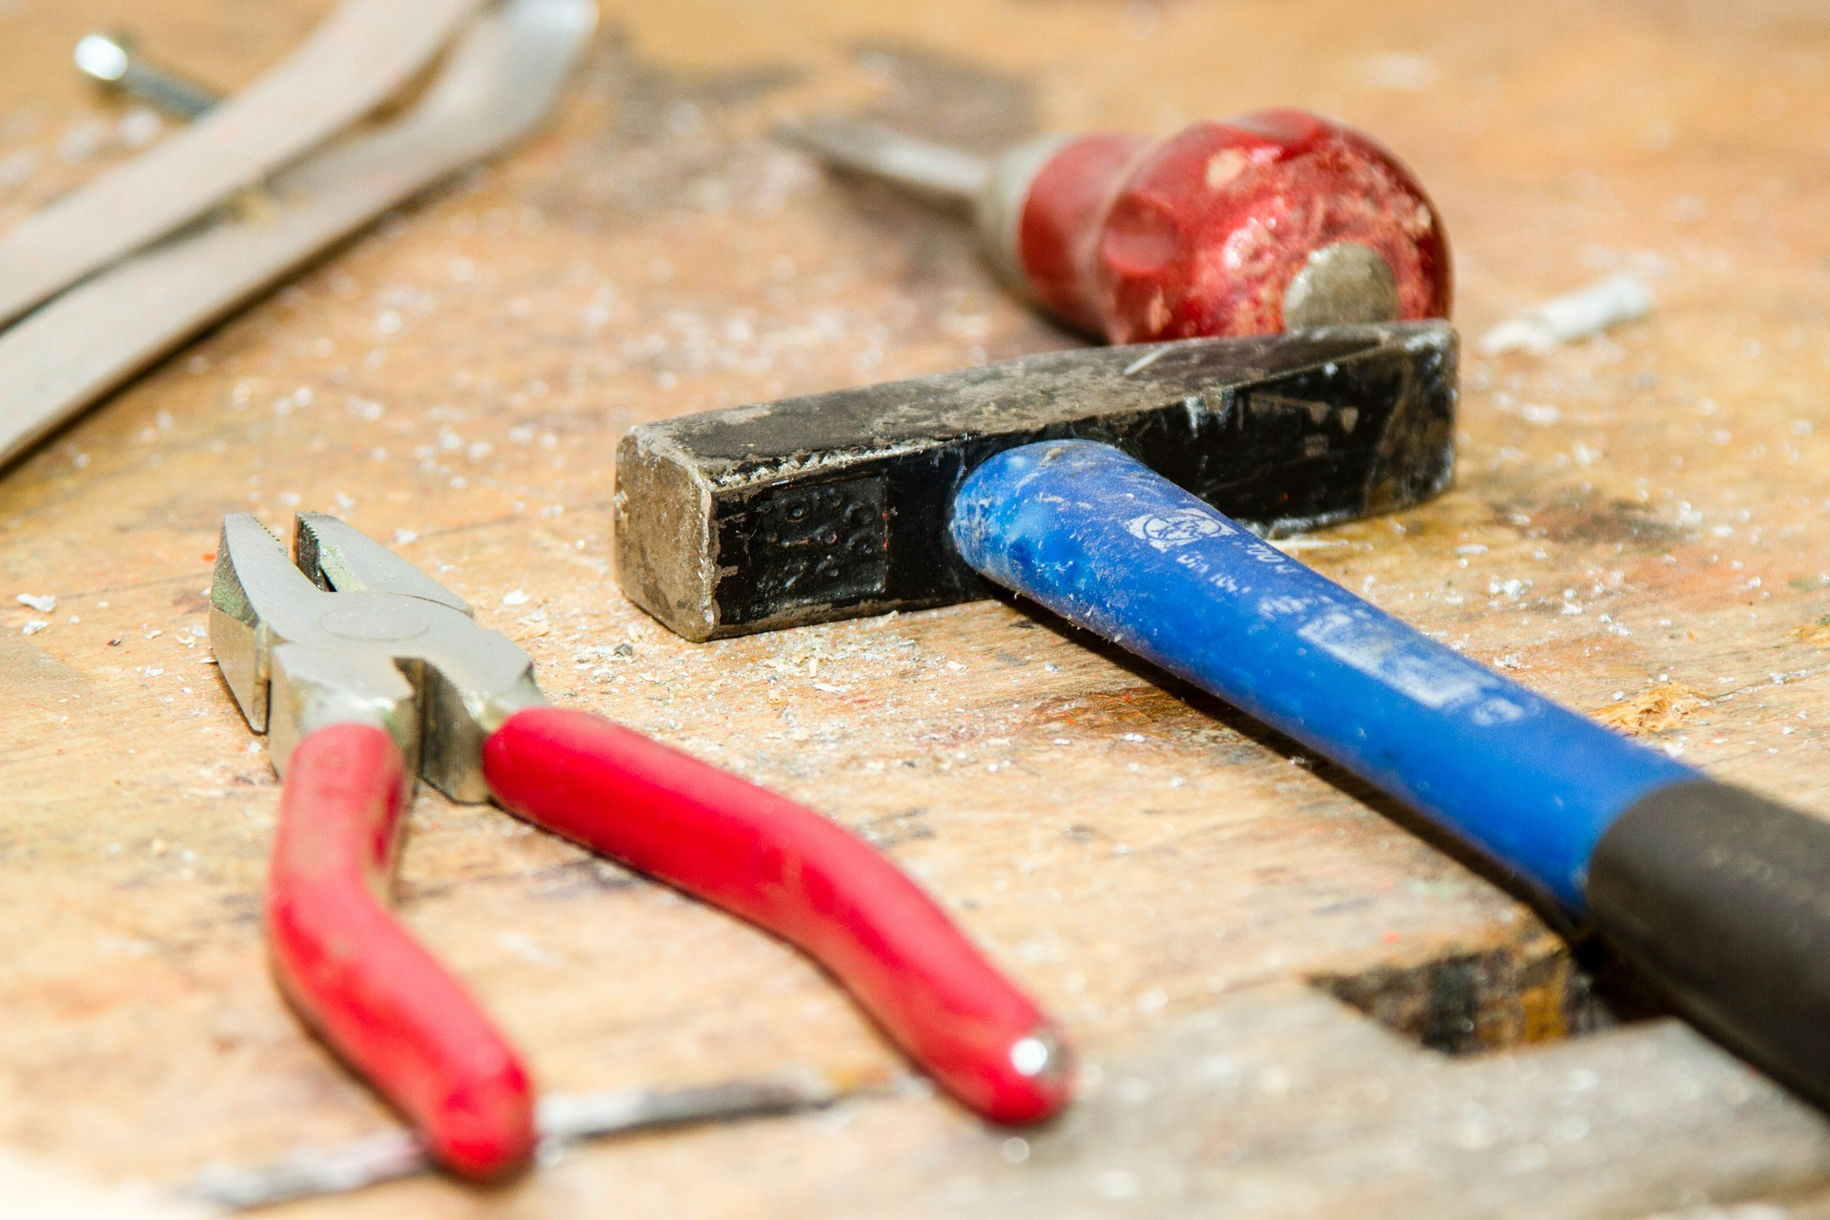
What’s the Danger?
STATISTICS
Each year, workers suffer approximately 125,000 caught or crushed injuries that occur when body parts get caught between two objects or entangled with machinery.
Notes:
WHAT’S THE DANGER?
STATISTICS
Each year, workers suffer approximately 125,000 caught or crushed injuries that occur when body parts get caught between two objects or entangled with machinery. The physical forces applied to a body part caught in a pinch point can vary and cause injuries ranging from bruises, cuts, amputated body parts, and even death.
A pinch point injury can be the result of something as large as an excavator or as small as a pair of pliers. Of the millions of disabling accidents that happen on the job, one third of them are hand injuries. Approximately 80% of these hand injuries are caused by pinch points.
Other Dangers
Certain pinch points are blaringly clear. These pinch points will typically have guards and mechanisms alerting the workers of the hazard. Other pinch points are less obvious, but can still result in serious injuries - even death. In either case, it's important to know the danger. For instance:
Vehicles in reverse could crush a worker against the wall.
Closely stored drums or crates may pinch hands or fingers between each other and a dolly.
The rungs of an extension ladder can catch feet, hands, and fingers as they slide past each other.
A body part or a piece of clothing can get caught up in machinery, between equipment or between a lid and a container when closing.
Common Causes of Injuries from Pinch Points:
Not paying attention to the location of hands and feet.
Walking or working in areas with mobile equipment and fixed structures;
Loose clothing, hair, or jewelry getting caught in rotating parts or equipment; Poor condition of equipment and guarding.
Dropping or carelessly handling materials or suspended loads.
Not using the proper work procedures or tools; and
Reaching into moving equipment and machinery.
Traditional Speak
Pinch Points are pervasive at work occurring traditionally with a number of machines and devices, including power presses, conveyors, robotic machines, metal-forming machines, powered rollers, assembling machines, plastic molding machinery, printing presses, power transmission equipment, powered doors, covers and hatches.
Caught in and caught in between injuries are consistently featured as one of OSHA’s Fatal Four. And non-fatal pinch point injuries can leave you with bruises and cuts, and on the serious end of the scale, it might even require amputating a limb.

Slide 5
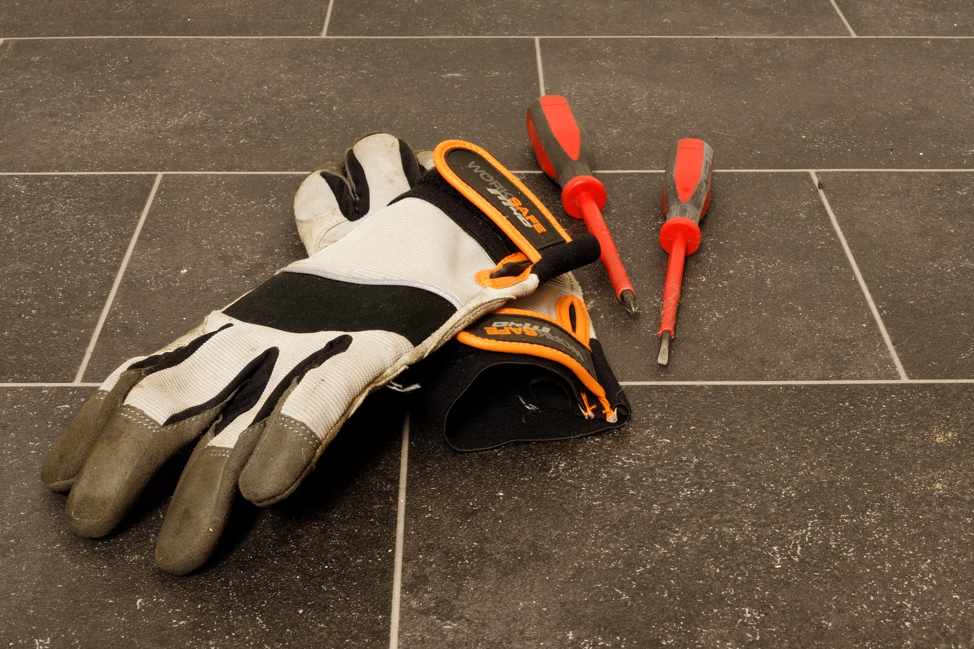
How to Protect Yourself
PINCH POINT PREVENTION
There are three major components to preventing pinch point injuries.
Awareness
Physical Barriers
Personal Protective Equipment (PPE)
Notes:
HOW TO PROTECT YOURSELF
PINCH POINT PREVENTION
There are three major components to preventing pinch point injuries.
Awareness:
All around us are things and activities that can cause pinch point injuries (form placement, tool usage, material handling, etc.). Many cannot be avoided, but if you are constantly alert you can protect yourself from injuries. Awareness comes in two forms, a common-sense alertness of the right thing to do, and training in the correct way to do things and use equipment.
Physical Barriers:
In service areas, physical barriers might be anything from the machine guard on your table saw to barricades or warning devices from a running engine. Physical barriers are there to protect you from injury, not prohibit your activity. Guards are important to protect you from direct contact with moving parts, flying chips, kickbacks, and splashing of metal or harmful liquids. Barricades are placed at construction sites to warn you of dangerous situations.
It takes knowledge and insight to properly prepare equipment for maintenance or storage. Blocks are used to prevent equipment from rolling and heavy parts from falling. Never remove them unless you know why they are there, and the reason for being there is completed. Always check for fellow workers in harm’s way before removing blocks.
Personal Protective Equipment (PPE):
Respecting and using physical barriers and being aware of your surroundings is only half of what you need to do to be safe. Make sure you are always wearing your safety gear and inspect it before each use. Although the last line of defense against a pinch point injury, PPE (proper gloves, footwear) is a necessity to ensure others notice your position and your extremities are protected.

Slide 6
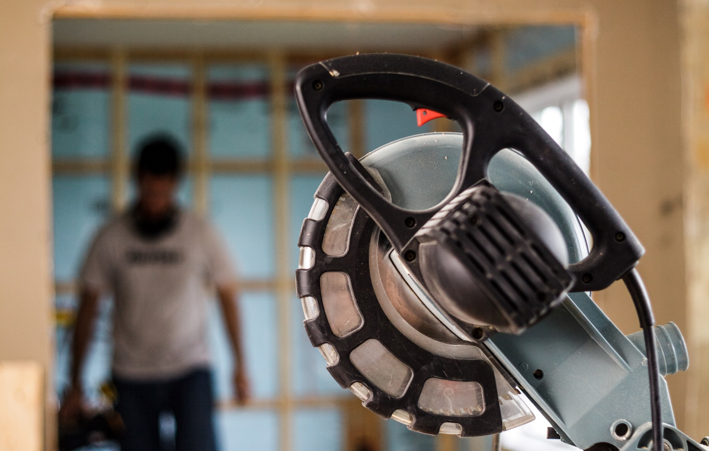
How to Protect Yourself
SAFETY TIPS TO AUDIO PINCH POINT INJURIES
Follow the dress code
Leave the jewelry home
Tuck away long hair
Wear your safety gear
Conduct a pre-inspection
Use machine guards
Know how to deal with a jam
Look beyond the machinery
Stay alert and focused
Notes:
How to Protect Yourself
SAFETY TIPS TO AVOID PINCH POINT INJURIES
Follow the dress code – Wearing the right kind of clothing when working in areas where pinch injuries can occur is critically important. Pant legs and shirt sleeves shouldn’t be too long or too loose. Shirts should be tucked into the pants to reduce the risk of them getting caught in moving machinery.
Leave the jewelry home – All jewelry should be removed, especially dangling earrings, necklaces, and rings.
Tuck away long hair – Long hair should be tied back, and braids and ponytails should be kept at the back of the head and secured. Hair falling forward or down toward the machinery could get caught in its pinch points.
Wear your safety gear – The right personal protective gear for the job should be kept on at all times. Make sure safety gloves fit properly to avoid getting them caught (consult this sizing chart to make sure you get the right size).
Conduct a pre-inspection – Inspect machinery for any potential hazards before anyone operates it. Make a safety plan and follow through with it during the entire time the machine is in operation.
Stay alert and focused – Anyone operating equipment should stay totally focused on the job at hand and keep their eyes focused on the moving parts. Minimize distractions in the work environment as much as possible.
Use machine guards – Make sure that the right guard has been installed on the equipment and make sure that it is fitted properly. If you notice missing or damaged safety guards during your pre-inspection, don’t put the machinery into operation.
Know how to deal with a jam – Make sure you learn how to safely deal with the machine if it becomes jammed. Before you clean or fix jammed equipment, make sure it has been turned off and come to a complete stop. Familiarize yourself with the lockout/Tagout procedures.
Look beyond the machinery – Pinch points aren’t just found in industrial equipment. Machinery pinch points can cause serious injuries, but so can a stack of heavy items. Even getting your hand or foot jammed in the door might cause enough damage to require medical attention.

Slide 7

Final Word
When it comes to working or operating machinery with rotating parts, pinch point safety is imperative. In the work environment, pinch points are used to explain situations where hand tools, machines, and various conditions place body parts or a worker's entire body at risk.
Notes:
FINAL WORD
When it comes to working or operating machinery with rotating parts, pinch point safety is imperative. In the work environment, pinch points are used to explain situations where hand tools, machines, and various conditions place body parts or a worker's entire body at risk.

