Slide 1

Click anywhere to get started…

Slide 2



INSTRUCTIONS FOR CONDUCTING A JOB HAZARD ANALYSIS
Notes:
Instructions For Conducting A Job Hazard Analysis

Slide 3
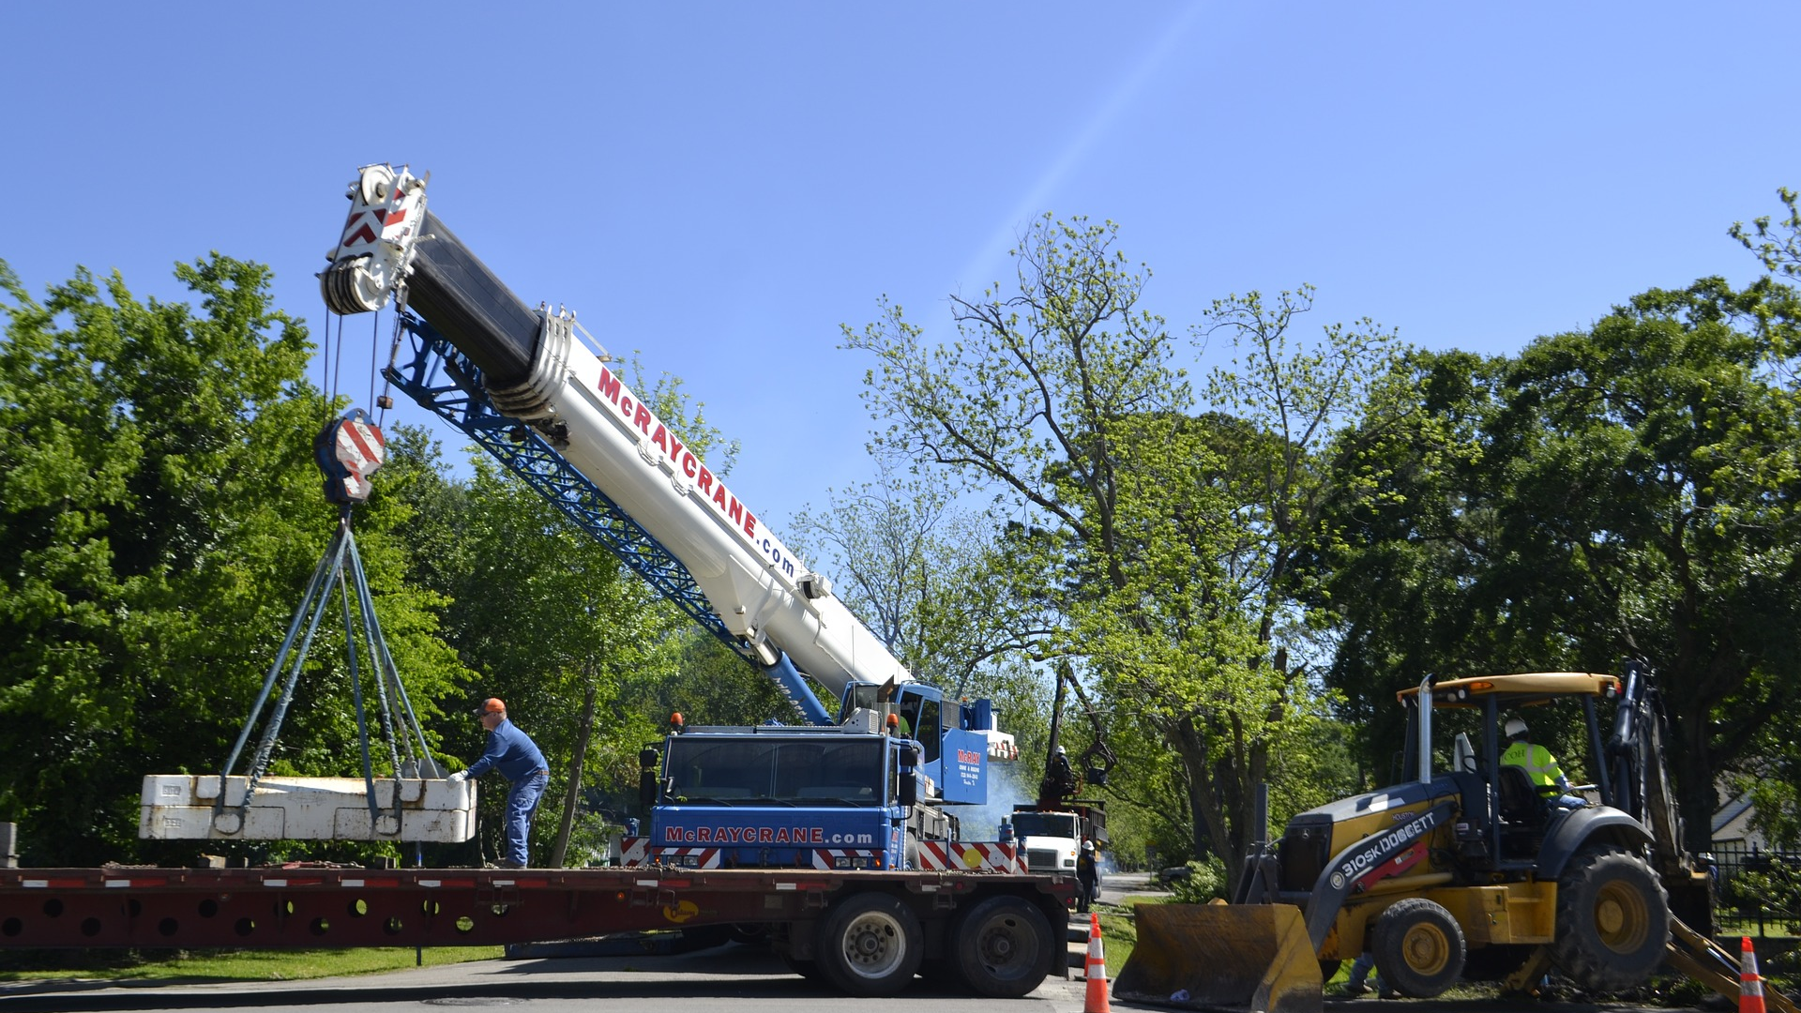
What’s at Stake?
A Job Hazard Analysis (JHA) is an analysis of the hazards and risk associated which focus on identifying and controlling hazards.
Notes:
What’s at Stake?
A job hazard analysis (JHA), also called a job safety analysis (JSA), is a technique to identify the dangers of specific tasks in order to reduce the risk of injury to workers.
A Job Hazard Analysis (JHA) is an analysis of the hazards and risk associated which focus on identifying and controlling hazards. Utilizing the JHA will provide a process for analyzing the work activities that will identify the tools, materials and equipment needed to develop work methods and procedures for accomplishing the task. The process will identify existing and potential hazards and assessing the risk and identify methods to eliminate or protect against the hazard.

Slide 4

What’s the Danger?
Effective risk management starts with identifying and addressing hazards before incidents occur.
Without a solid understanding of the hazards and risks your employees face with the tasks they accomplish each day, it’s impossible to keep them safe.
Notes:
What’s the Danger?
Effective risk management starts with identifying and addressing hazards before incidents occur.
Without a solid understanding of the hazards and risks your employees face with the tasks they accomplish each day, it’s impossible to keep them safe.

Slide 5

How to Protect Yourself
The critical steps in completing an effective JSA, are as follows:
Step One: Select Which Job to Analyze
Step Two: Job Task Breakdown
Notes:
How to Protect Yourself
How To Protect Yourself
The critical steps in completing an effective JSA, are as follows:
Step One: Select Which Job to Analyze
To start the JSA process, choose the jobs or tasks that need to be evaluated.
How do you determine which job or task to evaluate first? A good practice should be prioritized jobs using the following criteria:
jobs with the highest injury or illness rates,
jobs with the highest potential for injury or illness,
jobs in which one simple human error could lead to a severe accident or injury,
newly implemented jobs and processes, or ones that have undergone changes in processes and procedures and
jobs complex enough to require written instructions.
Step Two: Job Task Breakdown
To perform a thorough and accurate JSA, each job must be broken down into a defined sequence of individual tasks. It’s important to avoid defining individual job tasks too narrowly or too broadly. Generally speaking, a job should contain no more than ten individual tasks. If your JSA exceeds this number, consider separating the job into two or more separate phases. It also is vital to maintain the proper sequence of job tasks to ensure that during the hazard identification phase, hazards are addressed in the order they are encountered by employees.
Observation
Job task breakdown typically is accomplished through direct observation, with at least one EHS professional or direct supervisor familiar with the job and recording the series of individual tasks as they are performed by an experienced employee. Observation of an experienced employee helps ensure that job tasks are performed in the proper sequence with a high level of precaution, helping to identify unforeseen hazards more easily. This also helps ensure that all tasks, even frequently missed steps like set-up and clean-up, are being reviewed as well. Remember, if a task isn’t identified, risks can’t be identified either.
Once the observation is complete, participants should convene to review the findings and ensure that all steps sufficiently were identified.

Slide 6

How to Protect Yourself
Step Three: Identifying Hazards
Step Four: Develop Preventative Measures
Notes:
How to Protect Yourself
Step Three: Identifying Hazards
Hazards should be identified soon after the observation and job task breakdown, while the sequence of job tasks and potential hazards still is fresh in the minds of all participants. If one or more job tasks need to be repeated, it should be done immediately, if possible.
A number of questions should be asked to assess the potential hazards in performing individual job tasks. Proceed through the sequence of job tasks one at a time and answer questions such as:
Are there any pinch points or potential for body parts to be caught between moving machinery or objects?
Does the equipment in use present any potential hazards?
Is there a potential for slips, trips or falls?
Is there a risk of injury due to excessive strain from lifting, pushing or pulling?
Is there a risk of exposure to extreme heat or cold?
Does the task expose employees to excessive noise or vibration?
Is there potential for exposure to toxic/hazardous substances, harmful radiation or electrical hazards?
This list is by no means exhaustive, and the questions asked should reflect the unique potential hazards and work environments associated with each job. Employees performing the tasks for which the job safety analysis is being conducted should provide input and insight into the hazard identification process, and strive to consider every possible outcome in the performance of each task. Proper controls should then be developed to limit the potential for the job hazards to result in an environmental or safety incident.
Step Four: Develop Preventative Measures
The hierarchy of controls is a well-known and commonly-used tool for developing preventive measures for hazards associated with job tasks. The National Institute for Occupational Safety and Health lists the five controls, in order of effectiveness, with the following description:
Elimination – Physically remove the hazard
Substitution – Replace the hazard
Engineering controls – Isolate people from the hazard
Administration controls – Change the way people work
PPE – Protect the worker with personal protective equipment
Hazard elimination widely is considered to be the most effective, longest-term solution to improving job safety. However, it also often is the most difficult and expensive in the short term to implement. Administrative controls and PPE measures tend to be less expensive to implement initially, but often are less effective at controlling hazards and can be difficult to sustain in the long term.

Slide 7

How to Protect Yourself
Step Five: Document and Communicate Job Hazard Analysis Findings
Step Six: Get Help (If Needed)
Notes:
How to Protect Yourself
Step Five: Document and Communicate Job Hazard Analysis Findings
After a JSA has been completed, the findings should be documented and made available to employees so that they’re aware of the hazards associated with the jobs they will be performing, and know what preventive measures will help keep them safe. Too often, employers spend the time and effort creating JSAs, only to have the documents disappear into a binder, or get filed onto a computer hard drive and forgotten. When this happens, the JSAs are not fulfilling their purpose. JSAs should be living documents that capture information about risks, document controls and inform the employees about both the hazards in their job tasks and the best means of avoiding them.
Employees need to know JSAs exist, and have quick and easy access to them. Furthermore, workers also need to be able to understand and act on them. It’s a matter of training and ensuring that the JSAs are easy to read and understand. If it’s not clear what hazards correspond to which tasks, or which controls correspond to which tasks, then the JSA fails its primary duty and may not adequately prepare employees to understand and avoid risks. When it comes to communicating hazards, it’s important to remove as much ambiguity as possible.
Training
The importance of effective and well-documented training cannot be emphasized enough. In many situations following a serious accident, questions of liability hinge on the issue of whether training on the JSA was conducted, whether it adequately covered what needed to be covered, and whether the evidence sufficiently backs up your answers to these questions. With a good training management system in place, employers more easily can run an effective training program, and also demonstrate employee training completion during an audit or inspection.
Step Six: Get Help (If Needed)
A good electronic risk analysis program makes it easy to develop good assessments and track corrective actions, and when combined with an incident management software solution, you can oversee all aspects of incidents – from reporting to tracking of corrective actions. Often, these programs enable workers to easily report safety incidents and hazards using their mobile devices. Many systems run off a centralized platform available across locations via the cloud, giving workers better access to quickly and easily create risk registers that show the hazards, risk levels, causes and preventative measures associated with any work process. Through the use of these software systems, JSAs can be viewed by employees – even through the use of their mobile devices – giving them better access to hazard and preventive information so they can work safer and more efficiently.
Maintaining a good JSA program is an ongoing and evolving process. If a workplace injury occurs, a review of the relevant JSA should occur to see if it had a shortcoming that may have contributed to the incident. A good practice is to involve your workforce in a periodic review exercise for existing JSAs to make sure they still accurately capture the job tasks as performed today and address all associated risks.

Slide 8
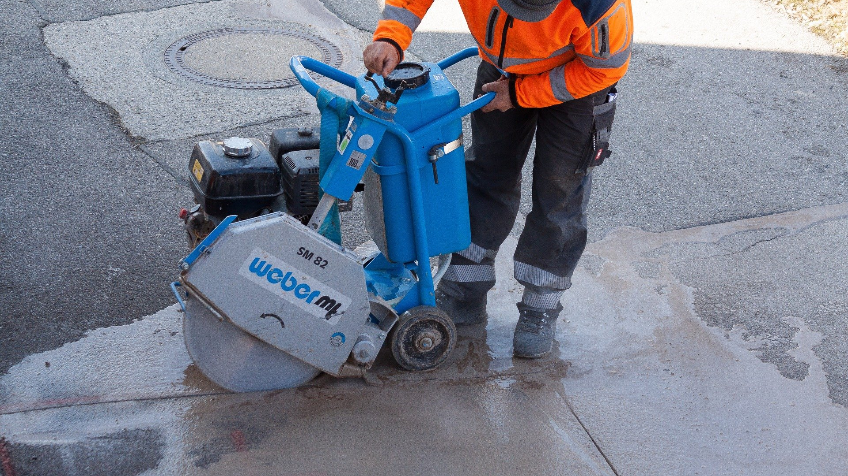
Final Word
It is critical to have accurate information about hazards that workers face every day. Today, mobile-optimized incident apps can be a valuable tool for employers to evaluate and prioritize which jobs to analyze. By offering front line workers the ability to report more accurate information and data around hazards, incidents and near misses, safety itself will be prioritized.
Notes:
Final Word
It is critical to have accurate information about hazards that workers face every day. Today, mobile-optimized incident apps can be a valuable tool for employers to evaluate and prioritize which jobs to analyze. By offering front line workers the ability to report more accurate information and data around hazards, incidents and near misses, safety itself will be prioritized.

