Slide 1

Click anywhere to get started…

Slide 2



Inspections
Notes:
Inspections

Slide 3
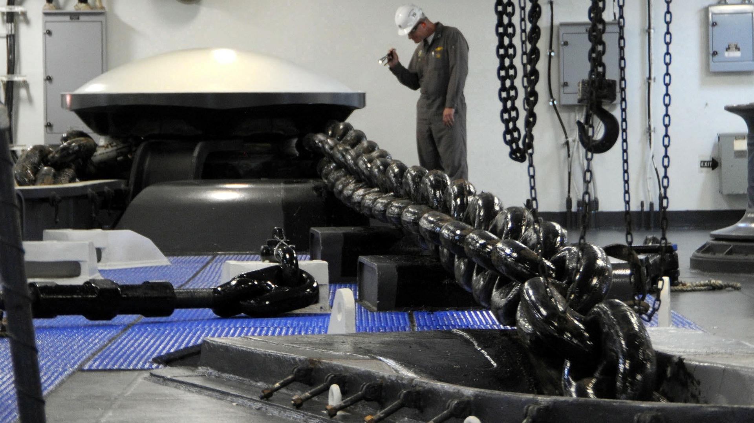
What’s at Stake?
Workplace inspections allow you to identify hazards and make sure you're complying with your OHS obligations. Workplace inspections are completed twice yearly to ensure all potential hazards are identified and controls put in place to manage the risk.
Notes:
What’s at Stake?
Workplace inspections allow you to identify hazards and make sure you're complying with your OHS obligations. Workplace inspections are completed twice yearly to ensure all potential hazards are identified and controls put in place to manage the risk.
Workplace inspections help prevent incidents, injuries and illnesses. Through a critical examination of the workplace, inspections help to identify and record hazards for corrective action. Health and safety committees can help plan, conduct, report and monitor inspections. Regular workplace inspections are an important part of the overall occupational health and safety program and management system, if present.

Slide 4

What’s the Danger?
Safety hazards
Biological hazards
Chemical hazards
Chemical hazards
Physical hazards
Psychosocial hazards
Notes:
What’s the Danger?
Types of workplace hazards include:
Safety hazards such as those caused by inadequate machine guards, unsafe workplace conditions, unsafe work practices.
Biological hazards caused by organisms such as viruses, bacteria, fungi and parasites.
Chemical hazards caused by a solid, liquid, vapour, gas, dust, fume or mist.
Chemical hazards caused by physiological and psychological demands on the worker, such as repetitive and forceful movements, awkward postures arising from improper work methods, and improperly designed workstations, tools, and equipment.
Physical hazards caused by noise, vibration, energy, weather, heat, cold, electricity, radiation and pressure.
Psychosocial hazards that can affect mental health or well-being such as overwork, stress, bullying, or violence.

Slide 5
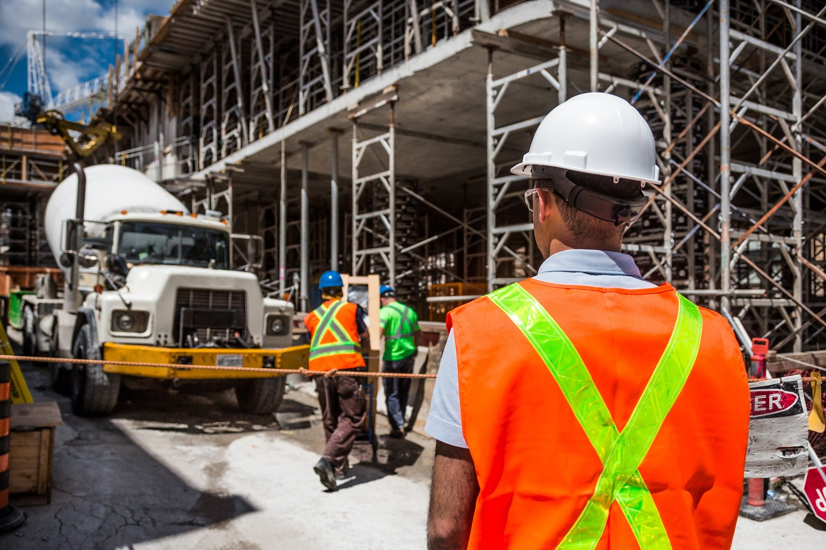
How to Protect Yourself
What to Examine
Every inspection must examine who, what, where, when and how. Pay particular attention to items that are or are most likely to develop into unsafe or unhealthy conditions because of stress, wear, impact, vibration, heat, corrosion, chemical reaction or misuse. Include areas where no work is done regularly, such as parking lots, rest areas, office storage areas and locker rooms.
Notes:
How to Protect Yourself
Planning Is Essential For An Effective Inspection
What to Examine
Every inspection must examine who, what, where, when and how. Pay particular attention to items that are or are most likely to develop into unsafe or unhealthy conditions because of stress, wear, impact, vibration, heat, corrosion, chemical reaction or misuse. Include areas where no work is done regularly, such as parking lots, rest areas, office storage areas and locker rooms.
Workplace Elements
Look at all workplace elements – the people, the environment, the equipment and the process. The environment includes such hazards as noise, vibration, lighting, temperature, and ventilation. Equipment includes materials, tools and apparatus for producing a product or a service. The process involves how the worker interacts with the other elements in a series of tasks or operations.
Observation
Look for deviations from accepted work practices. Use statements such as: "a worker was observed operating a machine without a guard." Do not use information derived from inspections for disciplinary measures.
Some common poor work practices include:
using machinery or tools without authority
operating at unsafe speeds or in other violation of safe work practice
removing guards or other safety devices, or making the devices ineffective
using defective tools or equipment or using tools or equipment in unsafe ways
using hands or body instead of tools or push sticks
overloading, crowding, or failing to balance materials or handling materials in unsafe ways, including improper lifting
repairing or adjusting equipment that is in motion, under pressure, or electrically charged
failing to use or maintain, or improperly using, personal protective equipment or safety devices
creating unsafe, unsanitary, or unhealthy conditions by improper personal hygiene, by using compressed air for cleaning clothes, by poor housekeeping, or by smoking in unauthorized areas
standing or working under suspended loads, scaffolds, shafts, or open hatches
discussion with or observation of workers who may be overloaded, fatigued, working in conflict with others, or working in isolation (working alone)

Slide 6
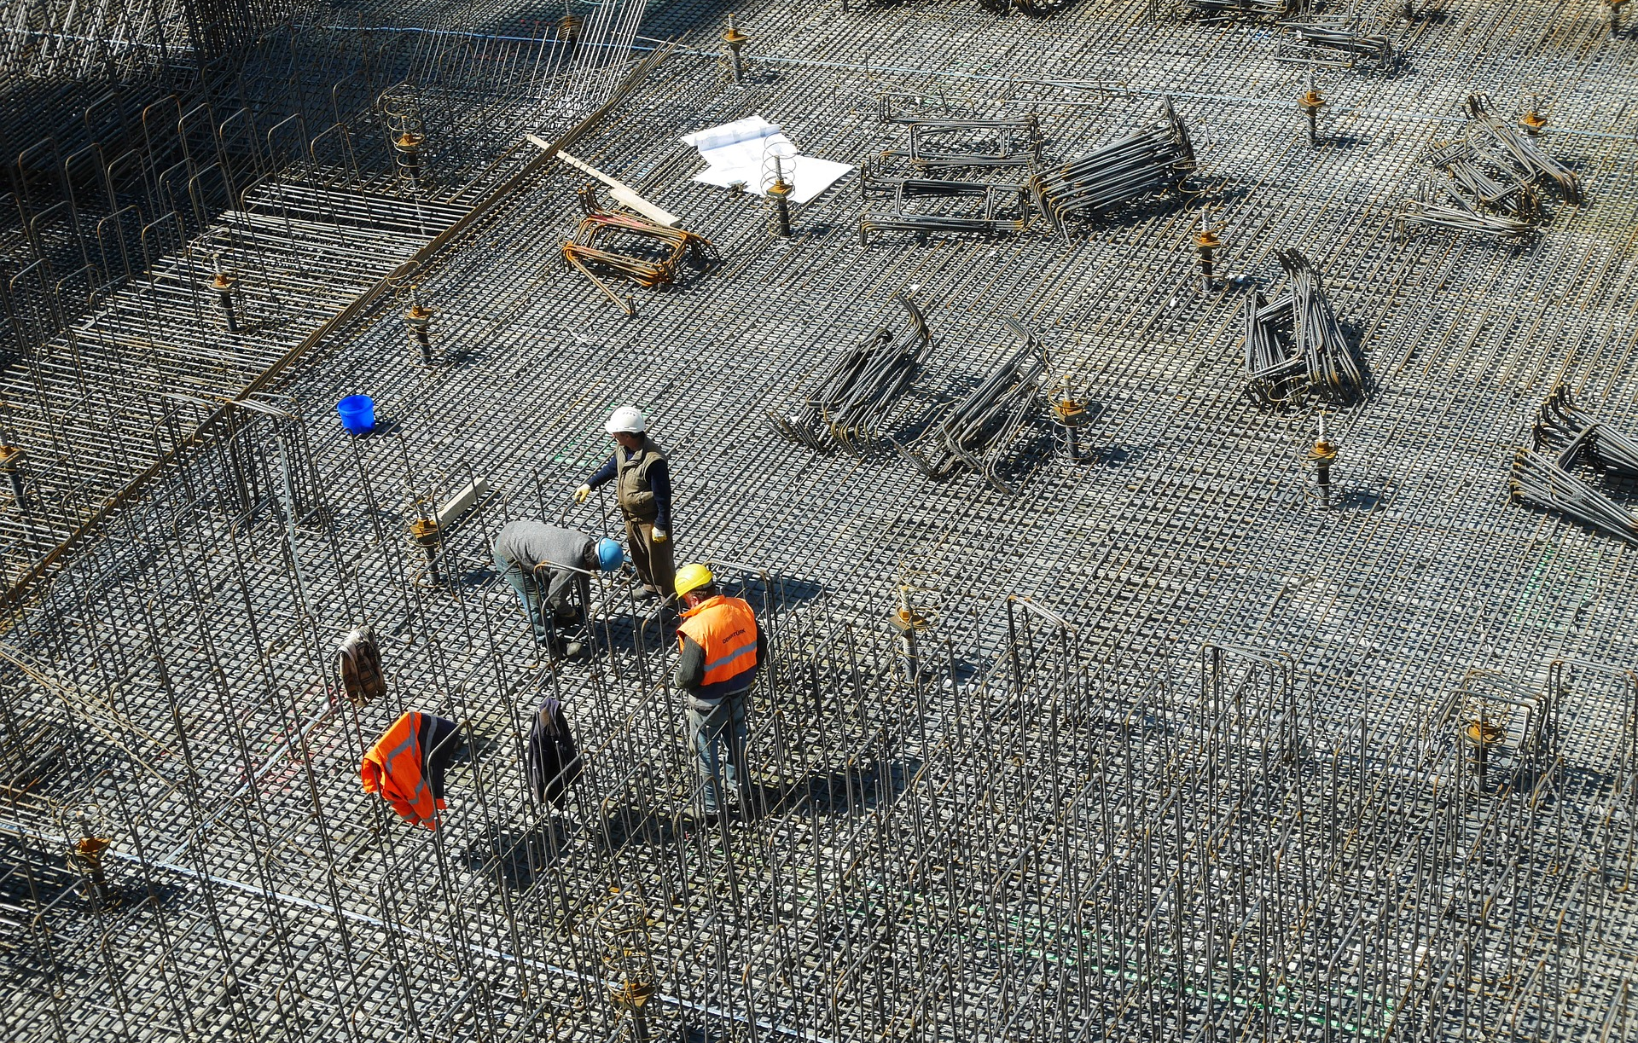
How to Protect Yourself
Inspection Principles
When conducting inspections, follow these basic principles:
Notes:
How to Protect Yourself
Inspection Principles
When conducting inspections, follow these basic principles:
Draw attention to the presence of any immediate danger - other items can await the final report.
Shut down and "lock out" any hazardous items that cannot be brought to a safe operating standard until repaired.
Do not operate equipment. Ask the operator for a demonstration. If the operator of any piece of equipment does not know what dangers may be present, this is cause for concern. Never ignore any item because you do not have knowledge to make an accurate judgement of safety.
Look up, down, around and inside. Be methodical and thorough. Do not spoil the inspection with a "once-over-lightly" approach.
Clearly describe each hazard and its exact location in your rough notes. Allow "on-the-spot" recording of all findings before they are forgotten. Record what you have or have not examined in case the inspection is interrupted.
Ask questions, but do not unnecessarily disrupt work activities. This interruption may interfere with efficient assessment of the job function and may also create a potentially hazardous situation.
Consider the static (stop position) and dynamic (in motion) conditions of the item you are inspecting. If a machine is shut down, consider postponing the inspection until it is functioning again.
Consider factors such as how the work is organized or the pace of work and how these factors impact safety.
Discuss as a group, "Can any problem, hazard or accident generate from this situation when looking at the equipment, the process or the environment?" Determine what corrections or controls are appropriate.
Do not try to detect all hazards simply by relying on your senses or by looking at them during the inspection. You may have to monitor equipment to measure the levels of exposure to chemicals, noise, radiation or biological agents.
Take a photograph if you are unable to clearly describe or sketch a particular situation.

Slide 7
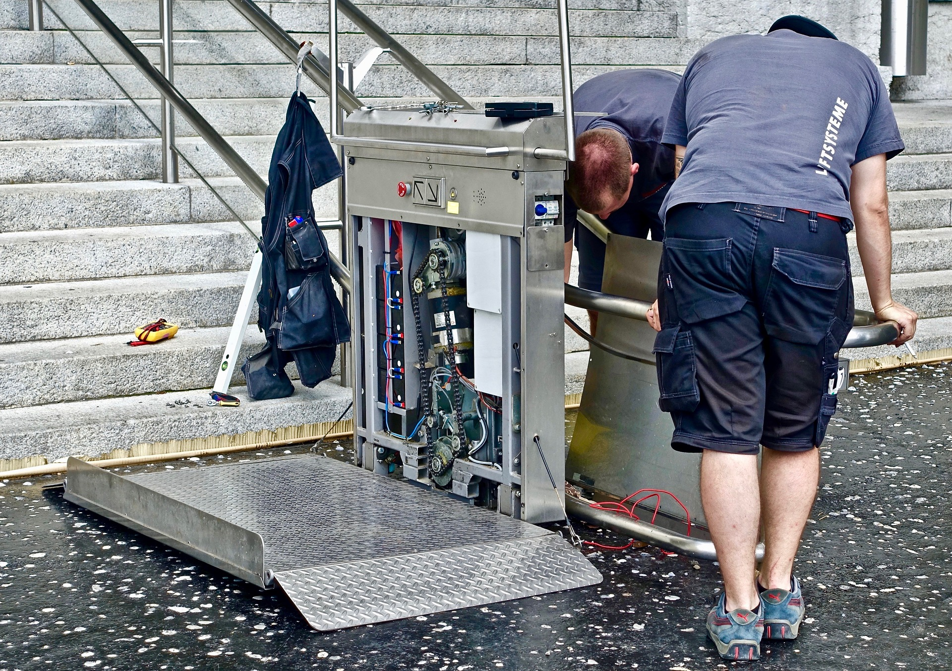
How to Protect Yourself
Other Types of Inspection Reports
The Inspection Team
Notes:
How to Protect Yourself
Other Types of Inspection Reports
Supervisors and workers continually conduct ongoing inspections as part of their job responsibilities. Such inspections identify hazardous conditions and either correct them immediately or report them for corrective action. The frequency of these inspections varies with the amount and conditions of equipment use. Daily checks by users assure that the equipment meets minimum acceptable safety requirements.
Pre-operation checks involve inspections of new or modified equipment or processes. Often these are done after workplace shutdowns.
Periodic inspections are regular, planned inspections of the critical components of equipment or systems that have a high potential for causing serious injury or illness. The inspections are often part of preventive maintenance procedures or hazard control programs. Laws and regulations may specify that qualified or competent persons must inspect certain types of equipment, such as elevators, boilers, pressure vessels, scaffolding, and fire extinguishers at determined points in the work process and at regular intervals.
The Inspection Team
Health and safety committee members are obvious choices of personnel to carry out formal inspections, especially if they have received training or certification.
Other criteria for selecting the inspection team are:
knowledge of regulations and procedures
knowledge of potential hazards
experience with work procedures involved
Engineers, maintenance personnel, occupational hygienists, health and safety professionals, supervisors or managers may be a part of the inspection team or they may be called upon to help with certain aspects of the inspection, or to help explain equipment or processes.

Slide 8
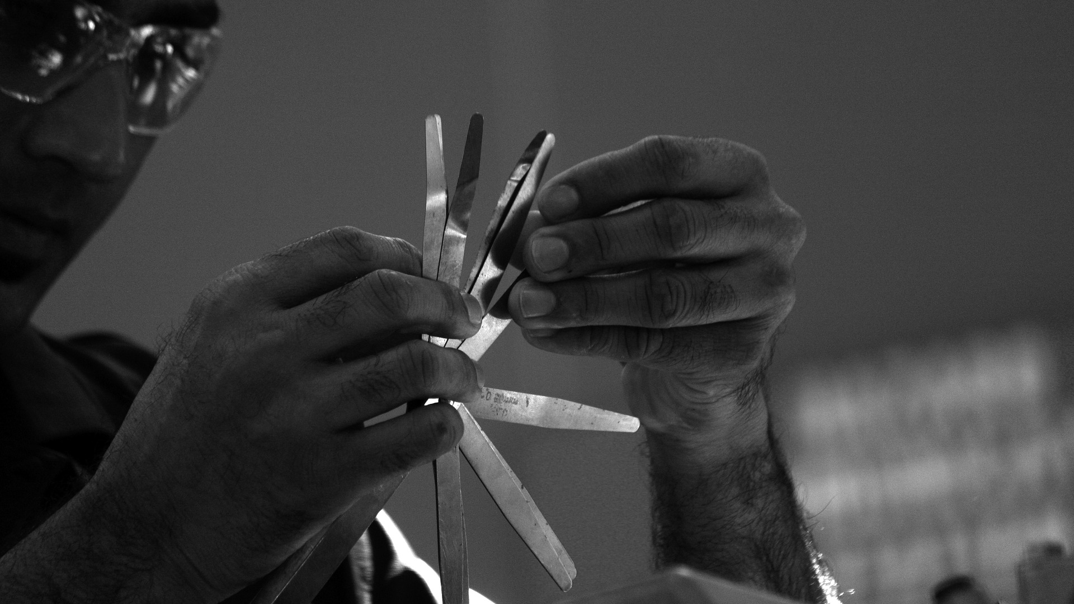
Final Word
The constituent elements that comprise an inspection include the people, the environment, the equipment, and the process. The environment includes such hazards as noise, vibration, lighting, temperature, and ventilation. Equipment includes materials, tools and apparatus for producing a product or a service. The process involves how the worker interacts with the other elements in a series of tasks or operations.
Notes:
Final Word
The constituent elements that comprise an inspection include the people, the environment, the equipment, and the process. The environment includes such hazards as noise, vibration, lighting, temperature, and ventilation. Equipment includes materials, tools and apparatus for producing a product or a service. The process involves how the worker interacts with the other elements in a series of tasks or operations.

