Slide 1

Click anywhere to get started…

Slide 2

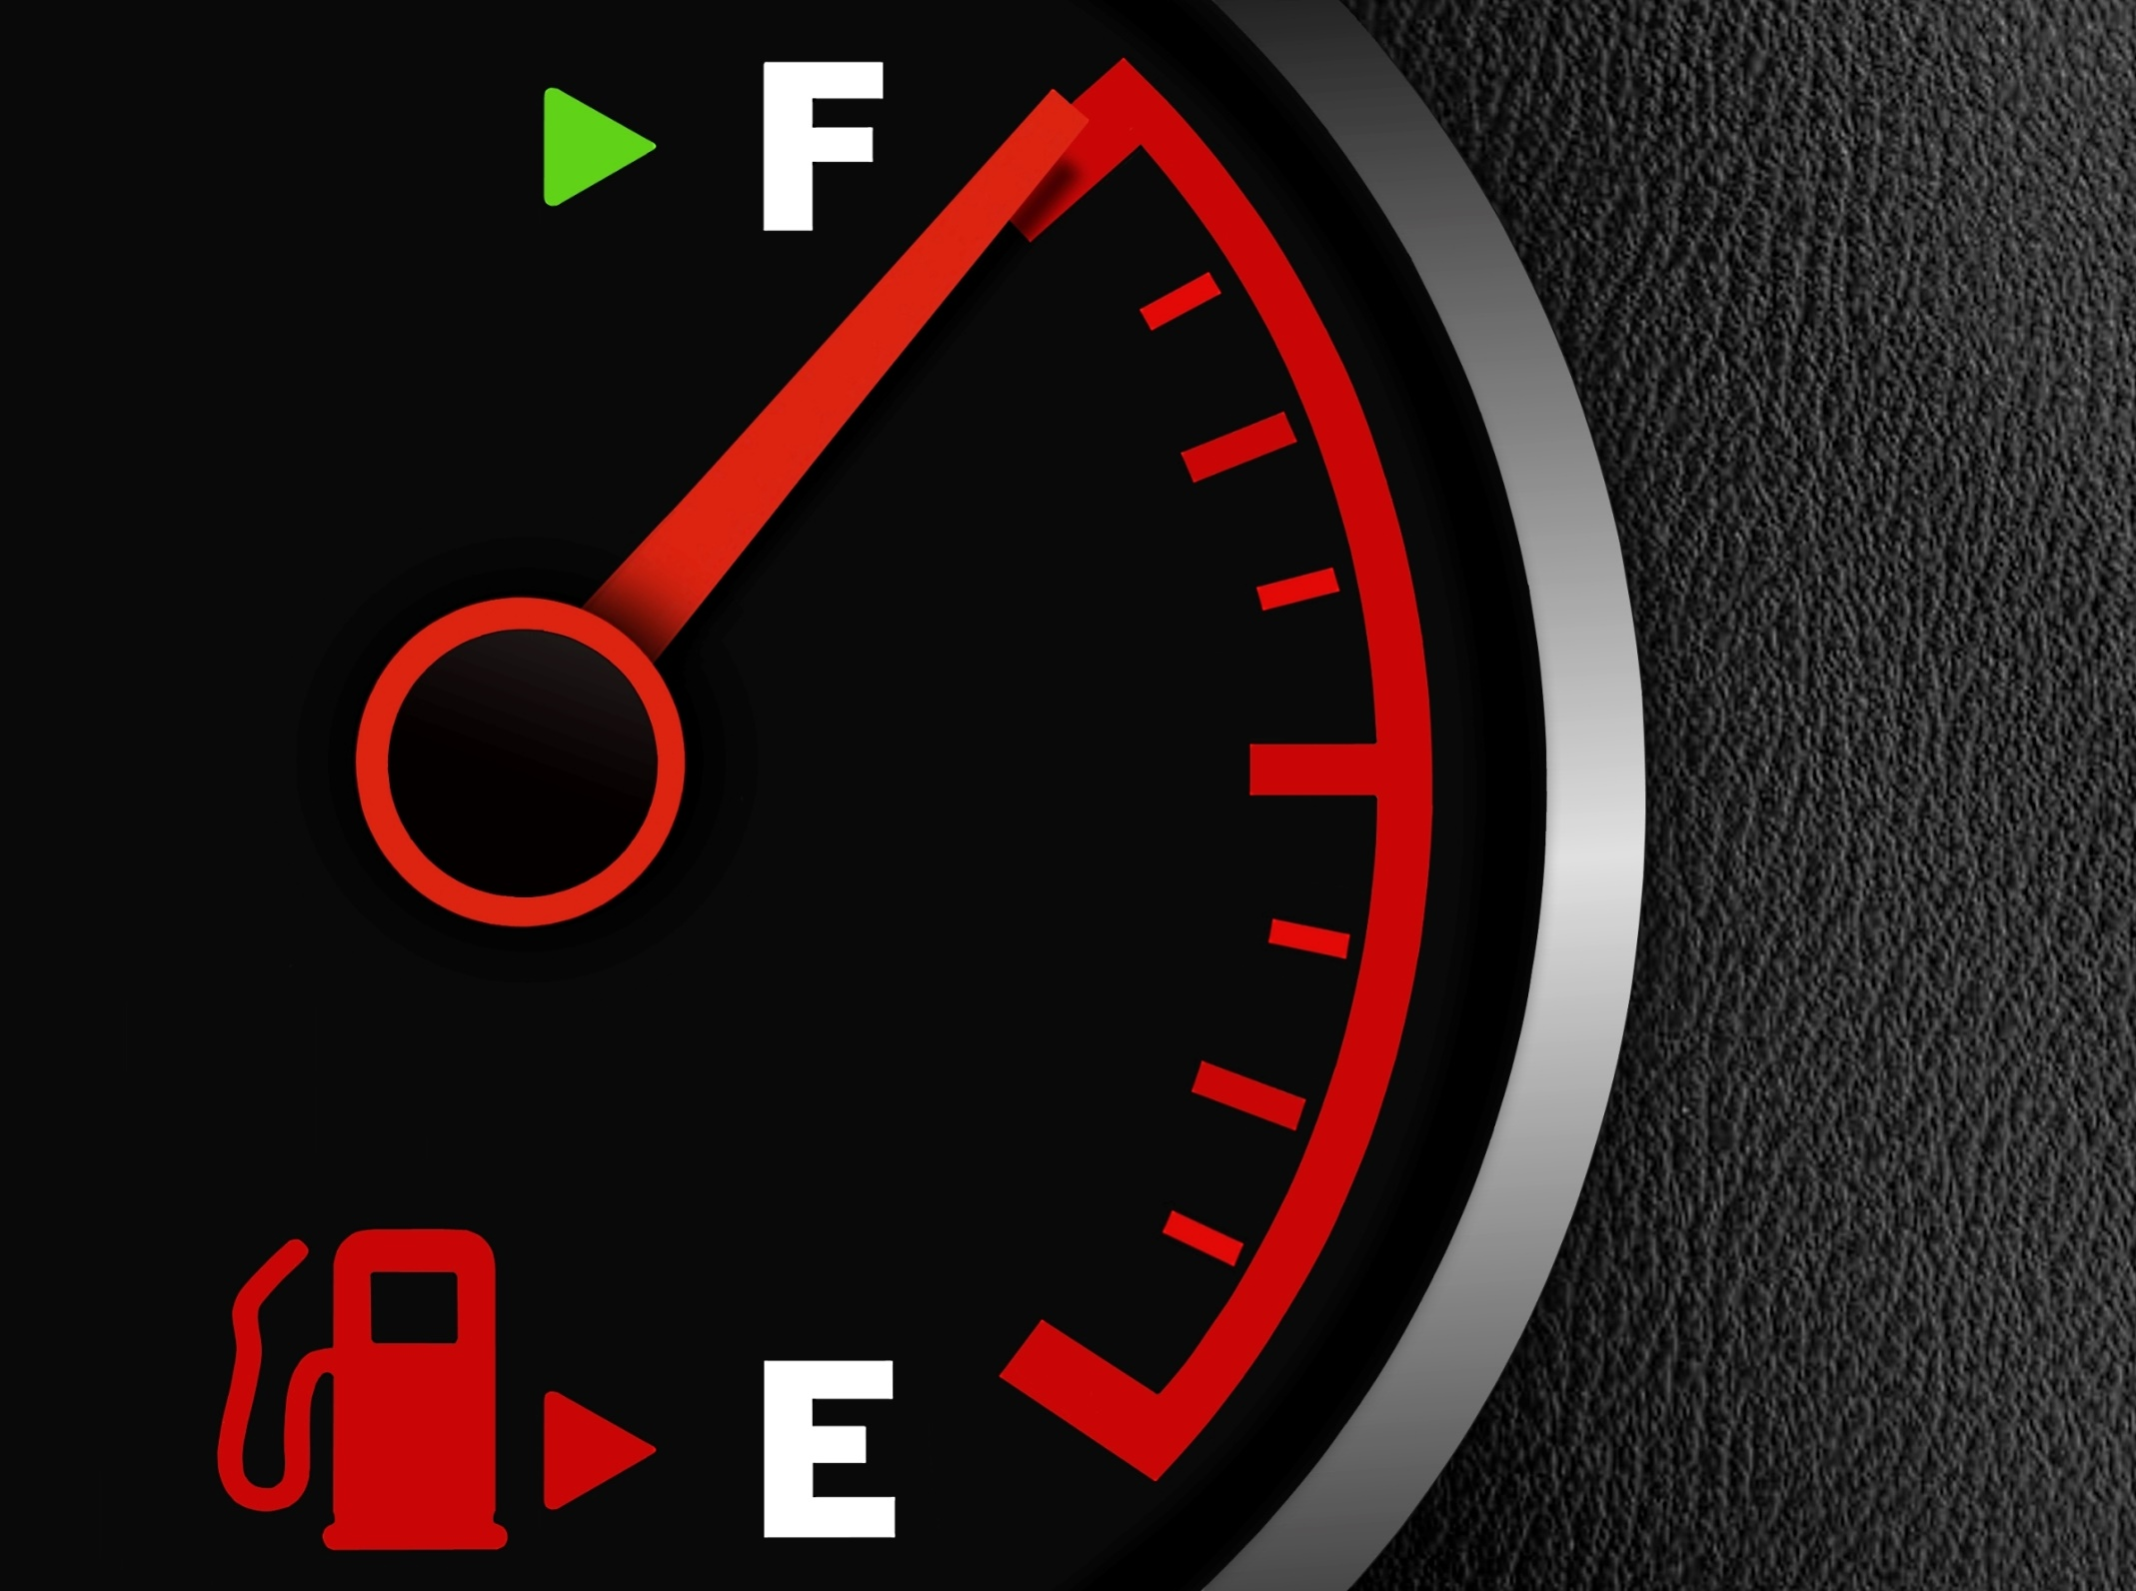

REFUELING EQUIPMENT
Notes:
REFUELING EQUIPMENT

Slide 3
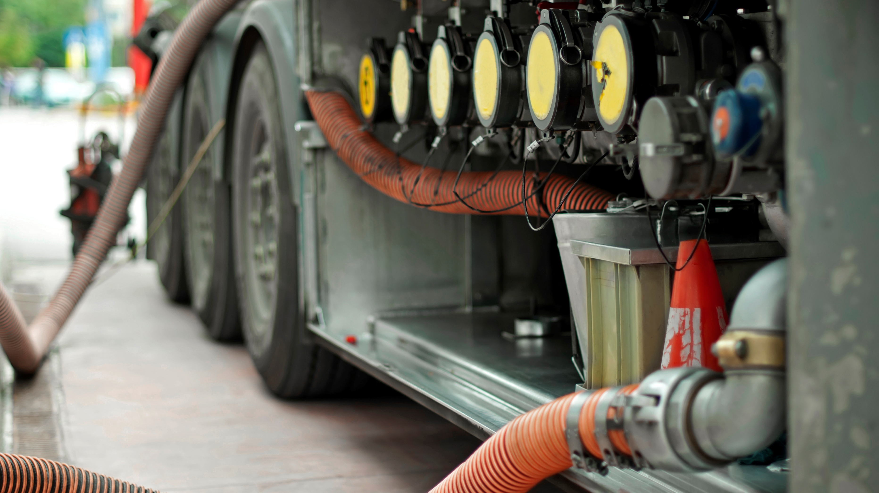
What’s at Stake?
FIRE PREVENTION
Fire prevention is the goal when refueling.
Clean up fuel spills immediately, no matter how small, to reduce the impact on safety and on the environment.
Notes:
What’s at Stake?
FIRE PREVENTION
Fire prevention is the goal when refueling.
Clean up fuel spills immediately, no matter how small, to reduce the impact on safety and on the environment.
While it’s easy to let your refueling routine slip, it’s important to remain alert and aware of the dangers of refueling. It only takes one misstep to cause a tragedy. Always have an appropriate and fully functional fire extinguisher close by and within reach.

Slide 4

What’s the Danger?
REFUELING MATTERS
Improper fueling techniques can have deadly consequences.
Fuel spills resulting from poor refueling procedures can cause needless damage to the environment.
Inhalation of gasoline fumes from improper refueling can cause nausea, dizziness, headaches, and loss of coordination.
Once ignited, fires from liquid fuels can be very difficult to extinguish, as they often spread quickly.
In the construction industry, dangerous fuels such as oil and gasoline are materials handled every day.
Take your time, and be careful not to spill the fuel
Leave enough space in the tank to compensate for expansion or tilting.
Notes:
What’s the Danger?
REFUELING MATTERS
Improper fueling techniques can have deadly consequences. Vapors from these liquids can ignite with explosive force from no more than a spark.
Fuel spills resulting from poor refueling procedures can cause needless damage to the environment.
Inhalation of gasoline fumes from improper refueling can cause nausea, dizziness, headaches, and loss of coordination.
Once ignited, fires from liquid fuels can be very difficult to extinguish, as they often spread quickly.
In the construction industry, dangerous fuels such as oil and gasoline are materials handled every day. Understanding their hazards and taking precautions when handling, dispensing, and storing them saves lives.
Take your time, and be careful not to spill the fuel because it could ignite if it contacts with something hot. Do not overfill or “top off” the tank. If the equipment is in the hot sun, the fuel will expand and may overflow. Leave enough space in the tank to compensate for expansion or tilting.

Slide 5
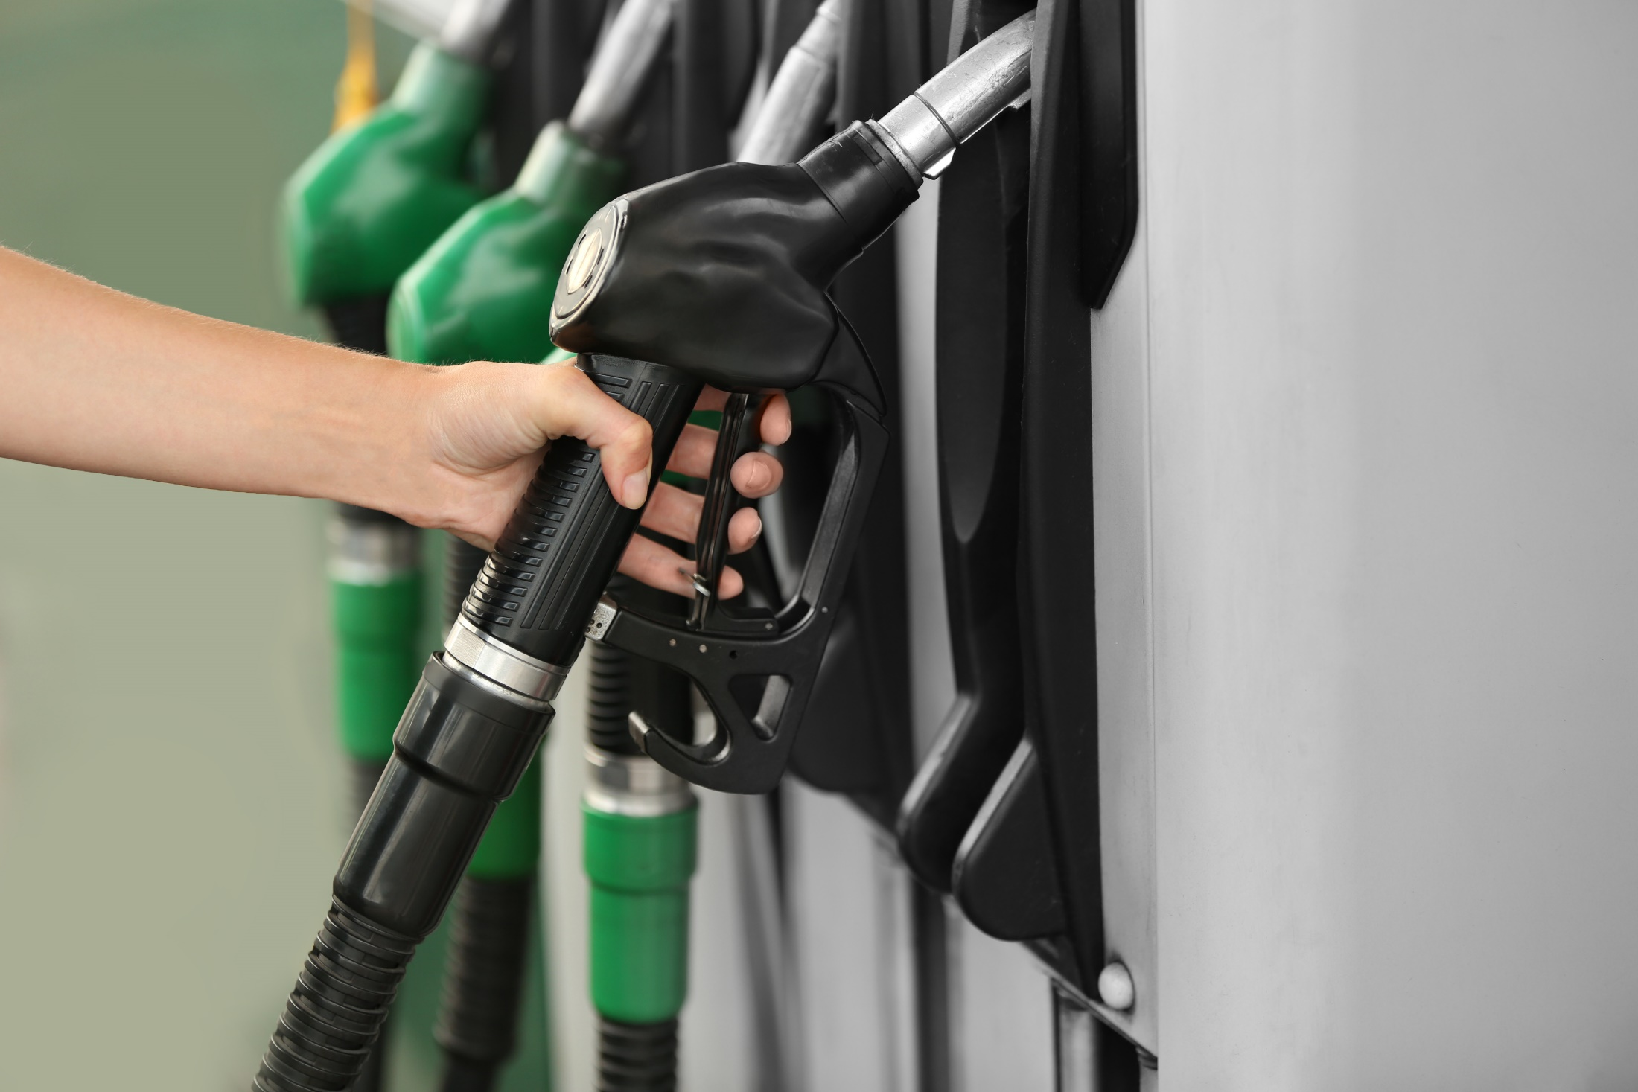
What’s the Danger?
Refueling Tractors and Gas-Powered Equipment
Safety recommendations for this process include:
Avoid spilling fuel on skin. It can cause irritation.
Avoid breathing in fumes as it can result in dizziness and headaches.
Turn off the engine and allow it to cool before refueling.
Dispense fuel slowly and avoid overfilling.
Refuel small equipment in the open. Refueling in a small enclosure can result in fume inhalation.
Notes:
What’s the Danger?
Refueling Tractors and Gas-Powered Equipment
Proper storage and transport of fuel are useless if there is a lapse in safety protocol when refueling. Safety recommendations for this process include:
Avoid spilling fuel on skin. It can cause irritation.
Avoid breathing in fumes as it can result in dizziness and headaches.
Turn off the engine and allow it to cool before refueling.
Dispense fuel slowly and avoid overfilling.
Refuel small equipment in the open. Refueling in a small enclosure can result in fume inhalation.

Slide 6
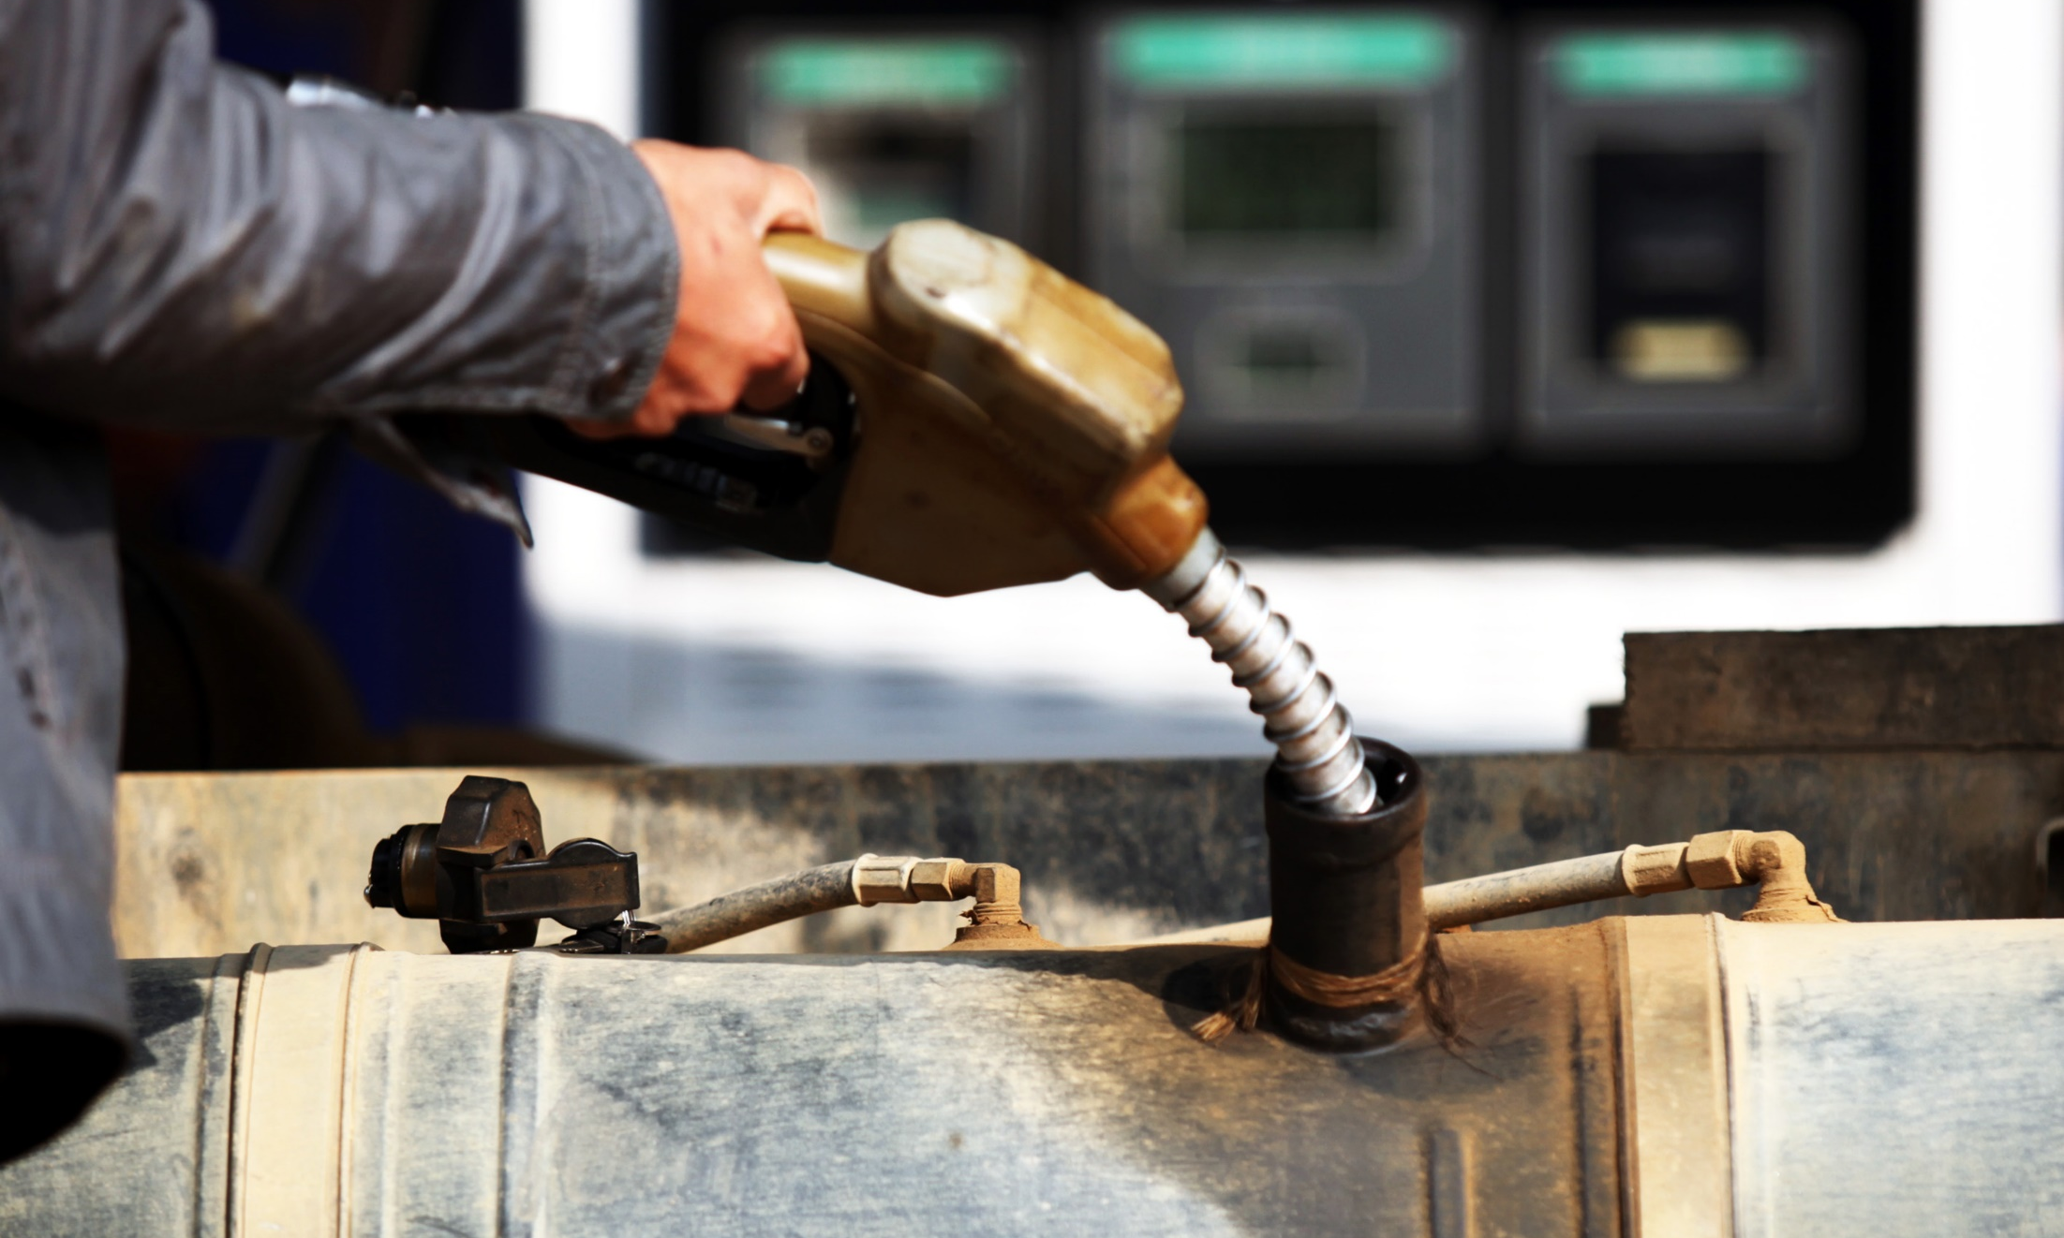
What’s the Danger?
FINAL DANGER TAKE AWAY
Static Electricity
It’s essential to ensure equipment is off and cooled before refueling. A spark from the ignition system or hot exhaust could ignite the fuel. If fuel spills on an engine, wipe away any excess and allow time for the fumes to dissipate. Always have your fueling station outside, in a well-ventilated area — never inside a building.
Notes:
What’s the Danger?
FINAL DANGER TAKE AWAY
Static Electricity
It’s essential to ensure equipment is off and cooled before refueling. A spark from the ignition system or hot exhaust could ignite the fuel. If fuel spills on an engine, wipe away any excess and allow time for the fumes to dissipate. Always have your fueling station outside, in a well-ventilated area — never inside a building.
It’s important to be aware of any source that could cause a spark or static electricity. Grounding the machine with a ground wire or dropping mounted equipment reduces the risk of static electricity. Remain still while refueling. Walking around, entering and exiting the machinery could result in a static charge build-up. Electronic devices, including cellphones or MP3 players, can also cause static electricity and shouldn’t be used when refueling. Open flames are also dangerous — items like cigarettes and butane torches need to be kept away from designated refueling areas. Exposing fuel to sparks, static electricity and open flames could result in explosions and fire.

Slide 7
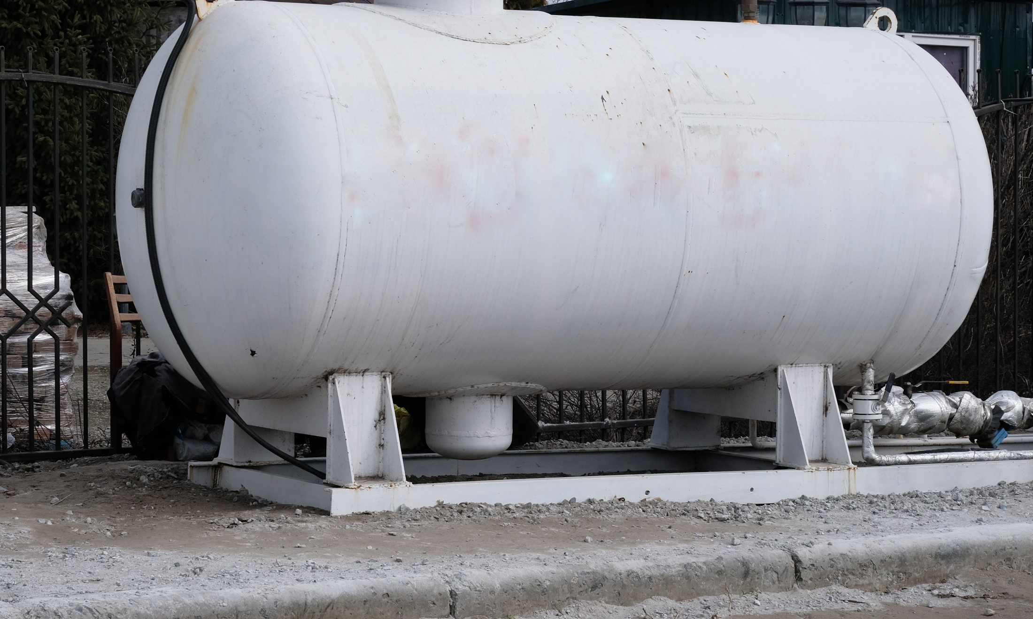
How to Protect Yourself
FUEL STORAGE
There are several safe storage solutions for farmers. For example, aboveground fuel tanks are cost effective, easy to relocate, and are unaffected by minor flooding.
Some additional fuel storage safety recommendations are:
Keep fuel storage containers and facilities out of direct sunlight.
Farmers can either use canopies or make use of natural shade.
Notes:
How to Protect Yourself
FUEL STORAGE
There are several safe storage solutions for farmers. For example, aboveground fuel tanks are cost effective, easy to relocate, and are unaffected by minor flooding. Some additional fuel storage safety recommendations are:
Keep fuel storage containers and facilities out of direct sunlight. Farmers can either use canopies or make use of natural shade. If a farmer cannot avoid sun exposure, he or she can invest in a pressure-vacuum relief valve to minimize evaporation.
Keep fuel storage areas clear of trash and weeds to reduce the risk of fire.

Slide 8
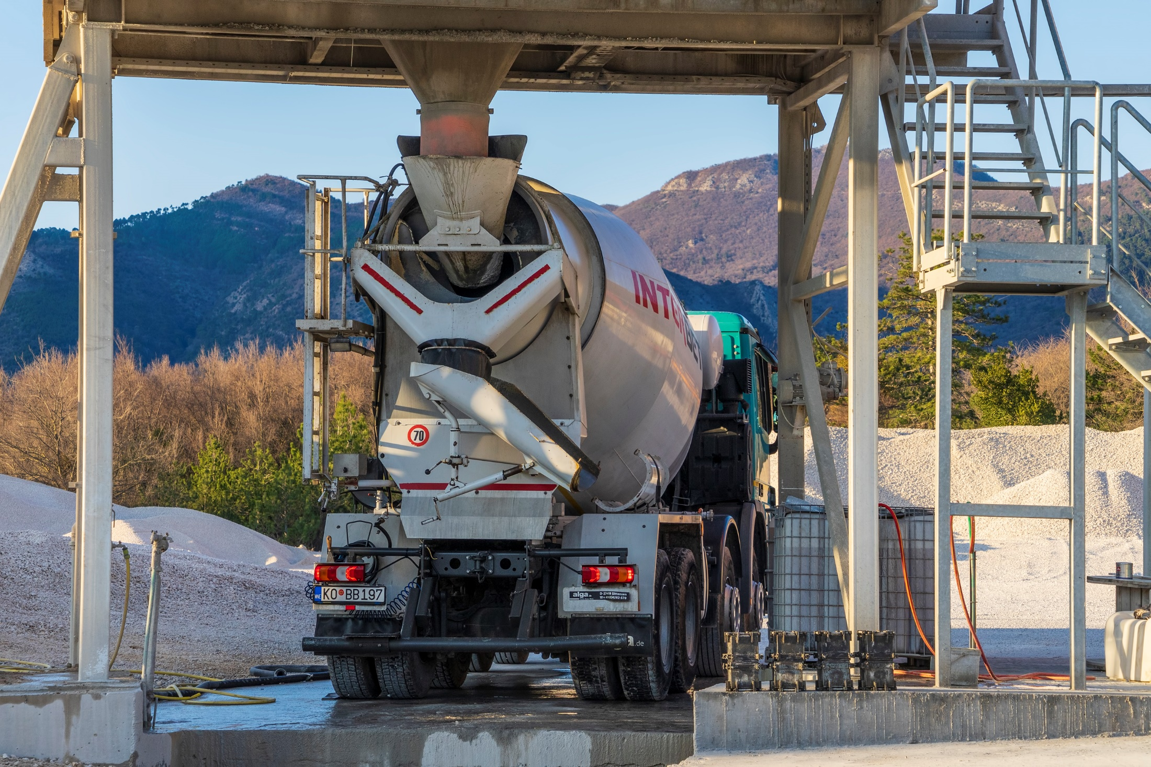
How to Protect Yourself
FLAMMABLE LIQUIDS
Gas, diesel fuel, and paint solvents are just some of the flammable liquids found on farms. Take the following preventive steps when handling these kinds of liquids to avoid fire or explosions.
Store flammable liquids far away from uncontained fires or motors that spark.
Notes:
How to Protect Yourself
FLAMMABLE LIQUIDS
Gas, diesel fuel, and paint solvents are just some of the flammable liquids found on farms. Take the following preventive steps when handling these kinds of liquids to avoid fire or explosions.
Store flammable liquids far away from uncontained fires or motors that spark.
Be cautious with empty containers that previously held a flammable liquid. Lingering vapors can still combust. Keep these containers away from fires and sparks as well.
Take pains to ensure all fuel containers have accurate labels and follow all directions for using the containers.

Slide 9
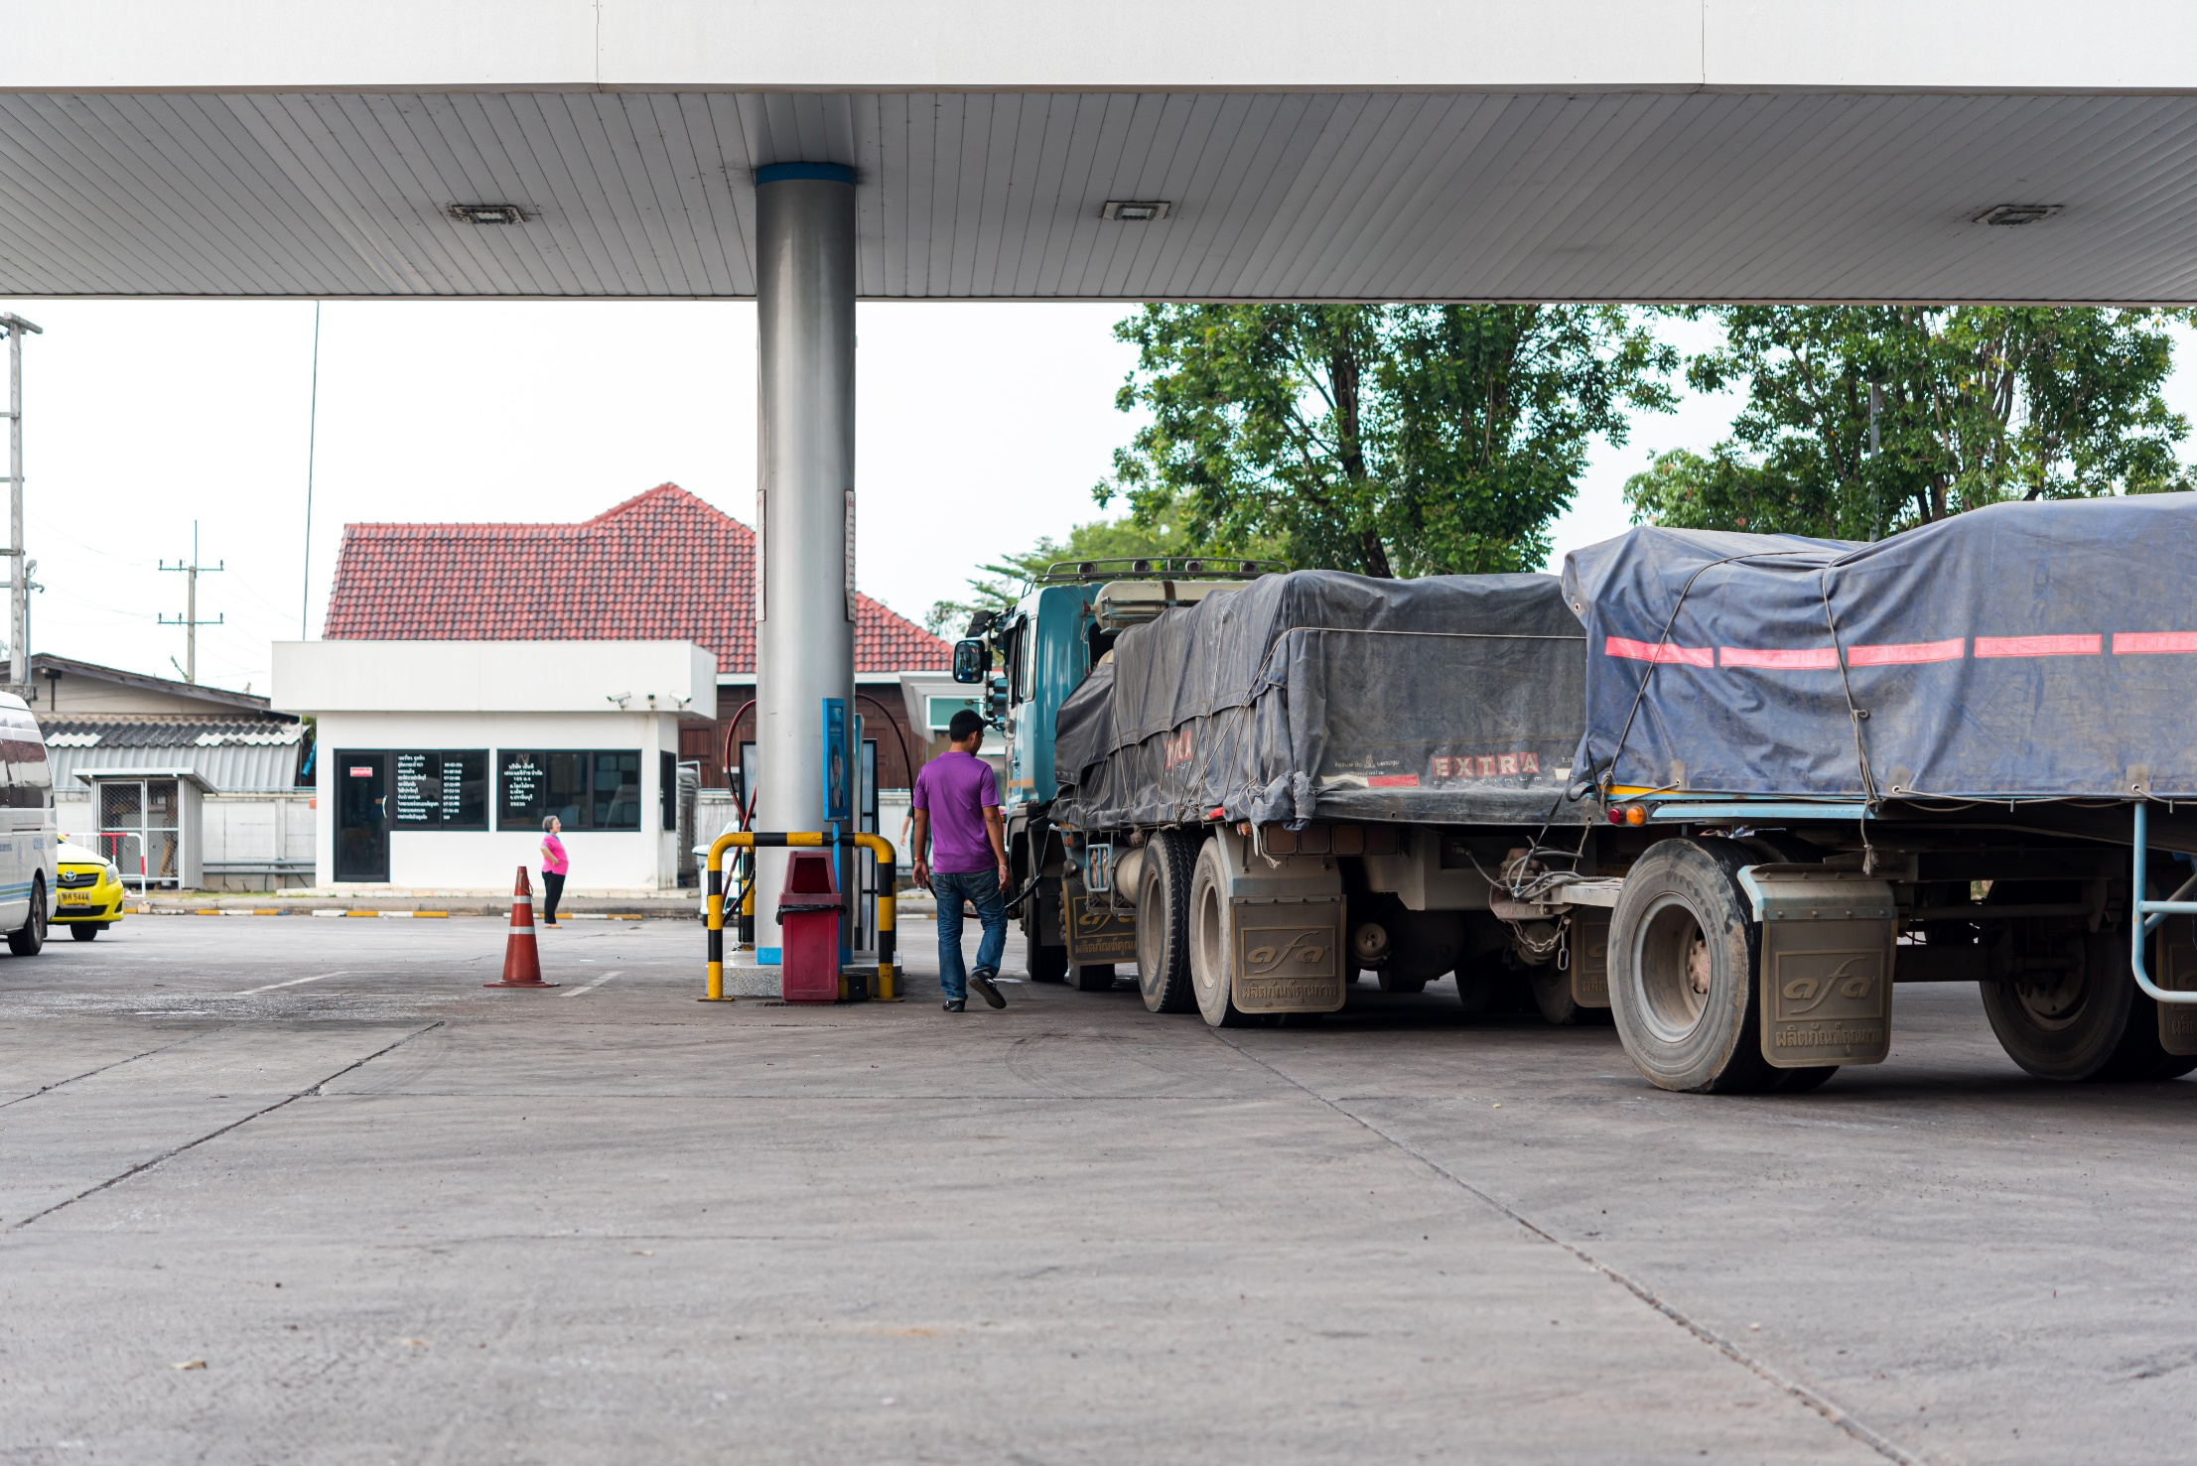
How to Protect Yourself
REFUELING REMINDERS
Never smoke during refueling operations.
If there’s a chance of a vehicle rolling while being refueled, chock the wheels.
If the fuel tank is located near the engine or other hot area, such as the manifold or muffler, let the engine cool before filling the tank.
When transferring fuel from a can, mobile tank or fuel truck, keep the spout or nozzle in contact with the fuel tank.
After refueling has been completed, be sure all fuel has been drained from the hose and that any spills are cleaned up immediately.
Notes:
How to Protect Yourself
REFUELING REMINDERS
Never smoke during refueling operations. Do not refuel near an open flame. Keep a C02 (carbon dioxide), or an ABC Dry Chemical extinguisher handy.
If there’s a chance of a vehicle rolling while being refueled, chock the wheels. Before filling the fuel tank, shut off the engine.
If the fuel tank is located near the engine or other hot area, such as the manifold or muffler, let the engine cool before filling the tank.
When transferring fuel from a can, mobile tank or fuel truck, keep the spout or nozzle in contact with the fuel tank. As fuel is poured, it can generate static electricity. If a spark ignites the fuel vapors, a fire or explosion could result.
After refueling has been completed, be sure all fuel has been drained from the hose and that any spills are cleaned up immediately.

Slide 10
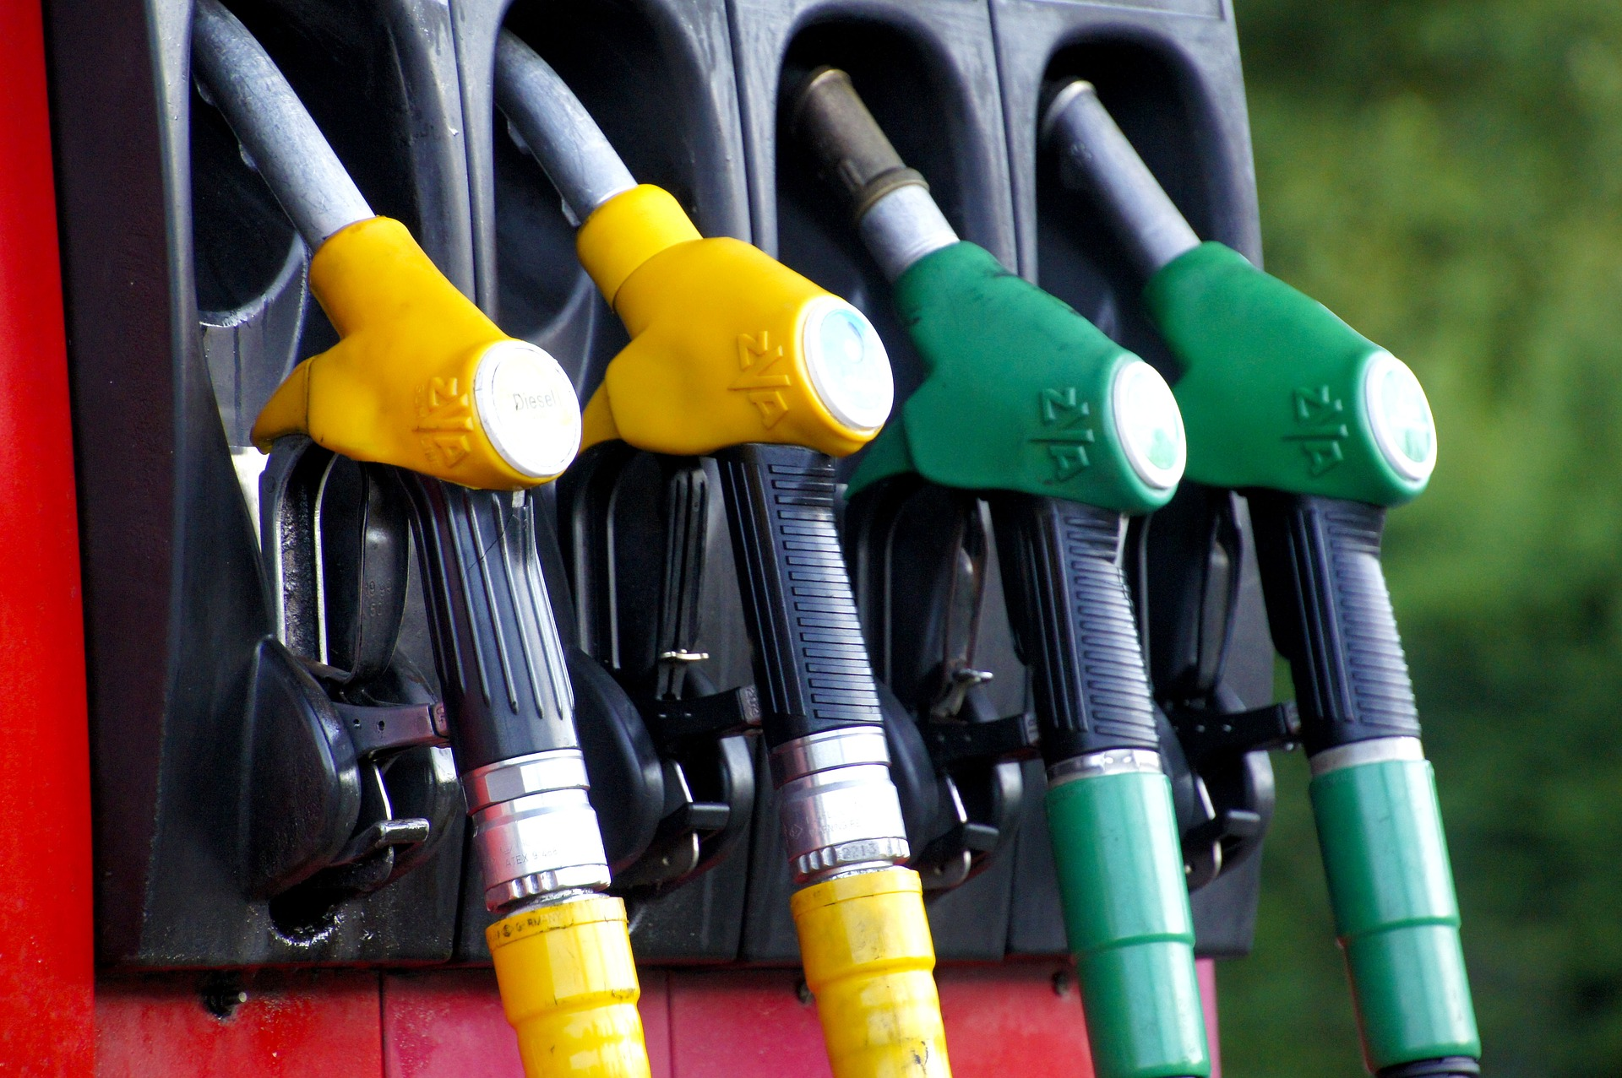
How to Protect Yourself
REFUELING PROTOCOL / PROCEDURES
When approaching equipment for refueling ensure both the Swamper and Operator see you and signal you to enter area.
Drive close to equipment to be fueled.
Shut off fuel truck if not required to run pump.
Have Operator shut off equipment and set attachment to rest.
Insure proper grounding of fuel truck and equipment.
Turn on fuel pump and remove nozzle.
If helper is available climb onto equipment and have some one hand you nozzle.
If no one around, attach the rope to a nozzle, climb onto equipment and pull nozzle up with rope.
Remove fuel cap, insert nozzle and squeeze trigger, wait until tank is full, then release trigger.
Either hand nozzle down or lower with rope.
Store your fuel outside.
Be sure of good ventilation before starting the tractor engine.
Notes:
How to Protect Yourself
REFUELING PROTOCOL / PROCEDURES
When approaching equipment for refueling ensure both the Swamper and Operator see you and signal you to enter area.
Drive close to equipment to be fueled.
Shut off fuel truck if not required to run pump.
Have Operator shut off equipment and set attachment to rest.
Insure proper grounding of fuel truck and equipment.
Turn on fuel pump and remove nozzle.
If helper is available climb onto equip and have some one hand you nozzle.
If no one around attach rope to nozzle climb onto equipment and pull nozzle up with rope.
Remove fuel cap, insert nozzle and squeeze trigger, wait till tank is full release trigger.
Either hand nozzle down or lower with rope.
Store your fuel outside. It's best to have fuel storage at least 40 feet from any building. Keep the area free of weeds or any other combustible material. Carry a first aid kit and an approved dry chemical fire extinguisher. Tractors should have least a five-pound extinguisher.
Be sure of good ventilation before starting the tractor engine. Exhaust gases contain carbon monoxide, which is odorless, colorless and deadly.

Slide 11
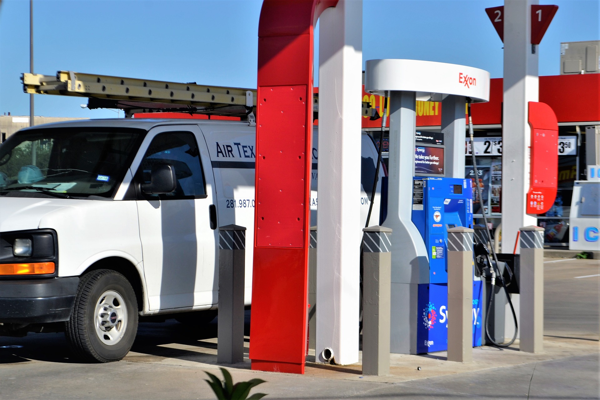
How to Protect Yourself
DOs
Ensure stationary storage fuel tanks are vented and kept clear of buildings, and if not buried, should be grounded.
Carry gasoline in a closed container, which is adequately vented.
Inspect the tanks daily for leaks and ensure that the static chain is attached.
Keep the metal fill nozzle in contact with the lip of the tank to eliminate any static accumulation.
Take care not to over fill any equipment tanks
Use three point system when climbing on or off equipment
Notes:
How to Protect Yourself
DOs
Ensure stationary storage fuel tanks are vented and kept clear of buildings, and if not buried, should be grounded.
Carry gasoline in a closed container, which is adequately vented.
Inspect the tanks daily for leaks and ensure that the static chain is attached.
Keep the metal fill nozzle in contact with the lip of the tank to eliminate any static accumulation.
Take care not to over fill any equipment tanks
Use three point system when climbing on or off equipment

Slide 12

How to Protect Yourself
DONTs:
Smoke while fueling is in progress.
Allow open fires, welding, etc. in the fueling zones.
Fuel equipment before it is shut off.
Overfill any equipment fuel tanks.
Climb on equipment until it has been shut off.
Leave fuel pumping unattended
Notes:
How to Protect Yourself
DONTs:
Smoke while fueling is in progress.
Allow open fires, welding, etc. in the fueling zones.
Fuel equipment before it is shut off.
Overfill any equipment fuel tanks.
Climb on equipment until it has been shut off.
Leave fuel pumping unattended

Slide 13
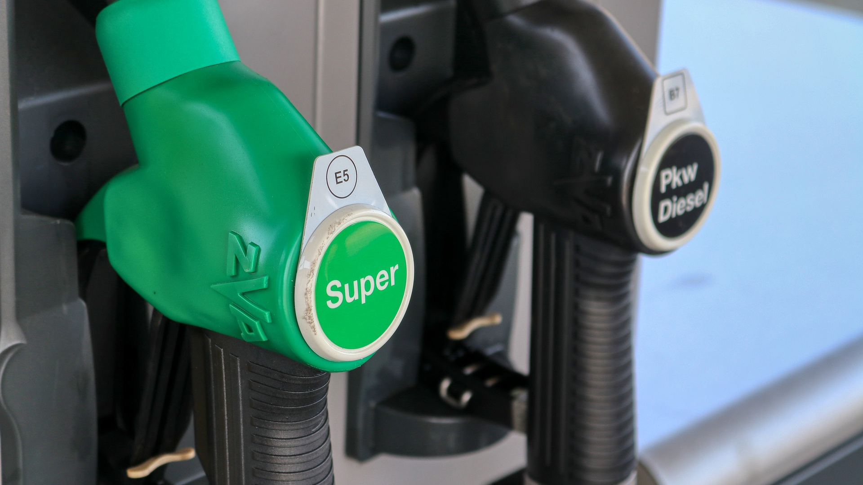
Final Word
Refueling happens so frequently that it is easy to get complacent about it. However, it must be remembered that diesel and gasoline are designed to cause explosions—hopefully within an engine. Beyond the act of refueling, further caution needs to be given to fuel fumes and the possibility of spills.
Ensure fuels tanks are clearly marked as “gas” or “diesel” and that the person refueling knows what kind of fuel is needed. This sounds simple, however it is a very expensive mistake!
Notes:
Final Word
Refueling happens so frequently that it is easy to get complacent about it. However, it must be remembered that diesel and gasoline are designed to cause explosions—hopefully within an engine. Beyond the act of refueling, further caution needs to be given to fuel fumes and the possibility of spills.
Ensure fuels tanks are clearly marked as “gas” or “diesel” and that the person refueling knows what kind of fuel is needed. This sounds simple, however it is a very expensive mistake!

