Slide 1

Click anywhere to get started…

Slide 2

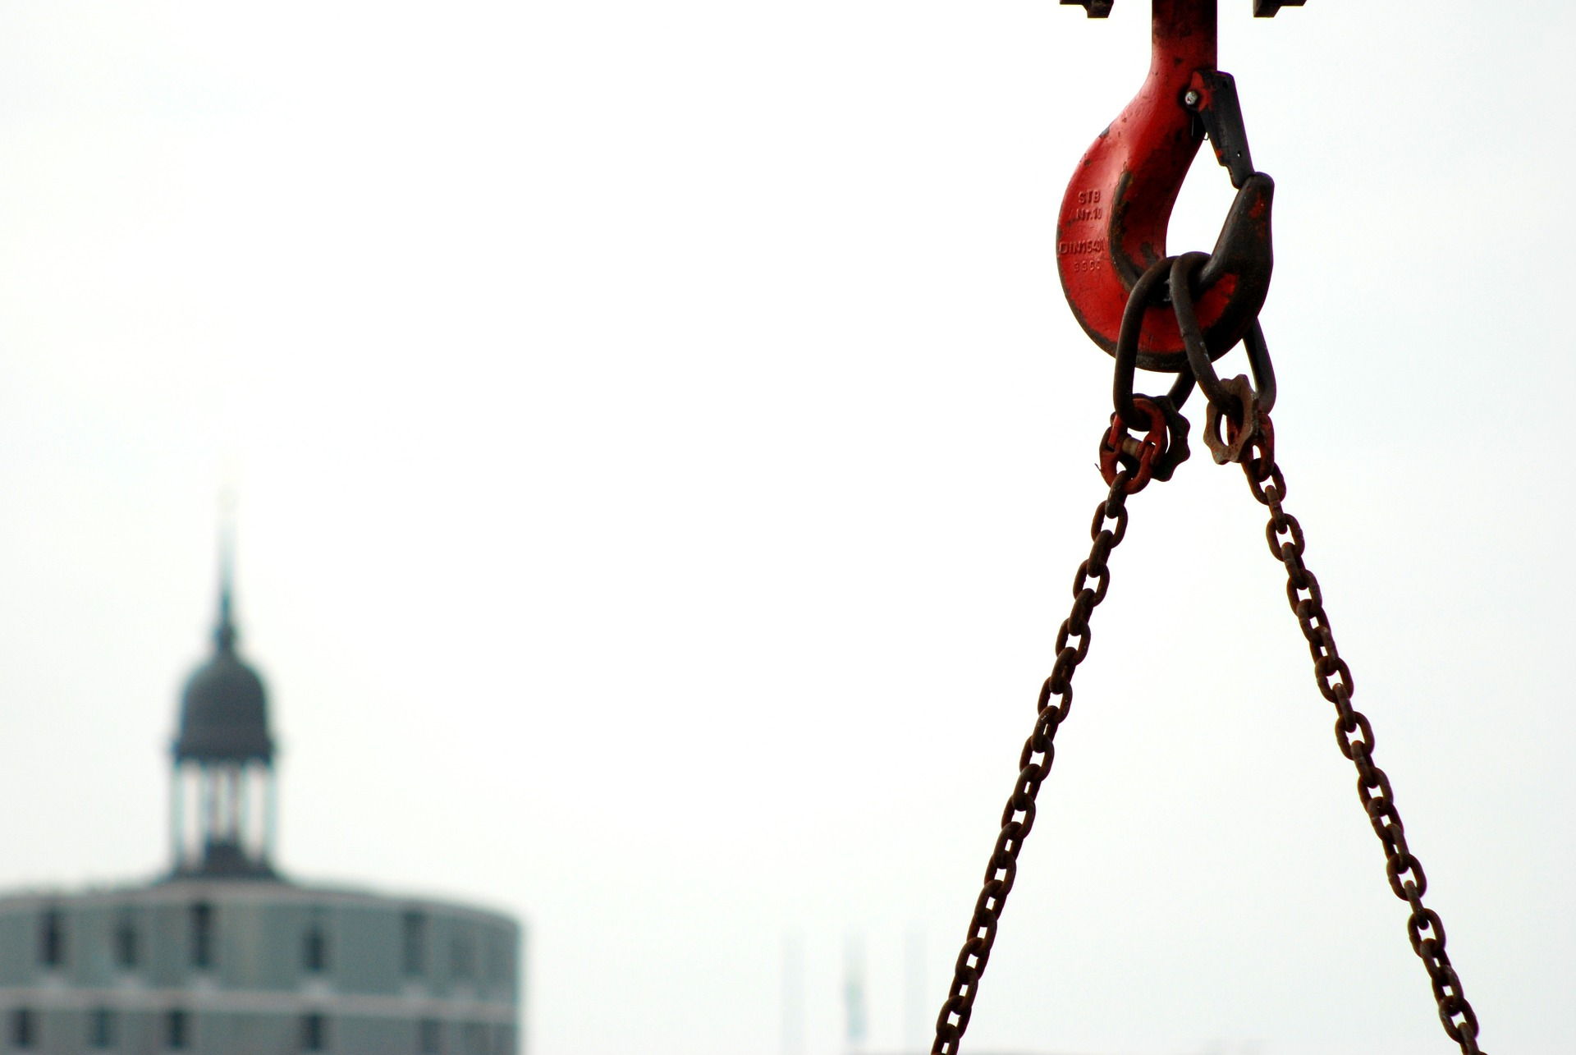

PROPER LOAD HANDLING
Notes:
PROPER LOAD HANDLING

Slide 3
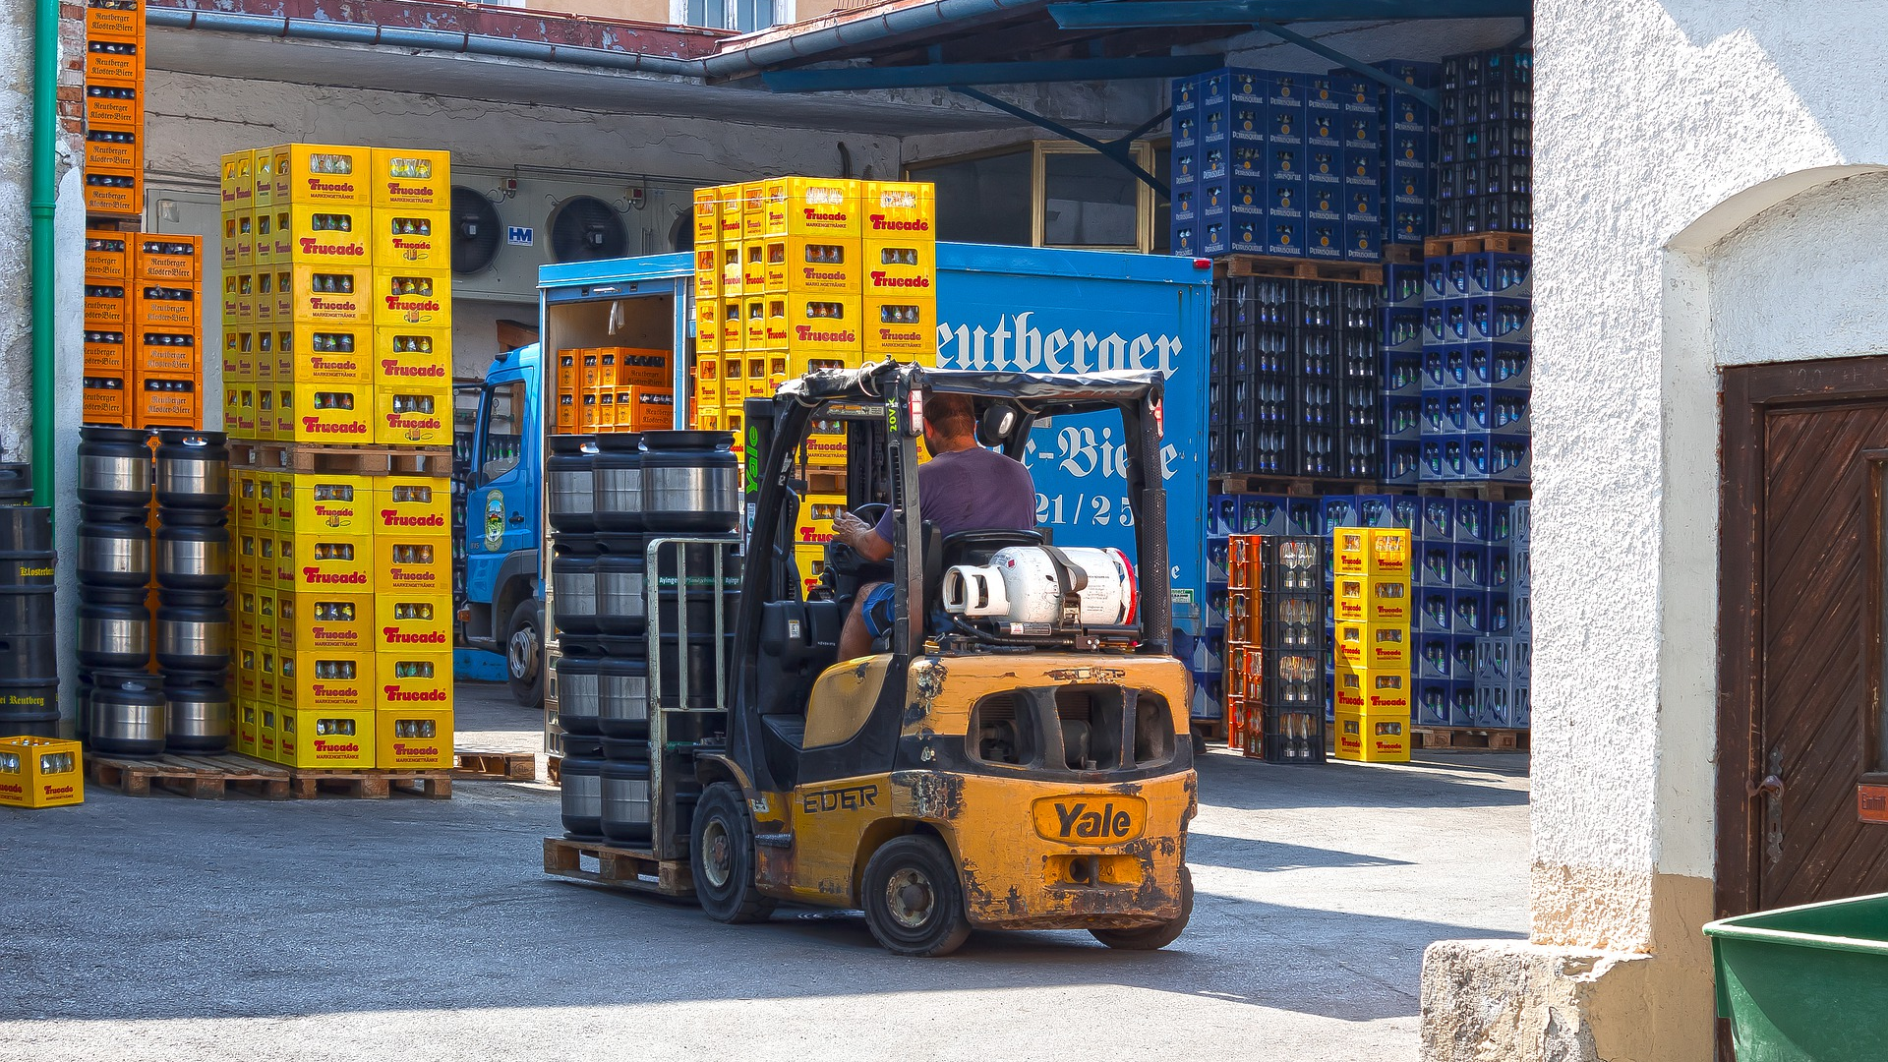
What’s at Stake?
Overhead majestic cranes and the work forklifts are the driving forces in our industrial and manufacturing operations.
Notes:
What’s at Stake?
Overhead majestic cranes and the work forklifts are the driving forces in our industrial and manufacturing operations. Business everywhere in the world would come to a deafening stop without them. The common denominator with them is lifting, moving or lowering a load in a smooth and safe operation.

Slide 4
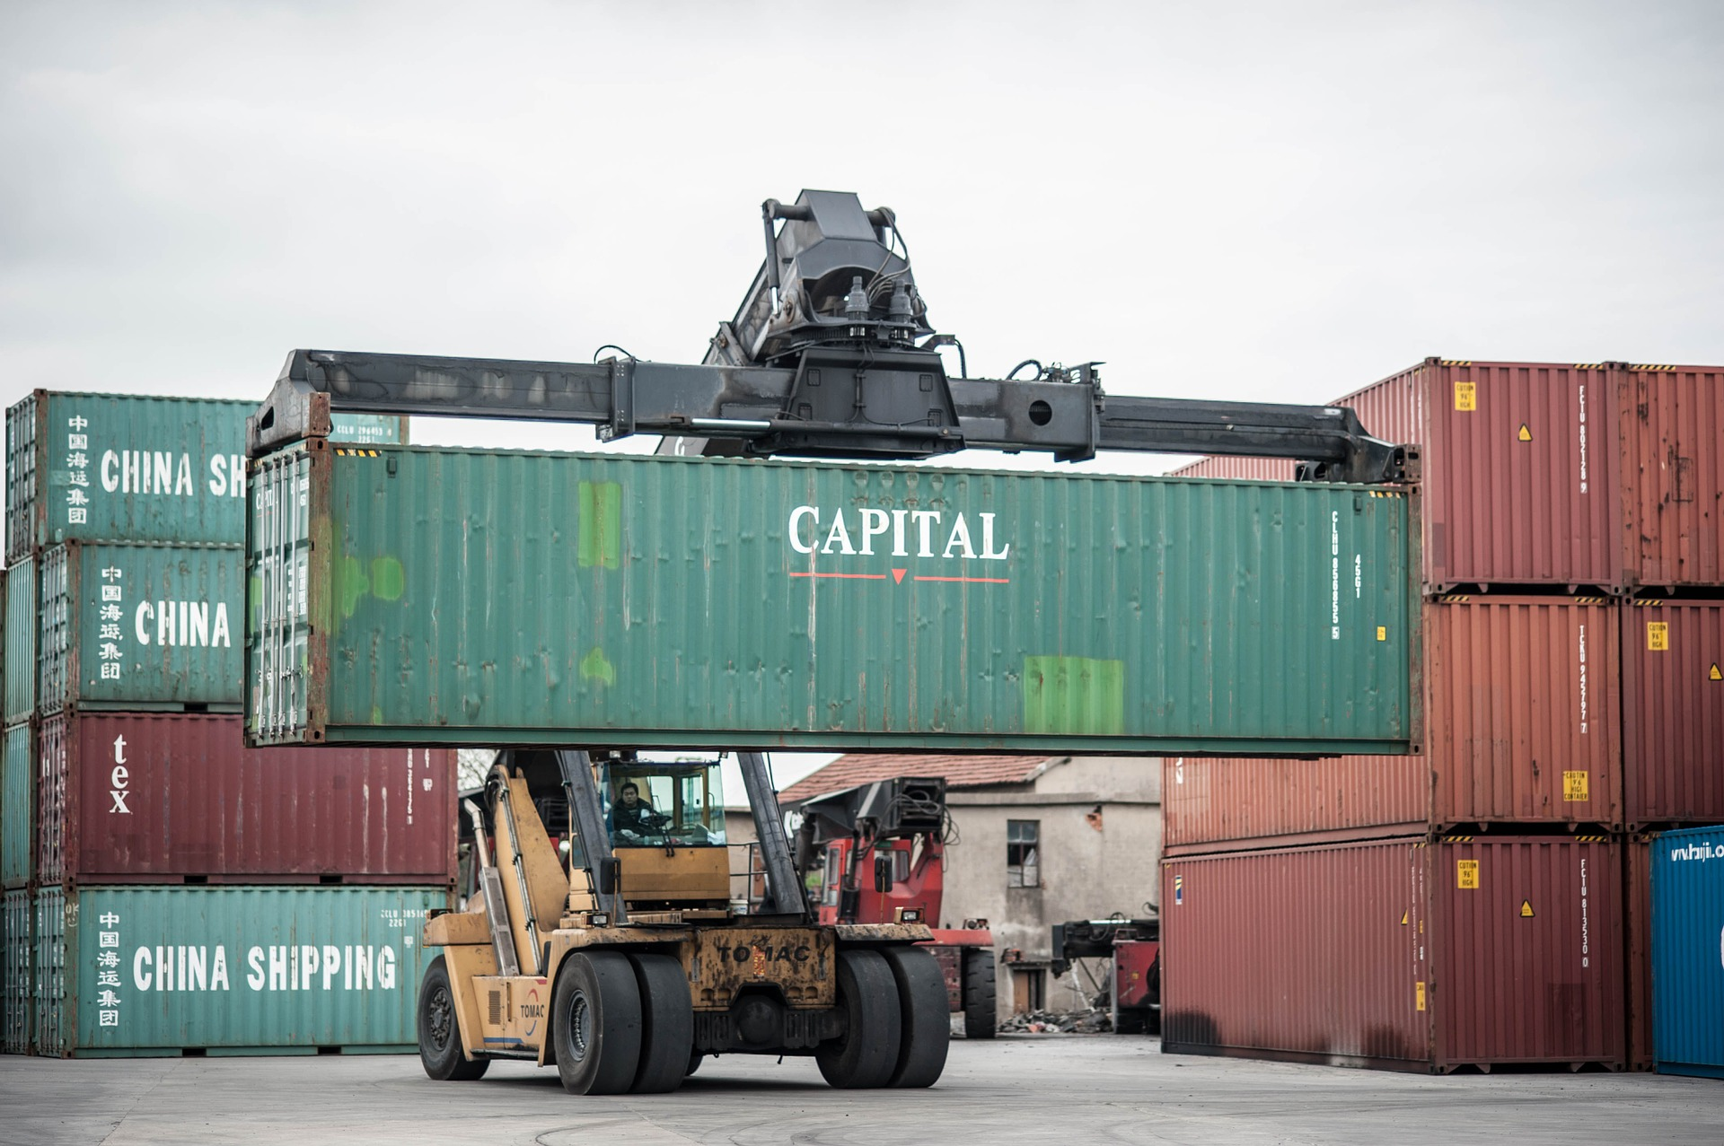
What’s the Danger?
FALLING LOADS
When working with overhead cranes and forklifts, falling loads are one of the most common, and most dangerous, hazards. A falling load can result in severe injuries, fatalities and significant structural damage to buildings and property. Additionally, it will also lead to significant time and money costs.
Notes:
What’s the Danger?
FALLING LOADS
When working with overhead cranes and forklifts, falling loads are one of the most common, and most dangerous, hazards. A falling load can result in severe injuries, fatalities and significant structural damage to buildings and property. Additionally, it will also lead to significant time and money costs.

Slide 5
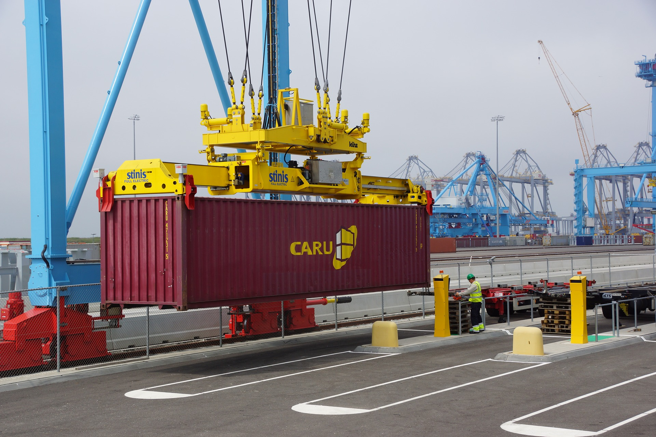
What’s the Danger?
Falling loads could be the result of:
Operator incompetency
Slipping
Mechanical failure
Two blocking
Notes:
What’s the Danger?
Falling loads crane could be the result of:
Operator incompetency. You must ensure your employees are adequately trained so they are able to carry out their roles competently and safely.
Slipping. If you don’t secure loads properly it can result in slipping material.
Mechanical failure. The risk of mechanical failure can be reduced if you ensure a competent person carries out routine inspections, maintenance and repairs at suitable intervals.
Two blocking. Two blocking occurs when an uppermost hoist line component (i.e the load block, hook block, overhaul ball) touches the upper block, boom tip or similar component. When two blocking occurs, increased tension is placed on the line which can result in falling loads or crane components.

Slide 6
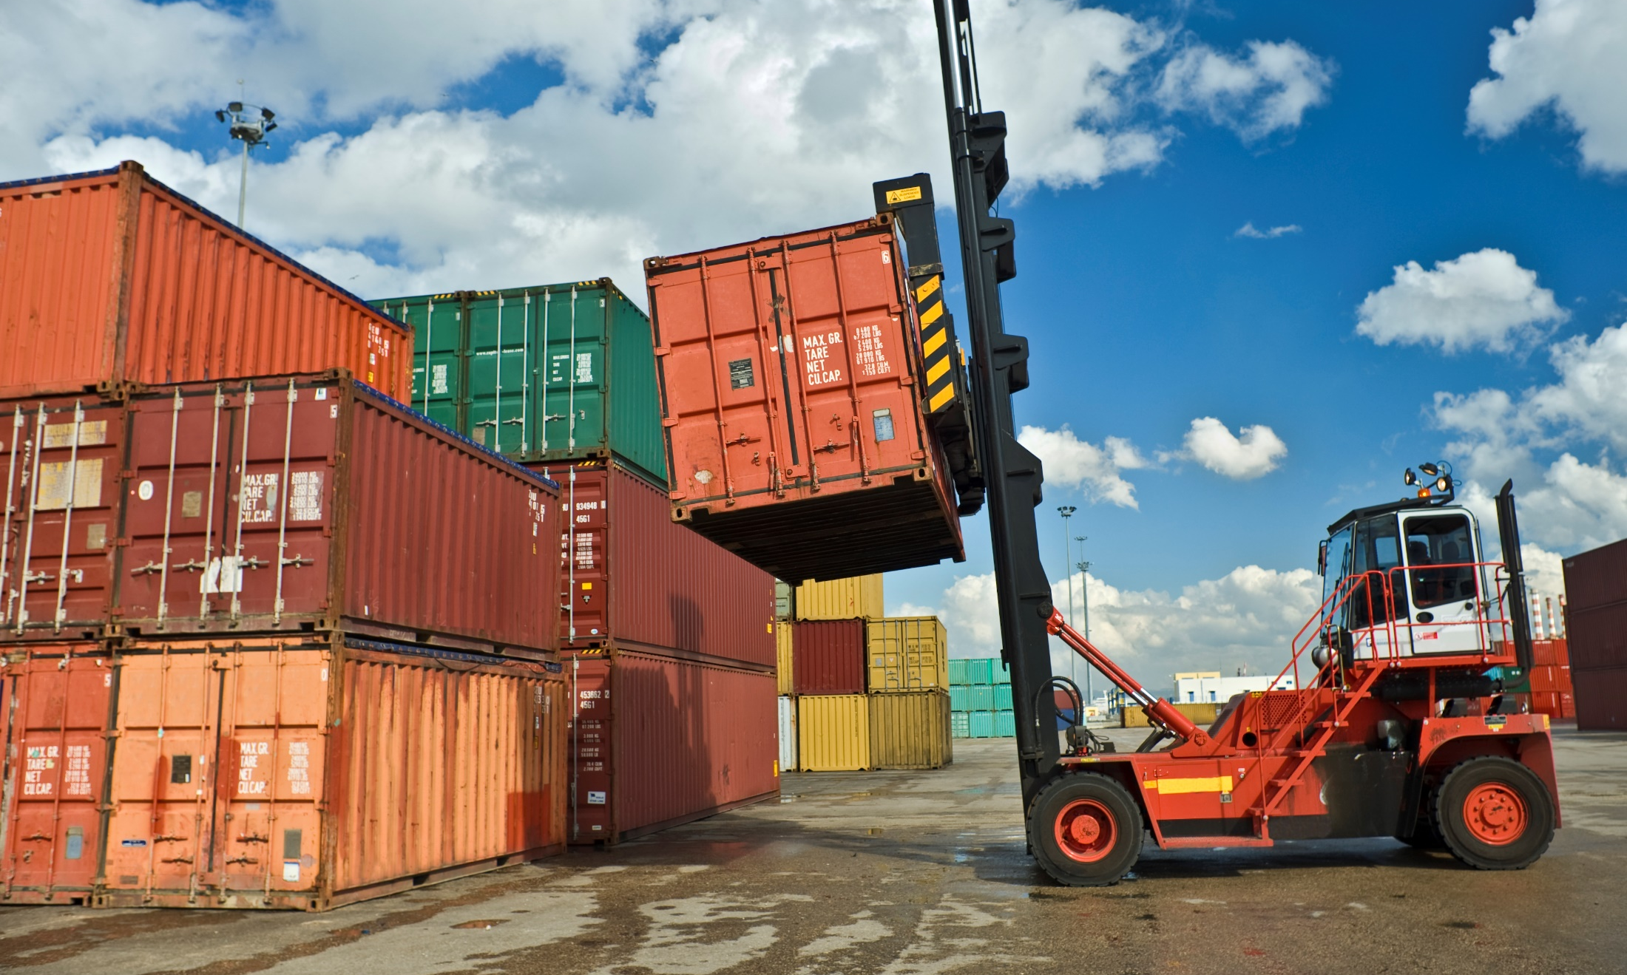
What’s the Danger?
Electrical Hazards
Around 50% of accidents involving overhead cranes are a result of a metal part of a crane coming into contact with a power source (i.e a high-voltage power line).
Crane Overload
The majority of crane structural failures and upsets are the result of somebody overloading a crane.
Notes:
What’s the Danger?
Electrical Hazards
Around 50% of accidents involving overhead cranes are a result of a metal part of a crane coming into contact with a power source (i.e a high-voltage power line). There’s a risk of a crane’s hoist line or boom touching energized power lines when moving materials nearby or underneath. While those directly touching the crane are the most likely to be electrocuted, any workers in the vicinity are also at risk. Therefore, one accident can result in multiple deaths and injuries. Around 200 fatalities per year are the result of contact with power lines, so it’s crucial that pre-job planning is carried out prior to starting work.
Crane Overload
The majority of crane structural failures and upsets are the result of somebody overloading a crane. If you exceed a crane’s operational capacity, you are likely to subject it to structural stresses and cause irreversible damage.

Slide 7
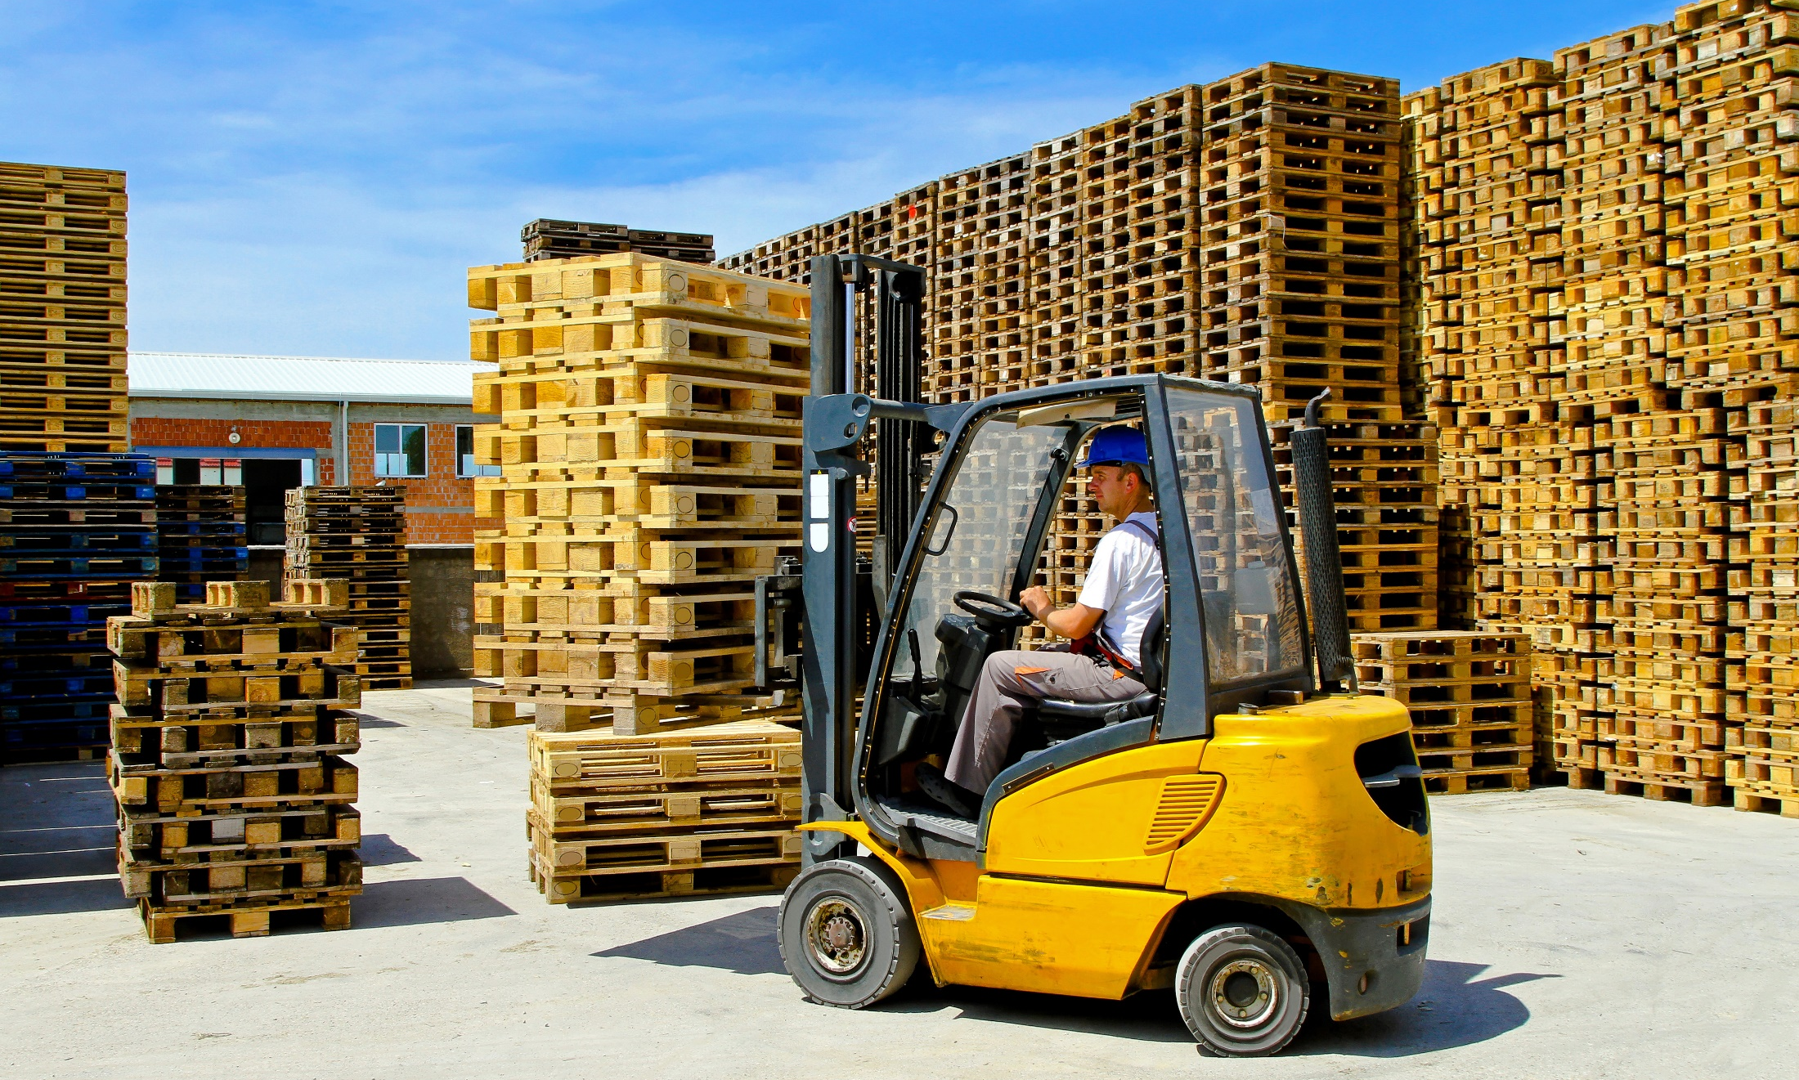
What’s the Danger?
You could overload a crane if you:
Swing or suddenly drop loads.
Hoist loads beyond the cranes capacity.
Use defective components.
Drag loads.
Side-load a boom.
Notes:
What’s the Danger?
You could overload a crane if you:
Swing or suddenly drop loads.
Hoist loads beyond the cranes capacity.
Use defective components.
Drag loads.
Side-load a boom.

Slide 8
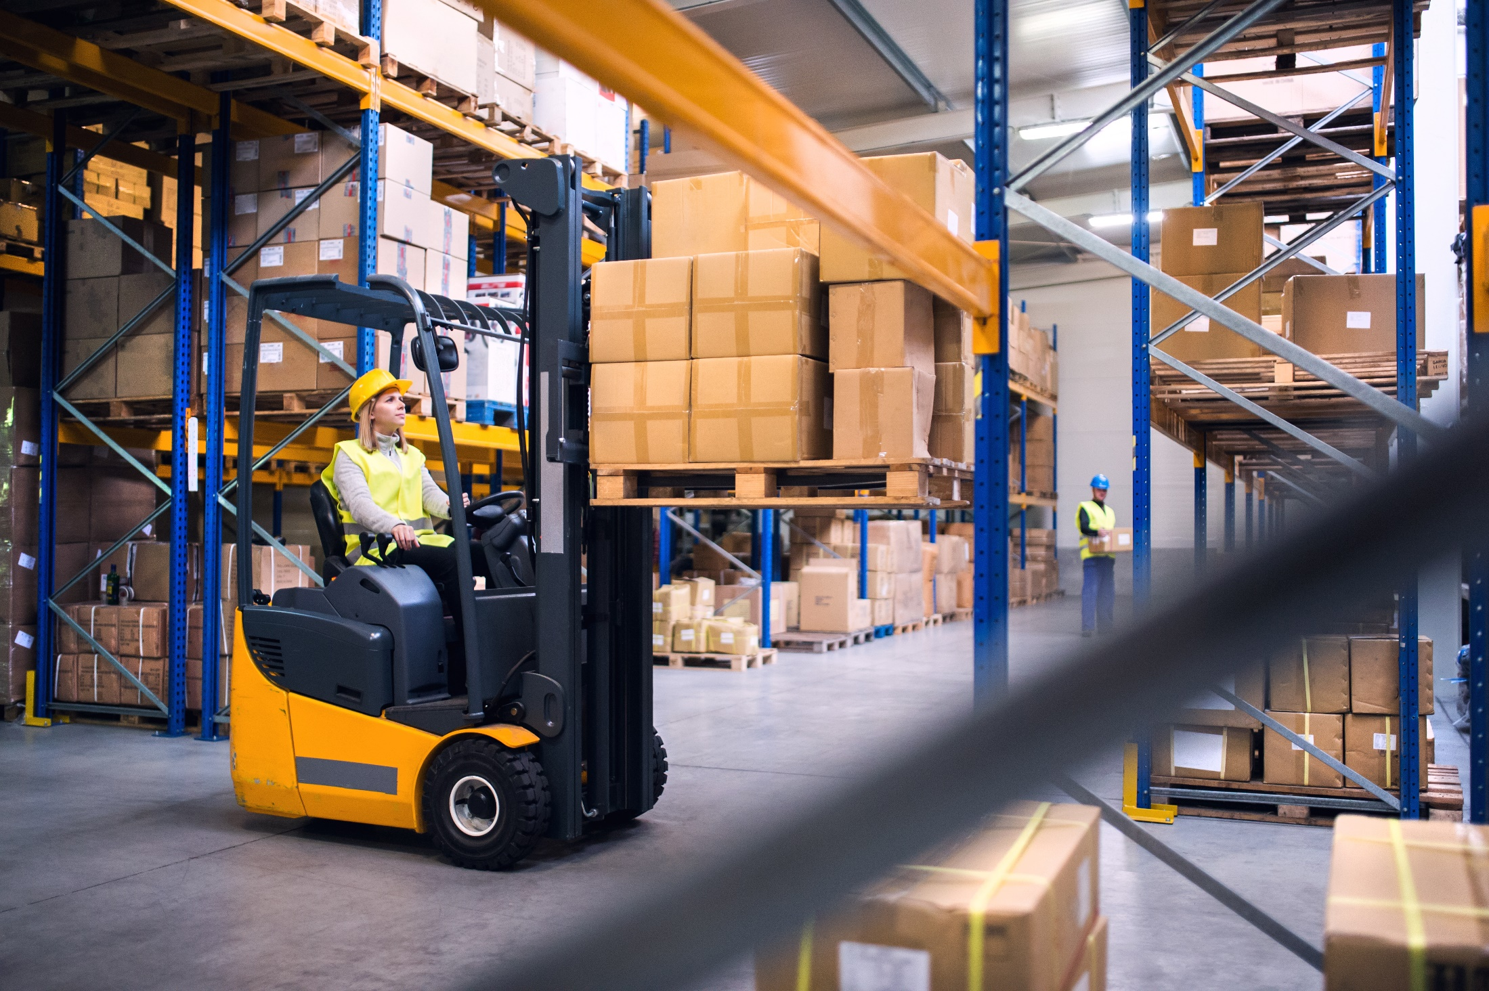
How to Protect Yourself
FIVE KEY SAFETY PRECAUTIONS
Pre – Operation Checks
Never Position Yourself Underneath the Load
Ensure Training Is Up to Date
Don’t Work on A Truck Bed
Raising the Load
Notes:
How to Protect Yourself
FIVE KEY SAFETY PRECAUTIONS
Pre – Operation Checks
It’s vital that you check every piece of equipment over before you use it. The necessary checks are typically outlined in the operating and maintenance manual that comes with all lifting equipment. Conducting these will ensure that the machinery you’re working with are set up correctly and ready for use.
You should also check the Certificate of Thorough Examination before using any equipment. If this is in date, it means that the machinery has been examined in line with the manufacturer’s instructions for cranes, this needs to be done at least once every 12 months.
If you don’t conduct these pre-operation checks, you will be putting yourself and those around you at risk.
2. Never Position Yourself Underneath the Load
While the risks seem obvious, it’s still quite common for workers to position themselves underneath a load when operating lifting equipment. It’s incredibly important that you don’t do this as, if anything goes wrong, you’ll be at serious risk of being struck by whatever you’re lifting.
It’s vital that you always stay a safe distance away from the load you’re moving. This will ensure that, if you do make a mistake, the equipment malfunctions, or you encounter any other problem, you’ll be out of harm’s way and will be able to deal with the situation safely.
3. Don’t Work on A Truck Bed
When using lifting equipment, it’s quite common for operators to jump on and off the truck bed to move and position loads for transit. However, this is a significant safety risk and should be limited as much as possible. Fully hydraulic lifts are ideal for solving this problem, as they can lift and precisely position a load on a truck bed with ease. This stops operators from having to work from a height, and allows them to carry out their work using just the crane’s controls.
4. Ensure Training Is Up to Date
Employers and operators of lifting equipment should ensure that their training is always up to date. This means that workers should be given extra training whenever they’re introduced to new equipment or feel like they could do with refreshing their knowledge. Being trained once at the beginning of their careers isn’t enough for operators. It’s an ongoing process. Having up to date knowledge is the only way staff will be able to work safely, effectively, and efficiently.
These are just some of the most common precautions businesses and lifting equipment operators might be tempted to ignore. But, they’re vital for helping you and staff to avoid taking unnecessary risks that could lead to accidents.
5. Raising the Load
When a load is raised, the lift truck is less stable.
Check that the overhead clearance is adequate before raising loads.
Do not raise or lower the fork unless the lift truck is stopped and braked.
Lift loads straight up or tilt back slightly.
Do not lift a load that extends above the load backrest unless no part of the load can possibly slide back toward the operator.
Attend the controls of the forklift truck when a load is elevated. In other words, the operator must stay on the forklift when the load is in a raised position.

Slide 9
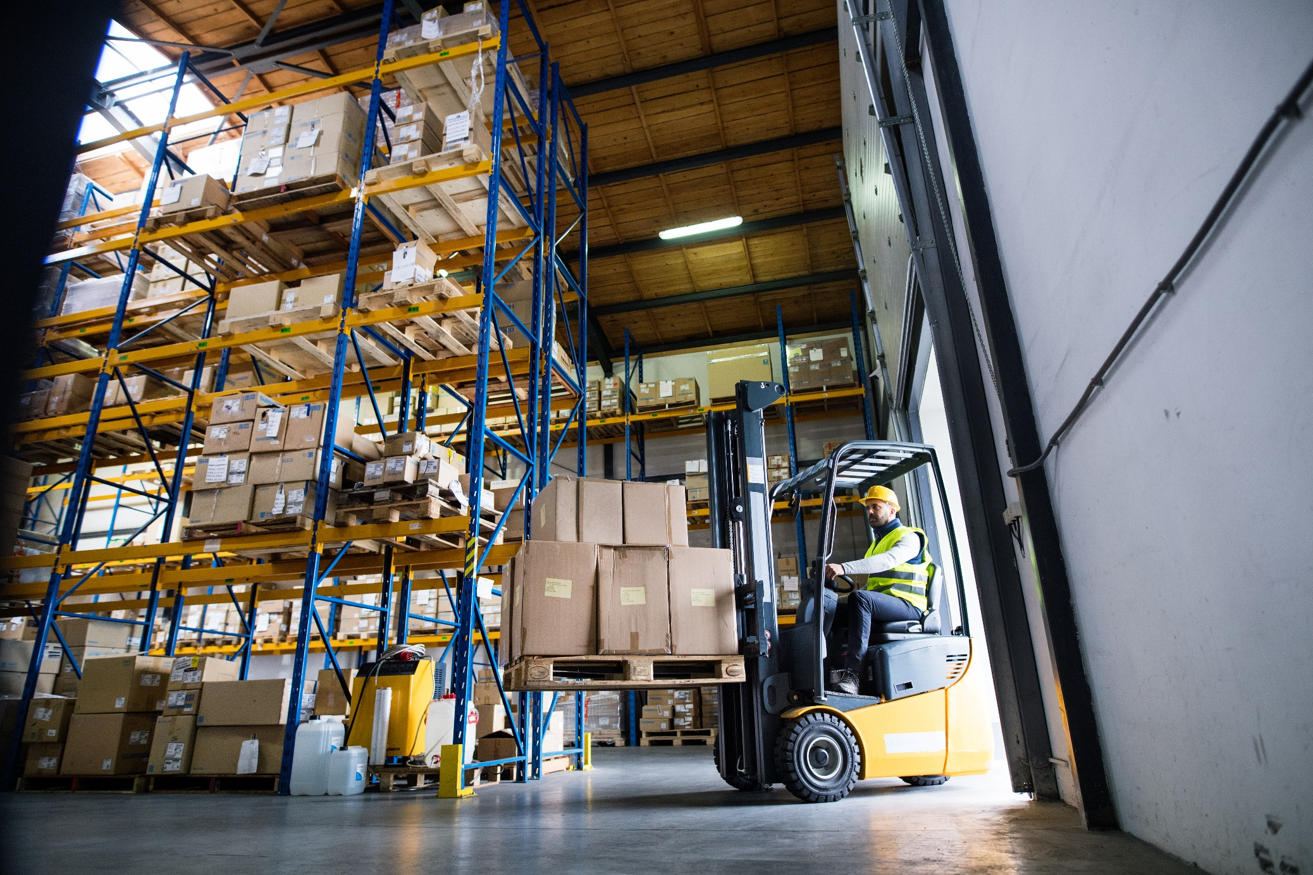
How to Protect Yourself
The Load
Fasten your seat belt.
Make sure the load is within the forklift’s rated capacity.
Use the proper lift fixture for the type of load, such as a carpet spike or drum grappler.
Make sure the load is stable and centered; stack or tie uneven or loose loads.
Spread the forks as wide as possible for even distribution and load stability.
Approach the load squarely, positioning and inserting the forks far enough to be sure the pallet is completely on the forks.
Drive under the load until it touches the carriage.
If the load is unbalanced, keep the heavier end closer to you.
Lift the load and tilt it back a little more before traveling.
Notes:
How to Protect Yourself
THE LOAD – THE CARRY – THE UNLOAD
The Load
Fasten your seat belt.
Make sure the load is within the forklift’s rated capacity. The nameplate on the forklift lists its maximum load weight. Never exceed it!
Use the proper lift fixture for the type of load, such as a carpet spike or drum grappler.
Make sure the load is stable and centered; stack or tie uneven or loose loads.
Spread the forks as wide as possible for even distribution and load stability.
Approach the load squarely, positioning and inserting the forks far enough to be sure the pallet is completely on the forks. Take care not to damage materials stacked next to the pallet.
Drive under the load until it touches the carriage. Tilt the forks back to shift the weight of the load and make it more stable.
If the load is unbalanced, keep the heavier end closer to you. Tilt the mast back.
Lift the load and tilt it back a little more before traveling.

Slide 10
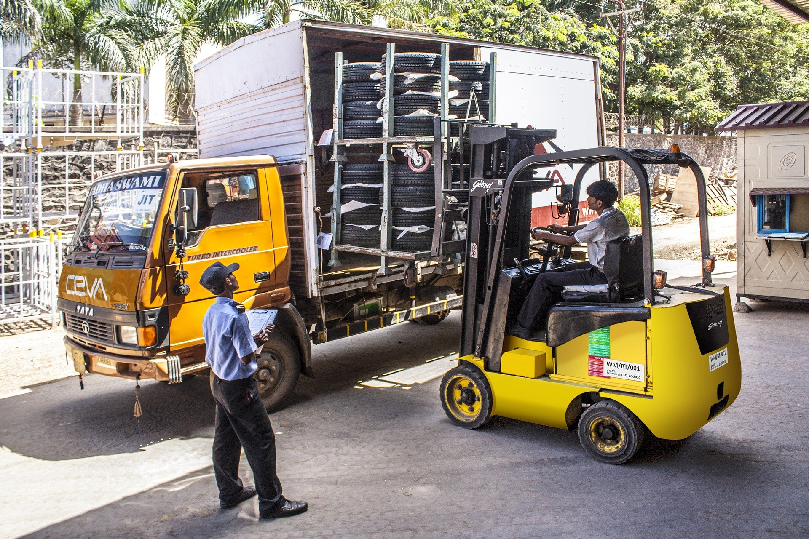
How to Protect Yourself
The Carry
Keep the forks 6 to 10 inches above the ground to avoid potential hazards on the ground.
Remember that forklifts are top-heavy.
Use caution when carrying a load on an uneven surface;
Don’t carry anything on the overhead guard.
Travel in reverse if the load blocks your vision.
Always look in the direction of travel.
Keep your arms and legs inside the forklift.
Never reach through the mast to adjust the load.
Do not raise or lower the load while moving.
Use a spotter if you don’t have a clear view.
Exercise caution and adjust your driving and speed to current weather conditions, particularly on wet surfaces.
Travel at a speed that will allow the forklift to be brought safely to a stop.
Notes:
How to Protect Yourself
The Carry
Keep the forks 6 to 10 inches above the ground to avoid potential hazards on the ground.
Remember that forklifts are top-heavy. Carry the load low and tilted back.
Use caution when carrying a load on an uneven surface; it creates a tip-over hazard.
Don’t carry anything on the overhead guard.
Travel in reverse if the load blocks your vision.
Always look in the direction of travel.
Keep your arms and legs inside the forklift.
Never reach through the mast to adjust the load.
Do not raise or lower the load while moving.
Use a spotter if you don’t have a clear view.
Exercise caution and adjust your driving and speed to current weather conditions, particularly on wet surfaces.
Travel at a speed that will allow the forklift to be brought safely to a stop.

Slide 11
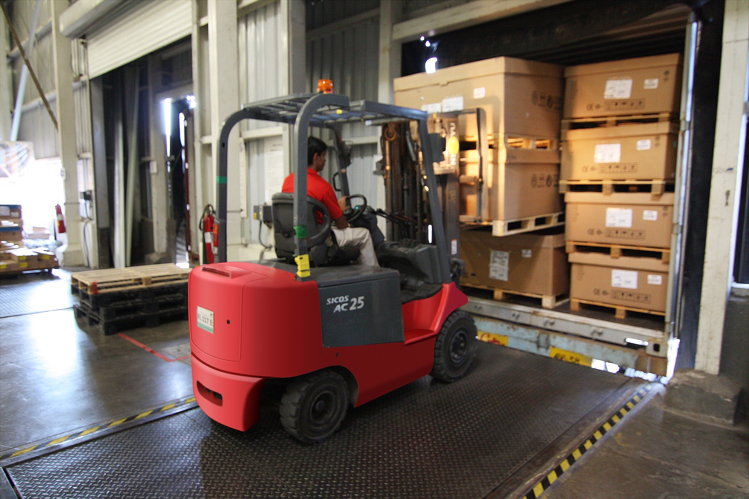
How to Protect Yourself
The Unload
Turn the forklift slowly into position, squaring it up to the drop-off location.
If unloading onto a stack:
position the forklift properly before lifting the forks;
check for overhead clearance before raising the load;
raise and position the load to the correct height – 2 inches above the stack;
allow 2 to 3 inches of clearance at the sides and back of the load;
move the load slowly into position;
tilt the load forward, then lower it;
level the forks so they are no longer tilted; and - pull the forks back slowly.
Notes:
How to Protect Yourself
The Unload
Turn the forklift slowly into position, squaring it up to the drop-off location.
If unloading onto a semi-truck and trailer:
before driving in, visually inspect the inside of the trailer to ensure that the bed is in good condition and of adequate height to accommodate the forklift;
make sure the trailer’s rear wheels are chocked, the parking brake is set, and the dock plate is down and secure;
slowly drive in, position the load, and tilt it forward until it is even with the surface of the unloading location;
then lower the load and release it.
If unloading onto a stack:
position the forklift properly before lifting the forks;
check for overhead clearance before raising the load;
raise and position the load to the correct height – 2 inches above the stack;
allow 2 to 3 inches of clearance at the sides and back of the load;
move the load slowly into position;
tilt the load forward, then lower it;
level the forks so they are no longer tilted; and - pull the forks back slowly.

Slide 12
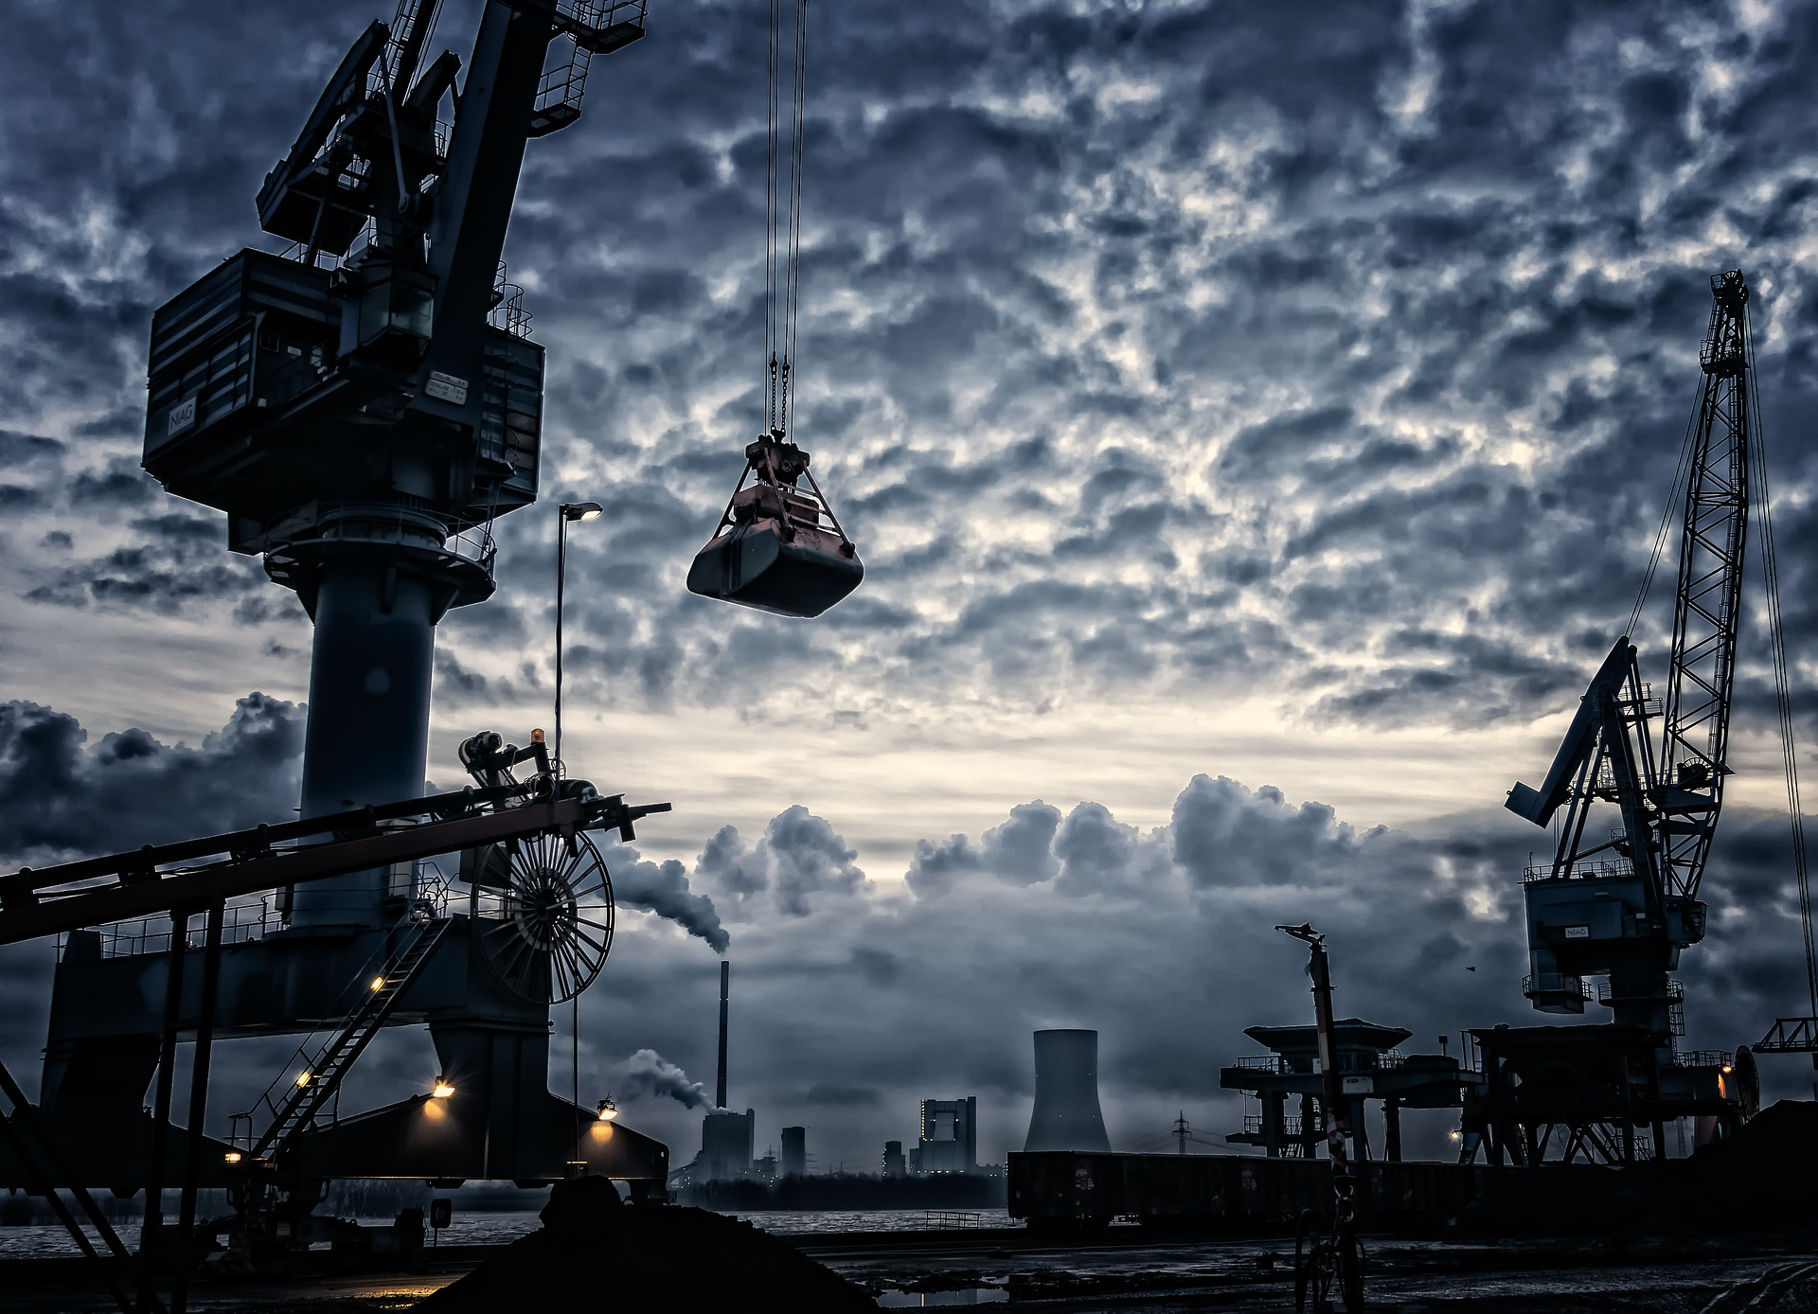
How to Protect Yourself
Overview Take Away
When using lifting equipment, it’s vital that you stay vigilant and take the necessary safety precautions. Accidents will be much more likely to happen, otherwise. These incidents can cause injuries, costly damage, and even death in the most serious of cases.
Notes:
How to Protect Yourself
Overview Take Away
When using lifting equipment, it’s vital that you stay vigilant and take the necessary safety precautions. Accidents will be much more likely to happen, otherwise. These incidents can cause injuries, costly damage, and even death in the most serious of cases.
The more time you spend using lifting equipment, the more respect you’ll gain for the safety procedures and requirements that are in place to protect you.

Slide 13
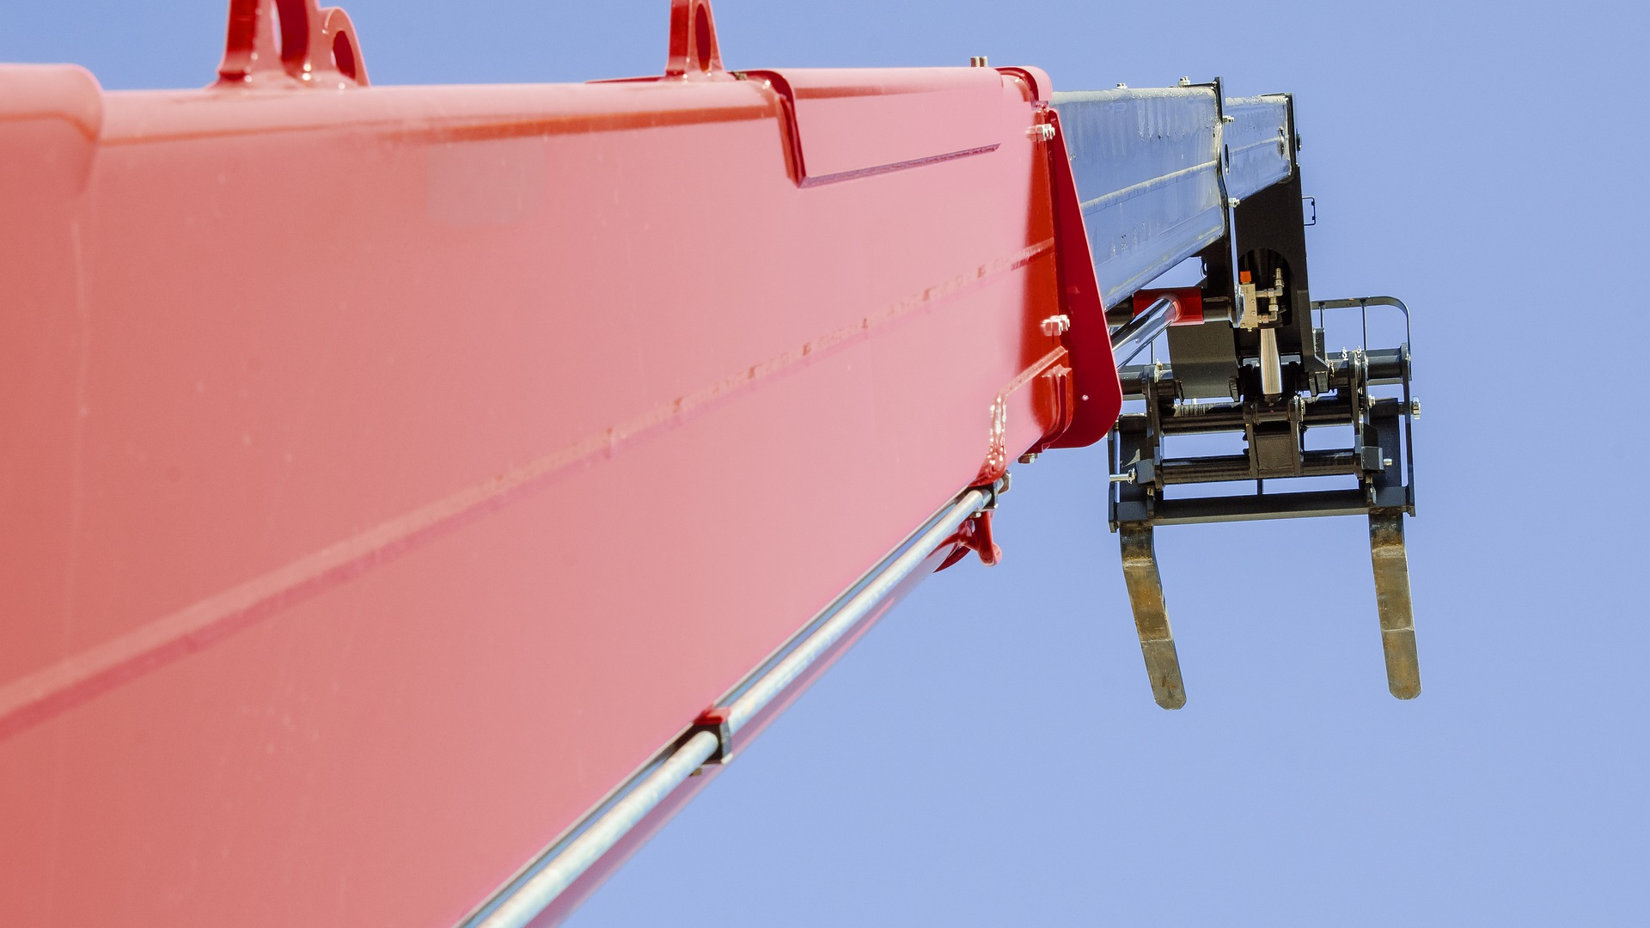
Final Word
Running over bystanders, touching overhead wires, and falling loads are just a few of the hazards of loading and unloading.
Notes:
Final Word
Running over bystanders, touching overhead wires, and falling loads are just a few of the hazards of loading and unloading.

