Slide 1

Click anywhere to get started…

Slide 2

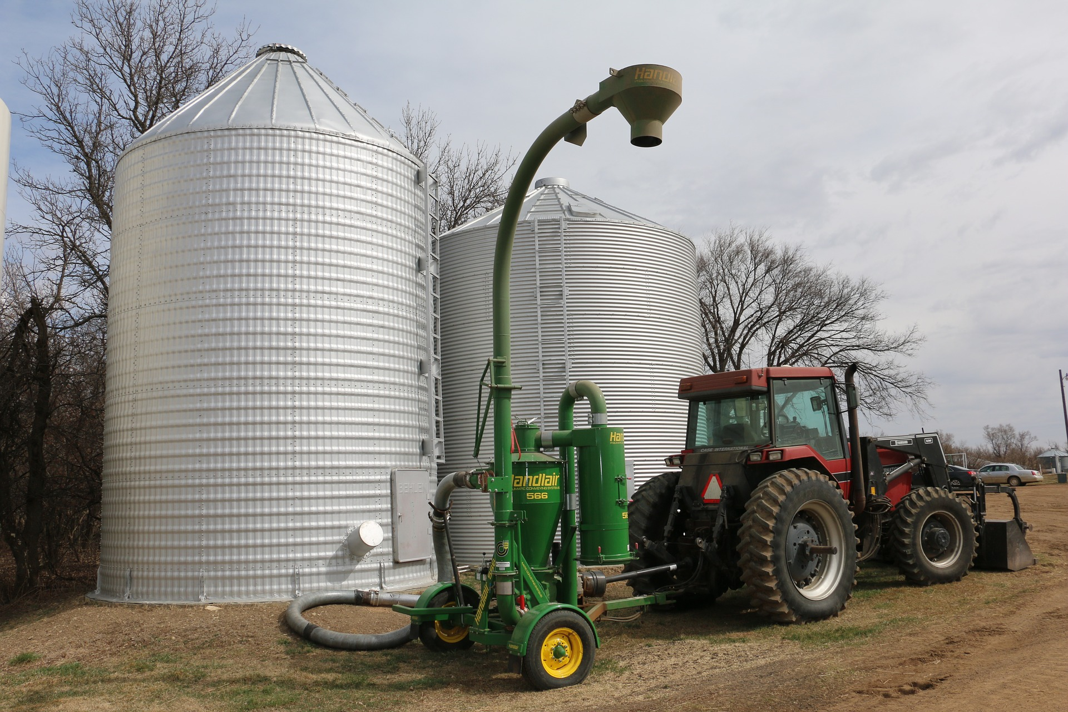

PREPARING GRAIN BINS FOR HARVEST
Notes:
PREPARING GRAIN BINS FOR HARVEST

Slide 3
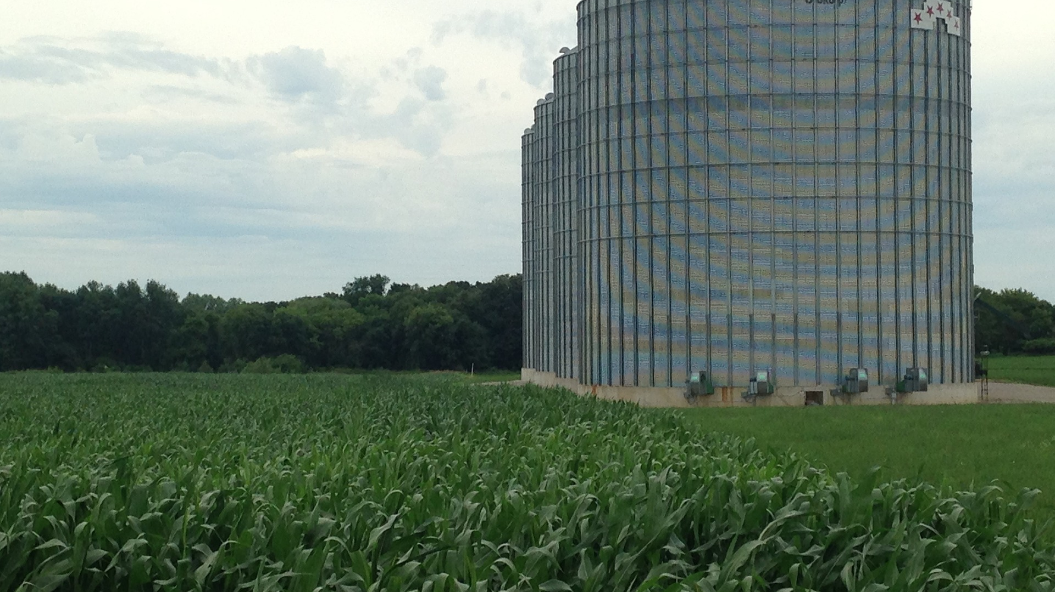
What’s at Stake?
Proper bin and equipment preparation is a key to preserving stored grain quality.
.
Notes:
What’s at Stake?
With harvest approaching, it’s time to prepare grain bins and harvesting equipment to help ensure that grain going into storage will remain in good condition. Don't wait until the middle of harvest to discover that a bin foundation is severely cracked, or find even later that insects from grain that was left in the combine last fall have severely infested a bin of new grain. Proper bin and equipment preparation is a key to preserving stored grain quality.

Slide 4
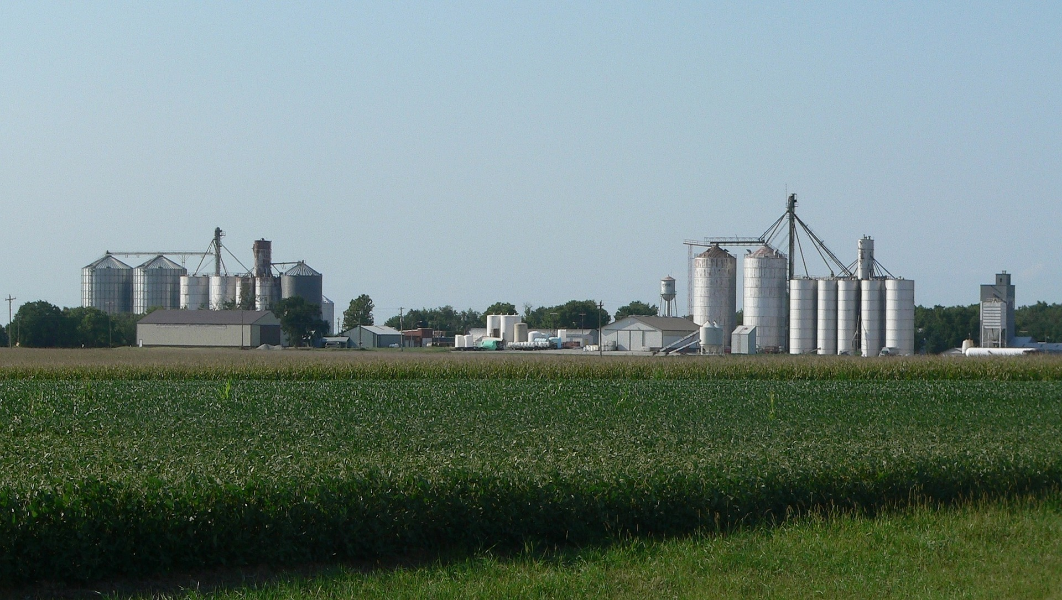
What’s the Danger?
GENERAL
The key to good grain storage is to put the highest quality grain into the bin, or bring it to the proper moisture condition as quickly as possible.
Notes:
What’s the Danger?
GENERAL
The key to good grain storage is to put the highest quality grain into the bin, or bring it to the proper moisture condition as quickly as possible. Overall quality of stored grain always deteriorates, it is just a matter of how fast. Having a good marketing plan and selling as much as possible before the grain heats up next spring is the best way to have quality stored grain. It is never as good as the day it is put into the bin. Storing the grain longer than next spring requires much more vigilance in management.

Slide 5
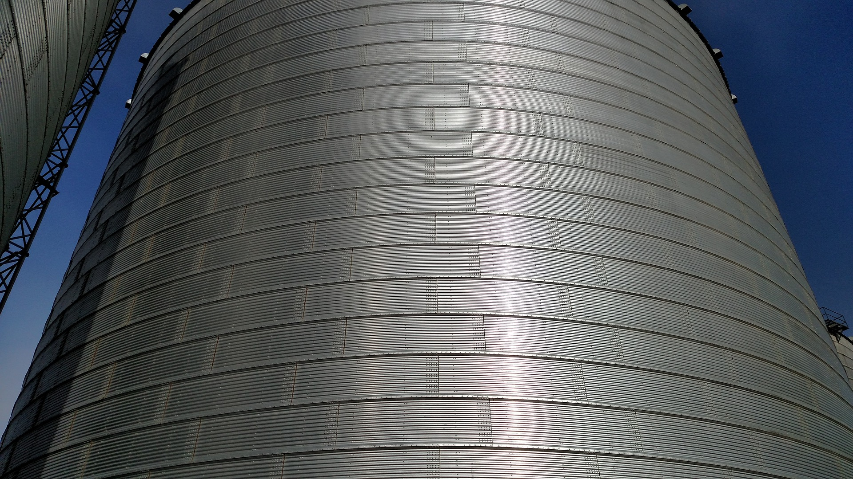
What’s the Danger?
Problems / Hazards in Grain storage
Remove all traces of old grain from combines,
Rodents and pest problems are big issues with left owner grain residue in bins and equipment / machinery.
Inspect bins and foundations for structural problems. Uneven settlement of foundations can cause gaps between the foundation and bottom edge of the bin.
Ensure bins are clean
Apply insecticides
Notes:
What’s the Danger?
Problems / Hazards in Grain storage
Remove all traces of old grain from combines, truck beds, grain carts, augers, and any other equipment used for harvesting, transporting, and handling grain. Even small amounts of moldy or insect-infested grain left in equipment can contaminate a bin of new grain.
Rodents and pest problems are big issues with left owner grain residue in bins and equipment / machinery.
Inspect bins and foundations for structural problems. Uneven settlement of foundations can cause gaps between the foundation and bottom edge of the bin. This can result in grain spills and provide entry points for water, insects, and rodents.
Ensure Bins Are Clean
Remove any old grain with brooms and vacuum cleaners. Never put new grain on top of old. Also, clean bins not being used for storage this year to keep insects from migrating to other bins.
Apply Insecticides
If you think there is any chance you might hold grain in the bin into May or later, it would be prudent to apply residual insecticides to the empty bin after thoroughly cleaning it. You may also apply certain insecticides onto the grain as it is being augured into the bin. A surface application is often recommended to prevent Indian meal moths from infesting the top surface of the grain.
Grain Take Away
Beware of spoiled grain.
Making sure that the bins are ready to be loaded with newly harvested grain reduces the risk of spoilage.

Slide 6

How to Protect Yourself
Tips – while working in and around these structures
Decide if the task is necessary now while there is still grain in the structure.
If the work is needed now, plan how to safely go about carrying out the tasks.
Let everyone on the farm know that there will be people working around the grain storage structures and that no one is to start any equipment at the site.
Assemble a team that will work on these tasks and assign each person their duties.
Notes:
How to Protect Yourself
Why do people have to work around grain bins and other storage and enclosed facilities?
Maintenance on the equipment.
Cleaning the equipment.
Dealing with grain that has gone out of condition and is stuck in the bin.
Tips – while working in and around these structures
Decide if the task is necessary now while there is still grain in the structure. Can the maintenance be done later when the structure is empty?
If the work is needed now, plan how to safely go about carrying out the tasks.
Let everyone on the farm know that there will be people working around the grain storage structures and that no one is to start any equipment at the site.
Assemble a team that will work on these tasks and assign each person their duties. Working in these structures is at minimum a two- to three-person job. At least one person needs to be outside the bin and to be able to hear the individual inside the bin. Station one individual on top of the bin who can always see the person in the bin. This individual can react quickly if something goes wrong. If a third person is on the ground, that person can call 911 and get help. They can direct emergency personnel when they get to the location and give them a rundown of what has taken place. The person on top of the bin stays there, watching the person and communicating with the person in the bin.

Slide 7
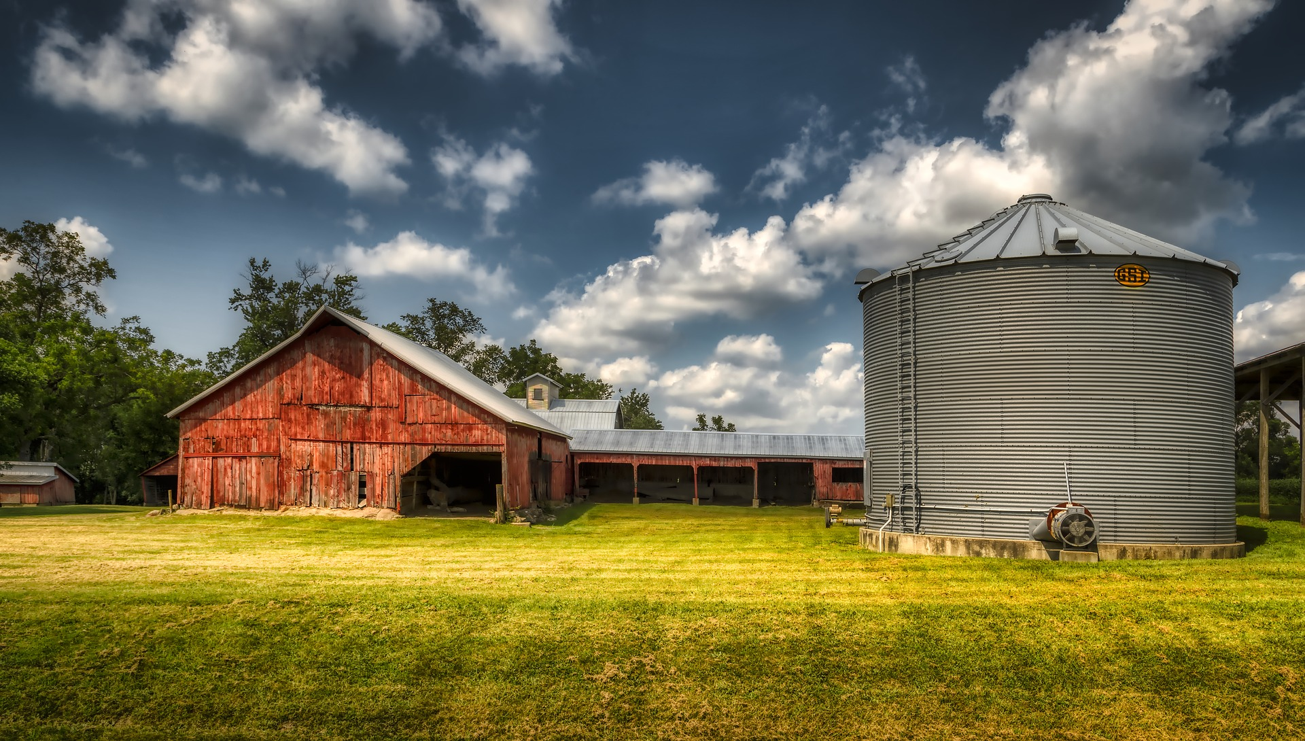
How to Protect Yourself
5. Prior to entering the enclosure, run the aeration system and open the top of the bin for at least an hour to help remove any toxic gas levels.
6. Before entering, take a gas reading to make sure the gas levels are safe.
7.When the team is ready to go to work, tag out and lock out all grain handling equipment.
8. The person entering the enclosure needs to be in a safety harness that is secured to the outside of the bin
Notes:
How to Protect Yourself
Prior to entering the enclosure, run the aeration system and open the top of the bin for at least an hour to help remove any toxic gas levels.
Before entering, take a gas reading to make sure the gas levels are safe.
When the team is ready to go to work, tag out and lock out all grain handling equipment. This helps prevent accidental operation of this equipment while working inside.
The person entering the enclosure needs to be in a safety harness that is secured to the outside of the bin.

Slide 8
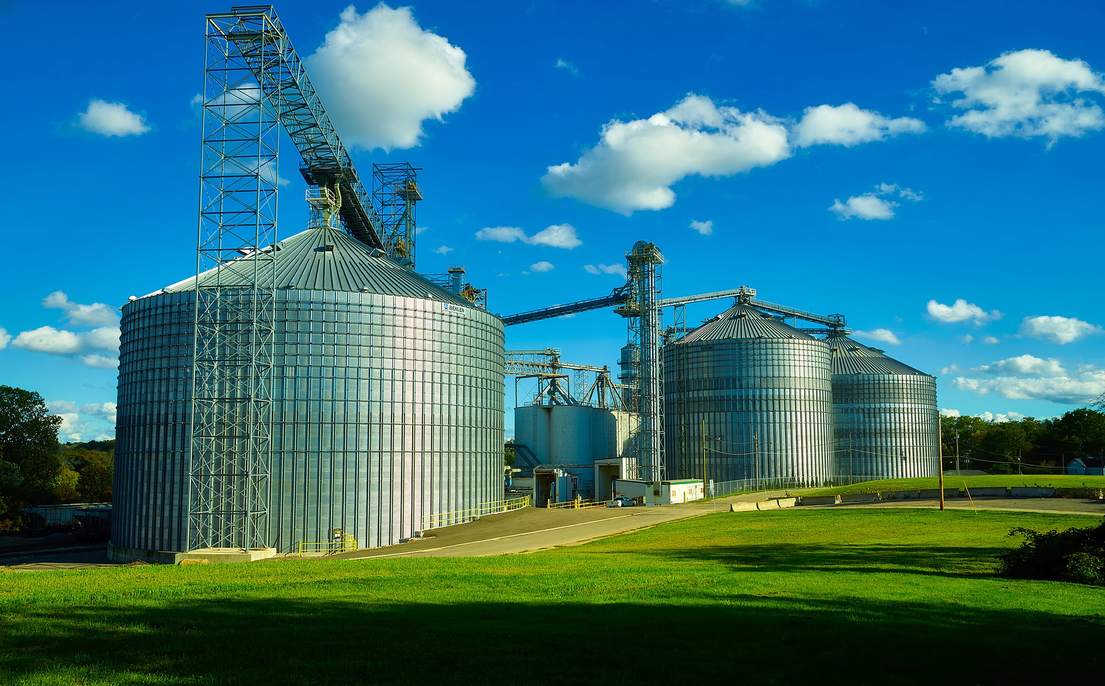
How to Protect Yourself
Safety Precautions when Entering A Grain Bin
If you must enter the bin, as a farm owner/operator you should:
Break up crusted grain from the outside of the bin with a long pole.
Wear a harness attached to a properly secured rope together with proper respiratory personal protective equipment.
Stay near the outer wall of the bin and keep walking if the grain should start to flow.
Have another person, preferably two people, outside the bin who can help if you become entrapped.
Grain fines and dust may cause difficulty in breathing.
Notes:
How to Protect Yourself
Safety Precautions on Entering A Grain Bin
If you must enter the bin, as a farm owner/operator you should:
Break up crusted grain from the outside of the bin with a long pole. When using a pole, check to see that it doesn't come into contact with electric lines.
Wear a harness attached to a properly secured rope together with proper respiratory personal protective equipment.
Stay near the outer wall of the bin and keep walking if the grain should start to flow. Get to the bin ladder or safety rope as quickly as possible.
Have another person, preferably two people, outside the bin who can help if you become entrapped. These people should be trained in rescue procedures and should know and follow safety procedures for entering the confined space.
Grain fines and dust may cause difficulty in breathing. Anyone working in a grain bin, especially for the purpose of cleaning the bin, should wear an appropriate dust filter or filter respirator.

Slide 9
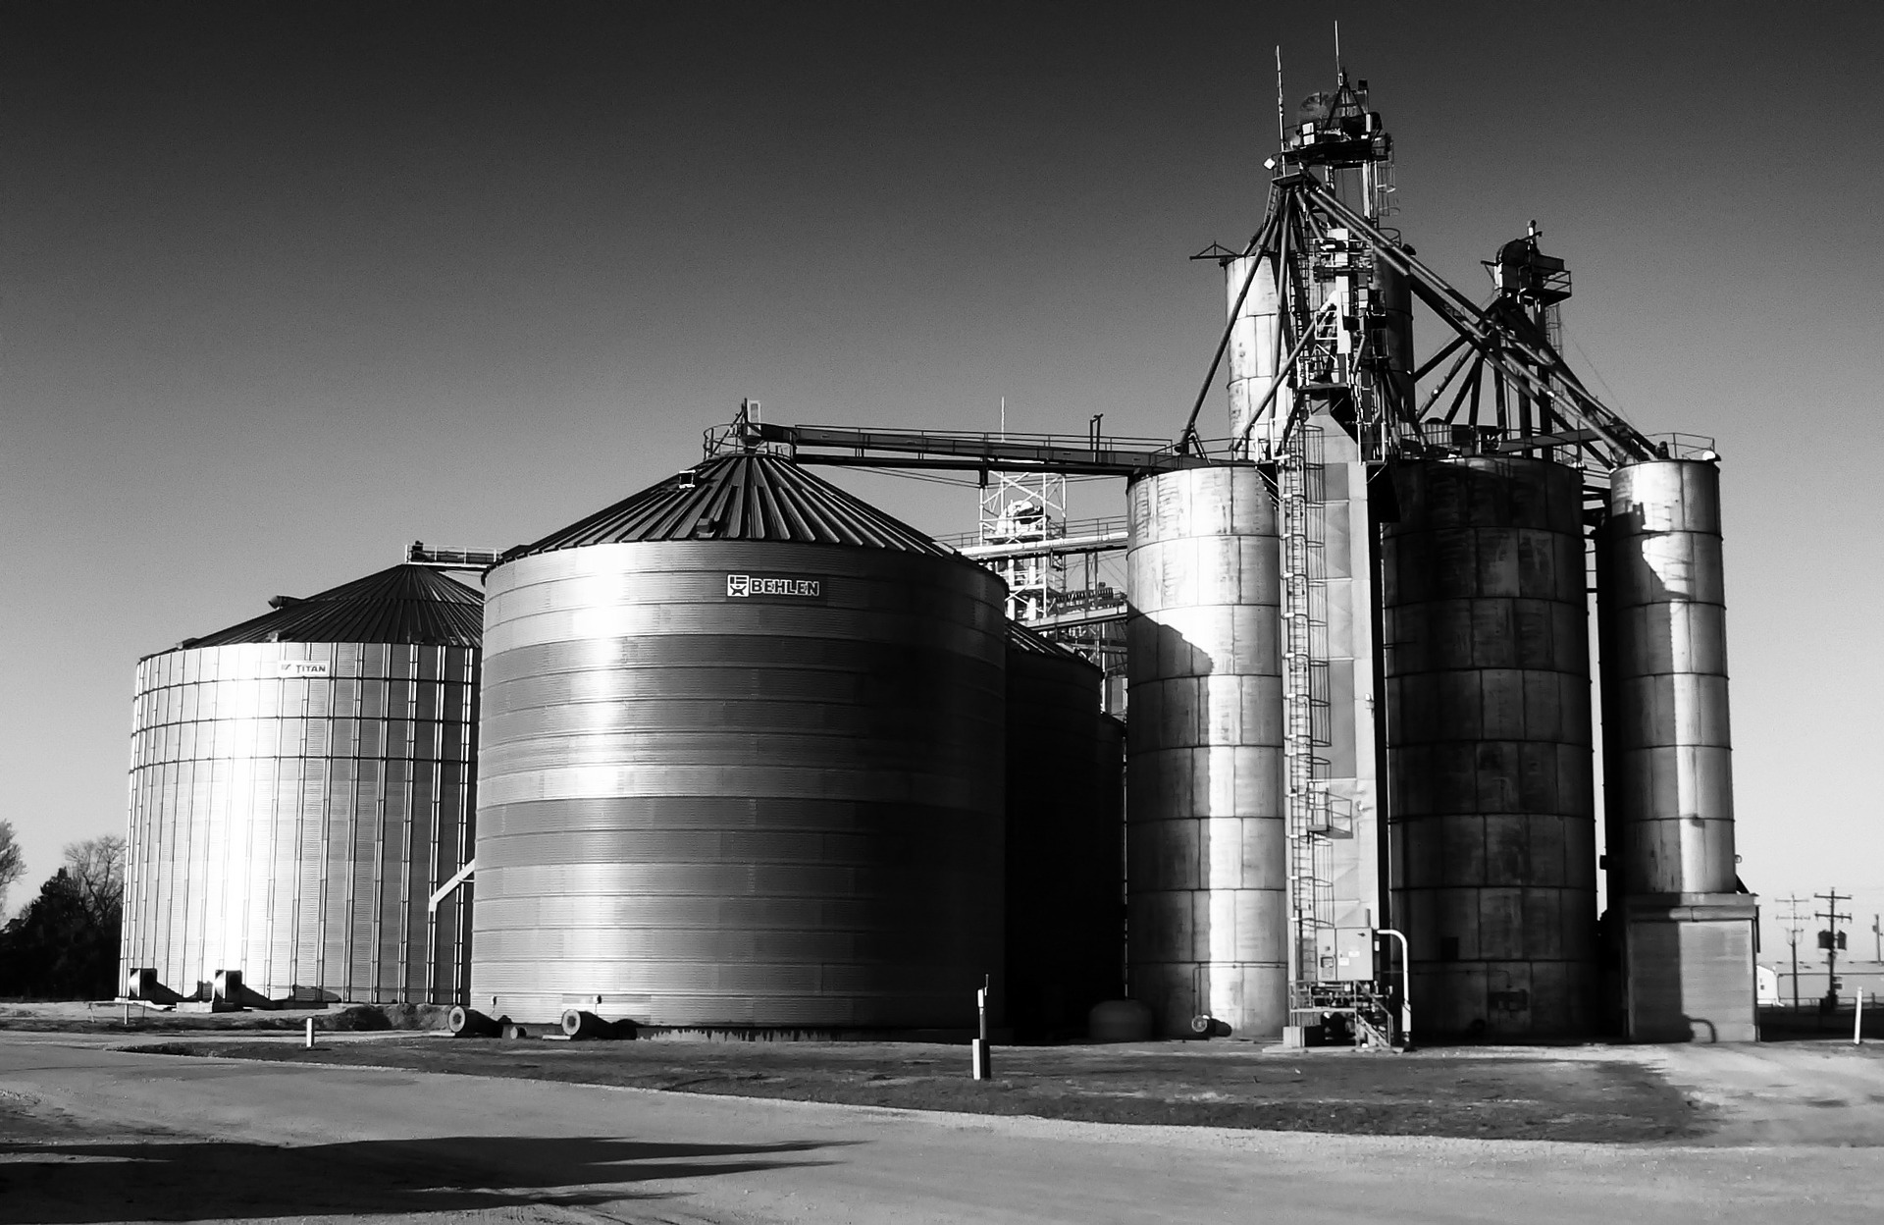
How to Protect Yourself
Stay out of grain bins, wagons and grain trucks when unloading equipment is running.
If it is necessary to enter the bin, remember to shut off the power to augers and fans. It is a good idea to lock out any unloading equipment before you enter a bin to prevent someone from unintentionally starting the equipment while you are in the bin.
Children should not be allowed to play in or around grain bins, wagons or truck beds.
Where possible, ladders should be installed inside grain bins to for an emergency exit.
Notes:
How to Protect Yourself
Stay out of grain bins, wagons and grain trucks when unloading equipment is running.
If it is necessary to enter the bin, remember to shut off the power to augers and fans. It is a good idea to lock out any unloading equipment before you enter a bin to prevent someone from unintentionally starting the equipment while you are in the bin.
Children should not be allowed to play in or around grain bins, wagons or truck beds.
Where possible, ladders should be installed inside grain bins to for an emergency exit. Ladders are easier to locate inside a dusty bin if there are brightly painted stripes just above or behind the ladder.

Slide 10
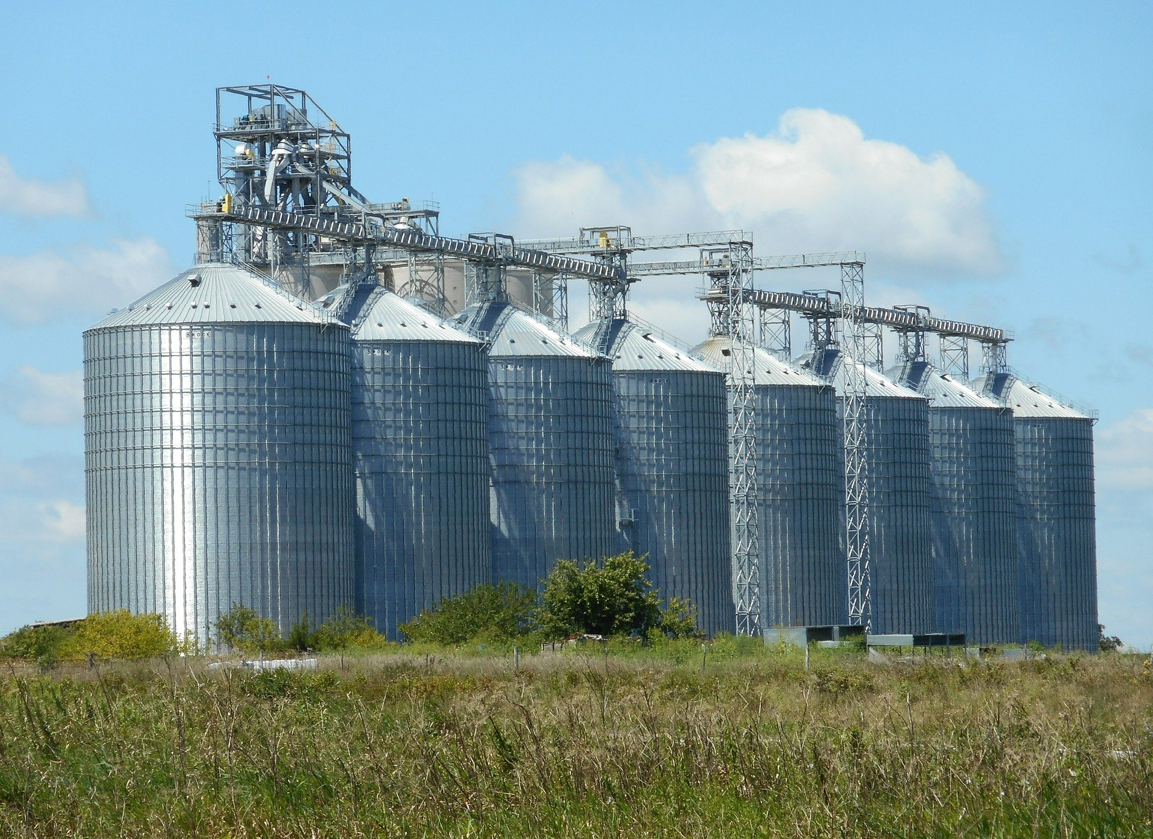
How to Protect Yourself
Final Protective Steps in Bin safety
Inspect the bin roof and sides, inside and out, for leaks, loose or sheared bolts, rust or other corrosion, etc. Check the roof vents and access hatch, and caulk any cracks at the roofline. Be sure the access ladder is complete and securely fastened to the bin. Repair or replace any deteriorated components.
Wiring for fans and other electrical components should be inspected for corrosion and cracked, frayed, or broken insulation. Exposed wiring should be run through waterproof, dust-tight conduit. Avoid kinking the conduit, and make sure all connections are secure.
Check fans, heaters, transitions, and ducts for corrosion and damage. Remove any accumulated dust and dirt that will reduce the operating efficiency. Be sure that all connections are tight.
Notes:
How to Protect Yourself
Final Protective Steps in Bin safety
Inspect the bin roof and sides, inside and out, for leaks, loose or sheared bolts, rust or other corrosion, etc. Check the roof vents and access hatch, and caulk any cracks at the roofline. Be sure the access ladder is complete and securely fastened to the bin. Repair or replace any deteriorated components.
Wiring for fans and other electrical components should be inspected for corrosion and cracked, frayed, or broken insulation. Exposed wiring should be run through waterproof, dust-tight conduit. Avoid kinking the conduit, and make sure all connections are secure.
Check fans, heaters, transitions, and ducts for corrosion and damage. Remove any accumulated dust and dirt that will reduce the operating efficiency. Be sure that all connections are tight.

Slide 11
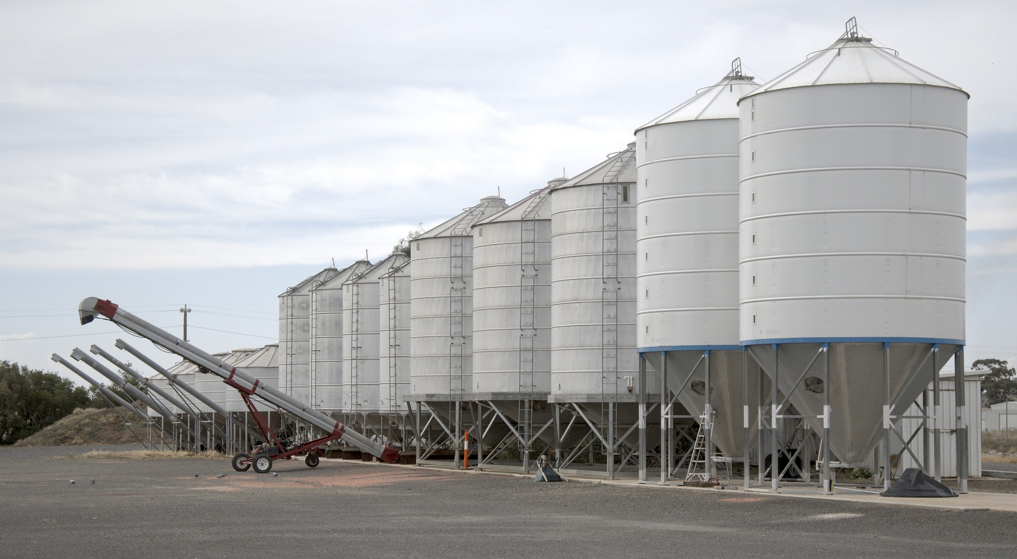
Final Word
Preparing grain bins for harvest should be done to maintain the quality of grain and to make sure the areas around bins are ready for the busy season ahead. It is also a good time to inspect any mechanical components and clean up around the bin. Simple maintenance and safety rules will make sure we don’t experience any difficulties in the season ahead.
Notes:
Final Word
Preparing grain bins for harvest should be done to maintain the quality of grain and to make sure the areas around bins are ready for the busy season ahead. It is also a good time to inspect any mechanical components and clean up around the bin. Simple maintenance and safety rules will make sure we don’t experience any difficulties in the season ahead.

