Slide 1

Click anywhere to get started…

Slide 2



PRE-OPERATIONAL INSPECTION OF EQUIPMENT
Notes:
PRE-OPERATIONAL INSPECTION OF EQUIPMENT

Slide 3
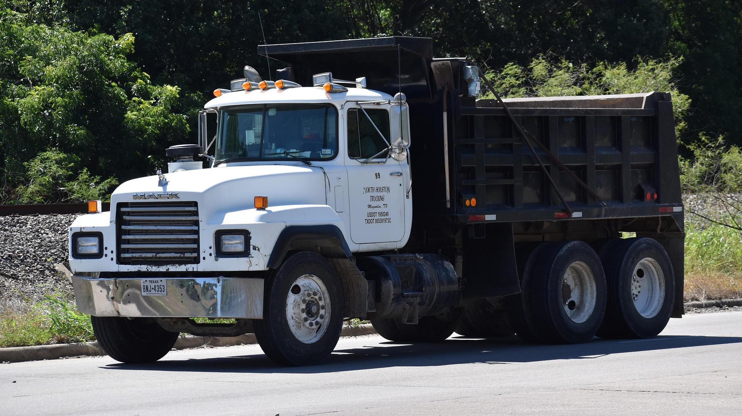
What’s at Stake?
The equipment operator can prevent downtime, extend service life and ensure more efficient operation with just a few minutes of preventive inspection both pre- and post-operation.
Notes:
What’s at Stake?
Performing the pre-operational check is important for the safety of the operator and everyone in its working environment. Unfortunately this safety check is often forgotten or ignored. Not every operator is aware about the items that need to be check before he can start his machine and begin to perform his daily tasks.
The equipment operator can prevent downtime, extend service life and ensure more efficient operation with just a few minutes of preventive inspection both pre- and post-operation.
But the key is consistency. These inspections must be engrained into the consciousness of all parties and performed every day.

Slide 4
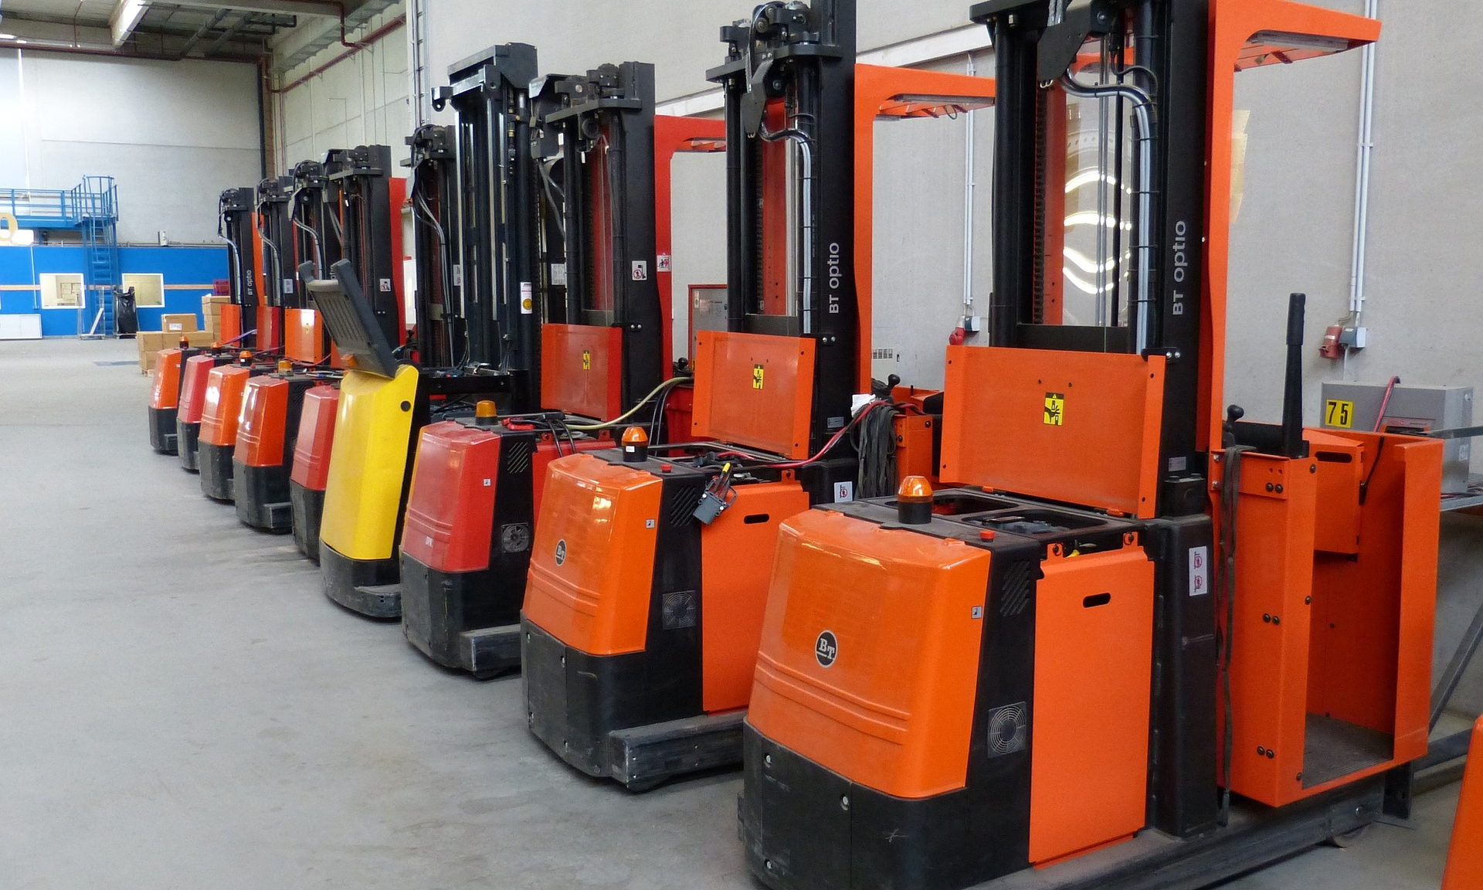
What’s the Danger?
LOWER RISK OF WORKPLACE INJURIES
Lost Time
Restaffing Costs
Higher Workers’ Compensation Premiums
Possible Fines
Could Be Held Liable
Notes:
What’s the Danger?
1. LOWER RISK OF WORKPLACE INJURIES
Regular inspections lower the chances of one of your workers getting injured. Unfortunately, injuries do happen on the job, and most of the time, they are preventable. Inspections are a preventive safety measure for you and your employees.
Consider that in 2016, there were 4,693 deaths in private industry, according to OSHA. About 21 percent of the deaths occurred in the construction industry. Excluding highway injuries, the leading causes of construction workers’ deaths were the “fatal four” — falls, struck by an object, electrocution or caught between two pieces of machinery. Eliminating the fatal four could save 631 lives each year in America.
Now, consider how failing equipment could play a part in these statistics. A failed horn, brakes or any other important component could lead to a crash, or a vehicle driver striking another worker. A collision or failed system could cause a heavy object to fall and lead to injury or death. Or, a worker could become distracted by broken-down equipment and less aware of nearby workers, putting their safety at risk. If brakes fail or if equipment suddenly shuts down, it could easily cause a dangerous chain reaction to occur.
A. Lost Time
If a worker gets injured as a result of damaged equipment, chances are, they are going to miss some time. Common injuries relating to heavy equipment are often serious, such as amputations, spinal injuries, sprains, fractures and cuts.
Workers who suffer any of these injuries could be out for days. According to a 2015 Bureau of Labor Statistics news release, workers who sustained sprains or strains resulting from a workplace injury required 10 days off work, on average. Workers with fractures needed 31 days, and those who suffered amputations required 22 days or more.
B. Restaffing Costs
If a worker is severely injured, they might need a long time to recover, or they may never return to the jobsite. In such a case, you will need to replace the worker with someone new. Whenever you hire a new employee, you take a chance.
According to a 2016 survey by the Society for Human Resource Management (SHRM), it takes 42 days to fill a job vacancy with a new employee, which is a lot of time with insufficient staff. New employees cost money, too. On average, it costs companies $4,129 to hire someone new.
Even if you think you’ve found the perfect worker, there is no guarantee they’ll stick around to see a project through. According to the SHRM survey, the average annual turnover rate is 19 percent. Considering an employee who makes $8 an hour could wind up costing a company $3,500 in turnover costs, your best bet is to try to keep the employees you have.
C. Higher Workers’ Compensation Premiums
Workers’ compensation means employers are required by law to pay for workers’ compensation benefits if a worker gets hurt on the job. Injuries can be from one event or repeated injuries, such as those caused by regular exposure to chemicals or loud noises. Sometimes, workers’ compensation even covers psychological stress.
When an employee files a workers’ compensation claim, your workers’ compensation premium increases as a result. Injury can also affect health care premiums. However, if your claim costs are lower than average compared to similar companies, your premium may decrease — more incentive to keep your equipment fully intact.
D. Possible Fines
Avoid fines and serious violations with regular inspections by ensuring safety at all times. Under OSHA law, employers are responsible for maintaining safe workplaces for their employees. If you ignore safety, you break the law.
E. Could Be Held Liable
There are plenty of ways you could legally be liable if equipment fails and causes injury. For example, if a worker is injured and sent home, and if you hurriedly hire another worker to help your team finish a project on time, you might be putting yourself and workers at risk if the new employee is unqualified for the job. If the new worker causes harm to another worker, you could be held liable for hiring someone who brought danger to other employees.
Another way you could be liable as an employer is if you are aware your equipment needs repair, even if it had passed a mandatory inspection, but fail to repair it. If someone is injured, you could be liable for negligence.

Slide 5
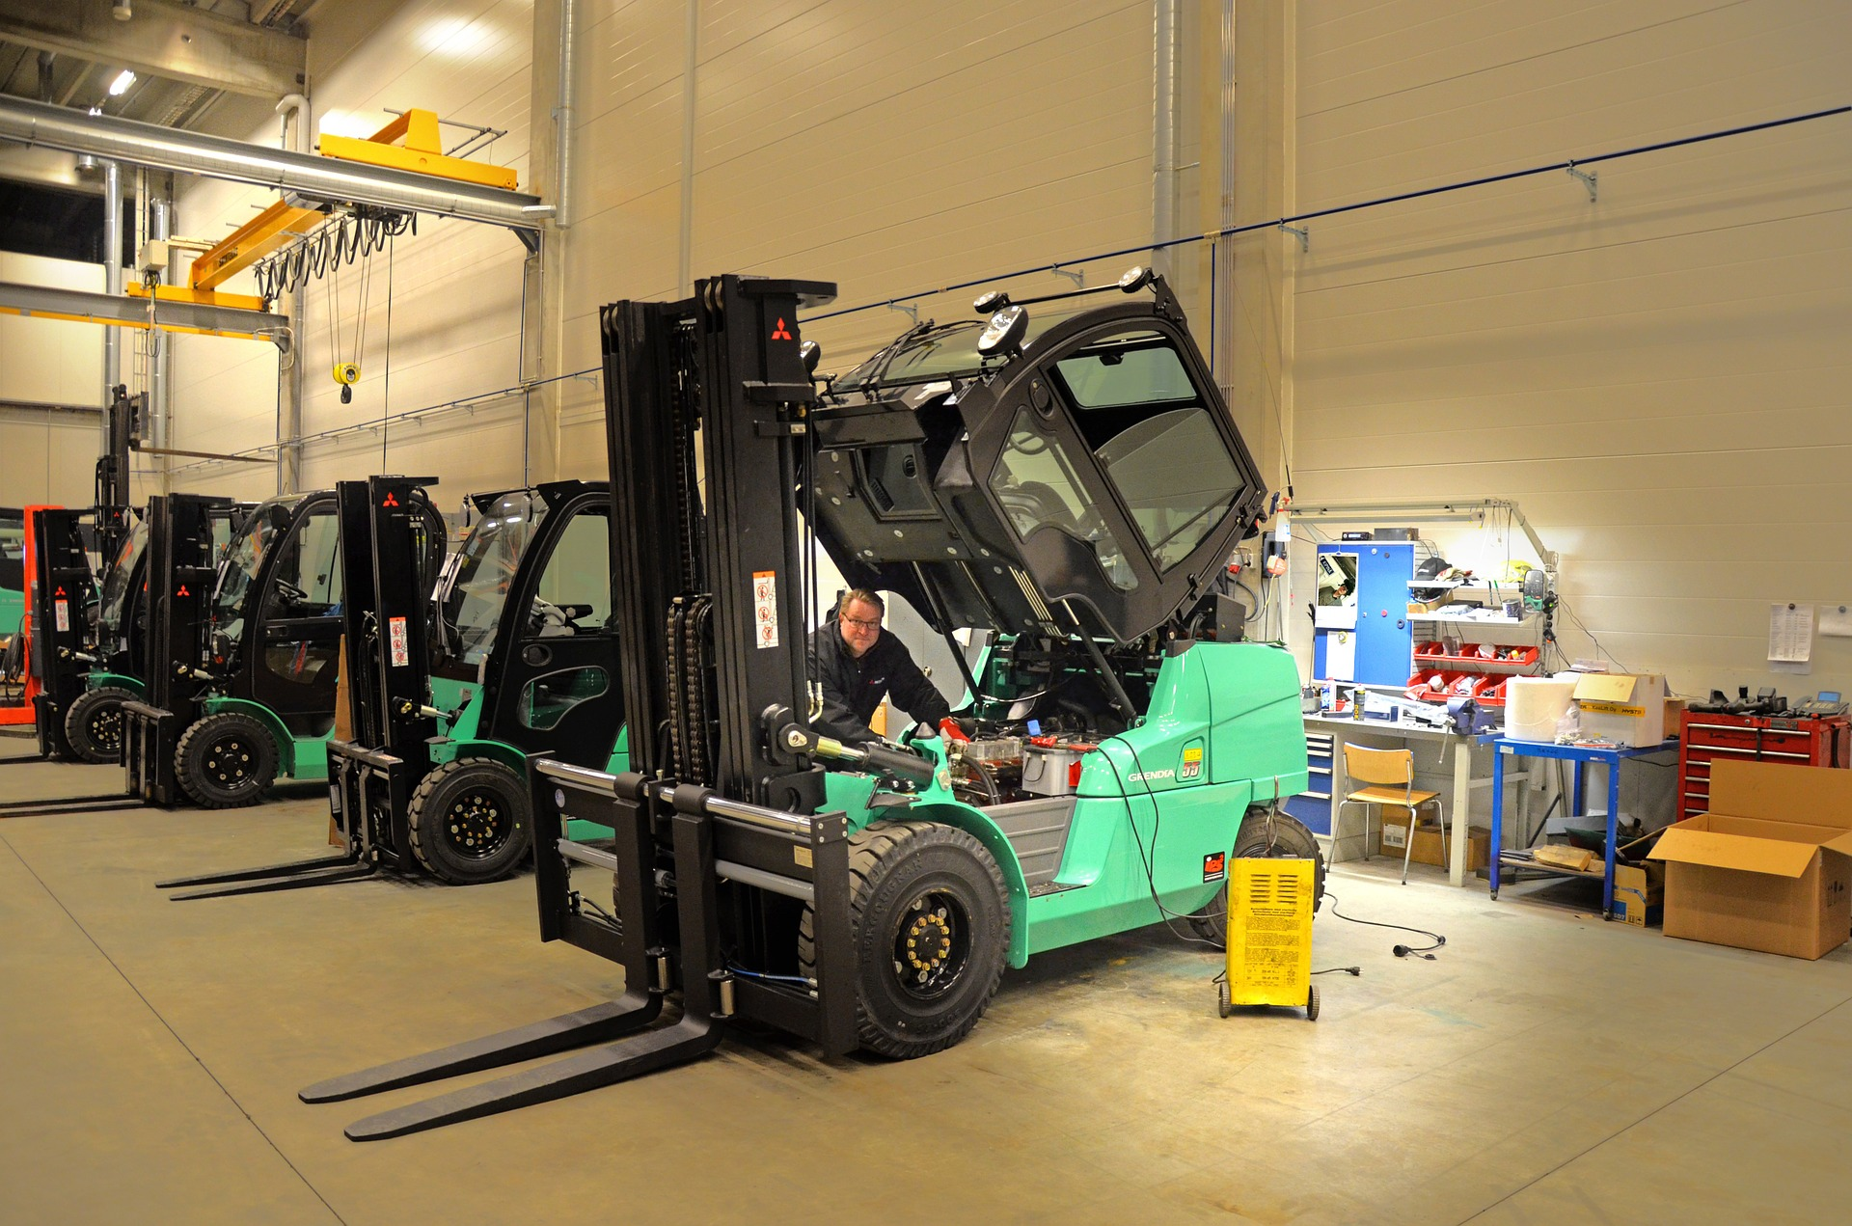
What’s the Danger?
2. INCREASE PRODUCTIVITY
3. LOWER REPAIR COSTS
Notes:
What’s the Danger?
2. INCREASE PRODUCTIVITY
Although safety is a priority, consider how damaged equipment can also affect productivity. When equipment fails, the workflow gets interrupted, and projects come to a halt.
When projects are interrupted, you might not be able to stick to your schedule and meet deadlines. It is important for customers to know they can depend on you, and regular inspections help make sure your equipment is reliable for you, your workers and your clients.
Machinery failure is usually due to one of the following.
• Thermally induced failure: Equipment overheats, or extreme temps cause equipment to break down.
• Mechanically induced failure: It is easy to prevent this with inspection and replacing parts. Mechanically induced failure often happens due to overexertion, collision and misuse or abuse.
• Erratic failure: Occurs randomly due to harder-to-detect reasons, such as electrical issues or software malfunction. Erratic failure can be prevented with the help of diagnostic equipment used during inspection.
Equipment failure can be sudden or gradual. Inspections are important because you may not notice the seriousness of an issue until it’s too late. By regularly having a professional check your equipment, you prevent disaster and make informed choices. You can replace parts when necessary and not wait until equipment breaks down in the middle of the workday to make repairs. As a result, you decrease unscheduled downtime and improve productivity.
3. LOWER REPAIR COSTS
With regular inspections performed by a trained technician, you will be able to make a repair before it leads to a much more expensive problem. Your equipment will run better, and you’ll extend its lifespan significantly with inspections and maintenance. The better condition your equipment is in, the less time you’ll need to spend on repairs, and the more work you can get done.

Slide 6
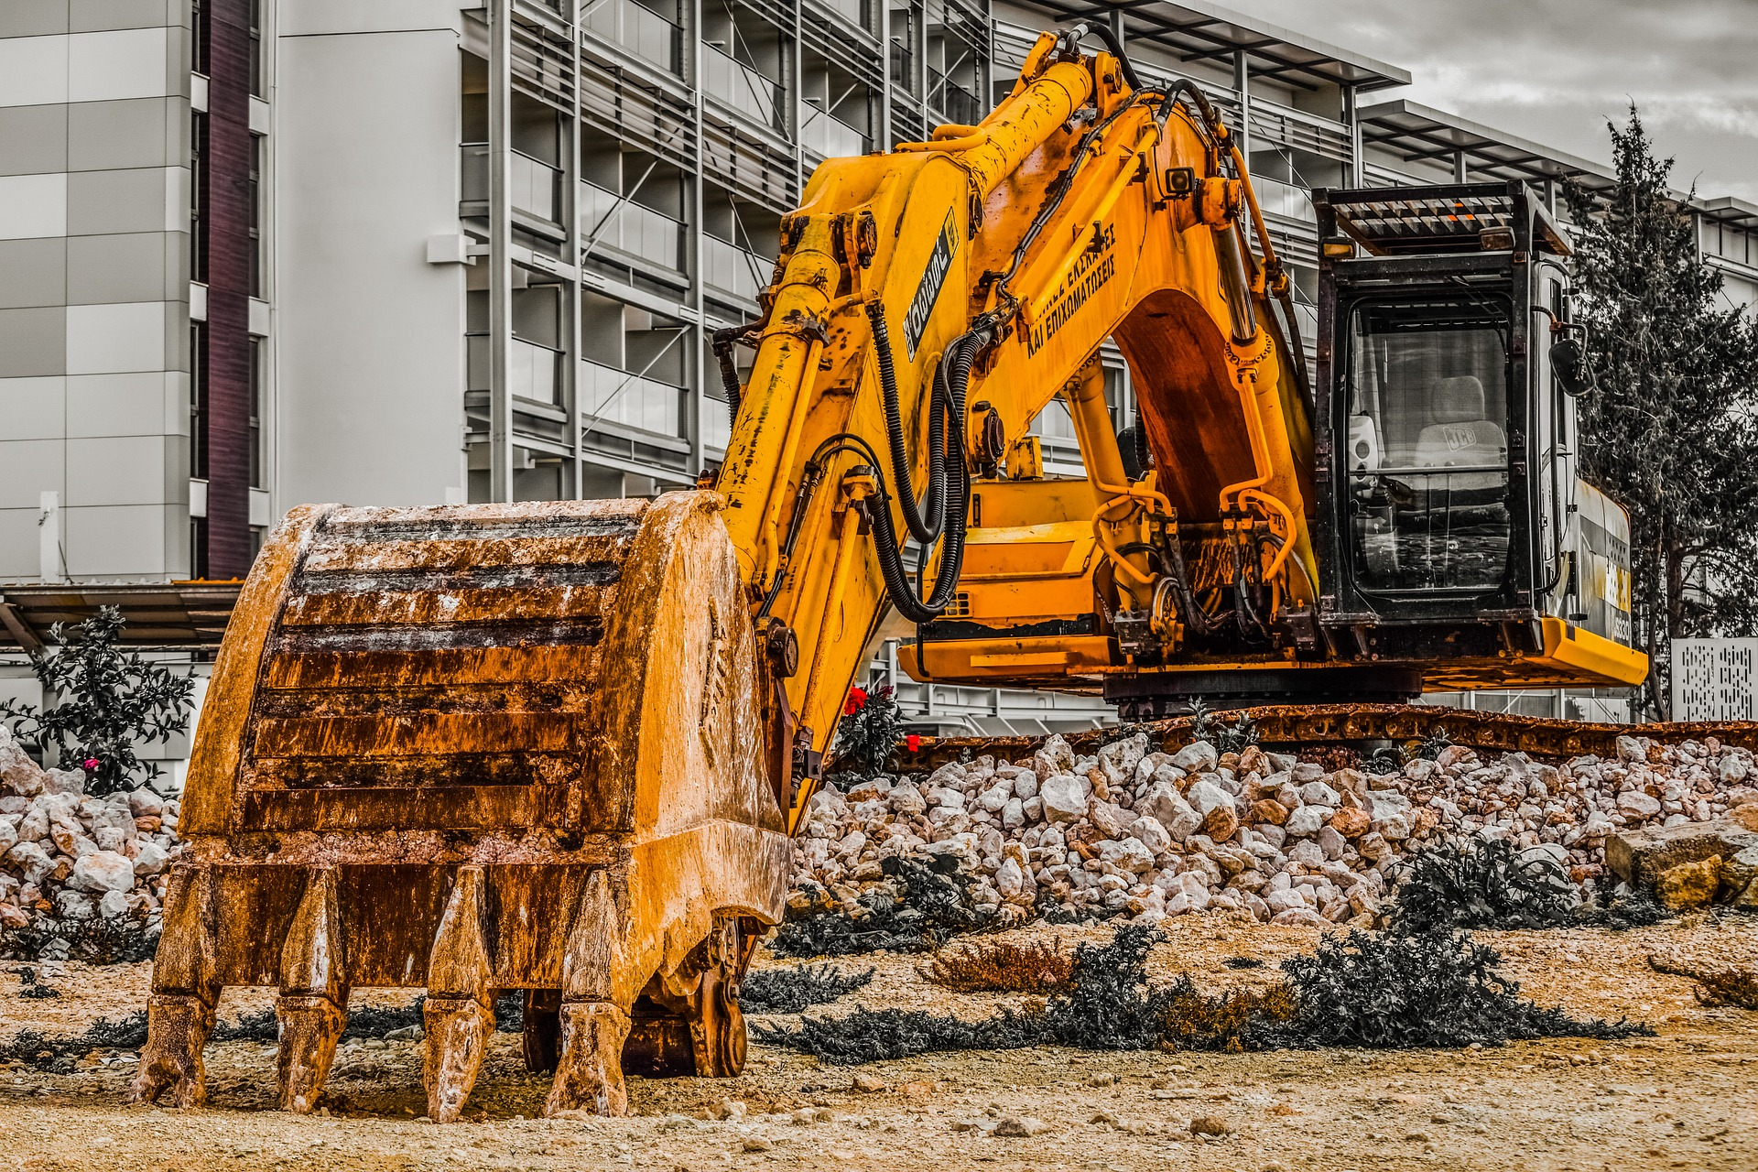
How to Protect Yourself
The Pre- and Post-Operation Equipment Inspection Checklist
Notes:
How to Protect Yourself
The Pre- and Post-Operation Equipment Inspection Checklist
• Check tires, rims or undercarriage for damage or abnormal wear and clear away debris. Much like you don’t operate at full capacity on a broken foot or while wearing shoes that are broken or don’t fit, a machine can be hobbled by the inefficiencies of the tires or tracks it sits on. Identify and report any damage or potential damage.
• Check fluid levels – engine and hydraulic oil, diesel and diesel exhaust fluid (DEF), and coolant. Fluids are the lifeblood of each machine and require specified levels to operate properly. A sudden drop in fluid levels may point to any number of problems with the machine that require immediate attention (blown hoses, leaking filter, etc.).
Clear any accumulated debris from around the radiator and other engine components. The engine is made of moving parts and belts that generate heat and friction – and systems designed to cool the engine compartment require room to breathe. It’s important to check and remove any clutter or material from the jobsite that may have found its way into the engine compartment.
• Check the fuel, oil, air and other filters for signs of damage or leaking. Filters are often a quick and easy item to replace – and operating with properly working filters can prevent any number of problems with the machine.
• Check belts (alternator, fan, etc.). A worn and frayed belt is another wear item that is relatively easy to replace. If noticed before it fails, then the operator can communicate with the maintenance team to replace during scheduled downtime or the next PM to ensure it doesn’t create unplanned downtime during the course of the work day.
• Identify greasing points and frequency. Every machine and every OEM is different – and keeping the machine properly greased is critical considering the power and friction created by these giant pieces of steel working together. It can also help keep out moisture and abrasive materials from the jobsite that can work into joints and friction points if not properly greased.
• Check for leaking or pooled fluid around and under the machine. This is an easy indicator that something isn’t right, and the source of that fluid should be identified and addressed/fixed before operation, and those fluids should be replaced.
• Check auxiliary hydraulic connections and pressure. Simply check the integrity of the coupling structure and that it hasn’t been damaged. Newer equipment often includes pressure relieving quick disconnects – take the time to relieve the pressure when disconnecting attachments.
• Check for new signs of structural damage, scratches or dents on the machine. This is almost more important post-operation than it is pre-operation. Once done for the day, noticing and identifying any damage to the machine ensures that needed repairs are made before the next shift starts, and also allows the operator to identify how that damage occurred. Is there another structure on site that the machine came into contact with? Is there damage elsewhere on site that needs to be addressed? Similarly, if damage is noticed before a shift starts, and it was not there when the operator inspected it the day before, that pinpoints that something happened overnight or that there was possible unauthorized use of the machine.
• Check for damage on ground engaging tools (buckets, teeth, etc.). A machine’s performance is affected greatly by the efficiency of how its working tools engage with the material it is digging into and moving. Worn or broken buckets and teeth lead to inefficient operation, greater fuel use, and greater wear and tear to the machine as a whole. Identifying and addressing these elements of the machine before they become problematic will make the operator more productive and efficient.
• Inspect the attachment mount-up to ensure proper connection. This includes checking that the coupler is flush and fully engaged (either via manual or automatic/hydraulic means), and that the hydraulic hoses (and electrical connections, if applicable) are properly connected.
• Inspect the operator compartment and clear away any debris or obstructions. Clutter can be distracting – and anything in the cab that ultimately prevents the full range of controls from being engaged is a hazard to operation.
• Check and set mirrors. This might seem obvious, but visibility is critical to jobsite awareness, safety and productivity. Having mirrors set to the operator’s preference will make them a better operator.
• Familiarize yourself with the control style and change as needed. Most of today’s machine’s come with rather simple pattern selectors that allow the operator to use the control pattern that they are most familiar with. This will lead to greater productivity and greater operator satisfaction.
• Identify auxiliary/attachment controls. Each type and style of machine controls attachments differently – operators should identify how to properly work their attachment prior to attempting to use it.
• Start the engine and review console indicators and warnings. Today’s machines are built to give the operator more feedback on the workings of internal systems than ever previously available. Take note of any flashing symbols or warning lights, check the owner’s manual and consult with maintenance staff prior to operation.
• If equipped, check the rearview camera. Again – jobsite awareness and safety is paramount. If that rearview camera is otherwise obstructed or disabled, it handicaps the operator’s ability to have full awareness of the worksite around him/her.
• Review all external surroundings from the cab. Know your work site, and the people and structures that exist inside your working envelope. This will ensure optimal jobsite safety and productivity.

Slide 7
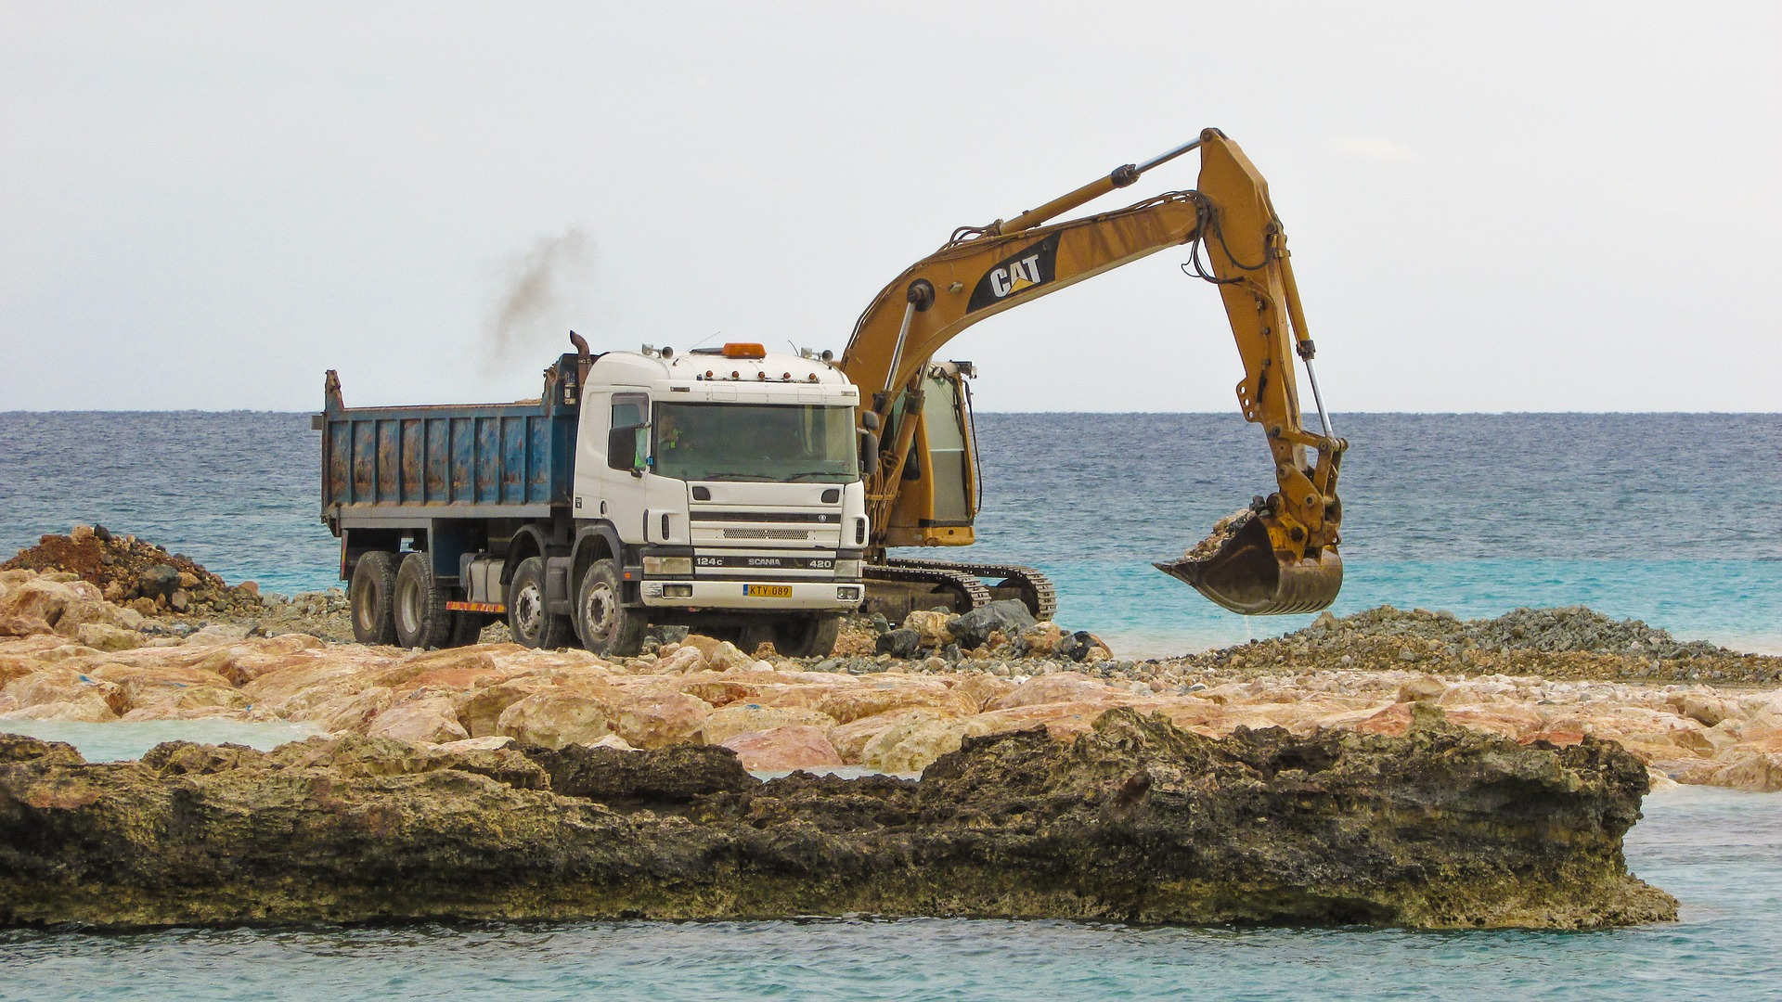
How to Protect Yourself
VISUAL, PRE-USE OPERATIONAL INSPECTIONS
A visual “circle check” and pre-use operational check
Visual Inspection
The Operational Inspection
Notes:
How to Protect Yourself
VISUAL, PRE-USE OPERATIONAL INSPECTIONS
A visual “circle check” and pre-use operational check will reduce the chance of equipment being operated in an unsafe condition (which could cause injury to operators workers, facilities or product). It also allows you to spot and deal with maintenance issues early, before they turn into larger problems like downtime, equipment damage, or expensive repairs.
Visual Inspection
Overall condition
Frame
Tires and wheels
Forks
Mast, carriage and load backrest extension
Lift chains
Hydraulic hoses
Overhead guard
Battery
Cables and connectors
Battery restraints
Electrolyte level
Hood latch
Capacity plate and all warning decals
Operator’s compartment
The Operational Inspection
Operator restraint system
Horn
Warning devices
Unusual engine noise
Fuel level
Displays and gauges
Hydraulics:
Mast
Tilt
Other hydraulic functions
Service and park brake
Steering
Plugging on electric lift trucks

Slide 8
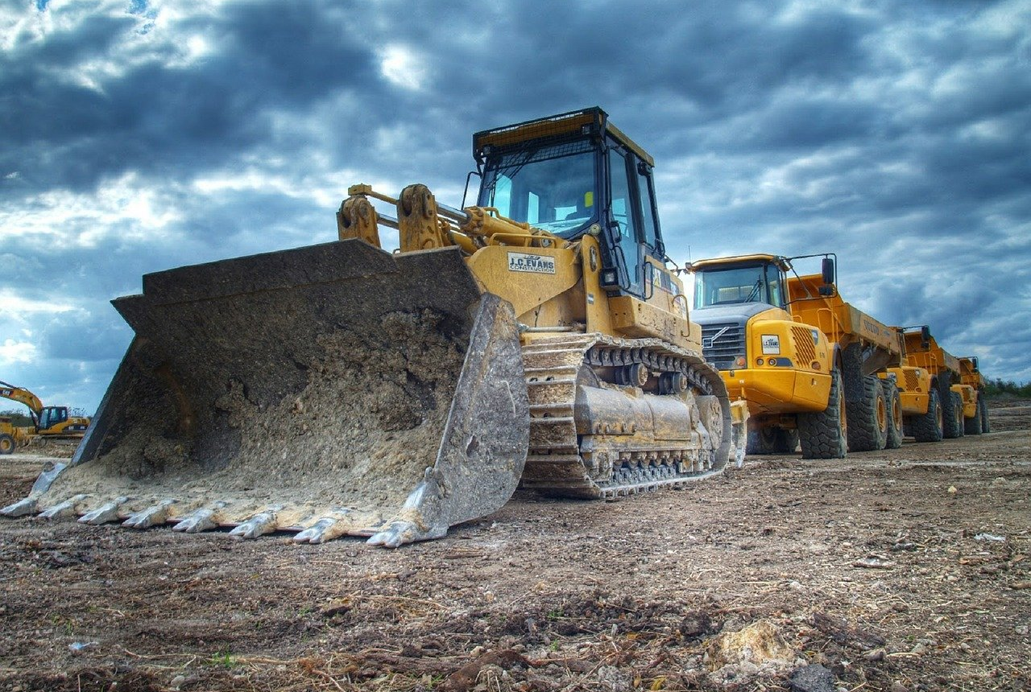
How to Protect Yourself
Pre-Operational Checklist
Use a checklist when performing the pre-operational inspection. A checklist may include the following cautions and checkpoints:
Notes:
How to Protect Yourself
Pre-Operational Checklist
Use a checklist when performing the pre-operational inspection. A checklist may include the following cautions and checkpoints:
CAUTION: When checking lift chain tension, use a board or a stick. Never place your fingers in this dangerous pinch point area.
CAUTION: When checking hydraulic hoses, use a piece of cardboard. Escaping fluids under pressure can penetrate body tissue causing serious injury or possibly death. If fluid is injected in your skin, seek medical attention immediately.
CAUTION: When checking LP tanks and fittings, always use personal protective equipment such as a face shield, long sleeves and gauntlet gloves when checking LP tanks and fittings. LP is very cold when released and can cause frostbite.
CAUTION: When checking LP tanks and fittings for leaks, use soap solution, no matches or lighter.
CAUTION: When checking battery levels, never use matches or a lighter – hydrogen gas may be present, resulting in an explosion or fire. Always use personal protective equipment such as a face shield and goggles, rubber apron and rubber gloves when checking electrolyte. This is an acid and will cause severe burns to the skin if in contact.

Slide 9
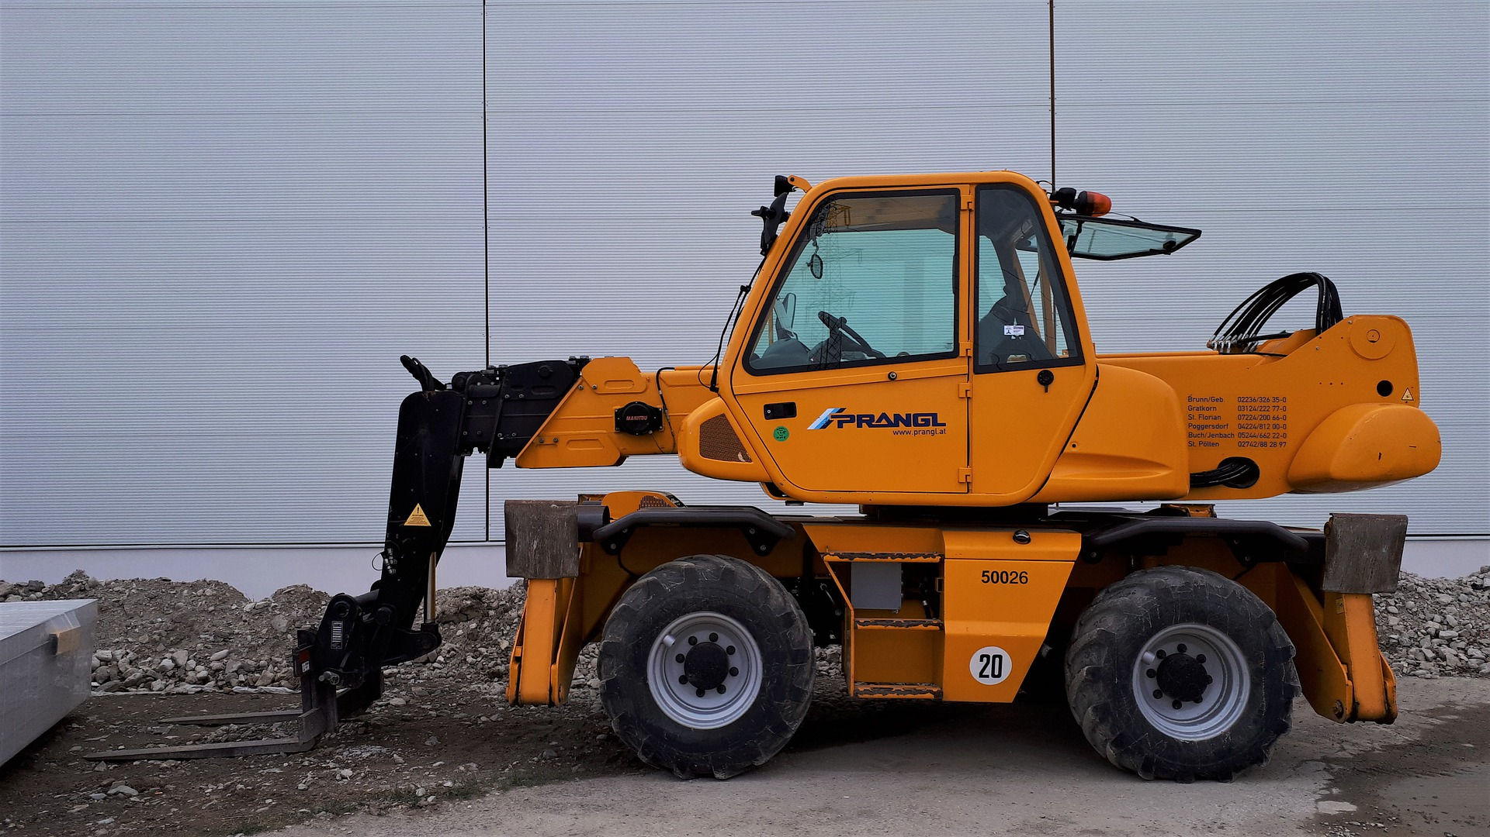
Final Word
A visual “circle check” or pre-operational inspection of equipment prior to every use will reduce the chance of equipment being operated in an unsafe condition. This makes it easier to spot and deal with maintenance issues early before they turn into a problem causing downtime, equipment damage or expensive repairs. Unsafe machinery can also cause injury to the operator or other workers and damage to facilities or product.
Notes:
Final Word
A visual “circle check” or pre-operational inspection of equipment prior to every use will reduce the chance of equipment being operated in an unsafe condition. This makes it easier to spot and deal with maintenance issues early before they turn into a problem causing downtime, equipment damage or expensive repairs. Unsafe machinery can also cause injury to the operator or other workers and damage to facilities or product.

