Slide 1

Click anywhere to get started…

Slide 2

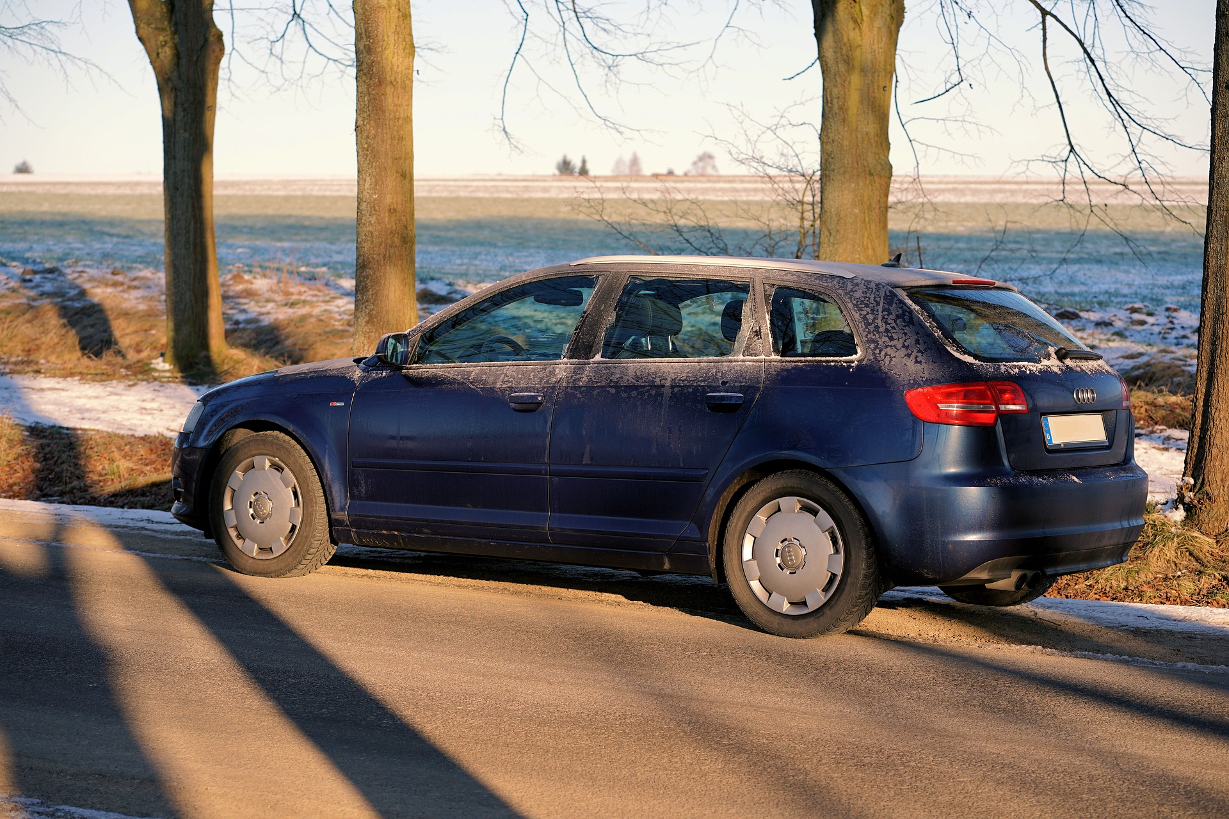

WINTER DRIVING TIPS
Notes:
Winter Driving Tips

Slide 3
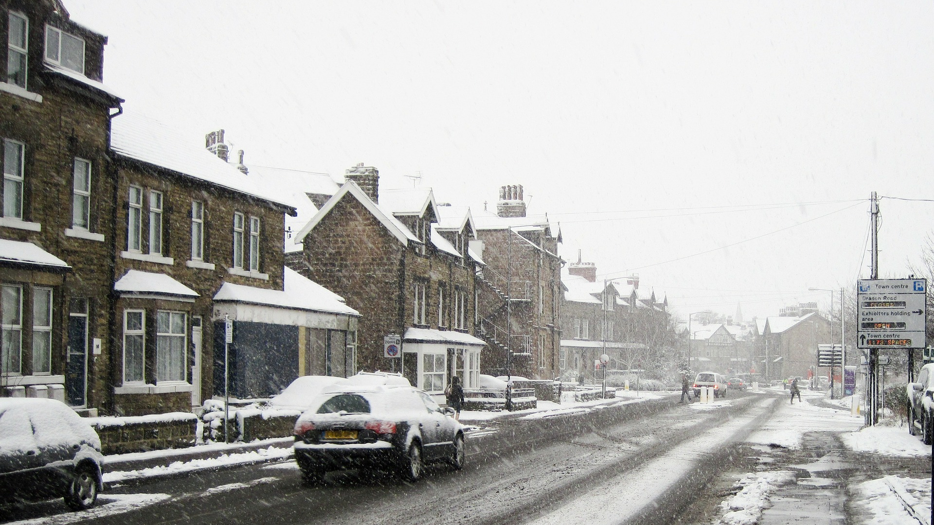
What’s at Stake?
Winter Driving can be hazardous, especially in northern regions that get a lot of snow and ice. Additional preparations can help make a trip safer, or help motorists.
Notes:
What’s at Stake?
Winter Driving can be hazardous, especially in northern regions that get a lot of snow and ice. Additional preparations can help make a trip safer, or help motorists.
Although employers cannot control roadway conditions, they can promote safe driving behavior by ensuring workers: recognize the hazards of winter weather driving, for example, driving on snow/ice covered roads; are properly trained for driving in winter weather conditions; and are licensed (as applicable) for the vehicles they operate.

Slide 4
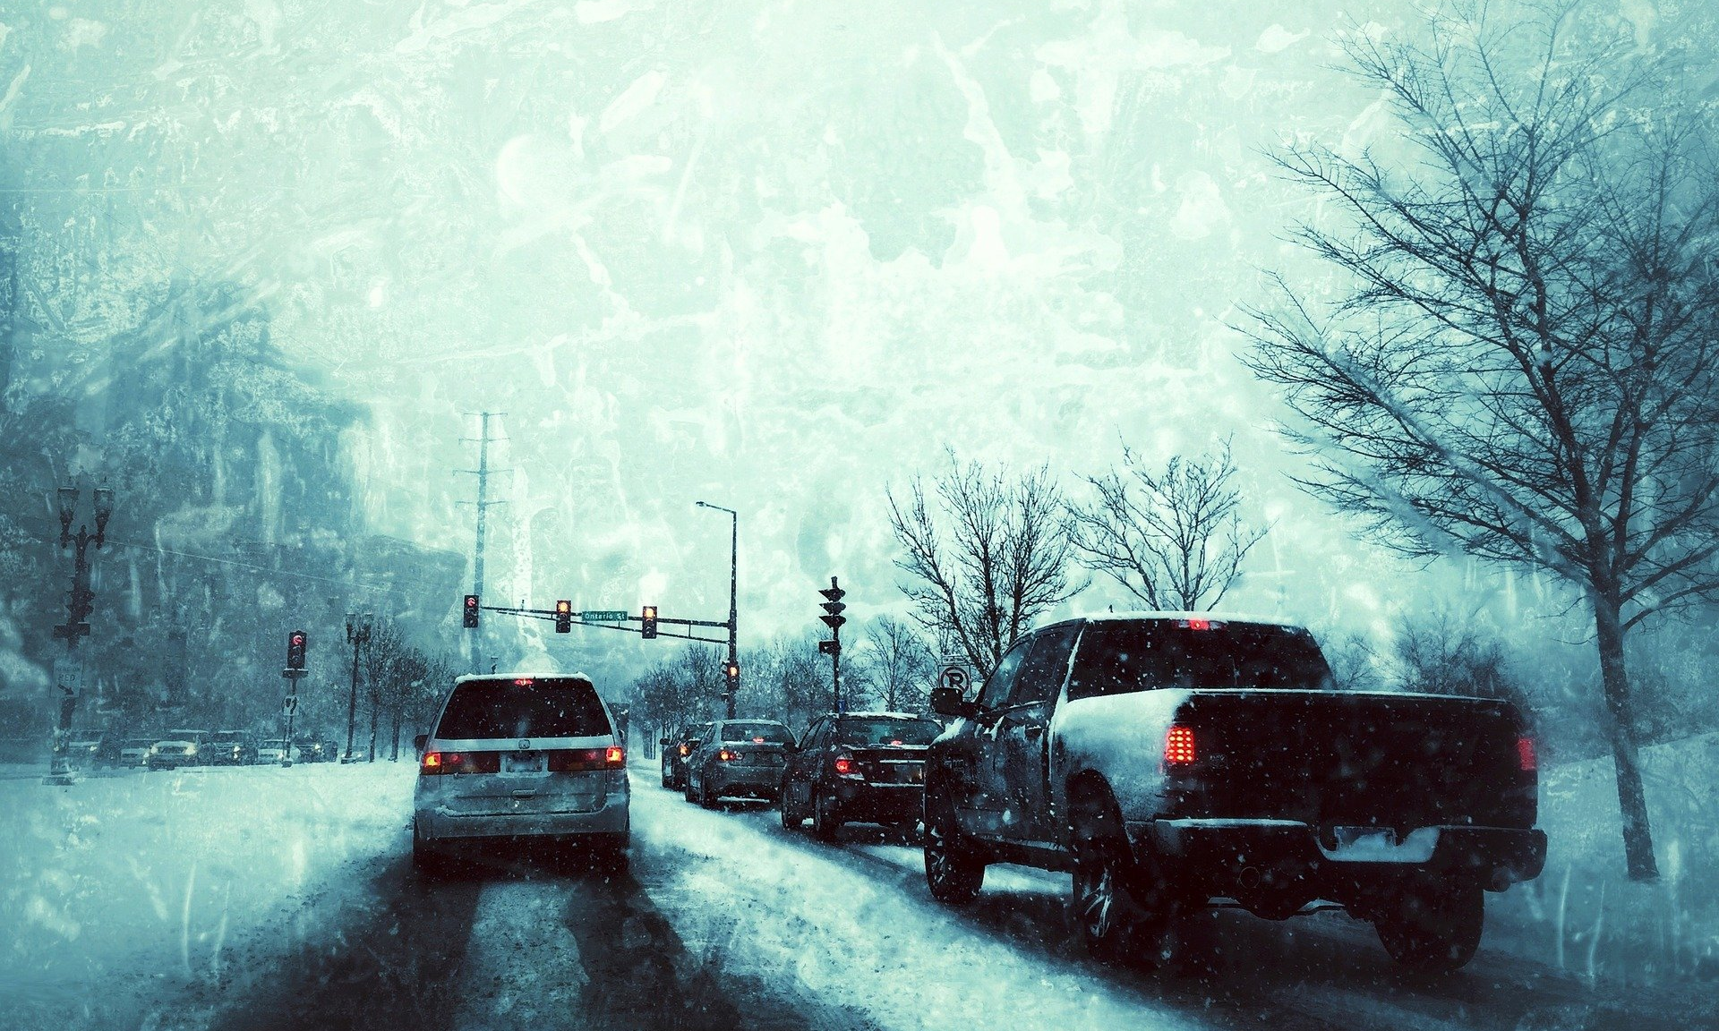
What’s the Danger?
Statistics
Winter storms, bad weather and sloppy road conditions are a factor in nearly half a million crashes and more than 2,000 road deaths every winter, according to research by the AAA Foundation for Traffic Safety.
FOUR DANGERS
The following four situational “zones” depict the importance for workers to heed the affects of driving in the winter.
Notes:
What’s the Danger?
Statistics
Winter storms, bad weather and sloppy road conditions are a factor in nearly half a million crashes and more than 2,000 road deaths every winter, according to research by the AAA Foundation for Traffic Safety.
Four Dangers
The following four situational “zones” depict the importance for workers to heed the affects of driving in the winter.
Work Zone Traffic Safety
Stranded
Frostbite
Lack of fluids

Slide 5
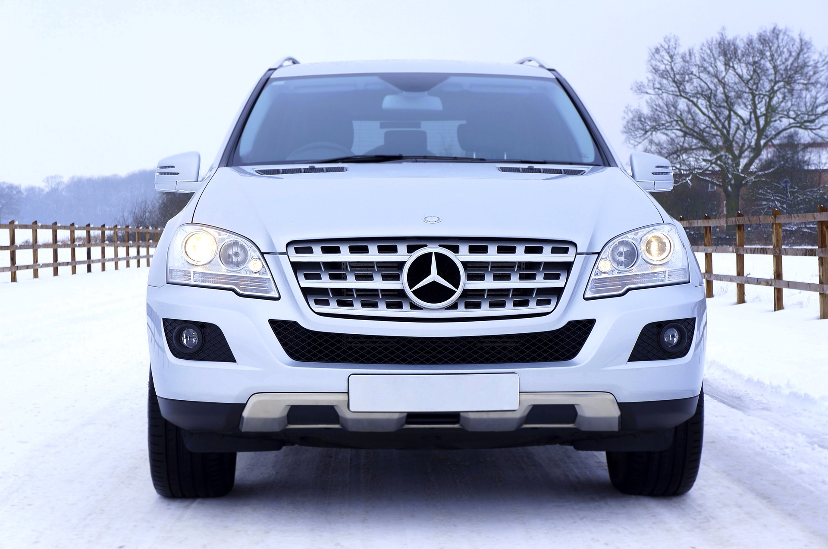
How to Protect Yourself
WINTER DRIVING RULES
Prepare for Winter Driving
Notes:
How to Protect Yourself
Winter Driving Rules
Slow Down! - posted speed limits are for ideal travel conditions. Driving at reduced speeds is the best precautionary measure against any misfortune while driving on slippery roads. "Black ice" is invisible.
Be alert. Black ice will make a road look like shiny new asphalt. Pavement should look grey-white in winter.
Reduce your speed while approaching intersections covered with ice or snow.
Allow for extra travelling time or delay a trip if the weather is inclement.
Lengthen your following distance behind the vehicle ahead of you. Stopping distance on an icy road is double that of stopping on a dry one. For example, from around 45 metres (140 ft) at the speed of 60 km/h, to 80 metres (over 260 ft) on an icy road surface.
Be aware and slow down when you see a sign warning that you are approaching a bridge. Steel and concrete bridges are likely to be icy even when there is no ice on the ground surface, (because bridges over open air cool down faster than roads which tend to be insulated somewhat by solid ground.)
Keep a safe distance back from snow plows, and salt/sand/anti-icing trucks. Never pass a snow plow due to the whiteout conditions and ridge of snow created by the plow.
Keep at least half a tank of fuel in your vehicle at all times.
Never warm up a vehicle in an enclosed area, such as a garage.
Prepare for Winter Driving
Avoid driving when fatigued.
Check weather conditions for your travel route (and time) before you begin driving.
Plan your arrival time at a destination by taking into account any delays due to slower traffic, reduced visibility, roadblocks, abandoned automobiles, collisions, etc.
Inform someone of your route and planned arrival time.
Warm up your vehicle BEFORE driving off. It reduces moisture condensing on the inside of the windows.
Remove snow and ice from your vehicle. It helps to see and, equally important, to be seen.

Slide 6
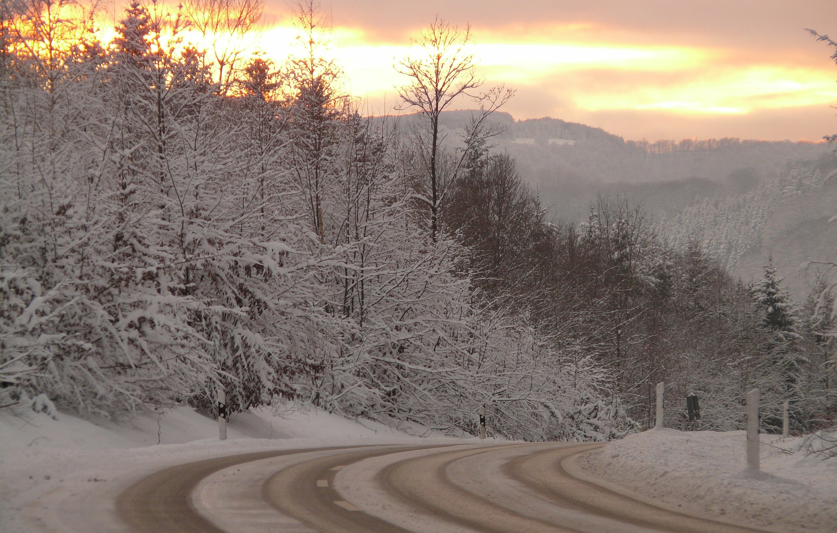
How to Protect Yourself
Prepare Vehicles for Driving in Winter
To prepare your vehicle for winter driving give it a complete checkup.
The Winter Driving Kit
A well-stocked winter driving kit helps to handle any emergency.
Notes:
How to Protect Yourself
Vehicles
Prepare Vehicles for Driving in Winter
To prepare your vehicle for winter driving give it a complete checkup. Look for the following:
Battery - recharge or replace if the battery is weak. Also have the charging system checked.
Ignition - check for damaged ignition wires and cracks in the distributor cap.
Lights - check all lights (headlights, side lights, emergency flashers, directional lights, taillights, brake lights and parking lights) for proper functioning.
Use four snow tires that are of the same type, size, speed rating, and load index for better handling, control and stability.
Where permitted, use chains or studded tires on all four wheels when you expect severe snow and icy roads.
Check tire pressure and if necessary restore it to levels recommended by the vehicle manufacturer. The pressure drops about 1 psi for every 5°C (9°F) drop in temperature.
Check the wear of the tires. Tires have tread wear indicators or bars that are inside the grooves of the tires. When the tread is close to (within 1.5mm) or the same level as the wear indicator, replace the tire as it no longer provides effective traction.
Check tire balance and correct if necessary.
Check wheel alignment and correct if necessary.
Check the exhaust system for leaks. A properly sealed exhaust system reduces the risk for carbon monoxide poisoning.
Check the radiator and hoses for leaks.
Ensure that your vehicle always has a sufficient amount of antifreeze rated for the coldest weather.
Check the defrosters (front and back) to make sure they are working efficiently.
Ensure that windshield wipers function efficiently. Replace them if they are old or worn.
Fill up the fuel tank before you leave on your trip. Do not let the fuel level get too low - the driving time to the next gas station may take much longer than you ever expected, and if you get stuck, the car engine will be your only source of heat.
The Winter Driving Kit
A well-stocked winter driving kit helps to handle any emergency. It should include:
Properly fitting tire chains.
Bag of sand or salt (or kitty litter).
Tow rope.
Traction mats.
Snow shovel.
Snow brush.
Ice scraper.
Booster cables.
Warning devices such as flares or emergency lights.
Fuel line de-icer (methanol, also called methyl alcohol or methyl hydrate).
Extra windshield wiper fluid appropriate for sub-freezing temperatures.
Roll of paper towels.
Flashlight
Blanket.
Extra clothing
First aid kit.
Snack bars or other "emergency" food and water.
Matches and emergency candles - only use with a window opened to prevent build-up of carbon monoxide.
Road maps.

Slide 7
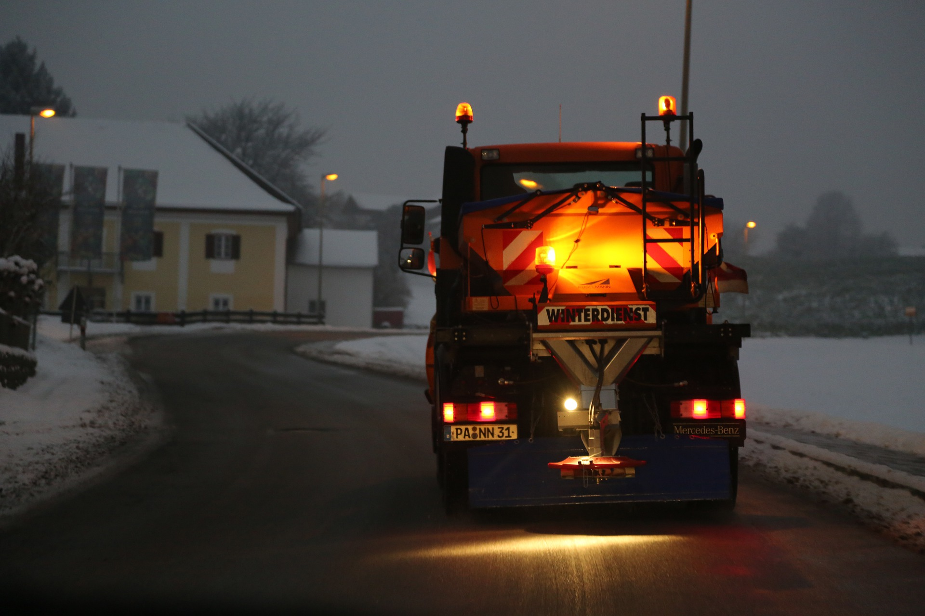
How to Protect Yourself
Stuck or Stranded in The Snow
Avoid over-exertion and over-exposure to the cold. Cold weather can put extra stress on the heart and contribute to the hazards of over-exertion. Sweaty clothes next to the skin are not good insulators against the cold and can increase how cold you feel. Change into dry clothes where possible.
Stay in the car if you cannot shovel your car out of the snow.
Notes:
How to Protect Yourself
Stuck or Stranded in The Snow
Avoid over-exertion and over-exposure to the cold. Cold weather can put extra stress on the heart and contribute to the hazards of over-exertion. Sweaty clothes next to the skin are not good insulators against the cold and can increase how cold you feel. Change into dry clothes where possible.
Stay in the car if you cannot shovel your car out of the snow.
Stay in the car in blizzard conditions - Do not leave the car for assistance unless help is very close and it is safe to walk. It is easy to get disoriented in a blizzard.
Turn on flashing lights or set up flares. A brightly coloured cloth on the radio antenna may make your vehicle more visible in daylight.
Run the car engine occasionally (about 10 minutes every hour) to provide heat (and to conserve fuel). Ensure that the tail exhaust pipe is free of snow and keep the window opened slightly (on the side shielded from the wind) to prevent the build up of carbon monoxide when the engine is running.
Bundle up in a blanket. If there is more than one person in the car, share - two people sharing blankets will be warmer than either person alone in a blanket.
Wear a hat and scarf - the head and neck are major sources of heat loss from the body.
Monitor for any signs of frostbite and hypothermia.
Do not fall asleep. If there is more than one person in the car, take turns sleeping.
Do not stay in one position too long. Do some exercises to help the circulation - move arms and legs, clap your hands, etc.
Watch for traffic or emergency vehicles.

Slide 8
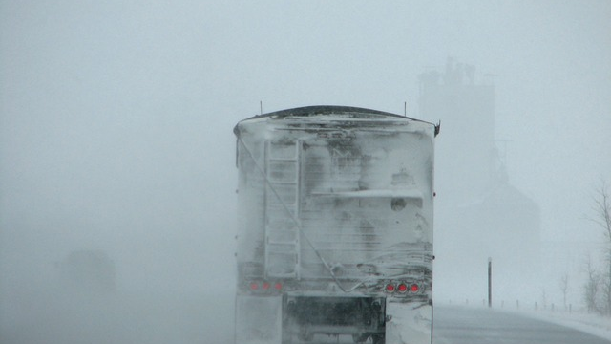
Final Word
Employers cannot control the weather which impact the condition of our roadways. But employers can promote and encourage safe driving protocols and practices by ensuring workers recognize the hazards of winter weather driving.
Notes:
Final Word
Employers cannot control the weather which impact the condition of our roadways. But employers can promote and encourage safe driving protocols and practices by ensuring workers recognize the hazards of winter weather driving.

