Slide 1

Click anywhere to get started…

Slide 2

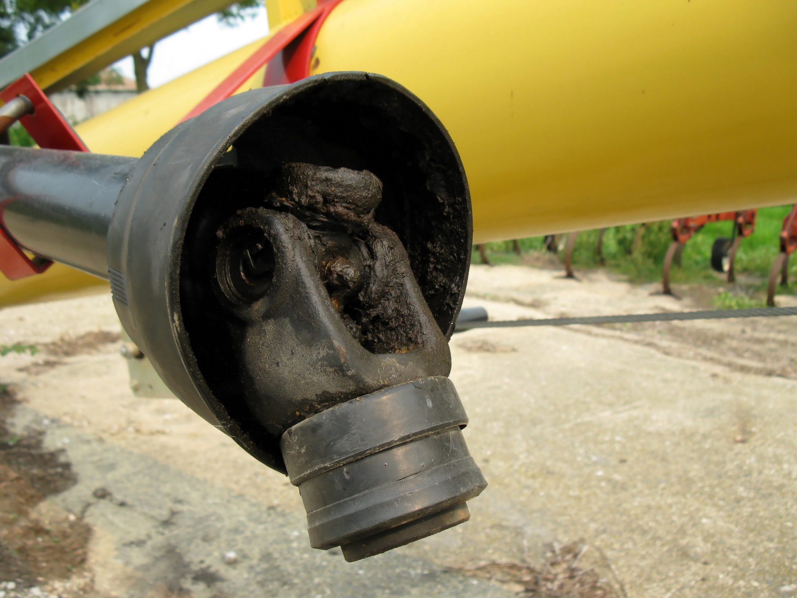

POWER TAKE OFF
Notes:
POWER TAKE OFF

Slide 3
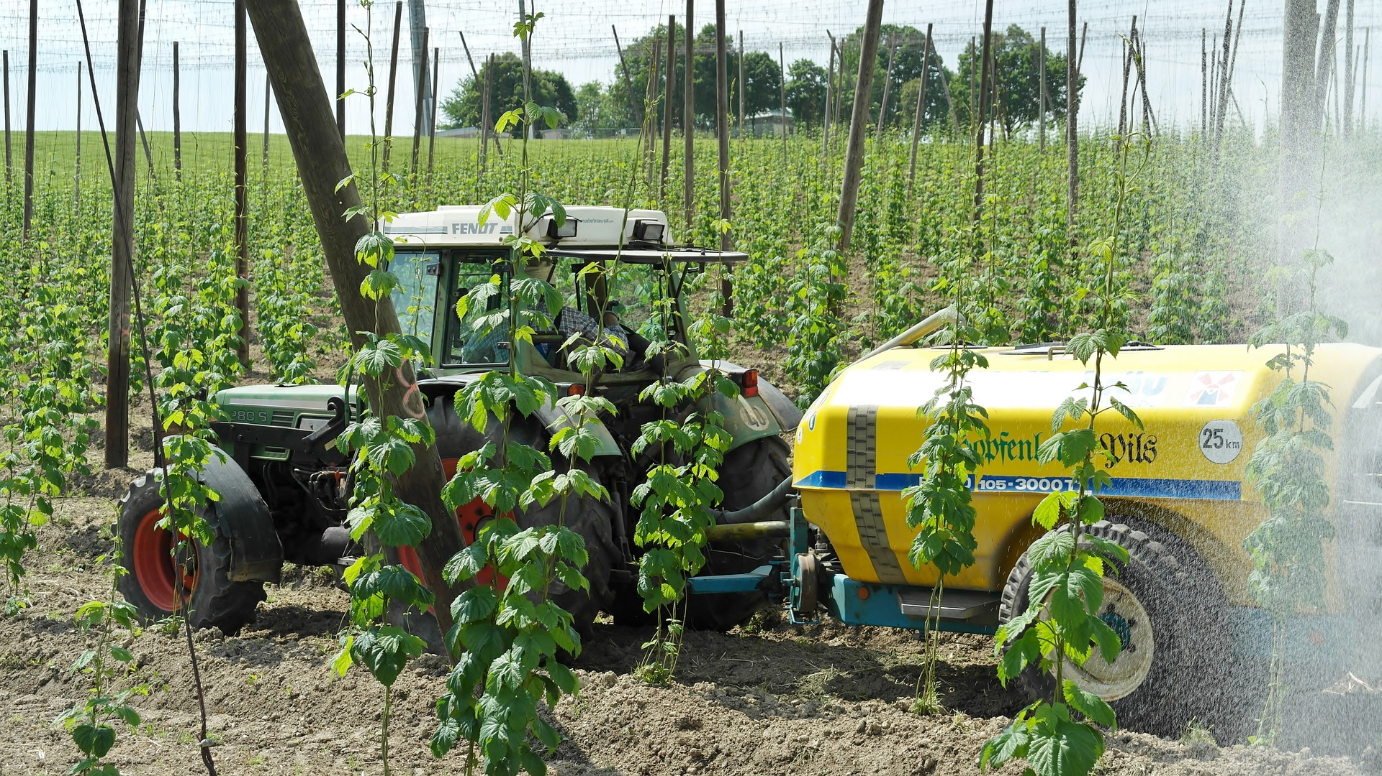
What’s at Stake?
A power take-off (PTO) shaft transfers mechanical power from a tractor to an implement. Some PTO-driven equipment is operated from the tractor seat, but many types of farm equipment, such as elevators, grain augers, silage blowers are operated in a stationary position, enabling an operator to leave the tractor and move in the vicinity of the implement.
Notes:
What’s at Stake?
A power take-off (PTO) shaft transfers mechanical power from a tractor to an implement. Some PTO-driven equipment is operated from the tractor seat, but many types of farm equipment, such as elevators, grain augers, silage blowers are operated in a stationary position, enabling an operator to leave the tractor and move in the vicinity of the implement.

Slide 4
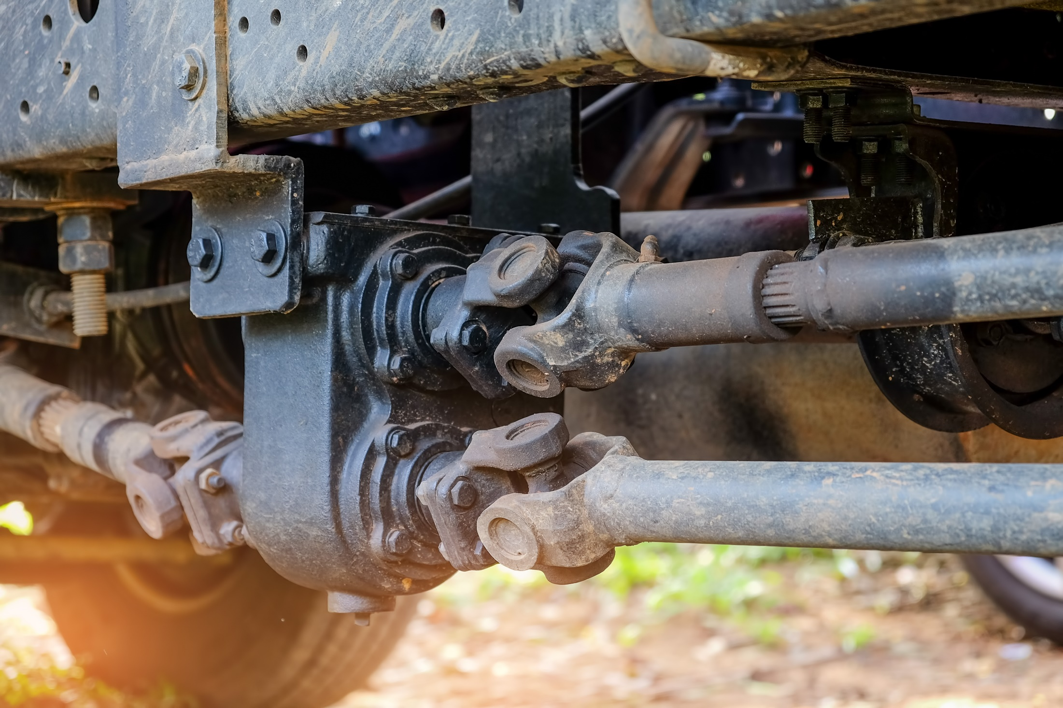
What’s the Danger?
GENERAL
A PTO shaft rotates at a speed of either 540 rpm (9 rotations per second) or 1,000 rpm (16.6 rotations per second). At these speeds, a person’s limb can be pulled into and wrapped around a PTO stub or driveline shaft several times before the person, even a person with extremely fast reflexes, can react. The fast rotation speed, operator error, and lack of proper guarding make PTOs a persistent hazard on farms and ranches.
Notes:
What’s the Danger?
GENERAL
A PTO shaft rotates at a speed of either 540 rpm (9 rotations per second) or 1,000 rpm (16.6 rotations per second). At these speeds, a person’s limb can be pulled into and wrapped around a PTO stub or driveline shaft several times before the person, even a person with extremely fast reflexes, can react. The fast rotation speed, operator error, and lack of proper guarding make PTOs a persistent hazard on farms and ranches.
PTO Entanglement Incidents
Generally, PTO entanglements:
• involve the tractor or machinery operator 78 percent of the time.
• shielding was absent or damaged in 70 percent of the cases.
• entanglement areas were at the PTO coupling, either at the tractor or implement connection just over 70 percent of the time.
• a bare shaft, spring loaded push pin or through bolt was the type of driveline component at the point of contact in nearly 63 percent of the cases.
• stationary equipment, such as augers, elevators, post-hole diggers, and grain mixers were involved in 50 percent of the cases.
• semi-stationary equipment, such as self-unloading forage wagons and feed wagons, were involved in 28 percent of the cases.
• nearly all incidents involving moving machinery, such as hay balers, manure spreaders, rotary mowers, etc., were non-moving at the time of the incident (the PTO was left engaged).
• only four percent of the incidents involved no attached equipment. This means that the tractor PTO stub was the point of contact four percent of the time.

Slide 5
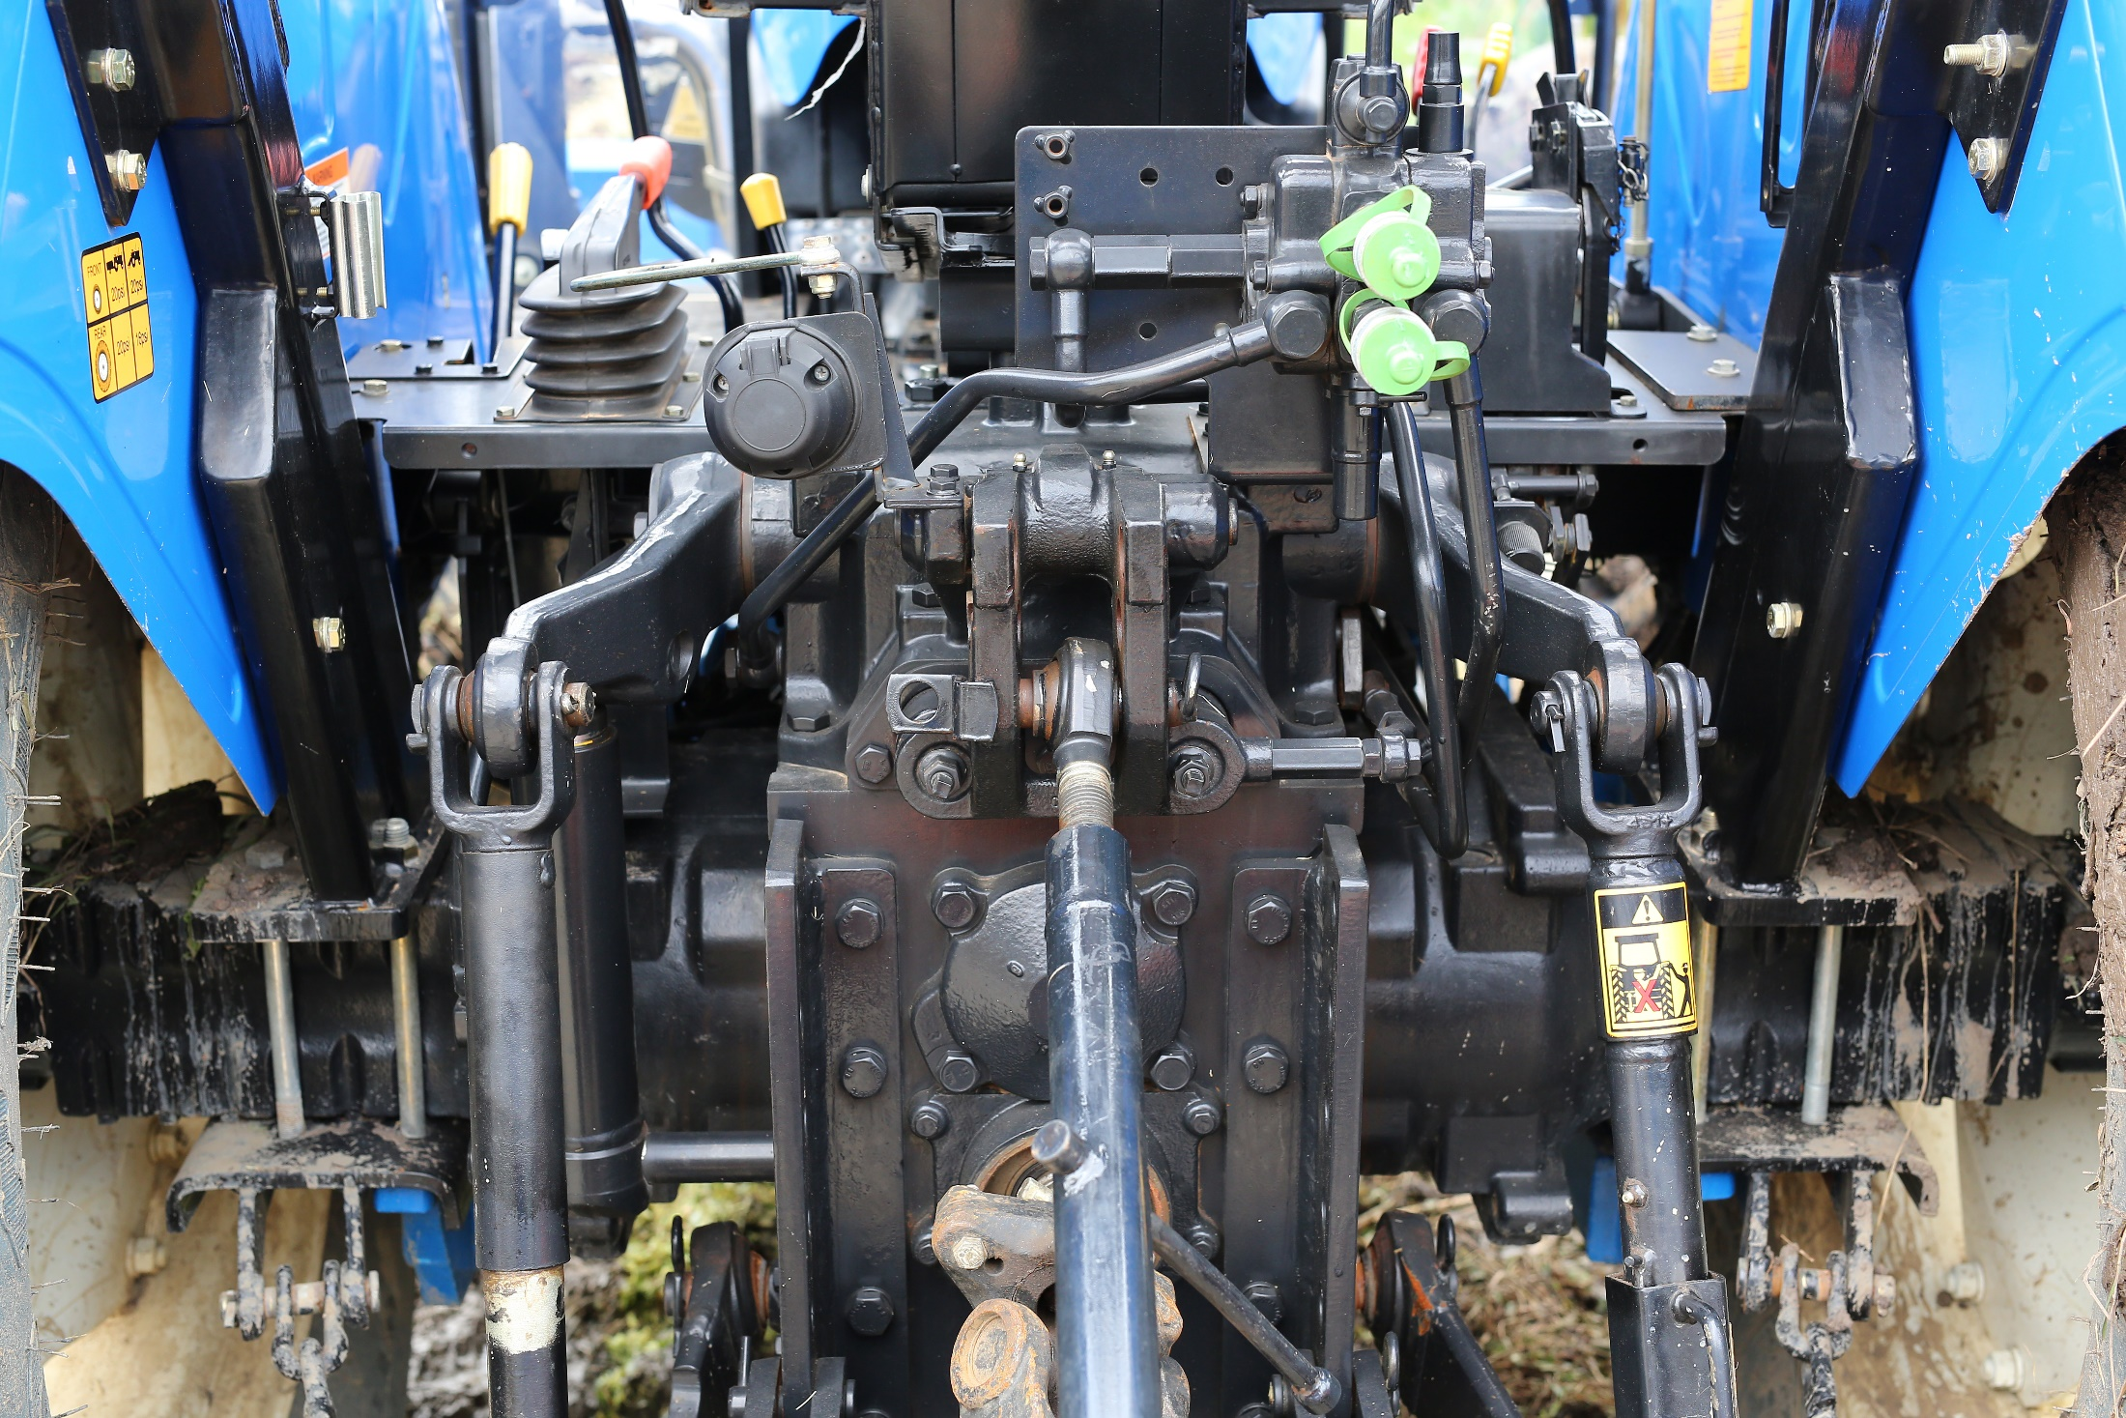
What’s the Danger?
Power Take-Off Injuries Case
Case #1: An operator finished loading a load of silage into the silo and was approaching the tractor’s PTO lever to turn off the forage blower.
Case #2: A teenager was helping her family load corn onto a grain elevator when her jacket sleeve because entangled by the elevator PTO shaft.
Case #3: A small child was killed when as an “extra rider” on his father’s tractor; he slipped off the tractor and became entangled by a spinning PTO shaft.
Notes:
What’s the Danger?
Power Take-Off Injuries Case
Case #1: An operator finished loading a load of silage into the silo and was approaching the tractor’s PTO lever to turn off the forage blower. As he stepped onto the drawbar, the laces on his boot became caught on the spring loaded push pin of the forage blower PTO driveline coupling. He was thrown backwards off the drawbar, with this boot and denim jeans being forcibly removed. He suffered considerable muscle damage to his right leg.
Case #2: A teenager was helping her family load corn onto a grain elevator when her jacket sleeve because entangled by the elevator PTO shaft. Her body was flung around the shaft and her arm was torn from its socket before the tractor could be turned off.
Case #3: A small child was killed when as an “extra rider” on his father’s tractor; he slipped off the tractor and became entangled by a spinning PTO shaft. The father grabbed for the boy as he began to slip but was unable to hold him out of the shaft.

Slide 6
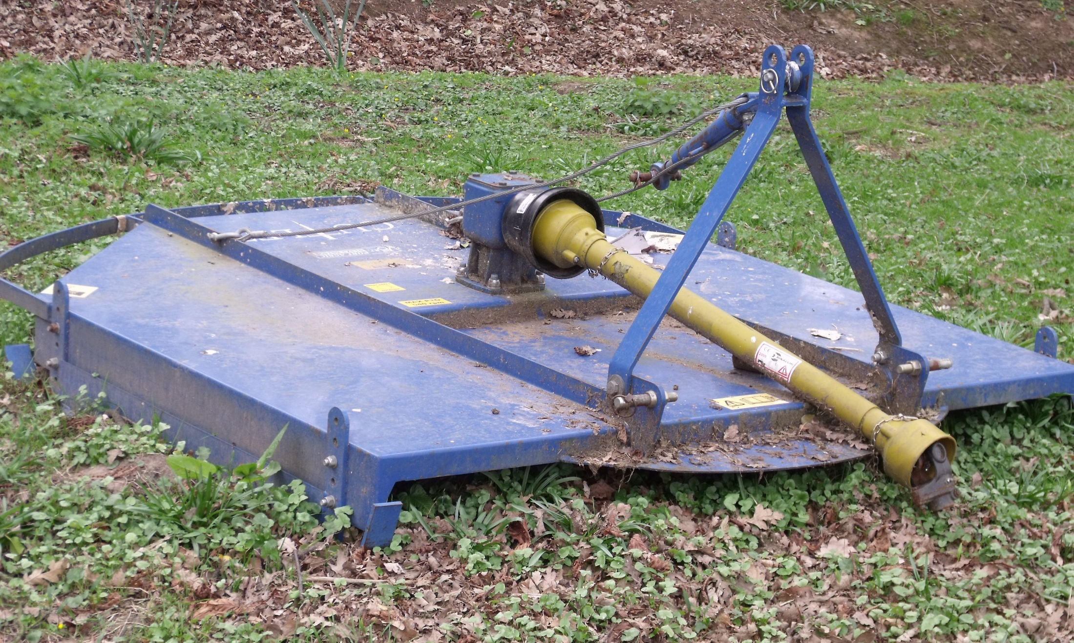
What’s the Danger?
PTO HAZARDS
The Main PTO Hazards Involve the PTO Stub and Driveline.
PTO Stub
The tractor’s stub output shaft, referred to as a PTO stub, transfers power from the tractor through a drive shaft to the implement or PTO-driven machine.
Driveline Separation
In addition to injuries caused by entanglement incidents with the PTO stub and driveline, injuries can occur when shafts separate while the tractor’s PTO is engaged.
Notes:
What’s the Danger?
PTO HAZARDS
The Main PTO Hazards Involve the PTO Stub and Driveline.
PTO Stub
The tractor’s stub output shaft, referred to as a PTO stub, transfers power from the tractor through a drive shaft to the implement or PTO-driven machine. The PTO stub rotates at rate of 540 or 1,000 rpm, and most incidents involving the PTO stub are entanglement incidents.
Entanglement incidents can occur when the operator is unaware that the PTO clutch is engaged, when the operator does not understand the dangers of the spinning PTO stub, or when the operator deliberately works close to an unguarded stub shaft that is in motion. Clothing, such as a pant leg, shoelace, thread from a jacket, and so on, is easily caught by the spinning shaft. Once caught, both the clothing and the wearer can quickly wrap around the stub shaft.
A PTO driveline or implement input driveline (IID) is the part of the implement drive shaft that connects to the tractor. When unguarded, the entire shaft of the driveline is considered a wrap-point hazard. Some drivelines have guards covering the straight part of the shaft, leaving the universal joints, PTO coupling, and the rear connector, or implement input connection (IIC), as wrap-point hazards. Clothing can catch on and wrap around the driveline. When clothing is caught on the driveline, the tension on the clothing from the driveline pulls the person toward and around the shaft. When a person caught in the driveline instinctively tries to pull away from wrap hazard, he or she actually creates a tighter wrap.
Driveline Separation
In addition to injuries caused by entanglement incidents with the PTO stub and driveline, injuries can occur when shafts separate while the tractor’s PTO is engaged. The IID shaft telescopes, meaning that one part of the shaft slides into another. The sliding sleeve on the shaft allows for easy hitching of PTO-powered machines to tractors and allows telescopic movement when the machine turns or is operated on uneven ground. If the IID is attached to a tractor by only the PTO stub, the tractor can pull apart the IID shaft. If this occurs and the PTO is engaged, the tractor shaft can swing wildly, striking anyone in range and possibly breaking a locking pin, allowing the shaft to become a projectile. This type of incident is not common, but it is more likely to occur with three-point hitched equipment that is not properly mounted or aligned.

Slide 7
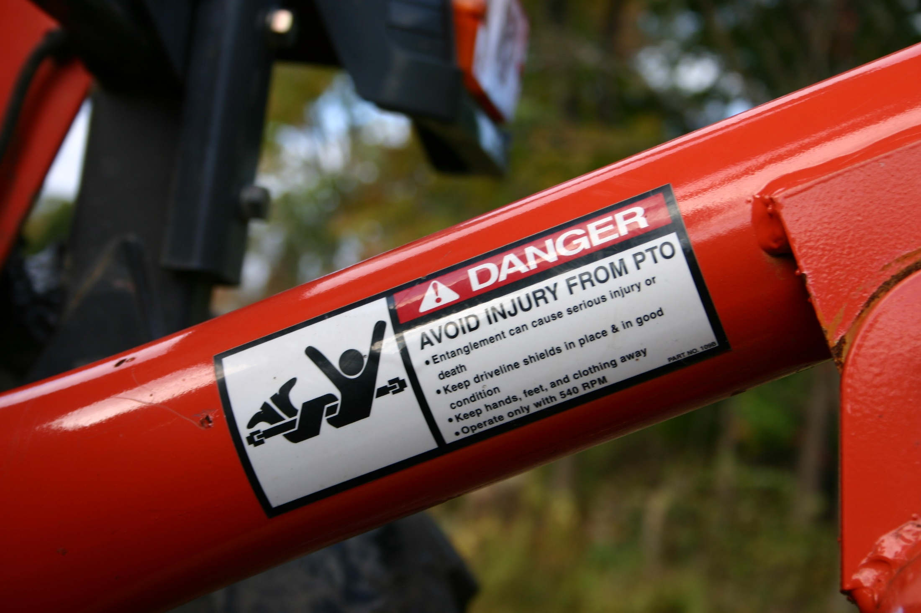
How to Protect Yourself
PREVENTION
The following preventive steps can reduce your risk of a PTO incident:
Never step over a rotating shaft.
Do not wear loose fitting clothing around PTO-driven equipment.
Tie back long hair or secure it under a hat before operating equipment.
Never work on machinery or equipment while the engine is running or is energized.
Keep universal joints in phase.
Do not switch drivelines between machines.
Notes:
How to Protect Yourself
PREVENTION
In addition to having the proper shields in place, taking the following preventive steps can reduce your risk of a PTO incident:
Never step over a rotating shaft.
Do not wear loose fitting clothing around PTO-driven equipment.
Tie back long hair or secure it under a hat before operating equipment.
Ensure that safety decals, such as “Rotating Driveline: Contact can cause death,” are readily visible. Replace decals that are obscured or incomplete.
Always disengage the PTO and shut off the tractor before dismounting the tractor.
Never work on machinery or equipment while the engine is running or is energized.
Keep universal joints in phase.
Do not switch drivelines between machines.
To reduce driveline stress and separation, position the tractor’s drawbar appropriately for each piece of machinery.
Reduce PTO shaft abuse by avoiding tight turns, reducing excessive telescoping, engaging power to the shaft gradually, and avoiding over-tightening the slip clutch on PTO-driven machines.
Examine the driveline for protruding pins or bolts and debris such as mud that has dried onto the driveline shield. Clothing snags easily on such protrusions, resulting in entanglement incidents.
As part of the preoperation inspection, if the driveline shield is equipped with a tether, ensure that the tether is attached and in good condition and that the driveline shield rotates freely on its bearings.

Slide 8
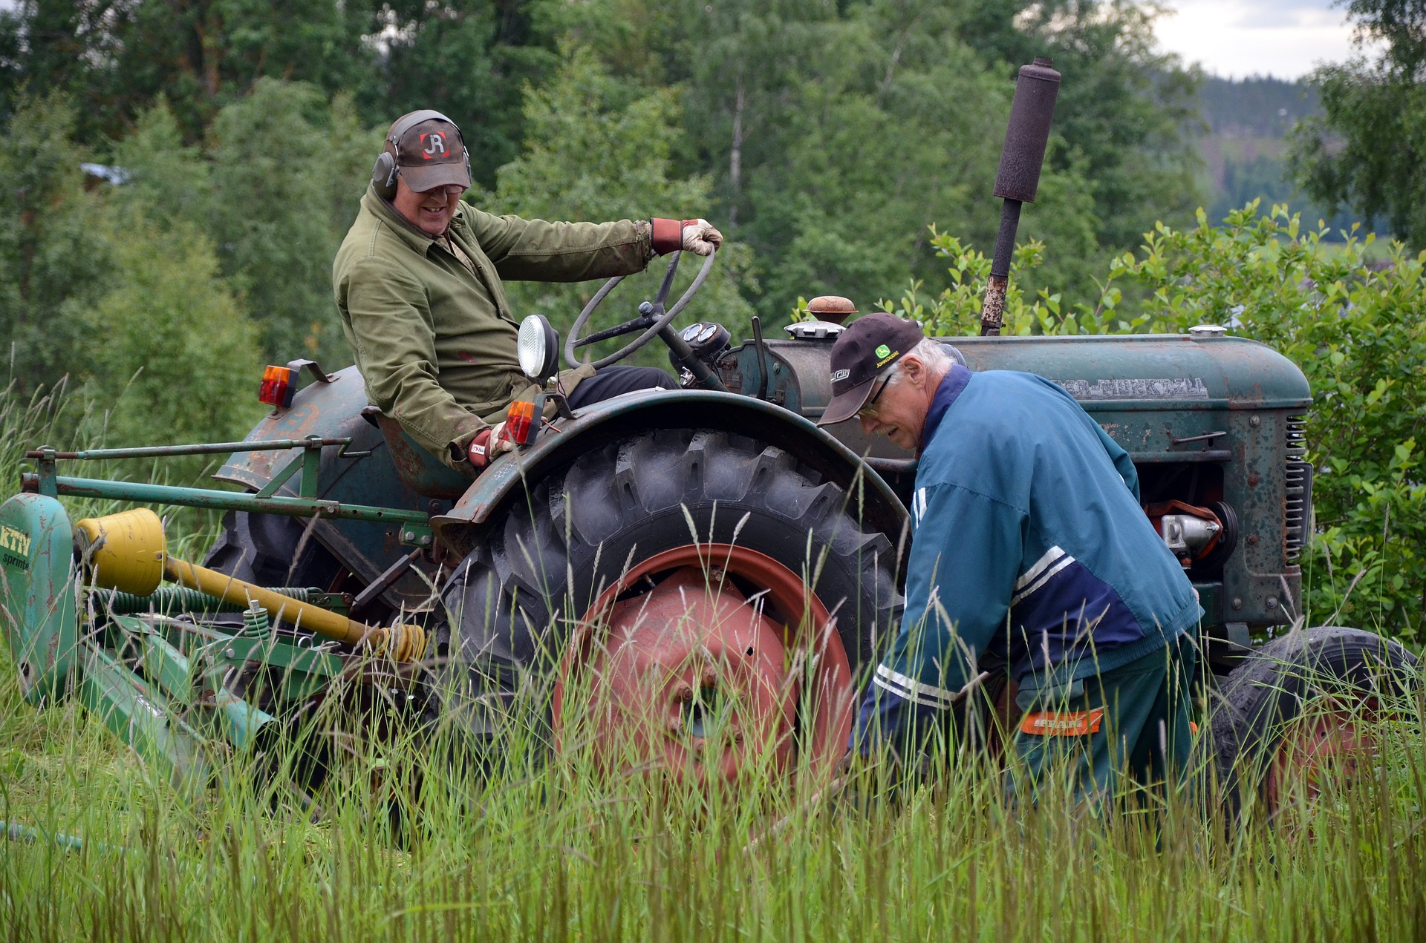
How to Protect Yourself
PTO Safety Practices
Though not always convenient or easy, there are several ways to reduce the risk of PTO injury incidents. These safety practices offer protection from the most common types of PTO entanglements.
Keep all components of PTO systems shielded and guarded.
Regularly test driveline guards by spinning or rotating them to ensure that they have not become stuck to the shaft.
Always walk around tractors and machinery instead of stepping over a rotating shaft.
Always use the driveline recommended for your machine. Never switch drivelines among different machines.
Notes:
How to Protect Yourself
PTO Safety Practices
Though not always convenient or easy, there are several ways to reduce the risk of PTO injury incidents. These safety practices offer protection from the most common types of PTO entanglements.
Keep all components of PTO systems shielded and guarded.
Regularly test driveline guards by spinning or rotating them to ensure that they have not become stuck to the shaft.
Disengage the PTO and shut off the tractor before dismounting to clean, repair, service, or adjust machinery.
Always walk around tractors and machinery instead of stepping over a rotating shaft.
Always use the driveline recommended for your machine. Never switch drivelines among different machines.
Position the tractor’s drawbar properly for each machine used to help prevent driveline stress and separation on uneven terrain and during tight turns.
Reduce PTO shaft abuse by observing the following: avoid tight turns that pinch rotating shafts between the tractor and machine; keep excessive telescoping to a minimum; engage power to the shaft gradually; and avoid over tightening of slip clutches on PTO driven machines.
Be sure PTO driveline is securely locked onto the tractor PTO stub shaft.
Keep universal joints in phase. (If unfamiliar with this term, check the operator manual or talk with a farm implement dealer.)

Slide 9
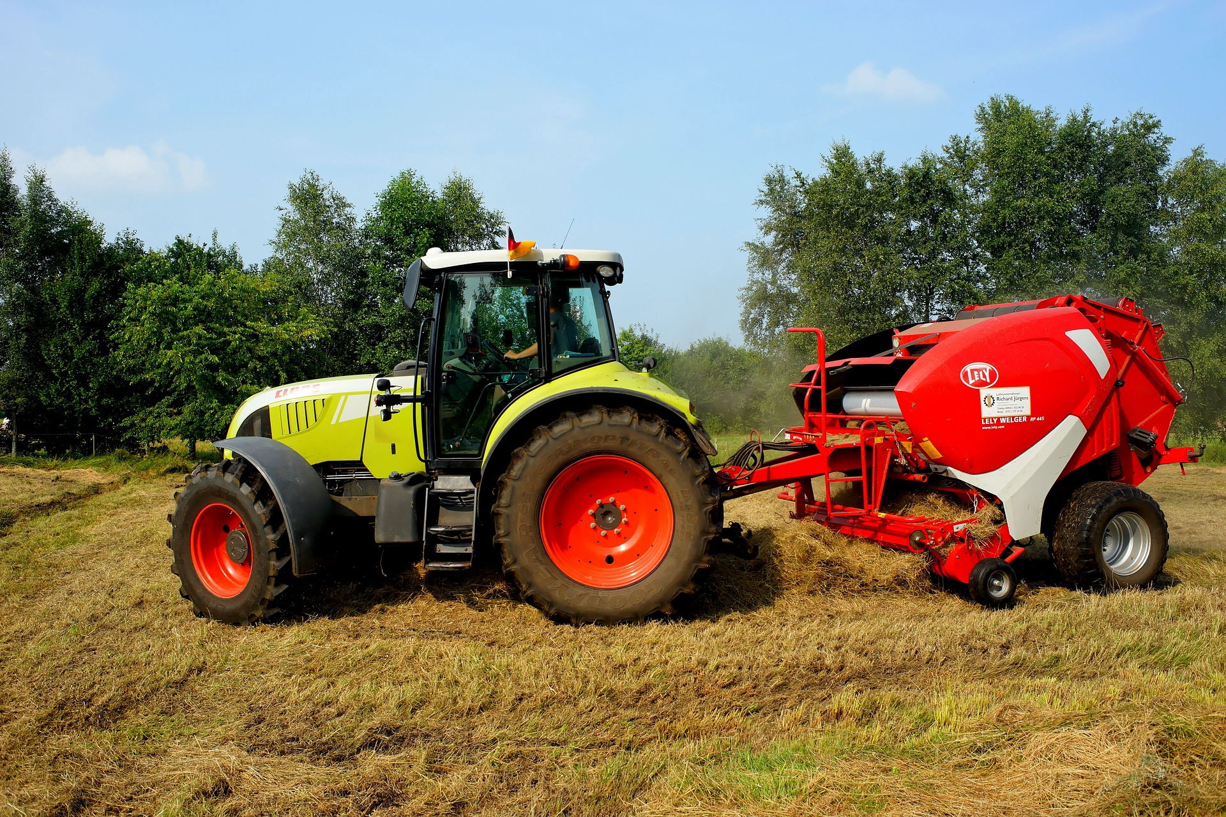
How to Protect Yourself
Use the proper type of guard
It is very difficult to select the best PTO guard to suit your needs simply by looking at the guard in a shop.
Before buying a new guard it is wise to speak to a reputable machinery dealer or agricultural engineer/mechanic as they can advise on the type and make of guard that should suit your needs.
Notes:
How to Protect Yourself
Use the proper type of guard
It is very difficult to select the best PTO guard to suit your needs simply by looking at the guard in a shop.
Before buying a new guard it is wise to speak to a reputable machinery dealer or agricultural engineer/mechanic as they can advise on the type and make of guard that should suit your needs.
A few tips to help select a suitable guard include:
selecting a guard with flexible end cones
a heavy duty plastic telescopic section
a guard which can be easily removed and replaced to allow regular maintenance

Slide 10
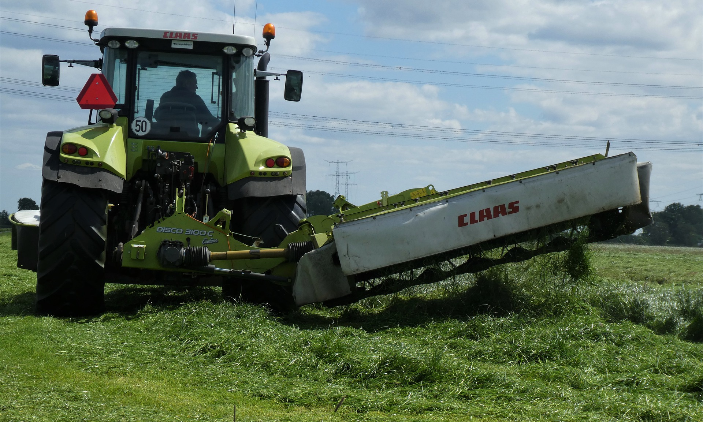
How to Protect Yourself
PTO maintenance
lubricate the bearings regularly
clean the inner and outer sliding surfaces of the telescopic section
regularly remove the guard and clean the shaft with penetrating oil
Notes:
How to Protect Yourself
PTO maintenance
lubricate the bearings regularly as recommended by the manufacturer - do not over grease the bearing as the excess grease will attract dirt and dust
clean the inner and outer sliding surfaces of the telescopic section of the guard daily or more frequently if the manufacturer recommends it - do not lubricate the sliding section of the guard with grease unless the manufacturer recommends it
regularly remove the guard and clean the shaft with penetrating oil
make sure that the U-guard on the tractor is in good condition. If it is bent it can damage the end of the PTO guard
make sure that the O-guard fitted to the implement is the correct size to suit the PTO guard
make sure that the U-guard on the tractor and the O-guard on the implement overlap the PTO shaft guard by at least 50mm
make sure that the PTO shaft and guard are the correct length for the machine - the PTO guard telescopic section should be slightly shorter (not by more than 25mm) than the length of the telescopic halves of the PTO drive shaft
lubricate the sliding metal PTO drive shafts as recommended by the manufacturer (usually before starting work and after every eight hours of use)
make sure that the button on the end of the PTO shaft moves freely as the shaft and guard can be damaged if the button or the end of the shaft is hammered into position
keep the tractor rear lower lift arms in a position to avoid them striking the PTO shaft or guard when the tractor is turning - if making tight turns reduce the PTO speed or disengage the PTO drive to protect the shaft
keep the restraining chains in place and secure them to a suitable point on the tractor and implement - this is usually near to the O-guard on the machine and the U-guard on the tractor (this makes sure that there is no restriction in the movement of the chains) - do not attach the end of the chain to the lower lift arms
if using a bellows type PTO guard make sure that the ends of the guard are held correctly in place at both the tractor and implement, to ensure the drive shaft is fully enclosed in the guard and replace if necessary
if buying a new PTO shaft for heavy drive machines, for example forage harvester, mower, feeder wagon or rotavator, make sure the shaft is heavy duty and suitable for the job
consider fitting a PTO shaft with a wide-angle universal joint on machines like balers, mowers and slurry tankers
make sure that draw-bar pins on trailed machines do not foul and damage the shaft or guard.

Slide 11
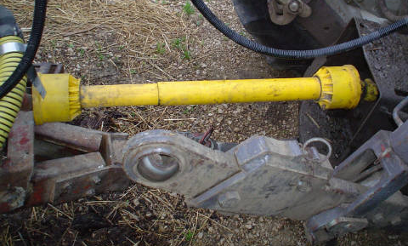
How to Protect Yourself
Summary
Recognize that the PTO shaft turns at speeds that are faster than our reaction time. It is easy to get snagged into a turning PTO shaft.
Notes:
How to Protect Yourself
Summary
Recognize that the PTO shaft turns at speeds that are faster than our reaction time. It is easy to get snagged into a turning PTO shaft. To prevent PTO entanglement with its potential for injury and death, follow these guidelines:
Stop the tractor engine and disengage the PTO to work on the machine or unclog it.
Keep guards in place.
Wear close fitting clothing to prevent entanglement of loose clothing parts.
Secure long hair under a hat when working around the PTO.
Instruct all operators about the hazards of the PTO.
Keep children away from all turning parts of the machine not just the PTO.

Slide 12
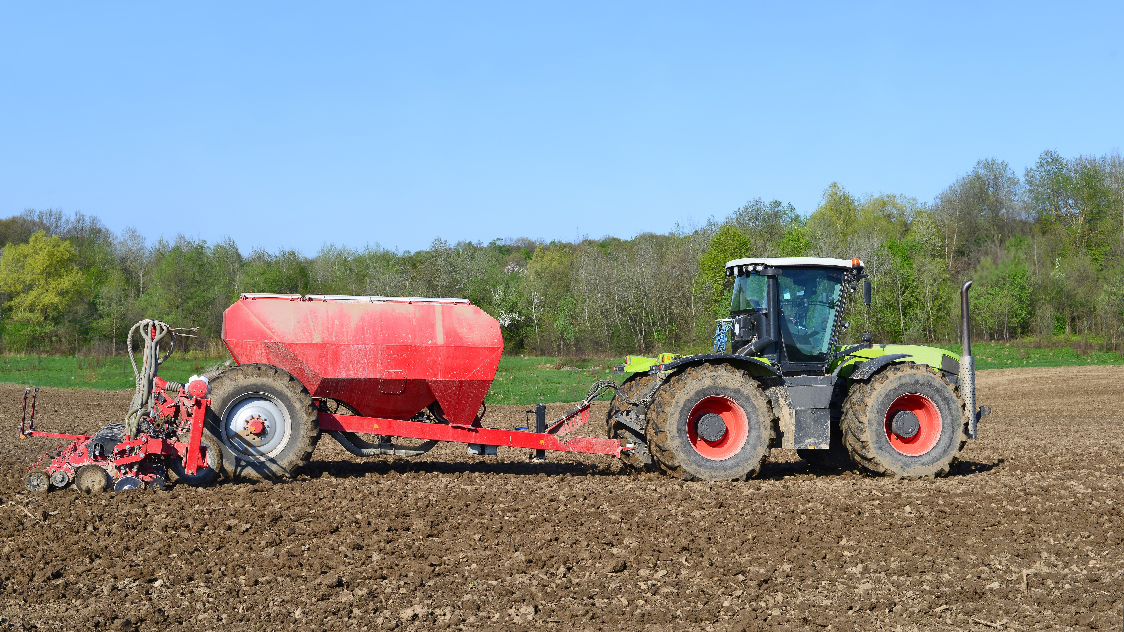
Final Word
Remember. A PTO turning at 540 RPM turns 9 times per second and one turning at 1000 RPM turns at 16.6 times per second. A Person cannot react so keep your distance. A PTO entanglement will have extreme consequences including death.
Notes:
Final Word
Remember. A PTO turning at 540 RPM turns 9 times per second and one turning at 1000 RPM turns at 16.6 times per second. A Person cannot react so keep your distance. A PTO entanglement will have extreme consequences including death.

