Slide 1

Click anywhere to get started…

Slide 2

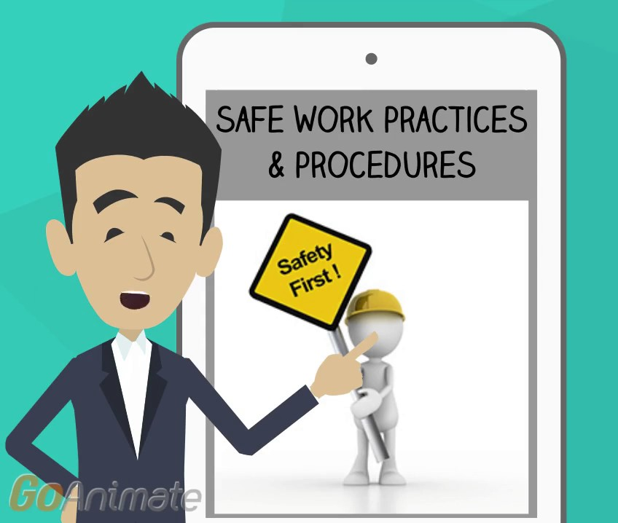

PRACTICES VS PROCEDURES
Notes:
Practices VS Procedures

Slide 3
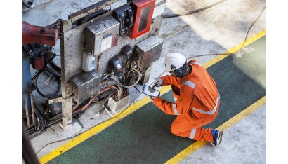
What’s at Stake?
A Safe Work Practice is more of a guideline helpful in performing non-standard activities in as safe a way as possible, such as using a portable grinder or ladder.
Safe Work Procedures are detailed step-by-step descriptions of how specific work-related activities (usually ones with associated high risk hazards) are safely performed from start to finish, (operating a fork lift, manhole entry, battery boosting, working alone).
Development
Safe work practices should be developed as a result of completing a job safety analysis (JSA) or a hazard risk assessment (HRA).
Notes:
What’s at Stake?
A Safe Work Practice is more of a guideline helpful in performing non-standard activities in as safe a way as possible, such as using a portable grinder or ladder. They are commonly found in owner’s manuals, industry guides, sample manuals, etc.
Safe Work Procedures are detailed step-by-step descriptions of how specific work-related activities (usually ones with associated high risk hazards) are safely performed from start to finish, (operating a fork lift, manhole entry, battery boosting, working alone). The procedure may be simply a series of steps, or a checklist where each step is checked off when completed. Standardized written work procedures can ensure that work is done safely.
Development
Safe work practices should be developed as a result of completing a job safety analysis (JSA) or a hazard risk assessment (HRA).
Safe job procedures are usually developed by management and workers as a result of a JSA/HRA, accident or incident investigation, and/or as a supplement to a safe work practice.

Slide 4
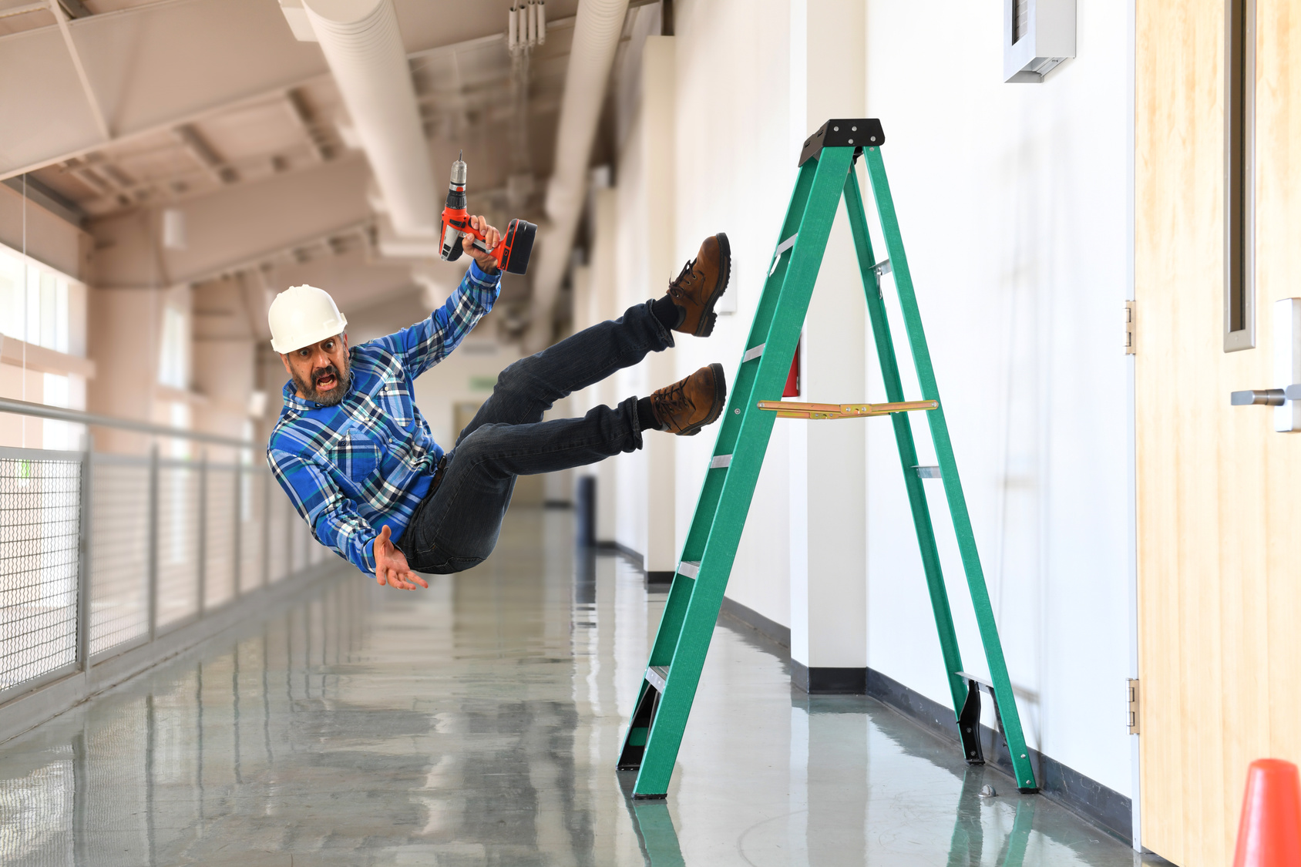
What’s the Danger?
Every employee, has the right to work in a safe environment. It is also the responsibility of employees to act responsibly and stick to the workplace health and safety rules and regulations.
Risk assessment
Types of accidents at work
There are a number of different dangerous practices and procedures that can lead to accidents happening in the workplace.
Pedestrian and forklift traffic areas have not been separated resulting in injury.
Notes:
What’s the Danger?
Every employee, whether they are full-time, part-time, and casual, contractors or agency staff has the right to work in a safe environment. Although your employer is mainly responsible for maintaining a safe environment, it is also the responsibility of employees to act responsibly and stick to the workplace health and safety rules and regulations.
Not all workplaces are safe, and millions of workers are put at risk every day, with some suffering serious and devastating injuries as a result of unsafe practices at work.
Risk assessment
All employers have a duty of care to their employees, but employees also have a responsibility not to put themselves in danger. Health and safety in the workplace is paramount and keeps everyone on or near the premises safe. Before you step foot in the workplace, your employer should have already carried out a risk assessment of the area in which you will be working as well as a risk assessment for the type of work you are going to do.
Types of accidents at work
There are a number of different dangerous practices and procedures that can lead to accidents happening in the workplace.
Pedestrian and forklift traffic areas have not been separated resulting in injury.
Failure to have ladders and stepladders footed or stabilized.
Using ladders instead of scaffolding.
Workers using inappropriate or poorly maintained tools for the job at hand.
Workers operating machinery for which they have had no training.
Workers carrying heavy objects without the appropriate training.
Employers failing to illuminate working areas correctly, including walkways.
Employers failing to fix potholes or unsafe floors.
Employers not providing their workers with the appropriate safety gear to do their job.
Workers being exposed to dangerous chemicals.
Workers using tables and chairs when stepladders would be more appropriate.
Employers not providing their workers with suitable Personal Protective Equipment (PPE).
Workplaces without cleaning procedures resulting in slipping and tripping hazards for employees.

Slide 5

How to Protect Yourself
The best way to prevent injuries or illness in your workplace is to find the hazards that could injure people and fix them.
Step 1 – Identify the hazard.
Step 2 – Assess the risk.
Step 3 – Control the risk.
Step 4 – Review the controls.
Notes:
How to Protect Yourself
The best way to prevent injuries or illness in your workplace is to find the hazards that could injure people and fix them. You can do this by following four key steps.
Step 1 – Identify the hazard by looking around your workplace, talking to your workers, reviewing incident reports, researching particular tasks and issues, or using the Hazard identification checklist
Step 2 – Assess the risk by considering how severe the harm could be and how likely it is to happen.
Step 3 – Control the risk by eliminating the hazard if possible, or otherwise minimizing the risk as far as possible.
Step 4 – Review the controls regularly to make sure they’re working as planned.

Slide 6

Final Word
Employees should know, understand and follow all SWP and SJP that pertain to the specific work tasks being completed. Training should be provided to ensure competency. Training should include a theoretical and practical component as outlined in the "Safety Orientation and Training" element and documented in the employee's safety training plan.
Notes:
Final Word
Employees should know, understand and follow all SWP and SJP that pertain to the specific work tasks being completed. Training should be provided to ensure competency. Training should include a theoretical and practical component as outlined in the "Safety Orientation and Training" element and documented in the employee's safety training plan.

