Slide 1

Click anywhere to get started…

Slide 2

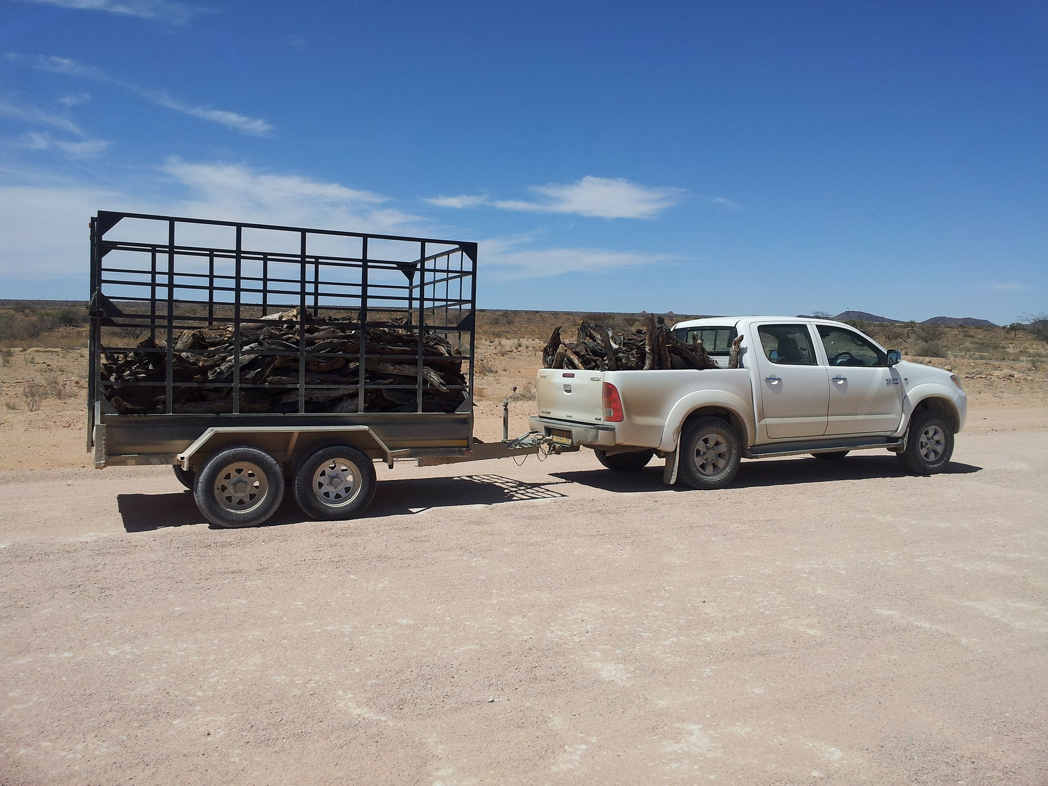

Trailer Safety
Notes:
Trailer Safety

Slide 3
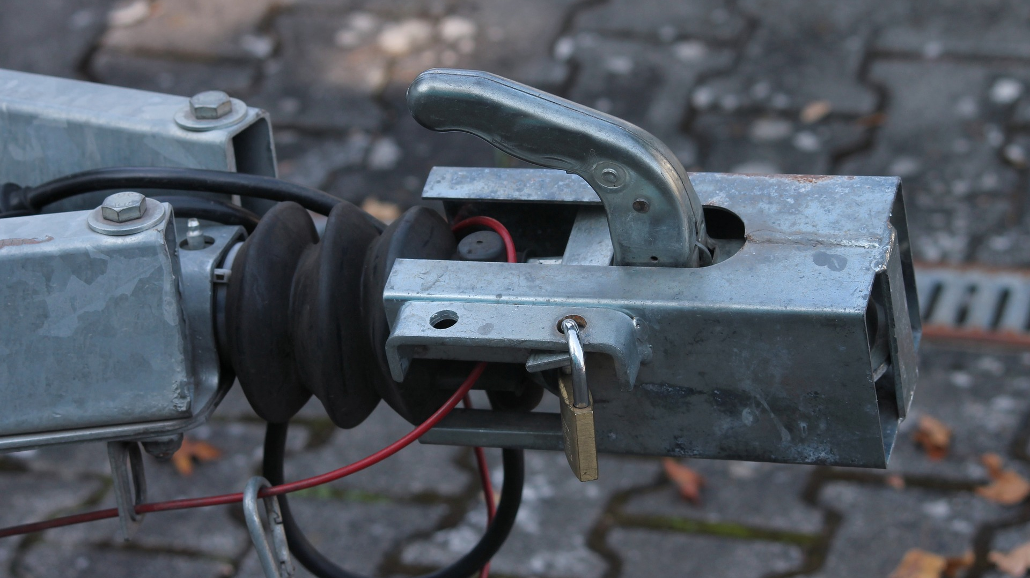
What’s at Stake?
Trailer safety plays an integral part in today's working environment. Towing trailers, caravans or mobile plant demands hazard awareness, safe practice, driving competence and knowledge of the trailer law.
Notes:
What’s at Stake?
Trailer safety plays an integral part in today's working environment. Towing trailers, caravans or mobile plant demands hazard awareness, safe practice, driving competence and knowledge of the trailer law.
All operatives and people who need to tow trailers, mobile plants, exhibition units, hospitality units, catering trailers for their work include e.g. Council and utilities personnel, civil engineers, landscape contractors, builders or exhibition demonstrators.

Slide 4
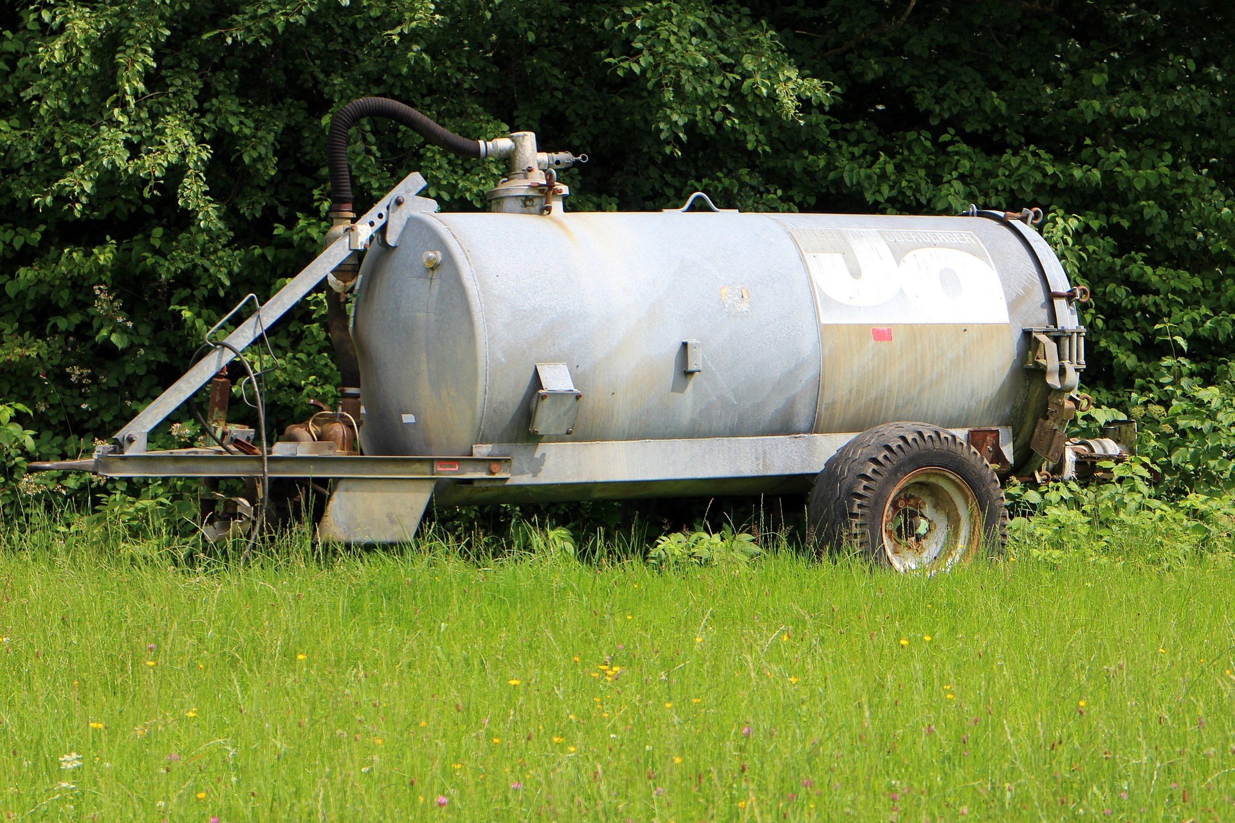
What’s the Danger?
To pull a trailer behind another vehicle, a driver needs to develop a whole new set of skills. Just the process of hitching and unhitching a trailer from a tow vehicle requires know-how and numerous steps, and forgetting even one crucial element in the process could compromise safety.
Notes:
What’s the Danger?
To pull a trailer behind another vehicle, a driver needs to develop a whole new set of skills. Just the process of hitching and unhitching a trailer from a tow vehicle requires know-how and numerous steps, and forgetting even one crucial element in the process could compromise safety.
Hooking up a trailer to your car or truck is an easy way to increase the storage capacity of your vehicle. However, failing to attach your trailer correctly can lead to damage to your own car, the trailer, and other vehicles around you as you drive. By securing the coupler to the hitch ball on your vehicle, making sure that it’s locked in properly, and wiring up the lights, you can hook up a trailer safely and easily.

Slide 5
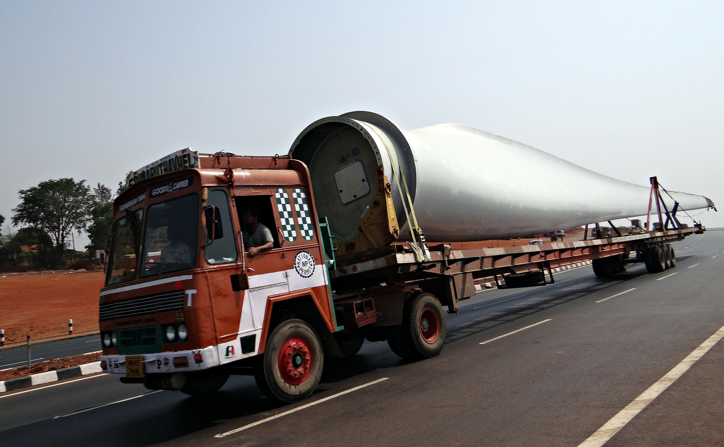
How to Protect Yourself
PRE-TRIP PLANNING:
1. Ensure staff has received appropriate training
2. Ensure the vehicle, hitch and trailer are sized properly and compatible.
3. Inspect the trailer to ensure it is safe to use.
4. Inspect the tow vehicle to ensure.
5. Properly load the trailer.
Notes:
How to Protect Yourself
Pre-trip Planning:
Ensure staff has received appropriate training
Ensure the vehicle, hitch and trailer are sized properly and compatible.
Inspect the trailer to ensure it is safe to use
Inspect the tow vehicle
Properly load the trailer.
Hooking Up The Trailer:
When assisted in hooking up and un-hooking a trailer ensure that the assistant can be seen at all times by the driver
Attach safety chains to the diagonally opposite point on the hitch.
Ensure all trailer lights work and that they are sufficiently bright.
Remove tires blocks after the trailer is hooked to the tow vehicle.

Slide 6
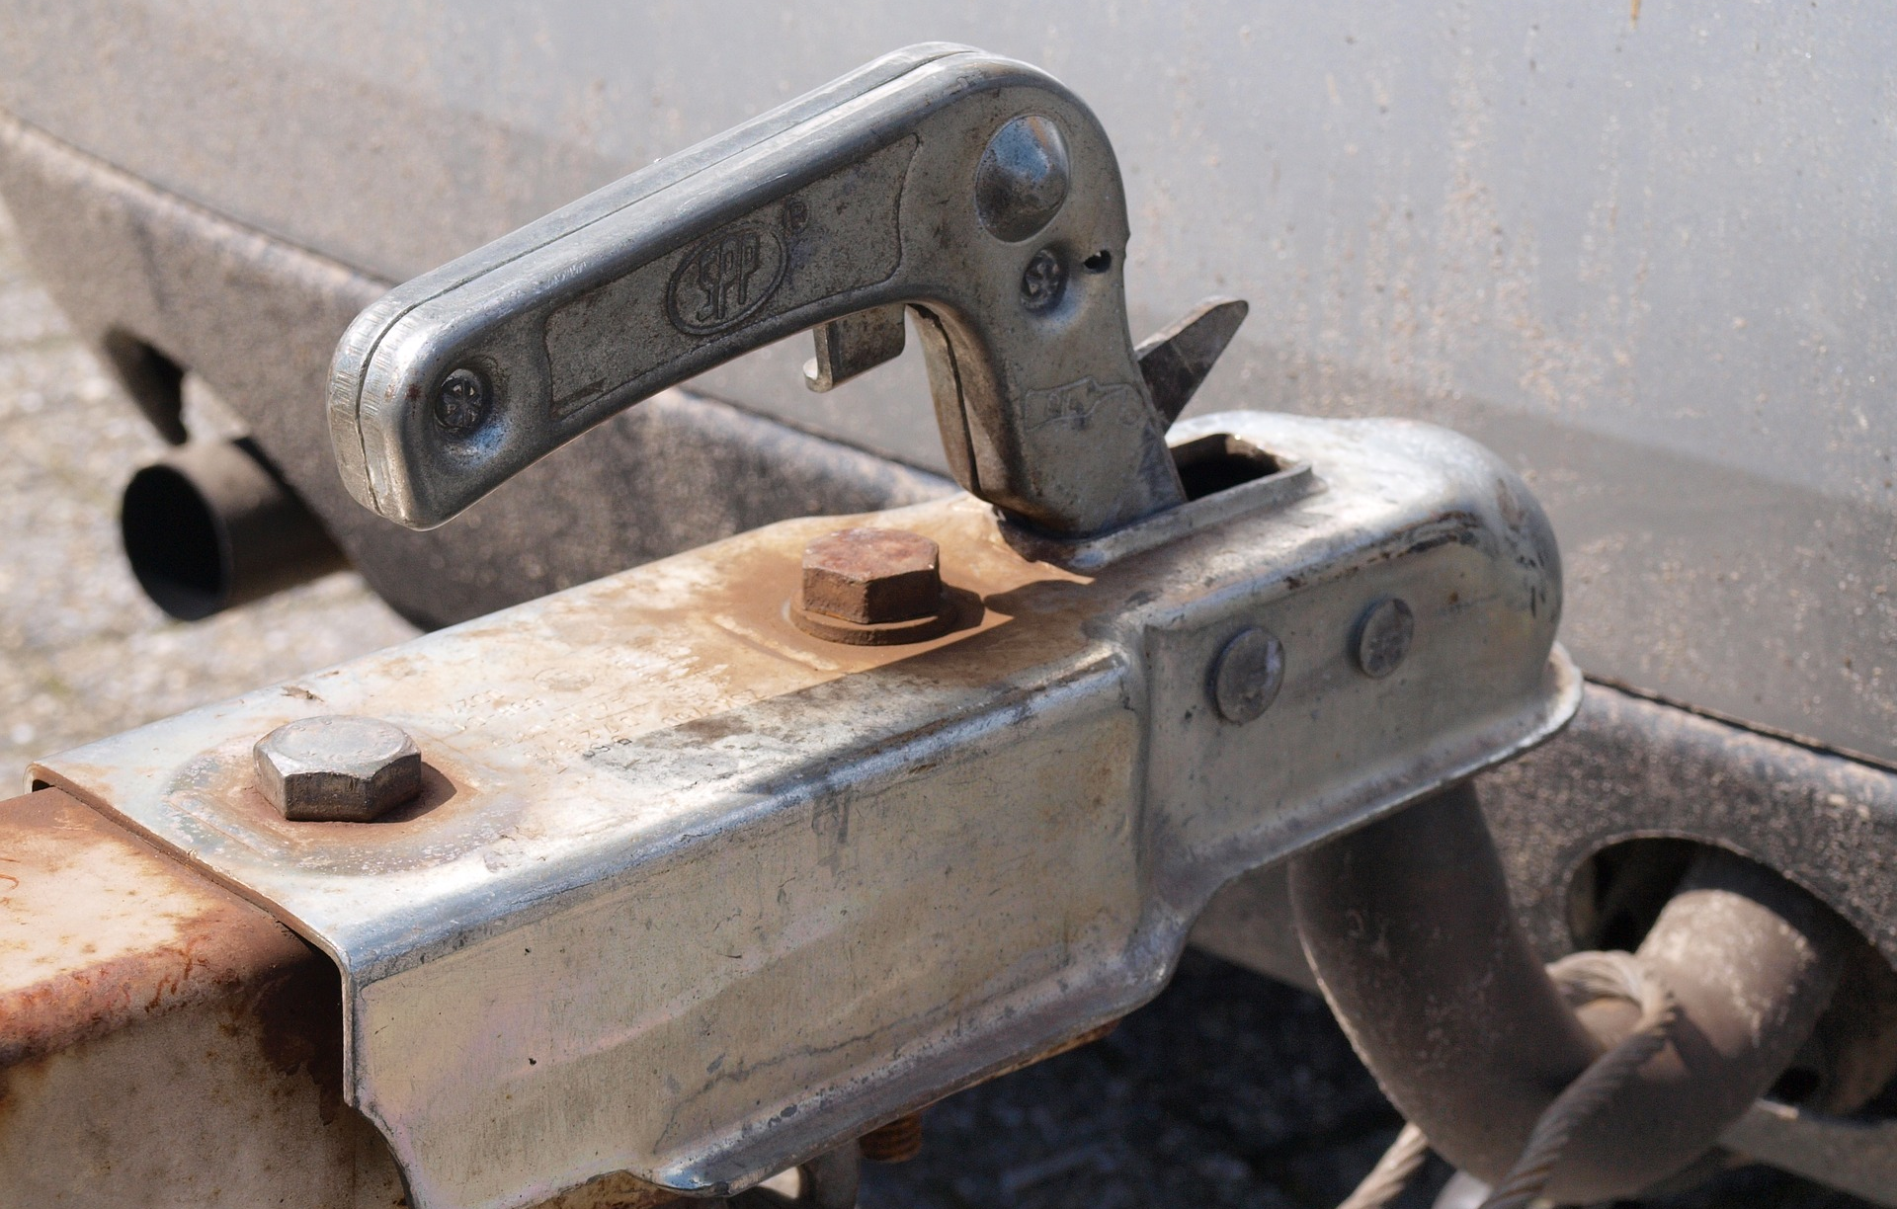
How to Protect Yourself
Driving Techniques
Parking and un-hooking the Trailer
Key Driving Tips for Safe Towing
Notes:
How to Protect Yourself
Driving Techniques:
When towing a trailer, you must be fully aware of the restrictions on manoeuvrability, visibility and acceleration. You should also know that the way your vehicle brakes changes considerably with the added weight of a trailer.
Trailer fishtailing, with the resulting loss of steering control, is a major cause of trailer accidents.
If your trailer is fishtailing, slow down immediately and pull over when it is safe to do so. Stop your vehicle, assess the problem and take corrective measures.
Parking and Un-hooking the Trailer:
Ensure the ground or surface where the trailer will rest is firm and is not on an unreasonable incline.
Ensure both trailer tires are blocked front and back to prevent movement.
Ensure there is a solid surface on which the tongue support can rest.
Key Driving Tips For Safe Towing
Make wider turns at curves and corners. Because your trailer’s wheels will end up closer to the inside of a turn than the wheels of your tow vehicle, the trailer tires are more likely to hit or ride up over curbs.
Allow for longer stopping distances. Stopping distances will increase from what your tow vehicle can normally achieve on its own, because of the added weight of the trailer.
Drive in the right lane on highways. Drive in the right lane as much as possible, so you can use the extra stopping room of the right shoulder of the road in case you need to brake suddenly.
Adjust trailer brakes according to load. Many trailers have electric brakes, and the power level can be adjusted by the driver if the truck is fitted with an optional in-vehicle trailer brake controller system.
Don’t ride your truck’s brakes on long downhills. Shift the truck’s transmission to a lower gear to help slow the vehicle and take some strain off of the brakes.
Practice driving with a trailer. Before hitting the road, it’s a good idea to practice accelerating, backing up, braking, making wide turns, and using your sideview mirrors. This is especially important if you are a new employee to the art of towing a trailer behind a vehicle.
Check your route ahead of time. Some roads don’t allow trailers on them, and certain roads also have weight, height, and width limits. Planning your route ahead of time will save you from the hassle of having to backtrack to find roads that allow your rig.

Slide 7
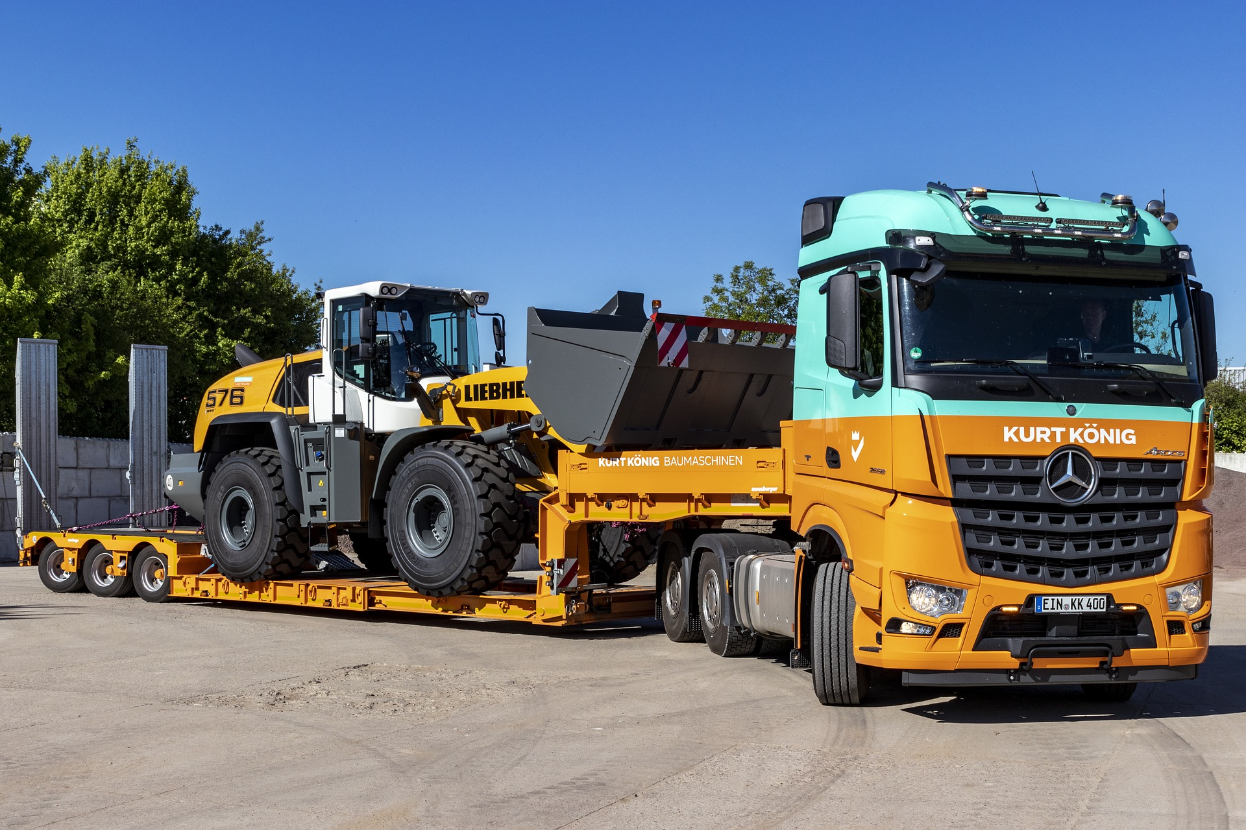
How to Protect Yourself
READY FOR TOWING
Check those trailer tires
Make sure your tow vehicle’s maintenance is up to date
Match the hitch ball to the trailer
Don’t get stuck on the side of the road
Use trailer safety chains
Check trailer lights
Use wheel chocks
Notes:
How to Protect Yourself
Ready For Towing
Check those trailer tires. Check the tire pressures on the trailer. Inspect the trailer tires for dry rot and cracking, especially if the trailer is stored outside and hasn’t been used for months.
Make sure your tow vehicle’s maintenance is up to date. Towing puts additional stress on the tow vehicle, so before heading out on a towing road trip, be sure your truck has recently had an oil and filter change, the brake pads have plenty of life remaining, the engine coolant is filled to the proper level in the reservoir, and the transmission fluid is topped off.
Match the hitch ball to the trailer. Ensure the ball on your tow hitch is the same size as the coupler on your trailer. Hitch balls typically come in three sizes: 1⅞ inches, 2 inches, and 2 5⁄16 inches.
Don’t get stuck on the side of the road. Ensure you have at least one spare tire for your trailer.
Use trailer safety chains. Ensure trailers have safety chains that hook up to the hitch. Always cross the trailer’s safety chains, don’t just run them straight.
Check trailer lights. Before hitting the road, double check to make sure the trailer’s electrical wiring system is properly connected to the tow vehicle.
Use wheel chocks. When unhooking the trailer from the tow vehicle, place wheel chocks (sturdy, wedge-shaped blocks) in front of and behind the trailer’s tires to ensure the trailer doesn’t roll away when it is released from the tow vehicle.

Slide 8
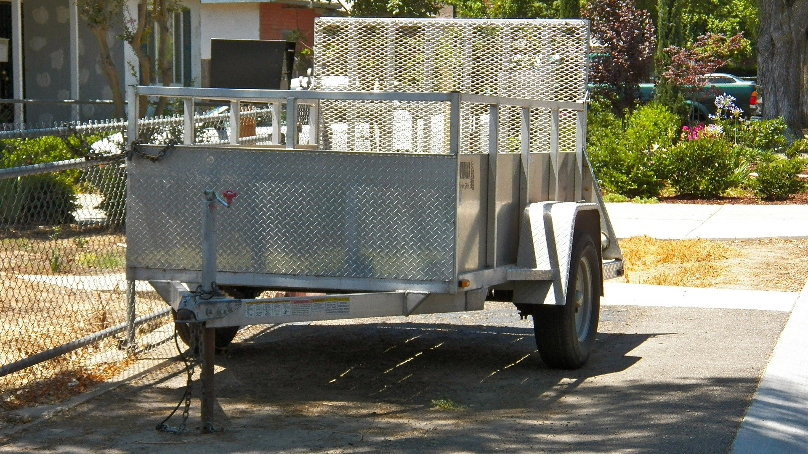
Final Word
Driving or towing a load and reading the load for towing are two functions or operations that are fundamentally different. The success or failure in either one will for certain affect the outcome or result of the work.
Notes:
Final Word
Driving or towing a load and reading the load for towing are two functions or operations that are fundamentally different. The success or failure in either one will for certain affect the outcome or result of the work.

